Slide 1
Comp 110
Functions
Instructor: Prasun Dewan

Slide 2
Prerequisite
Objects

Slide 3
Outline
Programmatic instantiation of objects
Functions calling other functions
Algorithm and stepwise refinement
Code Reuse
Programming Style
Variables, Named Constants, Literals
Comments and Identifier Names

Slide 4
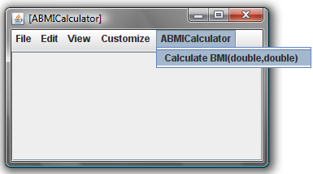
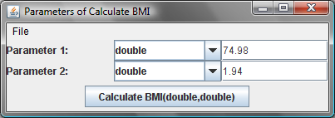
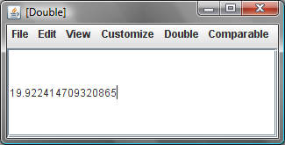
General Purpose BMI Calculator
Does not assume height or weight
Specialized could know my height

Slide 5
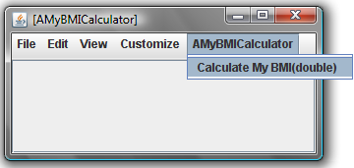
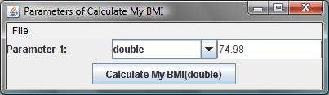
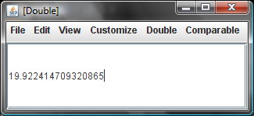
BMI Calculator Specialized for an Individual’s Height
Need to enter only weight
weight
Height is hard-coded into the program

Slide 6
A Solution
public class AMyBMICalculator {
public double calculateMyBMI(double weight) {
}
}

Slide 7
A Solution (Edit)
public class AMyBMICalculator {
public double calculateMyBMI(double weight) {
}
}

Slide 8
A Solution
public class AMyBMICalculator {
public double calculateMyBMI(double weight) {
return weight/ (1.94 * 1.94);
}
}
Relationship with ABMICalculator?

Slide 9
Customized vs. General Purpose
public class AMyBMICalculator {
public double calculateMyBMI(double weight) {
return weight/ (1.94 * 1.94);
}
}
One vs. two parameters
public class ABMICalculator {
public double calculateBMI (double weight,
double height) {
return weight/ (height * height);
}
}
Basic formula is the same (can cut and paste)

Slide 10
Should Reuse!
public class AMyBMICalculator {
public double calculateMyBMI(double weight) {
return weight/ (1.94 * 1.94);
}
}
Should reuse code to avoid duplication of effort and errors such as: (weight)/1.94
public class ABMICalculator {
public double calculateBMI (double weight,
double height) {
return weight/ (height * height);
}
}
Particularly important for complex code

Slide 11
How to Reuse ABMICalculator
Create an instance of ABMICalculator
Invoke the method calculateBMI() on this instance passing it my weight and my height as actual parameters
The value returned by the method is my BMI

Slide 12
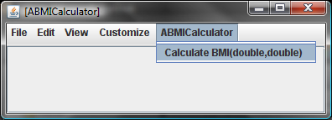
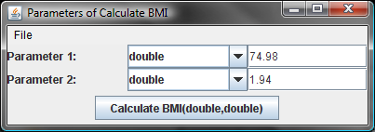
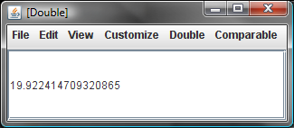
Interactive Execution of the Steps
Create an instance of ABMICalculator
Invoke the method calculateBMI() on this instance passing it my weight and my height as actual parameters
The value returned by the method is my BMI

Slide 13
Programming The Steps
Create an instance of ABMICalculator
Invoke the method calculateBMI() on this instance passing it my weight and my height as actual parameters
The value returned by the method is my BMI
public class AMyBMICalculator {
public double calculateMyBMI(double weight) {
}
}
return
(new ABMICalculator())
weight, 1.94
.calculateBMI( );

Slide 14
Method Invocation Syntax
(new ABMICalculator()).calculateBMI(weight, 1.94);
Target Object
Method Name
Actual Parameters

Slide 15
Function Composition
public class AMyBMICalculator {
public double calculateMyBMI(double weight) {
return (new ABMICalculator()).calculateBMI(weight,1.94);
}
}
The body of the calling function calls (invokes) other functions to do its job
Passes the “buck” to the callee or called functions
calculateMyBMI() calls calculateBMI()
Supports reuse

Slide 16
Call Graphs
calculateMyBMI(74.98)
19.92
19.92
calculateBMI(74.98,1.94)

Slide 17
Graphical Illustration of the CalculateMyBMI Call
Class AMyBMICalculator
Class ABMICalculator
❶
instance of
❷
AMyBMICalculator
instance of
public double calculateMyBMI(double weight) {
❷
return (new ABMICalculator())
ABMICalculator
.calculateBMI(weight, 1.94);
❸
}
public double calculateBMI(double weight,
double height) {
return weight/(height*height);
}
❹

Slide 18
Mathematical Intuition Behind Function Invocation
tan(x) = sin(x) / cos(x)
tan(90)
1
0
sin(90)
cos(90)

Slide 19
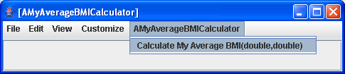
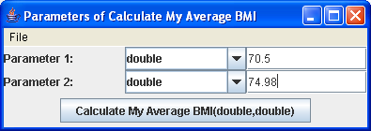
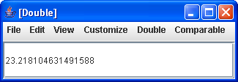
AverageBMICalculator
Weight 1
Weight 2

Slide 20
A Solution
public class AMyAverageBMICalculator {
public double calculateMyAverageBMI(double weight1,
double weight2) {
}
}

Slide 21
A Solution (Edit)
public class AMyAverageBMICalculator {
public double calculateMyAverageBMI(double weight1,
double weight2) {
<edit here>
}
}

Slide 22
A Solution
public class AMyAverageBMICalculator {
public double calculateMyAverageBMI(double weight1,
double weight2) {
return ((new ABMICalculator()).calculateBMI(weight1, 1.94) +
(new ABMICalculator()).calculateBMI(weight2, 1.94))/2;
}
}
Creating a new instance of AMyAverageBMICalculator each time calculateBMI is to be called!

Slide 23
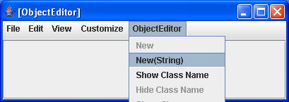
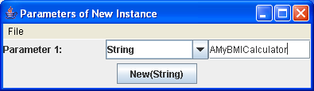

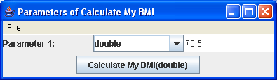
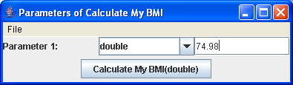
Interactive Equivalent
Instance 1
Instance 2

Slide 24
A Better Interactive Approach
Instance 1
ObjectEditor window identifies the appropriate instance. Need way to name objects in a program.

Slide 25
Naming Memory Locations
Can name values in a program by using variables
Each program value stored in a memory location
Variable declarations name memory locations
Have already seen variable declarations!

Slide 26
Formal Parameters as Variables
public class AMyBMICalculator {
public double calculateMyBMI(double weight) {
return weight/ (1.94 * 1.94);
}
}
Formal parameters are special kinds of variables.
weight is name of memory location that stores the actual parameter passed by caller

Slide 27
Internal Method Variables
Like formal parameters are declared with type and name
Name in subsequent code refers to value stored in memory location
Declared in a method body rather than header
Can be explicitly given initial values
Which can be changed later
Make program more efficient as an extra object is not instantiated
public class AMyAverageBMICalculator {
public double calculateMyAverageBMI(double weight1,
double weight2) {
ABMICalculator aBMICalculator = new ABMICalculator();
return (aBMICalculator .calculateBMI(weight1, 1.94) +
aBMICalculator.calculateBMI(weight2, 1.94))/2;
}
}

Slide 28
More Use of Variables
bmi1 and bmi2 name memory locations that store the two intermediate results
Not really needed to make programs efficient
public class AMyAverageBMICalculator {
public double calculateMyAverageBMI(double weight1,
double weight2) {
ABMICalculator aBMICalculator = new ABMICalculator();
double bmi1 = aBMICalculator.calculateBMI(weight1, 1.94);
double bmi2 = aBMICalculator.calculateBMI(weight2, 1.94);
return (bmi1 + bmi2)/2;
}
}

Slide 29
Which is Better?
public class AMyAverageBMICalculator {
public double calculateMyAverageBMI(double weight1,
double weight2) {
AMyBMICalculator aMyBMICalculator = new AMyBMICalculator();
return (aMyBMICalculator.calculateMyBMI(weight1) +
aMyBMICalculator.calculateMyBMI(weight2)) / 2;
}
public class AMyAverageBMICalculator {
public double calculateMyAverageBMI(double weight1,
double weight2) {
AMyBMICalculator aMyBMICalculator = new AMyBMICalculator();
double bmi1 = aMyBMICalculator.calculateMyBMI(weight1);
double bmi2 = aMyBMICalculator.calculateMyBMI(weight2);
return (bmi1 + bmi2) / 2;
}
}
First solution is more concise
Second solution separates various steps, giving names to each intermediate calculated value
Hard to argue between them
  Second solution makes it easier to single-step through code

Slide 30
Programming Style
More than one solution to a problem
Some solutions arguably “better” than others
  E.g. one solution allows reuse other does not.
Programming style determines which solution is chosen
Style as important as correctness
Good style often promotes correctness

Slide 31
Style Rules
Elements of Style
  Support code reuse
  Other style rules?

Slide 32
Improving the Style
public class AMyBMICalculatorWithReuse {
public double calculateMyBMI(double weight) {
return (new ABMICalculator()).calculateBMI(weight,1.94);
}
}
A Magic Number
A mysterious (at least to some) number in code

Slide 33
Named Constants
public class AMyBMICalculator {
public double calculateMyBMI(double weight) {
final double MY_HEIGHT = 1.94;
return (new ABMICalculator()).calculateBMI(weight, MY_HEIGHT);
}
}
Like variables have type, name and value
They must have an initial value
  Initial value of a variable is optional
The final keyword says value cannot be changed later
The name is all caps by convention

Slide 34
Named Constants, Literals, Constants & Variables
public class AMyBMICalculator {
public double calculateMyBMI(double weight) {
final double MY_HEIGHT = 1.94;
return (new ABMICalculator()).calculateBMI(weight, MY_HEIGHT);
}
}
Literal
Variable
Constant
Named Constant
Literal
  A value directly specified in the program
Constant
  A fixed value
  Can be literal or named constant
Variable
  A potentially variable value

Slide 35
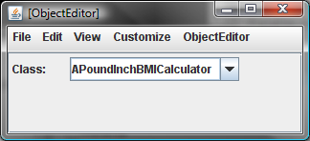
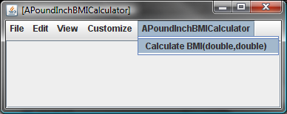
Pound Inch BMI Calculator

Slide 36
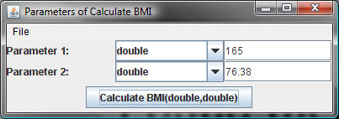
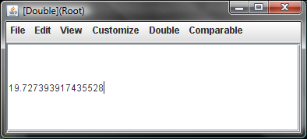
Pound Inch BMI Calculator
Weight in pounds
Height in inches

Slide 37
Steps for Reusing ABMICalculator

Slide 38
Steps for Reusing ABMICalculator

Slide 39
Steps for Reusing ABMICalculator
Calculate weight in Kgs from weight in Pounds
Calculate height in Metres from height in inches
Call calculateBMI() of ABMICalculator with these values
Return the value returned by this call

Slide 40
A Solution
public class APoundInchBMICalculator {
public double calculateBMI(
double weightInLbs, double heightInInches)
{
}
}

Slide 41
A Solution (Edit)
public class APoundInchBMICalculator {
public double calculateBMI(
double weightInLbs, double heightInInches)
{
}
}

Slide 42
A Solution (Edit)
public class APoundInchBMICalculator {
public double calculateBMI(
double weightInLbs, double heightInInches)
{
return (new ABMICalculator()).calculateBMI(
weightInLbs/2.2, heightInInches*2.54/100);
}
}

Slide 43
Algorithm
Description of solution to a problem.
Can be in any “language”
  graphical
  natural or programming language
  natural + programming language (pseudo code)
Can describe solution to various levels of detail

Slide 44
Real-World Algorithm
Enter Class
Distribute handouts
Set up laptop projection.
Revise topics learnt in the last class.
Teach today’s topics.
Leave Class

Slide 45
Algorithm for Reusing ABMICalculator
Calculate weight in Kgs from weight in Pounds
Calculate height in Metres from height in inches
Call calculateBMI() of ABMICalculator with these values
Return the value returned by this call

Slide 46
2nd Level Algorithm
Calculate weight in kgs from weight in Pounds
  Divide weight in Pounds by 2.2
Calculate height in Meters from height in inches
  Calculate height in centimeters from height in inches and divide it by 100 to get height in meters
Call calcuateBMI() of ABMICalculator with these values
Return the value returned by this call

Slide 47
3rd Level Algorithm
Calculate weight in kgs from weight in Pounds
  Divide weight in Pounds by 2.2
Calculate height in Metres from height in inches
  Calculate height in centimetres from height in inches and divide it by 100 to get height in metres
    Multiply height in Inches by 2.54 to get height in centimetres
Call calcuateBMI() of ABMICalculator with these values
Return the value returned by this call

Slide 48
Stepwise Refinement
Natural Language Algorithm
Calculate weight in Kgs from weight in Pounds
Calculate height in Meters from height in inches
Call calculateBMI() of ABMICalculator with these values
Return the value returned by this call
Programming Language Algorithm
public class APoundInchBMICalculator () {
public double calculateBMI(
double weightInLbs, double heightInInches) {
return (new ABMICalculator()).calculateBMI(
weightInLbs/2.2, heightInInches*2.54/100);
}
}

Slide 49
Style Problems
public class APoundInchBMICalculator {
public double calculateBMI(
double weightInLbs, double heightInInches)
{
return (new ABMICalculator()).calculateBMI(
weightInLbs/2.2, heightInInches*2.54/100);
}
}
Unlike algorithm, code is single-level
By defining functions for each algorithm level we can create multi-level code
Multi-level code would be more reusable as there are more parts that can be used independently

Slide 50
Multi-Level Code
public class APoundInchBMICalculator {
public double calculateBMI(
double weightInLbs, double heightInInches) {
return (new ABMICalculator()).calculateBMI(
toKgs(weightInLbs), toMetres(heightInInches));
}
public double toMetres(double heightInInches) {
???
}
public double toKgs(double weightInLbs) {
???
}
}
Can be reused in contexts other than BMI (designing for reuse).
Design for Reuse vs. Reusing available code

Slide 51
Multi-Level Code (Edit)
public class APoundInchBMICalculator {
public double calculateBMI(
double weightInLbs, double heightInInches) {
return (new ABMICalculator()).calculateBMI(
toKgs(weightInLbs), toMetres(heightInInches));
}
public double toMetres(double heightInInches) {
???
}
public double toKgs(double weightInLbs) {
???
}
}

Slide 52
Multi-Level Code
public class APoundInchBMICalculator {
public double calculateBMI(
double weightInLbs, double heightInInches) {
return (new ABMICalculator()).calculateBMI(
toKgs(weightInLbs), toMetres(heightInInches));
}
public double toMetres(double heightInInches) {
return toCentiMetres(heightInInches)/100;
}
public double toCentiMetres(double heightInInches) {
return heightInInches*2.54;
}
public double toKgs(double weightInLbs) {
return weightInLbs/2.2;
}
}

Slide 53
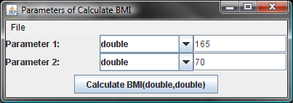
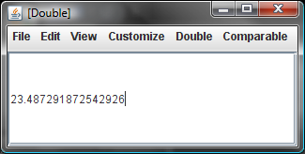
Multi-Level Call Graph
23.72
(new ABMICalculator). calculateBMI(75,1.77)
calculateBMI(165,70)
75
1.778
23.72
toKgs (165)
toMetres (70)
177.8
toCentiMetres (70)

Slide 54
External vs. Internal Method Invocation Syntax
(new ABMICalculator()).calculateBMI(75,1.77));
Actual Parameters
Target Object
Method Name
toKgs(165);

Slide 55
External vs. Internal Method Invocation Syntax
External Method Call
  Caller (calling method) and callee (called method) belong to different objects
  calculateBMI() of APoundInchBMICalculator instance calls calculateBMI() of ABMICalculator instance
Internal Method Call
  Caller and callee methods belong to same object
  calculateBMI() of APoundInchBMICalculator instance calls toKgs() of APoundInchBMICalculator instance
Target object optional in internal method call
Target object needed because multiple objects may have the same method
When target object omitted caller’s object is target object

Slide 56
Reusability
public class APoundInchBMICalculator {
public double calculateBMI(
double weightInLbs, double heightInInches) {
return (new ABMICalculator()).calculateBMI(
toKgs(weightInLbs), toMetres(heightInInches));
}
public double toMetres(double heightInInches) {
return toCentiMetres(heightInInches)/100;
}
public double toCentiMetres(double heightInInches) {
return heightInInches*2.54;
}
public double toKgs(double weightInLbs) {
return weightInLbs/2.2;
}
}
Can be reused in other classes
(new APoundInchBMICalculator()).toCentiMetres(70)
(new APoundInchBMICalculator()).toMetres(70)
(new APoundInchBMICalculator()).toKgs(165)

Slide 57
Lack of Reusability
public class APoundInchBMICalculator {
public double calculateBMI(
double weightInLbs, double heightInInches)
{
return (new ABMICalculator()).calculateBMI(
weightInLbs/2.2, heightInInches*2.54/100);
}
}
A single method implements all three conversions
Cannot reuse each conversion independent of BMI calculation

Slide 58
Magic Numbers Revisited
public class APoundInchBMICalculator {
public double calculateBMI(
double weightInLbs, double heightInInches) {
return (new ABMICalculator()).calculateBMI(
toKgs(weightInLbs), toMetres(heightInInches));
}
public double toMetres(double heightInInches) {
return toCentiMetres(heightInInches)/100;
}
public double toCentiMetres(double heightInInches) {
return heightInInches*2.54;
}
public double toKgs(double weightInLbs) {
return weightInLbs/2.2;
}
}
magic numbers?

Slide 59
“Well-Known” vs. “Obscure” Number
Well-Known Number (Natural constant)
weightInLbs/2.2
Obscure Number
(new ABMICalculator). calculateBMI(74, 1.77);

Slide 60
What is a Magic Number?
Obscure number is a magic number
Well-known number is not
  A number defined by law of nature
    e.g number of centimeters in an inch
    Π
What is well-known depends on the audience
  e.g. number of centimeters in an inch
Numbers defined by law of nature may not be considered magic numbers
All other numbers should be considered magic numbers

Slide 61
Removing All Potentially Magic Numbers
public class APoundInchBMICalculator {
public double calculateBMI(
double weightInLbs, double heightInInches) {
return (new ABMICalculator()).calculateBMI(
toKgs(weightInLbs), toMetres(heightInInches));
}
public double toMetres(double heightInInches) {
final double CMS_IN_METRES = 100;
return toCentiMetres(heightInInches)/ CMS_IN_METRES;
}
public double toCentiMetres(double heightInInches) {
final double CMS_IN_INCH = 2.54;
return heightInInches* CMS_IN_INCH;
}
public double toKgs(double weightInLbs) {
final double LBS_IN_KG = 2.2;
return weightInLbs/LBS_IN_KG;
}
}

