Slide 1
Accessing Grading Server
Instructor: Prasun Dewan (FB 150, dewan@unc.edu)

Slide 2
Steps Overview
Go to: https://grader.cs.unc.edu/
authenticate,
select upload from menu bar
fill menu entries (Choose Assignment for Type)
chose zip file you would submit to sakai (if this works we have a plugin also)
press upload button
pray
see results if you get them.

Slide 3
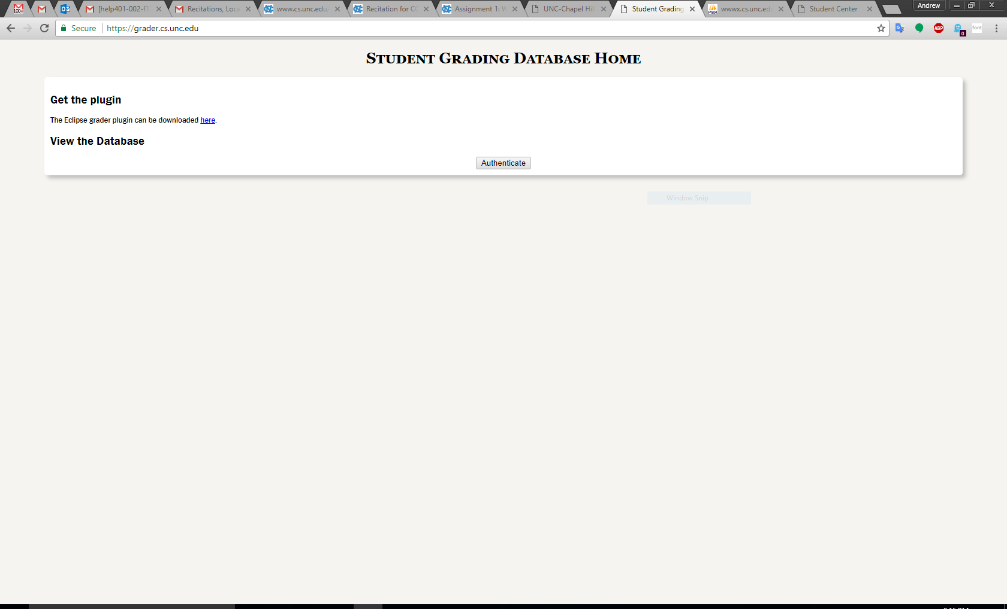
Go to https://grader.cs.unc.edu/

Slide 4
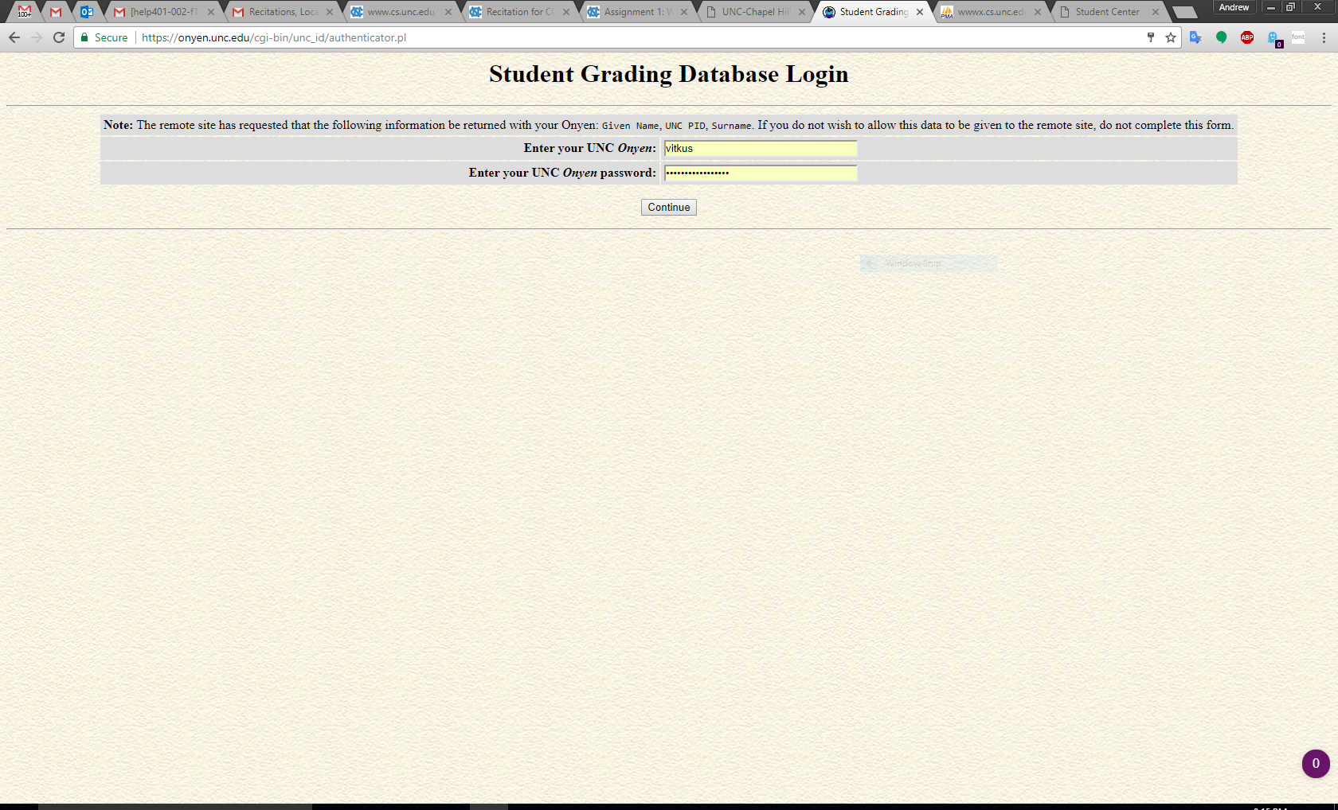
Authenticate

Slide 5
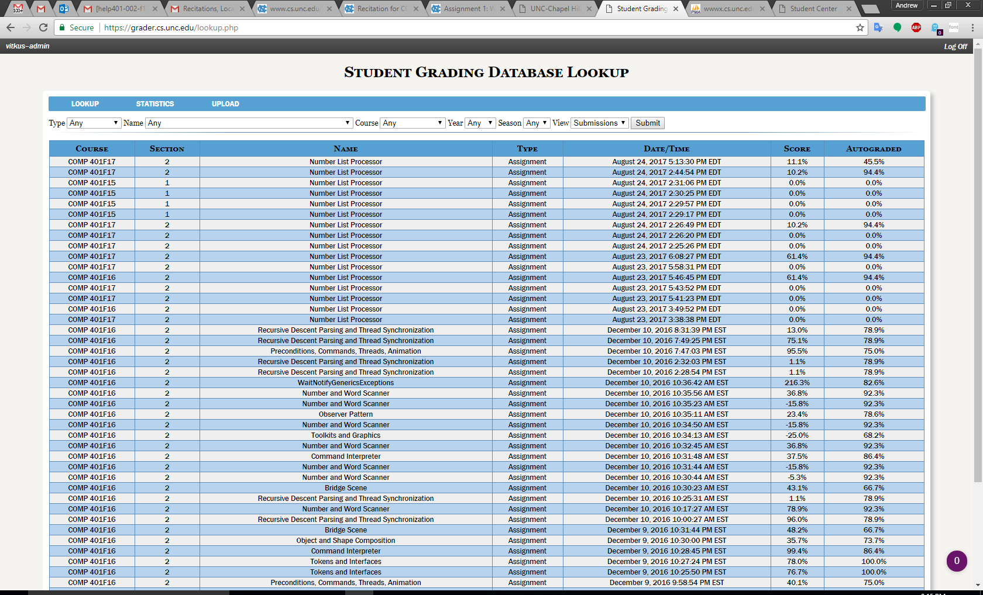
Select “Upload” from the menu bar

Slide 6
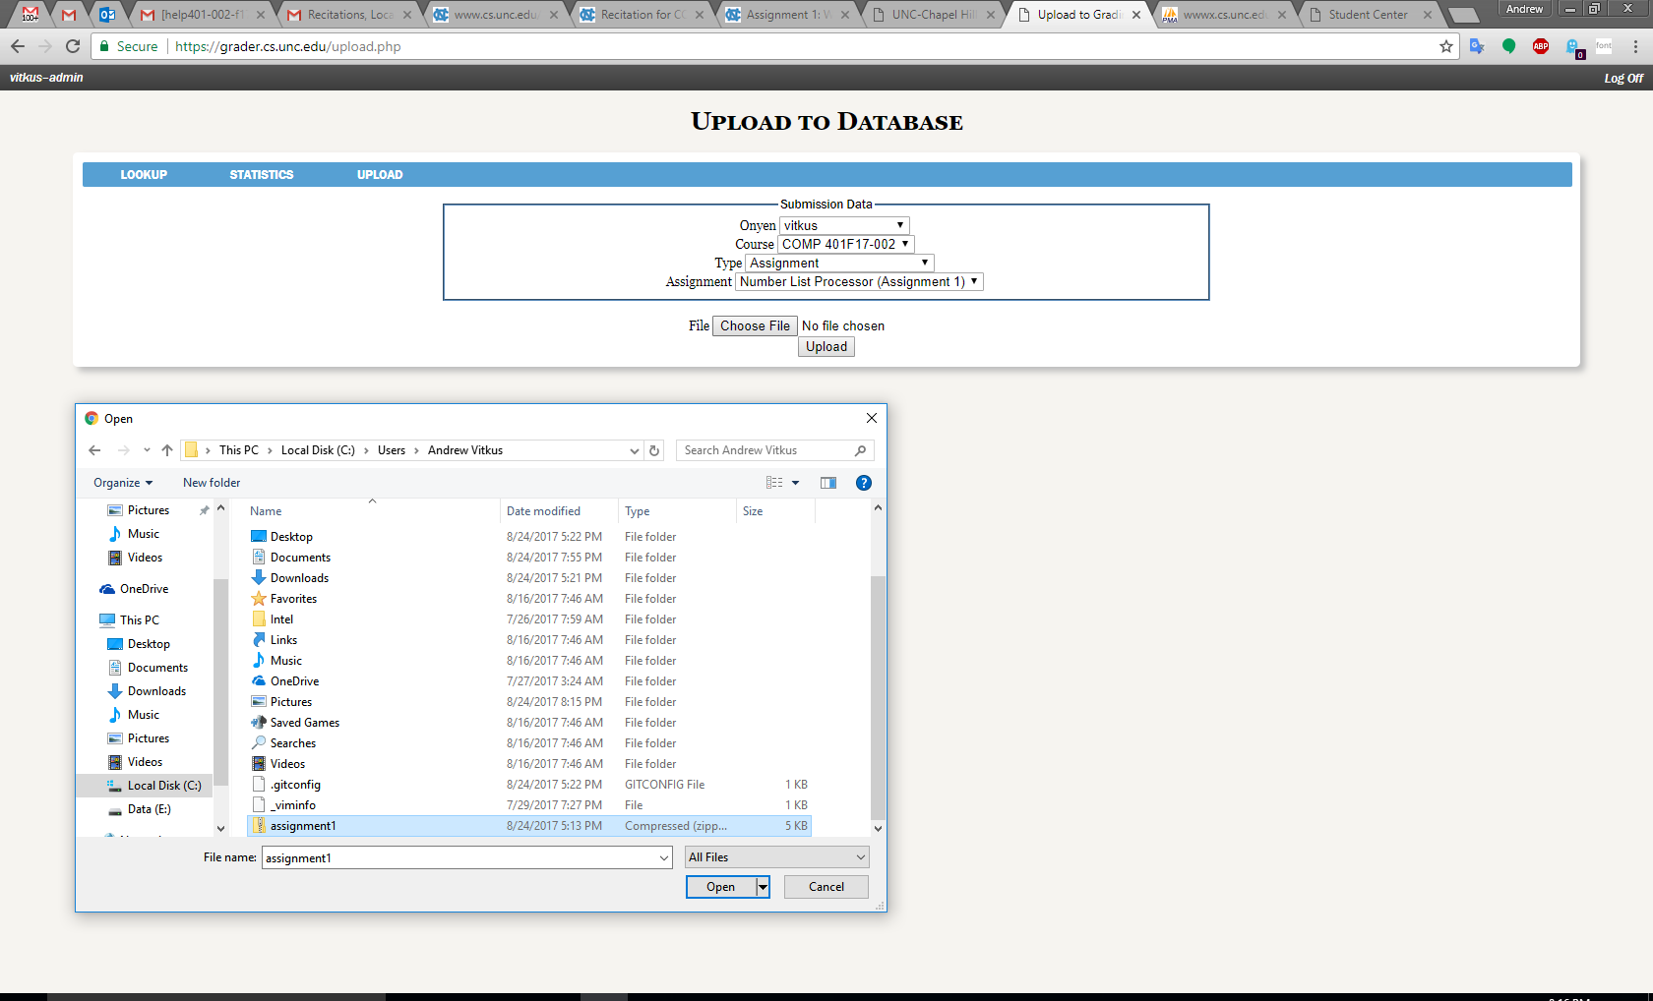
Select dropdowns and upload zip file

Slide 7
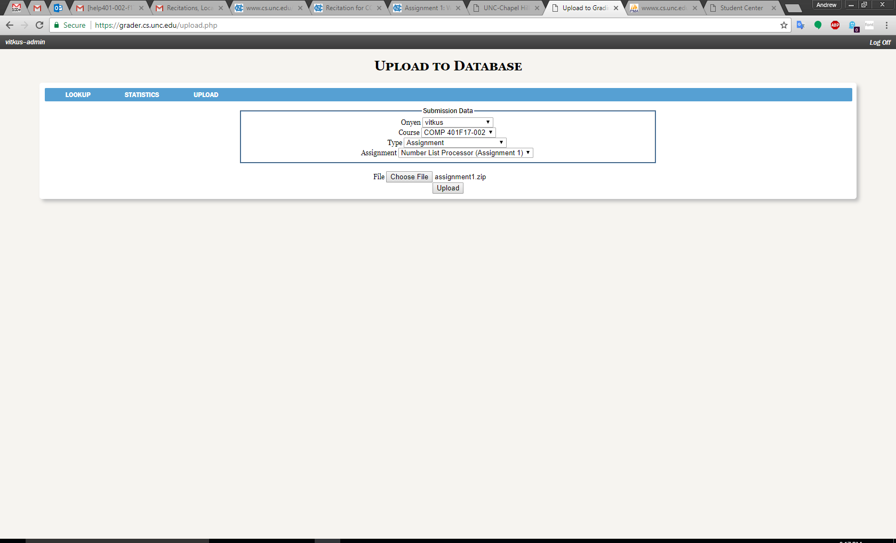
Upload

Slide 8
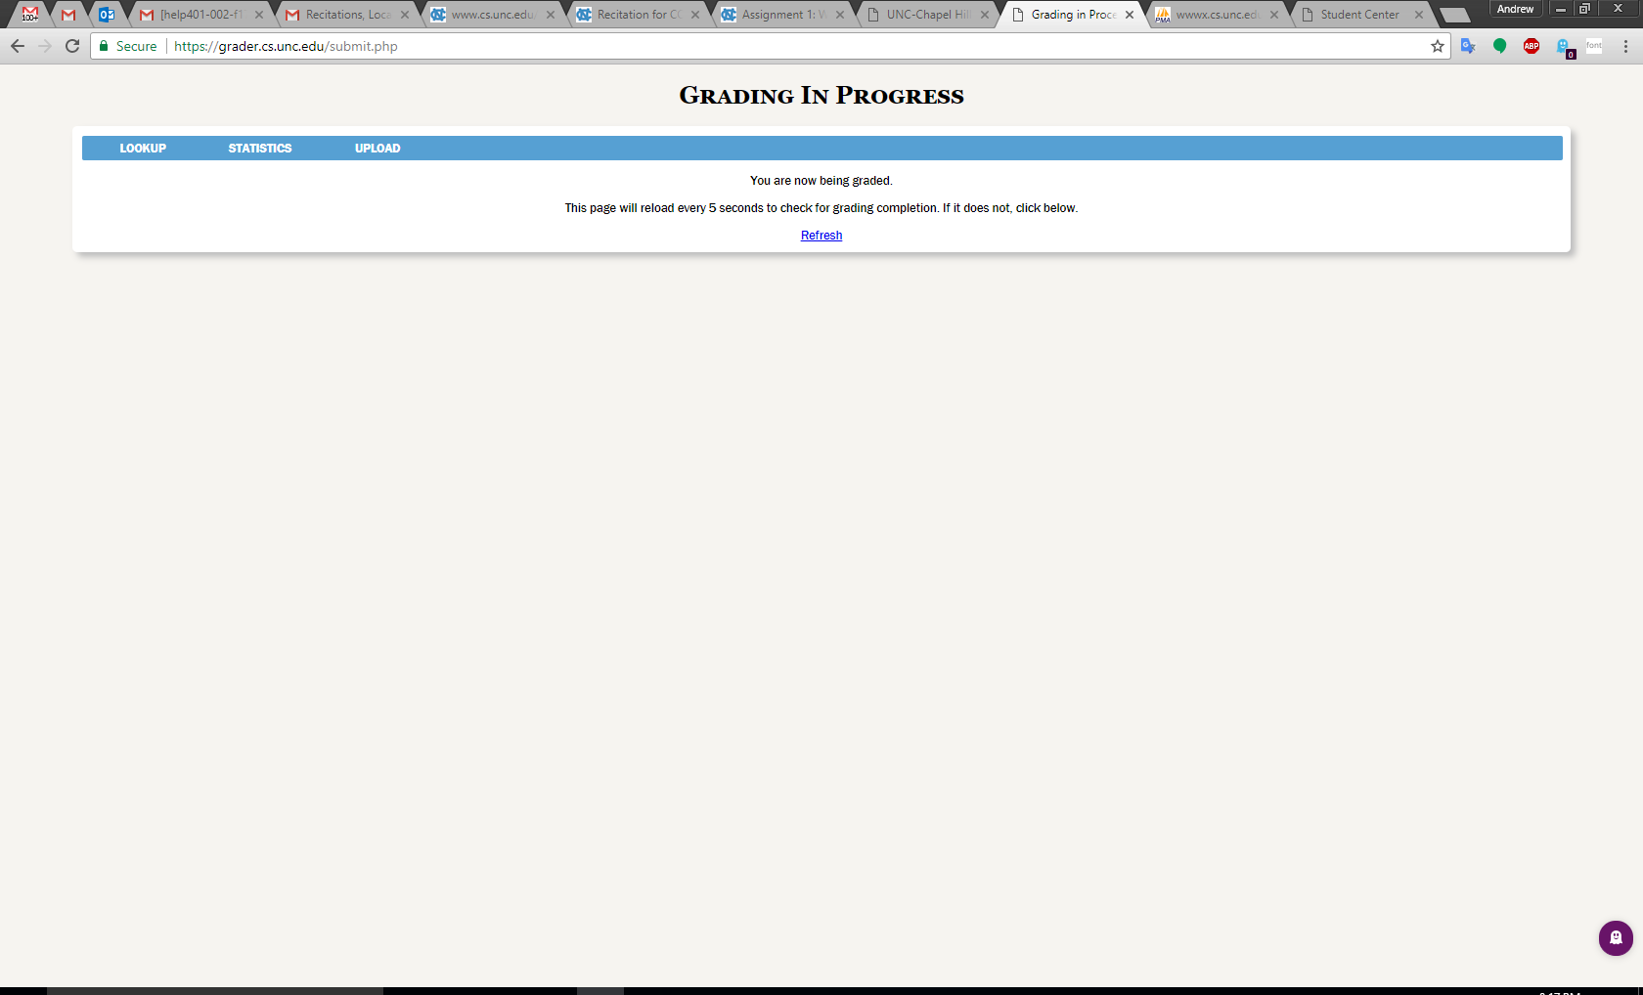
Grading

Slide 9
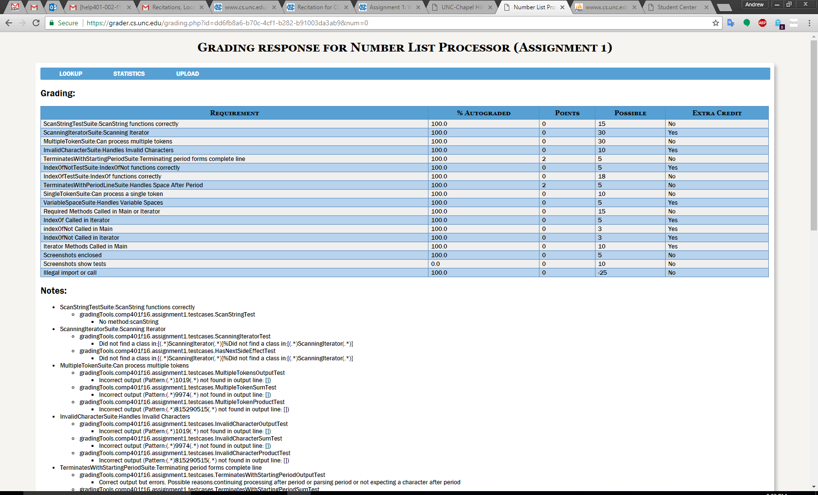
Results

