Slide 1

Comp 401
Graphics
Instructor: Prasun Dewan

Slide 2
Prerequisite
Interfaces

Slide 3
More on Objects
Graphics types
Test-first approach
Stubs
Physical vs. logical representation
Representations with errors

Slide 4
Mathematical Point
X
.
R
Y
θ
.

Slide 5
Java Coordinate System
(3,2)
(0,0)
X
pixels
X and Y coordinates must be int values
Radius and Angle can be double
Y
Angle is a decimal value between 0 and 2π
Each window has its own coordinate system

Slide 6
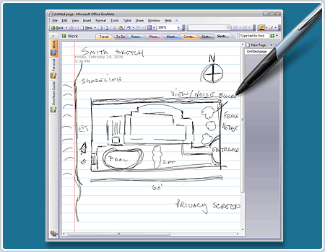
Why not Mathematical Coordinate System
Computer coordinate system modeled after paper documents
In LTR (left to write languages) coordinate origing top left, and x, goes left to right, and y top to bottom
A window typically shows an underlying electronic document

Slide 7
Point Interface
public interface Point {
public int getX();
public int getY();
public double getAngle();
public double getRadius();
}
Read-only properties defining immutable object!
Top-down, test-first?
Stubs?

Slide 8
Point Interface (Review)
public interface Point {
public int getX();
public int getY();
public double getAngle();
public double getRadius();
}
Read-only properties defining immutable object!
Top-down, test-first?
Stubs?

Slide 9
ACartesianPoint Tester
public class ACartesianPointTester {
public void test () {
test (10, 0, 10.0, 0); // 0 degree angle
test (0, 10, 10.0, Math.PI / 2); // 90 degree angle
.. //more tests
}
public void test (int theX, int theY,
double theCorrectRadius, double theCorrectAngle) {
Point point= new ACartesianPoint (theX, theY);
double computedRadius = point.getRadius();
double computedAngle = point.getAngle();
System.out.println("------------");
System.out.println(“X:" + theX);
System.out.println(“Y:" + theY);
System.out.println("Expected Radius:" + theCorrectRadius);
System.out.println("Computed Radius:" + computedRadius);
System.out.println(“Radius Error:"
+ (theCorrectRadius - computedRadius));
System.out.println("Expected Angle:" + theCorrectAngle);
System.out.println("Computed Angle:" + computedAngle);
System.out.println(“Angle Error:" +
(theCorrectAngle - computedAngle));
System.out.println("------------");
}
}

Slide 10
Stubs for ACartesianPoint
public class ACartesianPoint implements Point {
public ACartesianPoint(int theX, int theY) { }
public ACartesianPoint(double theRaidus,
double theAngle) { }
public int getX() {
return 0;
}
public int getY() {
return 0;
}
public double getAngle() {
return 0;
}
public double getRadius() {
return 0;
}
}

Slide 11
Test-First Approach
Write the interface
Create a class with stubs for each interface method and constructor
  If method is procedure method does nothing
  If method is function, it returns 0 or null value
  No variables need be declared as this point!
Write a tester for it
Write/rewrite in one or more stub methods
Use tester
If tester results not correct, go back to 4
Steps may be combined for simple classes!

Slide 12
Point Variable Representations
X, Y (Cartesian Representation)
Radius, Angle (Polar Representation)
X, Radius
X, Y, Radius, Angle
…
Does not completely specify the point

Slide 13
Algorithms
Cartesian Representation
R = sqrt (X² * Y²)
X
θ = arctan (Y/X)
.
R
Y
Polar Representation
θ
X = R*cos(θ)
.
Y = R*sin(θ)

Slide 14
Class: ACartesianPoint
public class ACartesianPoint implements Point {
int x, y;
public ACartesianPoint(int theX, int theY) {
x = theX;
y = theY;
}
public ACartesianPoint(double theRadius, double theAngle) {
x = (int) (theRadius*Math.cos(theAngle));
y = (int) (theRadius*Math.sin(theAngle));
}
public int getX() { return x; }
public int getY() { return y; }
public double getAngle() { return Math.atan2(y, x); }
public double getRadius() { return Math.sqrt(x*x + y*y); }
}

Slide 15
Class: APolarPoint
public class APolarPoint implements Point {
double radius, angle;
public APolarPoint(double theRadius, double theAngle) {
radius = theRadius;
angle = theAngle;
}
public APolarPoint(int theX, int theY) {
radius = Math.sqrt(theX*theX + theY*theY);
angle = Math.atan((double) theY/theX);
}
public int getX() { return (int) (radius*Math.cos(angle)); }
public int getY() { return (int) (radius*Math.sin(angle)); }
public double getAngle() { return angle; }
public double getRadius() { return radius; }
}

Slide 16
Using the Interface and Its Implementations
Point point1 = new ACartesianPoint (50, 50);
Point point2 = new APolarPoint (70.5, Math.pi()/4);
point1 = point2;
Constructor chooses implementation
Constructor cannot be in interface

Slide 17
Representing Geometric Objects
Geometric example to show multiple useful implementations of an interface
Most geometric objects have multiple representations

Slide 18
What is a Representation
Logical representation
  Defined by its interface
  Specifies properties
Physical representation
  Defined by its instance variables
ACartesianPoint and APolarPoint have the same logical reperesentation but different physical representation

Slide 19
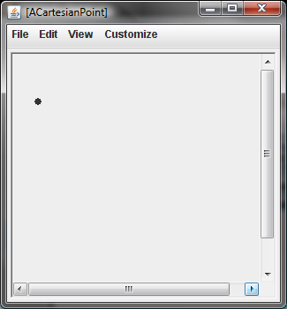
Using ObjectEditor
public interface Point {
public int getX();
public int getY();
public double getAngle();
public double getRadius();
}
ObjectEditor.edit(new ACartesianPoint (25, 50));

Slide 20
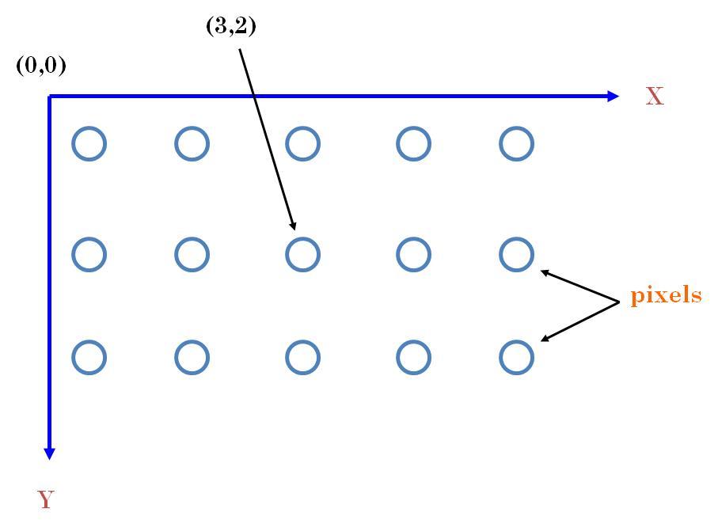
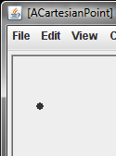
Java Graphics
Y
X

Slide 21
ObjectEditor Point Rules
An object is recognized as a point representation if:
  Its interface or class has the string “Point” in its name or has a Point annotation
  It has (read-only) int properties, X and Y, representing Cartesian window coordinates
  Can have additional properties
@StructurePattern(StructurePatternNames.POINT_PATTERN)
public interface Point {
public int getX();
public int getY();
public double getAngle();
public double getRadius();
}

Slide 22
Point Annotation
import util.annotations.StructurePattern;
import util.annotations.StructurePatternNames;
@StructurePattern(StructurePatternNames.POINT_PATTERN)
public interface Point{
…
}
Display textual properties?
Structure(<PatternName>) before class or interface asserts that the type is following the pattern. ObjectEditor ignores class/interface name and gives warnings if methods do not follow the pattern

Slide 23
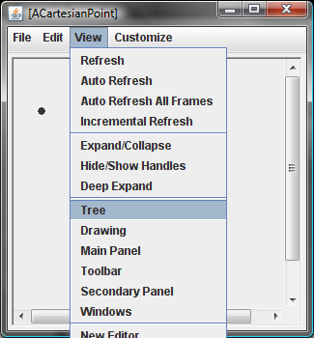
Adding Tree View

Slide 24
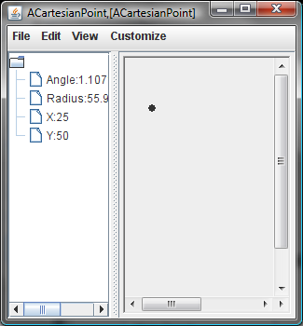
Tree View
OEFrame frame = ObjectEditor.edit(new ACartesianPoint (25, 50));
frame.showTreePanel();

Slide 25
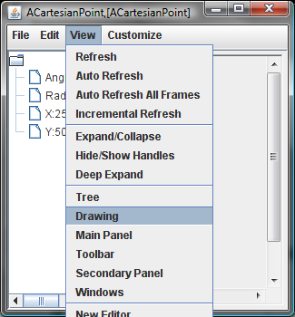
Removing Graphics View

Slide 26
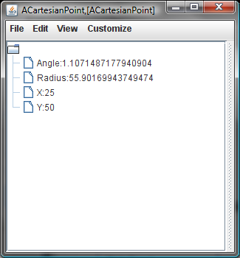
Tree-only View
OEFrame frame = ObjectEditor.edit(ObjectEditor.edit(new ACartesianPoint (25, 50);
frame.hideDrawingPanel(); //to be added
frame.showTreePanel();

Slide 27
Customizing the Size of the Window
OEFrame frame = ObjectEditor.edit(ObjectEditor.edit(new ACartesianPoint (25, 50);
frame.setSize(400, 300); // width and height
Frame.setLocation(500, 400);// x and y

Slide 28
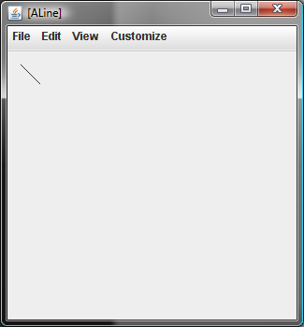
Line?

Slide 29
What is a Representation
Logical representation
  Defined by its interface
  Specifies properties
Physical representation
  Defined by its instance variables

Slide 30
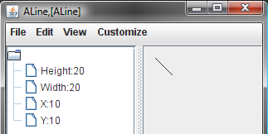
Line Logical Representation (Properties)
Bounding Rectangle
X, Y (int)
Height (int)
Width (int)

Slide 31
Line Implementation
@StructurePattern(StructurePatternNames.LINE_PATTERN)
public class ALine implements Line {
int x, y, width, height;
public ALine (int initX, int initY, int initWidth, int initHeight) {
x = initX;
y = initY;
width = initWidth;
height = initHeight;
}
public int getX() {return x;}
public void setX(int newX) {x = newX;}
public int getY() { return y; }
public void setY(int newY) {y = newY;}
public int getWidth() {return width;}
public void setWidth(int newVal) {width = newVal;}
public int getHeight() {return height;}
public void setHeight(int newHeight) {height = newHeight;}
}
Logical representation == physical repersentation

Slide 32
ObjectEditor Shape Rules
Line
Rectangle
Oval
X, Y
X, Y
X, Y
Height
Height
Height
Width
Width
Width

Slide 33
XY-Based Line/Oval/Rectangle Interface
public interface Line {
public int getX();
public void setX(int newX);
public int getY();
public void setY(int newY);
public int getWidth();
public void setWidth(int newVal);
public int getHeight();
public void setHeight(int newHeight);
}
Oval
Rectangle
Oval/Rectangle logical representation?
Other shapes needed in project?

Slide 34
XY-based String and Image Rules
X, Y
hello
Text
X, Y
ImageFileName
Location is the lower right corner in the case of a String (based on Java draw primitives)!
String and Image shapes can keep additional properties – in particular height and width.

Slide 35

AString Shape
@StructurePattern(StructurePatternNames.STRING_PATTERN)
public class AStringShape implements StringShape {
String text;
int x, y;
public AStringShape(String initText, int initX, int initY) {
text = initText;
x = initX;
y = initY;
}
public int getX() {return x;}
public void setX(int newX) {x = newX;}
public int getY() { return y;}
public void setY(int newY) {y = newY;}
public String getText() {return text;}
public void setText(String newVal) {text = newVal;}
}
public static void main(String args[]) {
StringShape hello= new AStringShape("hello", 0, 10);
ObjectEditor.edit(hello);
}

Slide 36

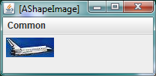
Image Implementation
@StructurePattern(StructurePatternNames.IMAGE_PATTERN)
public class AShapeImage implements ImageShape {
String imageFileName;
int x, y;
public AShapeImage (String initImageFileName, int initX, int initY) {
imageFileName = initImageFileName;
x = initX;
y = initY;
}
public int getX() {return x;}
public void setX(int newX) {x = newX;}
public int getY() { return y; }
public void setY(int newY) {y = newY;}
public String getImageFileName() {return imageFileName;}
public void setImageFileName(String newVal) {imageFileName = newVal ;}
}
public static void main (String args[]) {
ImageShape shuttle = new AShapeImage("shuttle2.jpg", 0, 0);
ObjectEditor.edit(shuttle);
}
Short file name (without “/”) implies file in the project folder, the one containing src and bin

Slide 37
ObjectEditor vs. Java Graphics
public class ALine implements Line{
int x, y, width, height;
public ALine (int initX, int initY, int initWidth, int initHeight) {
x = initX;
y = initY;
width = initWidth;
height = initHeight;
}
public int getX() {return x;}
public void setX(int newX) {x = newX;}
public int getY() {return y;}
public void setY(int newY) {y = newY;}
public int getWidth() {return width;}
public void setWidth(int newVal) {width = newVal;}
public int getHeight() {return height;}
public void setHeight(int newHeight) {height = newHeight;}
}
Encapsulates state of line in one object
Object and view are independent (can show object in tree view or graphics view)
If external state of object changes, the display is updated
ObjectEditor.edit(new ALine(x, y, w, h));
graphics.drawLine(x1, y1, x2, y2)
Requires knowledge of panel, paint events, inheritance

Slide 38
Graphics Types
Point
  No shape
  Just a location
Line/Rectangle/Oval
  A shape
  A location plus an area on the screen determined by object

Slide 39
ObjectEditor Graphics
Can automatically display objects representing points, rectangles, ovals, and lines as corresponding graphics
  Java provides libraries to manually display graphics
Has rules for recognizing these objects
Rules based on Java graphics standards
  Inverted coordinate system
  Cartesian coordinates for points
  Bounding rectangles for lines, rectangles, ovals
Plus naming conventions and annotations

Slide 40
ObjectEditor Bounding Box Rules
A shape object describes its bounding box if it:
  represents the size of the bounding box using int (read-only or editable) properties, “Height”, and “Width”
  describes the location of the upper left corner of the bounding box using “X”, “Y” properties of type int
X, Y
Height
Width

Slide 41
ObjectEditor Line/Shape/Oval Rules
An object is recognized as a rectangle/line/oval if:
  Its interface or class has the string “Rectangle”/”Oval”/”Line” in its name or has a Point/Oval/Line annotation
  It has (readonly or editable) properties describing the bounding box of the shape
  Can have additional properties
import util.annotations.StructurePattern;
import util.annotations.StructurePatternNames;
@StructurePattern(StructurePatternNames.LINE_PATTERN)
public interface Line{
…
}

Slide 42
ObjectEditor String Shape Rules
An object is recognized as a string shape if:
  Its interface or class has the string “String” in its name or a String annotation
  It has a (readonly/editable) “Text” of type String describing the string to be displayed
  It has (readonly or editable) int “X”, “Y” properties describing the location of the lower left corner of the bounding box of the shape
  Can have additional properties
public interface StringShape {
public int getX();
public void setX(int newX);
public int getY();
public void setY(int newY);
public String getText() ;
public void setText(String newVal);
}

Slide 43
ObjectEditor Image Shape Rules
An object is recognized as an image shape if:
  Its interface or class has the string “Image” in its name
  It has a (readonly/editable) String “ImageFileName” property describing the name of the image file to be displayed
  It has (readonly or editable) int X, Y properties describing the location of the upper left corner of the bounding box of the shape
  Can have additional properties
public interface ImageShape {
public int getX();
public void setX(int newX);
public int getY();
public void setY(int newY);
public String getImageFileName() ;
public void setImageFileName(String newVal);
}

Slide 44
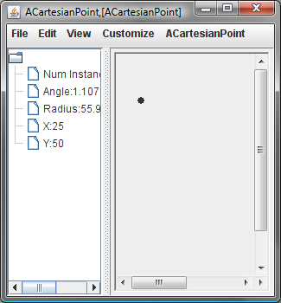
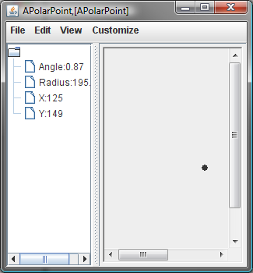
Typing Point Objects
ACartesianPoint
APolarPoint
Point

Slide 45
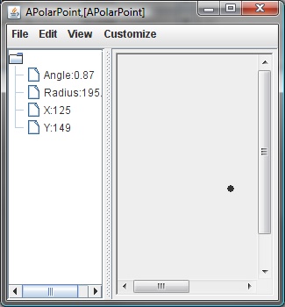
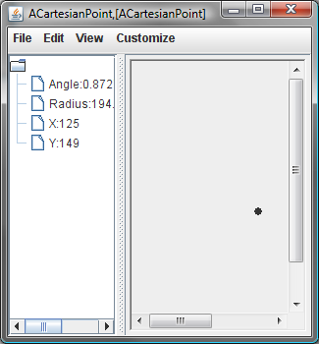
Equivalent Representations
ObjectEditor.edit(new APolarPoint (195.05, 0.87));
ObjectEditor.edit(new ACartesianPoint (125, 149));
Stored
Computed
Computed
Stored
Cartesian coordinates the same but not the polar coordinates!

Slide 46
Reason for Error
public int getX() {
return (int) (radius*Math.cos(angle));
}
Calculated X and Y values are truncated when converted to int

Slide 47
Consequence of Physical Representation Choice?
Physical representation determines
  Space efficiency
  Time efficiency
  Precision of various properties

Slide 48
EXTRA SLIDES

Slide 49
ObjectEditor Shape Rules
An object is recognized as a rectangle/line/oval if:
  Its interface or class has the string “Rectangle”/”Oval”/”Line” in its name
  It has properties describing the bounding box of the shape
  Can have additional properties
public interface Line {
public int getX();
public void setX(int newVal);
public int getY();
public void setY(int newVal);
public int getWidth();
public void setWidth(int newVal);
public int getHeight() ;
public void setHeight(
int newVal);
}
public interface AnotherLine {
public Point getLocation();
public void setLocation(
Point newVal);
public int getWidth();
public void setWidth(int newVal);
public int getHeight() ;
public void setHeight(int newVal);
}

Slide 50
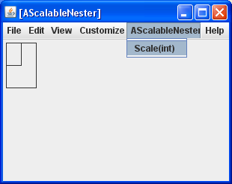

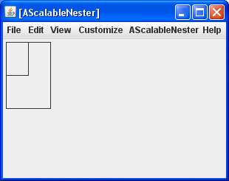
AScalableNester
Properties
NestedRectangle (Rectangle)
EnclosingRectangle (Rectangle)
Methods (non getter/setter)
public void scale (int percentage)

Slide 51
ACartesianPlane Stubs
public class ACartesianPlane implements CartesianPlane {
int axesLength ;
Line xAxis;
Line yAxis;
Label xLabel;
Label yLabel;
final int LABEL_BOUNDS_SIDE_LENGTH = 10;
public ACartesianPlane (int theAxesLength,
int theOriginX, int theOriginY ) {
}
public Line getXAxis() {return xAxis;}
public Line getYAxis() {return yAxis;}
public int getAxesLength() {return axesLength;}
public void setAxesLength(int newVal) {
}
public Label getXLabel() {return xLabel;}
public Label getYLabel() {return yLabel;}
}

Slide 52
ObjectEditor vs. Java Graphics
public class ALine implements Line{
int x, y, width, height;
public ALine (int initX, int initY, int initWidth, int initHeight) {
x = initX;
y = initY;
width = initWidth;
height = initHeight;
}
public int getX() {return x;}
public void setX(int newX) {x = newX;}
public int getY() {return y;}
public void setY(int newY) {y = newY;}
public int getWidth() {return width;}
public void setWidth(int newVal) {width = newVal;}
public int getHeight() {return height;}
public void setHeight(int newHeight) {height = newHeight;}
}
Encapsulates state of line in one object
Object and view are independent (can show object in tree view or graphics view)
If external state of object changes, the display is updated
ObjectEditor.edit(new ALine(x, y, w, h));
graphics.drawLine(x1, y1, x2, y2)
Requires knowledge of panel, paint events, inheritance

Slide 53
Graphics Types Seen So Far
Point
  No shape
  Just a location
Line
  A shape
  A location plus an area on the screen determined by object
Other shapes and rules?
  Line rules with slight adaptations

Slide 54
Line, Rectangle Oval, Label Patterns
public interface Line {
public int getX();
public void setX(int newX);
public int getY();
public void setY(int newY);
public int getWidth();
public void setWidth(int newVal);
public int getHeight();
public void setHeight(int newHeight);
}
Rectangle
Oval
public interface Label {
public int getX();
public void setX(int newX);
public int getY();
public void setY(int newY);
public int getWidth();
public void setWidth(int newVal);
public int getHeight() ;
public void setHeight(int newHeight);
public String getText();
public void setText(String newString);
public String getImageFileName();
public void setImageFileName(
String newVal);
}
public interface ImmutableIcon {
public int getX();
public int getY();
public int getWidth();
public int getHeight() ;
public String getText();
public String getImageFileName();
}

Slide 55
XY-based ObjectEditor Shape Rules
Rectangle
Line
X, Y
X, Y
Height
Height
Width
Width
Oval
TextBox
X, Y
Label
X, Y
X, Y
Height
Eiffel
Height
hello
Height
Width
Width
Width

Slide 56
ObjectEditor Bounding Box Rules
A shape object describes its bounding box if it:
  represents the size of the bounding box using int (read-only or editable) properties, Height, and Width
  describes the location of the upper left corner of the bounding box using X, Y properties of type int

Slide 57
ObjectEditor Shape Rules
An object is recognized as a rectangle/line/oval if:
  Its interface or class has the string “Rectangle”/”Oval”/”Line” in its name
  It has properties describing the bounding box of the shape
  Can have additional properties
public interface Line{
public int getX();
public void setX(int newVal);
public int getY();
public void setY(int newVal);
public int getWidth();
public void setWidth(int newVal);
public int getHeight() ;
public void setHeight(
int newVal);
}
Rectangle
Oval

Slide 58
ObjectEditor TextBox Rules
An object is recognized as a textbox if:
  Its interface or class has the string “Text” in its name
  It has properties described the bounding box of the text-box
  It has String property Text representing contents of the text-box
  Can have additional properties
public interface TextBox {
public int getX();
public void setX(int newVal);
public int getY();
public void setY(int newVal);
public int getWidth();
public void setWidth(int newVal);
public int getHeight() ;
public void setHeight(int newVal);
public String getText();
public void setText(String newVal);
}

Slide 59
ObjectEditor Label Rules
An object is recognized as a label if:
  Its interface or class has the string “Label” or “Icon” in its name
  It has properties described the bounding box of the label.
  It either has String property
    Text giving the label text.
    ImageFileName describing the name of a graphics file describing the label icon.
  Can have additional properties
public interface SimpleLabel {
public int getX();
public int getY();
public int getWidth();
public int getHeight() ;
public String getImageFileName();
}

Slide 60
Example Label Implementation
public class AnImmutableDownLabel implements ImmutableLabel {
int x, y;
int width = 100;
int height = 100;
String imageFileName = "dn.gif";
String text = "Down Button";
public AnImmutableDownLabel(int theX, int theY) {
x = theX;
y = theY;
}
public int getX() {return x;}
public int getY() {return y;}
public int getWidth() {return width;}
public int getHeight() {return height;}
public String getText() {return text;} public String getImageFileName() {return imageFileName;}
}
}

Slide 61
Generic Label Implementation
public class ALabel implements Label {
int width, height;
String text, imageFile;
Point location;
public ALabel (
int initX, int initY, int initWidth, int initHeight,
String initText, String theImageFile) {
location = new ACartesianPoint(initX, initY);
width = initWidth; height = initHeight;
text = initText; imageFile = theImageFile;
}
public Point getLocation() {return location;}
public void setLocation(Point newVal) {location = newVal;}
public int getWidth() { return width;}
public void setWidth(int newVal) {width = newVal;}
public int getHeight() {return height;}
public void setHeight(int newHeight) {height = newHeight;}
public String getText() {return text;}
public void setText(String newVal) {text = newVal;}
public String getImageFileName() {return imageFile;}
public void setImageFileName(String newVal) {imageFile = newVal;}
}

Slide 62
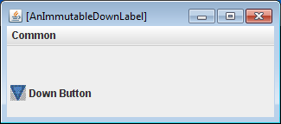
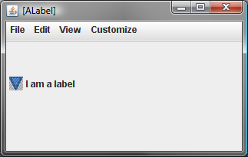
Using ALabel
ObjectEditor.edit(
new AnImmutableDownLabel(
0, 0);
}
The label icon and image are offset 0, height/2 from upper left corner
Text follows the label in a left-to-right order.
File should be in the project folder (directory) containing bin and src

