Slide 1

Comp 401
Iterator Design pattern
Instructor: Prasun Dewan

Slide 2
Prerequisite
Interfaces
Scanning
Arrays Collection Types (Optional)

Slide 3
Object-based Scanning
Redo the scanning solution
Monolithic, single class solution
  does UI and scanning
No reuse of code
Another scanning problem to show reuse
Illustrate streams and iterator design pattern

Slide 4
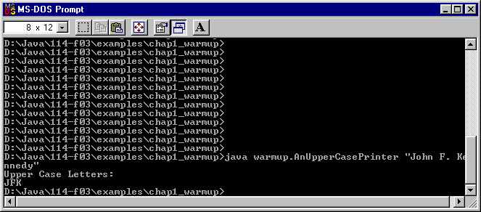
Upper case printing

Slide 5
Upper case printing
public class MonolithicUpperCasePrinter {
public static void main(String[] args){
// assume user enters arguments correctly
System.out.println("Upper Case Letters:");
int index = 0;
while (index < args[0].length()) {
if (Character.isUpperCase(args[0].charAt(index)))
System.out.print(args[0].charAt(index));
index++;
}
System.out.println();
}

Slide 6
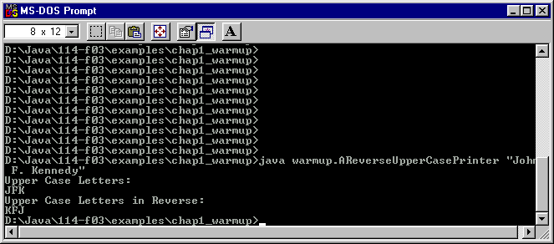
Printing Scanned Characters Forwards and Backwards
Solution cannot scan multiple times

Slide 7
Solution
public class MonolithicReverseUpperCasePrinter {
static final int MAX_CHARS = 5;
static char[] upperCaseLetters = new char[MAX_CHARS];
static int numberOfUpperCaseLetters = 0;
public static void main(String[] args){
int index = 0;
System.out.println("Upper Case Letters:");
while (index < args[0].length()) {
if (Character.isUpperCase(args[0].charAt(index))) {
System.out.print(args[0].charAt(index));
storeChar(args[0].charAt(index));
}
index++;
}
System.out.println();
printReverse();
}
}

Slide 8
Solution (contd.)
public static void storeChar(char c) {
if (numberOfUpperCaseLetters == MAX_CHARS) {
System.out.println("Too many upper case letters. Terminating program. ");
System.exit(-1);
}
upperCaseLetters[numberOfUpperCaseLetters] = c;
numberOfUpperCaseLetters++;
}
public static void printReverse() {
System.out.println("Upper Case Letters in Reverse:");
for (int index =numberOfUpperCaseLetters - 1; index >= 0; index--) {
System.out.print(upperCaseLetters[index]);
}
System.out.println();
}

Slide 9
Two Scanning Problems
One UI is a subset of the other
What about the code?

Slide 10
No reuse and UI Seperation in Monolithic Solutions
int index = 0;
System.out.println("Upper Case Letters :");//token processing
while (index < args[0].length()) {
if (Character.isUpperCase(args[0].charAt(index);))
System.out.print(args[0].charAt(index)); // token processing
index++;
}
UI and scanning mixed together
int index = 0;
System.out.println("Upper Case Letters :");//token processing
while (index < args[0].length()) {
if (Character.isUpperCase(args[0].charAt(index);)) {
System.out.print(args[0].charAt(index);); // token processing
storeChar(args[0].charAt(index));
}
index++;
}
Only difference
How to put it in separate class that only scans and does not store or print?

Slide 11
Division of Labor in Character Scanning
Scanner class that produces tokens
Main class that processes tokens (prints and/or stores tokens)

Slide 12
Index-Based Interface?
AnIndexedBasedScanner
Main class that processes tokens (prints and/or stores tokens)

Slide 13
Index-based Interface
public interface IndexBasedScanner {
public char[] getTokenArray () ;
public int getNumberOfTokens () ;
}

Slide 14
Implementation with Array Property
public class AnUppercaseIndexBasedScanner {
static final int MAX_TOKENS = 5;
String[] upperCaseLetters = new String[MAX_TOKENS];
int numberOfUpperCaseLetters;
public AnIndexBasedScanner(String theScannedString) {
scan(theScannedString);
}
void scan (String s) {
// store all scanned tokens in upperCaseLetters
…
}
public String[] getTokenArray () {
return upperCaseLetters;
}
public int getNumberOfTokens() {
return numberOfUpperCaseLetters;
}
}
All tokens scanned and stored even if only some may be used by code processing the tokens.

Slide 15
Better Scanning Interface?
Scanner class that produces tokens
Analogy with Division of Labor in Radio Station Scanning
Main class that processes tokens (prints and/or stores tokens)

Slide 16
Division of Labor in Radio Scanning

Slide 17
Division of Labor in Radio Scanning

Slide 18
Division of Labor in Radio Scanning

Slide 19
Division of Labor in Radio Scanning

Slide 20
Division of Labor in Radio Scanning

Slide 21
Division of Labor in Radio Scanning

Slide 22
Division of Labor in Radio Scanning

Slide 23
Division of Labor in Radio Scanning
?

Slide 24
Division of Labor in Radio Scanning

Slide 25
Analogous Division of Labor
Scanner class that produces tokens
Main class that processes tokens (prints and/or stores tokens)

Slide 26
Division of Labor in Character Scanning
Scanner Class
(Produces Token Stream)
Scanner User (Processes Token Stream)
Java input libraries illustrate this division of labor in scanning

Slide 27
Using Java Scanning Libraries
BufferedReader dataIn = new BufferedReader (new InputStreamReader( System.in));
int product = 1;
// add input list terminated by a negative number
while (true) {
  int num = Integer.parseInt (dataIn.readLine());
  if (num < 0) break;
  product = product*num;
}
System.out.println (product);
Parameter to InputStreamReader
Parameter to BufferedReader
Give next line in sequence of input lines

Slide 28
Constructor parameters
InputStreamReader takes System.in as parameter.
BufferedReader takes InputStreamReader as parameter.
In general, scanner takes object producing scanned stream as parameter.

Slide 29
Division of Labor in I/O
InputStreamReader (Produces Character Stream)
BufferedReader (Produces Line Stream)
BufferReader User (Users Line Stream)

Slide 30
BufferedReader Operations
Multi-line
input stream
Line
stream
Line 1
Line 2
dataIn.readLine()
Line 1
dataIn.readLine()
Line 2
dataIn.readLine()
IOException

Slide 31
Scanner Interface?
Input
stream
Token
Stream
token 1
token 2
scanner.next ()
token 1
scanner.next ()
token 2
scanner.next ()
ScannerException

Slide 32
Scanner Interface?
Input
stream
Token
Stream
token 1
token 2
scanner.next ()
token 1
scanner.next ()
token 2
scanner.hasNext()
false
scanner.next ()
???

Slide 33
Uppercase Scanner Interface?
J
o
h
n
F
.
K
e
n
n
e
d
y
token 1
token 2
token 3
scanner.next ()
‘J’
scanner.next ()
‘F’
scanner.next()
‘K’
Can check hasNext() before calling next().
scanner.hasNext()
false
scanner.next ()
???

Slide 34
Multiple Iterator Interfaces
public interface CharIterator {
  public char next ();
  public boolean hasNext();
}
public interface StringIterator{
  public String next ();
  public boolean hasNext();
}
package <P>;
public interface <Type>Iterator{
  public <Type> next ();
  public boolean hasNext();
}

Slide 35
Using an Iterator Interface
J
o
h
n
F
.
K
e
n
n
e
d
y
token 1
token 2
token 3
public static void printChars (CharIterator charIterator) {
while (charIterator.hasNext())
System.out.print(charIterator.next ());
}
Normally need to check hasNext() before each call to next()!
Unless expecting a certain minimum number of tokens (e.g. move 50)

Slide 36
Indexing vs. Iteration
In both cases elements from an ordered sequence are accessed.
Indexing allows random access, access to elements in any order.
Which to use when (some) elements are accessed in order?
Indexing less efficient: random access requires storing all sequence elements in memory, which takes time and space.
Indexing (slightly) more difficult to use: Object user must keep track of next element index.
Iterator can but does not need to store

Slide 37
Iterator
public class AnUpperCaseIterator implements CharIterator {
    …
    public AnUpperCaseIterator(String theString) {
    ...
    }
    public boolean hasNext() {
    ...
    }
    public char next () {
    ...;
    }
    …
}

Slide 38
Data Structure: Scanned String
public class AnUpperCaseIterator implements CharIterator {
    String string;
    …
    public AnUpperCaseIterator(String theString) {
    string = theString;
    ...
    }
    public boolean hasNext() {
    ...
    }
    public char next () {
    ...
    }
}

Slide 39
Data Structure: Marker
string
J
o
h
n
F
.
K
e
n
n
e
d
y
Scanned part
Unscanned part
nextElementPos
nextElementPos is a global rather than loop variable
Changed when next() is called
Accessed when hasNext() is called
next() has side effects!
All methods (next(), hasNext(), and internal methods called by them written for different kinds of tokens) must agree on where it points at various points in scanning process.

Slide 40
next ()
string
J
o
h
n
F
.
K
e
n
n
e
d
y
nextElementPos
public char next () {
}

Slide 41
next () Constraints
string
J
o
h
n
F
.
K
e
n
n
e
d
y
nextElementPos
//Assume nextElemPos is at start of next token or end of string when
//method is called.
//Method makes sure this is also true before returning.
//returns next element if one exists
public char next() {
}

Slide 42
next () Code
string
J
o
h
n
F
.
K
e
n
n
e
d
y
Unexecuted Loop
nextElementPos
//Assume nextElementPos is at start of next token or end of string when
//method is called.
//Method makes sure this is also true before returning.
//returns next element if one exists
public char next() {
}
char retVal = string.charAt(nextElementPos)
while (!isUpperCase(string.charAt(nextElementPos)))
nextElemPos++;
return retVal;

Slide 43
next () Modular Code
string
J
o
h
n
F
.
K
e
n
n
e
d
y
nextElementPos
//Assume nextElemPos is at start of next token or end of string when
//method is called.
//Method makes sure this is also true before returning.
//returns next element if one exists
public char next() {
}
char retVal = getToken();
movePastCurrentToken();
skipNonTokenCharacters();
return retVal;

Slide 44
extractToken()
string
J
o
h
n
F
.
K
e
n
n
e
d
y
nextElementPos
//Assume nextElemPos is at start of next token or end of string when
//method is called.
//returns next token if one exists
public char getToken() {
}
return string.charAt(nextElementPos);

Slide 45
movePastCurrentToken()
string
J
o
h
n
F
.
K
e
n
n
e
d
y
nextElementPos
//Assume nextElemPos is at start of next token or end of string when
//method is called.
//Moves past current token.
public void movePastCurrentToken() {
}
nextElemPos++;

Slide 46
skipNonTokenCharacters()
string
J
o
h
n
F
.
K
e
n
n
e
d
y
nextElementPos
StringIndexOutOfBounds
// keep advancing nextElementPos until we hit the next upper case
public void skipNonTokenCharacters() {
}
while (! isUpperCase(string.charAt(nextElementPos)))
nextElemPos++;

Slide 47
Short Circuit And
string
J
o
h
n
F
.
K
e
n
n
e
d
y
nextElementPos
short-circuit
StringIndexOutOfBounds?
// keep advancing nextElementPos until we hit the next upper case or go
// beyond the end of the string.
public void skipNonTokenCharacters() {
}
while (nextElementPos < string.length() && !Character.isUpperCase(string.charAt(nextElementPos)))
nextElemPos++;

Slide 48
Reversing order
string
J
o
h
n
F
.
K
e
n
n
e
d
y
nextElementPos
StringIndexOutOfBounds?
// keep advancing nextElementPos until we hit the next upper case or go
// beyond the end of the string.
public void skipNonTokenCharacters() {
}
while (!Character.isUpperCase(string.charAt(nextElementPos)) && nextElementPos < string.length() )
nextElemPos++;

Slide 49
Initialization
string
J
o
h
n
F
.
K
e
n
n
e
d
y
nextElementPos
String string;
int nextElementPos = 0;
public AnUpperCaseIteratorString theString) {
}
string = theString;

Slide 50
Initialization when first char is not at token start
string
j
o
h
n
F
.
K
e
n
n
e
d
y
nextElementPos
String string;
int nextElementPos = 0;
public AnUpperCaseIteratorString theString) {
}
string = theString;
skipNonTokenCharacters();

Slide 51
hasNext() Return Value
string
J
o
h
n
F
.
K
e
n
n
e
d
y
nextElementPos
public boolean hasNext () {
    ...
}
true

Slide 52
hasNext() Return Value
string
J
o
h
n
F
.
K
e
n
n
e
d
y
nextElementPos
public boolean hasNext () {
    ...
}
true

Slide 53
hasNext() Return Value
string
J
o
h
n
F
.
K
e
n
n
e
d
y
nextElementPos
public boolean hasNext () {
    ...
}
false

Slide 54
hasNext() Code
string
J
o
h
n
F
.
K
e
n
n
e
d
y
nextElementPos
//return false if nextElementPos is beyond end of string; true otherwise
public boolean hasNext () {
    return nextElementPos < string.length();
}

Slide 55
Complete Scanner
public class AnUpperCaseIterator implements CharIterator {
String string;
int nextElementPos = 0;
public AnUpperCaseIterator(String theString) {
string = theString;
skipNonTokenCharacters();
}
public boolean hasNext() { return nextElementPos < string.length();}
public char next () {
char retVal = extractToken();
movePastCurrentToken();
skipNonTokenCharacters();
return retVal;
}
void movePastCurrentToken() {nextElementPos++;}
void skipNonTokenCharacters() {
while (nextElementPos < string.length() && !Character.isUpperCase(string.charAt(nextElementPos)))
nextElementPos++;
}
char getToken() { return string.charAt(nextElementPos);}
}

Slide 56
Complete Scanner
public class AnUpperCaseIterator implements CharIterator {
String string;
int nextElementPos = 0;
public AnUpperCaseIterator(String theString) {
string = theString;
skipNonTokenCharacters();
}
public boolean hasNext() { return nextElementPos < string.length();}
public char next () {
char retVal = getToken();
movePastCurrentToken();
skipNonTokenCharacters();
return retVal;
}
void movePastCurrentToken() {nextElementPos++;}
void skipNonTokenCharacters() {
while (hasNext() && !Character.isUpperCase(string.charAt(nextElementPos)))
nextElementPos++;
}
char getToken() { return string.charAt(nextElementPos);}
}

Slide 57
Scanner Structure
public class <Scanner Name> implements <T>Iterator {
String string;
int nextElementStart = 0;
int nextElementEnd; // may not be global variable
public <Scanner Name> (String theString) {
string = theString;
skipNonTokenCharacters();
}
public boolean hasNext() { return nextElementStart < string.length();}
public <T> next () {
<T> retVal = getToken(…);
movePastCurrentToken(…);
skipNonTokenCharacters();
return retVal;
}
void movePastCurrentToken(…) {…};
void skipNonTokenCharacters(…) {…};
<T> getToken() { …}
}

Slide 58
Multiple Token Types
Need multiple next(), extractToken(), ..
e.g. nextNumber(), getNumber
public class <Scanner Name> implements <T>Iterator {
String string;
int nextElementStart = 0;
int nextElementEnd; // may not be global variable
public <Scanner Name> (String theString) {
string = theString;
skipNonTokenCharacters();
}
public boolean hasNext() { return nextElementStart < string.length();}
public <T> next () {
<T> retVal = getToken(…);
movePastCurrentToken(…);
skipNonTokenCharacters();
return retVal;
}
void movePastCurrentToken(…) {…};
void skipNonTokenCharacters(…) {…};
<T> getToken() { …}
}
e.g. nextWord(), extractWord
next() calls appropriate nextTokenType() method based on first token character.
e.g. if isDigit(firstTokenChar), return nextNumber(), else if isLetter(firstTokenChar) return nextWord()

Slide 59
Division of Labor in Character Scanning
Scanner Class
(Produces Token Stream)
Scanner User (Processes Token Stream)

Slide 60
Forward Printing
AnUpperCaseIterator
AnUpperCasePrinter

Slide 61
Forward and Reverse Printing
AnUpperCaseIterator
AReverseUpperCasePrinter

Slide 62
UpperCasePrinter
public class ReusingUpperCasePrinter {
public static void main (String args[]) {
printUpperCase(args[0]);
}
public static void printUpperCase(String s) {
System.out.println("Upper Case Letters:");
printChars (new AnUpperCaseIterator(s));
}
public static void printChars (CharIterator charIterator) {
while (charIterator.hasNext())
System.out.print(charIterator.next ());
}
}

Slide 63
Forward and reverse printing
public class ReusingForwardReverseUpperCasePrinter {
static final int MAX_CHARS = 5;
static char[] upperCaseLetters = new char[MAX_CHARS];
static int numberOfUpperCaseLetters = 0;
public static void main(String[] args){
printAndStore(args[0]);
printReverse();
}

Slide 64
Forward and reverse printing (contd)
public static void printAndStore (String s) {
System.out.println("Upper Case Letters:");
printAndStore (new AnUpperCaseIterator(s));
}
public static void printAndStore (CharIterator charIterator) {
while (charIterator.hasNext()) {
char inputChar = charIterator.next ();
System.out.print (inputChar);
storeChar(inputChar);
}
System.out.println();
}

Slide 65
Forward and reverse printing (contd.)
public static void storeChar(char c) {
if (numberOfUpperCaseLetters == MAX_CHARS) {
System.out.println("Too many upper case letters. Terminating program. ");
System.exit(-1);
}
upperCaseLetters[numberOfUpperCaseLetters] = c;
numberOfUpperCaseLetters++;
}
public static void printReverse() {
System.out.println("Upper Case Letters in Reverse:");
for (int index =numberOfUpperCaseLetters - 1; index >= 0; index--) {
System.out.print(upperCaseLetters[index]);
}
}
}

Slide 66
Reuse of Iterator
Scanner use in ReusingForwardReverseUpperCasePrinter
while (charIterator.hasNext()) {
char nextChar = charIterator.next());
System.out.print(nextChar);
storeChar(nextChar);
}
Scanner use in ReusingUpperCasePrinter
while (charIterator.hasNext())
System.out.print(charIterator.next ());

Slide 67
No reuse in Monolithic Solutions
int index = 0;
System.out.println("Upper Case Letters :");//token processing
while (index < args[0].length()) {
if (Character.isUpperCase(args[0].charAt(index);))
System.out.print(args[0].charAt(index)); // token processing
index++;
}
int index = 0;
System.out.println("Upper Case Letters :");//token processing
while (index < args[0].length()) {
if (Character.isUpperCase(args[0].charAt(index);)) {
System.out.print(args[0].charAt(index);); // token processing
storeChar(args[0].charAt(index));
}
index++;
}
Only difference
How to put it in separate class that only scans and does not store?

Slide 68
Need Reuse?
public class AnUpperCasePrinter {
public static void main(String[] args){
// assume user enters arguments correctly
System.out.println("Upper Case Letters:");
int index = 0;
while (index < args[0].length()) {
if (Character.isUpperCase(args[0].charAt(index)))
System.out.print(args[0].charAt(index));
index++;
}
System.out.println();
}
initialize
while there is more input
set next line;
application-specific code to process next line
move next line markers
Input scanning code would be much more complex

Slide 69
Multiple Streams
InputStreamReader (Produces Character Stream)
BufferedReader (Produces Line Stream)
BufferReader User (Users Line Stream)

Slide 70
Single Stream
AnUpperCaseIterator
Multiple streams in example?
AnUpperCasePrinter

Slide 71
Stream→Stream
string
J
o
h
n
F
.
K
e
n
n
e
d
y
AnUpperCaseIterator (Scanner)
J
F
K
JFK
FDR
AnInitialsIterator (Parser)
AnInitialsIterator converts AnUpperCaseItertor characters into initial string like BufferReader converts InputStream characters into line strings

Slide 72
Parser
public interface StringIterator {
public String next();
public boolean hasNext();
}

Slide 73
Constructor
public class AnInitialsIterator implements StringIterator {
CharIterator charIterator;
public AnInitialsIterator(CharIterator aCharIterator) {
charIterator = aCharIterator;
}
public String next() {
…
}
public boolean hasNext() {
…
}
}

Slide 74
Next
public class AnInitialsIterator implements StringIterator {
CharIterator charIterator;
public AnInitialsIterator(CharIterator aCharIterator) {
charIterator = aCharIterator;
}
public String next() {
return "" + charIterator.next() + charIterator.next() +
charIterator.next();
}
public boolean hasNext() {
…
}
}

Slide 75
HasNext
public class AnInitialsIterator implements StringIterator {
CharIterator charIterator;
public AnInitialsIterator(CharIterator aCharIterator) {
charIterator = aCharIterator;
}
public String next() {
return "" + charIterator.next() + charIterator.next() +
charIterator.next();
}
public boolean hasNext() {
return charIterator.hasNext();
}
}

Slide 76
Iterator vs. Scanning & Parsing
J
o
h
n
F
.
K
e
n
n
e
d
y
token 1
token 2
token 3
public interface CharIterator {
  public char next ();
  public boolean hasNext();
}

Slide 77
Iterator without Scanning
AllUppercaseLettersInOrder
‘A’
‘B’
...
‘Z’
implements
public interface CharIterator {
  public char next ();
  public boolean hasNext();
}

Slide 78
Iterating all Uppercase Letters
//instance variables
???
public char next () {
???
}
public boolean hasNext() {
????
}

Slide 79
Iterating all Uppercase Letters
public class AllUpperCaseLettersInOrder implements CharIterator {
char nextLetter = 'A';
public boolean hasNext() {
return nextLetter <= 'Z';
}
public char next () {
char retVal = nextLetter;
nextLetter = (char) (nextLetter + 1);
return retVal;
}
}

Slide 80
Comparing Two Implementations
J
o
h
n
F
.
K
e
n
n
e
d
y
token 1
token 2
token 3
AnUpperCaseIterator
‘J’
‘F’
‘K’
implements
public interface CharIterator {
  public char next();
  public boolean hasNext();
}

Slide 81
Radically Different Behavior
AllUppercaseLettersInOrder
‘A’
‘B’
...
‘Z’
implements
public interface CharIterator {
  public char next ();
  public boolean hasNext();
}
Syntactic Specification!

Slide 82
Can Write Code Reusing Polymorphic Code
print (new AnUppercaseIterator(s));
print (new AllUppercaseLettersInOrder());
Do not have to write two different overloaded methods
public static void printChars (CharIterator charIterator) {
while (charIterator.hasNext())
System.out.print(charIterator.next ());
}
Single polymorphic method, that is, method that can work on objects of different classes

Slide 83
Names Do Not Matter
public interface CharIterator {
  public char next ();
  public boolean hasNext();
}
Convention used by java.util.Iterator
public interface CharEnumeration{
  public char nextElement ();
  public boolean hasMoreElements());
}
Convention used by java.util.Enumeration
Enumeration vs. enum is confusing

Slide 84
Generalized Definition of Iterator
Iterator provides:
A method that gives the next object is some object sequence.
A method or exception or special next object value that indicates there are no more objects in the sequence.
Iterator
Iterator User
An application often contains an iterator and its user.
Iterator is a design pattern.

Slide 85
Java Iterator and Iterable
Java iterator
  java.util.Iterator<T> (next(), hasNext(), remove())
Java Iterable
  java.util.Iterable<T> (Iterator<T> iterator()))
List<T> extends it.
Iterable or Array
List<String> strings;
for (String string:strings) {
Sytem.out.println(string);
}

Slide 86
Scanning, Iterator, Streams
Scanner can be an iterator
Iterator may not be a scanner
A stream is another term for an iterator:
  InputStreamReader
  BufferedReader
  Console
  …..
Previous Java stream objects did not implement an interface.
Java 1.6 provides interface java.io.Console and object System.console that implements this interface and automatically composes Sytem.in and BufferedReader.

Slide 87
Extra Slides

Slide 88
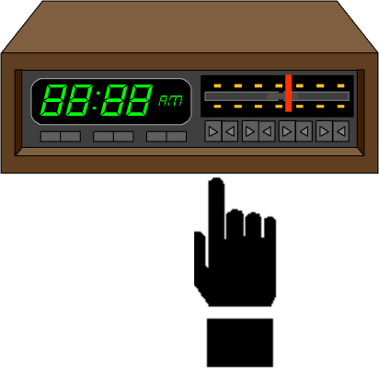
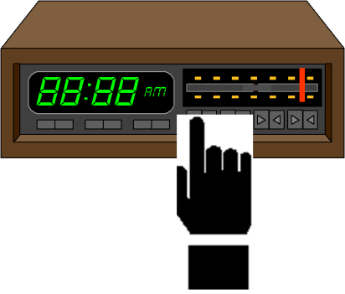
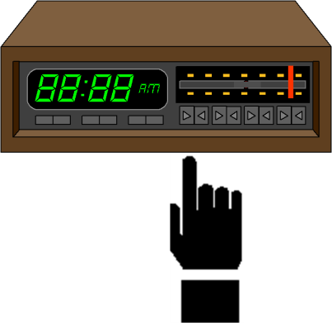
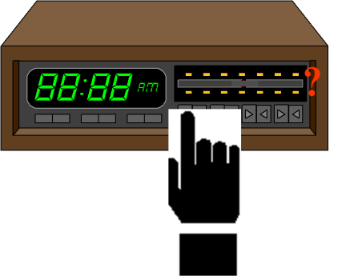

Slide 89
Redoing UpperCasePrinter
package main;
import iterators.CharIterator;
import iterators.AnUpperCaseIterator;
public class UpperCasePrinter {
public static void main (String args[]) {
printUpperCase(args[0]);
}
public static void printUpperCase(String s) {
System.out.println("Upper Case Letters:");
printChars (new AnUpperCaseIterator(s));
}
public static void printChars (CharIterator charIterator) {
while (charIterator.hasNext())
System.out.print(charIterator.next ());
}
}

Slide 90
Implementing Scanner
package iterators;
public class AnUpperCaseIterator implements CharIterator {
    …
    public AnUpperCaseIterator(String theString) {
    ...
    }
    public boolean hasNext() {
    ...
    }
    public char next () {
    ...;
    }
    …
}

Slide 91
Simple Storage-based Approach : No Scanning in next(), hasNext()
public class AnUpperCaseIterator implements CharIterator {
static final int MAX_CHARS = 5;
String[] upperCaseLetters;
int numberOfUpperCaseLetters;
….
public AnUpperCaseIterator(String theString) {{
scanAndStore(theString);
}
void scanAndStore (String theString) {
// store all scanned tokens in array
…
}
public boolean hasNext() {
….
}
public String next() {
…
}
}
Not property
Non trivial
Again, all tokens scanned even if only some may be used by code processing the tokens.

Slide 92
Division of Labor in Character Scanning
Scanner class that produces tokens
Scanner object
Instance of
Intantiates
Uses: Invokes methods in
UserClass that processes( prints and/or stores tokens)

Slide 93
Forward Printing
AnUpperCaseIterator
AnUpperCaseIterator
instance
Instance of
Intantiates
Uses: Invokes methods in
AnUpperCasePrinter

Slide 94
Forward and Reverse Printing
AnUpperCaseIterator
AnUpperCaseIterator instance
Instance of
Intantiates
Uses: Invokes methods in
AReverseUpperCasePrinter

Slide 95
Division of Labor in Character Scanning
Scanner class that produces tokens
Scanner object
Instance of
Intantiates
Uses: Invokes methods in
UserClass that processes( prints and/or stores tokens)

Slide 96
Forward Printing
AnUpperCaseIterator
AnUpperCaseIterator
instance
Instance of
Intantiates
Uses: Invokes methods in
AnUpperCasePrinter

Slide 97
Forward and Reverse Printing
AnUpperCaseIterator
AnUpperCaseIterator instance
Instance of
Intantiates
Uses: Invokes methods in
AReverseUpperCasePrinter

