Slide 1
Comp 110 Main & Console Input
Instructor: Sasa Junuzovic

Slide 2
Prerequisites
Loops
Static State
Types Char String
.

Slide 3
Removing Training Wheels
Notepad
creates
ALoanPair Source Code
MainClass Source Code
ALoanPairInstance
reads
Compiler
getTotalLoan()
writes
calls
ALoanPair Object (byte) Code
MainClass Object Code
ObjectEditor
instantiates
main
calls
Interpreter

Slide 4
Main & Console Input
Programming without ObjectEditor
Main Class
Programmer-Defined Overloading
Console Input
Programmer-Defined Library Class

Slide 5
Hello World

Slide 6
Hello World
main header
List of user-supplied arguments
public class AHelloWorldGreeter {
public static void main (String[] args) {
System.out.println ("Hello World");
}
}

Slide 7
Main Arguments

Slide 8
Main Arguments
public class AnArgPrinter {
public static void main (String[] args) {
System.out.println (args[0]);
}
}
args[0]
1st Argument
args[1]
2nd Argument
…

Slide 9
Main Arguments
Program refers to argument
public class AnArgPrinter {
public static void main (String[] args) {
System.out.println (args[0]);
}
}
User does not supply argument → Exception

Slide 10
String Input

Slide 11
String Input
import java.io.BufferedReader;
import java.io.InputStreamReader;
public class AnInputPrinter {
public static void main (String[] args) {
System.out.println("Please enter the line to be printed");
System.out.println ("The input was: " + readString());
}
}

Slide 12
Reading a String
Wait for the user to enter a string (of digits) on the next line
In case the user terminates input before entring a string, return “” and print an error message
static BufferedReader inputStream =
new BufferedReader(new InputStreamReader(System.in));
public static String readString() {
try {
return inputStream.readLine();
}
catch (Exception e) {
System.out.println(e);
return "";
}
}

Slide 13
String Input
import java.io.BufferedReader;
import java.io.InputStreamReader;
public class AnInputPrinter {
public static void main (String[] args) {
System.out.println("Please enter the line to be printed");
System.out.println ("The input was: " + readString());
}
static BufferedReader inputStream = new BufferedReader(
new InputStreamReader(System.in));
public static String readString() {
try {
return inputStream.readLine();
}
catch (Exception e) {
System.out.println(e);
return "";
}
}
}
Global variables referred to by static readString must be static
static main() can call only static methods

Slide 14
Importing a Package
public class AnInputPrinter {
… new BufferedReader (System.in)
…
}
Import declaration
import java.io. BufferedReader ;
Short name
package java.io;
public class BufferedReader {
….
}
public class AnInputPrinter {
… new java.io. BufferedReader (System.in)
…
}
Full name

Slide 15
Try-Catch Block
Program fragment that can cause an exception
try {
return inputStream.readLine();
}
catch (Exception e) {
System.out.println(e);
return "";
}
Exception handler
Exception object

Slide 16
Integer Input

Slide 17
Integer Input
import java.io.BufferedReader;
import java.io.InputStreamReader;
public class AnInputSquarer {
public static void main (String[] args) {
System.out.println("Please enter the integer to be squared:");
int num = readInt();
System.out.println ("The square is: " + num*num);
}
}

Slide 18
readInt()
Wait for the user to enter a string (of digits) on the next line
Return the int represented by the string
In case the user makes an error or terminates input before entring a valid int, return 0 and print an error message
public static int readInt() {
try {
return Integer.parseInt(inputStream.readLine());
} catch (Exception e) {
System.out.println(e);
return 0;
}
}

Slide 19
readInt()
Wait for the user to enter a string (of digits) on the next line
Return the int represented by the string
In case the user makes an error or terminates input before entring a valid int, return 0 and print an error message
static BufferedReader inputStream =
new BufferedReader(new InputStreamReader(System.in));
public static int readInt() {
try {
return new Integer(inputStream.readLine()).intValue();
} catch (Exception e) {
System.out.println(e);
return 0;
}
}
Less efficient and not clear that parsing occurs

Slide 20
Integer Input
import java.io.BufferedReader;
import java.io.InputStreamReader;
public class AnInputSquarer {
public static void main (String[] args) {
System.out.println("Please enter the integer to be squared:");
int num = readInt();
System.out.println ("The square is: " + num*num);
}
static BufferedReader inputStream =
new BufferedReader(new InputStreamReader(System.in));
public static int readInt() {
try {
return Integer.parseInt(inputStream.readLine());
} catch (Exception e) {
System.out.println(e);
return 0;
}
}
}

Slide 21
Reading Other Primitive Values
new Double (inputStream.readLine()).doubleValue());
new Boolean (inputStream.readLine()).booleanValue());
new T (inputStream.readLine()).tValue());
General pattern for reading primitive value of type t

Slide 22
Pausing a Program to View Output in an Interactive Programming Environment

Slide 23
Pausing a Program to View Output in an Interactive Programming Environment
public class AHelloWorldGreeterWithPause {
public static void main (String[] args) {
System.out.println ("Hello World");
pause();
}
public static void pause() {
try {
System.in.read();
} catch (Exception e) {
}
}
}
Wait for the user to enter a character and return it
Legal?

Slide 24
Expression vs. Statement
Expression cannot be used as statement
public static void pause() {
try {
5 + 3;
}
catch (Exception e) {
System.out.println(
System.out.println(“hello”));
}
}
Statement cannot be used as expression

Slide 25
Four Kinds of Methods
procedure
public void setWeight (double newVal) {
weight = newVal;
}
setWeight(70);
→
function
pure function
public static double calculatBMI(
double weight, double height) {
return weight/(height*height);
}
calculateBMI(70, 1.77)
→ 24.57
…
calculateBMI(70, 1.77)
→ 24.57
impure function
public int getWeight() {
return weight;
}
getWeight()
→ 70
setWeight(77)
→
getWeight()
→ 77
impure function with side effects
getWeight()
→ 77
public static int readNextNumber() {
System.out.println(”Next Number:");
return Console.readInt();
}
5
readNextNumber ()
→ 5
4
readNextNumber ()
→ 4
1

Slide 26
Side Effects
Effect other than computing the return value
public int getWeight() {
System.out.println(“get Weight called” );
return weight;
}
Printing something
public static int readNextNumber() {
System.out.println(”Next Number:");
return new Console.readInt();
}
Reading input
public int increment() {
counter++;
return counter;
}
Changing global variable

Slide 27
Alternative to Changing a Global Variable
public int increment() {
counter++;
return counter;
}
public void incrementCounter() {
counter++;
}
public int getCounter() {
return counter;
}

Slide 28
Function Calls
Can be used as expression
Can be used as statement
When return value is to be ignored
Rarely happens
Check program to see all return values being used as expressions
Other expressions not statements
Procedure calls never expressions

Slide 29
Pausing a Program to View Output in an Interactive Programming Environment
public class AHelloWorldGreeterWithPause {
public static void main (String[] args) {
System.out.println ("Hello World");
pause();
}
public static void pause() {
try {
System.in.read();
} catch (Exception e) {
}
}
}
Legal expression and statement
We do not care about the return value

Slide 30
Separate Class
Console
readInt
pause
readDouble
readBoolean
readChar
readString

Slide 31
Separate Class for Input
import java.io.BufferedReader;
import java.io.InputStreamReader;
public class Console {
static BufferedReader inputStream =
new BufferedReader(new InputStreamReader(System.in));
public static int readInt() {
try {
return Integer.parseInt(inputStream.readLine());
} catch (Exception e) {
System.out.println(e);
return 0;
}
}
public static String readString() {
try {
return inputStream.readLine();
} catch (Exception e) {
System.out.println(e);
return "";
}
}
... //other methods
}

Slide 32
Without Console
import java.io.BufferedReader;
import java.io.InputStreamReader;
public class AnInputPrinter {
public static void main (String[] args) {
System.out.println("Please enter the line to be printed");
System.out.println ("The input was: " + readString());
}
static BufferedReader inputStream =
new BufferedReader(new InputStreamReader(System.in));
public static String readString() {
try {
return inputStream.readLine();
}
catch (Exception e) {
System.out.println(e);
return "";
}
}
}

Slide 33
Using Console
public class AnInputPrinter {
public static void main (String[] args) {
System.out.println("Please enter the line to be printed");
System.out.println ("The input was: " + Console.readString());
}
}

Slide 34
Separation of Concerns
Make independent piece of code as separate method
Make independent set of methods as separate class
Use operation and data abstraction!

Slide 35
Multiple Integer Input

Slide 36
Multiple Integer Input
public class AnInputSummer {
public static void main (String[] args) {
System.out.println(
"Please enter the numbers to be added on separate lines:");
System.out.println (
"Their sum is: " + (Console.readInt() + Console.readInt()));
}
}

Slide 37
Multiple Integer Input
Entire line read as string and then parsed as int

Slide 38
Computing Polar Coordinates

Slide 39
Computing Polar Coordinates
public class AMonolithicPolarCoordinatesComputer {
public static void main (String args[]) {
int x = readX();
int y = readY();
print (x, y, Math.sqrt(x*x + y*y), Math.atan(y/x));
Console.pause();
}
public static int readX() {
System.out.println("Please enter x coordinate:");
return Console.readInt();
}
public static int readY() {
System.out.println("Please enter y coordinate:");
return Console.readInt();
}
public static void print(int x, int y, double radius, double angle) {
System.out.println("radius: " + radius);
System.out.println("angle: " + angle);
}
}
Not reusing previous implementation

Slide 40
Computing Polar Coordinates
public class APolarCoordinatesComputer {
public static void main (String args[]) {
print(readPoint());
Console.pause();
}
public static Point readPoint() {
System.out.println("Please enter x coordinate:");
int x = Console.readInt();
System.out.println("Please enter y coordinate:");
return new ACartesianPoint(x, Console.readInt());
}
public static void print(Point p) {
/*
System.out.println("x: " + p.getX());
System.out.println("y: " + p.getY());
*/
System.out.println("radius: " + p.getRadius());
System.out.println("angle: " + p.getAngle());
}
}
Reusing previous implementation

Slide 41
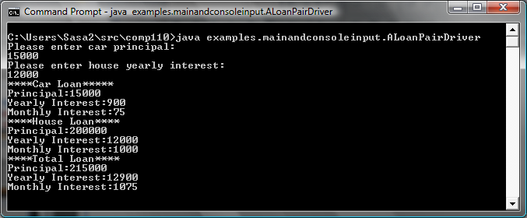
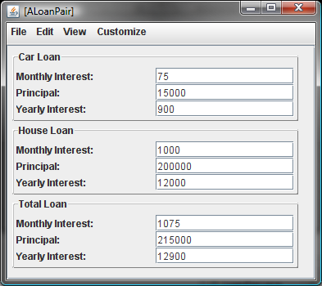
Equivalent User Interfaces

Slide 42
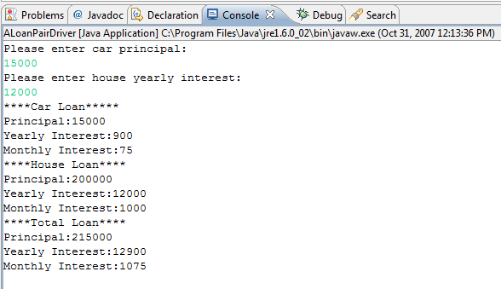
Equivalent User Interfaces

Slide 43
Algorithm (edit)

Slide 44
Algorithm
Create ALoanPair instance based on the two values entered by the user in the console window
Print the properties of the loan pair object in the console window

Slide 45
Main Method
public static void main (String[] args) {
LoanPair loanPair = new ALoanPair(
readCarLoan(), readHouseLoan());
print(loanPair); bus.uigen.ObjectEditor.edit(loanPair);
pause();
}
Method chaining

Slide 46
Main Method Without Method Chaining
public static void main (String[] args) {
Loan carLoan = readCarLoan();
Loan houseLoan = readHouseLoan();
LoanPair loanPair = new ALoanPair(carLoan, houseLoan);
print (loanPair);
bus.uigen.ObjectEditor.edit(loanPair);
pause();
}
Undefined

Slide 47
readCarLoan()

Slide 48
readCarLoan()
Prompt user
Return an instance of ALoan constructed from the principal
public static Loan readCarLoan() {
System.out.println("Please enter car principal:");
return new ALoan(Console.readInt());
}

Slide 49
Printing a LoanPair

Slide 50
Printing a LoanPair
public static void print (LoanPair loanPair) {
System.out.println("****Car Loan*****");
print(loanPair.getCarLoan());
System.out.println("****House Loan****");
print(loanPair.getHouseLoan());
System.out.println("****Total Loan****");
print(loanPair.getTotalLoan());
}
Programmer-defined overloading
public static void print (Loan loan) {
System.out.println("Principal:" + loan.getPrincipal());
System.out.println("Yearly Interest:" + loan.getYearlyInterest());
System.out.println("Monthly Interest:" + loan.getMonthlyInterest());
}

Slide 51
ObjectEditor.edit
Full name of the ObjectEditor class
bus.uigen.ObjectEditor.edit(loanPair);
Displays an edit window for the object passed as parameter

Slide 52
Class-Level Decomposition
Monolithic Main Class
(Loan User Interface and Loan Computation)
ObjectEditor
Programmer-defined Class
(ALoanPair)
Driver
(ALoanPairDriver)

Slide 53
Multi-Level Algorithm/Code
main
readCarLoan
readHouseLoan
print(LoanPair)
Console.pause
Console.readInt
print(Loan)

Slide 54
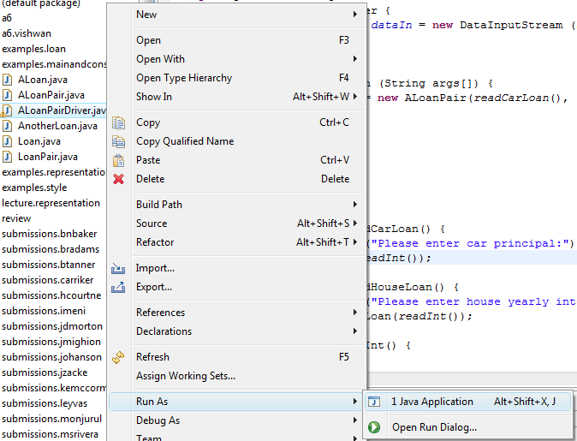
Running Main

Slide 55
Inserting a Break Point

Slide 56
Single-Stepping

Slide 57
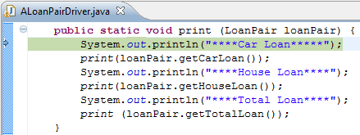
Step Into vs. Step Over

Slide 58
Inspecting Variables

