Slide 1
Comp 401 MVC and Graphics/Window Systems
Instructor: Prasun Dewan

Slide 2
Prerequisites
MVC and Toolkits
Composite Object Shapes

Slide 3
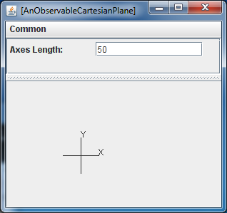
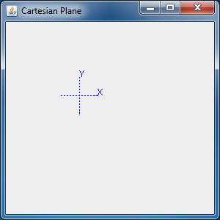
Cartesian Plane: Extra Manual View

Slide 4
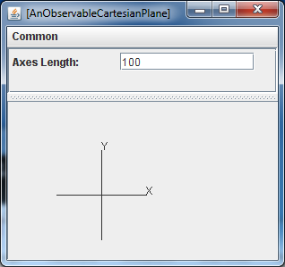
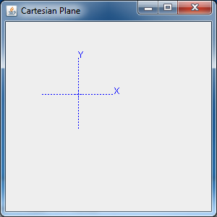
Synchronized Extra Manual View

Slide 5
Logical Structure
JFrame
Component
Super class of all widgets (JTextField, JButton)

Slide 6
Multiple Properties→One View
JFrame
Component is superclass of all AWT/Screen windows (Rectangular screen areas such as JTextField)
Component
Causes change in
int
Line
Line
String
Shape
String
Shape
Multiple properties in one component
Axes Length
X Axis
Y Axis
X label
Y label
CartesianPlane

Slide 7
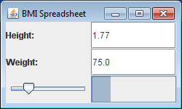
Dual: One Property→Multiple Views
JSlider
JProgressBar
Causes change in
One property mapped to multiple components
double
bmi
CartesianPlane

Slide 8
Component API?
drawString()
Component
fillOval()
drawOval()
fillLine ()
drawLine()
fillRect()
drawRect()
setColor()
drawImage()
setStroke()
Need some object that encapsulates a component and a pen

Slide 9
Graphics Context (Pen + Component)
drawString()
Graphics
fillOval()
drawOval()
fillLine ()
drawLine()
fillRect()
drawRect()
setColor()
drawImage()
setStroke()
IS-A
Graphics2D
draw3DRect()
Graphics2D actually passed to paint(Graphics)

Slide 10
Use of Graphics
Which component of MVC has this method?
public void paint(Graphics g) {
Graphics2D g2 = (Graphics2D) g;
g2.setStroke(dotted);
g.setColor(Color.BLUE);
draw(g, cartesianPlane);
}
public static void draw(Graphics g,
CartesianPlane aCartesianPlane) {
draw(g, aCartesianPlane.getXLabel());
draw(g, aCartesianPlane.getYLabel());
draw(g, aCartesianPlane.getXAxis());
draw(g, aCartesianPlane.getYAxis());
}
public static void draw(Graphics g, Line aLine) {
g.drawLine(aLine.getX(), aLine.getY(), aLine.getX() +
aLine.getWidth(), aLine.getY() + aLine.getHeight());
}
public static void draw(Graphics g, Label aLabel) {
Point location = aLabel.getLocation();
String s = aLabel.getText();
g.drawString(s, location.getX(), location.getY());
}
When is it called?
Can we call paint, draw?
How is a Graphics object assigned?

Slide 11
(Re)Painting Responsibility
Window Manager
JFrame
HAS-A
Component
Who repaints the window: window manager or application
While the component is unexposed, the drawing might have changed.
How should application react to window being re-exposed?
So, in general the application must redraw it.
How can we combine code for drawing and redrawing when exposed

Slide 12
Paint Event: What the Window System Does
Window Manager
JFrame
HAS-A
paint(Graphics)
Component
Paint event: Occurs when a component is uncovered (exposed) or when it is first displayed
repaint()
Paint event causes the repaint() method of the associated component to be called so that the component can (re)draw itself
Repaint calls paint passing it the graphics object representing the component and pen.
How to make application view (re) draw graphics in component?

Slide 13
The Inheritance Approach in Swing/AWT
Window Manager
JFrame
HAS-A
Application view becomes subclass of component and overrides the paint() method
paint(Graphics)
Component
repaint()
In the paint method it does the view task of displaying the shapes.
IS-A
propertyChanged()
ACartesianPlane View
On receiving a property change it calls repaint since it cannot manufacture a graphics context
paint(Graphics)
A view is not conceptually a component!
SWT uses observer pattern.

Slide 14
IS-A vs. HAS-A (1.1)
Component
Component
Component
IS-A
IS-A
IS-A
JTextField
JButton
ACartesianPlane View
HAS-A
HAS-A
A view is not conceptually a component!
ACounter JTextFieldView
ACounter ButtonController
Input events uses observer pattern.

Slide 15
IS-A vs. HAS-A Event Interception (1.0)
Component
Component
Component
IS-A
IS-A
IS-A
JTextField
JButton
ACartesianPlane View
HAS-A
IS-A
A view is not conceptually a component!
ACounter JTextFieldView
ACounter ButtonController
Input and output events intercepted through IS-A

Slide 16
Eclipse SWT Event Interception
Component
Component
Component
HAS-A
IS-A
IS-A
JTextField
JButton
ACartesianPlane View
HAS-A
IS-A
A view is not conceptually a component!
ACounter JTextFieldView
ACounter ButtonController
SWT uses observer pattern.

Slide 17
Observable Cartesian Plane
public class AnObservableCartesianPlane extends ACartesianPlane
implements ObservableCartesianPlane {
PropertyListenerSupport propertySupport =
new APropertyListenerSupport();
public AnObservableCartesianPlane (int theAxesLength,
int theOriginX, int theOriginY ) {
super(theAxesLength, theOriginX, theOriginY);
xAxis = new AnObservableLine(toXAxisX(), toXAxisY(), axesLength, 0);
yAxis = new AnObservableLine(toYAxisX(), toYAxisY(), 0, axesLength);
xLabel = new AnObservableStringShape ("X", toXLabelX(), toXLabelY());
yLabel = new AnObservableStringShape ("Y", toYLabelX(), toYLabelY());
}
public void setAxesLength(int newVal) {
int oldVal = getAxesLength();
super.setAxesLength(newVal);
propertySupport.notifyAllListeners(
new PropertyChangeEvent(this, "axesLength",
oldVal, newVal));
}
…
}

Slide 18
Atomic Objects Announcing Event
If a single setX (anX) shared by all classes in a project, then a single X setter method must be changed.
AStringShape
public void setX(int newX) {
x = newX;
}
AnObservableStringShape
public void setX(int newVal) {
int oldVal = getX();
super.setX(newVal);
propertySupport.notifyAllListeners(
new PropertyChangeEvent(this, "X", oldVal, newVal));
}

Slide 19
Overriding Paint Method
public class ACartesianPlaneView extends Component
implements PropertyChangeListener {
BasicStroke dotted = new BasicStroke(1f, sicStroke.CAP_ROUND,
BasicStroke.JOIN_ROUND, 1f, new float[] {2f}, 0f);
CartesianPlane cartesianPlane;
public ACartesianPlaneView(
CartesianPlane aCartesianPlane) {
cartesianPlane = aCartesianPlane;
}
public void propertyChange(PropertyChangeEvent evt) {
repaint(); // causes paint to be called
}
public void paint(Graphics g) {
Graphics2D g2 = (Graphics2D) g;
g2.setStroke(dotted);
g.setColor(Color.BLUE);
draw(g, cartesianPlane);
}

Slide 20
Drawing
public static void draw(Graphics g,
CartesianPlane aCartesianPlane) {
draw(g, aCartesianPlane.getXLabel());
draw(g, aCartesianPlane.getYLabel());
draw(g, aCartesianPlane.getXAxis());
draw(g, aCartesianPlane.getYAxis());
}
public static void draw(Graphics g, Line aLine) {
g.drawLine(aLine.getX(), aLine.getY(), aLine.getX() +
aLine.getWidth(), aLine.getY() + aLine.getHeight());
}
public static void draw(Graphics g, Label aLabel) {
Point location = aLabel.getLocation();
String s = aLabel.getText();
g.drawString(s, location.getX(), location.getY());
}

Slide 21
Cartesian Plane Composer
public class CartesianPlaneComposer {
public static void main(String[] args) {
CartesianPlane cartesianPlane =
new AnObservableCartesianPlane(100, 100, 100);
PropertyChangeListener view = new
ACartesianPlaneView(CartesianPlane);
cartesianPlane.addPropertyChangeListener(view);
((ObservableLine) cartesianPlane.getXAxis()).
addPropertyChangeListener(view);
((ObservableLine)
cartesianPlane.getYAxis()).addPropertyChangeListener(view);
((ObservableStringShape)
cartesianPlane.getXLabel()).addPropertyChangeListener(view);
((ObservableStringShape)
cartesianPlane.getYLabel()).addPropertyChangeListener(view);
JFrame frame = new JFrame(" Cartesian Plane");
frame.add((Component) view);
frame.setSize(300, 300);
frame.setVisible(true);
ObjectEditor.edit(CartesianPlane);
}
}
Making view a listener not only of model but also all of its components though not needed in this problem

Slide 22
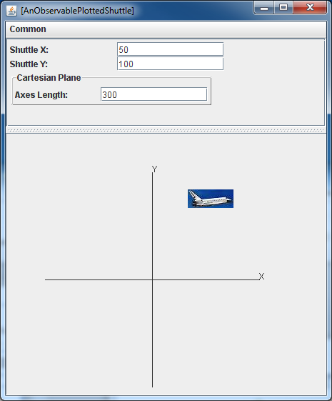
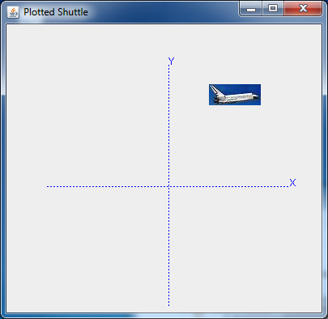
Plotted Shuttle

Slide 23
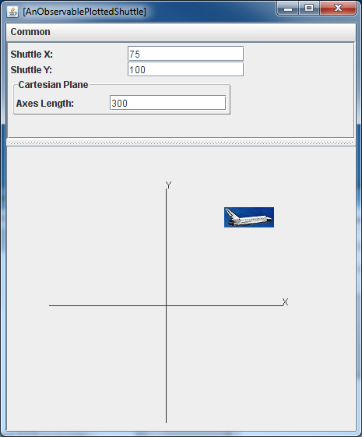
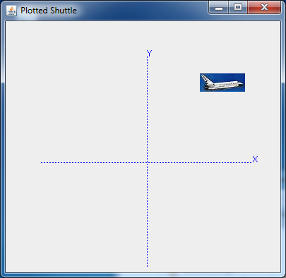
User Edits Shuttle X in OE Window
Mouse click

Slide 24
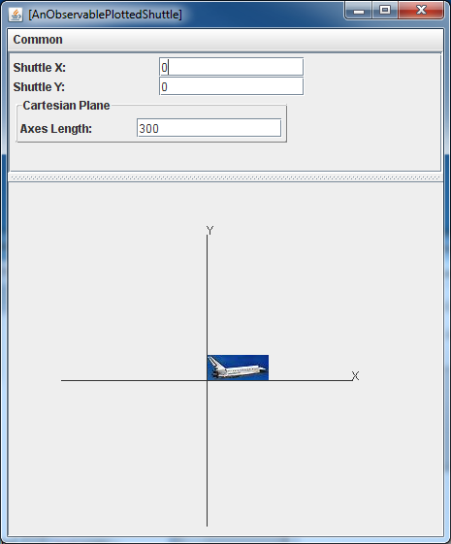
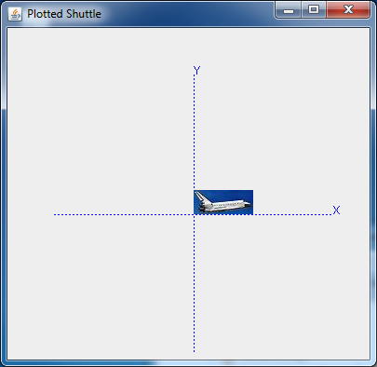
User Clicks Mouse in Manual Display
Focus
‘x’
Mouse click
Focus on window (Frame) by clicking in its border in Windows
Focus window is the one that gets keyboard events

Slide 25
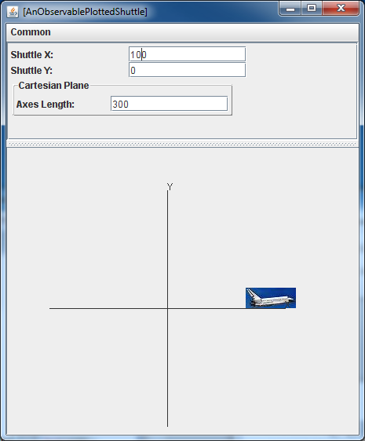
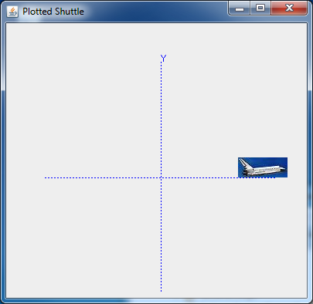
Result of Typing ‘x’ in Manual Display
‘y’
Shuttle goes to some preset X coordinate

Slide 26
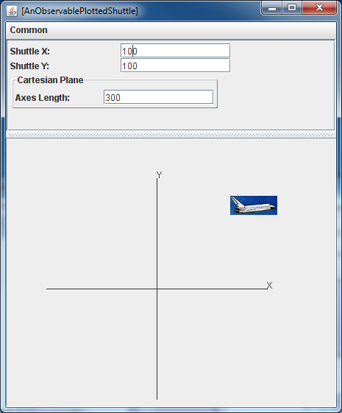
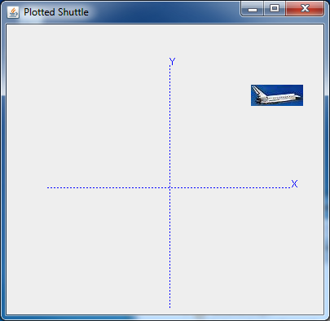
Result of ‘y’ in Manual Display
Shuttle goes to some preset Y coordinate

Slide 27
Logical Structure
JFrame
Component
Re-use of view?

Slide 28
Plotted Shuttle MVC
key
click
addKey Listener()
Component
paint()
CartesianPlaneView
paint()
addMouse Listener()
repaint()
IS-A
property changed()
IS-A
APlotted ShuttleKey Controller
APlotted
ShuttleMouse Controller
PlottedShuttle View
key Typed()
mouse Clicked()
paint()
ObservablePlotted Shuttle
getCartesianPlane()
setShuttleX(Y)()
getShuttleImage()

Slide 29
Reusing View and Drawing Images
public class APlottedShuttleView
extends ACartesianPlaneView implements BeanView {
ObservablePlottedShuttle plottedShuttle;
public APlottedShuttleView (
ObservablePlottedShuttle aPlottedShuttle) {
super((ObservableCartesianPlane) aPlottedShuttle.getCartesianPlane());
plottedShuttle = aPlottedShuttle;
}

Slide 30
Reusing View and Drawing Images
public void paint(Graphics g) {
super.paint(g);
Graphics2D g2 = (Graphics2D) g;
draw(g2, plottedShuttle.getShuttleImage());
}
public void draw(Graphics2D g, ShuttleImage anImage) {
Image img =
Toolkit.getDefaultToolkit().getImage(anImage.getImageFileName());
g.drawImage(img, anImage.getX(), anImage.getY(), this);
}
public void draw(Graphics2D g, PlottedShuttle aShuttleLocation) {
draw(g, aShuttleLocation.getCartesianPlane());
draw (g, aShuttleLocation.getShuttleImage());
}
}
Shuttle image drawn over the Cartesian plane
Shuttle or Cartesian plane on top?

Slide 31
Mouse Controller
public class APlottedShuttleMouseController implements MouseListener {
Component shuttleComponent;
PlottedShuttle plottedShuttle;
public APlottedShuttleMouseController (PlottedShuttle aPlottedShuttle,
Component aShuttleComponent) {
shuttleComponent = aShuttleComponent;
plottedShuttle = aPlottedShuttle;
shuttleComponent.addMouseListener(this);
}
public void mouseClicked(MouseEvent e) {
plottedShuttle.setShuttleX(0);
plottedShuttle.setShuttleY(0);
}
public void mouseEntered(MouseEvent e) {}
public void mouseExited(MouseEvent e) {}
public void mousePressed(MouseEvent e) {}
public void mouseReleased(MouseEvent e) {}
}

Slide 32
Key Controller
public class APlottedShuttleKeyController implements KeyListener {
Component shuttleComponent;
PlottedShuttle plottedShuttle;
public static final int TARGET_X = 100;
public static final int TARGET_Y = 100;
public APlottedShuttleKeyController (PlottedShuttle aPlottedShuttle,
Component aShuttleComponent) {
shuttleComponent = aShuttleComponent;
plottedShuttle = aPlottedShuttle;
shuttleComponent.addKeyListener(this);
shuttleComponent.setFocusable(true);
}
}

Slide 33
Key Controller
public void keyTyped(KeyEvent e) {
char typedChar = e.getKeyChar();
switch (typedChar) {
case 'x' :
plottedShuttle.setShuttleX(TARGET_X);
break;
case 'y':
plottedShuttle.setShuttleY(TARGET_Y);
break;
}
}
public void keyPressed(KeyEvent e) {}
public void keyReleased(KeyEvent e) {}

Slide 34
Plotted Shuttle Composer
public class PlottedShuttleComposer {
public static void main(String[] args) {
ObservablePlottedShuttle plottedShuttle = new
AnObservablePlottedShuttle(50, 100);
PropertyChangeListener view = new APlottedShuttleView(plottedShuttle);
plottedShuttle.addPropertyChangeListener(view);
MouseListener mouseController =
new APlottedShuttleMouseController(plottedShuttle, (Component) view);
KeyListener keyController =
new APlottedShuttleKeyController(plottedShuttle, (Component) view);
JFrame frame = new JFrame("Plotted Shuttle");
frame.add((Component) view);
frame.setSize(300, 300);
frame.setVisible(true);
ObjectEditor.edit(plottedShuttle);
plottedShuttle.setShuttleY(100);
plottedShuttle.setShuttleX(50);
}
}
In general should make view listener of all model components to which it listens

Slide 35
Window System, Toolkit and Window Manager
Window system
Supports hierarchical rectangular areas on screens called windows with no predefined behavior
Toolkit
Extends windows to widgets by adding behavior to them
A widget IS-A window
Sometimes use widget and window synonymously as Java blurs the distinction
Window manager
Allows manipulation of top-level windows (JFrame or Frame instances in Java)
Provides user commands and an API to move, resize, iconify, restore, and focus on (for key board input) windows.
Puts decorations around windows for invoking these commands

Slide 36
MVC with Beans and Window Output
Like MVC with Beans we saw earlier
One or more properties now displayed in an instance of a window class (Component, Panel, JPanel, Canvas) rather than a widget class (JTextField, TextField)
A view class is now a subclass of a window class. Earlier a view class had a reference to an instance of a widget class.
A view overrides the paint() method of the window class to draw the properties using its Graphics argument
Graphics class provides methods to draw lines, rectanges, ovals ….
When a view receives a notification from the model class it calls the repaint() method which calls the paint() method

Slide 37
MVC with Window Input and Output
Like MVC with window output: A view class IS-A Window Class
A controller now listens to mouse and/or key events of a view (window) which it gets in its constructor
Calls write methods in the model in response to mouse/key events instead of action events

