Slide 1
Comp 401 MVC and User-Interface Toolkits
Instructor: Prasun Dewan

Slide 2
Prerequisites
MVC

Slide 3
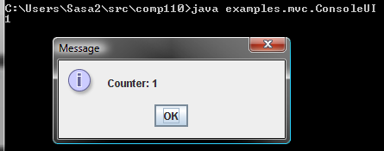
Counter Application

Slide 4
Complete MVC
Model Connection Method
Controller
Notification Method
View
Performs Input
Performs Output
Model
add()
getValue()
Observer Registration Method

Slide 5
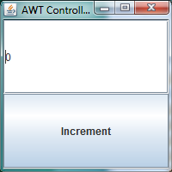
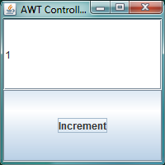
More Sophisticated AWT/Swing Counter User Interface

Slide 6
Widgets and Display Logical Structure
JFrame
HAS-A
HAS-A
JButton
JTextField
Layout?

Slide 7
AWT Single Frame Composer
public class SingleFrameAWTComposer {
public static void main (String args[]) {
// compose AWT components
JFrame frame = new JFrame("AWT Controller and View");
JButton button = new JButton("Increment");
JTextField textField = new JTextField();
frame.setLayout(new GridLayout(2,1));
frame.add(textField);
frame.add(button);
frame.setSize(200, 200);
frame.setVisible(true);
//compose model view and controller
ObservableCounter model = new AnObservableCounter();
…
}
}
Separate layout object

Slide 8
Widgets and Display Logical Structure
JFrame
HAS-A
HAS-A
JButton
JTextField
HAS-A == is parent of in logical structure
Has a reference to
Output vs. Input widgets?
How should the view tell the text field to display a new String.
How should the button tell a controller that it has been pressed so it can increment the counter?

Slide 9
MVC and Toolkits
Observable Widget (Button, TextField)
Observer Registration Method
Write Methods
Notification Method
Controller
Notification Method
View
Performs Input
Performs Output
Model
Write Methods
Read Methods
Observer Registration Method
Controller and view can be tightly coupled

Slide 10
MVC in Example Application
Press
JButton
addActionListener()
JTextField
setText()
actionPerformed()
ACounterJButton Controller
ACounter JTextFieldView
update()
ObservableCounter
addt()
getValue()

Slide 11
MVC in Example Application (Review)
Press
JButton
addActionListener()
JTextField
setText()
actionPerformed()
ACounterJButton Controller
ACounter JTextFieldView
update()
ObservableCounter
increment()
getValue()

Slide 12
Observer Pattern in Java Toolkit
import java.awt.ActionListener;
public void addActionListener (ActionListener actionListener)
import java.awt.ActionEvent;
public interface ActionListener {
public void actionPerformed(ActionEvent e);
}
When you edit text and hit return this event sent by JTextField, TextField widget to its listeners such as ObjectEditor
When you press a button, this event sent by Button/Jbutton to its listeners such as ObjectEditor

Slide 13
Counter Observable
public class AnObservableCounter implements ObservableCounter {
int counter = 0;
ObserverList observers = new AnObserverList();
public void add (int amount) {
counter += amount;
notifyAllObservers();
}
public int getValue() {
return counter;
}
public void addObserver(CounterObserver observer) {
observers.addElement(observer);
observer.update(this);
}
public void removeObserver(CounterObserver observer) {
observers.removeElement(observer);
}
void notifyAllObservers() {
for (int observerNum = 0; observerNum < observers.size();
observerNum++)
observers.elementAt(observerNum).update(this);
}
}

Slide 14
Button Controller also an Observer
public class ACounterJButtonController implements CounterController, ActionListener {
JButton button;
ObservableCounter counter;
public ACounterJButtonController(JButton theButton) {
button = theButton;
button.addActionListener(this);
}
public void setModel (ObservableCounter theCounter) {
counter = theCounter;
}
// do not need to implement anything in this controller
public void processInput() {
}
//ActionListener method
public void actionPerformed(ActionEvent arg0) {
counter.add(1);
}
}

Slide 15
TextField View Invoking Widget Write Methods
public class ACounterJTextFieldView implements CounterObserver {
JTextField textField;
public ACounterJTextFieldView(JTextField theTextField){
textField = theTextField;
}
public void update(ObservableCounter counter) {
textField.setText("" + counter.getValue());
}
}

Slide 16
Dual Role Composer
public class SingleFrameAWTComposer {
public static void main (String args[]) {
// compose AWT components
JFrame frame = new JFrame("AWT Controller and View");
JButton button = new JButton("Increment");
JTextField textField = new JTextField();
frame.setLayout(new GridLayout(2,1));
frame.add(textField);
frame.add(button);
frame.setSize(200, 200);
frame.setVisible(true);
//compose model view and controller
ObservableCounter model = new AnObservableCounter();
CounterObserver view =
new ACounterJTextFieldView(textField);
model.addObserver(view);
CounterController controller =
new ACounterJButtonController(button);
controller.setModel(model);
}
}

Slide 17
Window Systems and UI Toolkits
Window system
Provides hierarchical rectangular areas called windows
Windows have no associated behavior
User Interface toolkit
Provides widgets: windows with some behavior
E.g: JTextField, Jslider, JMenuItem, JMenu
Widgets are observables and the ones we have seen
Support action listeners through the addActionListener method
Notify listeners about ActionEvent
Widgets provide write methods to change their state
setText(), setValue()
Window Toolkit
Window system + user interface toolkit

Slide 18
MVC with Toolkit Widgets for I/O
Like regular MVC:
Controller for input, View for output, and Model for semantics
Main program instantiates model, views and controllers and connects these objects together
Additional twists;
The main program also builds a widget/window tree
A controller
gets in its constructor (or through a setter method) a set of input widgets such JTextField, JMenuItem and registers itself as a listener of these widgets
On receiving event from input widgets, calls write methods in the model
A view
gets in its constructor a set of output widgets such as JTextField
calls write methods in them when it receives notifications from the model

Slide 19
Controller/View Roles with widgets
Controller:
Receives events from widgets and calls read methods in the widgets
Calls write methods in the model
Essentially reads widget state and writes model state: widget state → model state)
View
Receives notifications in the model
Calls read methods in the model
Calls write methods in the widgets
Essentially reads model state and writes widget state: model state → widget state

Slide 20
Writing Only the Observable
OE Controller
propertyChange (PropertyChangeEvent )
OE View
Performs Input
Performs Output
Model
Write Methods
Read Methods
addPropertyChangeListener (PropertyChangeListener )

Slide 21
The Full App
Custom Controller
propertyChange (PropertyChangeEvent )
Custom View
Performs Input
Performs Output
Model
Write Methods
Read Methods
addPropertyChangeListener (PropertyChangeListener )

Slide 22
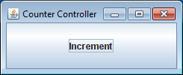
AWT Single Frame Composer
public class SingleFrameAWTComposer {
public static void main (String args[]) {
// compose AWT components
JFrame frame = new JFrame("AWT Controller and View");
JButton button = new JButton("Increment");
JTextField textField = new JTextField();
frame.setLayout(new GridLayout(2,1));
frame.add(textField);
frame.add(button);
frame.setSize(200, 200);
frame.setVisible(true);
//compose model view and controller
ObservableCounter model = new AnObservableCounter();
CounterObserver view =
new ACounterJTextFieldView(textField);
model.addObserver(view);
CounterController controller =
new ACounterJButtonController(button);
controller.setModel(model);
}
}
Separate button and text field into different frames?

Slide 23
Widgets and Display Logical Structure
JFrame
JFrame
JButton
JTextField

Slide 24
AWT Multi Frame Composer
public class MultiFrameButtonTextFieldAWTComposer {
public static void main (String args[]) {
ObservableCounter model = new AnObservableCounter();
CounterController controller = createControllerAndControllerFrame();
CounterObserver view = createViewAndViewFrame();
model.addObserver(view);
controller.setModel(model);
}
public static CounterController createControllerAndControllerFrame() {
JFrame frame = new JFrame("Counter Controller");
JButton button = new JButton("Increment");
frame.add(button);
frame.setSize(200, 100);
frame.setVisible(true);
return new ACounterJButtonController(button);
}
public static CounterObserver createViewAndViewFrame() {
JFrame frame = new JFrame("Counter View");
JTextField textField = new JTextField();
frame.add(textField);
frame.setSize(200, 100);
frame.setVisible(true);
return new ACounterJTextFieldView(textField);
}
}
Separation of controller and view allows reuse by writing a different composer
If two pieces can change independently, separate them

Slide 25
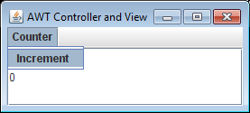
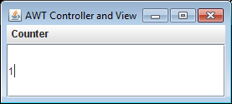
Reusing View with Different Input Widget

Slide 26
Widgets and Display Logical Structure
JFrame
JMenuBar
JTextField
JMenu
JMenu

Slide 27
Original Controller and Input Widget
JButton
addActionListener()
JTextField
setText()
actionPerformed()
ACounterJButton Controller
ACounter JTextFieldView
update()
ObservableCounter
increment()
getValue()

Slide 28
New Controller and Input Widget
JMenuItem
addActionListener()
JTextField
setText()
actionPerformed()
ACounterJMenu ItemController
ACounter JTextFieldView
update()
Must create a new controller
ObservableCounter
increment()
getValue()
addActionListener() not implemented by a common super type

Slide 29
Exists vs. Ideal
Swing/AWT
JButton
JMenuItem
JTextField
addAction
Listener()
addAction
Listener()
addAction
Listener()
Swing/AWT++
ActionNotifier
addActionListener()
IS-A
JButton
JMenuItem
JTextField

Slide 30
Using JTextField
JButton
addActionListener()
JTextField
setText()
actionPerformed()
ACounterJMenu Controller
ACounter JTextFieldView
update()
ObservableCounter
increment()
getValue()

Slide 31
Using TextField
JButton
addActionListener()
TextField
setText()
actionPerformed()
ACounterJMenu Controller
ACounter TextFieldView
update()
Must create a new view
ObservableCounter
increment()
getValue()

Slide 32
Exists vs. Ideal
Swing/AWT
TextField
JTextField
setText()
setText()
getText()
getText()
Swing/AWT++
TextWidget
setText()
getText()
IS-A
TextField
JTextField

Slide 33
Menu Item Controller
public class ACounterJMenuItemController
implements CounterController, ActionListener {
JMenuItem menuItem;
ObservableCounter counter;
public ACounterJMenuItemController(JMenuItem theMenuItem) {
menuItem = theMenuItem;
menuItem.addActionListener(this);
}
public void setModel (ObservableCounter theCounter) {
counter = theCounter;
}
public void processInput() {
}
public void actionPerformed(ActionEvent arg0) {
counter.add(1);
}
}

Slide 34
Menu Item Composer
public class SingleFrameAWTMenuItemTextFieldComposer {
public static void main (String args[]) {
// compose AWT components
JFrame frame = new JFrame("AWT Controller and View");
JMenuItem menuItem = new JMenuItem("Increment");
JMenu menu = new JMenu("Counter");
JMenuBar menuBar = new JMenuBar();
JTextField textField = new JTextField();
frame.add(textField);
menu.add(menuItem);
menuBar.add(menu);
frame.setJMenuBar(menuBar);
frame.setSize(250, 125);
frame.setVisible(true);
//compose model view and controller
ObservableCounter model = new AnObservableCounter();
CounterObserver view = new ACounterJTextFieldView(textField);
model.addObserver(view);
CounterController controller = new ACounterJMenuItemController(menuItem);
controller.setModel(model);
}
}

Slide 35
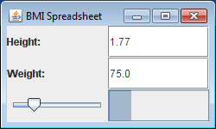
MVC, Toolkits and Beans
import java.beans.PropertyChangeEvent;
import java.beans.PropertyChangeListener;
import util.annotations.ObserverRegisterer;
import util.annotations.ObserverTypes;
import util.models.PropertyListenerRegisterer;
public class AnObservableBMISpreadsheet
implements BMISpreadsheet, PropertyListenerRegisterer {
PropertyListenerSupport propertyListenerSupport =
new APropertyListenerSupport();
@ObserverRegisterer(ObserverTypes.PROPERTY_LISTENER)
public void addPropertyChangeListener(
PropertyChangeListener listener) {
propertyListenerSupport.addElement(listener);
}
…
public void setWeight(double newWeight) {
double oldWeight = weight;
double oldBMI = getBMI();
weight = newWeight;
propertyListenerSupport.notifyAllListeners(
new PropertyChangeEvent(this, "weight", oldWeight, newWeight));
propertyListenerSupport.notifyAllListeners(
new PropertyChangeEvent(this, "bmi", oldBMI, getBMI()));
}
}
BMI value shown in two different widgets

Slide 36
Widgets and Model Structures
JFrame
HAS-A
JPanel
JPanel
JPanel
JLabel
JTextField
JLabel
JTextField
JSlider
JProgressBar
Causes change in
Causes change in
Causes change in
double
double
double
height
weight
bmi
BMISpreadsheet

Slide 37
MVC and Toolkits: General Structure
Observable Widget (Button, TextField)
Observer Registration Method
Write Methods
Notification Method
Controller
Notification Method
View
Model
Write Methods
Read Methods

Slide 38
MVC and Toolkits: BMI SPreadsheet
enter
enter
JTextField
addAction Listener ()
addAction Listener ()
JTextField
JSlider
JProgress Bar
setText()
setText()
setValue()
setValue()
actionPerformed()
ABMISpreadsheetController
ABMISpreadsheet View
property Changed()
setHeight()
BMISpreadsheet
setWeight()

Slide 39
MVC and Toolkits: General Structure
JTextField
JTextField
setText()
Same method called by two widgets
actionPerformed()
ABMISpreadsheetController
ActionEvent
getSource()
Performs different actions
Better to subdivide controller into height and weight controllers
setHeight()
BMISpreadsheet
Illustrates the use of getSource()
setWeight()

Slide 40
BMI Controller
public class ABMISpreadsheetController implements ActionListener {
JTextField height, weight;
BMISpreadsheet bmiSpreadsheet;
public ABMISpreadsheetController (
BMISpreadsheet theBMISpreadsheet,
JTextField theHeight, JTextField theWeight) {
height = theHeight;
weight = theWeight;
bmiSpreadsheet = theBMISpreadsheet;
height.addActionListener(this);
weight.addActionListener(this);
}
public void actionPerformed(ActionEvent event) {
JTextField source = (JTextField) event.getSource();
String text = source.getText();
double val = Double.parseDouble(text);
if (source == height) {
bmiSpreadsheet.setHeight(val);
} else {
bmiSpreadsheet.setWeight(val);
}
}
}

Slide 41
BMI View
public class ABMISpreadsheetView implements PropertyChangeListener{
JTextField heightField, weightField;
JSlider bmiSlider;
JProgressBar bmiProgressBar;
public ABMISpreadsheetView (JTextField theHeightField,
JTextField theWeightField, JSlider theBMISlider,
JProgressBar theBMIProgressBar) {
heightField = theHeightField;
weightField = theWeightField;
bmiSlider = theBMISlider;
bmiProgressBar = theBMIProgressBar;
}
public void propertyChange(PropertyChangeEvent event) {
String propertyName = event.getPropertyName();
Double newValue = (Double) event.getNewValue();
if (propertyName.equalsIgnoreCase("height")) {
heightField.setText(newValue.toString());
} else if (propertyName.equalsIgnoreCase("weight")) {
weightField.setText(event.getNewValue().toString());
} else if (propertyName.equalsIgnoreCase("bmi")) {
double newBMI = newValue;
bmiSlider.setValue((int) newBMI);
bmiProgressBar.setValue((int) newBMI);
}}}}

Slide 42
BMI Composer
public class BMIFrameComposer {
static JFrame frame = new JFrame("BMI Spreadsheet");
static JTextField heightField = new JTextField();
static JLabel heightLabel = new JLabel("Height:");
static JPanel heightPanel = new JPanel();
static JTextField weightField = new JTextField();
static JLabel weightLabel = new JLabel("Weight:");
static JPanel weightPanel = new JPanel();
static JSlider bmiSlider = new JSlider();
static JProgressBar bmiProgressBar = new JProgressBar();
static JPanel bmiPanel = new JPanel();
public static void main (String args[]) {
composeLabelledField(heightPanel, heightLabel, heightField);
composeLabelledField(weightPanel, weightLabel, weightField);
composeBMI();
composeFrame();
composeMVC();
}

Slide 43
BMI Composer (contd)
public static void composeBMI() {
bmiPanel.setLayout(new GridLayout(1, 2));
bmiPanel.add(bmiSlider);
bmiPanel.add(bmiProgressBar);
}
public static void composeFrame() {
frame.setLayout(new GridLayout(3, 1));
frame.add(heightPanel);
frame.add(weightPanel);
frame.add(bmiPanel);
frame.setSize(250, 150);
frame.setVisible(true);
}
public static void composeMVC() {
BMISpreadsheet bmiSpreadsheet =
new AnObservableBMISpreadsheet();
new ABMISpreadsheetController(bmiSpreadsheet,
heightField, weightField);
PropertyChangeListener bmiSpreadsheetView =
new ABMISpreadsheetView(heightField, weightField,
bmiSlider, bmiProgressBar);
bmiSpreadsheet.
addPropertyChangeListener(bmiSpreadsheetView);
}}

Slide 44
MVC, Toolkits + Beans
Like MVC with toolkits we saw earlier
Additional twists
Model now is divided into multiple properties
User interface composed of multiple input/output widgets
View must now implement the Java java.beans.PropertyChangeListener interface
Do not implement your interface that follows the same naming conventions
View and controllers can get multiple widgets from main, usually one for each properties they change/display, to which they store references. Sometimes a view may display the same property using multiple widgets (e.g. slider and progress bar for bmi) or a controller may listen to multiple widgets for setting a property (e.g. menu item and button)

Slide 45
Widgets and Model Structures
JFrame
HAS-A
JPanel
JPanel
JPanel
JLabel
JTextField
JLabel
JTextField
JSlider
JProgressBar
Causes change in
Causes change in
Causes change in
double
double
double
height
weight
bmi
BMISpreadsheet
Mapping can be done automatically or manually

Slide 46
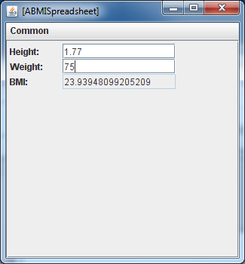
Visualizing Model Structure

Slide 47
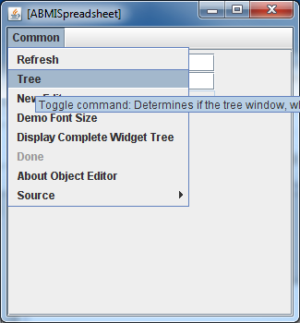
Visualizing Model Structure

Slide 48
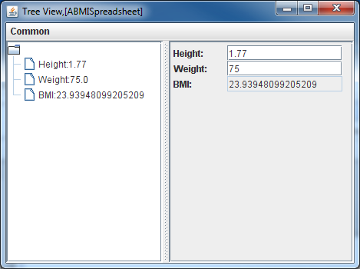
Model Structure

Slide 49
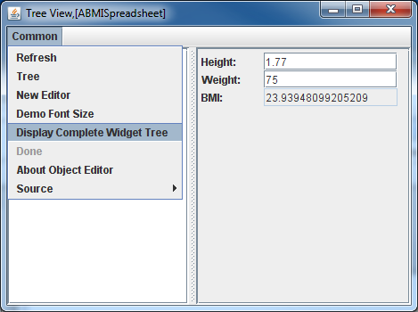
Visualizing Widget Structure

Slide 50
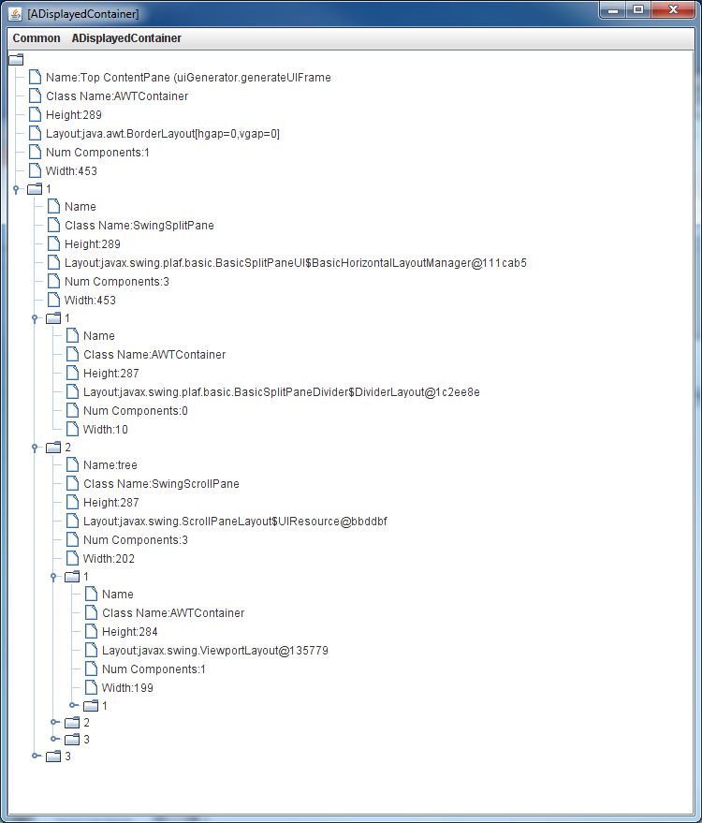
Widget Structures

