Slide 1
Comp 110/401 Appendix: Installing and Using Object Editor
Instructor: Prasun Dewan (FB 150, dewan@unc.edu)

Slide 2
Downloading ObjectEditor From Course Page

Slide 3
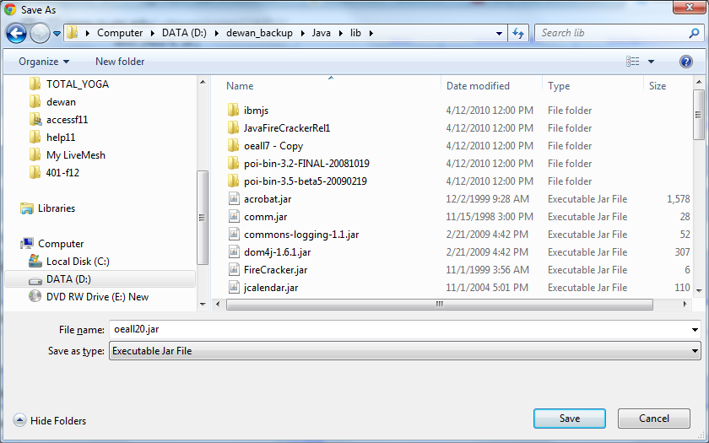
Saving the jar

Slide 4
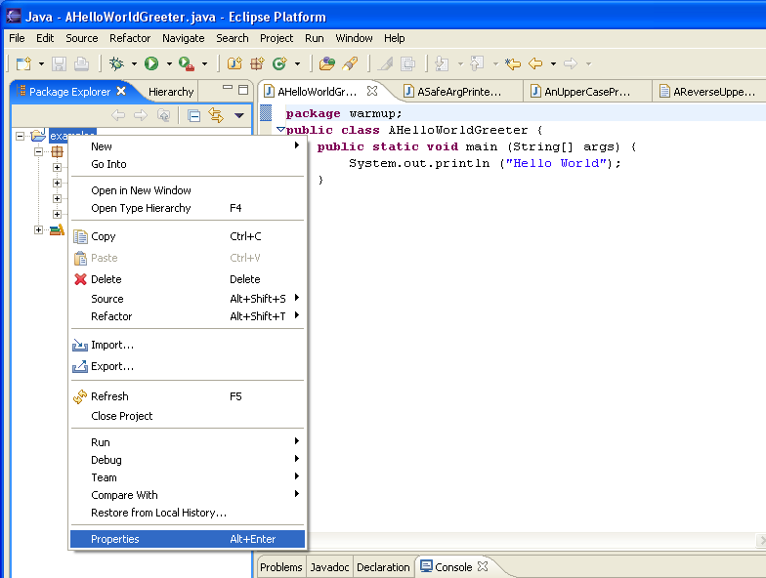
Associating Project with Library
Must do this for each project!

Slide 5
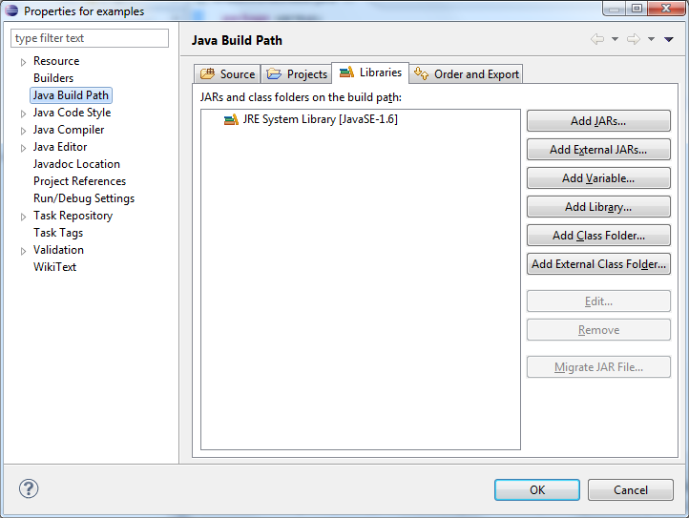
Build Path

Slide 6
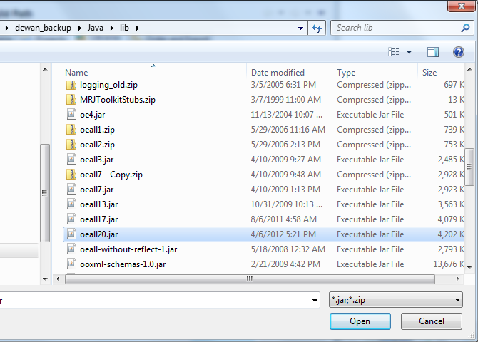
Installing ObjectEditor Software

Slide 7
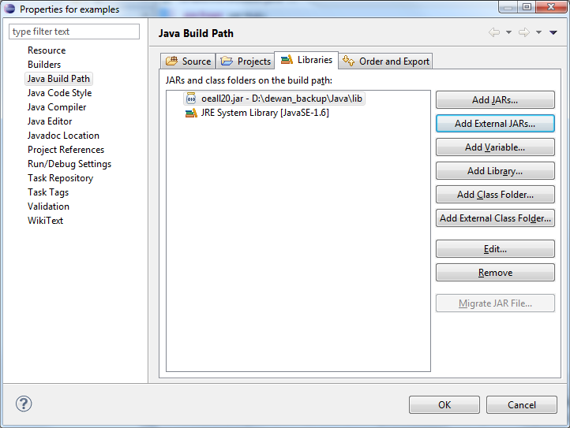
Installing ObjectEditor Software

Slide 8
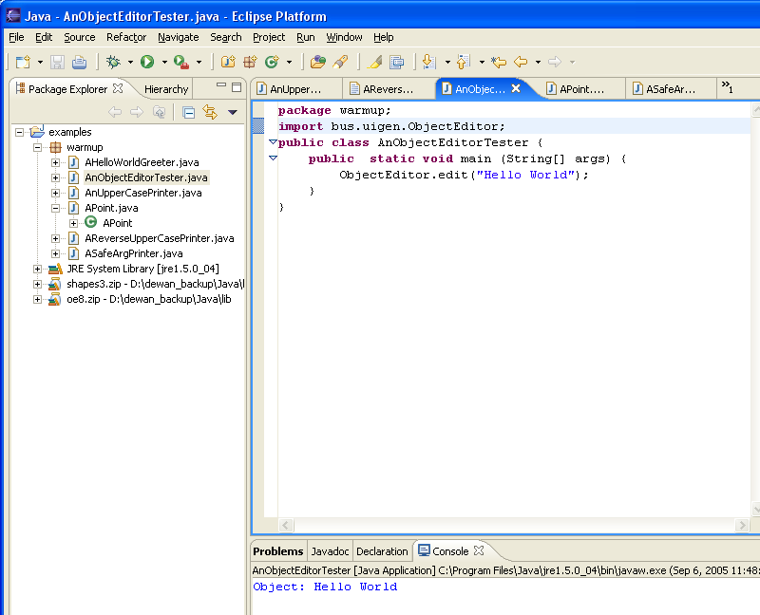
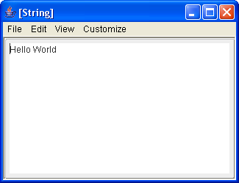
Testing ObjectEditor Software
Any object instance!

