Slide 1

Comp 110
Objects
Instructor: Prasun Dewan

Slide 2
Prerequisites
Theater (optional)

Slide 3
Structuring in Scripts
Script
Introduction
Body
Conclusion
Script components are abstract.
Paragraph 1
Paragraph 2
So are program components!
Sentence 1
Sentence 2

Slide 4
Conventional Languages
Program
Methods
Declarations
Script analogy sufficient for conventional programming
Declarations
Statements
For O-O programming additional analogy is physical objects
If Statement
While Statement

Slide 5
Program Components ~ Physical Objects
Natural Objects
Manufactured Objects
~ Program Components

Slide 6
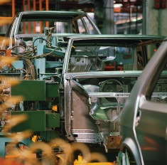
Program Objects ~ Manufactured Objects
Factory
Operations
perform
manufactured by
accelerate
class ASquare Calculator
object ASquare Calculator instance
Methods
execute invoke
call
instance of
square()
object ASquare Calculator instance

Slide 7
Factories and Classes as Objects
Factory
Operations
perform
perform
manufactured by
accelerate
start assembly
Class (instance) method: method invoked on class (class instance)
Factory Operations
Instance Methods
class ASquare Calculator
object ASquare Calculator instance
invoke
instance of
square()
invoke
object ASquare Calculator instance
Since class can be active, more like a factory than a blue print.
square()
Class (static) Methods
Factory-metaphor != factory pattern.

Slide 8
Class vs. Instance Methods: Two Important Predefined Examples
Predefined Class
Math.round(4.5)
5
Class method
Option or parameter, a la amount to accelerate
Instance method
Predefined object
Output: Transferring information from the computer to the user
System.out.println(4.5);
Input: Transferring information from the user to the computer (to be studied later)

Slide 9

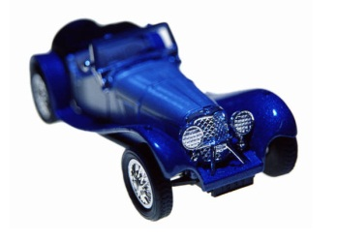
Physical Object Classification Through Factories
manufactured
by
manufactured
by

Slide 10
Java Object Classification Through Classes
class ASquareCalculator
instance of
object ASquareCalculator Instance
object ASquareCalculator Instance
class ABMICalculator
instance of
object ABMICalculator Instance
object ABMICalculator Instance

Slide 11
Factory Classification Through Factory Groups
Accord Parts Factories
Accord Steering Wheel Factories
Accord Accelerator Factories
An Accord Steering Wheel Factory
Another Accord Steering Wheel Factory
Factory groups do not do any work, have no operations, simply group.

Slide 12
Class Classification through Packages
package lectures
package objects
package functions
class ASquareCalculator
class ABMICalculator
Packages do not do any work, have no methods, simply group

Slide 13
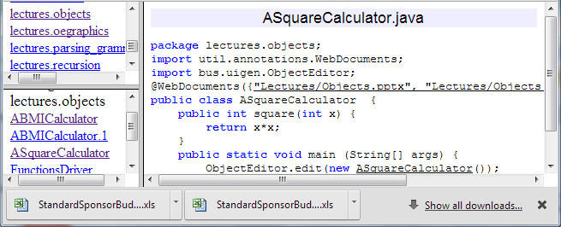
Using Packages to Browse Project Code
Code of ASquareCalculator
Packages in project
Classes in lectures,objects

Slide 14
A Simple Class: ASquareCalculator
ASquareCalculator is in package objects
package lectures.objects;
public class ASquareCalculator
{
  public int square(int x) {
  {
return x*x;
  }
}
Package objects is in top-level or root package lectures
Can be accessed from classes in other packages
Short class name
ASquareCalculator
Instance method because operation on instance of ASquareCalculator rather than on the class ASquareCalculator
Full class name
lectures.objects.ASquareCalculator
Package names omitted from now on

Slide 15
Nature of a Function
Domain
Range
Parameter Values
Result Values
1
1
2
4
3
9
…
…
Mapping

Slide 16
Mathematics vs. Java Function Syntax
Math
square: I → I
square(x) = x²
Programing Environment for Java functions
Java
public int square(int x)
{
return x*x;
}
mathematical functions may not be transferred to the computer; and if they are, they are stored as unstructured text

Slide 17
Programming Environment
Source Code Editor
Mechanisms a way to run compiler and interpreter
Mechanisms to determine the location of libraries
Error reporting
Console for input and output

Slide 18
Example Programming Environments
Bare Bones: text editor, command window
Complexity of simple tasks
Dr. Java
BlueJ
Complexity of difficult tasks
Eclipse
Free to use any programming environment
We will provide help with Eclipse, a (more) Interactive Development Environment (IDE) than Bare Bones

Slide 19
Where is Class Source Code Stored?
public class ASquareCalculator
{
  public int square(int x) {
  {
return x*x;
  }
}

Slide 20
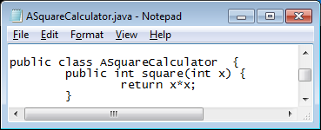

Saving Class Source Code in a File
Source code of Class C is saved in a source file called C.Java
Programming environment may automatically create file name from class name

Slide 21
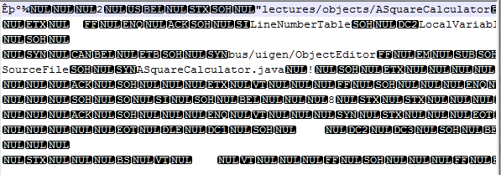
Where is Class Object Code Stored?
Object code of Class C is saved in an object file called C.class

Slide 22
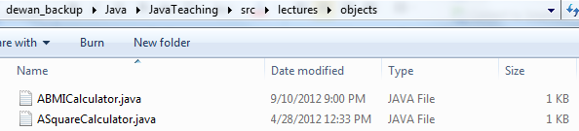
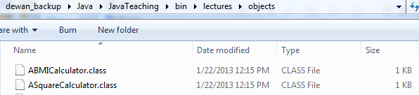
Source and Object File Folders
package lectures
package objects
package functions
A package P is associated with one or more folders named P
Good practice to put them in different folders named P1
The source and object files for class C in package P¹ are in a folder named P¹
class ASquareCalculator
class ABMICalculator
The folder for package P¹ contained in another package P² is a subfolder of a folder named P²
✓
Standard practice to create a unique root folder containing source (object) files/folders, call it as. src (bin) and make them subfolders of a common folder called project folder
The folder for the root package can be a subfolder of a folder with an arbitrary name

Slide 23
Assuming Standard Practice
Project folder
Parent of root source and object folder
Root object folder
Root source folder
Parent of root package folder containing object folders/files (bin folder)
Parent of root package folder containing source folders/files (src folder)
There can be multiple root source and object folders when code is used as library,
but we will assume a unique root object and source folder

Slide 24
Compilation?
What steps were taken to create the object file for a class file?

Slide 25
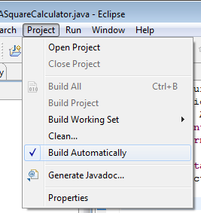

Compiling a Class: Eclipse vs. Bare-bones
Root object folder
Directory
Compiler
Source file name

Slide 26
Java Translation/Execution Process
Source Code
Compiler
javac
Platform Independent Intermediate Code
Interpreter
java
Platform Specific Machine Code
Processor

Slide 27
Using ASquareCalculator (Object Code)
public class ASquareCalculator
{
  public int square(int x) {
  {
return x*x;
  }
}
How to create an instance of this class?
Program Object
How do we invoke the square operation on this instance?

Slide 28
Using ASquareCalculator (Object Code)
public class ASquareCalculator
{
  public int square(int x) {
  {
return x*x;
  }
}
Class instantiation / Object creation
System.out.println (
(new ASquareCalculator()).square(5)
);
Method invocation
How to execute this code?
Can put in in a method, and have some other code called that method, but then how to call that other code?

Slide 29
Main Method
Class method, Invoked on SquareCalculator
public class ASquareCalculator
{
  public int square(int x)
  {
return x*x;
  }
}
Main class: class containing main method
Special predefined name
Special magic parameters for beginners
public class SquareCalculatorDriver
{
public static void main (String[] args)
{
System.out.println (
(new ASquareCalculator()).square(5)
);
}
Does not return any type of value: procedure
We can now “run” main to” start operations on the factory” SquareCalculatorDriver

Slide 30
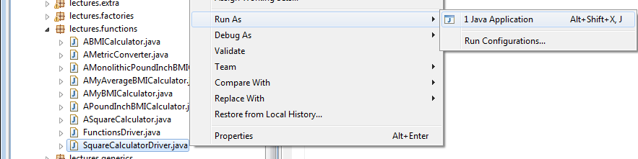


Running Your Own Main
Root object folder
Full name of main class
Interpreter

Slide 31
Java Translation Process
Source Code
Compiler
javac
Platform Independent Intermediate Code
Interpreter
java
Platform Specific Machine Code
Processor

Slide 32
Changing Parameter
public class ASquareCalculator
{
  public int square(int x)
  {
return x*x;
  }
}
Calculates 5*5
public class SquareCalculatorDriver
{
public static void main (String[] args)
{
System.out.println (
(new ASquareCalculator()).square(5));
}

Slide 33
Changing Parameter
public class ASquareCalculator
{
  public int square(int x)
  {
return x*x;
  }
}
Calculates 341*341
public class SquareCalculatorDriver
{
public static void main (String[] args)
{
System.out.println (
(new ASquareCalculator()).square(341));
}
For different parameter values must modify, compile and run program

Slide 34
Main Arg
public class ASquareCalculator
{
  public int square(int x)
  {
return x*x;
  }
}
101 students must understand arrays
Can get value from user as a main arg
Must run program multiple times
public class SquareCalculatorDriver
{
public static void main (String[] args)
{
System.out.println (
(new ASquareCalculator()).square
(Integer.parseInt(args[0])));
}

Slide 35
User Input
Must run program multiple times
public class ASquareCalculator
{
  public int square(int x)
  {
return x*x;
  }
}
Unless we write tedious loops with prompting
Can get value from user
110 students do not know loops
public class SquareCalculatorDriver
{
public static void main (String[] args)
{
System.out.println (
(new ASquareCalculator(Console.readInt()));
}
Can we build an interactive tool to have our cake and eat it too ?

Slide 36
Ordering and Using a Manufactured Object
Factory
Operations
perform
manufactured by
accelerate
More control
More convenient and necessary for beginners and non drivers
You can do it yourself
You can give orders to your chauffeur

Slide 37
ObjectEditor
public class ASquareCalculator
{
  public int square(int x)
  {
return x*x;
  }
}
Telling Java to “include” or “import” library class in this class
import bus.uigen.ObjectEditor;
public class SquareCalculatorEditor {
public static void main(String[] args) {
ObjectEditor.edit(new ABMICalculator());
}
}

Slide 38
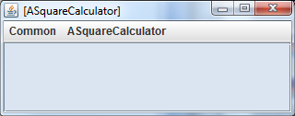
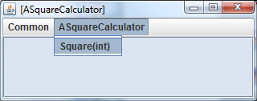
ASquareCalculator Instance

Slide 39
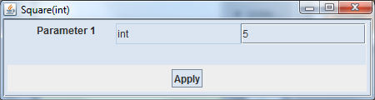
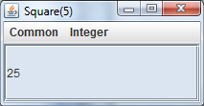
Invoking a Method And Viewing the Result

Slide 40
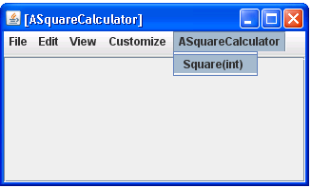
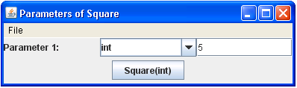
Programmatic vs. Interactive Method Invocation
(new ASquareCalculator()) .square (5);
Target Object
Method Name
Parameter
Invoking methods is essentially form filling

Slide 41
How does the Chauffeur (ObjectEditor) Enter our World?
You can give orders to your chauffeur
Chauffeur is a library class

Slide 42
Java Language vs. Library
Language
Allows us to create and call methods
Library
Provides predefined methods
A library method is in some library class which is in some library package

Slide 43
Java.lang vs. other Library Packages
java.lang
e.g. Classes: System, Math
Other packages
java.util
bus.uigen
e.g. Classes ArrayList, ObjectEditor
Classes in other packages are imported (for convenience) after giving package name
import java.util.ArrayList;
import bus.uigen.ObjectEditor;

Slide 44
Java Libraries vs. External Libraries
External ObjectEdiftor Library
Java library
Other packages
java.util
bus.uigen
Java library code is at well-known location known to the interpreter
The interpreter must be told about the location of external library classes

Slide 45
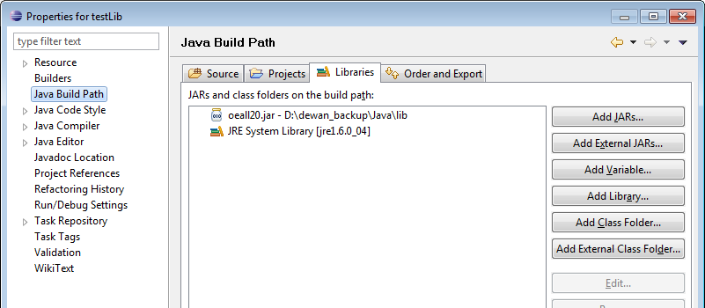
Telling Java About Library Location
Zipped ObjectEditor Library Class(es)

Slide 46
Import vs. Class Path
public class ASquareCalculator
{
  public int square(int x)
  {
return x*x;
  }
}
Telling Java to “include” or “import” known library class in this class
import bus.uigen.ObjectEditor;
public class SquareCalculatorEditor {
public static void main(String[] args) {
ObjectEditor.edit(new ABMICalculator());
}
}
Must know the package name of class to use it

Slide 47
Omitted Import
In Eclipse press CTRL-SHIFT-O to automatically import all used classes not in the same package that have not been imported
If class is in more than one package, Eclipse gives a choice
This is why package names and imports are typically omitted
Missing
import
public class SquareCalculatorEditor {
public static void main(String[] args) {
ObjectEditor.edit(new ABMICalculator());
}
}
Error

Slide 48
Another Simple Class: ABMICalculator
ASquareCalculator
ABMICalculator
Specification:
Given an integer x, calculate the square of x.
Specification:
Given the weight (kg) and height (m) of a person, calculate the person’s body mass index a.k.a. BMI.
public class ASquareCalculator
{
  public int square(int x)
  {
return x*x;
  }
}
?

Slide 49
Multiple Parameters
public class ASquareCalculator
{
  public int square(int x)
  {
return x*x;
  }
}
int weight, int height
ABMICalculator
public class ASquareCalculator
{
  public int square(int x)
  {
return x*x;
  }
}
calculateBMI
return weight/(height*height)

Slide 50
Different type
double
public class ABMICalculator
{
  public int calculateBMI(int weight, int height)
  {
return weight/(height*height);
  }
}
Doubles are decimal/real numbers

Slide 51
ABMICalculator
public class ABMICalculator
{
  public double calculateBMI(double weight, double height)
  {
return weight/(height*height);
  }
}

Slide 52
Anatomy of a Class
Class Header
Class Body
Method Header
Method Body
Parameter Type
Parameter Name
1: public class ABMICalculator
2: {
3: public double calculateBMI (double weight, double height)
4: {
5: return weight/(height*height);
6: }
7: }
Access Specifier
Return Type
Return Statement
Return Expression

Slide 53
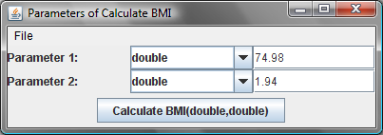
Formal vs. Actual Parameters
public class ABMICalculator
{
  public double calculateBMI(double weight, double height)
  {
return weight/(height*height);
  }
}
Parameters
Formal Parameters
Invoke calculateBMI
assigned
variables
memory
weight
0
74.98
height
0
1.94
Parameters
Actual Parameters

Slide 54
Java Case Conventions
Start Class Names With Upper Case Letters
aBMICalculator
ABMICalculator
Start Variable and Method Names With Lower Case Letters
weight
Weight
Square
square
Start Variable and Method Names With Lower Case Letters
Each New Word in the Name Starts with a Capital Letter
converttoinches
convertToInches
ABMICalculator
aBMICalculator

Slide 55
ObjectEditor Changes Case
Method name starts with capital letter
Adds spaces to names
Different conventions for programmers and end users.

Slide 56
Legal Class?
public class class
{
  public int square(int int)
  {
return x*x;
  }
}

Slide 57
Identifiers
Reserved Words
(Keywords)
Program-defined Names
int, double, class, return, public
Variable names, method names, class names
boldface
Must begin with a letter
Other characters can be letters, digits, or underscore “_”
calculate_bmi2
calculateBMI3

Slide 58
Identifier Name Choices
public class ABMICalculator
{
  public double calculateBMI(double weight, double height)
  {
return weight/(height*height);
  }
}
Use mnemonic identifier names!
public class C
{
  public double f (double p1, double p2)
  {
return p1/(p2*p2);
  }
}

Slide 59
Mnemonic?
public class ABMICalculator
{
  public double calculateBMI(double weight, double height)
  {
return weight/(height*height);
  }
}
Acronyms are bad
public class ABMIC
{
  public double cBMI(double w, double h)
  {
return w/(h*h);
  }
}
Use self explanatory identifier names

Slide 60
Self Explanatory Program?
public class ABMICalculator
{
  public double calculateBMI(double weight, double height)
  {
return weight/(height*height);
  }
}
public class ABMICalculator
{
// weight is in Kgs, height in metres
  public double calculateBMI(double weight, double height)
  {
return weight/(height*height);
  }
}
Comment: Any code in the program removed by the compiler.
Single-line Comment: Begins with // and ends at line end.

Slide 61
Errors
class ABMICalculator
{
  double calculateBMI(double weight, double height)
  {
return (height*heigh)/weight
  }
Logic Error
Syntax Error
Access Error
Semantics Error

Slide 62

Javac Syntax Error Reporting
ABMICalculator.java (3,3) : error J0232: Expected '{' or ';'
ABMICalculator.java (3,3) : error J0021: Expected type specifier
ABMICalculator.java (3,3) : error J0019: Expected identifier
ABMICalculator.java (5,1) : error J0020: Expected 'class' or 'identifier'
Line Number
Character Number

Slide 63
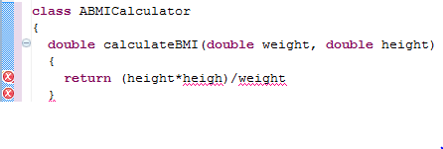
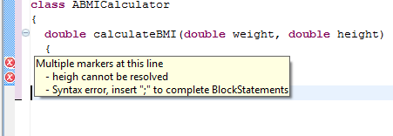
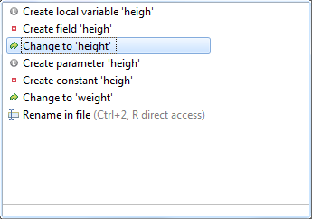
Eclipse: We’ve Come a Long Way
Place (Hover )
mouse on error
Click
mouse on error

Slide 64
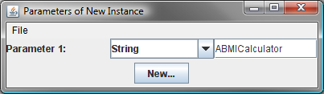
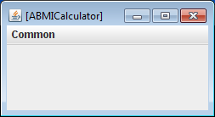
Method Access Error
You instantiate a ABMICalculator object
but there is no ABMICalculator menu item
Reason
  You have not defined any public methods in ABMICalculator

Slide 65
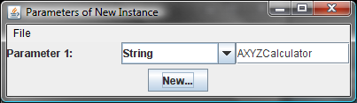
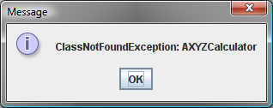
User Error
While instantiating a AXYZCalculator object
you get the following error
Reason
  AXYZCalculator class does not exist

Slide 66
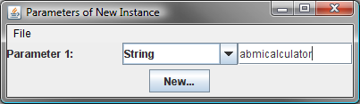
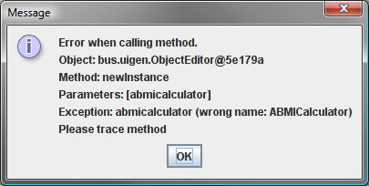
User Error
While instantiating a abmicalculator object
you get the following error
Reason
  Class name is spelled with incorrect case

Slide 67
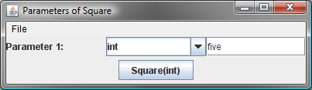
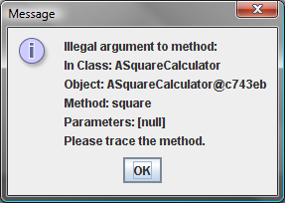
User Error
When invoking the Square method in ASquareCalculator
you get the following error
Reason
  Parameter value is not in the function domain (set of allowed parameter values)

Slide 68
More on Objects: Integrated instantiation and method invocation
public class ASquareCalculator
{
  public int square(int x)
  {
return x*x;
  }
}
Instantiation and method invocation in one expression
public class SquareCalculatorDriver
{
public static void main (String[] args)
{
System.out.println (
(new ASquareCalculator()).square(5));
}

Slide 69
Object Variables
public class ASquareCalculator
{
  public int square(int x)
  {
return x*x;
  }
}
ASquareCalculator type
A variable that holds instances of ASquareCalculator
public class SquareCalculatorUser
{
public static void main (String[] args)
{
ASquareCalculator squareCalculator = new ASquareCalculator();
System.out.println (squareCalculator.square(5));
System.out.println (squareCalculator.square(341));
}
}
An instance of ASquareCalculator
Invoke method on object being held by variable squareCalculator

Slide 70
Uniinitialized Object Variable
public class ASquareCalculator
{
  public int square(int x)
  {
return x*x;
  }
}
No object being held: error
A variable that holds instances of ASquareCalculator
public class SquareCalculatorUser
{
public static void main (String[] args)
{
ASquareCalculator squareCalculator ;
System.out.println (squareCalculator.square(5));
System.out.println (squareCalculator.square(341));
}
}
Invoke method on object being held by variable squareCalculator

Slide 71
Types
Predefined
int
double
Programmer-defined
ASquareCalculator
ABMICalculator

Slide 72
Java Instanceof Boolean Operator
System.out.println(5 > 3);
true
System.out.println(3 > 5);
false
true and false are values of Java type boolean

Slide 73
Java Instanceof Boolean Operator
(new ASquareCalculator()) instanceof ASquareCalculator
true
((new ASquareCalculator()) instanceof ABMICalculator
false
((new ASquareCalculator()) instanceof ObjectEditor
false
ASquareCalculator instanceof ASquareCalculator
false
If class of object o is T then o instanceof T is true

Slide 74
Summary: Java vs. Real-world
Java | Real-world
Class | Factory
Computer Object | Manufactured Physical Object
Method | Operation
Invoking/Executing a Method | Performing an Operation
Instance of a Class | Manufactured by a Factory
Defining/Declaring a Class | Constructing a Factory
Instantiating a Class | Manufacturing an Object
Class (Static) Method | Operation on a Factory
Main Class Method | Initiates computation
Instance (Non static) method | Operation on an instance of a class
Instance (Non static) method | Grouping of factories by states, country

