Slide 1
Comp 110/401 Packages
Instructor: Prasun Dewan

Slide 2
Prerequisite
Objects

Slide 3
A Simple Instantiated Class
No (default) package
public class ASquareCalculator
{
public int square(int x)
{
return x*x;
}
}
public class SquareCalculatorDriver
{
public static void main (String[] args) {
ASquareCalculator squareCalculator = new ASquareCalculator();
System.out.println (squareCalculator.square(5));
}
}

Slide 4
Packages
package lectures.functions;
public class ASquareCalculator
{
public int square(int x)
{
return x*x;
}
}
Class in different package must be imported using full name of class ( a la full file name)
package main;
import lectures.functions.ASquareCalculator;
public class SquareCalculatorDriver
{
public static void main (String[] args) {
ASquareCalculator squareCalculator = new ASquareCalculator();
System.out.println (squareCalculator.square(5));
}
}

Slide 5
Packages
package lectures.functions;
public class ASquareCalculator
{
public int square(int x)
{
return x*x;
}
}
Class in same package need not be imported
package lectures.functions;
public class SquareCalculatorDriver
{
public static void main (String[] args) {
ASquareCalculator squareCalculator = new ASquareCalculator();
System.out.println (squareCalculator.square(5));
}
}

Slide 6
Packages
package lectures.functions;
public class ASquareCalculator
{
public int square(int x)
{
return x*x;
}
}
No package means package named default, hence import needed
import lectures.functions.ASquareCalculator;
public class SquareCalculatorDriver
{
public static void main (String[] args) {
ASquareCalculator squareCalculator = new ASquareCalculator();
System.out.println (squareCalculator.square(5));
}
}

Slide 7
Packages
public class ASquareCalculator
{
public int square(int x)
{
return x*x;
}
}
No package means package named default, hence no import needed here
public class SquareCalculatorDriver
{
public static void main (String[] args) {
ASquareCalculator squareCalculator = new ASquareCalculator();
System.out.println (squareCalculator.square(5));
}
}

Slide 8
Packages
public class ASquareCalculator
{
public int square(int x)
{
return x*x;
}
}
Short name of class in default package same as its full name
package main;
public class SquareCalculatorDriver
{
public static void main (String[] args) {
ASquareCalculator squareCalculator = new ASquareCalculator();
System.out.println (squareCalculator.square(5));
}
}

Slide 9
Long name with no import
package lectures.functions;
public class ASquareCalculator
{
public int square(int x)
{
return x*x;
}
}
Can use the full name of class directly
package main;
public class SquareCalculatorDriver
{
public static void main (String[] args) {
lectures.functions.ASquareCalculator squareCalculator = new lectures.functions.ASquareCalculator();
System.out.println (squareCalculator.square(5));
}
}

Slide 10
Long name with no import
Works but does not tell the reader what is being imported from the package name
package lectures.functions;
public class ASquareCalculator
{
public int square(int x)
{
return x*x;
}
}
Important role of import is documentation
package main;
import lectures.functions.*;
public class SquareCalculatorDriver
{
public static void main (String[] args) {
ASquareCalculator squareCalculator = new ASquareCalculator();
System.out.println (squareCalculator.square(5));
}
}
Programming style violation

Slide 11
Why imports/full name?
package lectures.functions;
public class ASquareCalculator
{
public int square(int x)
{
return x*x;
}
}
package lectures.safe_functions;
public class ASquareCalculator
{
public long square(int x)
{
return x*x;
}
}
Twice the size of ints
package main;
import lectures.functions.ASquareCalculator;
public class SquareCalculatorDriver
{
public static void main (String[] args) {
ASquareCalculator squareCalculator = new ASquareCalculator();
System.out.println (squareCalculator.square(5));
}
}
Disambiguates

Slide 12
Ambiguous Import
package lectures.functions;
public class ASquareCalculator
{
public int square(int x)
{
return x*x;
}
}
package lectures.safe_functions;
public class ASquareCalculator
{
public long square(int x)
{
return x*x;
}
}
package main;
import lectures.functions.ASquareCalculator;
import lectures.safe_functions.ASquareCalculator;
public class SquareCalculatorDriver
{
public static void main (String[] args) {
ASquareCalculator squareCalculator = new ASquareCalculator();
System.out.println (squareCalculator.square(5));
}
}
Ambiguous

Slide 13
Unsuccessful Import
package lectures.functions;
class ASquareCalculator
{
public int square(int x)
{
return x*x;
}
}
package lectures.safe_functions;
public class ASquareCalculator
{
public long square(int x)
{
return x*x;
}
}
Non public class usable only within its package
package main;
import lectures.functions.ASquareCalculator;
public class SquareCalculatorDriver
{
public static void main (String[] args) {
ASquareCalculator squareCalculator = new ASquareCalculator();
System.out.println (squareCalculator.square(5));
}
}

Slide 14
Why Packages?
Can create competing implementations of same class.
A la creating files Test.java in different assignment directories/folders
Groups related classes together
Can browse/search for related classes
A la browsing through all files in an assignment directory/folder.
Like directories/folders packages can be hierarchical
package recitations.functions;
package lectures.functions;
Provides documentation of what unrelated classes are being used

Slide 15
Browsing Java Classes

Slide 16
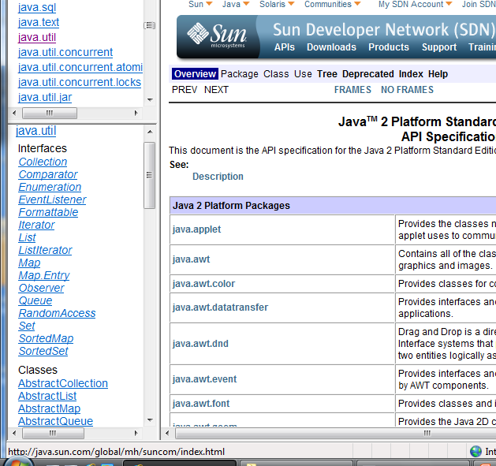
Browsing Java Classes
Very useful package

Slide 17
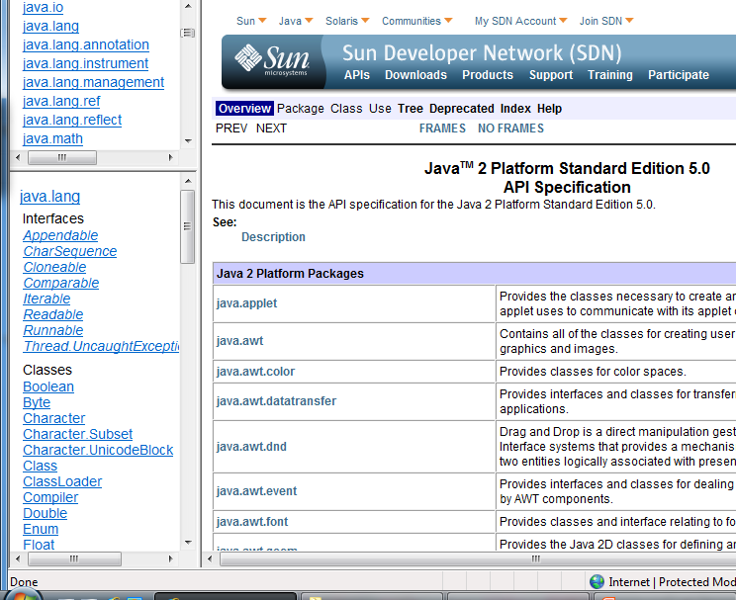
Language vs. Library
Built-in classes
Do not have to be explicitly imported

Slide 18
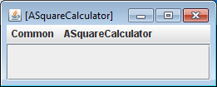
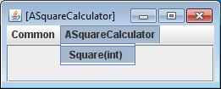
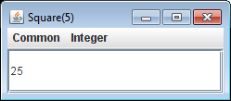
Starting Object Editor Interactively
Can we tell short circuit this step
java –classpath .;oeall20.jar Comp110ObjectEditor

Slide 19
Starting ObjectEditor Programmatically
package lectures.functions;
public class ASquareCalculator
{
public int square(int x)
{
return x*x;
}
}
ObjectEditor is predefined packaged class
package main;
import lectures.functions.ASquareCalculator;
import bus.uigen.ObjectEditor;
public class SquareCalculatorDriver
{
public static void main (String[] args) {
ASquareCalculator squareCalculator = new ASquareCalculator();
ObjectEditor.edit(squareCalculator );
}
}

Slide 20
No Need to Enter Class Name

Slide 21
Remembering Package Names?
package math;
public class ASquareCalculator
{
public int square(int x)
{
return x*x;
}
}
What if we do not remember the package names?
In Eclipse CTRL_SHIFT_O
package main;
public class SquareCalculatorTester
{
public static void main (String[] args) {
ASquareCalculator squareCalculator = new ASquareCalculator();
ObjectEditor.edit(squareCalculator );
}
}

Slide 22
Automatic Imports in Eclipse
package math;
public class ASquareCalculator
{
public int square(int x)
{
return x*x;
}
}
Automatically added
Gives a dialogue box in case multiple classes in same package
package main;
import math.ASquareCalculator;
import bus.uigen.ObjectEditor;
public class SquareCalculatorTester
{
public static void main (String[] args) {
ASquareCalculator squareCalculator = new ASquareCalculator();
ObjectEditor.edit(squareCalculator );
}
}
Package names will not be given in class examples

Slide 23
Extra Slides

Slide 24
Comp 401 Packages
Instructor: Prasun Dewan

Slide 25
Prerequisites
Objects

Slide 26
Grouping Factories
Wuhan Factory
Civic Factories
Honda factories
Indiana Factory
Accord Factories
Car Factories
Corvette Factories
Tablet Factories

Slide 27
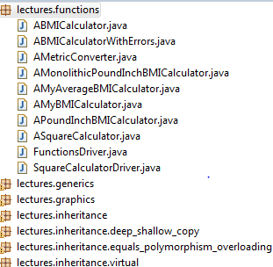
Grouping Classes
Package

Slide 28
Grouping Classes
Package

