Slide 1
Comp 401 Packages
Instructor: Prasun Dewan

Slide 2
Prerequisites
Objects

Slide 3
Grouping Factories
Wuhan Factory
Civic Factories
Honda factories
Indiana Factory
Accord Factories
Car Factories
Corvette Factories
Tablet Factories

Slide 4
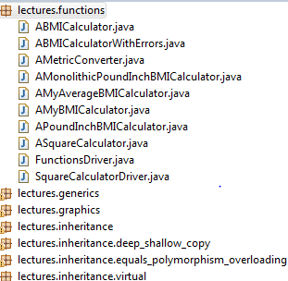
Grouping Classes
Package

Slide 5
Grouping Classes
Package

Slide 6
A Simple Instantiated Class
No (default) package
public class ASquareCalculator
{
public int square(int x)
{
return x*x;
}
}
public class SquareCalculatorDriver
{
public static void main (String[] args) {
ASquareCalculator squareCalculator = new ASquareCalculator();
System.out.println (squareCalculator.square(5));
}
}

Slide 7
Packages
package lectures.functions;
public class ASquareCalculator
{
public int square(int x)
{
return x*x;
}
}
Class in different package must be imported using full name of class ( a la full file name)
package main;
import lectures.functions.ASquareCalculator;
public class SquareCalculatorDriver
{
public static void main (String[] args) {
ASquareCalculator squareCalculator = new ASquareCalculator();
System.out.println (squareCalculator.square(5));
}
}

Slide 8
Packages
package lectures.functions;
public class ASquareCalculator
{
public int square(int x)
{
return x*x;
}
}
Class in same package need not be imported
package lectures.functions;
public class SquareCalculatorDriver
{
public static void main (String[] args) {
ASquareCalculator squareCalculator = new ASquareCalculator();
System.out.println (squareCalculator.square(5));
}
}

Slide 9
Packages
package lectures.functions;
public class ASquareCalculator
{
public int square(int x)
{
return x*x;
}
}
No package means package named default, hence import needed
import lectures.functions.ASquareCalculator;
public class SquareCalculatorDriver
{
public static void main (String[] args) {
ASquareCalculator squareCalculator = new ASquareCalculator();
System.out.println (squareCalculator.square(5));
}
}

Slide 10
Packages
public class ASquareCalculator
{
public int square(int x)
{
return x*x;
}
}
No package means package named default, hence no import needed here
public class SquareCalculatorDriver
{
public static void main (String[] args) {
ASquareCalculator squareCalculator = new ASquareCalculator();
System.out.println (squareCalculator.square(5));
}
}

Slide 11
Packages
public class ASquareCalculator
{
public int square(int x)
{
return x*x;
}
}
Short name of class in default package same as its full name
package main;
public class SquareCalculatorDriver
{
public static void main (String[] args) {
ASquareCalculator squareCalculator = new ASquareCalculator();
System.out.println (squareCalculator.square(5));
}
}

Slide 12
Long name with no import
package lectures.functions;
public class ASquareCalculator
{
public int square(int x)
{
return x*x;
}
}
Can use the full name of class directly
package main;
public class SquareCalculatorDriver
{
public static void main (String[] args) {
lectures.functions.ASquareCalculator squareCalculator = new lectures.functions.ASquareCalculator();
System.out.println (squareCalculator.square(5));
}
}

Slide 13
Long name with no import
Works but does not tell the reader what is being imported from the package name
package lectures.functions;
public class ASquareCalculator
{
public int square(int x)
{
return x*x;
}
}
Important role of import is documentation
package main;
import lectures.functions.*;
public class SquareCalculatorDriver
{
public static void main (String[] args) {
ASquareCalculator squareCalculator = new ASquareCalculator();
System.out.println (squareCalculator.square(5));
}
}
Programming style violation

Slide 14
Why imports/full name?
package lectures.functions;
public class ASquareCalculator
{
public int square(int x)
{
return x*x;
}
}
package lectures.safe_functions;
public class ASquareCalculator
{
public long square(int x)
{
return x*x;
}
}
Twice the size of ints
package main;
import lectures.functions.ASquareCalculator;
public class SquareCalculatorDriver
{
public static void main (String[] args) {
ASquareCalculator squareCalculator = new ASquareCalculator();
System.out.println (squareCalculator.square(5));
}
}
Disambiguates

Slide 15
Ambiguous Import
package lectures.functions;
public class ASquareCalculator
{
public int square(int x)
{
return x*x;
}
}
package lectures.safe_functions;
public class ASquareCalculator
{
public long square(int x)
{
return x*x;
}
}
package main;
import lectures.functions.ASquareCalculator;
import lectures.safe_functions.ASquareCalculator;
public class SquareCalculatorDriver
{
public static void main (String[] args) {
ASquareCalculator squareCalculator = new ASquareCalculator();
System.out.println (squareCalculator.square(5));
}
}
Ambiguous

Slide 16
Unsuccessful Import
package lectures.functions;
class ASquareCalculator
{
public int square(int x)
{
return x*x;
}
}
package lectures.safe_functions;
public class ASquareCalculator
{
public long square(int x)
{
return x*x;
}
}
Non public class usable only within its package
package main;
import lectures.functions.ASquareCalculator;
public class SquareCalculatorDriver
{
public static void main (String[] args) {
ASquareCalculator squareCalculator = new ASquareCalculator();
System.out.println (squareCalculator.square(5));
}
}

Slide 17
Why Packages?
Can create competing implementations of same class.
A la creating files Test.java in different assignment directories/folders
Groups related classes together
Can browse/search for related classes
A la browsing through all files in an assignment directory/folder.
Like directories/folders packages can be hierarchical
package recitations.functions;
package lectures.functions;
Provides documentation of what unrelated classes are being used

Slide 18
Browsing Java Classes

Slide 19
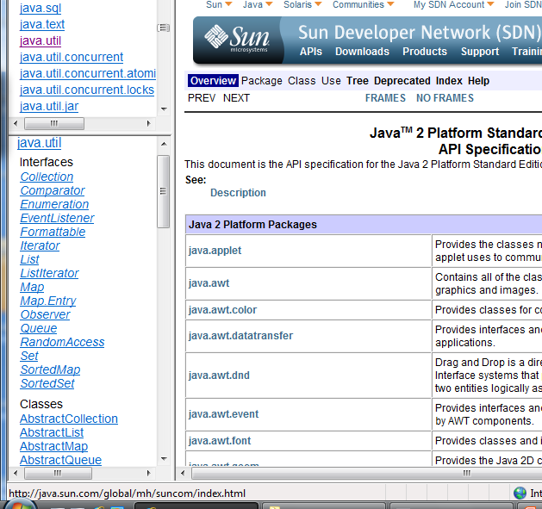
Browsing Java Classes
Very useful package

Slide 20
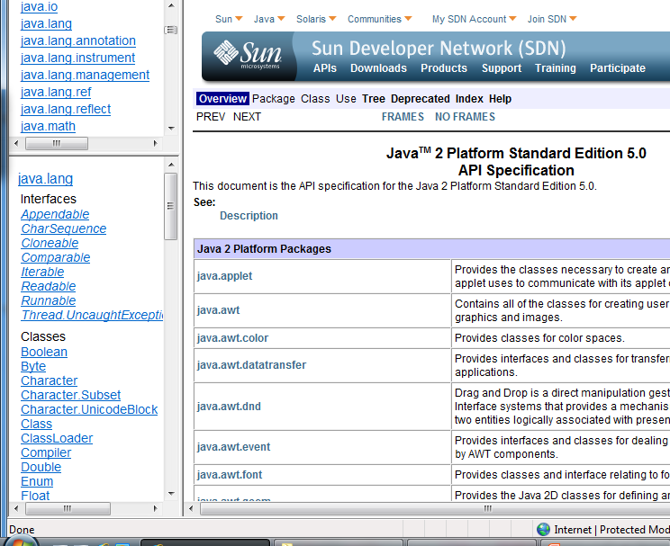
Language vs. Library
Built-in classes
Do not have to be explicitly imported

Slide 21
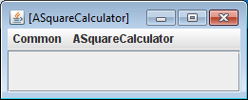
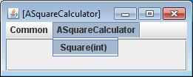
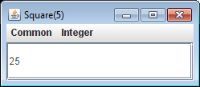
Starting Object Editor Interactively
Can we tell short circuit this step
java –classpath .;oeall20.jar Comp110ObjectEditor

Slide 22
Starting ObjectEditor Programmatically
package lectures.functions;
public class ASquareCalculator
{
public int square(int x)
{
return x*x;
}
}
ObjectEditor is predefined packaged class
package main;
import lectures.functions.ASquareCalculator;
import bus.uigen.ObjectEditor;
public class SquareCalculatorDriver
{
public static void main (String[] args) {
ASquareCalculator squareCalculator = new ASquareCalculator();
ObjectEditor.edit(squareCalculator );
}
}

Slide 23
No Need to Enter Class Name

Slide 24
Remembering Package Names?
package math;
public class ASquareCalculator
{
public int square(int x)
{
return x*x;
}
}
What if we do not remember the package names?
In Eclipse CTRL_SHIFT_O
package main;
public class SquareCalculatorTester
{
public static void main (String[] args) {
ASquareCalculator squareCalculator = new ASquareCalculator();
ObjectEditor.edit(squareCalculator );
}
}

Slide 25
Automatic Imports in Eclipse
package math;
public class ASquareCalculator
{
public int square(int x)
{
return x*x;
}
}
Automatically added
Gives a dialogue box in case multiple classes in same package
package main;
import math.ASquareCalculator;
import bus.uigen.ObjectEditor;
public class SquareCalculatorTester
{
public static void main (String[] args) {
ASquareCalculator squareCalculator = new ASquareCalculator();
ObjectEditor.edit(squareCalculator );
}
}
Package names will not be given in class examples

