Slide 1
Comp 401 Patterns, Interfaces and ObjectEditor
Instructor: Prasun Dewan

Slide 2
A Tale of Two Piazza Threads
In part 1 of Assignment 5, we are required to create a line class that implements the line pattern for Object Editor and line interface. Tianwen Gu (Dereck)
Where can I find documentation for ObjectEditor? (Kevin Kimball)
I agree. As with any type of API there should be a place where all of the features of it should be described in detail. http://www.youtube.com/watch?v=aAb7hSCtvGw (Andrew Gerst)
I find the use of OE, with scant documentation sources and non-standard utilisation of concepts, just absurd and it makes things even more difficult than they should be (if sticking with command-line or standard libraries). I know that we're told to not bang head about this...but considering that outside class there is almost no info on this, I find little choice but to head-desk on trying to make sense out of it. (anon to class mates visible to us)

Slide 3
Prerequisite
StateProperties (Beans)
Graphics (Shape patterns)

Slide 4
Interfaces vs. Patterns
In part 1 of Assignment 5, we are required to create a line class that implements the line pattern for Object Editor and line interface. Tianwen Gu (Dereck)
For each interface there are an infinite number of classes
For each pattern there are an infinite number of interfaces

Slide 5
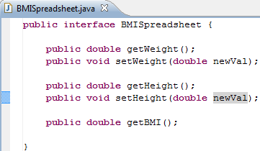
Interface

Slide 6
Infinite Classes Implement a Single Interface
implements
ABMISpreadsheet
BMISpreadsheet
implements
AnotherBMISpreadsheet
At least two reasonable and correct implementations of the intended semantics and interface
Infinite number of unreasonable implementations of the semantics but correct implementation of the interface

Slide 7
Bean Pattern
Typed, Named Unit of Exported Object State
public class C
{
Name P
Type T
Bean
public T getP() {
...
}
Read-only
Editable
public void setP(T newValue) {
...
}
Getter method
Setter method
}
obtainP
Violates Bean convention
newP

Slide 8
Infinite Interfaces Follow a Single Pattern
follows
BMISpreadsheet
Bean Pattern
follows
Point

Slide 9
Infinite Interfaces Follow a Single Pattern
follows
???
PointPattern
follows
Point

Slide 10
ObjectEditor Point Rules
An object is recognized as a point representation if:
Its interface or class has the string “Point” in its name or has a Point annotation
It has (read-only) int properties, X and Y, representing Cartesian window coordinates
Can have additional properties
@StructurePattern(StructurePatternNames.POINT_PATTERN)
public interface Point {
public int getX();
public int getY();
public double getAngle();
public double getRadius();
}

Slide 11
ObjectEditor Point Rules
An object is recognized as a point representation if:
Its interface or class has the string “Point” in its name or has a Point annotation
It has (read-only) int properties, X and Y, representing Cartesian window coordinates
Can have additional properties
@StructurePattern(StructurePatternNames.POINT_PATTERN)
public interface CartesianPoint {
public int getX();
public int getY();
}

Slide 12
ObjectEditor Point Rules
An object is recognized as a point representation if:
Its interface or class has the string “Point” in its name or has a Point annotation
It has (read-only) int properties, X and Y, representing Cartesian window coordinates
Can have additional properties
@StructurePattern(StructurePatternNames.POINT_PATTERN)
public interface CartesianPoint {
public int getX();
public int getY();
public void setX(int newVal);
}

Slide 13
ObjectEditor Point Rules
An object is recognized as a point representation if:
Its interface or class has the string “Point” in its name or has a Point annotation
It has (read-only) int properties, X and Y, representing Cartesian window coordinates
Can have additional properties
@StructurePattern(StructurePatternNames.POINT_PATTERN)
public interface CartesianPoint {
public int getX();
public int getY();
public PolarPoint toPolarPoint();
}

Slide 14
Interfaces vs. Patterns
In part 1 of Assignment 5, we are required to create a line class that implements the line pattern for Object Editor and line interface. Tianwen Gu (Dereck)
For each interface there are an infinite number of classes
For each pattern there are an infinite number of interfaces
Should we require you to follow interface or pattern when we specify your work? Tianwen Gu (Dereck)

Slide 15
Learning Point of View
follows
???
PointPattern
Student makes more decisions
follows
Point
I just want to create a universal line interface and use it to derive all other line interfaces. Tianwen Gu (Dereck)

Slide 16
Understanding Point of View
But the rotatable line class is allowed to have setters for height and weight properties, even if I'm not gonna directly call them, right? Tianwen Gu (Dereck)
Java tells you if you do not implement an interface at compile time
ObjectEditor will tell you problems at run time for Java, C# will try you at compile time for BeanPattern

Slide 17
A Tale of Two Piazza Threads
In part 1 of Assignment 5, we are required to create a line class that implements the line pattern for Object Editor and line interface. Tianwen Gu (Dereck)
✓
✓
Where can I find documentation for ObjectEditor? (Kevin Kimball)
✓
I agree. As with any type of API there should be a place where all of the features of it should be described in detail. http://www.youtube.com/watch?v=aAb7hSCtvGw (Andrew Gerst)
I find the use of OE, with scant documentation sources and non-standard utilisation of concepts, just absurd and it makes things even more difficult than they should be (if sticking with command-line or standard libraries). I know that we're told to not bang head about this...but considering that outside class there is almost no info on this, I find little choice but to head-desk on trying to make sense out of it. (anon to class mates visible to us)

Slide 18
Does ObjectEditor Have an API
An API is a set of public methods of an object type
Only required call
public class SquareCalculatorEditor {
public static void main(String[] args) {
bus.uigen.ObjectEditor.edit(new ABMICalculator());
}
}
ObjectEditor is a tool like Eclipse or your compiler – it reacts to you what you write; there is a contract

Slide 19
A Tale of Four Piazza Questions/Comments
In part 1 of Assignment 5, we are required to create a line class that implements the line pattern for Object Editor and line interface. Tianwen Gu (Dereck)
✓
✓
Where can I find documentation for ObjectEditor? (Kevin Kimball)
✓
✓
I agree. As with any type of API there should be a place where all of the features of it should be described in detail. http://www.youtube.com/watch?v=aAb7hSCtvGw (Andrew Gerst)
I find the use of OE, with scant documentation sources and non-standard utilisation of concepts, just absurd and it makes things even more difficult than they should be (if sticking with command-line or standard libraries). I know that we're told to not bang head about this...but considering that outside class there is almost no info on this, I find little choice but to head-desk on trying to make sense out of it. (anon to class mates visible to us)

Slide 20
Spread Out Doc
PPT, Word, Code
Piazza

Slide 21
Tool Documentation in One Place
Need to be on UNC network to get papers

Slide 22
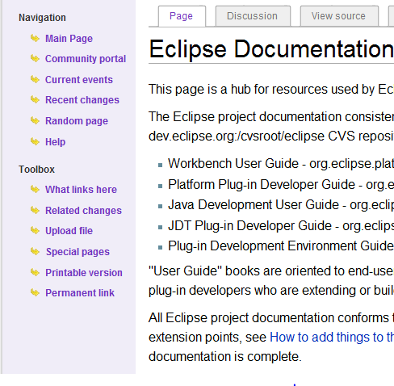
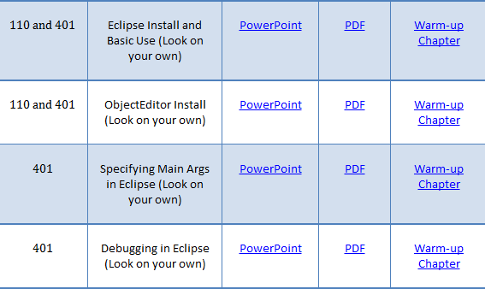
Problem based vs. Complete Documentation
Research shows people do not use or know about even a small fraction of tool features available

Slide 23
A Tale of Four Piazza Questions/Comments
In part 1 of Assignment 5, we are required to create a line class that implements the line pattern for Object Editor and line interface. Tianwen Gu (Dereck)
✓
✓
Where can I find documentation for ObjectEditor? (Kevin Kimball)
✓
✓
I agree. As with any type of API there should be a place where all of the features of it should be described in detail. http://www.youtube.com/watch?v=aAb7hSCtvGw (Andrew Gerst)
✓
I find the use of OE, with scant documentation sources and non-standard utilisation of concepts, just absurd and it makes things even more difficult than they should be (if sticking with command-line or standard libraries). I know that we're told to not bang head about this...but considering that outside class there is almost no info on this, I find little choice but to head-desk on trying to make sense out of it. (anon to class mates visible to us)

Slide 24
“Intuitive” Design?
An object is recognized as a point representation if:
Its interface or class has the string “Point” in its name or has a Point annotation
It has (read-only) int properties, X and Y, representing Cartesian window coordinates
Can have additional properties
@StructurePattern(StructurePatternNames.POINT_PATTERN)
public interface Point {
public int getX();
public int getY();
public double getAngle();
public double getRadius();
}

Slide 25
“Intuitive Design”
Line
Rectangle
Oval
X, Y
X, Y
X, Y
Height
Height
Height
Width
Width
Width

Slide 26
A Tale of Four Piazza Questions/Comments
In part 1 of Assignment 5, we are required to create a line class that implements the line pattern for Object Editor and line interface. Tianwen Gu (Dereck)
✓
Where can I find documentation for ObjectEditor? (Kevin Kimball)
✓
✓
I agree. As with any type of API there should be a place where all of the features of it should be described in detail. http://www.youtube.com/watch?v=aAb7hSCtvGw (Andrew Gerst)
✓
I find the use of OE, with scant documentation sources and non-standard utilisation of concepts, just absurd and it makes things even more difficult than they should be (if sticking with command-line or standard libraries). I know that we're told to not bang head about this...but considering that outside class there is almost no info on this, I find little choice but to head-desk on trying to make sense out of it. (anon to class mates visible to us)
✓
✓

Slide 27
Graphics Pattern vs. Command Line
Graphics Project
Patterns rather than command line syntax (also used non standard)
Code understandability can be verified by TAs
Standardization shows opportunities for reuse and inheritance
Incremental steps: Training wheels to be removed ultimately

Slide 28
Tradeoffs
This options is available for free

Slide 29
A Tale of Four Piazza Questions/Comments
In part 1 of Assignment 5, we are required to create a line class that implements the line pattern for Object Editor and line interface. Tianwen Gu (Dereck)
✓
Where can I find documentation for ObjectEditor? (Kevin Kimball)
✓
✓
I agree. As with any type of API there should be a place where all of the features of it should be described in detail. http://www.youtube.com/watch?v=aAb7hSCtvGw (Andrew Gerst)
✓
✓
I find the use of OE, with scant documentation sources and non-standard utilisation of concepts, just absurd and it makes things even more difficult than they should be (if sticking with command-line or standard libraries). I know that we're told to not bang head about this...but considering that outside class there is almost no info on this, I find little choice but to head-desk on trying to make sense out of it. (anon to class mates visible to us)
✓
✓
✓
✓

Slide 30
The case for Challenging
I want to make sure I understand Part 4: Composite Angle Class of the assignment. The whole point is trying to represent the value of an angle by using two lines connected at the origin. So, the value for the "angle" will be represented as the actual angle between the two lines. So if the angle is PI/2 radians, the lines should look like this: I_ And if the angle is PI/3, the lines should a look a little bit like this: I/ If my interpretation is right, it seems like the vertical line is fixed, and that all the angles can really be represented by just moving the other line. I want to make sure this is right, because the assignment asks for two rotating lines, but it seems to be that one fixed line and one rotating line are enough. Thank you. Eliezer Encarnaci

