Slide 1
Executing Runtime Checks (For Comp401 and Comp410)
Instructor: Prasun Dewan (FB 150, dewan@unc.edu)

Slide 2
Goal
To run checks provided by the instructor on some testable project that a student has written

Slide 3
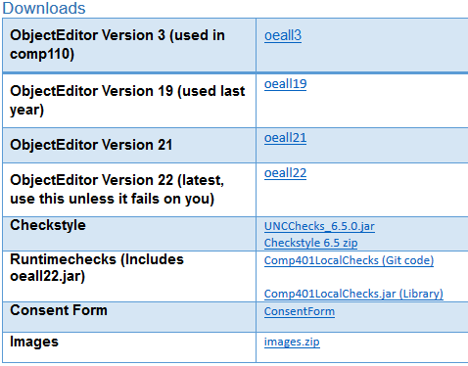
Download Instructor Checks
The name of the jar file and the web page from where it is accessible will depend on the course. This is the Comp401 jar
Next step is to associate the tested project with this downloaded external library, which also includes oeall22.jar, in case your project requires it

Slide 4
Select Testable Project and Right-Click

Slide 5
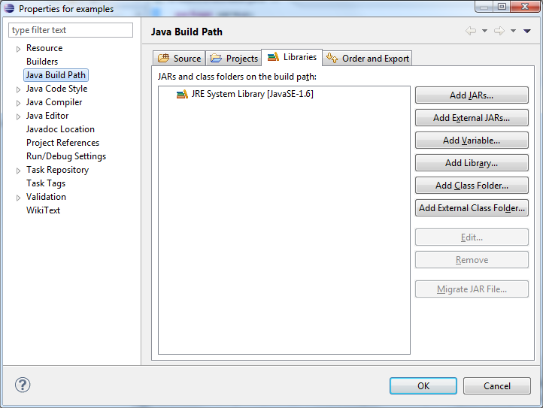
Build Path
Under the “Libraries” tab, click “Add External JARs and find the testing jar you downloaded
Next step is to run the appropriate method of the downloaded checks
There are three ways to do so; Method 1 may be the easiest but requires the creation of a new class, which methods 2 and 3 do not

Slide 6
Creating Test Main Class in Testable Project: Method 1
Create a class in your project (e.g. RunTests.java) with a main method
Import the library class used for testing (The name follows the pattern: gradingTools.<CourseName><Semester>.<Assignment>.testcases.<Assignment>Suite
Call the library main method from your main class, passing through args

Slide 7
Let Eclipse Find the Import
Import commented out, click on error message to let Eclipse find the package

Slide 8
Call Test Main: Method 1
Right-click the testing class to run it

Slide 9
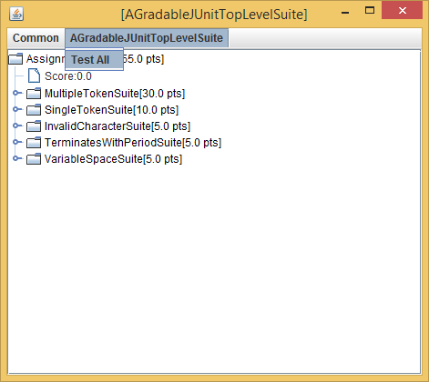
Test Controls
A UI is created to test assignment features and display results
Test All will test all of them.
Unfortunately Java does not resize text when you resize windows, this window may be too small to read. Will use a bigger font as soon as I get a chance to change the UI code.
This is research code and we will collect data to improve its usage and report on it – so you must agree to our doing so.

Slide 10
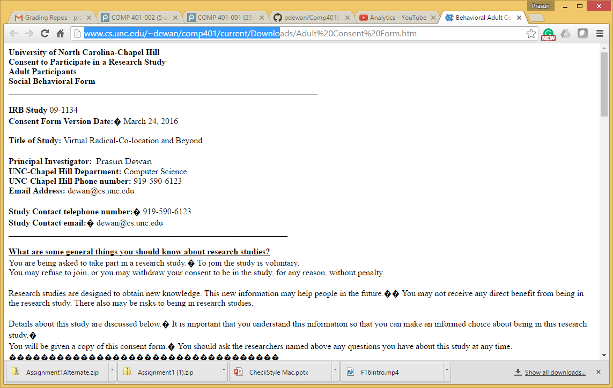
IRB Form Displayed in Browser
Please read it
If you have already signed the form for Checkstyle, you will not get this message

Slide 11
Signing Consent Form
Sign it if you agree (We will not look at the data the semester you take the course)
This window may be under some other windows – in particular the web browser, so you may have to minimize other windows to find it

Slide 12
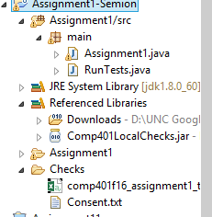
Consent File and Log
Consent is per project
If you create a new project by copying a previous project, the consent form gets copied
(The folder on the left can be found by using the “Navigator” view of eclipse (Window->Show View->Navigator). Right-click and hit refresh if you do not see it.)

Slide 13
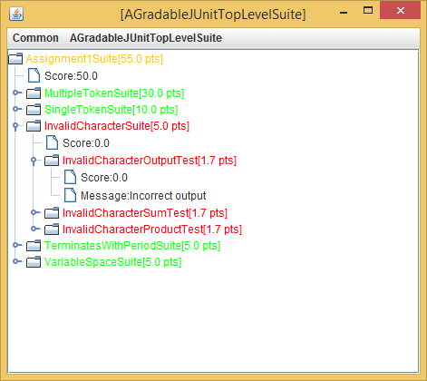
Result of Running Tests in Controls
Pink, orange in between
Max points
Actual points
Green means success
Red means failure

Slide 14
Result of Running Tests in Console
Feature name
Transcript of actions taken by testcase to arrive at score
Fraction correct

Slide 15
Run an Individual test or Suite
Hovering on a test or suite shows explanation message, if it exists
Double clicking on the suite/test will run it individually

Slide 16
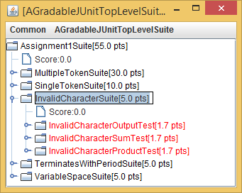
Run an Individual test or Suite
Only that test or suite is run
The transcript contains results of only that test/suite

Slide 17
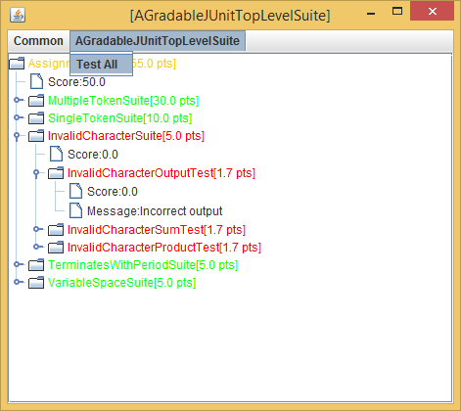
Iterative Development
You can modify code and run tests again, to iteratively develop program

Slide 18
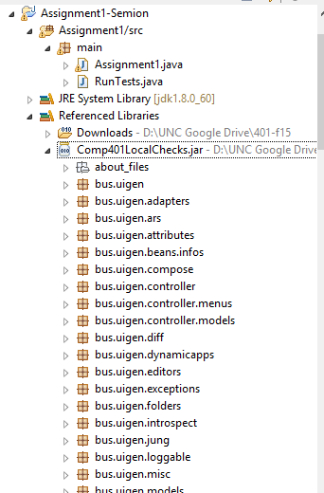
Running Local Check Main Directly: Method 2
After adding the jar to Libraries, expand “local checks” jar in Referenced Libraries
There are lots of packages in the jar!
Scroll down to the test suite: gradingTools.<CourseName><Semester>.<Assignment>.testcases.<Assignment>Suite

Slide 19
Running Local Check Main Directly: Method 2
Run the library class directly as Java Application

Slide 20
Running Local Check Main Directly: Method 2
From there, the process is the same as before

Slide 21
Running Local Check as JUNIT Test: Method 3
Method 3 is similar to Method 2, but run the library class as JUnit Test

Slide 22
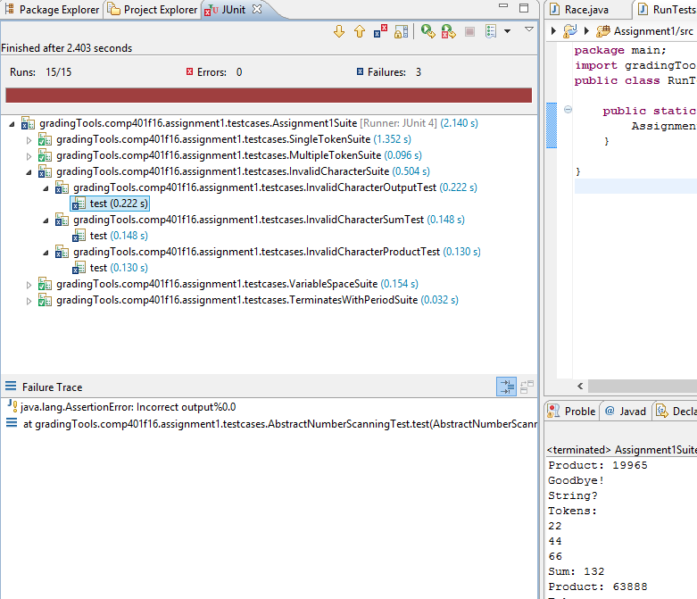
Standard Eclipse Junit UI
Successful test (green)
Failed test (blue)
Console output (not tied to tests individually)
Unsuccessful test message

Slide 23
Running Individual tests in Junit (Method 3)
You can find the individual tests inside the jar and run them as a Junit test

Slide 24
Feedback
Send feedback (pain points, suggestions) to dewan@unc.edu

