Slide 1
Screen Sharing
Instructor: Prasun Dewan (FB 150, dewan@unc.edu)

Slide 2
Problem
You may have an issue with installing or running software that is shared with others
Goal: Share your screen with the computer that is being projected

Slide 3
Solution
Chrome bowser
The web site: appear.in
The room: 401
Go to: https://appear.in/401 and follow instructions

Slide 4
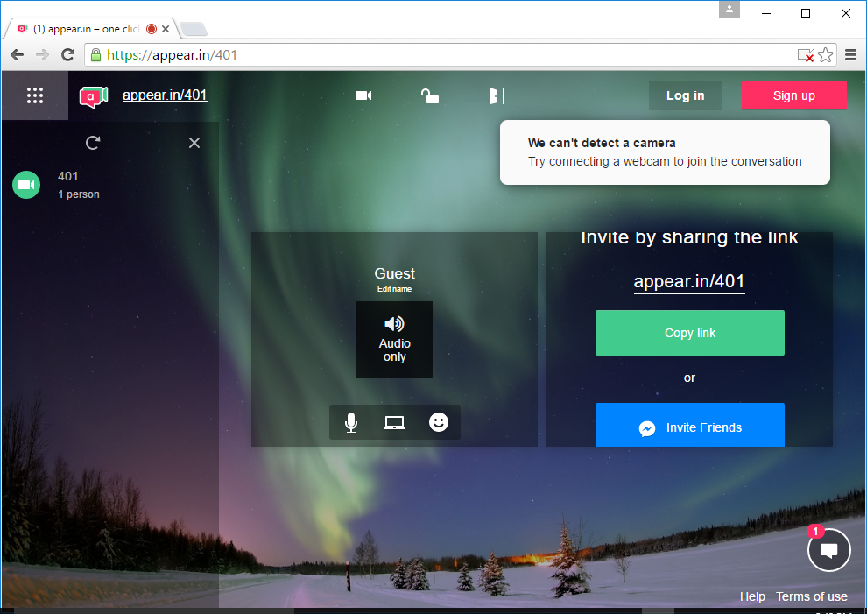
Screen Sharing
URL: https://appear.in/401
Screen sharing command: appears only if he cursor is in this area

Slide 5
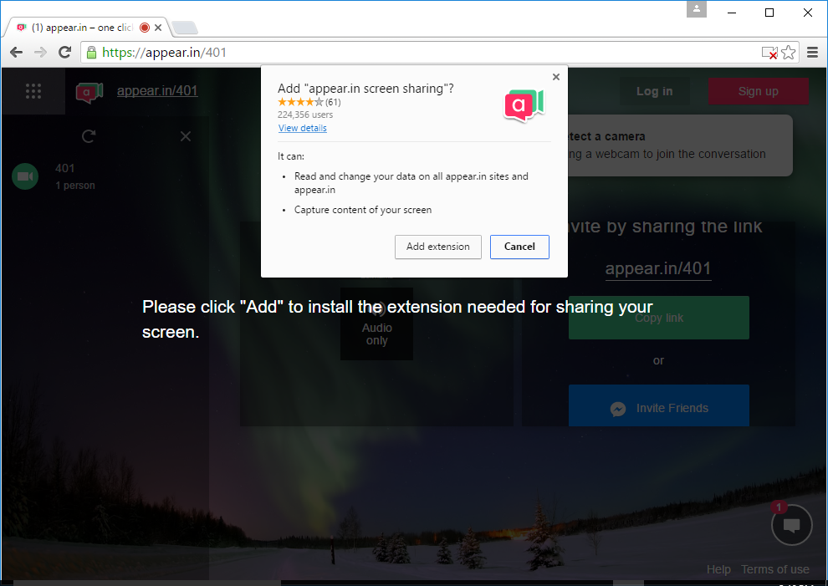
Chrome Screen Sharing extension

