Slide 1
Comp 110/401 State, Property and Java Beans
Instructor: Prasun Dewan

Slide 2
Prerequisite
Objects

Slide 3
ABMICalculator
public class ABMICalculator
{
public double calculateBMI(double weight, double height)
{
return weight/(height*height);
}
}
Instance Method)
Formal Parameters
ABMICalculator type
A variable that holds instances of ABMICalculator
public class BMICalculatorTester
{
public static void main (String[] args) {
ABMICalculator bmiCalculator = new ABMICalculator();
System.out.println (bmiCalculator.calculateBMI(75, 1.77));
}
}
Actual Parameters

Slide 4
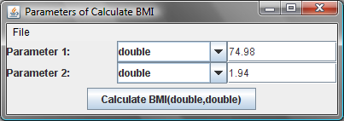
ABMICalculator
public class ABMICalculator
{
public double calculateBMI(double weight, double height)
{
return weight/(height*height);
}
}
Parameters
Formal Parameters
Invoke calculateBMI
assigned
variables
memory
weight
0
74.98
height
0
1.94
Parameters
Actual Parameters
Each time formal parameters are assigned new actual parameters

Slide 5
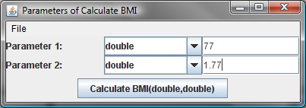
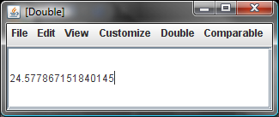
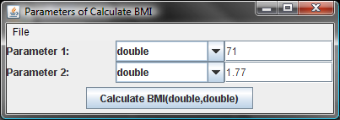
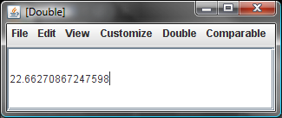
“What if” BMI Calculations With General Purpose Calculator
Must re-enter height each time!

Slide 6
“What if” BMI Calculations With Specialized Calculator
public double calculateMyBMI(double weight) {
final double MY_HEIGHT = 1.77;
return (new ABMICalculator).calculateBMI(weight, MY_HEIGHT);
}
Must only enter the weight
But the height is hardwired! Must create a separate class for each user!
General purpose solution that does not require re-entry of height each time?

Slide 7
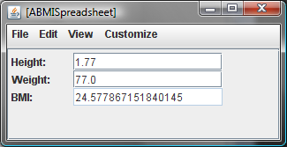
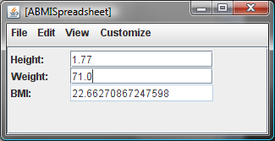
BMI Spreadsheet
Calculate two BMIs using one instance of ABMISpreadsheet and changing only the weight
State: Data remembered by an object between method invocations

Slide 8
Instance Variables
ABMICalculator Instance
ABMISpreadsheet Instance
calculateBMI
getBMI
Body
Body
accesses
accesses
Instance
Variables
Parameters
Belong to a single method
Belong to all methods of an instance
Local variable
Global variable

Slide 9
State-less vs. State-full Objects
Identical Instances ~ car radios with no presets
Different Instances ~ car radios with presets

Slide 10
Declaring Instance Variables
Instance Variables
public class ABMISpreadsheet {
double height;
...
double weight;
...
public double getBMI() {
return weight/(height*height);
}
…
}
Missing Code
No Parameters

Slide 11
Exporting State
public class ABMISpreadsheet {
double height;
...
double weight;
...
public double getBMI() {
return weight/(height*height);
}
…
}
Variables should not be public (like hidden thoughts)
Outside Access:
ObjectEditor
But ObjectEditor needs their values

Slide 12
Accessing Instance Variables via Public Methods
ABMISpreadsheet Instance
weight
height
reads
writes
reads
writes
reads
getWeight()
setWeight()
getHeight()
setHeight()
getBMI()
calls
calls
calls
calls
new weight
new height
weight
height
ObjectEditor

Slide 13
Coding Getter and Setter Methods
ABMISpreadsheet Instance
weight
reads
writes
getWeight()
setWeight()
calls
calls
new weight
weight
ObjectEditor

Slide 14
Coding Getter and Setter Methods
ABMISpreadsheet Instance
public double getWeight()
{
return weight;
}
weight
reads
writes
public void setWeight(double newWeight)
{
weight = newWeight;
}
getWeight()
setWeight()
calls
calls
procedure – returns nothing
function
new weight
weight
ObjectEditor

Slide 15
Function vs. Procedure
public class ABMISpreadsheet {
double height;
public double getHeight() {
return height;
}
public void setHeight(double newHeight) {
height = newHeight;
}
double weight;
public double getWeight() {
return weight;
}
public void setWeight(double newWeight) {
weight = newWeight;
}
public double getBMI() {
return weight/(height*height);
}
}
function
procedure – returns nothing

Slide 16
Function vs. Procedure
procedure: deposit
function: withdraw

Slide 17
Pure vs. Impure Functions
ABMICalculator Instance
ABMISpreadsheet Instance
calculateBMI
getWeight
Body
accesses
Body
accesses
weight
weight
height
setWeight(77)
calculateBMI(77,1.77)
24.57
getWeight()
77
setWeight(71)
...
...
calculateBMI(77,1.77)
24.57
getWeight()
71

Slide 18
Functions with Side Effects
public class ASquareAndCubeSpreadsheetWithSideEffects {
int number;
int square;
public void setNumber(int theNumber) {
number = theNumber;
}
public int getNumber() {
return number;
}
public int getSquare() {
square = number*number;
return square;
}
public int getCube() {
int retVal = square*number;
System.out.println("The Cube is: " + retVal);
return retVal;
}
}
setNumber(5)
getCube()
0
getSquare()
25
getCube()
125

Slide 19
Functions with Side Effects
public class ASquareAndCubeSpreadsheetWithSideEffects {
int number;
int square;
public void setNumber(int theNumber) {
number = theNumber;
}
public int getNumber() {
return number;
}
public int getSquare() {
square = number*number;
return square;
}
public int getCube() {
int retVal = square*number;
System.out.println("The Cube is: " + retVal);
return retVal;
}
}
Side effect: Changing global state or printing (non debugging) output in function
Unexpected: makes function behave like a procedure
Side effects are confusing and should be avoided in the functions you write in this course

Slide 20
Function”ness” of Method
Pure Function: computes a value
Does not access global variables or produce (non-debug) output
Impure Function without side effects: computes a value
Does not write global variables
Impure Function with side effects: computes a value
Reads/writes global variables or produces (non-debug) output
Procedure: returns nothing
Reads/writes global variables/produces output

Slide 21
Properties
public class ABMISpreadsheet {
double height;
public double getHeight() {
return height;
}
public void setHeight(double newHeight) {
height = newHeight;
}
double weight;
public double getWeight() {
return weight;
}
public void setWeight(double newWeight) {
weight = newWeight;
}
public double getBMI() {
return weight/(height*height);
}
}

Slide 22
Read-only and Editable Properties
Typed, Named Unit of Exported Object State
public class C
{
Name P
Type T
Bean
public T getP() {
...
}
Read-only
Editable
public void setP(T newValue) {
...
}
Getter method
Setter method
Bean convention:
For humans and tools
}
obtainP
Violates Bean convention
newP

Slide 23
Read-only and Editable Properties (review)
Typed, Named Unit of Exported Object State
public class C
{
Name P
Type T
Bean
public T getP() {
...
}
Read-only
Editable
public void setP(T newValue) {
...
}
Getter method
Setter method
Bean convention:
For humans and tools
}
obtainP
Violates Bean convention
newP

Slide 24
Properties
public class ABMISpreadsheet {
double height;
public double getHeight() {
return height;
}
public void setHeight(double newHeight) {
height = newHeight;
}
double weight;
public double getWeight() {
return weight;
}
public void setWeight(double newWeight) {
weight = newWeight;
}
public double getBMI() {
return weight/(height*height);
}
}
Height
Weight
BMI

Slide 25
ObjectEditor Property Manipulation
public class ABMISpreadsheet {
double height;
public double getHeight() {
return height;
}
public void setHeight(double newHeight) {
height = newHeight;
}
double weight;
public double getWeight() {
return weight;
}
public void setWeight(double newWeight) {
weight = newWeight;
}
public double getBMI() {
return weight/(height*height);
}
}

Slide 26
Tracing Method Calls
public class ABMISpreadsheet {
double height;
public double getHeight() {
System.out.println(“getHeight Called”);
return height;
}
public void setHeight(double newHeight) {
System.out.println(“setHeight Called”);
height = newHeight;
}
double weight;
public double getWeight() {
System.out.println(“getWeight Called”);
return weight;
}
public void setWeight(double newWeight) {
System.out.println(“setWeight Called”);
weight = newWeight;
}
public double getBMI() {
System.out.println(“getBMI Called”);
return weight/(height*height);
}
}
Debug output

Slide 27
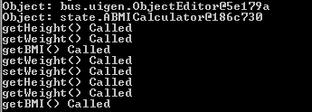
Actual Trace
Load
Change weight
Extra getWeight() call made by the undo-redo mechanism in ObjectEditor

Slide 28
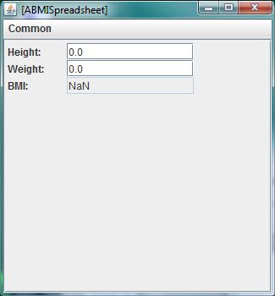
Displaying and then Changing Object
public class ABMISpreadsheetManipulatedByMainAndObjectEditor {
public static void main (String[] args) {
ABMISpreadsheet bmiSpreadsheet = new ABMISpreadsheet();
ObjectEditor.edit(bmiSpreadsheet);
bmiSpreadsheet.setHeight(1.77);
bmiSpreadsheet.setWeight(75);
}
}
Setters not called through ObjectEditor, so it does not know it should refresh

Slide 29
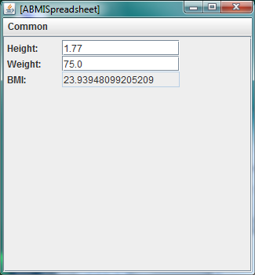
Refreshing ObjectEditor from Main
public class ABMISpreadsheetRefreshedByMain {
public static void main (String[] args) {
ABMISpreadsheet bmiSpreadsheet = new ABMISpreadsheet();
OEFrame oeFrame = ObjectEditor.edit(bmiSpreadsheet);
bmiSpreadsheet.setHeight(1.77);
bmiSpreadsheet.setWeight(75);
oeFrame.refresh();
}
}
Better ways to refresh we will learn later

Slide 30
Demoing Object
public class ABMISpreadsheetAnimatingDemoer {
public static void main (String[] args) {
ABMISpreadsheet bmiSpreadsheet = new ABMISpreadsheet();
bmiSpreadsheet.setHeight(1.77);
bmiSpreadsheet.setWeight(75);
OEFrame editor = ObjectEditor.edit(bmiSpreadsheet);
ThreadSupport.sleep(5000);
editor.select(bmiSpreadsheet, "Weight");
bmiSpreadsheet.setWeight(70);
editor.refresh();
ThreadSupport.sleep(5000);
editor.select(bmiSpreadsheet, "Height");
bmiSpreadsheet.setHeight(0);
editor.refresh();
ThreadSupport.sleep(5000);
editor.select(bmiSpreadsheet, "Weight");
bmiSpreadsheet.setWeight(0);
editor.refresh(); }
}
ThreadSupport() makes program wait for specified number of milliseconds

Slide 31
Demo
https://www.youtube.com/watch?v=dYfSuP3Io8I&feature=plcp

Slide 32
Properties Classification
public class ABMISpreadsheet {
double height;
public double getHeight() {
return height;
}
public void setHeight(double newHeight) {
height = newHeight;
}
double weight;
public double getWeight() {
return weight;
}
public void setWeight(double newWeight) {
weight = newWeight;
}
public double getBMI() {
return weight/(height*height);
}
}
Height
Editable
Independent
Stored
Editable
Weight
Independent
Stored
Read-only
BMI
Dependent
Computed

Slide 33
Properties?
public class ABMISpreadsheet {
double hght;
public double getHowTall() {
return hght;
}
public void setHowTall(double newHeight) {
hght = newHeight;
}
double weight;
public double getWeight() {
return weight;
}
public void setWeight(double newWeight) {
weight = newWeight;
}
public double getBMI() {
return weight/(hght*hght);
}
}
HowTall
Weight
BMI

Slide 34
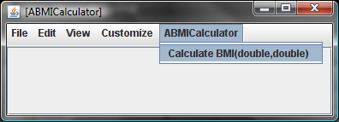
Properties?
public class ABMICalculator {
public double calculateBMI (double weight,
double height) {
return weight/ (height * height);
}
}
No Properties

Slide 35
No_Pattern Annotation
import util.annotations.StructurePattern
@StructurePattern(StructurePatternNames.NO_PATTERN)
public class ABMICalculator {
public double calculateBMI (double weight,
double height) {
return weight/ (height * height);
}
}
Annotation is like a comment except it is typed and available at runtime
Available to ObjectEditor
Structure(<PatternName>) before class asserts that the class is following the pattern.

Slide 36
Bean Pattern Annotation
import util.annotations.StructurePattern
@StructurePattern(StructurePatternNames.BEAN_PATTERN)
public class ABMISpreadsheet {
double height;
public double getHeight() {
return height;
}
public void setHeight(double newHeight) {
height = newHeight;
}
double weight;
public double getWeight() {
return weight;
}
public void setWeight(double newWeight) {
weight = newWeight;
}
public double getBMI() {
return weight/(height*height);
}
}
Why pattern annotation?
Documentation
Efficiency: OE does not need to look for pattern
Errors/warnings: Can give error message if pattern not followed

Slide 37
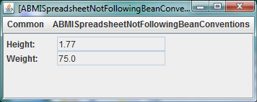
Error?
public class ABMISpreadsheetNotFollowingBeanConventions {
double height = 1.77;
double weight = 75;
public double getWeight() {
return weight;
}
public void set(double newWeight, double newHeight) {
weight = newWeight;
height = newHeight;
}
public double getHeight() {
return height;
}
public void setHeight(int newHeight) {
height = newHeight;
}
public double BMI() {
return weight/(height*height);
}
}
Can system catch these errors?

Slide 38
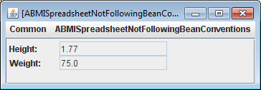
(Editable) Property Name Annotations
import util.annotations.EditablePropertyNames;
import util.annotations.PropertyNames;
@StructurePattern(StructurePatternNames.BEAN_PATTERN)
@PropertyNames({ "Height", "Weight", "BMI"})
@EditablePropertyNames({"Height", "Weight"})
public class ABMISpreadsheetNotFollowingBeanConventions {
double height = 1.77;
double weight = 75;
public double getWeight() {
return weight;
}
public void set(double newWeight, double newHeight) {
weight = newWeight;
height = newHeight;
}
public double getHeight() {
return height;
}
public void setHeight(int newHeight) {
height = newHeight;
}
public double BMI() {
return weight/(height*height);
}
}

Slide 39
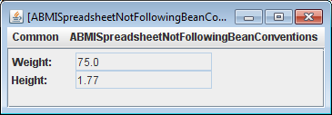
Order of Properties
@StructurePattern(StructurePatternNames.BEAN_PATTERN)
@PropertyNames({ "Weight", "Height", "BMI"})
@EditablePropertyNames({"Height", "Weight"})
public class ABMISpreadsheetNotFollowingBeanConventions {
double height = 1.77;
double weight = 75;
public double getWeight() {
return weight;
}
public void set(double newWeight, double newHeight) {
weight = newWeight;
height = newHeight;
}
public double getHeight() {
return height;
}
public void setHeight(int newHeight) {
height = newHeight;
}
public double BMI() {
return weight/(height*height);
}
}

Slide 40
Overloading
Two different words with the same name
Look at that plane fly.
The fly is bothering me.
Operation Definitions
Context of actual parameters
Two different operations with the same name
String
double
public void println(String val) {…}
System.out.println(“setWeight called”);
public void println(double val) {…}
System.out.println(newWeight);

Slide 41
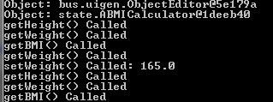
More on Println
Operator Overloading
System.out.println(“setWeight called”);
System.out.println(newWeight);
System.out.println(“setWeight called” + newWeight);
5 + 6

Slide 42
Ambiguous Context
Time flies like an arrow.
Fruit flies like an orange.
Operation Definitions
Java cannot use context to disambiguate
public void println(String val) {…}
System.out.println(“setWeight called”);
public void println(String val) {…}
System.out.println(newWeight);
Defining two versions of a method ?
Why is overloading useful?

Slide 43
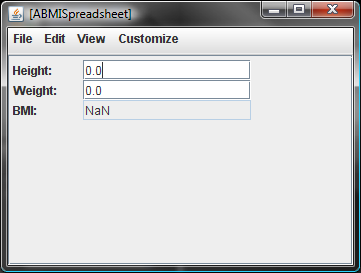
Inconsistent BMI State
ObjectEditor.edit(new ABMISpreadsheet());

Slide 44
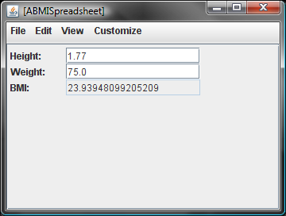
Fixing Inconsistent BMI State
ABMISpreadsheet aBMISpreadsheet = new ABMISpreadsheet();
aBMISpreadsheet.setHeight(1.77);
aBMISpreadsheet.setWeight(75.0);

Slide 45
Always Consistent BMI State
ABMISpreadsheet aBMISpreadsheet = new ABMISpreadsheet(
1.77, 75.0);

Slide 46
Constructor
public class ABMISpreadsheet {
double height, weight;
public ABMISpreadsheet(
double theInitialHeight, double theInitialWeight) {
setHeight(theInitialHeight);
setWeight(theInitialWeight);
}
public double getHeight() {
return height;
}
public void setHeight(double newHeight) {
height = newHeight;
}
public double getWeight() {
return weight;
}
public void setWeight(double newWeight) {
weight = newWeight;
}
public double getBMI() {
return weight/(height*height);
}
}
Calling setter methods instead of modifying variable directly makes debugging easier as you can set breakpoint on setter to trap writes to it

Slide 47
Constructor
public class ABMISpreadsheet {
double height, weight;
public ABMISpreadsheet(
double theInitialHeight, double theInitialWeight) {
setHeight(theInitialHeight);
setWeight(theInitialWeight);
}
public double getHeight() {
return height;
}
public void setHeight(double newHeight) {
height = newHeight;
}
public double getWeight() {
return weight;
}
public void setWeight(double newWeight) {
weight = newWeight;
}
public double getBMI() {
return weight/(height*height);
}
}
Constructor name must be the name of the class
Constructor name must be the name of the class
Constructor name is also the type of object returned
Constructor name is also the type of object returned

Slide 48
Every Class has a Constructor
public class ABMISpreadsheet {
double height, weight;
public double getHeight() {
return height;
}
public void setHeight(double newHeight) {
height = newHeight;
}
public double getWeight() {
return weight;
}
public void setWeight(double newWeight) {
weight = newWeight;
}
public double getBMI() {
return weight/(height*height);
}
}

Slide 49
Equivalent Class Created by Java
public class ABMISpreadsheet {
double height, weight;
public ABMISpreadsheet() { }
public double getHeight() {
return height;
}
public void setHeight(double newHeight) {
height = newHeight;
}
public double getWeight() {
return weight;
}
public void setWeight(double newWeight) {
weight = newWeight;
}
public double getBMI() {
return weight/(height*height);
}
}
Inserted in Object Code not in Source Code
If Programmer Specifies no Constructor, Java inserts a null constructor

Slide 50
A Class Can Have Multiple Constructors
public class ABMISpreadsheet {
double height, weight;
public ABMISpreadsheet() { }
public ABMISpreadsheet(
double theInitialHeight, double theInitialWeight) {
setHeight(theInitialHeight);
setWeight(theInitialWeight);
}
public double getHeight() {
return height;
}
public void setHeight(double newHeight) {
height = newHeight;
}
public double getWeight() {
return weight;
}
public void setWeight(double newWeight) {
weight = newWeight;
}
public double getBMI() {
return weight/(height*height);
}
}
Overloaded Constructor

Slide 51
Using Overloaded Constructors
public class BMISpreadsheetUser {
public static void main(String[] args) {
ABMISpreadsheet bmiSpreadsheet = new ABMISpreadsheet();
bmiSpreadsheet.setHeight(1.77);
bmiSpreadsheet.setWeight(75);
System.out.println(bmi.getBMI() );
//equivalent computation
bmiSpreadsheet = new ABMISpreadsheet(1.77, 75);
System.out.println(bmi.getBMI() );
}
}
Using Overloaded Constructor

Slide 52
Are (Programmer-Defined) Constructors ever Absolutely Necessary?
ABMISpreadsheet aBMISpreadsheet = new ABMISpreadsheet(
1.77, 75.0);
ABMISpreadsheet aBMISpreadsheet = new ABMISpreadsheet();
aBMISpreadsheet.setHeight(1.77);
aBMISpreadsheet.setWeight(75.0);
Programmer can initialize state after instantiation (requires a bit more work but possible in this case)
Always possible?
Some part of the exported state (e.g. height) may be readonly
Can use the full functionality of class without programmer-defined constructor

Slide 53
Immutable Objects
String s = new String("hello");
String is immutable.
An immutable object cannot be changed after initialization.
An immutable object with state must have one or more programmer-defined constructors to initialize the state

Slide 54
Assigning to String Variable
s = s + “ world";
Assigns to s a new String object
Does not change the original String

Slide 55
Why Immutable String?
Easier to implement (do not have to address insertions)
Immutable objects make it is easier to implement correct programs with threads and hashtables
String s1 = "hello world";
String s2 = "hello world";
System.out.println(s1 == s2);
true
Allows literals (String constants) to share memory location
StringBuffer supports mutable strings

Slide 56
Why Immutable String?
String s1 = new String ("hello world");
String s2 = new String ("hello world");
System.out.println(s1 == s2);
false
New String Allocated
StringBuffer supports mutable strings

Slide 57
Changing variable vs. Object
String s = "hello";
String hello = s;
s += " world";
System.out.println(s == hello);
false
Assigns to s a new String object
Does not change the original String
StringBuffer s = new StringBuffer("hello");
StringBuffer hello = s;
s.append(" world");
System.out.println(s == hello);
true
Does not reassign sb
Reassigning a new object less efficient
Changes the object to which sb points

Slide 58
Programmatic Property Manipulation
public class BMISpreadsheetUser {
public static void main(String[] args) {
ABMISpreadsheet bmiSpreadsheet = new ABMISpreadsheet();
bmiSpreadsheet.setHeight(1.77);
bmiSpreadsheet.setWeight(75);
double computedBMI = bmiSpreadsheet.getBMI();
System.out.println(computedBMI );
}
}

Slide 59
Objects vs. Primitives
public class BMISpreadsheetUser {
public static void main(String[] args) {
ABMISpreadsheet bmiSpreadsheet = new ABMISpreadsheet();
bmiSpreadsheet.setHeight(1.77);
bmiSpreadsheet.setWeight(75);
double computedBMI = bmiSpreadsheet.getBMI();
System.out.println(computedBMI );
}
}
Primitive Variable
Primitive Value
Object Variable
Object Value

Slide 60
Uninitialized Primitive vs. Object Variables
public class BMISpreadsheetUser {
public static void main(String[] args) {
ABMISpreadsheet bmiSpreadsheet;
bmiSpreadsheet.setHeight(1.77);
bmiSpreadsheet.setWeight(75);
double computedBMI;
System.out.println(computedBMI );
}
}
Uninitialized Primitive Variable
Uninitialized Object Variable

Slide 61
Default Values for Variables
Primitive Variables
variables
memory
Legal double values
double computedBMI;
computedBMI
0.0
double weight;
weight
0.0
Object Variables
ABMISpreadsheet bmiSpreadsheet;
bmiSpreadsheet
null
Illegal ABMISpreadsheet value

Slide 62
Invoking Methods on null
bmiSpreadsheet.getBMI()
null pointer exception
Exception is an unexpected event (error)
Guilty method will be terminated and exception reported
Will see other exceptions later

Slide 63
Memory Representation
ABMISpreadsheet bmiSpreadsheet1 = new ABMISpreadsheet(); ABMISpreadsheet bmiSpreadsheet2 = new ABMISpreadsheet();
bmiSpreadsheet1.setHeight(1.77)
bmiSpreadsheet2 = bmiSpreadsheet1;
Stack: area at bottom of memory where slots for local variables (formal parameters, internal variables get allocated, stack grows upwards
memory
Heap
Heap: area at top of memory where objects get allocated, heap grows downwards
bmiSpreasheet1 and bmiSpreadsheet2 are internal variables of some method
bmiSpreadsheet2
null
Stack
bmiSpreadsheet1
null

Slide 64
New Instance created
ABMISpreadsheet bmiSpreadsheet1 = new ABMISpreadsheet(); ABMISpreadsheet bmiSpreadsheet2 = new ABMISpreadsheet();
bmiSpreadsheet1.setHeight(1.77);
bmiSpreadsheet2 = bmiSpreadsheet1;
addresses
variables
memory
New instance created from heap
52
height
0
weight
0
Heap
bmiSpreadsheet2
null
Stack
bmiSpreadsheet1
null

Slide 65
Object Assignment
ABMISpreadsheet bmiSpreadsheet1 = new ABMISpreadsheet(); ABMISpreadsheet bmiSpreadsheet2 = new ABMISpreadsheet();
bmiSpreadsheet1.setHeight(1.77);
bmiSpreadsheet2 = bmiSpreadsheet1;
addresses
variables
memory
52
height
0
weight
0
Heap
Address of new instance assigned bmiSpreadsheet1
bmiSpreadsheet2
null
Stack
bmiSpreadsheet1
52

Slide 66
Second Instance Created
ABMISpreadsheet bmiSpreadsheet1 = new ABMISpreadsheet(); ABMISpreadsheet bmiSpreadsheet2 = new ABMISpreadsheet();
bmiSpreadsheet1.setHeight(1.77);
bmiSpreadsheet2 = bmiSpreadsheet1;
addresses
variables
memory
52
height
0
weight
0
Heap
New instance created from heap
64
height
0
weight
0
bmiSpreadsheet2
null
Stack
bmiSpreadsheet1
52

Slide 67
Second Assignment
ABMISpreadsheet bmiSpreadsheet1 = new ABMISpreadsheet(); ABMISpreadsheet bmiSpreadsheet2 = new ABMISpreadsheet();
bmiSpreadsheet1.setHeight(1.77);
bmiSpreadsheet2 = bmiSpreadsheet1;
addresses
variables
memory
52
height
0
weight
0
Heap
64
height
0
weight
0
Address of second instance assigned bmiSpreadsheet2
bmiSpreadsheet2
64
Stack
bmiSpreadsheet1
52

Slide 68
Start of setHeightCall
ABMISpreadsheet bmiSpreadsheet1 = new ABMISpreadsheet(); ABMISpreadsheet bmiSpreadsheet2 = new ABMISpreadsheet();
bmiSpreadsheet1.setHeight(1.77);
bmiSpreadsheet2 = bmiSpreadsheet1;
addresses
variables
memory
52
height
0
weight
0
Heap
64
height
0
weight
0
Formal parameter of setHeight allocated from stack
newHeight
1.77
bmiSpreadsheet2
64
Stack
bmiSpreadsheet1
52

Slide 69
After setHeight Assignment
ABMISpreadsheet bmiSpreadsheet1 = new ABMISpreadsheet(); ABMISpreadsheet bmiSpreadsheet2 = new ABMISpreadsheet();
bmiSpreadsheet1.setHeight(1.77);
bmiSpreadsheet2 = bmiSpreadsheet1;
addresses
variables
memory
Formal parameter of setHeight assigned to instance variable
52
height
1.77
weight
0
Heap
64
height
0
weight
0
newHeight
1.77
bmiSpreadsheet2
64
Stack
bmiSpreadsheet1
52

Slide 70
setHeight Returns
ABMISpreadsheet bmiSpreadsheet1 = new ABMISpreadsheet(); ABMISpreadsheet bmiSpreadsheet2 = new ABMISpreadsheet();
bmiSpreadsheet1.setHeight(1.77)
bmiSpreadsheet2 = bmiSpreadsheet1;
addresses
variables
memory
52
height
1.77
weight
0
Heap
64
height
0
weight
0
newHeight popped from stack
bmiSpreadsheet2
64
Stack
bmiSpreadsheet1
52

Slide 71
After Assignment
ABMISpreadsheet bmiSpreadsheet1 = new ABMISpreadsheet(); ABMISpreadsheet bmiSpreadsheet2 = new ABMISpreadsheet();
bmiSpreadsheet1.setHeight(1.77)
bmiSpreadsheet2 = bmiSpreadsheet1;
addresses
variables
memory
52
height
1.77
weight
0
Heap
64
height
0
weight
0
== does an address (pointer) copy
bmiSpreadsheet2
52
Stack
bmiSpreadsheet1
52

Slide 72
After Garbage Collection
ABMISpreadsheet bmiSpreadsheet1 = new ABMISpreadsheet(); ABMISpreadsheet bmiSpreadsheet2 = new ABMISpreadsheet();
bmiSpreadsheet1.setHeight(1.77)
bmiSpreadsheet2 = bmiSpreadsheet1;
addresses
variables
memory
52
height
1.77
weight
0
Heap
Unreferenced object garbage collected later
bmiSpreadsheet2
52
Stack
bmiSpreadsheet1
52

Slide 73
Assignment is not a copy
bmiSpreadsheet2 = bmiSpreadsheet1;
bmiSpreadsheet1.setWeight(75);
bmiSpreadsheet1.getWeight() == bmiSpreadsheet1.getWeight()
→ true
addresses
variables
memory
52
height
1.77
weight
75
Heap
bmiSpreadsheet2
52
Stack
bmiSpreadsheet1
52

Slide 74
Primitives vs. Objects Again
ABMISpreadsheet bmiSpreadsheet1 = new ABMISpreadsheet(); ABMISpreadsheet bmiSpreadsheet2 = new ABMISpreadsheet();
bmiSpreadsheet1.setHeight(1.77);
bmiSpreadsheet2 = bmiSpreadsheet1;
addresses
variables
memory
Primitive Variable
52
height
1.77
weight
0
Heap
Primitive Value
64
height
0
weight
0
Object Variable
Object Value (Address)
bmiSpreadsheet2
64
Stack
bmiSpreadsheet1
52

Slide 75
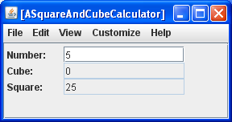
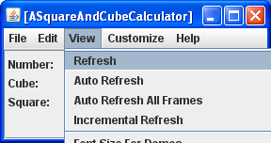
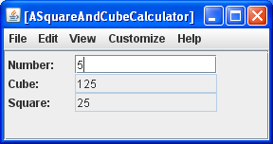
Functions with Side Effects
After calling setNumber(), ObjectEditor calls getCube() before calling getSquare() to do automatic refresh
public class ASquareAndCubeSpreadsheetWithSideEffects {
int number;
int square;
public void setNumber(int theNumber) {
number = theNumber;
}
public int getNumber() {
return number;
}
public int getSquare() {
square = number*number;
return square;
}
public int getCube() {
int retVal = square*number;
System.out.println("The Cube is: " + retVal);
return retVal;
}
}
Explicit refresh calls getters again, and square has the correct value now

Slide 76
Extra Slides

Slide 77
Why Immutable String
Easier to implement (do not have to move string)
Do not have to create a physical copy of a string
s1 = “world";
s2 = s1;
s.setCharAt(1,‘0’); System.out.println(s2.charAt(1));
Make is easier to implement correct programs with threads
Make is easier to implement correct programs with threads and hashtables

Slide 78
Classifying Methods
Procedures
return nothing
write global variables and produce output
Functions
Return values.
Can also write global variables and produce output
Pure Functions
Do not read or write global variables or produce output
Impure functions:
Access global variable or produce output.
Impure functions without side effects
Read global variables but do not write global variables or produce output
Impure functions with side effects
Impure functions write global variables and/or produce output

Slide 79
Bean Pattern?
@StructurePattern(StructurePatternNames.BEAN_PATTERN)
public class ABMISpreadsheetNotFollowingBeanConventions {
double height = 1.77;
double weight = 75;
public double getWeight() {
return weight;
}
public void set(double newWeight, double newHeight) {
weight = newWeight;
height = newHeight;
}
public double getHeight() {
return height;
}
public void setHeight(int newHeight) {
height = newHeight;
}
public double BMI() {
return weight/(height*height);
}
}
Warning if (editable) properties not declared?
Overhead, chances of mistake low, C# has built in support for properties
Why warning if no structure annotation?

Slide 80
(Pattern )Annotation
import util.annotations.StructurePattern;
import util.annotations.StructurePatternNames;
@StructurePattern(StructurePatternNames.BEAN_PATTERN)
public class ABMISpreadsheetNotFollowingBeanConventions {
double height = 1.77;
double weight = 75;
public double getWeight() {
return weight;
}
public void set(double newWeight, double newHeight) {
weight = newWeight;
height = newHeight;
}
public double getHeight() {
return height;
}
public void setHeight(int newHeight) {
height = newHeight;
}
public double BMI() {
return weight/(height*height);
}
}
Annotation is like a comment except it is typed and available at runtime
Structure(<PatternName>) before class asserts that the class is following the pattern.

Slide 81
ObjectEditor Property Manipulation
public class ABMISpreadsheet {
double height;
public double getHeight() {
return height;
}
public void setHeight(double newHeight) {
height = newHeight;
}
double weight;
public double getWeight() {
return weight;
}
public void setWeight(double newWeight) {
weight = newWeight;
}
public double getBMI() {
return weight/(height*height);
}
}
Height
Weight
BMI

