Slide 1
Comp 110/401 Class (Static) vs. Instance State
Instructor: Prasun Dewan

Slide 2
Prerequisite
State and Properties
Interfaces

Slide 3
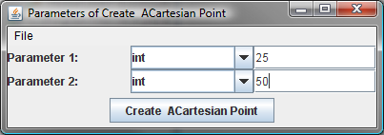
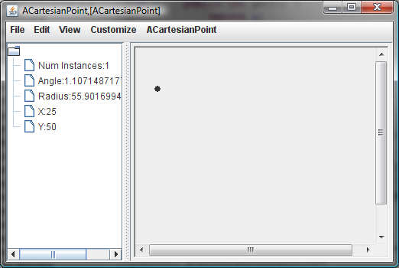
Counting Instances of ACartesianPoint

Slide 4
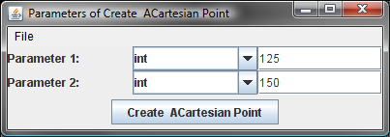
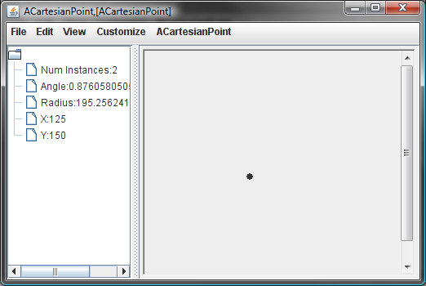
Incremented Number of Instances

Slide 5
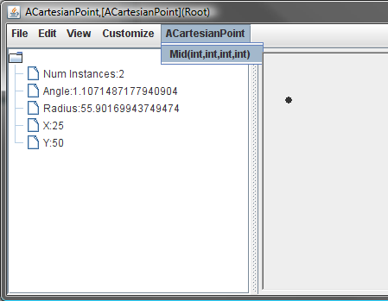
Creating MidPoint

Slide 6
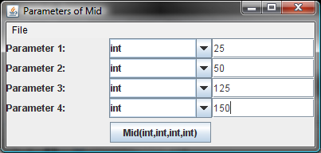
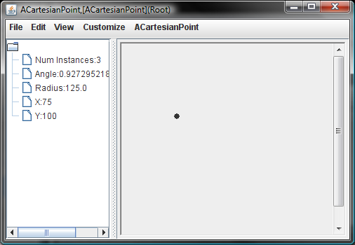
Specifying Two End Points

Slide 7
Type of Methods
Difference between method returning number of instances and other methods seen so far?
Difference between mid and other methods seen so far?

Slide 8
Real-World Analogy
numCarsProduced();
101234
new ACorvette(silver)
new ACorvette(red)
getMileage()
64000
blend(silverCar, redCar);

Slide 9
O-O World
3
numInstances()
Point1
new ACartesianPoint( 25, 50)
Point2
ACartesianPoint
new ACartesianPoint( 125, 150)
59
getRadius()
mid(25,50, 125,150);
mid(point1x,point1y,
point2x,point2y);

Slide 10
Class Methods
Methods can be invoked on class itself
Called class or static methods
Declared in class on which they are invoked
Keyword static in header
Accesses no instance variable

Slide 11
Programmer-Defined Mid
Instance Method
Access instance variables
public getRadius (){
return Math.sqrt(x*x + y*y);
}
Class Method
public static Point mid (int x1, int y1, int x2, int y2 ) {
return new ACartesianPoint(x1 + (x2 - x1)/2, y1 + (y2 - y1)/2);
}
Access no instance variable

Slide 12
External Call of Class Method
ACartesianPoint.mid(x1, y1, x2, y2)
Class as target
Math.sqrt(x*x + y*y);

Slide 13
numInstances Algorithm
Declare variable, numInstances initialized to zero
Increment numInstances each time a new instance is created
getNumInstances() returns numInstances

Slide 14
Returning numInstances
public static int getNumInstances() {
return numInstances;
}
Class property
numInstances() returns numInstances

Slide 15
Incrementing numInstances
Increment numInstances each time a new instance is created

Slide 16
Incrementing numInstances (Solution)
public ACartesianPoint(int theX, int theY) {
x = theX;
y = theY;
numInstances++;
}
Increment numInstances each time a new instance is created

Slide 17
Declaring numInstances
Declare variable, numInstances initialized to zero
static int numInstances = 0;
// class variable

Slide 18
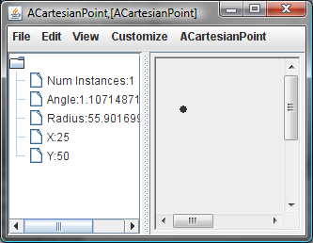
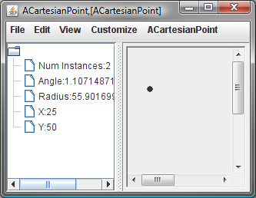
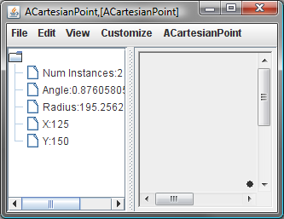
Tracing Execution
variables
memory
numInstances;
1
2
0
x
25
0
y
0
50
x
125
0
y
0
150
public ACartesianPoint(int theX, int theY) {
x = theX;
y = theY;
numInstances++;
}

Slide 19
Instance vs. Class Members
Class Members
Class method
Class variables
Instance Members
Instance methods
Instance variables

Slide 20
Scope of Class and Instance Members
Class Members
visible to other class members
visible to all instance members
class & instance methods can access class variables
class and instance methods can call class methods
Instance Members
visible to other instance members
not visible to class members
which of (zero to many) copies of an instance variable should a class member refer to?

Slide 21
Legal & Illegal Access
static int numInstances = 0;
public static int getNumInstances() {
System.out.println(x);
return numInstances;
}
int x, y;
public ACartesianPoint(int theX, int theY) {
x = theX; y = theY;
numInstances = numInstances + 1;
System.out.println(getNumInstances());
}
public double getRadius() {
return Math.sqrt(x*x + y*y);
}

Slide 22
Instance vs. Class Named Constant
public class AnotherBMISpreadsheet implements BMISpreadsheet{
double height, weight, bmi;
...
public static final
double LBS_IN_KG = 2.2;
public static final
double CMS_IN_INCH = 2.54;
double calculateBMI() {
return (weight/LBS_IN_KG) / (height*CMS_IN_INCH/100*height*CMS_IN_INCH/100);
}
}
variables
memory
LBS_IN_KGS
2.2
new AnotherBMISpreadsheet()
new AnotherBMISpreadsheet()
AnotherBMISpreadsheet.LBS_IN_KGS;

Slide 23
Instance vs. Class Named Constant
public class AnotherBMISpreadsheet implements BMISpreadsheet{
double height, weight, bmi;
...
final
double LBS_IN_KG = 2.2;
public static final
double CMS_IN_INCH = 2.54;
double calculateBMI() {
return (weight/LBS_IN_KG) / (height*CMS_IN_INCH/100*height*CMS_IN_INCH/100);
}
}
variables
memory
LBS_IN_KGS
2.2
public final
LBS_IN_KGS
2.2
new AnotherBMISpreadsheet()
new AnotherBMISpreadsheet()
(new AnotherBMISpreadsheet()).LBS_IN_KGS;

Slide 24
Class vs. Instance Constant
Should be class constant
one copy
easy to refer (require no instance creation)
Unless some good reason for hiding named constants from static methods

Slide 25
Class vs. Instance Methods
Class Method
public static Point mid (int x1, int y1, int x2, int y2 ) {
return new ACartesianPoint(x1 + (x2 - x1)/2, y1 + (y2 - y1)/2);
}
ACartesianPoint.mid(25, 50, 125, 150)
Accesses no instance variable
Math.round(5.7)
Instance Method
public Point mid (int x1, int y1, int x2, int y2 ) {
return new ACartesianPoint(x1 + (x2 - x1)/2, y1 + (y2 - y1)/2);
}
(new ACartesianPoint(25, 50)).mid(25, 50, 125, 150)
(new Math()).round(5.7)

Slide 26
Class vs. Instance Method
Instance method has all the privileges of a class method
Any class method can be made an instance method
Bad style to have instance method that does not access any instance variable
They belong to the class
Violate least privilege principle
Require needless instantiation

Slide 27
Class vs. Instance Constant/Method
Named constants should be static
Unless some good reason for hiding named constants from static methods
Methods not accessing instance variables should be static
Unless need to be listed in interface

Slide 28
Class Member Restrictions
Cannot define interfaces for classes
No conceptual reason why not
Non object oriented languages supported them
Class members go against the idea of OO programming (not instantiated) so treated as second class.
Cannot use super in class methods
Can name super class directly
Non dynamic dispatch (discussed later)

Slide 29
Static Example in Loan
Revisit, through non-graphical objects, concepts illustrated in previous sections

Slide 30
Instance Add
public Loan getTotalLoan(){
return houseLoan.add( carLoan);
}
public Loan add(Loan loan2) {
return new ALoan(getPrincipal() + loan2.getPrincipal()));
}

Slide 31
Class (Static) Add
Accesses instance variables
Instance Method
public Loan getTotalLoan(){
return ALoan.add(houseLoan, carLoan);
}
Class Method
public static Loan add(Loan loan1, Loan loan2) {
return new ALoan(loan1.getPrincipal() + loan2.getPrincipal()));
}
Access no instance variable

Slide 32
Non-Polymorphic Methods
public static Loan add(ALoan loan1, ALoan loan2) {
return new ALoan(loan1.getPrincipal() + loan2.getPrincipal()));
}
public static Loan add(AnotherLoan loan1, AnotherLoan loan2) {
return new ALoan(loan1.getPrincipal() + loan2.getPrincipal()));
}
public static Loan add(ALoan loan1, AnotherLoan loan2) {
return new ALoan(loan1.getPrincipal() + loan2.getPrincipal()));
}
Code duplication!

Slide 33
Overloading vs. Polymorphism
add (new ALoan(10000), new ALoan(5000));
add (new ALoan(10000), new AnotherLoan(5000));
public static Loan add(Loan loan1, Loan loan2) {
return new ALoan(loan1.getPrincipal() + loan2.getPrincipal()));
}
public static Loan add(ALoan loan1, ALoan loan2) {
return new ALoan(loan1.getPrincipal() + loan2.getPrincipal()));
}
public static Loan add(ALoan loan1, AnotherLoan loan2) {
return new ALoan(loan1.getPrincipal() + loan2.getPrincipal()));
}
Polymorphism
Overloading

Slide 34
Primitive vs. Object Types
types
Object types
Classes
Primitive types
ABMICalculator
ABMISpreadsheet
double
int
ALoan
AnotherLoan
Interfaces
BMISpreadsheet
Loan
type = set of operations

Slide 35
Real-World Analogy (O-O Programming)
numCarsProduced();
101234
new ACorvette(silver)
new ACorvette(red)
getMileage()
64000
O-O programming with class methods and variables
blend(silverCar, redCar);
Blueprints as classes would not have modelled class state and operations

Slide 36
O-O World
3
numInstances()
Point1
new ACartesianPoint( 25, 50)
Point2
ACartesianPoint
new ACartesianPoint( 125, 150)
59
getRadius()
O-O programming with class methods and variables
mid(25,50, 125,150);
mid(point1x,point1y,
point2x,point2y);

Slide 37
General Class Structure
Class
Class Method 1
Class Var 1
Class Var 2
Class Method 2
Instance Var 2
Instance Method 1
Instance Var 2
Instance Method 2

Slide 38
Example of Class With Instance and Class Methods
Integer
static parseInt(String)
static int MAX_VALUE
int value
int intValue()
Example of Java Class?

Slide 39
Class with no Instance Members?
Class
Class Method 1
Class Var 1
Class Var 2
Class Method 2
Creating instances meaningless
Example of Java class?

Slide 40
Math
Math
public static double log(double a)
public static final double E
public static final double PI
public static double abs(double a)

Slide 41
System
System
public static void exit(int status)
public static final InputStream in
public static final PrintStream out
public static long currentTimeMillis()
Real-world analogy?

Slide 42
Real Life Analogy
Warehouse, dealership

Slide 43
Class with Only Class Methods?
Class
Class Method 1
Class Method 2
Example?

Slide 44
Math
Math
public static double log(double a)
public static final double E
public static final double PI
public static double abs(double a)

Slide 45
Modified Math
Math
public static double abs(double a)
Real-world analogy?

Slide 46
Real Life Analogy: Pure Service
Assume nothing stored

Slide 47
Class with only Class Variables?
Class
Class Var 1
Class Var 2
Example?

Slide 48
System
System
public static void exit(int status)
public static final InputStream in
public static final PrintStream out
public static long currentTimeMillis()

Slide 49
Modified System
System
public static final InputStream in
public static final PrintStream out
Real-world analogy?

Slide 50
Unguarded Air Hose

Slide 51
Class vs. Instance Object
Should some state and associated methods be accessed as a class or instance object
As class object
Multiple independent instances of that state will not occur
Do not need dynamic dispatch or interfaces to that state
E.g: System.in
Singleton class
A class with only one instance, useful when dynamic dispatch or interface needed

Slide 52
Class or Instance?
Franchise: Multiple franchisees exist, so corresponds to an instance object

Slide 53
Class or Instance?
One of, corresponds to a class object
Mom and pop store can later become franchise as it becomes popular and evolves
Class objects often converted to instance objects as program becomes popular and evolves
When in doubt make it an instance object

