Slide 1
Appendix: Installing and Using CheckStyle with UNC-Checks (Process depends on OS and Eclipse Version)
Instructor: Prasun Dewan (FB 150, dewan@unc.edu)

Slide 2
What is CheckStyle?
A tool that checks your source code to ensure that your code meets requirements specified by a configuration file.
There are many configuration files that use predefined Checkstyle checks.
Sun Checks
Google checks
All check are assignment independent.
Very few assignment-dependent checks have to do with code structure –they address naming, formatting, comment stricture, and other issues.
Coding checks are sometimes too rigid
Magic numbers

Slide 3
What is UNC CheckStyle
Defines new code-structure checks
More flexible magic number checks
New kinds of assignment-independent checks – e.g. side effects, code repetition, design patterns
Assignment-dependent checks
Different configuration files to exercise different assignment-specific checks.

Slide 4
Checkstyle Installation and Use Instructions
1. Install Checkstyle
2. Download Install Configuration Files
3. Invoke Checkstyle

Slide 5
Installation Instructions
Checkstyle plugin is integrated with the difficulty plugin.
Follow instructions for (un) installing difficulty plugin
Difficulty Plugin | PowerPoint PDF

Slide 6
Checkstyle Installation and Use Instructions
1. Install Checkstyle
2. Download Install Configuration Files
3. Invoke Checkstyle

Slide 7
Examine Project Properties of Some Project You want Checked

Slide 8
Finding UNC Checks
If you do not see the Checkstyle item in the left pane, then Checkstyle did not install properly
If you do not see the UNC Checks option then UNCChecks did not install properly
Do not give up if something goes wrong, please use Piazza and instructor help

Slide 9
Checkstyle Installation and Use Instructions
1. Install Checkstyle
2. Download Install Configuration Files
✓
3. Invoke Checkstyle

Slide 10
Assignment Specific Checks?
Every assignment has its own checks
Need to tell Checkstyle to use the correct checks for an assignment

Slide 11
Access Checks File on Course Page/Folder
On the course page, next to the link to an assignment is the checks file

Slide 12
Download Assignment-Specific File
Now we need to tell Checkstyle to use it

Slide 13
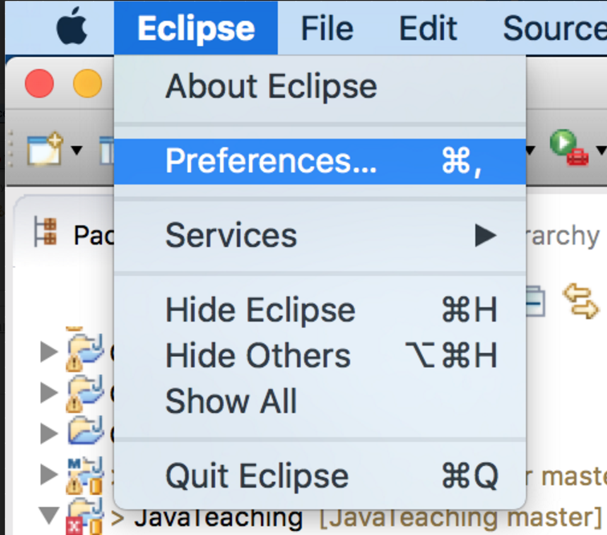
Select Preferences Eclipse Sub-Menu (Windows and Mac)
On Windows it is a submenu of the Window top-level pull-down menu
On a Mac it is a submenu of the Eclipse top-level pull-down menu

Slide 14
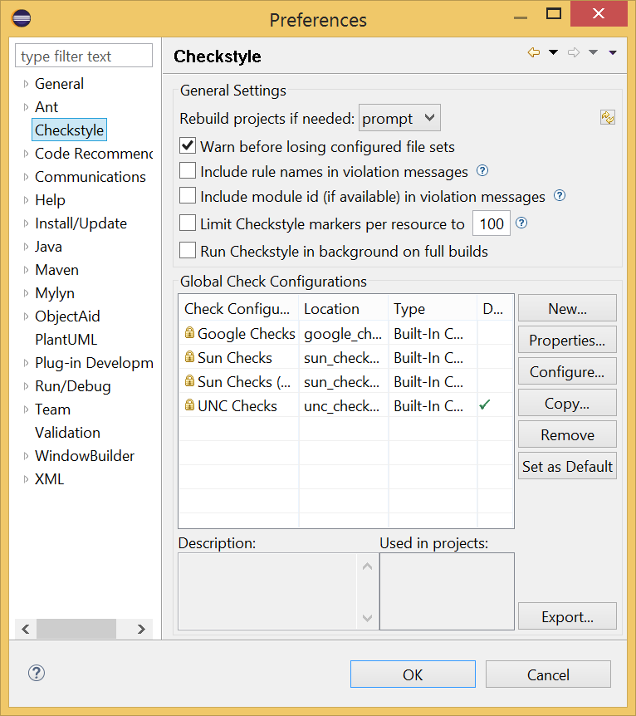
Select Checkstyle Left Pane Item
You should see the same options you saw in project properties, but here we can add to the options
Click new

Slide 15
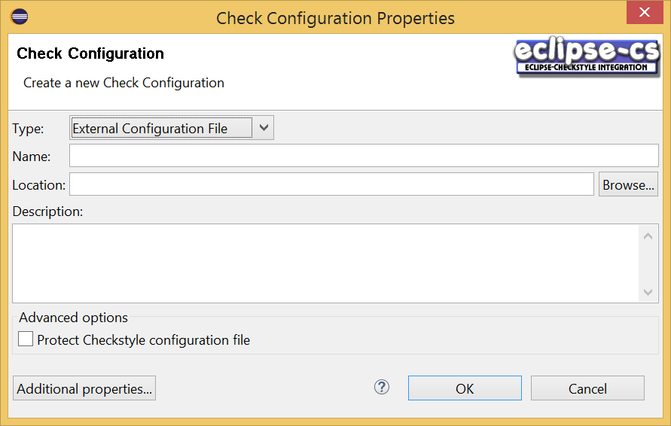
Executing New Command
Specify that you will load the configuration from an external file
Next browse to the downloaded file

Slide 16
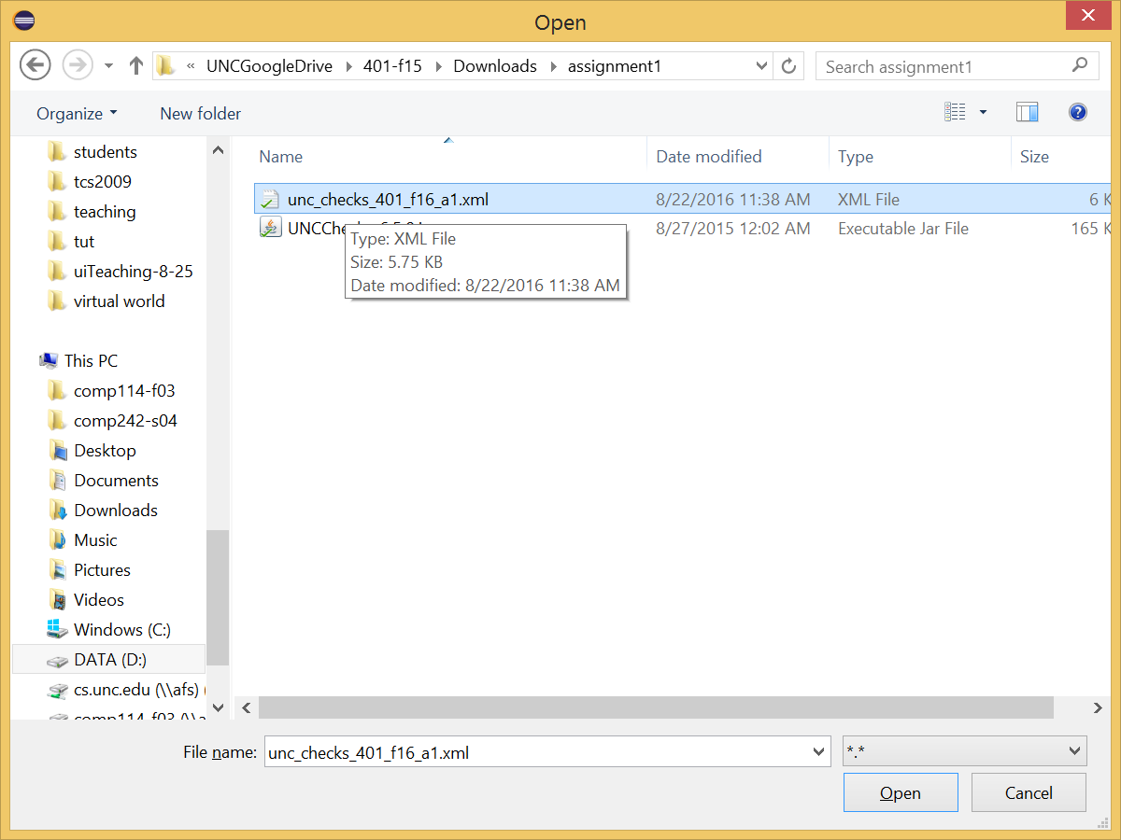
Browse to Downloaded File

Slide 17
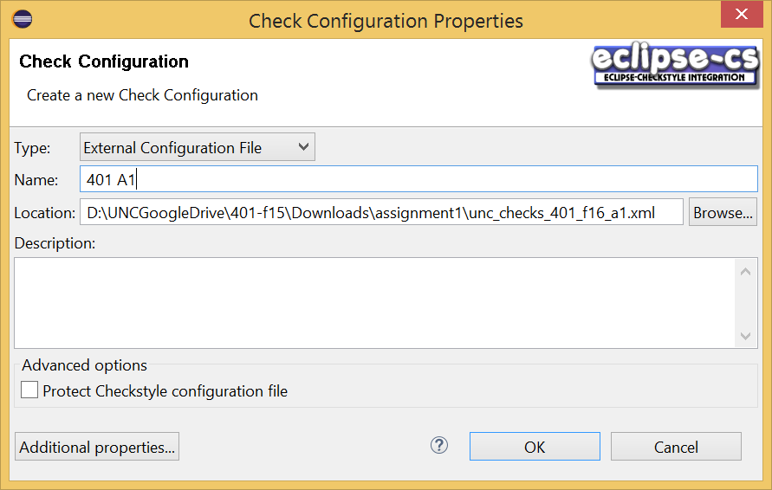
Give the checks a name

Slide 18
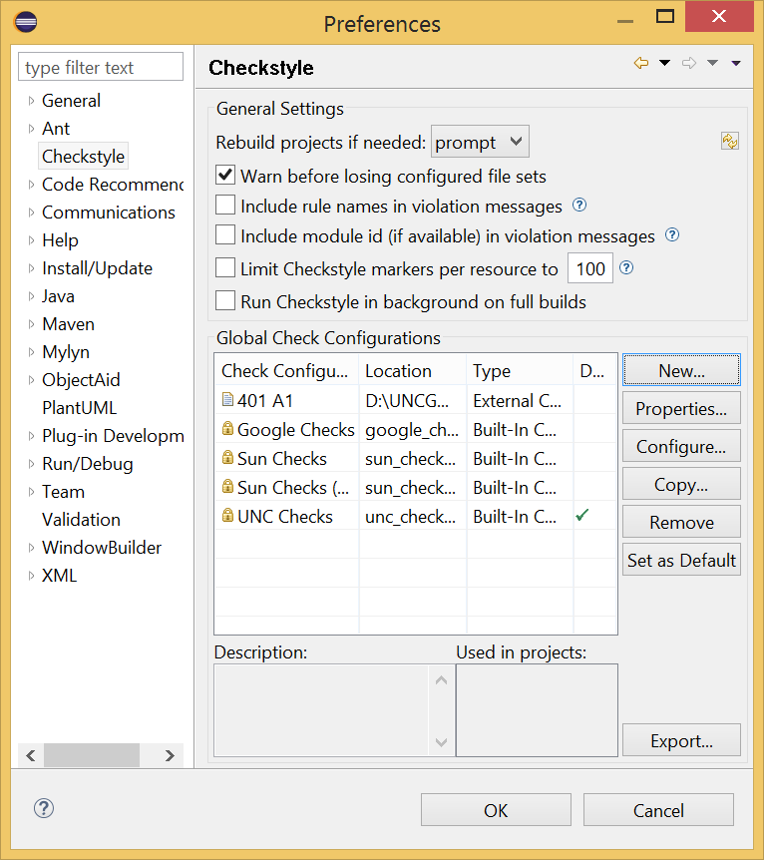
New Configuration Added
The file has been converted into a form that Checkstyle can process
Now we want to associate our assignment project with this configuration

Slide 19
Examining Project Properties
Select project properties

Slide 20
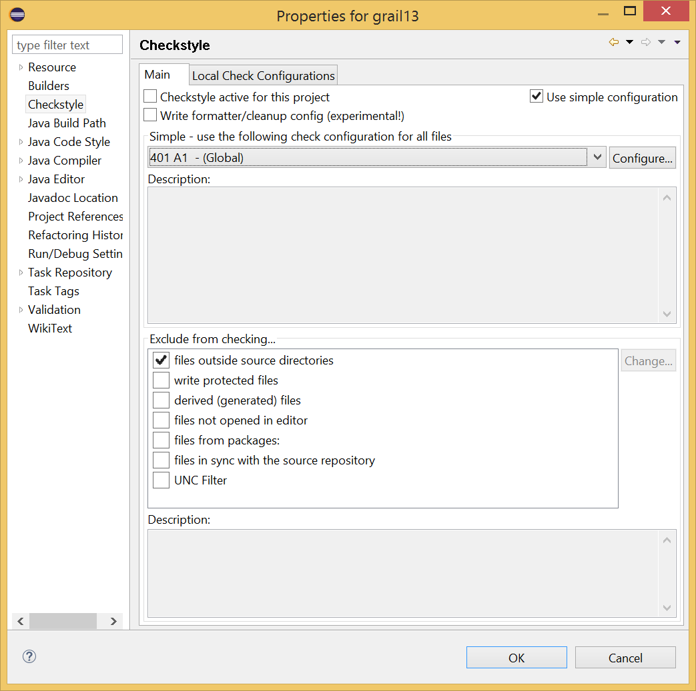
Assign New Configuration

Slide 21
For each new Assignment
Download the checks file
Create a new global configuration using the preferences command.
If the file changes (I post an update) the configuration does not have to be recreated, though you will need to replace the file and restart Eclipse.
Associate the assignment project with the configuration using project properties.
The checks file assumes modules in unc checks, so if you have not added the jar to the dropins (or plugins) folder, you will get an error. See next ppt.

Slide 22
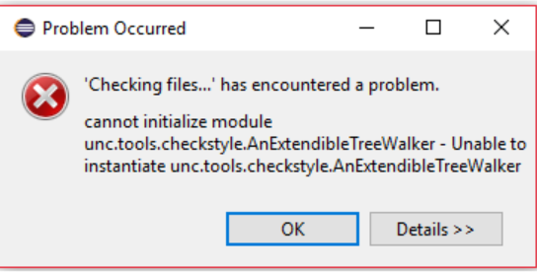
Error with Missing Modules
If you were getting the following error, see next slides:
Slide by Kent Torell

Slide 23
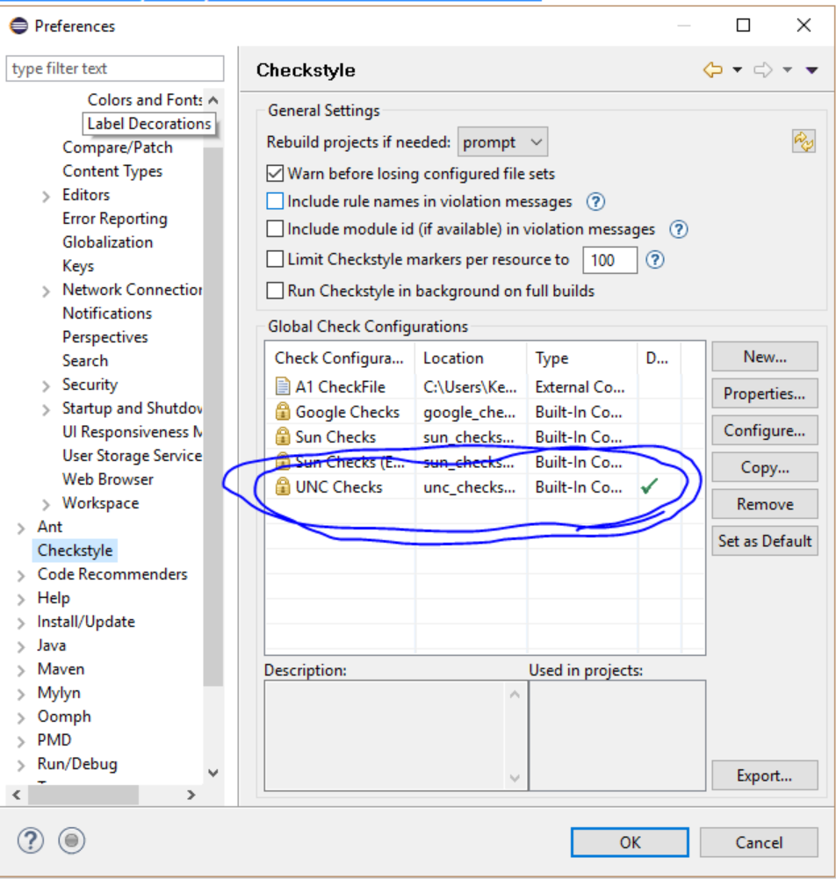
Check if Unc Checks are installed
First check in Window --> Preferences (or if on Mac Eclipse --> Preferences). Under the CheckStyles tab you should see UNC Checks as seen below:
Slide by Kent Torell

Slide 24
Error Fix
If you don't see UNC CheckStyle you did not put the UNCChecks_6.5.0 in the dropins folder of your eclipse.
Make sure that you put UNCChecks in the correct spot, restart eclipse and try again.
Slide by Kent Torell

Slide 25
Checkstyle Installation and Use Instructions
1. Install Checkstyle
2. Download Install Configuration Files
3. Invoke Checkstyle
✓
If Checkstyle does not install, reverse 1 and 2 after uninstalling Checkstyle

Slide 26
Checking Code With Checkstyle
On each save, checkstyle can checks can be automatically done if checkstyle has been activated. However, UNC checks need to access multiple files, so do not activate checkstyle to avoid annoying messages
Instead, invoke Checks Code With Checkstyle when you want the whole project (rather than a single file) checked.

Slide 27
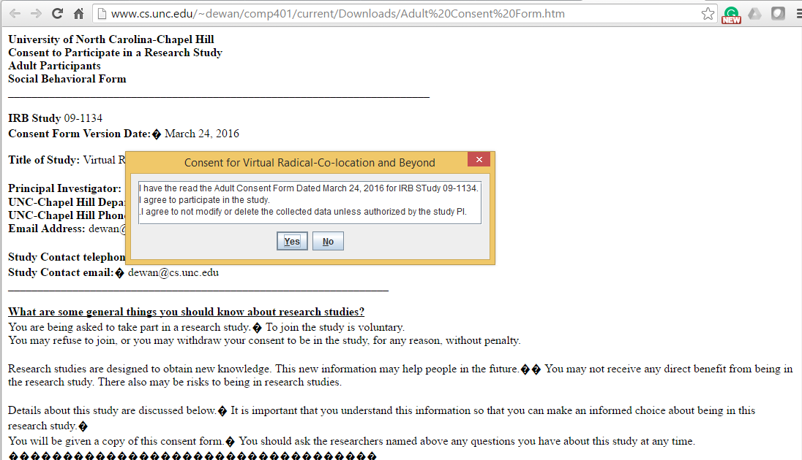
Consent form
Explicitly checked unc checks are part of a research project and will work only if you agree to allow usage data to be gathered for research
If you do not see the yes/no dialog, minimize other windows that may be covering it

Slide 28
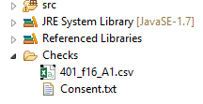
Consent Form and Log Per Project
Per assignment log
Consent form
Will probably not look at data this semester
Need to give consent per project – files stored per project

Slide 29
Check Style Violations in Warnings Window of Eclipse

Slide 30
Check Style Violations in Eclipse Editor Window

Slide 31
Bad Warnings vs. Good Info
This is bad, you did not define something we expect (shown in warnings section of “problems”)
This is good, you defined something we expect (Shown in info section)

Slide 32
Warning vs Info Sections
Bad warning if you are implementing these extra credit features
This is good info, tells you one of the expected types has been found
This is pure info, tells you what classes are being expected
//EC suffix means extra credit
You should see such a message for each expected type

Slide 33
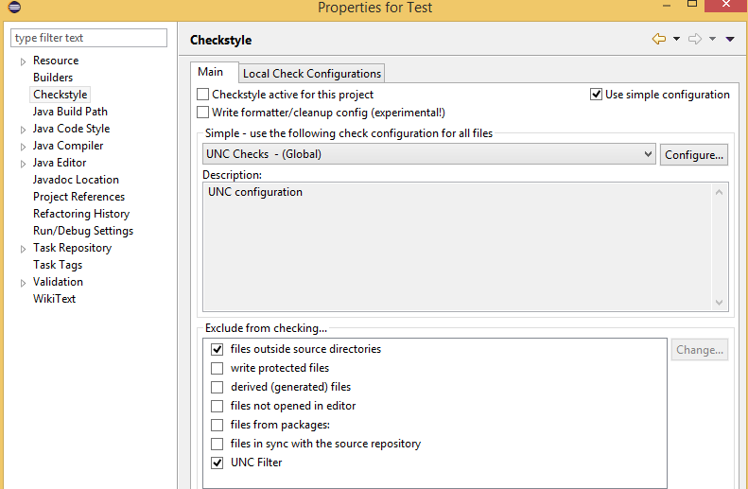
Removing UNC Checks
Select UNC Filter as an exclude from checking item in project properties, checkstyle

Slide 34
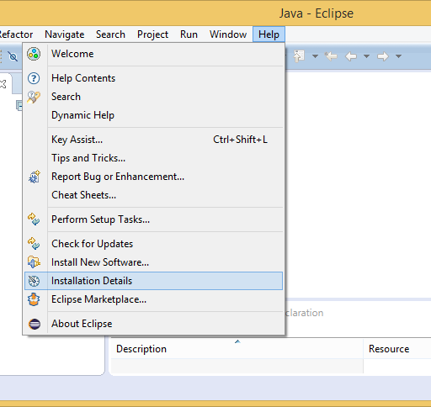
Removing Checkstyle Completely

Slide 35
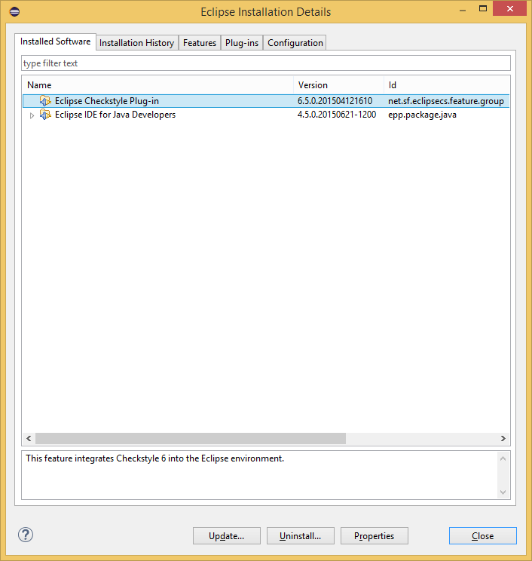
Removing Checkstyle Completely

Slide 36
Eclipse Checks
Checkstyle and UNC Checks
Built-in Eclipse Checks
✓
Checkstyle augments Eclipse built in checks

Slide 37
Enabling Built in Eclipse Checks

Slide 38
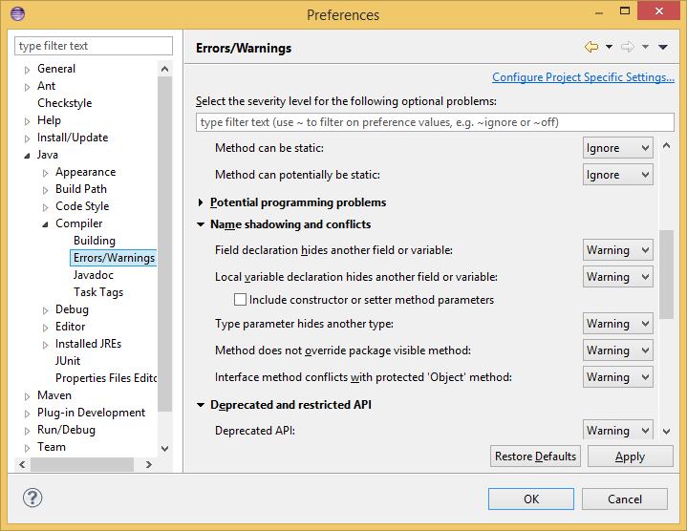
Two Important Built-in Checks
These are done by the compiler, not Checkstyle or UNCChecks

Slide 39
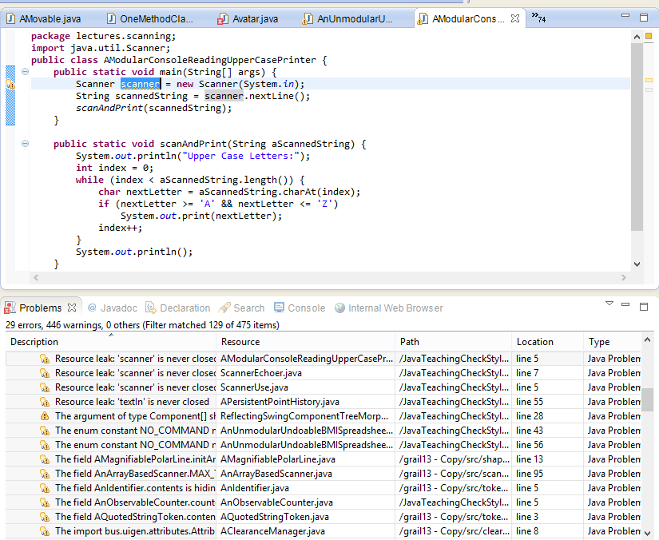
Checkstyle and Compiler Checks are Integrated
These are displayed using the same framework in Eclipse

