Slide 1
Comp 110/401 Appendix: Installing and Using Bare Bones Development Environment on Windows
Instructor: Prasun Dewan (FB 150, dewan@unc.edu)

Slide 2
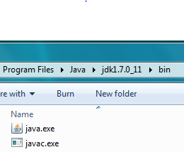
Install Latest JDK and JRE
Look at Install JDK Documentation

Slide 3
Create Folder for All Java Projects You Create
You can create this folder in any existing folder on your computer
A folder is another word for a directory
You do not have to use the command line to create folder
The command line command to create folder is: mkdir <folder name> (mkdir Java)

Slide 4
In Java Folder Create Project Folder for This Warmup Exercise

Slide 5
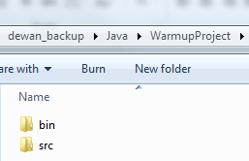
In Project Folder Create Project-Source (src) and Project-Binary (bin) Folders

Slide 6
In Source Folder Create Source-Package Folder

Slide 7
Use Command Interpreter to CD to Source Package FOLDER
See command Interpreter documentation on CD and Pasting Text such as Folder Names in Command Interpreter

Slide 8
Use a Text Editor to Create New Source Java File

Slide 9
Copy and Paste Code in Text Editor and Save File
Package folder name
Source file without .java
package warmup;
import java.io.BufferedReader;
import java.io.InputStreamReader;
public class AGreeter {
static BufferedReader inputStream = new BufferedReader(new InputStreamReader(System.in));
public static void main(String[] args) {
System.out.println("Hello World");
if (args.length > 0) {
System.out.println(args[0]);
}
try {
System.out.println (inputStream.readLine());
} catch (Exception e) {
System.out.println("Could not read line");
e.printStackTrace();
}
}
}

Slide 10
Compile Source File
See Command Interpreter documentation on how to set PATH if you will use the barebones environment again
Do not omit the space between bin and AGreeter.java
The JDK binary folder name will be different on your computer
JDK Binary Folder followed by \javac, in quotes
Project-binary folder
Source file name
Directory (folder) option

Slide 11
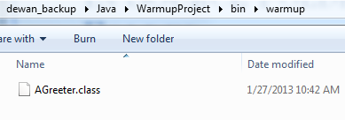
Explore Package Binary Folder
Automatically created binary package folder
Automatically crated Binary-file
If you do not see the binary package folder or the binary file, and no errors were reported, check that you saved the source file (by say reopening it)

Slide 12
Cd to Project Binary Folder and Run Java Interpreter with Full Class Name
If you see the message saying the Java command was not found, then execute it the same way as you did javac – using the full file name with the JDK binary folder – and just replace javac with java in the full name you used
Output
Full class name

Slide 13
Input a Line
Input

Slide 14
Hit Enter and See Output
Echoed Input

Slide 15
Providing User Argument
User argument in quotes

Slide 16
Seeing Echoed Argument
Echoed Argument

Slide 17
HIT CTRL-C to Terminate Program Waiting for User Input
Forcibly Terminated program

