Slide 1

Comp 110/401
Windows Command Interpreter
Instructor: Prasun Dewan (FB 150, dewan@unc.edu)

Slide 2
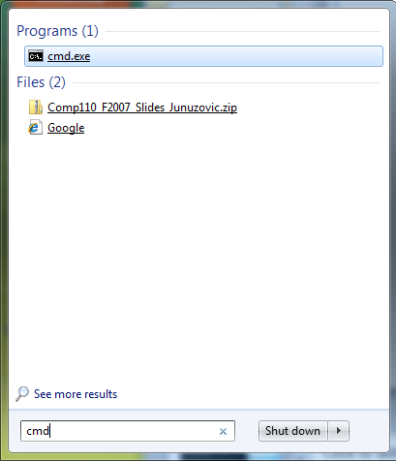
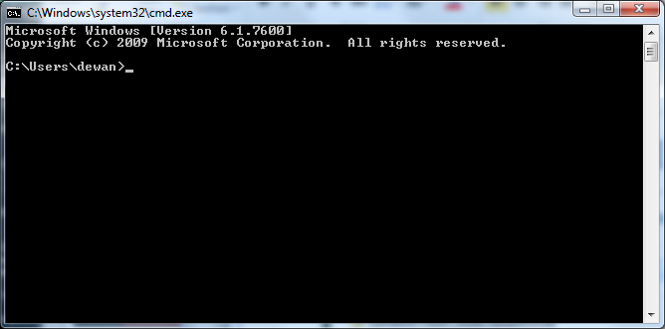
Windows Command Interpreter

Slide 3
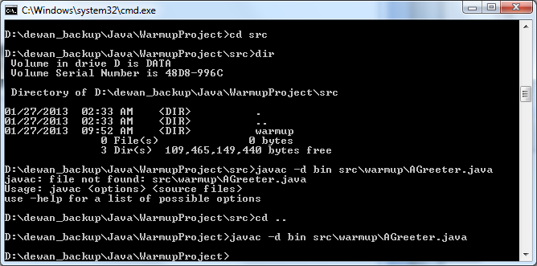
Command Interpreter?
Interprets Command Lines
Provides alternative to (OS and Application) GUIs

Slide 4
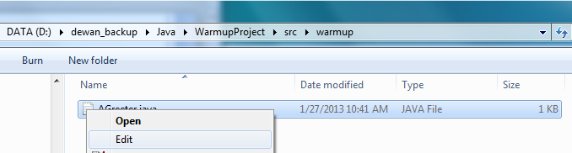
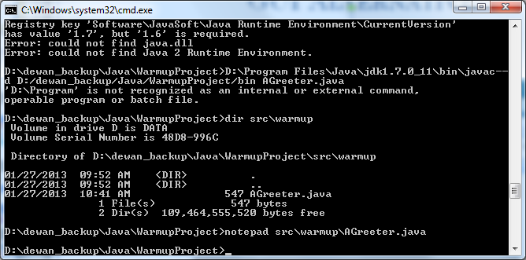
GUI Alternative
GUI
Command Interpreter

Slide 5
Why Command Interpreter?
Command lines may be preferred to GUIs in some situations and by some people
Some applications and OS’s do not come with GUIs and must be used through command interpreter
java, javac, kindlegen
Some think you do not know computers if you do not understand a command interpreter

Slide 6
Command Line Syntax
<command name> <parameters>
javac -d bin src\warmup\AGreeter.java
cd warmup
<command name>
parameters
Command = Command Line
Command = Command Name

Slide 7
Classifying Command (Names)
Internal
Execute code built-into OS
cd
External
Execute some application program installed on top of OS
javac
Command interpreter does not know about external command names; so how does it run and interpret them?

Slide 8
Running External Command: Tokenization and Two-Stage Command Interpretation
javac -d bin src\warmup\AGreeter.java
Name of an executable file
A sequence of parameters
Command interpreter separates the command line into a sequence of units or tokens divided by “separators” ( spaces and tabs)
It treats the first token as the name of an executable file, finds it and executes it
It passes the remaining tokens to the newly executed program, which then interprets them
One or more of the parameters may be file (and folder) names

Slide 9
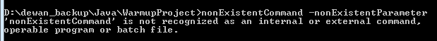
Command Interpreter Searching for Executable Command: First Interpretation Stage
It treats the first token as the name of an executable file, finds it and executes it

Slide 10
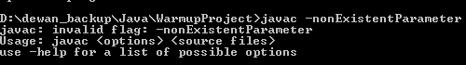
External Program Interpreting Parameters: Second Interpretation Stage
It passes the remaining tokens to the newly executed program, which then interprets it

Slide 11
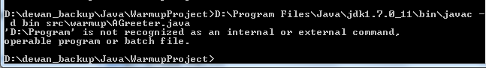
Tokenization
D:\Program Files\Java\jdk1.7.0_11\bin\javac -d bin src\warmup\AGreeter.java
First token = command-name

Slide 12
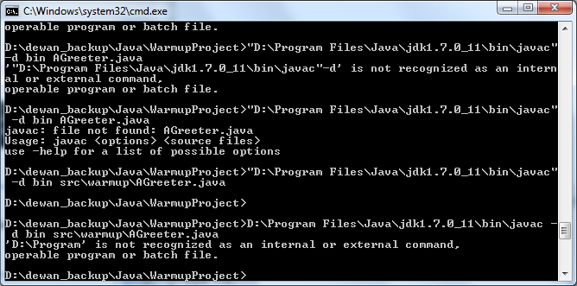
Using Quotes for Tokens with Spaces
"D:\Program Files\Java\jdk1.7.0_11\bin\javac" -d D:\dewan_backup\Java\WarmupProject\bin AGreeter.java
First token = command-name

Slide 13
How to Name Files (and Folders)
One or more of the parameters may be file (and folder) names
"D:\Program Files\Java\jdk1.7.0_11\bin\javac" -d D:\dewan_backup\Java\WarmupProject\bin AGreeter.java
File Names
Files and folders are both often called files

Slide 14
Relative/Partial vs. Absolute/Full Names
Longer names but simpler naming scheme
Absolute name
"D:\Program Files\Java\jdk1.7.0_11\bin\javac" -d D:\dewan_backup\Java\WarmupProject\bin AGreeter.java
Relative name
Shorter names but more complicated naming scheme

Slide 15
Local Name of File/folder
A file or folder is always created within some parent folder to create a hierarchical file system
Local Name
“D:\Program Files\Java\jdk1.7.0_11\bin\javac" –d D:\dewan_backup\Java\WarmupProject\bin AGreeter.java
The name given within the parent folder is called the local name of the file/folder

Slide 16
Absolute/Full Name
Drive name
…
Preceded by Local name of its parent’s parent
Preceded by Local name of its parent
Local name of the target flile(folder)
“D:\Program Files\Java\jdk1.7.0_11\bin\javac" –d D:\dewan_backup\Java\WarmupProject\bin AGreeter.java
Gives the full “path” name, with each name taking isone level down in the folder hierarchy
Names are separated by \

Slide 17
Traversing Down the Hierarchy
D:
dewan_backup
D:\dewan_backup\Java\WarmupProject\bin
Java
WarmupProject
src
bin
warmup
warmup
AGreeter.java
AGreeter.class

Slide 18
Reducing Effort to Enter Absolute Names
Copy Absolute Name from GUI and Paste into Command Line
Edit Previously Entered Command Line

Slide 19
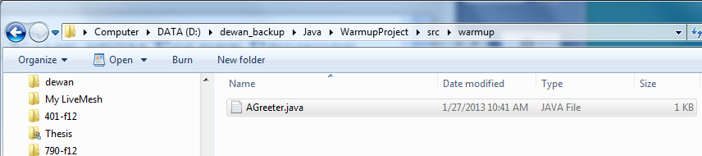
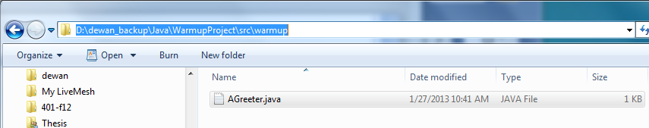
Copy Absolute Name from Folder Browser GUI
Click mouse to get full name
CTRL + C

Slide 20
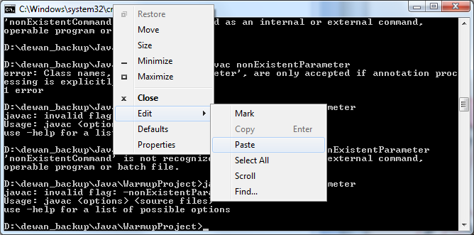
Paste into Command Line
Top border, Right menu→Edit→Paste

Slide 21
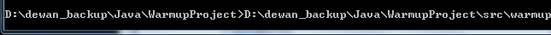
Text Pasted at Current Cursor Position

Slide 22

Use left and right arrow Keys to change Cursor Position
Cursor at start of line

Slide 23
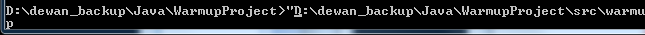
Can insert or Delete at Cursor Point
“ inserted at start of line

Slide 24
Relative Name
Relative to current directory (or folder)
Relative to folders in System Path

Slide 25
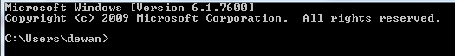
Current Directory
Each command interpreter is associated with a current directory or folder name, parts of the Windows prompt
Build-in cd command can be used to change the current directory to some other directory on the same drive
Build-in drive command can be used to change drive
Initial folder is home directory of logged in user

Slide 26
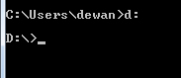
Changing Drives
Command = Drive Name:
Case does not matter in drive file names on Windows

Slide 27
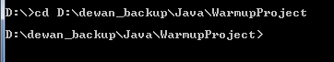
Changing Folder within Drive: CD Command
cd <folder name>
Current directory ← <folder name>

Slide 28
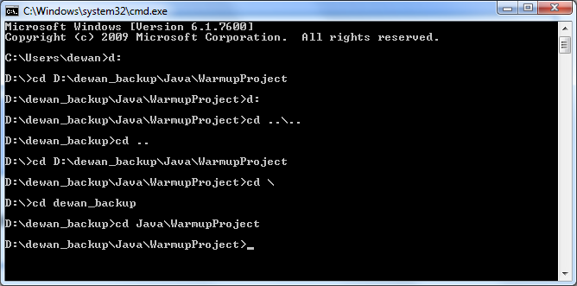
Name Relative to Current Directory
Relative to current directory (or folder)
Given current directory with absolute name: a
Relative name: r =
a file with absolute name: a\r

Slide 29
Relative Name
Relative to single current directory (or folder)
Can be used in both command names and file parameters
“D:\Program Files\Java\jdk1.7.0_11\bin\javac" –d D:\dewan_backup\Java\WarmupProject\bin AGreeter.java
Used only in command names
Relative to multiple folders in System Path

Slide 30
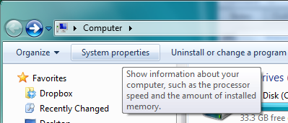
Setting System Path: System Properties

Slide 31
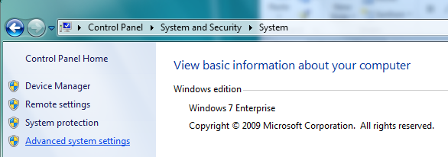
Setting System Path: Advanced System Settings

Slide 32
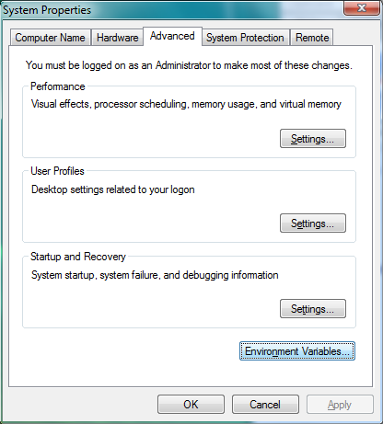
Setting System Path: Environment Variables

Slide 33
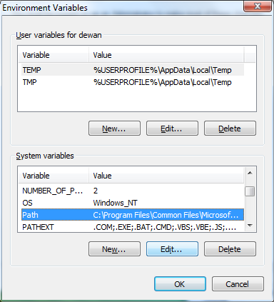
Select Path System: Select Path Variable and Edit

Slide 34
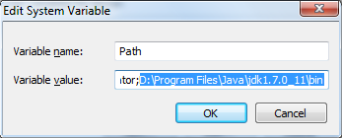
Select Path System: Add Folder to Path after Semicolon
No need for quotes because of ;
D:\Program Files\Java\jdk1.7.0_11\bin\javac

Slide 35
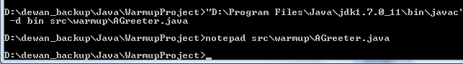
Reusing Commands: Command History
Want to execute (portion of) a command in history
Use up and down arrow keys to reuse commands in history

Slide 36
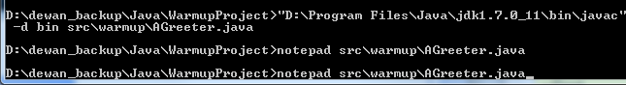
Reusing Commands: Up Arrow Displays Previous Editable Command
First Up-Arrow shows last command

Slide 37
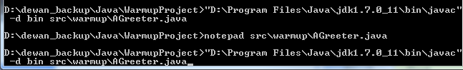
Reusing Commands: Up Arrow Displays Previous Editable Command
Second Up Arrow shows second last command

Slide 38
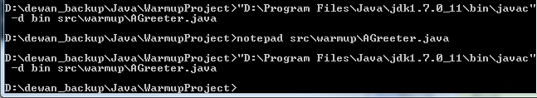
Reusing Commands: Enter Executes (Possibly Edited) Previous Command
Enter
Could have edited command
History particularly useful if absolute files names entered

Slide 39
More on Names: Traversing Down the Hierarchy
D:
dewan_backup
D:\dewan_backup\Java\WarmupProject\bin
Java
WarmupProject
src
bin
warmup
warmup
AGreeter.java
AGreeter.class

Slide 40
Traversing Up (and Down) the Hierarchy
..
D:
Name denoting the parent
dewan_backup
Java
WarmupProject
..\..\bin
src
bin
Target Directory
Current Directory
warmup
warmup
AGreeter.java
AGreeter.class

Slide 41
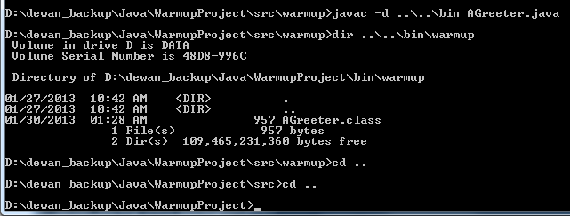
Use of ..

Slide 42
Naming Current Directory
D:
dewan_backup
Java
.
WarmupProject
The current directory
src
bin
A la this in Java
Current Directory
warmup
warmup
AGreeter.java
AGreeter.class

Slide 43
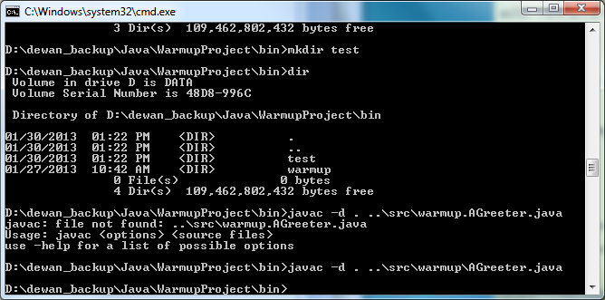
Use of .
Current directory

Slide 44
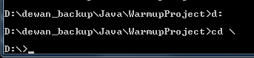
NAMING Root Folder on Drive
D:
dewan_backup
Java
\
WarmupProject
D:
Changes drive, not directory within drive
src
bin
warmup
warmup
AGreeter.java
AGreeter.class

Slide 45
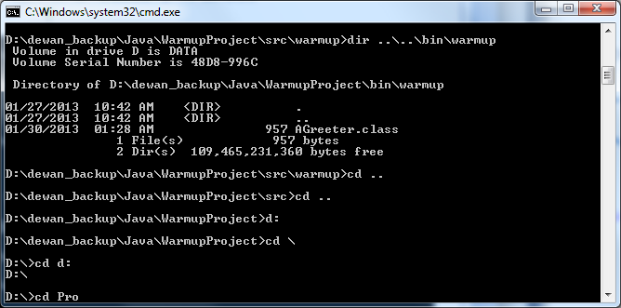
Completing File Name Token
Hit tab

Slide 46
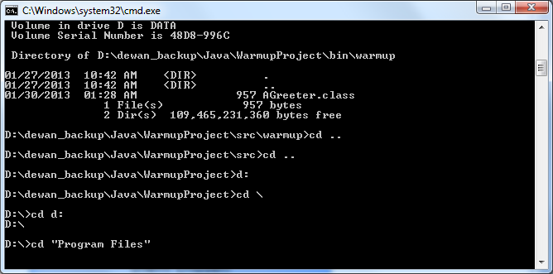
Completing File Name Token
Hit tab to complete token if known to application cmpleting
Should choose unique prefix

Slide 47
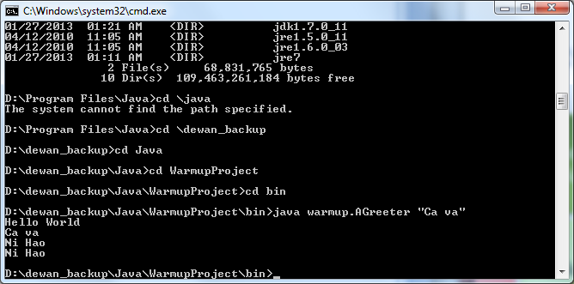
Saving Interaction
Input

Slide 48
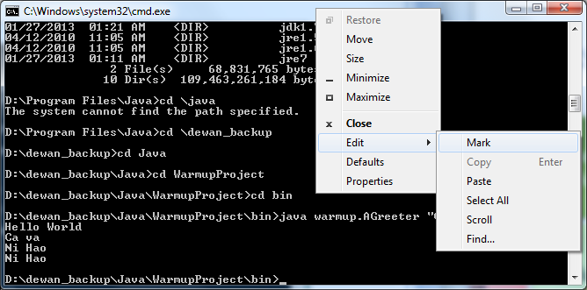
Marking Text

Slide 49
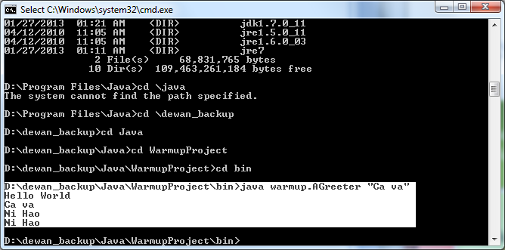
Marking Text
Drag mouse to select text

Slide 50
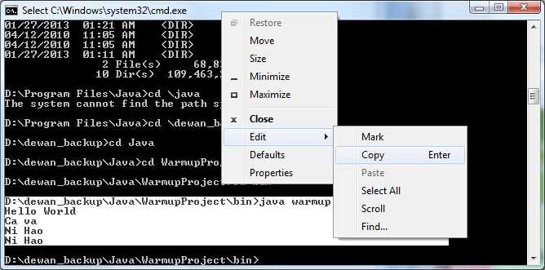
Copy Text
This text can now be pasted anywhere

Slide 51
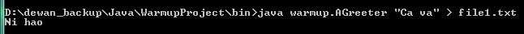
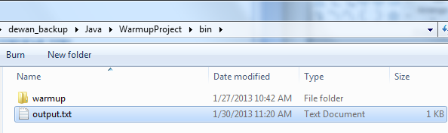
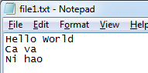
Output Redirection
Input
Command > File
Output of Command goes to File rather than the command window
Echoed Input of “Ca va” command

Slide 52

Input Redirection
Echoed input from file
Command < File
Input of Command comes from File rather than the command window
Input for “Buon Girono Command

Slide 53

Pipe
Command1 | Command2
Output of Command1 becomes input of Command2

Slide 54
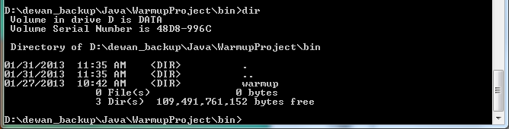
GUI Alternative: Dir Command

Slide 55
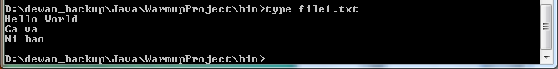
GUI Alternative: Type Command

Slide 56
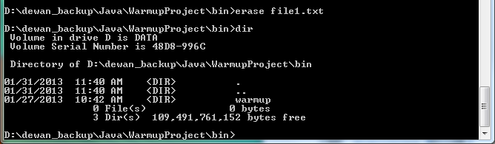
GUI Alternative: Erase Command

Slide 57
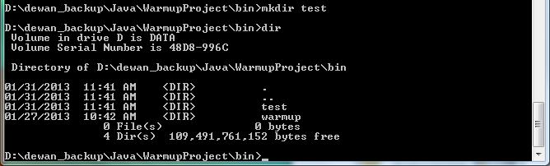
GUI Alternative: Mkdir Command

Slide 58
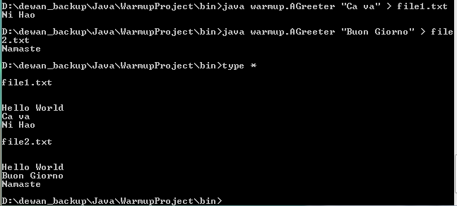
WildCard: *

Slide 59
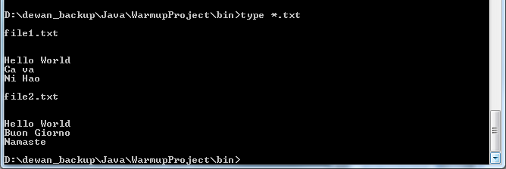
WildCard: *

Slide 60
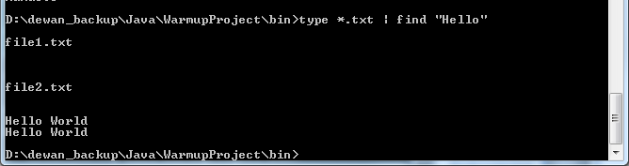
Partial WildCard and Find (Piped)

Slide 61
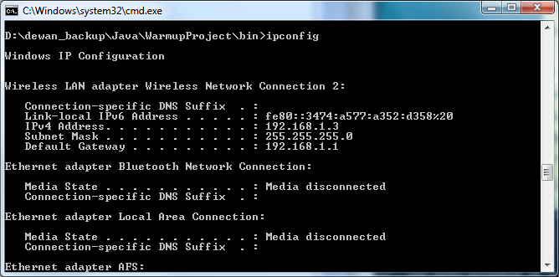
Ipconfig

Slide 62
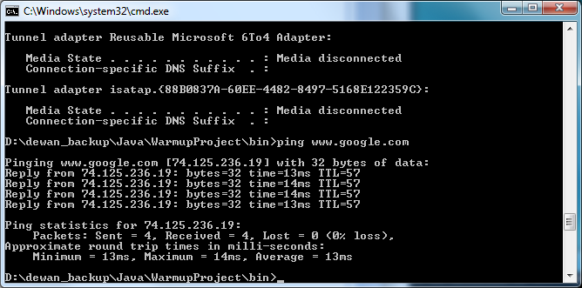
PING

Slide 63
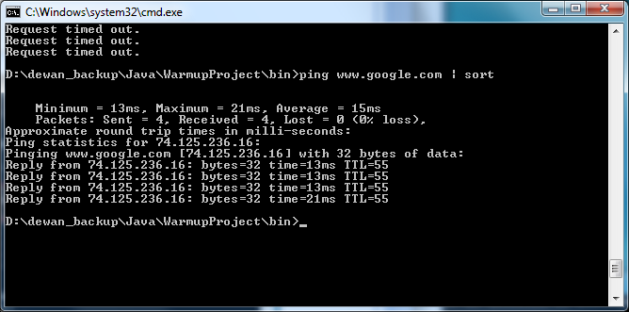
Sort (Piped)

Slide 64
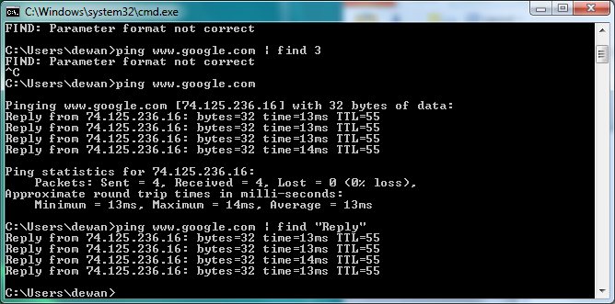
Find(Piped)

Slide 65
Starting Separate Command Interpreter

Slide 66
Extra Slides

Slide 67

Starting Another Command Interpreter in Same Window and Exit

Slide 68
Command Interpreter?
Interprets Command Lines
Provides alternative to (OS and Application) GUIs

Slide 69
Why Command Interpreter
Command lines may be preferred to GUIs
Some applications and OS’s do not come with GUIs and must be used through command interpreter
java, javac, kindlegen

Slide 70
GUI Alternative
GUI
Command Interpreter
Command interpreters came first

Slide 71
Command Name Relative to Folder in Path

Slide 72
Advance

Slide 73
Relative Name
Relative to current directory (or folder)
Can used in both command names and file parameters
“D:\Program Files\Java\jdk1.7.0_11\bin\javac" –d D:\dewan_backup\Java\WarmupProject\bin AGreeter.java
Used only in command names
Relative to folders in System Path

Slide 74
Relative Name: Going Backward
A .. After some directory D refers to the parent of the D
Given current directory with absolute name: d
Given current directory with absolute name: “D:\dewan_backup\Java\WarmupProject>"
Relative name: ... denotes a file with absolute name: d\f
Relative name: src\warmup\AGreeter.java denotes a file with absolute name “D:\dewan_backup\Java\WarmupProject>“\ src\warmup\AGreeter.java

Slide 75
…
Relative to current directory (or folder)
Given current directory with absolute name: d
Given current directory with absolute name: “D:\dewan_backup\Java\WarmupProject>"
Relative name: f denotes a file with absolute name: d\f
Relative name: src\warmup\AGreeter.java denotes a file with absolute name “D:\dewan_backup\Java\WarmupProject>“\ src\warmup\AGreeter.java

Slide 76
Relative/Partial vs. Absolute/Full Names
javac -d bin src\warmup\AGreeter.java
D:\dewan_backup\Java\WarmupProject\src\warmup>"D:\Program Files\Java\jdk1.7.0_11
\bin\javac" -d D:\dewan_backup\Java\WarmupProject\bin AGreeter.java
D:\Program Files\Java\jdk1.7.0_11
\bin\javac" -d D:\dewan_backup\Java\WarmupProject\bin AGreeter.java

Slide 77

Tokenization
D:\dewan_backup\Java\WarmupProject\src\warmup>D:\Program Files\Java\jdk1.7.0_11
\bin\javac -d D:\dewan_backup\Java\WarmupProject\bin AGreeter.java
First token = command-name
D:\dewan_backup\Java\WarmupProject\src\warmup>"D:\Program Files\Java\jdk1.7.0_11
\bin\javac" -d D:\dewan_backup\Java\WarmupProject\bin AGreeter.java

Slide 78
Using Quotes to Separate Tokens
D:\dewan_backup\Java\WarmupProject\src\warmup>"D:\Program Files\Java\jdk1.7.0_11
\bin\javac" -d D:\dewan_backup\Java\WarmupProject\bin AGreeter.java
First token = command-name

Slide 79


GUI Alternative
GUI
Command Interpreter
Command interpreters came first

Slide 80
Tokenization
D:\dewan_backup\Java\WarmupProject>D:\Program Files\Java\jdk1.7.0_11\bin\javac -
d bin src\warmup\AGreeter.java
First token = command-name

Slide 81
Relative Name: Going Forward
Relative to current directory (or folder)
Given current directory with absolute name: d
Given current directory with absolute name: D:\dewan_backup\Java\WarmupProject>
Relative name: f denotes a file with absolute name: d\f
Relative name: src\warmup\AGreeter.java denotes a file with absolute name D:\dewan_backup\Java\WarmupProject>\ src\warmup\AGreeter.java

Slide 82
GUI Alternative
GUI
Command Interpreter
Command interpreters came first

Slide 83
Classifying Command-Names
Internal
Identify code built-into OS
cd
External
Identify some application program installed on top of OS
javac
Command interpreter does not know about external command names; so how does it run and interpret them?

Slide 84
Relative/Partial vs. Absolute/Full Names
D:\dewan_backup\Java\WarmupProject\src\warmup>"D:\Program Files\Java\jdk1.7.0_11
\bin\javac" -d D:\dewan_backup\Java\WarmupProject\bin AGreeter.java
Absolute name
Relative name
Longer names and simpler naming scheme
Shorter names but more complicated naming scheme

Slide 85
How to Name Files (and Folders)
One or more of the parameters may be file (and folder) names
javac -d bin src\warmup\AGreeter.java
File names
Files and folders are both often called files

Slide 86
File/folder Hierarchies and Local Names
D:
dewan_backup
Java
WarmupProject
src
bin
warmup
warmup
AGreeter.java
AGreeter.class

Slide 87
Completing File Name
Enter
Could have edited command
History particularly useful if absolute files names entered

Slide 88


Redirecting Output
Echoed input
Input
Command < File
Input of Command comes fromFile rather than the command window

Slide 89
Traversing Up (and Down) the Hierarchy
D:
dewan_backup
..
Java
WarmupProject
src
bin
warmup
warmup
AGreeter.java
AGreeter.class

Slide 90

Output Redirection
Input
Command > File
Output of Command goes to File rather than the command window
Echoed Input

Slide 91
Input Redirection
Echoed input from file
Command < File
Input of Command comes from file rather than the command window
Input

