Slide 1

Comp 401
Object and Shape Composition
Instructor: Prasun Dewan

Slide 2
Prerequisite
Interfaces
Graphics

Slide 3
More on Objects
Structure vs. atomic types
Physical vs. logical structure

Slide 4
Primitive vs. Object Types
Primitive types
Object types
double
Classes
int
ABMICalculator
ABMISpreadsheet
String
AnotherBMISpreadsheet
Interfaces
BMISpreadsheet
Point
type = set of operations
Notes:
Show this earlier also, when primtive vs class types are introduced and then when interfaces are introduced

Slide 5
Line Interface with Primitive Properties
public interface Line {
public int getX();
public void setX(int newX);
public int getY();
public void setY(int newY);
public int getWidth();
public void setWidth(int newVal);
public int getHeight();
public void setHeight(int newHeight);
}
Object rather than primitive properties?

Slide 6
LineWithObjectProperty Interface
public interface LineWithObjectProperty {
public Point getLocation();
public void setLocation(Point newLocation);
public int getWidth();
public void setWidth(int newVal);
public int getHeight();
public void setHeight(int newHeight);
}
Object with object property == Composite Object

Slide 7
Primitive vs. Object Properties
public class ALineWithObjectProperty implements LineWithObjectProperty {
int width, height;
Point location;
public ALineWithObjectProperty (Point initLocation, int initWidth, int initHeight) {
location = initLocation;
width = initWidth;
height = initHeight;
}
public ALineWithObjectProperty() { }
public Point getLocation() {return location;}
public void setLocation(Point newVal) {location = newVal;}
public int getWidth() {return width;}
public void setWidth(int newVal) {width = newVal;}
public int getHeight() {return height;}
public void setHeight(int newHeight) {height = newHeight;}
}

Slide 8
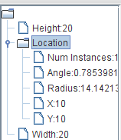
Predefined, Primitive vs. Programmer-Defined, Object
Point
Object
Programmer-defined
Structured
int
Primitive
Predefined
Atomic

Slide 9
Programmer-defined vs. Predefined
Predefined
Programmer-defined Types
Primitive types
double
int
Classes
ACartesianPoint
ABMISpreadsheet
java.lang Object Types
AnotherBMISpreadsheet
String
Other Object Types
Interfaces
ArrayList
BMISpreadsheet
Point
Java.lang types do not have to be imported
Notes:
Show this earlier also when primtive types ate introduced

Slide 10
Programmer-defined vs. Predefined Types
Programmer-defined interface/class (Point/ACartesianPoint) is programmer-defined type
Programmer-defined types in Java must be object (or enum) types
Some object types are predefined
  Could be predefined by Java (in java.lang)
    String
    Integer
  Could be predefined by Java library
    ArrayList
    Vector
All primitive types are predefined

Slide 11
Structured vs. Atomic Types
Atomic Types
Structured Types
Primitive types
double
int
Classes
ACartesianPoint
ABMISpreadsheet
Classes
AnotherBMISpreadsheet
ABMICalculator
Interfaces
Interfaces
BMICalculator
BMISpreadsheet
Point
Instances of structure type decomposed into one or more smaller values

Slide 12
Decomposing ALineWithObjectProperty Instance
Initialized to 0s
public class ALineWithObjectProperty implements LineWithObjectProperty {
int width, height;
Point location;
public ALineWithObjectProperty (Point intLocation, int initWidth, int initHeight) {
location = initLocation;
width = initWidth;
height = initHeight;
}
public ALineWithObjectProperty() { }
public Point getLocation() {return location;}
public void setLocation(Point newVal) {location = newVal;}
public int getWidth() {return width;}
public void setWidth(int newVal) {width = newVal;}
public int getHeight() {return height;}
public void setHeight(int newHeight) {height = newHeight;}
}
Initialized to null
Composition illustrated
new ALineWithObjectProperty(new ACartesianPoint (10, 10), 20, 20)
new ALineWithObjectProperty()

Slide 13
Physical Structure
Child
Leaf
Ancestor
Parent
Composite or internal node
int
Descendent
Root
x
int
ACartesianPoint
y
Variable name
location
ALineWith ObjectProperty
width
int
Class or primitive type of value stored in variable
height
int
node (vertex)
edge
new ALineWithObjectProperty(new ACartesianPoint (10, 10), 20, 20)

Slide 14
Logical Structure
int
int
Property name
X
Y
Point
double
Location
Angle
Width
Radius
LineWith ObjectProperty
int
double
Interface, Class or primitive type of property value
Height
int
new ALineWithObjectProperty(new ACartesianPoint (10, 10), 20, 20)

Slide 15
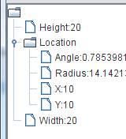
Logical Structure Shown by ObjectEditor
Angle
Radius
…
ObjectEditor cannot see instance variables
Tool for showing physical structure?

Slide 16
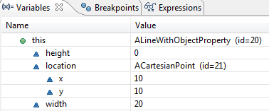
Physical Structure Shown by Debugger

Slide 17
Instance-Specific Structure
double
angle
double
APolarPoint
radius
location
ALineWith ObjectProperty
width
int
height
int
new ALineWithObjectProperty(new APolarPoint (14.01, 0.78), 20, 20)

Slide 18
Instance-Specific Structure
int
x
int
ACartesianPoint
y
location
ALineWith ObjectProperty
width
int
height
int
new ALineWithObjectProperty(new ACartesianPoint (10, 10), 20, 20)
Structures of instances of same class can be different!

Slide 19
Null Component
null
location
ALineWith ObjectProperty
width
int
height
int
new ALineWithObjectProperty(null, 20, 20)
Object (but not primitive) properties can lead to null pointer exceptions

Slide 20
Computer Data Structures
Connect items called nodes with directed lines called edges.
Start with node with no incoming edge called root
Nodes with no outgoing edge called leafs
Non leaf or root node called internal node or composite nodes
If a node a has a direct edge to another node b, then a is a parent of b and b is a child of a
If a is a parent of b and b is a parent of c, then a is an ancestor of c and c is a descendent of a

Slide 21
Two Ways to Decompose Objects
Logical and physical structures decompose objects
Physical Decomposition
  components of objects are its instance variables
    x, y, location, width, size
  the component can be further decomposed
    location into x, y
Logical Decomposition
  components of object are its properties
    Location, X, Y, Radius, Angle, Width, Height
  each of these can be further decomposed
    Location can be decomposed into X, Y, Angle, Radius

Slide 22
Drawing the Physical Structure of a Value of Some Type
Start with the name of the type of root value
  type can be class or primitive type
  cannot be interface because no associated physical representation
For each instance variable of the value
  draw an edge
  end point of edge is primitive type/class of value assigned to variable if value is non-null, and null otherwise
  label of edge is variable name
Follow the same algorithm to physically decompose value of each instance variable
Stop at value of atomic type or a value already drawn in the figure (in case of recursive structures where a component points to an ancestor)

Slide 23
Drawing the Logical Structure of a Value of Some Type
Start with the name of the class/primitive type of root value
For each property defined by the type
  draw an edge
  end point of edge is primitive type/class of property value if not null and null otherwise
  label of edge is property name
Follow the same algorithm to logically decompose value of each property
Stop at value of atomic type, or value drawn in the figure (in case of recursive structures where a component points to an ancestor)

Slide 24
Atomic vs. Structured Types
All primitive types are atomic
Object types with >= 1 properties are logically structured
Object types with >= 1 instance variables are physically structured
Some object types may be physically or logically atomic

Slide 25
ObjectEditor Shape Rules
Line
Rectangle
Oval
X, Y (int)
X, Y (int)
X, Y (int)
Height (int)
Height (int)
Height (int)
Width (int)
Width (int)
Width (int)
Location (Point )
Location (Point )
Location (Point )
Height (int)
Height (int)
Height (int)
Width (int)
Width (int)
Width (int)
The type of Location is any type following point rules given earlier

Slide 26
XY-based String and Shape Shape Rules
String Shape
Image Shape
X, Y (int)
X, Y (int)
Text
hello
ImageFileName
Location
Location
Text
hello
ImageFileName

Slide 27
Creating Other Geometric Objects
Polygon, triangle, ….
Compose the existing geometric objects into a logically structured object
  Point, Line, Rectangle, Oval, TextBox, Icon
  Arc, Curves added in latest ObjectEditor
Any graphical image can be created from triangles!

Slide 28
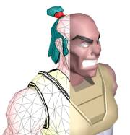
Lines of Composition
Lines can be composed into triangles
Triangles can be composed to create arbitrary computer graphics

Slide 29
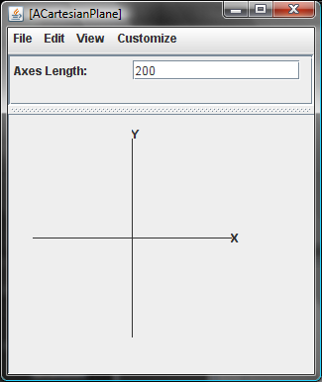
ACartesianPlane
Text Property
Axes Length (int)
XAxis (Line)
YAxis (Line)
XLabel (Label)
YLabel (Label)
Graphics Property

Slide 30
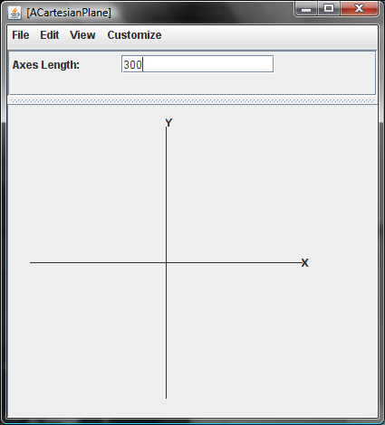
Changing the Length
Axes Length (int)
XAxis (Line)
YAxis (Line)
XLabel (StringShape)
YLabel (StringShape)
Cartesian plane retains the same origin
Other properties are dependent on the axes length property

Slide 31
ACartesianPlane : Constructor
public class ACartesianPlane implements CartesianPlane {
int originX, originY;
int axesLength;
Line xAxis;
Line yAxis;
StringShape xLabel;
StringShape yLabel;
public ACartesianPlane (int theAxesLength,
int theOriginX, int theOriginY ) {
axesLength = theAxesLength;
originX = theOriginX;
originY = theOriginY;
xAxis = new ALine(toXAxisX(), toXAxisY(), axesLength, 0);
yAxis = new ALine(toYAxisX(), toYAxisY(), 0, axesLength);
xLabel = new AStringShape ("X", toXLabelX(), toXLabelY());
yLabel = new AStringShape ("Y", toYLabelX(), toYLabelY());
}

Slide 32
ACartesianPlane: Properties
public Line getXAxis() {return xAxis;}
public Line getYAxis() {return yAxis;}
public StringShape getXLabel() {return xLabel;}
public StringShape getYLabel() {return yLabel;}
public int getAxesLength() {return axesLength;}
public void setAxesLength(int anAxesLength) {
axesLength = anAxesLength;
xAxis.setWidth(axesLength);
yAxis.setHeight(axesLength);
xAxis.setX(toXAxisX());
xAxis.setY(toXAxisY());
yAxis.setX(toYAxisX());
yAxis.setY(toYAxisY());
xLabel.setX(toXLabelX());
xLabel.setY(toXLabelY());
yLabel.setX(toYLabelX());
yLabel.setY(toYLabelY());
}

Slide 33
ACartesianPlane: Dependencies
int toXAxisX() {
return originX - axesLength/2;
}
int toXAxisY() {
return originY;
}
int toYAxisX() {
return originX;
}
int toYAxisY() {
return originY - axesLength/2;
}
int toXLabelX() {
return originX + axesLength/2;
}
int toXLabelY() {
return originY;
}
int toYLabelX() {
return originX;
}
int toYLabelY() {
return originY - axesLength/2;
}

Slide 34
Code Duplication:Constructor vs. Set
public ACartesianPlane (int theAxesLength,
int theOriginX, int theOriginY ) {
axesLength = theAxesLength;
originX = theOriginX;
originY = theOriginY;
xAxis = new ALine(toXAxisX(), toXAxisY(), axesLength, 0);
yAxis = new ALine(toYAxisX(), toYAxisY(), 0, axesLength);
xLabel = new AStringShape ("X", toXLabelX(), toXLabelY());
yLabel = new AStringShape ("Y", toYLabelX(), toYLabelY());
}
public void setAxesLength(int anAxesLength) {
axesLength = anAxesLength;
xAxis.setWidth(axesLength);
yAxis.setHeight(axesLength);
xAxis.setX(toXAxisX());
xAxis.setY(toXAxisY());
yAxis.setX(toYAxisX());
yAxis.setY(toYAxisY());
xLabel.setX(toXLabelX());
xLabel.setY(toXLabelY());
yLabel.setX(toYLabelX());
yLabel.setY(toYLabelY());
}
In ACartesianPlane constructor, could instantiate dependent objects with null constructors or constructors with wrong values and then simply call setAxesLength

Slide 35
No Code Duplication
public ACartesianPlane (int theAxesLength,
int theOriginX, int theOriginY ) {
originX = theOriginX;
originY = theOriginY;
xAxis = new ALine();
yAxis = new ALine();
xLabel = new AStringShape ();
yLabel = new AStringShape ();
setAxesLength(theAxesLength);
}
public void setAxesLength(int anAxesLength) {
axesLength = anAxesLength;
xAxis.setWidth(axesLength);
yAxis.setHeight(axesLength);
xAxis.setX(toXAxisX());
xAxis.setY(toXAxisY());
yAxis.setX(toYAxisX());
yAxis.setY(toYAxisY());
xLabel.setX(toXLabelX());
xLabel.setY(toXLabelY());
yLabel.setX(toYLabelX());
yLabel.setY(toYLabelY());
}
In ACartesianPlane constructor, could instantiate dependent objects with null constructors or constructors with wrong values and then simply call setAxesLength

Slide 36
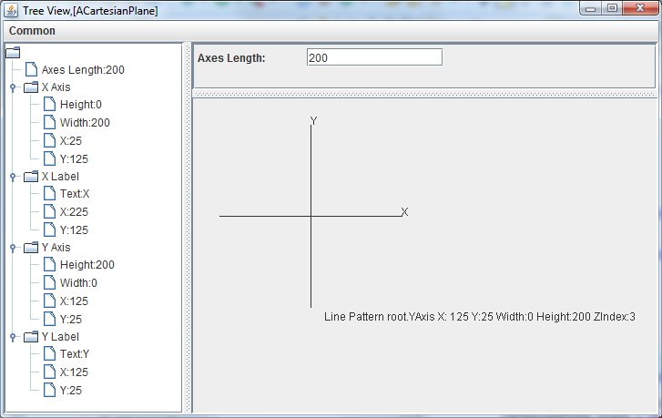
ACartesianPlane Logical Structure
Logical Structure Without Graphical Properties
Graphical Properties
public static void main (String[] args) {
CartesianPlane plane = new ACartesianPlane(200, 125, 125);
ObjectEditor.edit(plane);
}
Complete Logical Structure

Slide 37
ACartesianPlane : Constructor
public class ACartesianPlane implements CartesianPlane {
int originX, originY;
int axesLength;
Line xAxis;
Line yAxis;
StringShape xLabel;
StringShape yLabel;
public ACartesianPlane (int theAxesLength,
int theOriginX, int theOriginY ) {
axesLength = theAxesLength;
originX = theOriginX;
originY = theOriginY;
xAxis = new ALine(toXAxisX(), toXAxisY(), axesLength, 0);
yAxis = new ALine(toYAxisX(), toYAxisY(), 0, axesLength);
xLabel = new AStringShape ("X", toXLabelX(), toXLabelY());
yLabel = new AStringShape ("Y", toYLabelX(), toYLabelY());
}

Slide 38
ACartesianPlane: Properties
public Line getXAxis() {return xAxis;}
public Line getYAxis() {return yAxis;}
public StringShape getXLabel() {return xLabel;}
public StringShape getYLabel() {return yLabel;}
public int getAxesLength() {return axesLength;}
public void setAxesLength(int anAxesLength) {
axesLength = anAxesLength;
xAxis.setWidth(axesLength);
yAxis.setHeight(axesLength);
xAxis.setX(toXAxisX());
xAxis.setY(toXAxisY());
yAxis.setX(toYAxisX());
yAxis.setY(toYAxisY());
xLabel.setX(toXLabelX());
xLabel.setY(toXLabelY());
yLabel.setX(toYLabelX());
yLabel.setY(toYLabelY());
}

Slide 39
Inefficient CartesianPlane
public class AnInefficientCartesianPlane implements CartesianPlane {
int originX, originY;
int axesLength;
public AnInefficientCartesianPlane (int theAxesLength,
int theOriginX, int theOriginY ) {
axesLength = theAxesLength;
originX = theOriginX;
originY = theOriginY;
}
public Line getXAxis() {
return new ALine(toXAxisX(), toXAxisY(), axesLength, 0);
}
public Line getYAxis() {
return new ALine(toYAxisX(), toYAxisY(), 0, axesLength);
}
public StringShape getXLabel() {
return new AStringShape ("X", toXLabelX(), toXLabelY());
}
public StringShape getYLabel() {
return new AStringShape ("Y", toYLabelX(), toYLabelY());
}
public void setAxesLength(int anAxesLength) {
axesLength = anAxesLength;
}
…
New objects constructed on each refresh!
Much simpler setAxesLength
Notes:
Add some more examples: (1) no getters, variables (2) setX and setY, and setWidth and setHeight do not change the components.

Slide 40
Uniting Structure Graphics and Types
Structured Types
APlottedShuttle
ACartesianPlane
ALine
AStringShape
AnImageWithHeight

Slide 41
Composite Object/Shape vs. Atomic Object/Shape
Composite object
Object with one or more object logical components
Non composite object
Object with zero or more primitive logical components
Atomic (wrapper) object
Object with one primitive logical component
Composite Shape
Object with one or more shape (geometric/graphic) components
Atomic Shape
Shape that cannot be decomposed into component shapes

Slide 42
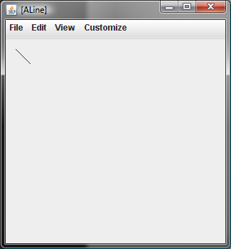
Atomic Shape, Composite Object
public interface LineWithObjectProperty {
public Point getLocation();
public void setLocation(Point newLocation);
public int getWidth();
public void setWidth(int newVal);
public int getHeight();
public void setHeight(int newHeight);
}

Slide 43
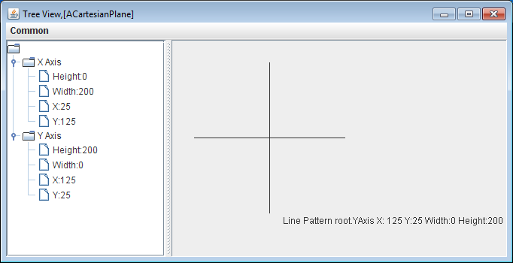
Composite Shapes and object
public interface CartesianPlane {
public Line getXAxis();
public Line getYAxis();
}

Slide 44
Mutable Object Properties in Atomic Shapes
public interface LineWithObjectProperty {
public Point getLocation();
public void setLocation(Point newLocation);
public int getWidth();
public void setWidth(int newVal);
public int getHeight();
public void setHeight(int newHeight);
}

Slide 45
None in Composite Shapes
public interface CartesianPlane {
public int getAxesLength();
public void setAxesLength(int newVal);
public Label getXLabel();
public Label getYLabel();
public CartesianPlane getCartesianPlane();
}
Changes in composite shape usually take place through changes in their atomic descendants
public interface ShuttleLocation {
public FancyCartesianPlane getCartesianPlane();
public ImageLabel getShuttleLabel();
public int getShuttleX();
public void setShuttleX(int newVal);
public int getShuttleY();
public void setShuttleY(int newVal);
}

Slide 46
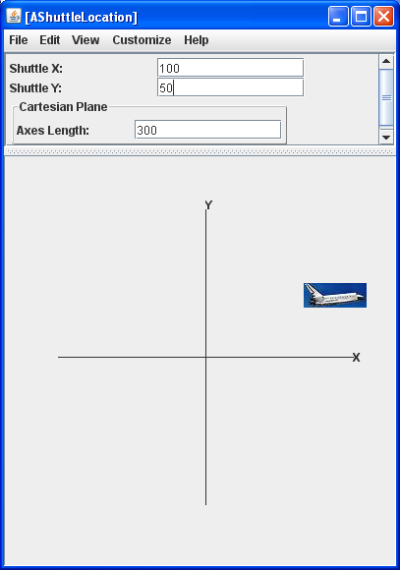
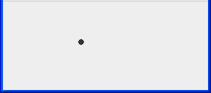
ObjectEditor Graphics Rules
public interface ShuttleLocation {
public FancyCartesianPlane getCartesianPlane();
public ImageLabel getShuttleLabel();
public int getShuttleX();
public void setShuttleX(int newVal);
public int getShuttleY();
public void setShuttleY(int newVal);
}
public interface NotAPoint {
public FancyCartesianPlane
getCartesianPlane();
public ImageLabel getShuttleLabel();
public int getX();
public void setX(int newVal);
public int getY();
public void setY(int newVal);
public Point getLocation();
}
Type interpreted as a Point as its name contains “Point” and has X and Y Properties

Slide 47
ObjectEditor Point Rules
An object is recognized as a point representation if:
  Its interface or class has the string “Point” in its name or has a Point annotation
  It has (read-only) int properties, X and Y, representing Cartesian window coordinates
  Can have additional properties
@StructurePattern(StructurePatternNames.POINT_PATTERN)
public interface Point {
public int getX();
public int getY();
public double getAngle();
public double getRadius();
}

Slide 48
IS_ATOMIC_SHAPE Class Annotation
import util.annotations.IsAtomicShape;
@IsAtomicShape(false)
//same as AShuttleLocation except interface name
public class AShuttleLocationImplementingABadlyNamedInterface implements NotAPoint {
IsAtomicShape(false) before class name says do not interpret the class as an atomic shape (it can be a composition)

Slide 49
Composite Shape (Review)
Logical Structure Without Graphical Properties
Graphical Properties
public static void main (String[] args) {
CartesianPlane plane = new ACartesianPlane(200, 125, 125);
ObjectEditor.edit(plane);
}
Complete Logical Structure

Slide 50
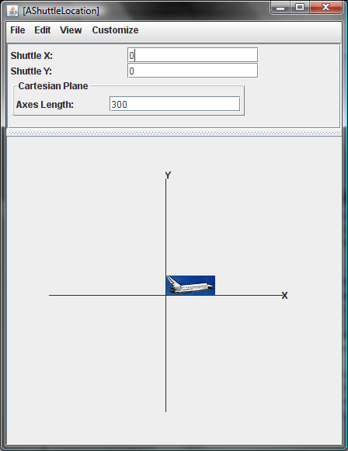
Plotted Shuttle
Cartesian, not Java coordinates, require translation
ShuttleX (int)
ShuttleY (int)
ShuttleImage (ImageWithHeight )
Axes Length (int)
XAxis (Line)
YAxis (Line)
XLabel (StringShape)
YLabel (StringShape

Slide 51
Plotted Shuttle (Reuse)
Cartesian, not Java coordinates, require translation
ShuttleX (int)
ShuttleY (int)
ShuttleImage (ImageWithHeight )
CartesianPlane (CartesianPlane)
Lower left rather than upper left corner is at (0, 0) so shuttle object needs to know the height of shuttle image

Slide 52
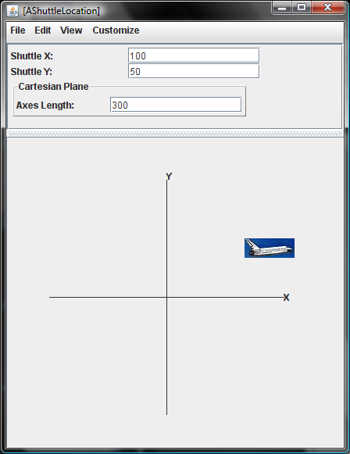
Plotted Shuttle
ShuttleX (int)
ShuttleY (int)
ShuttleImage (ImageWithHeight )
CartesianPlane (CartesianPlane)
ShuttleLabel depends on ShuttleX and ShuttleY

Slide 53
PlottedShuttle
public interface ShuttleLocation {
public CartesianPlane getCartesianPlane();
public ShuttleImage getShuttleImage();
public int getShuttleX();
public void setShuttleX(int newVal);
public int getShuttleY();
public void setShuttleY(int newVal);
}

Slide 54
APlottedShuttle: Constructor
public class APlottedShuttle implements PlottedShuttle {
static final String SHUTTLE_IMAGE_FILE_NAME = "shuttle2.jpg";
static final int ORIGIN_X = 200, ORIGIN_Y = 200;
static final int AXES_LENGTH = 300;
int shuttleX = 0, shuttleY = 0;
CartesianPlane cartesianPlane;
ImageWithHeight shuttleImage;
public APlottedShuttle(int anX, int aY) {
cartesianPlane = new ACartesianPlane (AXES_LENGTH,
ORIGIN_X, ORIGIN_Y);
shuttleImage = new AnImageWithHeight(SHUTTLE_IMAGE_FILE_NAME);
setShuttleX(anX);
setShuttleY(aY);
}

Slide 55
APlottedShuttle: Properties
public CartesianPlane getCartesianPlane() {return cartesianPlane;}
public ShuttleImage getShuttleImage() {return shuttleImage;}
public int getShuttleX() {return shuttleX;}
public void setShuttleX(int newVal) {
shuttleX = newVal;
shuttleImage.setX(toWindowX());
}
public int getShuttleY() {return shuttleY;}
public void setShuttleY(int newVal) {
shuttleY = newVal;
shuttleImage.setY(toWindowY());
}
int toWindowX() {
return ORIGIN_X + shuttleX;
}
int toWindowY() {
return ORIGIN_Y - shuttleY - shuttleImage.getHeight();
}
Extra optional height property

Slide 56
AShuttleImage
public class AnImageWithHeight implements ImageWithHeight {
int x, y;
String imageFileName;
int imageHeight;
public AnImageWithHeight(String anImageFileName) {
imageFileName = anImageFileName;
Icon icon = new ImageIcon(imageFileName);
imageHeight = icon.getIconHeight();
}
public int getX() {return x;}
public void setX(int newX) {x = newX;}
public int getY() { return y; }
public void setY(int newY) {y = newY;}
public String getImageFileName() {return imageFileName;}
public int getHeight() { return imageHeight;}
}

Slide 57
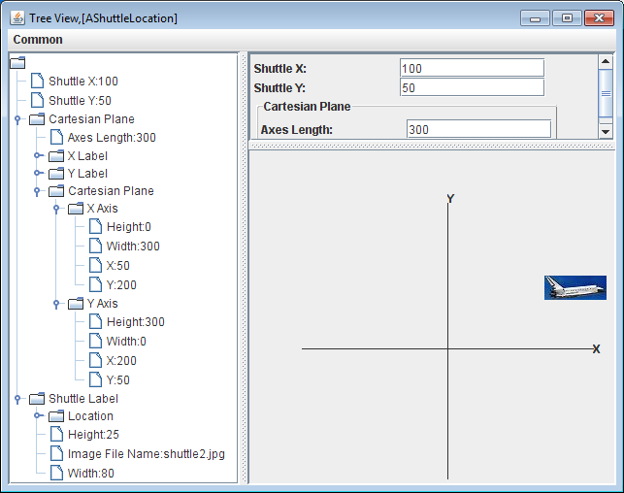
Alternate Views of Logical Structure
Logical Structure Without Graphical Properties
Graphical Properties
Complete Logical Structure

