Slide 1
JavaTeaching and Importing a github repository
Dong Nie

Slide 2
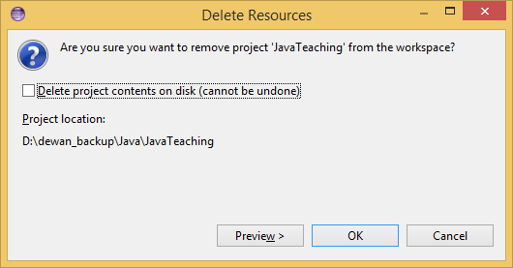
Example used: JavaTeaching
If you have already loaded JavaTeahcing from zip file, you should delete it before starting on this exercise
Right click project and delete. Usually not a good idea to delete project on disk, can always use the OS to do so, which will put it in the recycling bin

Slide 3
Eclipse: File->import

Slide 4
Choose Git: Projects from Git, and click “next”
If you do not see the Git choice, see PPT on importing Egit in reference material or install most recent version of Eclipse

Slide 5
Choose Clone URI, and click “next”

Slide 6
Use the url: https://github.com/pdewan/JavaTeaching.git
Only the URI field needs to be filled, the others will be set automatically

Slide 7
Choose Destination Directory (you can set default, and click “next”

Slide 8
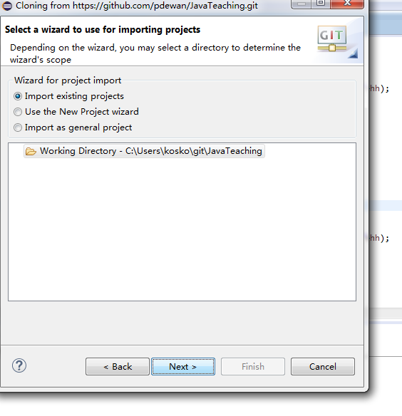
Click “next”

Slide 9
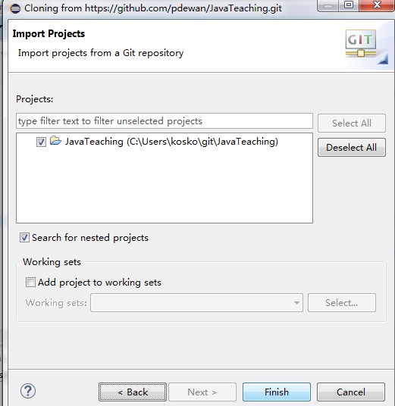
Finish

Slide 10
Here comes the Project with Compile Errors
You will have errors, be sure to delete the oeall22 reference (if it exists in the class path) and add your oeall22 library (See eclipse install and objecteditor library sections and the next two slides) Until you need ObjectEditor, you can ignore the errors

Slide 11
Replacing/Adding oeall22 (or any other JAR)
Right-click on the project you want to modify → Properties

Slide 12
Replacing/Adding oeall22 (or any other JAR)
Go to Java Build Path → Libraries tab. Remove the old JAR (if it exists), and choose Add External JARs. Click Apply→OK
If you see modulepath or classpath as options, select classpath
You need not add external jar if you can live with the compiler errors in code you will not access in the first few praxes. However, if you have time, look at objecteditor PPT on how to download oeall from the web page and then use add external jar to add it. At this point there should be no errors.

Slide 13
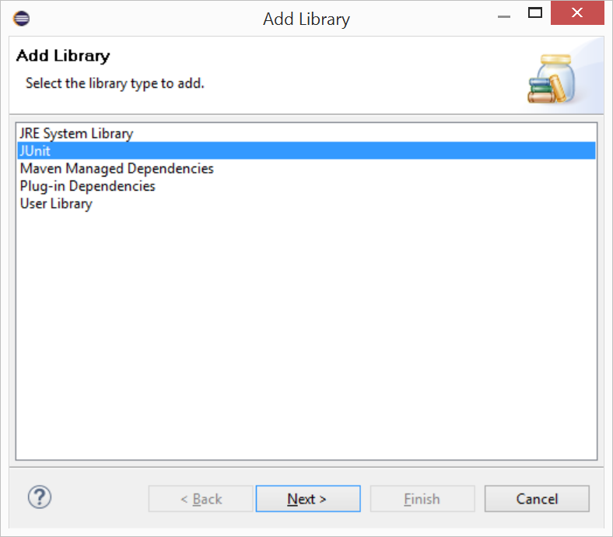
Add junit library to your classpath
Select Add Library instead of Add External Jar and then select Junit

Slide 14
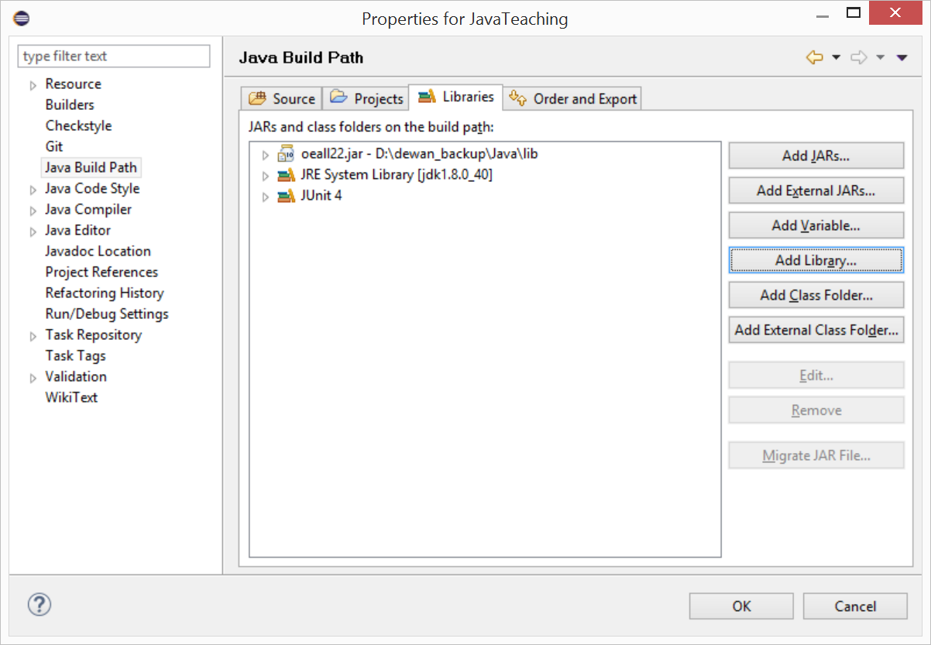
What your libraries in build path should look after both additions
You will probably have a later version of the JRE system library

Slide 15
Pulling (Updating) the Project
Right click project, Team>Pull (not Pull…)
You may get conflicts if you changed files that were updated in the master version you are pulling
In this case, you should save the folders you changed (they will have a > next to them) and then reset the project and then pull again

Slide 16
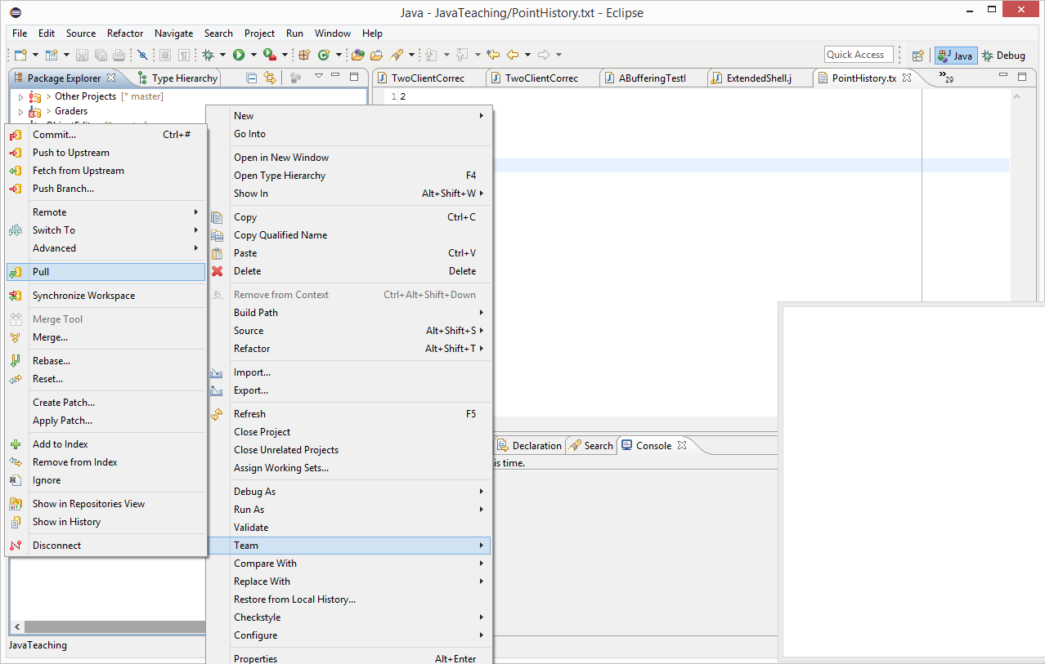
Pulling the project

Slide 17
Conflict
This happens if you (accidentally) changed a file that was also changed by some one else – in this case the instructor
The name(s) of the changed files are given in the message, and next to the project name you see you are behind the version in the repository
If your changed files have important information, save them, or save the whole project
Then reset (hard) the project

Slide 18
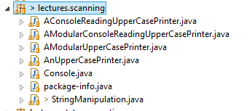
Saving folders changed
Click on each changed folder/file and execute CTRL-C (copy)

Slide 19
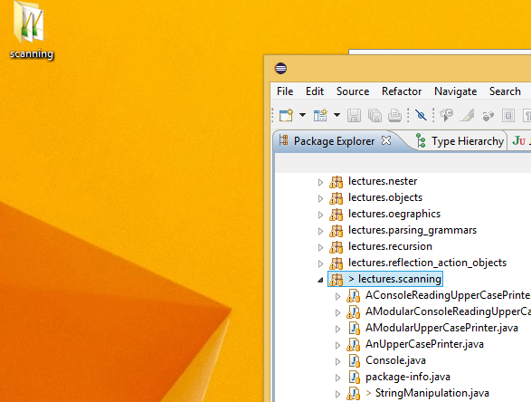
Saving folders changed
Go to desktop or some folder and hit CTRL-V (paste)

Slide 20
Resetting the Project
After doing an exercise with the code or when you get a conflict, you can reset the project
Right click project, select Team>reset

Slide 21
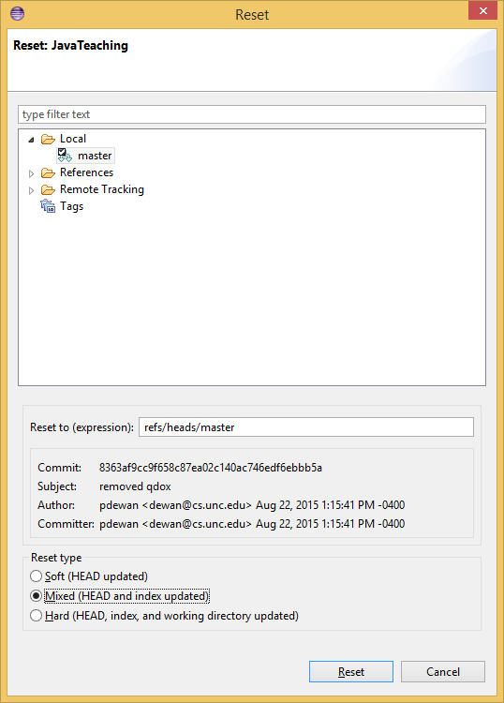
Reset Dialog to Pick Kind of Reset Option
Default picks Mixed Option

Slide 22
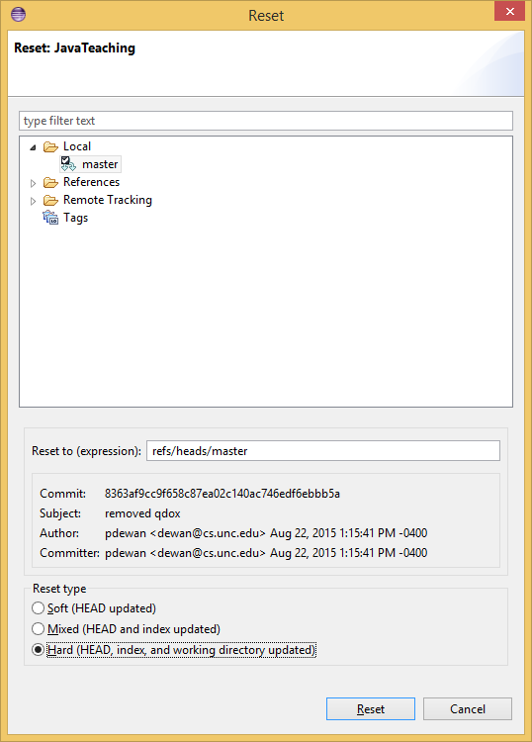
Hard Reset Deletes all of Your Changes
Pick hard and press reset

Slide 23
Hard Reset Deletes all of Your Changes

Slide 24
Pull the project again to get latest non conflicting changes

Slide 25
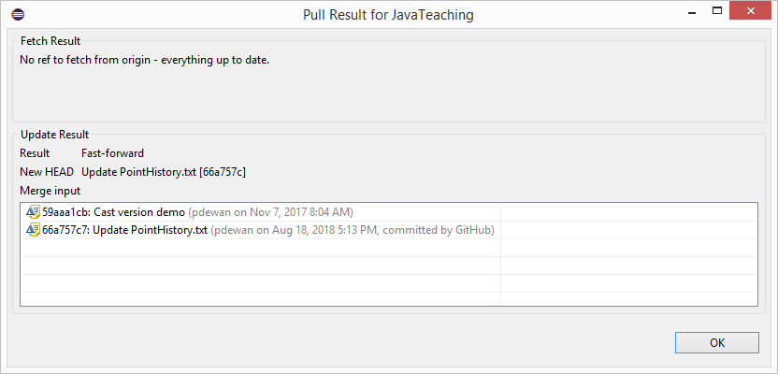
Successful Pull After Conflict

Slide 26
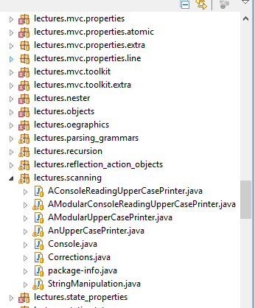
Going to a package and class in Java Teaching
Packages (class folders)
Classes (Java source code files)
package-info (starting point of praxes)

Slide 27
Collapsed parts

Slide 28
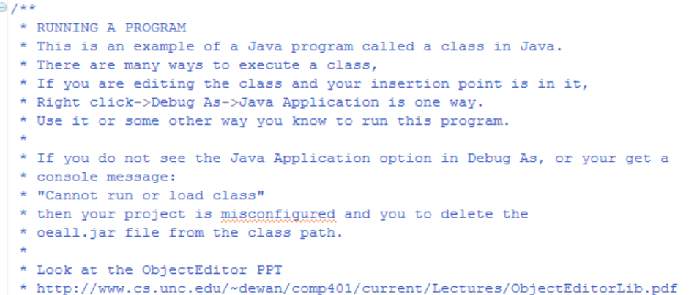
Open them

