Slide 1
Comp 110/401 Appendix: JDK Install
Instructor: Prasun Dewan (FB 150, dewan@unc.edu)

Slide 2
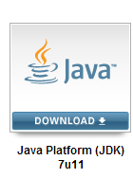
Find Latest JDK from http://www.oracle.com/technetwork/java/javase/downloads/index.html

Slide 3
Follow Download Link: Accept License Agreement, Find JDK for Appropriate Platform, and Click on exe Link to Download EXE in some temporary folder

Slide 4
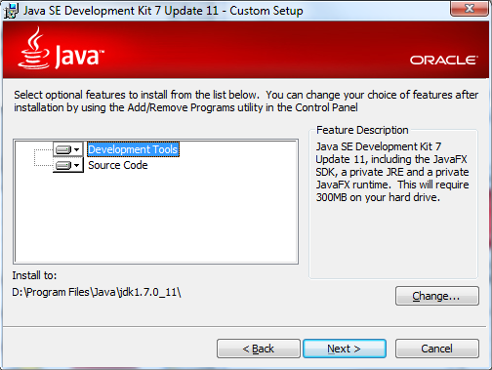
Run Exe and Choose JDK Folder

Slide 5
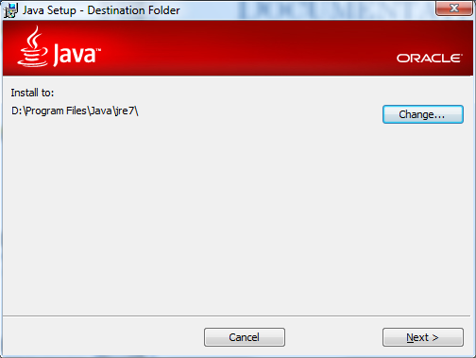
Choose JRE Folder

Slide 6
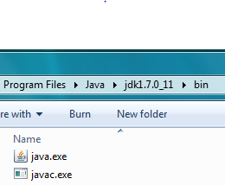
Open bin Subfolder of JDK Folder and Find Java and JAVAC Programs

Slide 7
Open Command Window and Check Java Version (See PPT DECK on how to use Command Interpreter)

