Slide 1
Recitation #3
Comp 401-002
Semion Piskarev

Slide 2
Review: why classes?
Tedious and unreliable

Slide 3
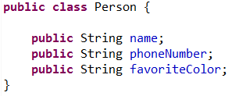
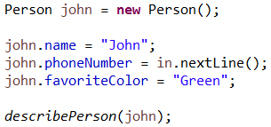
Class as a Type

Slide 4
Class for Modularization

Slide 5
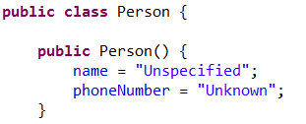
Constructors
Constructor gets called

Slide 6
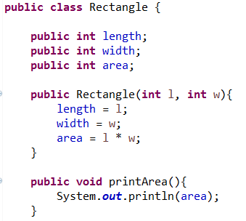
Why Getters and Setters?

Slide 7
Using Getters and Setters
Or…
In this case, you don’t even need to have an “area” variable stored!
A “JavaBean” class is one that only lets things be accessed with getters and setters.
A property is something that can be accessed through a getter or setter.

Slide 8
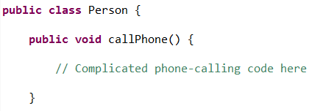
Today’s topic: Why interfaces?
Can’t keep up- what if someone makes something else I can call?

Slide 9
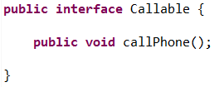
Interfaces
Will work for anything that implements “Callable”!

Slide 10
Informal definitions
Modularity: the ability to add, remove, and exchange parts without having to change EVERYTHING
Encapsulation: keeping the workings of a class hidden or contained inside it as much as possible
Polymorphism: Letting code correctly work with data of many forms (types)
Modularity and encapsulation allow pieces of code to have some independence, so different people can work on different parts.
Modularity and polymorphism allow code to be reused in many contexts.

Slide 11
Today’s Activity
Go to the course website -> click Recitations
Scroll down and click on “Activity Slides” under “Interfaces and Annotations”

Slide 12
What you’ll do
Create an interface that specifies some getters and setters
Implement the interface in a class
End up with a Bean class
Get to see the Object Editor, a class created by Dr. Dewan that you will soon start using in your assignments

Slide 13
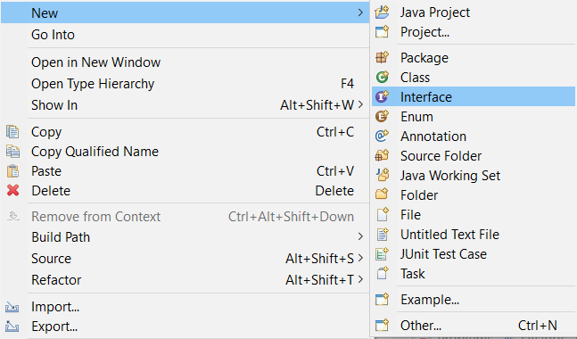
Creating an interface
Notice the semicolon.
This is a “declaration”, not a “definition” of a function.

Slide 14
To do:
1. Create an interface named “UppercaseFilter” that requires the following methods:
getInputString() – takes no arguments, returns a String
setInputString() – takes a String as an argument, returns nothing
getUppercaseLetters()- takes no arguments, returns a String
2. Create a class named AnUpperCaseFilter that:
Implements the interface
When you call getUppercaseLetters(), returns a string of the uppercase letters.
Methods print out statements when called (ex: “setInputString is called”)
Has the annotations required (placed above the class name)
3. Create a class named “Driver” with this code:
4. Run the Driver, and submit a screenshot on Sakai
Implementing the interface:
This will add the method headers for you
Code for scanning a string:

