Slide 1
Recitation 5
Composite Objects with Object Editor
With slides from Andrew Ghobrial

Slide 2
Composite objects and ObjectEditor
A composite object has properties that are objects (that is, non-primitive values)
In this recitation you will have an example of a composite object whose class is called AUniverse.
You will change the class of the composite object.
You will use ObjectEditor to view the changed and unchanged object.
The code can be found on the recitation page.

Slide 3
AUniverse
Class AUniverse is the class of the composite object which implements the interface Universe
To ensure that ObjectEditor can “see” the components of the composite object every component needs to be a property (i.e. it must have a getter, and potentially a setter).
The line object theLine and point object lineLocation: theLine takes lineLocation as its X and Y. As a result, every time you set a new value for lineLocation, theLine will also move.

Slide 4
AStringShape and AShapeImage
AStringShape and AShapeImage are objects that displays a string text and an image respectively.
Both of them have a String property called Text and ImageFileName, which represents the string text or the filename of the image, respectively. These two properties need to be initialized before the getters that access them are called. (Otherwise ObjectEditor cannot display them.)
The image file named by AShapeImage has to be located in the project folder, not in the package, not in the src folder.

Slide 5
Try these out
Modify the constants of AUniverse, use some different values to initialize the component objects.
Modify the constant that is being used in the constructor of AStringShape
Uncomment the annotation @Visible(false)
And import util.annotations.Visible;

Slide 6
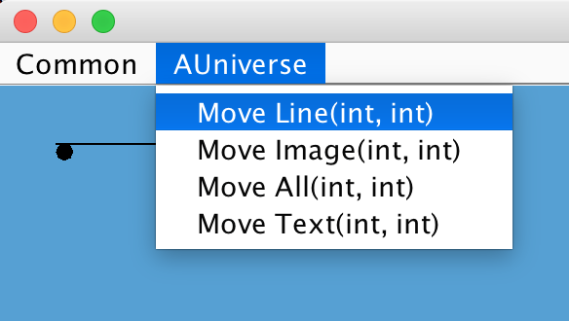
Use the tree view to observe the textual values of all components of the composite object and its (logical) structure.
Try changing the values in the tree view, and observe the effects in the graphics view.
When ObjectEditor is running, notice the menu bar, under the list AUniverse, you can
see a list of methods. They are
actually public methods in
AUniverse (except setters and
getters). Try to use these methods
to control these objects. You will need to use menu
in next assignment.

Slide 7
“Assignment”
Add a method to AUniverse that allows you to close the ObjectEditor from the menu
An easy way to do this is to utilize the System.exit(0) command
The Quiz assumes that you have finished this assignment before attempting to answer the questions
Try putting the annotation @Postion(0) above the close() method you created
Make sure you also add import util.annotations.Position;
(Or press ctrl+shift+o to automatically do it)

