Slide 1
How a Language-based GUI Generator Can Influence the Teaching of Object-Oriented Programming
Prasun Dewan
The University of North Carolina
(dewan@cs.unc.edu)

Slide 2
Why is Programming Exciting?
Abstractions
Interpreter not requiring any I/O
list
function
Lisp
Smalltalk
No interactive applications
inheritance
BlueJ
Dr. Java
Applications
Some l/O library
Console I/O
Android Toolkit
Library use takes class and student time
Swing
Beauty both in abstractions and applications

Slide 3
UI Implementation
Interactive Application
50%
Semantics
User
Interface
50%
Library
Toolkit
Console I/O
Myers ‘95
Sutton & Sprague ‘78

Slide 4
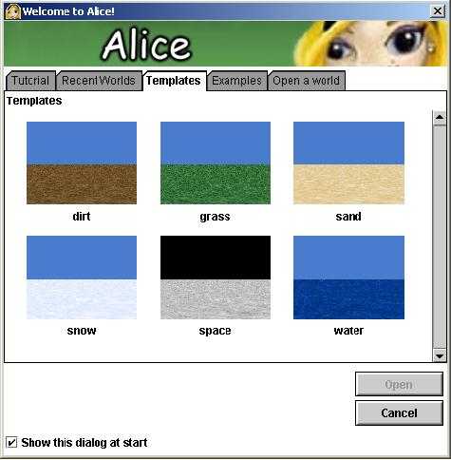
Plugging into Application Environment
Application Environment: An existing set of classes
Students plug-in their code into the application environment
Interactive primitives for using predefined classes
Compelling applications without I/O
Manipulating predefined classes motivates rather than teaches “serious” programming

Slide 5
UI Generation
Semantics
UI Specification
UI Generator
Toolkit
User Interface

Slide 6
Language-based UI Generation: ObjectEditor
(Java ) Encapsulated Model
Optional Specification
Students write entire model
ObjectEditor
Toolkit
View and controller automatically generated
View + Controller

Slide 7
Target Courses
CS 1
CS 2
Prereq: None
Prereq: Primitive Types, Array, Function, Conditional, Loops, I/O
Primitive Types, Array, Function, Conditional, Loops, I/O
How influenced by ObjectEditor?
Objects, Interfaces, Composition, Observer, Model View Controller, Animation
Inheritance, Delegation, Exceptions, Preconditions, Generics, Iterators, Command Objects, Undo/redo, Threads

Slide 8
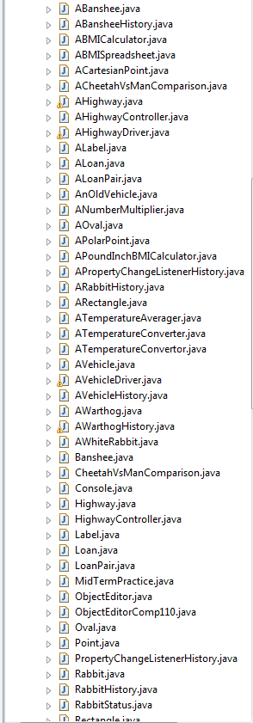
Example Student CS 1 Project
~ 25 Java classes and interfaces built from scratch!

Slide 9
~ 75 classes and interfaces from srcatch (after refactoring)
~ 40 command classes and interfaces from scratch (after refactoring)
Example Student CS 2 Project

Slide 10
My “much wimpier” Halloween project

Slide 11
First Program
public class ABMICalculator
{
public double calculateBMI(double weight, double height)
{
return weight/(height*height);
}
}
Function, as in functional programming
Embedded in model object
import bus.uigen.ObjectEditor
public class BMILauncher
{
public static void main (String[] args) {
ObjectEditor.edit(new ABMICalculator() );
}
}

Slide 12
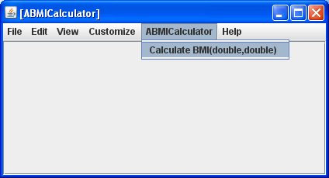
First Program
public class ABMICalculator
{
public double calculateBMI(double weight, double height)
{
return weight/(height*height);
}
}
Menu to invoke methods of instance
Menu item, Calculate BMI, beautified version of method name, calculateBMI()

Slide 13
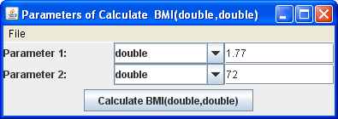
Interactive method invocation
Demystifies parameter passing, reducing to familiar form filling
Visualizes Polymorphism

Slide 14
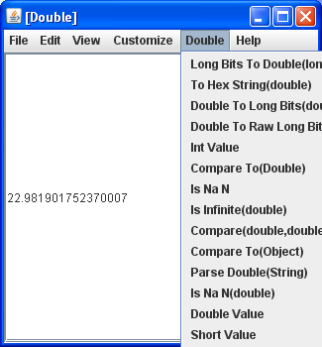
Method Return Value
Return value visualized like any other object
Can invoke any method on it

Slide 15
Main as Magic or Not
import bus.uigen.ObjectEditor
public class BMILauncher
{
public static void main (String[] args) {
ObjectEditor.edit(new ABMICalculator() );
}
}
Main as magic for Comp 1
import bus.uigen.ObjectEditor
public class Comp110ObjectEditor
{
public static void main (String[] args) {
ObjectEditor.edit(new ObjectEditor() );
}
}
Predefined main: Editing ObjectEditor

Slide 16
Running Predefined Main

Slide 17
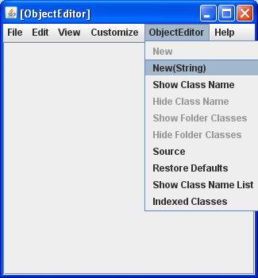
OE GUI

Slide 18
Interactive New Invocation
Invoking method instantiates class

Slide 19
OE Return Value
Returned instance visualized in ObjectEditor window

Slide 20
Meta Circular Editing
ObjectEditor.edit(
new ObjectEditor() );
ObjectEditor.edit(new ABMICalculator() );
Like Lisp, ObjectEditor bootstrapped using itself
Meta circular editing vs. interpretation

Slide 21
Where is the Editing?
GIUs are simply menus
No real editing so far

Slide 22
Stateless
public class ABMICalculator
{
public double calculateBMI(double weight, double height)
{
return weight/(height*height);
}
}

Slide 23
The Problem with Encapsulated State
(Java ) Encapsulated Model
Encapsulated model cannot define public variables
ObjectEditor
Private variables cannot be accessed by ObjectEditor
Toolkit
View + Controller
ObjectEditor assumes programming conventions

Slide 24
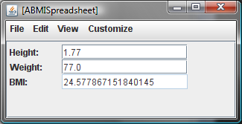
How to Extract State?
public class ABMISpreadsheet {
double height, weight;
public ABMISpreadsheet {}
public ABMISpreadsheet(double initHeight, double initWeight) {
height = initHeight;
weight = initWeight; }
public double getHeight() {
return height; }
public void setHeight(double newHeight) {
height = newHeight;}
public double getWeight() {
return weight;
}
public void setWeight(double newWeight) {
weight = newWeight;
}
public double getBMI() {
return weight/(height*height);
}
}
Bean pattern:
for humans and tools

Slide 25
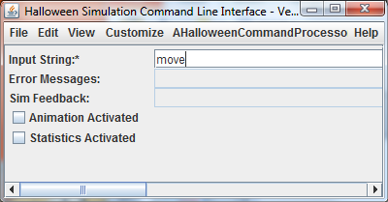
Bean Pattern in Examples

Slide 26
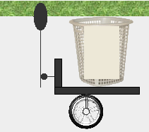
Graphics and Collections
Graphics
No existing conventions
for graphics and collections
Collections

Slide 27
Patterns for Graphics and Collections
@StructurePattern(StructurePatternNames.OVAL_PATTERN)
public interface Oval{
public int getX();
public void setX(int newVal);
public int getY();
public void setY(int newVal);
public int getWidth();
public void setWidth(int newVal);
public int getHeight() ;
public void setHeight(int newVal);
}
Allow error checking
Motivates annotations
@StructurePattern(StructurePatternNames.LIST_PATTERN)
public interface CandyList {
public int size();
public Candy get(int i);
public Candy pop();
public void push(Candy newVal);
}

Slide 28
Programmer-Defined Composable Structure Types
Conventional Languages
Record
Array
Sequence
Table
Composable constructors
O-O Languages
Objects with private instance variables
Physical Structure
Record
Array
Sequence
Table
Composable Conventions

Slide 29
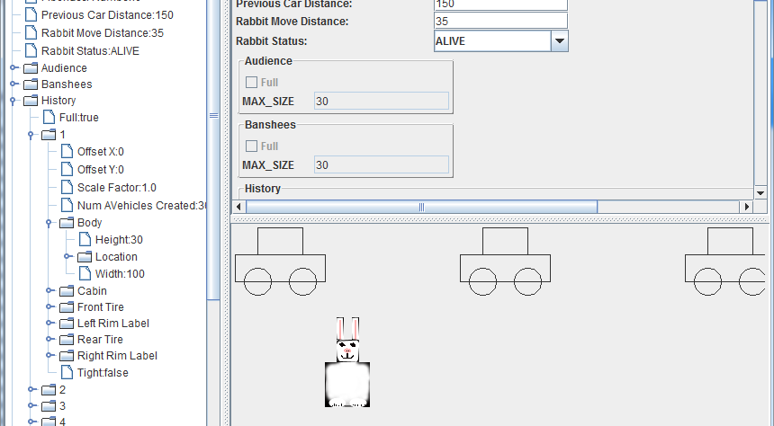
Logical Structure
Tree view shows logical structure distinct from physical structure

Slide 30
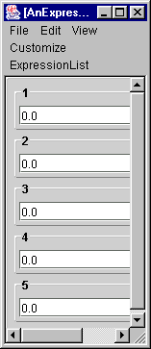
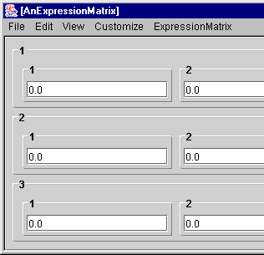
Incremental Structure Creation and Visualization: Cumulative Assignments
Candy
Candy List in Container
Candy List in Container
Halloween Simulation
Expression
Expression List
Expression Matrix
Spreadsheet

Slide 31
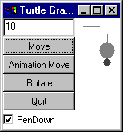
Models vs. Spaghetti Code
(Java ) Encapsulated Model
Edited objects are models with replacable views and controllers
No spaghetti code!
ObjectEditor View + Controller
Manual View + Controller
CS 1 Project: Replace OE View/Controller with Student Versions

Slide 32
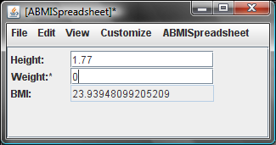
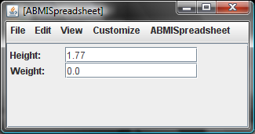
Hiding Invalid Items

Slide 33
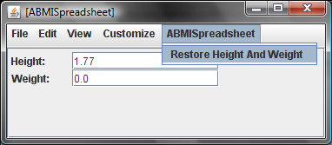
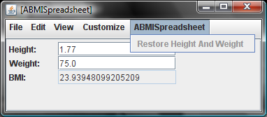
Hiding Invalid Items

Slide 34
Getter Preconditions and Pattern
public boolean preGetBMI() {
return weight > 0 && height > 0;
}
public double getBMI() {
assert preGetBMI();
return weight/(height*height);
}
Precondition of method M() is preM()
ObjectEditor does not allow M() to be called if preM() is false.
public boolean preRestoreHeightAndWeight() {
return height != initialHeight || weight != initialWeight;
}
public void restoreHeightAndWeight() {
assert preRestoreHeightAndWeight();
height = initialHeight;
weight = initialWeight;
}

Slide 35
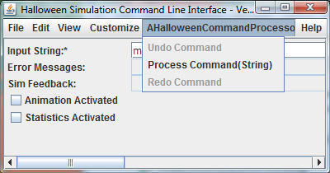
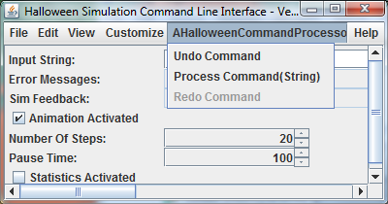
Preconditions in Example
Data type behind spinners?

Slide 36
Encouraging Subranges
@MinValue(1)
@MaxValue(500)
public int getNumberOfSteps()
{
assert preGetNumberOfSteps();
return numberOfSteps;
}
ObjectEditor supports and encourages students to use subranges rather than full ints
The user-interface makes it clear if students have used subranges

Slide 37
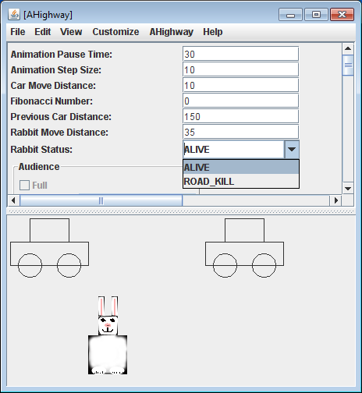
Named Spinner
Data type behind naming spinner?

Slide 38
Encouraging Enums
public enum RabbitStatus {
ALIVE,
ROAD_KILL
}
ObjectEditor encourages students to use enums rather than ints
The user-interface makes it clear if students have used enums

Slide 39
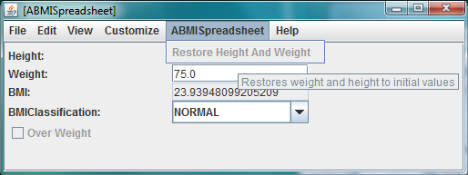
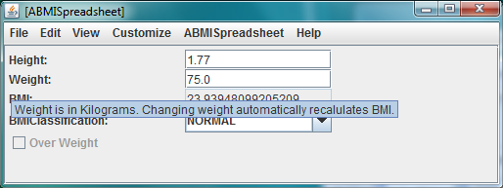
ToolTip
Menu
tooltip?
Property
tooltip?

Slide 40
Encouraging Documentation
Method explanation?
@Explanation("Weight is in Kilograms. ")
public double getWeight() {
return weight;
}
@Explanation("Restores weight and height to initial values")
public void restoreHeightAndWeight() {
assert preRestoreHeightAndWeight();
height = initialHeight;
weight = initialWeight;
}
Method explanation?

Slide 41
Conclusion
 | Interpreter | I/O Library | Application environment | UI Generator
Concept/ Work | High | Medium or Low | High | High
Range of Concepts | High | High | Low | High
Range of Applications | Low | High | High | High
Concept Understand-ability | Meta circularity: Interpreter interprets itself |  | Class instantiation and method invocation | Meta circularity, Class instantiation and method invocation, MVC, Preconditions, Polymorphism, Composite objects, Programming conventions, Annotations, Subranges, Enums

Slide 42
Future Work
Better loading time
Better error detection and recovery
3-D Graphics
More testing to uncover bugs

Slide 43
Summary
Abstractions
It is possible to teach certain concepts more effectively
list
function
Separation of model from view and controller
inheritance
Preconditions
Applications
Polymorphism
Composite objects
Programming conventions
Annotations
Meta circularity

Slide 44
Rest are Extra Slides

Slide 45
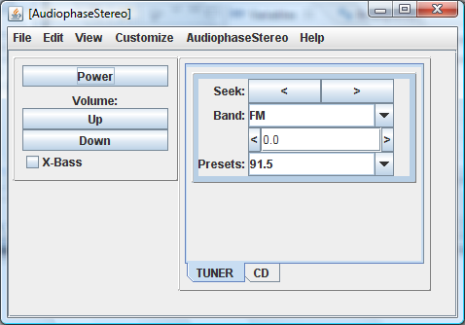
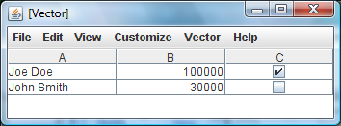
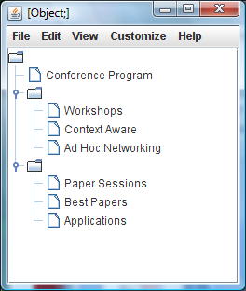
Semi-Automatic Generation
Focus on programming and not ObjectEditor
No more time spent on OE in semester course than was done here

Slide 46
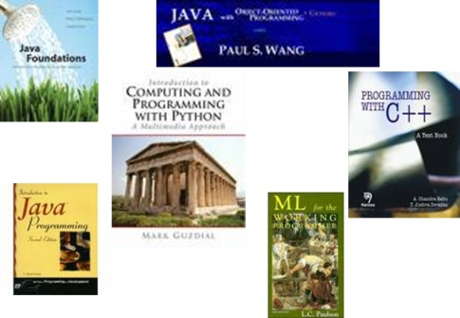
The Problem
Teaching programming is difficult
Paradox
Programming is exciting
Any computer scientist should be able to teach it
CS field with probably largest number of books
Yet few CS professors volunteer to teach programming

Slide 47
OE GUI vs. App-Object GUI
Same mechanism used to create both kinds of GUIs

Slide 48
Interactive New vs. App-Method Invocation
Invoking method instantiates class

Slide 49
OE vs. App-Object Method Return Value
Returned instance visualized in ObjectEditor window
Like Lisp, ObjectEditor bootstrapped using itself
Meta circular editing

Slide 50
Replacing ObjectEditor
ObjectEditor View and Controller
Manual View and Controller
Edited Objects are models

Slide 51
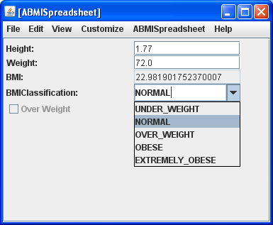
Fully Automatic Generation
Each property mapped to a widget based on its type
Strings and numbers to text components
Booleans to checkboxes.
Enums to combo-boxes

Slide 52
Named Spinner
Data type behind spinner?

Slide 53
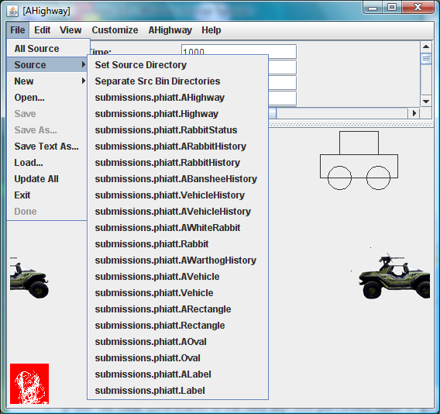
Combined Abstraction and Application View Point
19 classes/ interfaces built from scratch

Slide 54
Highlight
Recursive descent
1
2
Recursive descent
Recursive descent
Recursive descent

Slide 55
Bean Programming Pattern
Property: Typed, Named Unit of Exported Object State
public class C
{
Name P
Type T
public T getP() {
...
}
Read-only
Editable
public void setP(T newValue) {
...
}
Relationship among method signatures allowing extracting of object semantics.
}
obtainP()

Slide 56
Patterns for Variable-Sized Collection
Write methods (optional)
public interface C{
public void addElement (T t);
public T elementAt (int index);
public int size();
public Any setElementAt(T t, int index);
public Any removeElementAt(int index);
public Any removeElementAt(T t);
…
}
Arbitrary Type.
Read methods
Pattern based on Vector
Unconstrained Type (void or T in practice)
Another Pattern based on List

Slide 57
Why is Programming Exciting?
Abstractions
Interpreter not requiring any I/O
Students cannot create interactive applications
list
function
Lisp
Smalltalk
inheritance
BlueJ
Dr. Java
Applications
Some (generic/specific) l/O library
Library taught as magic
Traditional I/O
Android Toolkit
Library use takes class and student time
Swing

Slide 58
ObjectEditor Shape Pattern
@StructurePattern(StructurePatternNames.LINE_PATTERN)
public interface Line {
public int getX();
public void setX(int newVal);
public int getY();
public void setY(int newVal);
public int getWidth();
public void setWidth(int newVal);
public int getHeight() ;
public void setHeight(int newVal);
}
Shape patterns built on top of Bean pattern
A line/rectangle/textbox/label must have properties describing its bounding box (X, Y, Width, Height) (plus several optional properties.)
An optional annotation explicitly indicates kind of shape.
Name of type used if annotation missing.

Slide 59
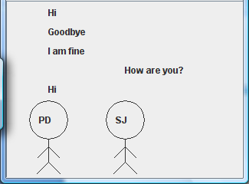
Graphics or Variable-Size Collections
Really complex constraints and object composition
Visualization

Slide 60
Graphics or Variable-Size Collections
Really complex constraints and object composition
Visualization

Slide 61
ObjectEditor Shape Pattern
@StructurePattern(StructurePatternNames.LINE_PATTERN)
public interface Line {
public int getX();
public void setX(int newVal);
public int getY();
public void setY(int newVal);
public int getWidth();
public void setWidth(int newVal);
public int getHeight() ;
public void setHeight(int newVal);
}
Shape patterns built on top of Bean pattern
A line/rectangle/textbox/label must have properties describing its bounding box (X, Y, Width, Height) (plus several optional properties.)
An optional annotation explicitly indicates kind of shape.
Name of type used if annotation missing.

Slide 62
Named Spinner
Data type behind spinner?

Slide 63
Encouraging Enums
public enum BMIClassification {
UNDER_WEIGHT,
NORMAL,
OVER_WEIGHT,
OBESE,
EXTREMELY_OBESE
}
public BMIClassification getBMIClassification() {…}
ObjectEditor encourages students to use enums rather than ints
The user-interface makes it clear if students have used enums

Slide 64
ObjectEditor
(Java ) Encapsulated Model
Optional Specification
It is possible to teach certain concepts more effectively
No I/O Required
Separation of model from view and controller
Library
ObjectEditor
No special language or application/ programming environment
Preconditions
Polymorphism
Toolkit
Composite objects
Programming conventions
Entire model created by student
View + Controller
Annotations
View and controller generated from model
Meta circularity

Slide 65
Separation of model from view and controller

Slide 66
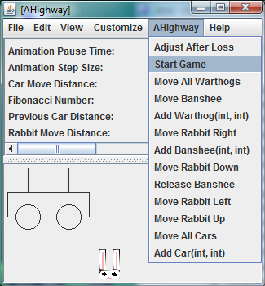
Method Invocation in Example
Class Name
Method Name

Slide 67
Patterns for Variable-Sized Collection
Write methods (optional)
@StructurePattern(StructurePatternNames.LIST_PATTERN)
public interface C {
public void add (T t);
public T get (int index);
public int size();
public Any set (int index) T 2);
public Any remove(int index);
public Any remove(T t);
…
}
Arbitrary Type.
Read methods
Pattern based on List
Unconstrained Type (void or T in practice)
Another Pattern based on List

Slide 68
A Tale of Two Courses: Abstractions
CS 1
CS 2
Prereq: None
Prereq: Primitive Types, Array, Function, Conditional, Loops, I/O
Primitive Types, Array, Function, Conditional, Loops, I/O
Serious Programming!
Objects, Interfaces, Composition, Observer, Model View Controller
Inheritance, Delegation, Exceptions, Preconditions, Generics, Iterators, Command Objects, Undo/redo, Threads

Slide 69
The Problem with Encapsulated State
(Java ) Encapsulated Model
Encapsulated model cannot define public variables
ObjectEditor
Private variables cannot be accessed by ObjectEditor
Toolkit
Application-specific view and controllers can interpret methods of application-specific model to extract & change state
View + Controller
ObjectEditor assumes programing conventions

Slide 70
Traditional Constructors vs. Patterns
Conventional Language
Object-Oriented Language
Record
Bean
Variable Length Sequence
List Pattern
Table
Table Pattern

Slide 71
The Problem
Teaching programming is difficult.
Teaching object-oriented programming is particularly difficult.
Benefits of O-O programming occur only in large projects.
Programming is exciting
Any computer scientist should be able to teach it
CS field with probably largest number of books
Yet few CS professors volunteer to teach programming

Slide 72
Bean Pattern in Examples
Bean = Programmer-Defined Records

Slide 73
Why is Programming Exciting?
Abstractions
Interpreter not requiring any I/O
list
function
Lisp
Smalltalk
No interactive applications
inheritance
BlueJ
Dr. Java
Applications
Some l/O library
Library taught as magic
Console I/O
Android Toolkit
Library use takes class and student time
Swing
Beauty both in abstractions and applications

