Slide 1
Increasing the Automation of a Toolkit without Reducing its Abstraction and User-Interface Flexibility
Prasun Dewan
University of North Carolina

Slide 2
GUI Implementation
Interactive Application
Semantics
50%
User Interface
50%
Library
Toolkit
I/O Routines
Myers ‘95
Sutton & Sprague ‘78

Slide 3
Model-based Systems
Data Type
Record
Enum
Model
Automatic creation of widget
Automatic widget update
Model-based Tool
Toolkit
Automatic data update
User Interface
Form
Menu
Widget

Slide 4
Limitations: Encapsulated Model
Data Type
Encapsulated Model
Record
Enum
Automatic creation of widget
Automatic widget update
Model-based Tool
Toolkit
Automatic data update
User Interface
Form
Menu
Widget

Slide 5
“Solution 1”: Predefined Interfaces
Data Type
Tool-defined interfaces (JTable, Jtree)
Record
Enum
Encapsulation with no programmer-defined types
Automatic creation of widget
Automatic widget update
Model-based Tool
Low abstraction flexibility
Toolkit
Automatic data update
User Interface
Form
Menu
Widget

Slide 6
“Solution 2”: Public Variables
Data Type
Engelson et al ‘96
Model with public variables
Record
Enum
Programmer-defined types with no encapsulation
Automatic creation of widget
Automatic widget update
Model-based Tool
Low abstraction flexibility
Toolkit
Automatic data update
User Interface
Form
Menu
Widget

Slide 7
“Solution 3”: Manual Mapping
Data Type
Developer Provided External Structure
Encapsulated Model
Record
Enum
Automatic creation of widget
Hodes & Katz ‘01
Nicholas, Myers, Rothtrock ‘06
Ponnekanti, Lee, Fox, Hanrahan, et al ‘01
Automatic widget update
Model-based Tool
Gajos et al ‘05
Toolkit
Automatic data update
Tedious/error prone, special language
Only one-level structure currently
User Interface
Form
Menu
Widget

Slide 8
Our Solution : Automatic Mapping
Data Type
Encapsulated Model
Record
Enum
Automatic creation of widget
Automatic widget update
Model-based Tool
Toolkit
Automatic data update
User Interface
Form
Menu
Widget

Slide 9
Limitation: Lack of UI Flexibility
Data Type
Record
Enum
Model
Automatic creation of widget
Automatic widget update
Model-based Tool
Toolkit
Automatic data update
Uniformity!
Highly Customized User Interface
Form
Menu
Widget

Slide 10
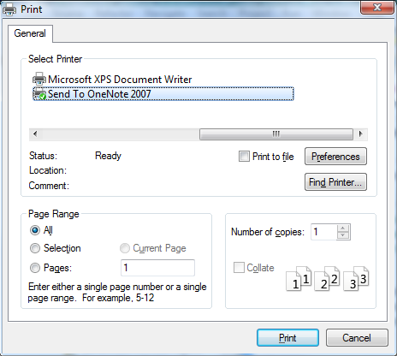
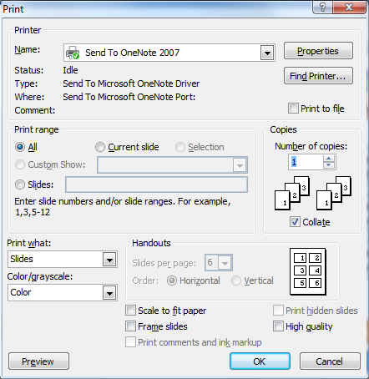
The Case Against Uniformity
PPT Print Dialog
Eclipse Print Dialog
Grudin ‘89

Slide 11
“Solution” 1: High Parameterization
Data Type
Developer Provided Parameters
Record
Enum
Model
Automatic creation of widget
Highly Parameterized Model-based Tool
Automatic widget update
Demo ”The flexibility of widget generation” addresses this approach
Toolkit
Automatic data update
Highly Customized User Interface
Form
Menu
Widget

Slide 12
Our Solution : Appearance Independent Automation
Developer Provided Widget Structure
Data Type
Record
Enum
Model
Automatic creation of widget
Highly Parameterized Model-based Tool
Automatic widget update
Other opportunities for automation?
Toolkit
Automatic data update
Highly Customized User Interface
Form
Menu
Widget

Slide 13
Goals: High Abstraction/UI Flexibility
Data Type
Automatically map encapsulated models to conventional data types
Encapsulated Model
Record
Enum
Automatic creation of widget
Automation of features that show little variability
Automatic widget update
Model-based Tool
Automation independent of UI appearance
Toolkit
Automatic data update
Highly Customized User Interface
Form
Menu
Widget

Slide 14
Encapsulated Object
public class ABMISpreadsheet {
double height, weight;
DynamicEnum name;
public double getHeight() {return height; }
public void setHeight(double newHeight) {height = newHeight;}
public double getWeight() {return weight; }
public void setWeight(double newWeight) {weight = newWeight;}
public double getBMI() {return weight/(height*height); }
public DynamicEnum getName() { return name;}
public void setName(DynamicEnum newVal) {name = newName;}
}
Record data type
Conventions for code understandability

Slide 15
Bean Programming Pattern
Property: Typed, Named Unit of Exported Object State
public class C
{
Name <P>
Type <T>
public <T> get<P>() {
...
}
Read-only
Editable
public void set<P>(<T> newValue) {
...
}
Relationship among method signatures allowing extraction of object semantics.
}
Prolog-like Unification
obtainP()
Design pattern

Slide 16
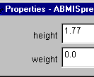
BeanBox “UI Generation”
public class ABMISpreadsheet {
double height, weight;
DynamicEnum name;
public double getHeight() {return height; }
public void setHeight(double newHeight) {height = newHeight;}
public double getWeight() {return weight; }
public void setWeight(double newWeight) {weight = newWeight;}
public double getBMI() {return weight/(height*height); }
public DynamicEnum getName() { return name;}
public void setName(DynamicEnum newVal) {name = newName;}
}
BMI readonly property not displayed
Name programmer-defined properties not displayed
Bean patterns map to records
BeanBox is not a user-interface tool!
Patterns for other types?

Slide 17
Example
public interface BMIList {
int size();
BMISpreadsheet bmiSpreadsheetAt(int index);
void insertBMISpreadsheetAt(BMISpreadsheet newElement, int index);
void removeBMISpreadsheetAt(int index) ;
}
List data type

Slide 18
Patterns for Variable-Sized Collection
An optional annotation explicitly indicates kind of pattern
Write methods (optional)
@StructurePattern(StructurePatternNames.VECTOR_PATTERN)
public interface C{
  public void add<E> (<T> t);
  public <T> <E>At (int index);
  public int size();
  public Any set<E>At(<T> t, int index);
  public Any remove<E>At(int index);
  public Any remove<E>At(<T> t);
  …
}
Arbitrary Element Designation
Arbitrary Type.
Read methods
Pattern based on Vector
Unconstrained Type (void or T in practice)

Slide 19
Shape Pattern
@StructurePattern(StructurePatternNames.LINE_PATTERN)
public interface Line {
public int getX();
public void setX(int newVal);
public int getY();
public void setY(int newVal);
public int getWidth();
public void setWidth(int newVal);
public int getHeight() ;
public void setHeight(int newVal);
}
Shape patterns built on top of Bean pattern.
A line/rectangle/textbox/label must have properties describing its bounding box (X, Y, Width, Height) (plus several optional properties.)
An optional annotation explicitly indicates kind of shape.
Name of type used if annotation missing.

Slide 20
Dynamically Registered Mapper Classes
Encapsulated Model
Vector Mapper
List Mapper
Bean Mapper
List Type Interface
Model-based Tool
Toolkit
Record Type Interface
New mapper classes created when patterns change
Line Type Interface
User Interface
Enum Type Interface

Slide 21
Goal 1: Automatic Mapping
Data Type
✓
Dynamically Registered , Pattern-Specific Mappers
Encapsulated Model
Record
Enum
Automatic creation of widget
Automatic widget update
Model-based Tool
Toolkit
Automatic data update
User Interface
Form
Menu
Widget

Slide 22
Goal 2: Appearance Independent Automation
Data Type
Developer Provided Widget Structure
Record
Enum
Model
Automatic creation of widget
Highly Parameterized Model-based Tool
Automatic widget update
Other opportunities for automation?
Toolkit
Automatic data update
Highly Customized User Interface
Form
Menu
Widget

Slide 23
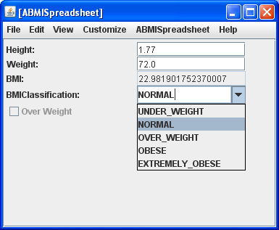
Appearance-Dependent Automation
ObjectEditor.edit(bmiSpreadsheet)

Slide 24
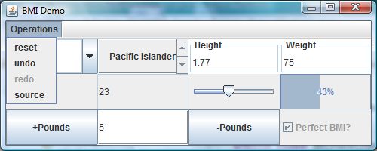
Manual Step: Create the Widget Structure
Syntactic Sugar Widgets
Control Widgets
Parameter State Widgets
Model State Widgets
State Widgets

Slide 25
Binding Methods to Control Widgets
Component[] parameterComponents =
{incrementTextField};
ObjectEditor.bind(bmiSpreadsheet, “subtractPounds”, decreaseWeightButton, parameterComponents);
Control Widget
Parameter State Widget
Method Designation

Slide 26
Atomic Model State Binding
ObjectEditor.bind(bmiSpreadsheet, “name”, nameComboBox);
Atomic model component
Atomic state widgets

Slide 27
Composite Binding
bind (bmiList, jTable)
Composite Model
Composite Widget

Slide 28
Goal 2: Appearance Independent Automation
✓
Data Type
Developer Provided Widget Structure
Record
Enum
Model
Automatic creation of widget
Highly Parameterized Model-based Tool
Automatic widget update
Other opportunities for automation?
Toolkit
Automatic data update
Semantic validation of user input
Highly Customized User Interface
Form
Menu
Widget

Slide 29
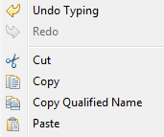
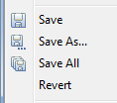
Other Opportunities for Automation
Dynamically change enable, editable, hidden status of widgets
Undo/redo arbitrary command
Copy/cut/delete/paste arbitrary object
Save/load arbitrary object
“Luxuries” that typically get added late
Appearance independent?

Slide 30

Appearance Independent?

Slide 31
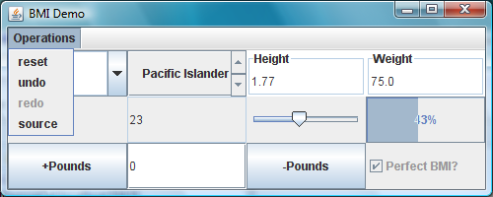
Appearance Independent
✓
Developer provides the control and state widgets to invoke the operations
Tool provides predefined models implementing these operations
Developer binds widgets to model operations
✓
ObjectEditor.bindToUndo(undoMenuItem);

Slide 32
Key: Programming Patterns
Input validation
Precondition patterns
Dynamically change enable, editable, hidden status of widgets
Undo patterns
Undo/redo arbitrary command
Data type patterns
/Copy/cut/delete/paste arbitrary object
Save/load arbitrary object

Slide 33
Undo/Redo Automation
Undo
(Hierarchical) Command Object
Execute
(Hierarchical) Command Object
(Hierarchical) Command Object
(Hierarchical) Command Object
(Hierarchical) Command Object
(Hierarchical) command objects undo/redo (sequence of) commands
Application dependent
History objects that manipulates command objects in response to command creation, undo and redo
Application independent

Slide 34
Set-Last Example
public void setCell(int row, int col, double newVal) {
matrix [row, col] = newVal;
}
public double getCell(int row, int col) {
return matrix [row, col];
}

Slide 35
Set-Last Pattern and Command Creator
<AnyType> set<S>(<T₁> p₁, … <T_{N}> p_{N}, <T> newVal)
<T> get<S>(<T₁> p₁, <T₂> p₂, … <T_{N}> p_{N})
Command object creation
1. store set<S>, p₁ .. p_{N}, newVal
2. oldVal ← <T> get<S>(<T₁> p₁, <T₂> p₂, … <T_{N}> p_{N}
Command object execution
set<S>(<T₁> p₁, … <T_{N}> p_{N}, <T> newVal)
Command object undo
set<S>(<T₁> p₁, … <T_{N}> p_{N}, <T> oldVal)

Slide 36
Set-First Example and Pattern
public void setCell(double newVal, int row, int col) {
matrix [row, col] = newVal;
}
public double getCell(int row, int col) {
return matrix [row, col];
}
<AnyType> set<S>(<T> newVal, <T₁> p₁, … <T_{N}> p_{N})
<T> get<S>(<T₁> p₁, <T₂> p₂, … <T_{N}> p_{N})

Slide 37
Inverse Examples and Pattern
public void add(int amount) { …}
public double subtract(int amount ) {…}
public void on() { …}
public double off(){…}
<AnyType> <W>( <T₁> p₁, … <T_{N}> p_{N})
<AnyType> <W Antonym>(<T₁> p₁, … <T_{N}> p_{N})

Slide 38
Add-First Examples and Pattern
public void insertCellAt(double newVal, int row, int col) {…}
public double removeCellAt(int row, int col) { …}
public void push(double newVal) {…}
public double pop(int row, int col) { …}
<AnyType> <W>(<T> newVal, <T₁> p₁, … <T_{N}> p_{N})
<T> <W Antonym>(<T₁> p₁, … <T_{N}> p_{N})

Slide 39
Add-Last Examples and Pattern
public void insertCellAt(int row, int col, double newVal) {…}
public double removeCellAt(int row, int col) { …}
<AnyType> <W>(<S<T₁> p₁, … <T_{N}> p_{N,}, <T> newVal)
<T> <W Antonym><S>(<T₁> p₁, <T₂> p₂, … <T_{N}> p_{N})

Slide 40
Pattern-Based Command Creator Classes
Method invocation
Set-Last Creator
Inverse Creator
Add-First Creator
Command Object

Slide 41
Goal 2: Appearance Independent Automation
✓
Data Type
Developer Provided Widget Structure
Record
Enum
Model
Automatic creation of widget
✓
Highly Parameterized Model-based Tool
Automatic widget update
Other opportunities for automation
Toolkit
Automatic data update
Highly Customized User Interface
Form
Menu
Widget

Slide 42
Evaluation of Significance
Ease of following data type patterns
  3 offerings of CS 1, CS 2, CSCW courses
    Trouble with models rather than patterns
    Annotations added since paper was written to address pattern problems
  Several research projects
    100 models
    MSFT TechFest demo would not have occurred without it
Precondition patterns
  Motivated programmers to use assertions.
Undo patterns
  Java.util classes with no known false positives and negatives
Mapper Classes
  Dynamically added 1.4 List, Map patterns by easily extending Vector, Hashtable patterns
Binding widgets
  Recently put, only author has tried it
  Prefers automatic generation

Slide 43
Summary/Conclusions
From Beans → Programming Patterns
Specific patterns
  Record, List, Line, SetFirst, SetLast, AddFirst, Add Last Inverse, and Others
Appearance-independent automation
  Tool-supported binding to programmer-defined widgets
  Undo, semantic validation, automatic widget status change, cut, copy, paste, delete, save, load
Preliminary evaluation

Slide 44
Future Work
More appearance-independent automation
More extensive evaluation
Tool architecture

Slide 45
Thank You

Slide 46
Rest are Extra Slides

Slide 47

Additional Boolean and Enum Properties
public boolean getOverWeight() {…}
public BMIClassification getBMIClassification() {…}
package examples.objects;
public enum BMIClassification {
    UNDER_WEIGHT,
    NORMAL,
    OVER_WEIGHT,
    OBESE,
    EXTREMELY_OBESE
}

Slide 48
Type→Widget Mapping
Each property mapped to a widget based on its type.
Strings and numbers to text components.
Booleans to checkboxes.
Enums to combo-boxes

Slide 49
Graphics
Rectangle
Line
Oval
Textbox
Label
Eiffel
hello

Slide 50
Preconditions
public boolean preGetBMI() {
return weight > 0 && height > 0;
}
public double getBMI() {
assert (preGetBMI());
return weight/(height*height);
}
Precondition of method M()
boolean preM()

Slide 51
Preconditions of Non Getters/Setters
public boolean preRestoreHeightAndWeight() {
return height != initialHeight || weight != initialWeight; }
public void restoreHeightAndWeight() {
assert preRestoreHeightAndWeight();
height = initialHeight;
weight = initialWeight;
}

Slide 52
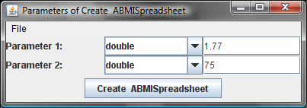
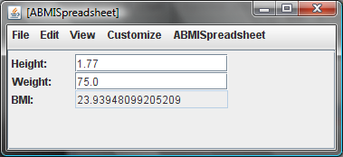
ObjectEditor Uses Preconditions

Slide 53
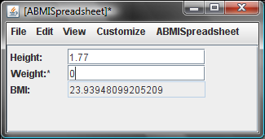
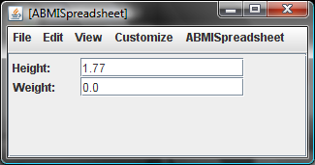
ObjectEditor Uses Preconditions

Slide 54
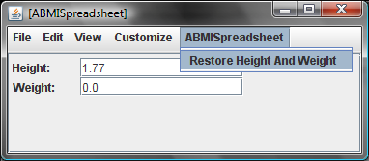
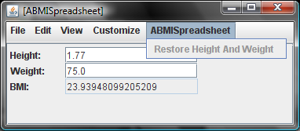
ObjectEditor Uses Precondition
The menu item for a method is disabled when its precondition not met

Slide 55
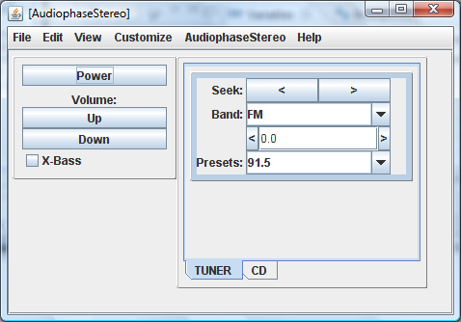
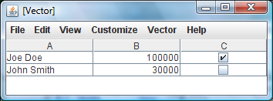
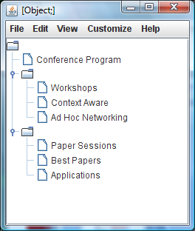
Some Ignored Aspects of ObjectEditor
Focus on programming and not ObjectEditor
No more time spent on OE in semester course than was done here.

Slide 56
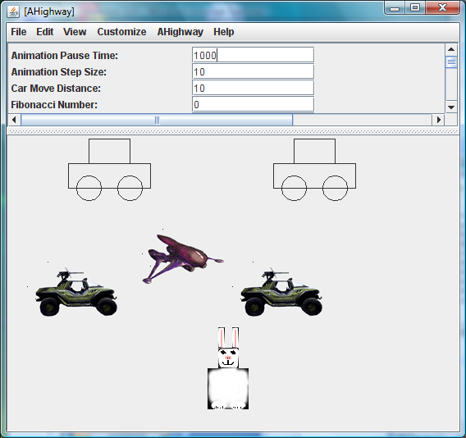
CS 110 (Non-Programmers) Project

Slide 57
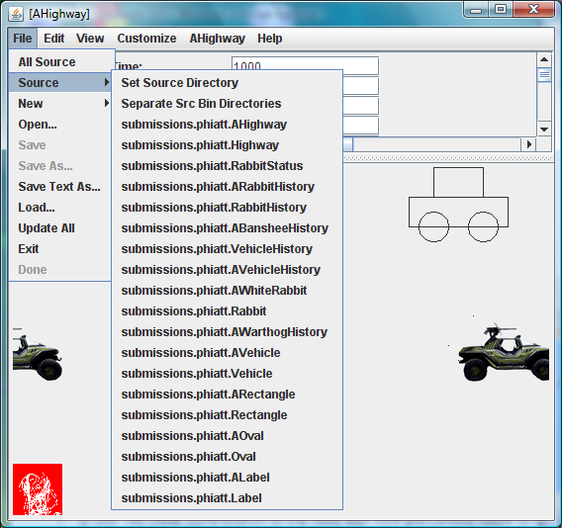
CS 110 (Non-Programmers) Project

Slide 58
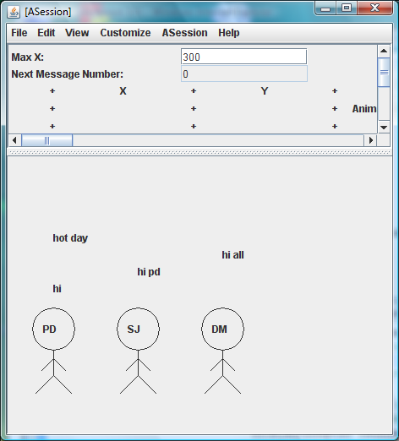
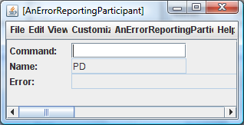
CS 401(HS-Programmers) Project

Slide 59
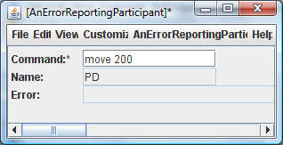
CS 401(HS-Programmers) Project

Slide 60
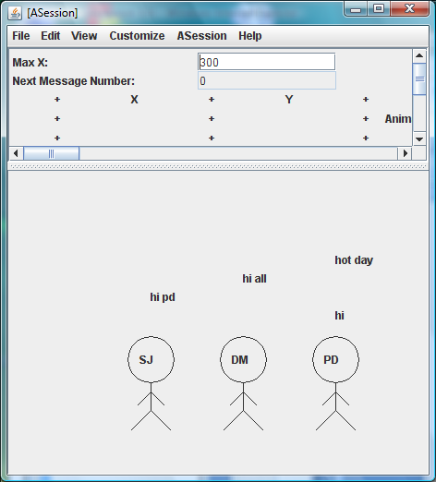
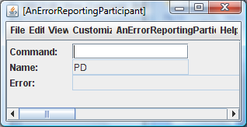
CS 401(HS-Programmers) Project

Slide 61
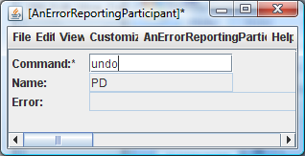
CS 401(HS-Programmers) Project

Slide 62
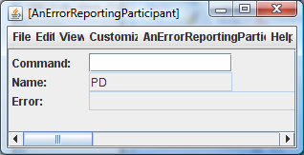
CS 401(HS-Programmers) Project

Slide 63
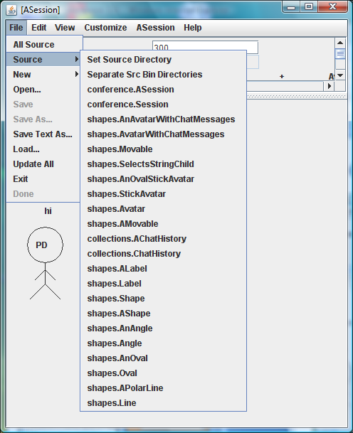
CS 401(HS-Programmers) Project
Several additional Internal classes (Scanner, parser, undoer, …)

Slide 64
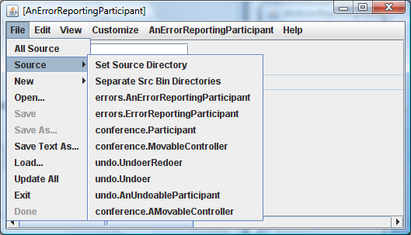
CS 401(HS-Programmers) Project
Several more classes that are not displayed in the UI (Scanner/Parser)
Several alternatives tried (e.g. delegating vs. inheriting scanner)

Slide 65
Monolithic Number Scanner
Thus, if the argument is:
“2 3 100 “
The output should be of the form:
Numbers: 2 3 100 Sum: 105 Product: 600

Slide 66
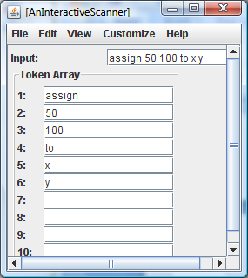
Number and Word Scanner Object
Iterator Interface

Slide 67
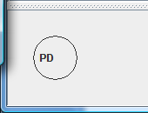
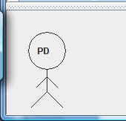
Two Movable Avatars
Structured Object
Multiple Representations
Constraints

Slide 68
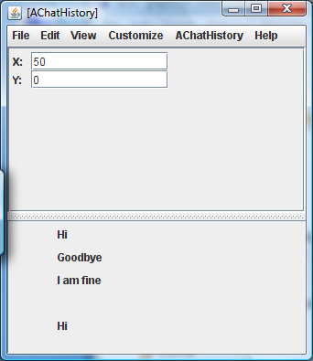
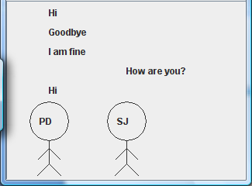
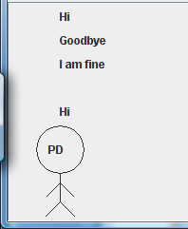
Variable-Size Collections
Really complex constraints and object composition
Visualization

Slide 69
Inheritance
Token and Shape Hierarchies

Slide 70
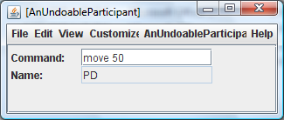
Parsing and More Object Composition
Abstract classes
Observable to avoid refresh
Replace inheritance with delegation
Exception handling, undo and assertions

Slide 71
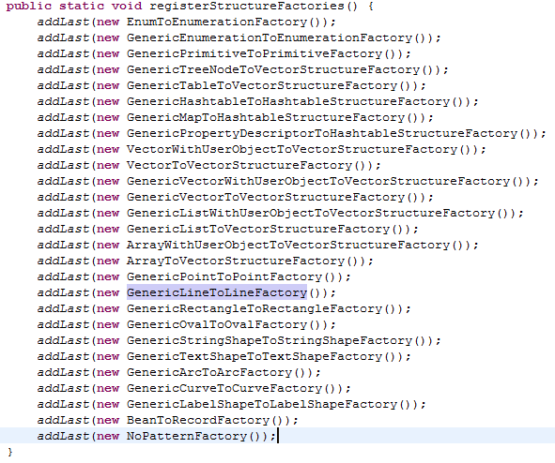
Dynamic Registration

Slide 72
Record Interface
public interface ConcreteRecord {
Vector fieldNames();
Class fieldType (String fieldName);
Object get (String fieldName);
Object set (String fieldName, Object value);
boolean isReadOnly (String fieldName);
boolean preRead (String fieldName);
boolean preWrite (String fieldName);
boolean validate (String fieldName, Object value);
}

