Slide 1
Operating System
The OS is JUST A PROGRAM
  but it runs in SUPERVISOR state
    access to PHYSICAL addresses
    access to special registers (like page table register)
    all IO devices, etc.
  whereas ordinary programs run in USER state
    only access to VIRTUAL addresses through page tables
    normally no access to IO devices
Programs ask the OS for services (syscall)
  give me more memory
  read/write data from/to disk
  put pixel on screen
  give me the next character from the keyboard

Slide 2
OS Execution
The OS keeps a PROCESS TABLE of all running programs
  disk location of executable
  memory location of page tables
  priority
  current status (running, waiting ready, waiting on an event, etc.)
  PID (process ID) a number assigned to the process
A PROCESS is an independent program running in its own memory space
The OS allocates a new entry in the PROCESS TABLE
And sets up the PAGE TABLE for the new process

Slide 3
Initial Page Table
memory
page table
0x00000000 | 0 | text segment
0x00001000 | 0 | text segment
0x00002000 | 1 | data segment
0x00003000
0x00004000
0x00005000
0xffffe000
0xfffff000 | 1 | stack
disk
foo
swap
foo

Slide 4
Program Startup
Now everything is ready
  The PROCESS TABLE entry has been set up
  The PAGE TABLE for the process has been initialized
  The TEXT SEGMENT is out on disk
  The DATA SEGMENT is in memory
  The STACK SEGMENT has been allocated 1 PAGE
The OS is ready to take the leap of faith
ONLY ONE program runs at a time
When your program is running the OS is not
To run your program and maintain control the OS must trust that is will eventually get control again
  when the program asks for a service
  when the program does something illegal
  when a timer goes off

Slide 5
Page Fault in the Text
When we branch to the beginning of “main” we get a page fault
So the OS copies the first page of the TEXT of main to a free page in memory

Slide 6
Page Fault in the Text
memory
page table
0x00000000 | 1 | text segment
0x00001000 | 0 | text segment
0x00002000 | 1 | data segment
0x00003000
0x00004000
0x00005000
0xffffe000
0xfffff000 | 1 | stack
disk
foo
swap
foo

Slide 7
Allocate a block of memory
Now suppose the first thing our program needs to do is get 6k of memory for an array
The program uses “new” to make an array
Down inside “new” it calls “malloc”
Down inside “malloc” it uses a system call to ask the OS for memory
The OS will have to find 2 pages to hold 6k

Slide 8
Allocate a block of memory
page table
0x00000000 | 1 | text segment
0x00001000 | 0 | text segment
0x00002000 | 1 | data segment
0x00003000 | 1 | heap
0x00004000 | 1 | heap
0x00005000
0xffffe000
0xfffff000 | 1 | stack
disk
foo
swap
foo

Slide 9
Fault in the other page of TEXT
memory
page table
0x00000000 | 1 | text segment
0x00001000 | 1 | text segment
0x00002000 | 1 | data segment
0x00003000 | 1 | heap
0x00004000 | 1 | heap
0x00005000
0xffffe000
0xfffff000 | 1 | stack
disk
foo
swap
foo

Slide 10
Grow the stack
Now our program needs more stack space
Perhaps it has to call a recursive function to traverse a complex data structure
Or perhaps the user declares an “automatic” array like
double work[1000];
which needs 8000 bytes of memory

Slide 11
Grow the stack
memory
page table
0x00000000 | 1 | text segment
0x00001000 | 1 | text segment
0x00002000 | 1 | data segment
0x00003000 | 1 | heap
0x00004000 | 1 | heap
0x00005000
...
0xffffd000 | 1
0xffffe000 | 1
0xfffff000 | 1 | stack
disk
foo
swap
foo

Slide 12
Get partially paged out
Sometime later, some other program running on the system needs more memory
It asks the OS
The OS realizes that not enough physical memory remains available
So the OS chooses to PAGE OUT one page from our program
It would choose one that hasn’t been used for a while
  like possibly one of the heap segments

Slide 13
Partially Paged Out
memory
page table
0x00000000 | 1 | text segment
0x00001000 | 1 | text segment
0x00002000 | 1 | data segment
0x00003000 | 0 | heap
0x00004000 | 1 | heap
0x00005000
...
0xffffd000 | 1
0xffffe000 | 1
0xfffff000 | 1 | stack
disk
foo
swap
foo

Slide 14
Later we need that page
memory
page table
0x00000000 | 1 | text segment
0x00001000 | 1 | text segment
0x00002000 | 1 | data segment
0x00003000 | 1 | heap
0x00004000 | 1 | heap
0x00005000
...
0xffffd000 | 1
0xffffe000 | 1
0xfffff000 | 1 | stack
disk
foo
swap
foo

Slide 15
Exit
Finally our program exits
It calls the “exit” system call to notify the OS that it is done
The OS puts the memory back on the free list
Cleans up the PAGE TABLE and PROCESS TABLE
And goes on about its business...

Slide 16
Interrupts
How does the CPU manage SLOW I/O devices?
Programmed I/O
Interrupt Driven I/O

Slide 17
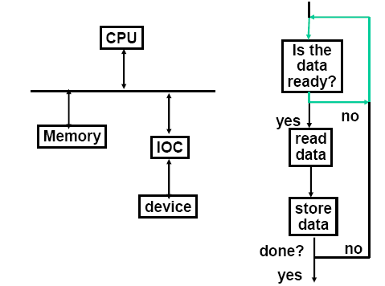
Polling
Advantages
Simple
No surprises
Processor in full control
Disadvantages
Polling can waste lots of time

Slide 18
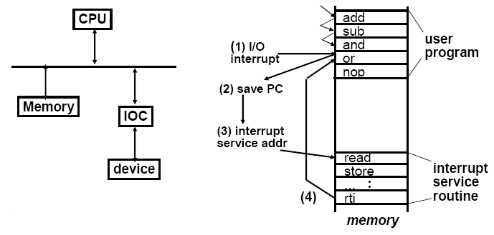
Interrupt Driven I/O
Advantage
CPU only bothered when actually needed
Disadvantage
Can occur at surprising or inconvenient times
Have to save and restore state

Slide 19
MIPS Exceptions
Reset
Hardware Errors (Bus Error, Cache Error)
External Interrupt (6 inputs)
Address Error
Reserved Instruction
TLB Miss
System Call
Breakpoint
Trap
Integer Overflow
Floating Point Error
Timer
And a few more

Slide 20
Exception Processing
EPC gets address of faulty instruction or of next instruction depending on type of exception
Switch to kernel mode
Jump to a new location based on type of exception
  PC ← FFFF FFFF BFC0 0000 for Reset
  PC ← FFFF FFFF BFC0 0300 for Hardware error
  PC ← FFFF FFFF BFC0 0380 for external interrupts
  PC ← FFFF FFFF BFC0 0400 for …
Save registers
Examine the “cause” register to find out why you came here
Branch to code to do the right thing

Slide 21
Quick overview of I/O devices
This is the “rest” of the computer
  Used to be called “peripherals”
  …but that term does not do justice to them!

Slide 22
Magnetic Disk
Long term, nonvolatile storage
Large, inexpensive, and slow
Rotating platter(s) coated with magnetic material
Use a movable read/write head to access
When magnetized region zips past coils in head, a tiny signal is produced
Force current through coils to generate magnetic field to magnetize tiny regions on the disk
Use feedback to keep the head in the right place

Slide 23
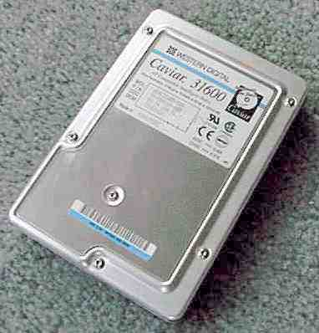
Magnetic Disks: Outside

Slide 24
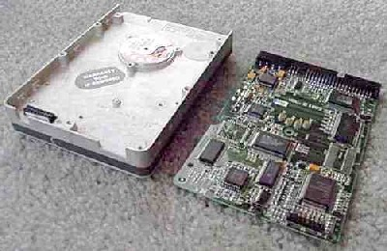
Inside

Slide 25
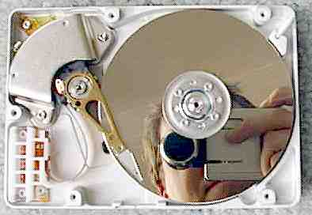
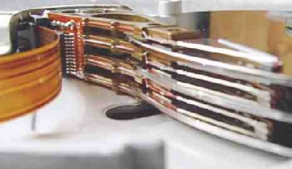
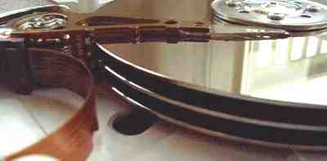
Platters and Heads

Slide 26
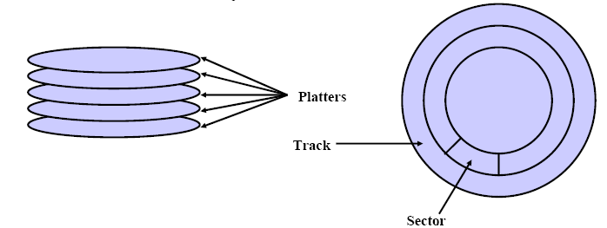
Magnetic Disk Organization
Cylinder: All tracks under head with arm in a fixed position
Read/Write time has 3 components
  Seek time to move the arm
  Rotational latency: wait for the desired sector to come by
  Transfer time: transfer bits

Slide 27
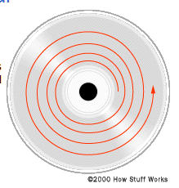
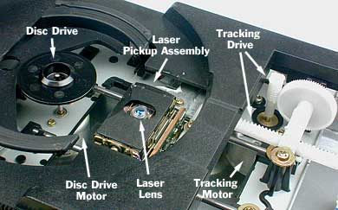
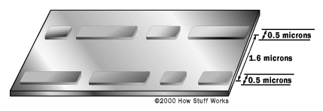
CD

Slide 28
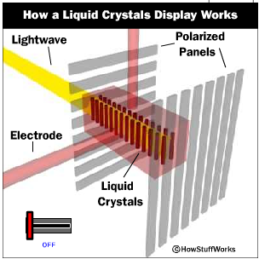
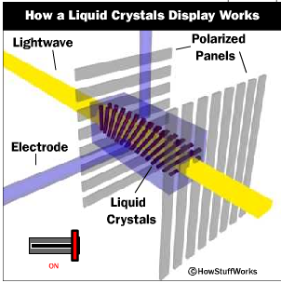
LCD

Slide 29
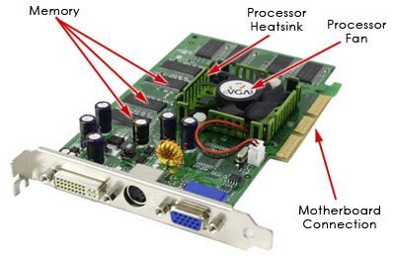
Graphics Cards

Slide 30
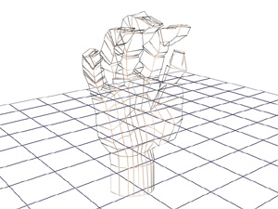
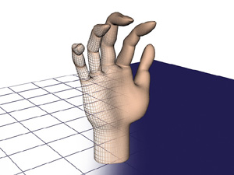
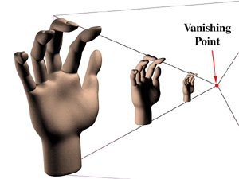
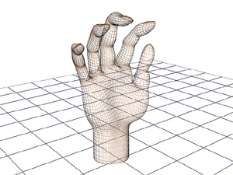

Polygons to Surfaces
Numerical coordinates specify vertex positions in 3D
Matrix multiply transforms 3D coordinates to eye coordinates
Divide projects 3D to 2D in perspective
Pixel processors fill polygons with appropriate colors based on lighting model

Slide 31
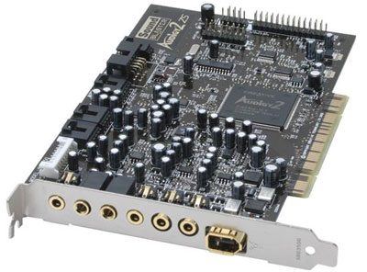
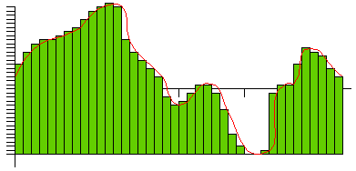
Sound
Sound is variations in air pressure
A microphone converts these into an analog electrical signal
An analog-to-digital converter samples this at frequent intervals
The resulting numbers are stored in a file (.wav)
On playback a digital-to-analog converter changes these numbers into an analog electrical signal
And the moving cone of a speaker converts this into varying air pressure

Slide 32
That’s it folks!
You now have a pretty good idea about:
How computers are designed and how they work
  How data and instructions are represented
  How arithmetic and logic operations are performed
  How ALU and control circuits are implemented
  How registers and the memory hierarchy are implemented
  How performance is measured
  How performance is increased via pipelining
  (briefly) What the rest of the computer looks like (disks, sound, etc.)
Final exam 30 April 4-7pm here
Next Time: Review Everything for the final exam

