Slide 1
Modeling of Granular Materials
Abhinav Golas
COMP 768 - Physically Based Simulation

Slide 2
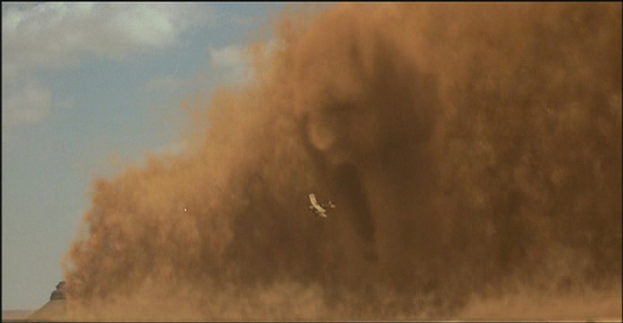
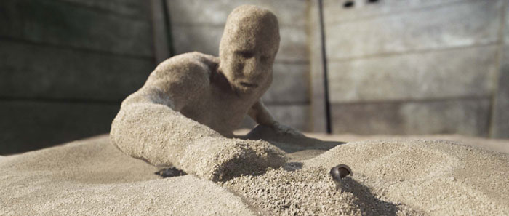
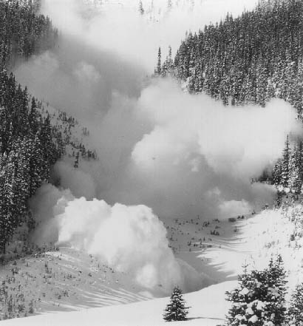
Motivation
Movies, games
Engineering design – grain silos
Avalanches, Landslides
Spiderman 3
The Mummy
www.stheoutlawtorn.com

Slide 3
Overview
What are Granular Materials?
Simulation
Rendering

Slide 4
Overview
What are Granular Materials?
Simulation
Rendering

Slide 5
What are Granular Materials?
A granular material is a conglomeration of discrete solid, macroscopic particles characterized by a loss of energy whenever the particles interact (Wikipedia)
Size variation from 1μm to icebergs
Food grains, sand, coal etc.
Powders – can be suspended in gas

Slide 6
What are Granular materials?
Can exist similar to various forms of matter
  Gas/Liquid – powders can be carried by velocity fields
    Sandstorms
  Liquid/Solid – similar to liquids embedded with multiple solid objects
    Avalanches, landslides
    Hourglass
Similar to viscous liquids

Slide 7
Why the separate classification?
Behavior not consistent with any one state of matter
  Can sustain small shear stresses – stable piles
    Hydrostatic pressure achieves a maximum
  Particle interactions lose energy
    Collisions approach inelastic
    Infinite collisions in finite time – inelastic collapse
  Inhomogeneous and anisotropic
    Particle shape and size inhomogeneous
Granular solids, liquids, and gases – Jaeger et al.

Slide 8
Understanding the behavior - Stress
_{y}
_{z}
Stress
At equilibrium – matrix is symmetric – 6 degrees of freedom
Pressure for fluids – tr(σ)/ 3
_{y}
_{z}
Shear
Normal

Slide 9
Stress
Different matrix for different basis – need invariants
  Pressure! – I₀
  Deviatoric invariants – Invariants based on  J₁,J₂
Eigen values? – called principle stresses

Slide 10
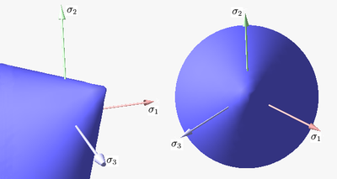
Understanding the behavior
Why can sand sustain shear stress?
  Friction between particles
When does it yield? – yield surface/condition

Slide 11
Yield surface
Many surfaces – suitable for different materials
Mohr Coulomb surface with Von-Mises equivalent stress – f(I₀, J₁)
Condition for stability/rigidity:
sinΦ – coefficient of friction

Slide 12
So why is it difficult to simulate?
Scale - >10M particles
Nonlinear behavior – yield surface
Representation – discrete or continuum?

Slide 13
Overview
What are Granular Materials?
Simulation
Rendering

Slide 14
Simulation
Depends on what scenario to simulate
  2 dimensional – Animating Sand, Mud, and Snow, Sumner et al.
  Discrete particles – Particle-Based Simulation of Granular Materials, Bell et al.
  Continuum – Animating Sand as a Fluid, Zhu et al.

Slide 15
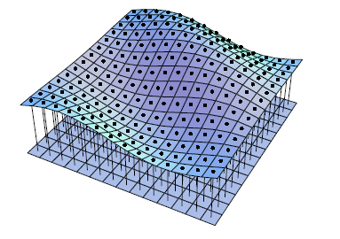
Animating Sand, Mud, and Snow
Model deformations on a 2D height field surface caused by rigid bodies
  Hash based grid – space saving
Model features
  Material redistribution, compression
  Particles that get stuck to rigid body

Slide 16
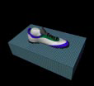

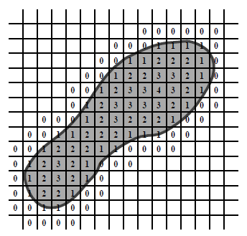
Animating Sand, Mud, and Snow
Rigid body intersection check – ray casting
Extra material
  Displaced
  Compressed
Transferring extra material
  Construct distance field to nearest clear cell
  Transfer material to that cell

Slide 17
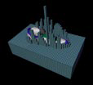
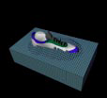
Redistribution of material
Erosion
  Distribute material equally to all neighboring lower height cells – if slope > threshold
Particle Generation
  Material may get stuck to bottom of body
  Seed particle system from each contact triangle on rigid body – volume = c * area of triangle
    Volume lost per time step – exponential decay

Slide 18
Particle-Based Simulation of Granular Materials
Use a particle system with collision handling
Define objects in terms of spheres
  Need to define per sphere pair interaction forces
Collision system based on Molecular Dynamics
  Allow minor spatial overlap between objects

Slide 19
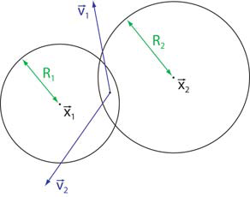
Sphere pair interaction
Define overlap(ξ), relative velocity(V), contact normal(N), normal and tangential velocities(V_{n}, V_{t}), rate of change of overlap(V.N)
Normal forces
k_{d} : dissipation during collisions, k_{r} : particle stiffness
Best choice of coefficients: α=1/2, β=3/2
Given coefficient of restitution ε, and time of contact t_{c}, we can determine k_{d} and k_{r}

Slide 20
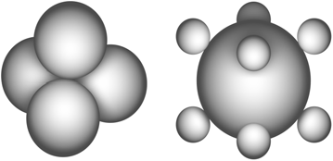
Sphere pair interaction
Tangential forces
These forces cannot stop motion – require true static friction
  Springs between particles with persistent contact?
  Non-spherical objects

Slide 21
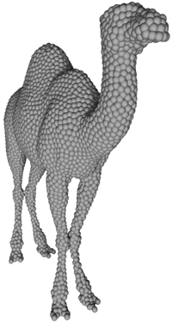
Solid bodies
Map mesh to structure built from spheres
  Generate distance field from mesh
  Choose offset from mesh to place spheres
  Build iso-surface mesh (Marching Tetrahedra)
  Sample spheres randomly on triangles
  Let them float to desired iso-surface by repulsion forces
D=sphere density, A=triangle area, R=particle radius, place particles, 1 more with fractional probability

Slide 22
Solid bodies
K – interaction kernel, P – Position of particle, V – velocity of particle, Φ – distance field
Rigid body evolution
  Overall force = Σ forces
  Overall torque = Σ torques around center of mass

Slide 23
Efficient collision detection
Spatial hashing
  Grid size = 2 x Maximum particle radius
Need to look at 27 cells for each particle O(n)
Not good enough, insert each particle into not 1, but 27 cells check only one cell for possible collisions
Why better?
  Spatial coherence
  Particles moving to next grid cell, rare (inelastic collapse)
  Wonderful for stagnant regions

Slide 24
Advantages/Disadvantages
The Good
  Faithful to actual physical behavior
The Bad and the Ugly
  Computationally intensive
    Small scale scenes
    Scenes with some “control” particles

Slide 25
Animating Sand as a Fluid
Motivation
  Sand ~ viscous fluids in some cases
Continuum simulation
Bootstrap additions to existing fluid simulator
Why?
  Simulation independent of number of particles
  Better numerical stability than rigid body simulators

Slide 26
Fluid simulation? what’s that?
v
Discretize 3D region into cuboidal grid
3 step process to solve Navier Stokes equations
  Advect
  Add body forces
  Incompressibility projection
Stable and accurate under CFL condition
u
p, ρ
u
v

Slide 27
Extending our fluid simulator
Extra things we need for sand
  Friction (internal, boundary)
  Rigid portions in sand
Recall
  Stress
  Yield condition

Slide 28
Calculating stress
Exact calculation infeasible
Smart approximations
Define strain rate – D = d/dt(strain)
Approximate stresses
  Rigid
  Fluid

Slide 29
The algorithm in a nutshell
Calculate strain rate
Find rigid stress for cell
Cell satisfies yield condition?
  Yes – mark rigid, store rigid stress
  No – mark fluid, store fluid stress
For each rigid connected component
  Accumulate forces and torques
For fluid cells, subtract friction force

Slide 30
Yield condition
Recap
Can add a cohesive force for sticky materials

Slide 31
Rigid components
All velocities must lie in allowed space of rigid motion (D=0)
Find connected components – graph search
Accumulate momentum and angular momentum
R_{i} – solid region, u – velocity, ρ – density, I – moment of inertia
Rigid Fluid: Animating the Interplay Between Rigid Bodies and Fluid, Carlson et al.

Slide 32
Friction in fluid cells
Update cell velocity
Boundary conditions
  Normal velocity:
  Tangential velocity:

Slide 33
Representation
Defining regions of sand
  Level sets
  Particles
    Allow improved advection
    Hybrid simulation
      PIC – Particle In Cell
      FLIP – FLuid Implicit Particle

Slide 34
Advection
Semi – Lagrangian advection
  Dissipative
  Relies on incompressibility – volume conservation
Hybrid approach
  Use grids coupled with particles
  Advect particles – no averaging losses!

Slide 35
PIC and FLIP methods
PIC – Particle in cell
  Particles support grid
  Particles take velocity from grid
FLIP – Fluid Implicit Particle
  Grid supports particles
  Particles take acceleration from grid

Slide 36
PIC and FLIP methods
No grid based advection
  Lesser dissipation
  Particle advection is simpler
No need for a level set
PIC, more dissipative – suited for viscous flows, FLIP for inviscid flows
Surface reconstruction?

Slide 37
Surface reconstruction
Surface Φ(x) – define using all particles i
k(s) – kernel function, R – 2 x average particle spacing, x – position, r – radius, w_{i} – weight for particle
Suitable choice of kernel?
  Must provide flat surfaces for what should be flat
  k(s) =max(0,(1-s²)³)

Slide 38
Surface reconstruction
Issues
  Concave regions – centre might lie outside region
    Smoothing pass
  Radii must be close approximation to distance from surface
    Non-trivial, constant particle radius assumed
Advantages
  Fast
  No temporal interdependence

Slide 39
Advantages/Disadvantages
Advantages
  Fast & stable
  Independent of number of particles – large scale scenes possible
Disadvantages
  Not completely true to actual behavior
  Detail issues – smoothing in simulation, surface reconstruction

Slide 40
Overview
What are Granular Materials?
Simulation
Rendering

Slide 41
Rendering
Non-trivial due to scale and visual complexity
Surface based rendering
  Use volumetric textures
  Texture advected by fluid velocity
Particle rendering

Slide 42
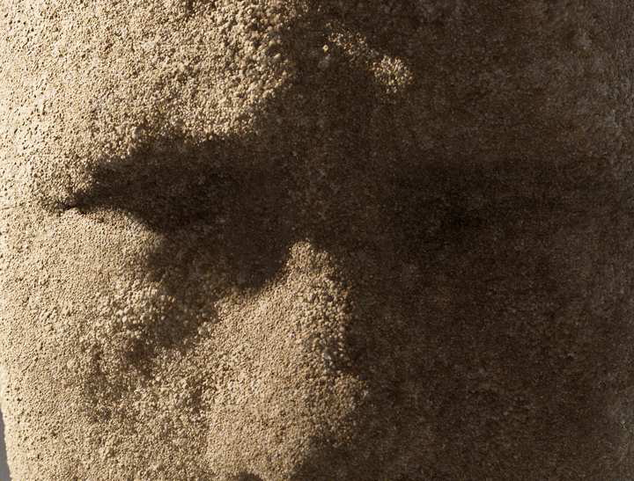
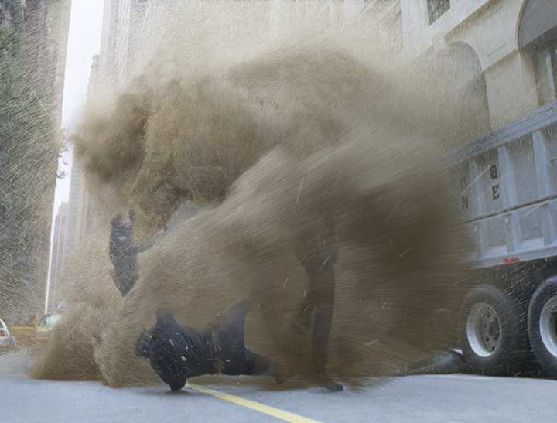
Particle Rendering
Level of detail necessary
Different approaches for different levels
Rendering Tons of Sand, Sony Pictures Imageworks

Slide 43
Particle Rendering
Sand clouds
  Light Reflection Functions for Simulation of Clouds and Dusty Surfaces, Blinn
  Defines lighting and scattering functions for such materials
  Suitable options for dust, clouds

Slide 44
Rendering Tons of Sand
Surfaces with sand
  Generate particles on mesh at runtime with temporal coherence
Sand particles
  Generate required number for visual detail from base “control” particles
Rendering level of detail
Peak of 480 million particles at render time
Polygon mesh
Camera aligned patches
Point clusters
Single points

Slide 45
Conclusions
Interesting, albeit difficult problem
Models not perfect
  Speed vs. scale/realism tradeoff
Similar tradeoff in rendering

Slide 46
References
Granular Solids, Liquids, and Gases – Jaeger et al.
Review of Modern Physics ’96
Particle-Based Simulations of Granular Materials – Bell et al., Eurographics ‘05
Animating Sand as a Fluid – Zhu et al.
SIGGRAPH ‘05
Rigid Fluid: Animating the Interplay Between Rigid Bodies and Fluid – Carlson et al.
SIGGRAPH ’04

Slide 47
References
Rendering Tons of Sand – Allen et al. Sony Pictures Imageworks
SIGGRAPH 2007 sketches
A Fast Variational Framework for Accurate Solid-Fluid Coupling – Batty et al.
SIGGRAPH 2007
Animating Sand, Mud, and Snow – Sumner et al.
Eurographics 1999

