Slide 1
Sand Simulation
COMP 768 Project Proposal
Abhinav Golas

Slide 2
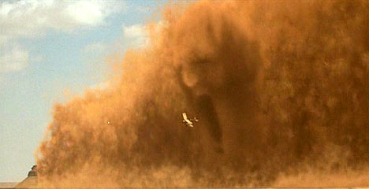
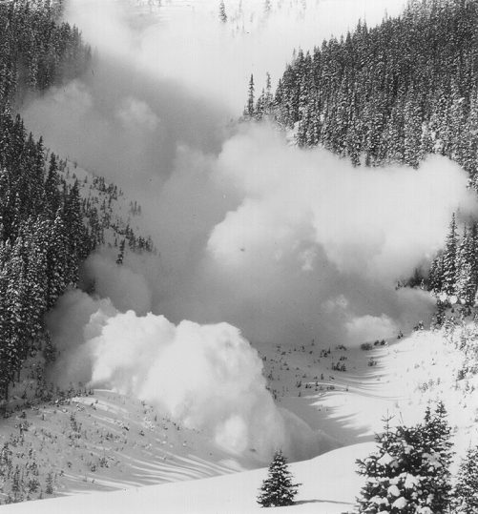
Motivation
Simulation of granular materials like sand
Per-particle simulation expensive – Billions to trillions of particles in medium sized scenes
Complex behavior – between solids, liquids and gases due to multi particle interaction
Applicability to multiple types of natural scenarios
  Sand
  Avalanches
  Granular materials
The Mummy
NSIDC

Slide 3
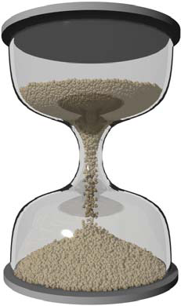
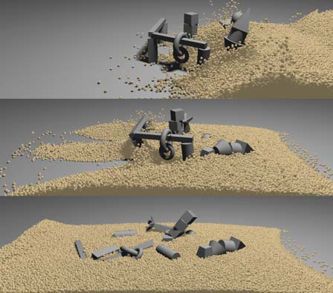
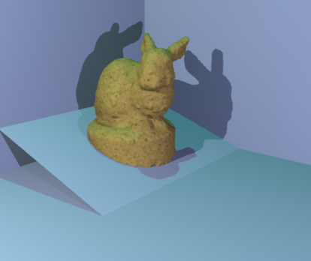
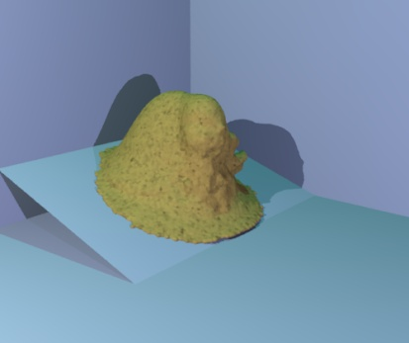
State-of-the-art
Particle-Based Simulation of Granular Materials – Bell et al. (2005)
  Approximate all objects as sphere agglomerates
  Visually accurate behavior
  Few hundred thousand particles only for at least 3min/frame
Animating Sand as a Fluid – Zhu & Bridson (2005)
  Modify commodity fluid simulator for sand
  Macro-level behavior – no concept of separate grains, approximation
  6 seconds per frame for 100³ grid

Slide 4
Desired Tasks
Short term
  Accurate physical model for sand simulation
    Model all behavior – Pressure capped to a maxima
  Hybrid model with multiple LOD
    Fluid
    Particles
  Rendering improvements
Long Term
  Generalization to Granular material simulation w. multiple particle sizes

Slide 5
Ideas
Use fluid model to begin with
Better stress model
  Handle pressure capping
Look at unilateral incompressibility and LCP for modeling various behaviors
  Sparse sand
  Solid contact

Slide 6
Timeline
April 7, 2009
  Complete physical simulator with unilaterally incompressible sand and stress/friction model
  Basic renderer (OpenGL/Blender/POVRAY/Renderman)
May 6, 2009
  Add LCP based contact handling
  LOD for sand – Hybrid between fluids and particles
  Improved renderer with better lighting

Slide 7
References
Animating Sand as a Fluid, Zhu et al. (SIGGRAPH 2005)
Particle Based Simulation of Granular Materials, Bell et al. (Eurographics 2005)
Granular solids, liquids, and gases, Jaeger & Nagel (Reviews of Modern Physics, '96)
Instability in the Evolution Equations Describing Granular Flow, Schaeffer (1985)
The Material Point Method for Granular Materials, Bardenhagen et al. (Comput. Methods Appl. Mech. Engrg, 2000)
Two dimensional Lagrangian particle finite-difference method for modeling large soil deformations, Konagai & Johannson (Structural Eng./Earthquake Eng, 2001)
Mechanics of Materials, Third Edition, Gere & Timoshenko (For basic physics reference)

