Slide 1
Sand Simulation
Abhinav Golas
COMP 768 - Physically Based Simulation
Final Project Presentation

Slide 2
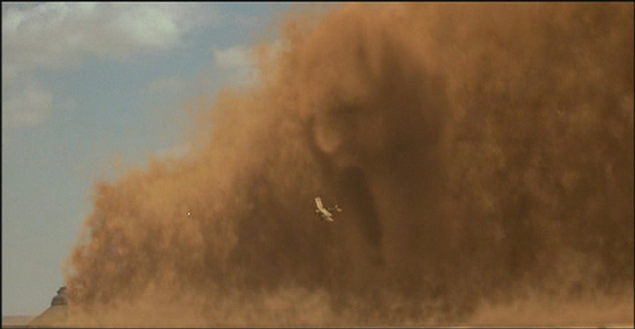
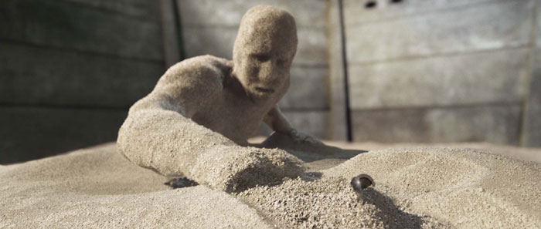
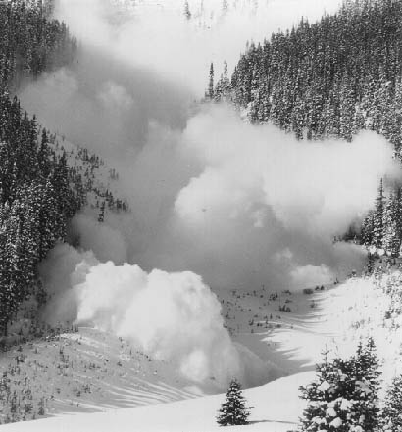
Motivation
Movies, games
Engineering design – grain silos
Avalanches, Landslides
Spiderman 3
The Mummy
www.stheoutlawtorn.com

Slide 3
Overview
What are Granular Materials?
Proposed Model
Actual Progress

Slide 4
Overview
What are Granular Materials?
Proposed Model
Actual Progress

Slide 5
What are Granular Materials?
A granular material is a conglomeration of discrete solid, macroscopic particles characterized by a loss of energy whenever the particles interact (Wikipedia)
Size variation from 1μm to icebergs
Food grains, sand, coal etc.
Powders – can be suspended in gas

Slide 6
What are Granular materials?
Can exist similar to various forms of matter
Gas/Liquid – powders can be carried by velocity fields
Sandstorms
Liquid/Solid – similar to liquids embedded with multiple solid objects
Avalanches, landslides
Hourglass
Similar to viscous liquids

Slide 7
Why the separate classification?
Behavior not consistent with any one state of matter
Can sustain small shear stresses – stable piles
Hydrostatic pressure achieves a maximum
Particle interactions lose energy
Collisions approach inelastic
Infinite collisions in finite time – inelastic collapse
Inhomogeneous and anisotropic
Particle shape and size inhomogeneous
Granular solids, liquids, and gases – Jaeger et al.

Slide 8
Understanding the behavior - Stress
_{y}
_{z}
Stress
At equilibrium – matrix is symmetric – 6 degrees of freedom
Pressure for fluids – tr(σ)/ 3
_{y}
_{z}
Shear
Normal

Slide 9
Stress
Different matrix for different basis – need invariants
Pressure! – I₀
Deviatoric invariants – Invariants based on  J₁,J₂
Eigen values? – called principle stresses

Slide 10
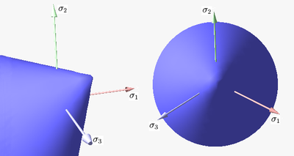
Understanding the behavior
Why can sand sustain shear stress?
Friction between particles
When does it yield? – yield surface/condition

Slide 11
Yield surface
Many surfaces – suitable for different materials
Mohr Coulomb surface with Von-Mises equivalent stress – f(I₀, J₁)
Condition for stability/rigidity:
sinΦ – coefficient of friction

Slide 12
So why is it difficult to simulate?
Scale - >10M particles
Nonlinear behavior – yield surface
Representation – discrete or continuum?

Slide 13
Simulation
Depends on what scenario to simulate
Discrete particles – Particle-Based Simulation of Granular Materials, Bell et al.
Continuum – Animating Sand as a Fluid, Zhu et al.

Slide 14
Particle-Based Simulation of Granular Materials
Use a particle system with collision handling
Define objects in terms of spheres
Need to define per sphere pair interaction forces
Collision system based on Molecular Dynamics
Allow minor spatial overlap between objects

Slide 15
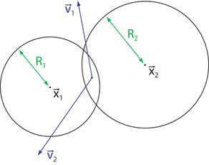
Sphere pair interaction
Define overlap(ξ), relative velocity(V), contact normal(N), normal and tangential velocities(V_{n}, V_{t}), rate of change of overlap(V.N)
Normal forces
k_{d} : dissipation during collisions, k_{r} : particle stiffness
Best choice of coefficients: α=1/2, β=3/2
Given coefficient of restitution ε, and time of contact t_{c}, we can determine k_{d} and k_{r}

Slide 16
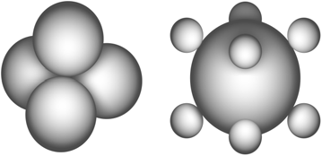
Sphere pair interaction
Tangential forces
These forces cannot stop motion – require true static friction
Springs between particles with persistent contact?
Non-spherical objects

Slide 17
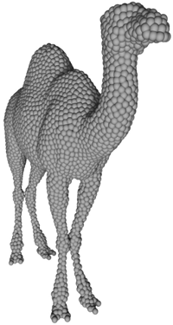
Solid bodies
Map mesh to structure built from spheres
Generate distance field from mesh
Choose offset from mesh to place spheres
Build iso-surface mesh (Marching Tetrahedra)
Sample spheres randomly on triangles
Let them float to desired iso-surface by repulsion forces
D=sphere density, A=triangle area, R=particle radius, place particles, 1 more with fractional probability

Slide 18
Solid bodies
K – interaction kernel, P – Position of particle, V – velocity of particle, Φ – distance field
Rigid body evolution
Overall force = Σ forces
Overall torque = Σ torques around center of mass

Slide 19
Efficient collision detection
Spatial hashing
Grid size = 2 x Maximum particle radius
Need to look at 27 cells for each particle O(n)
Not good enough, insert each particle into not 1, but 27 cells check only one cell for possible collisions
Why better?
Spatial coherence
Particles moving to next grid cell, rare (inelastic collapse)
Wonderful for stagnant regions

Slide 20
Advantages/Disadvantages
The Good
Faithful to actual physical behavior
The Bad and the Ugly
Computationally intensive
Small scale scenes
Scenes with some “control” particles

Slide 21
Animating Sand as a Fluid
Motivation
Sand ~ viscous fluids in some cases
Continuum simulation
Bootstrap additions to existing fluid simulator
Why?
Simulation independent of number of particles
Better numerical stability than rigid body simulators

Slide 22
Fluid simulation? what’s that?
v
Discretize 3D region into cuboidal grid
3 step process to solve Navier Stokes equations
Advect
Add body forces
Incompressibility projection
Stable and accurate under CFL condition
u
p, ρ
u
v

Slide 23
Extending our fluid simulator
Extra things we need for sand
Friction (internal, boundary)
Rigid portions in sand
Recall
Stress
Yield condition

Slide 24
Calculating stress
Exact calculation infeasible
Smart approximations
Define strain rate – D = d/dt(strain)
Approximate stresses
Rigid
Fluid

Slide 25
The algorithm in a nutshell
Calculate strain rate
Find rigid stress for cell
Cell satisfies yield condition?
Yes – mark rigid, store rigid stress
No – mark fluid, store fluid stress
For each rigid connected component
Accumulate forces and torques
For fluid cells, subtract friction force

Slide 26
Yield condition
Recap
Can add a cohesive force for sticky materials

Slide 27
Rigid components
All velocities must lie in allowed space of rigid motion (D=0)
Find connected components – graph search
Accumulate momentum and angular momentum
R_{i} – solid region, u – velocity, ρ – density, I – moment of inertia
Rigid Fluid: Animating the Interplay Between Rigid Bodies and Fluid, Carlson et al.

Slide 28
Friction in fluid cells
Update cell velocity
Boundary conditions
Normal velocity:
Tangential velocity:

Slide 29
Representation
Defining regions of sand
Level sets
Particles
Allow improved advection
Hybrid simulation
PIC – Particle In Cell
FLIP – FLuid Implicit Particle

Slide 30
Advantages/Disadvantages
Advantages
Fast & stable
Independent of number of particles – large scale scenes possible
Disadvantages
Not completely true to actual behavior
Detail issues – smoothing in simulation, surface reconstruction

Slide 31
Overview
What are Granular Materials?
Proposed Model
Actual Progress

Slide 32
Proposed Model
Minimization problem
Inelasticity -> stress tries to minimize kinetic energy
Constraints
Friction, yield condition
Boundary conditions
Unilateral incompressibility

Slide 33
Proposed Model
Friction
Nice, but not linear – Frobenius Norm
Infinity/1 Norm – linear
Unilateral Incompressibility
Boundary conditions

Slide 34
Problems
Friction not orthogonal
Goodbye LCP
KKT solver slow
Iterative solvers
LCP for unilateral incompressibility, boundary conditions
Friction checking after that
Recurse till convergence

Slide 35
Overview
What are Granular Materials?
Proposed Model
Actual Progress

Slide 36
Actual progress
Boundary cases!
90% of all effort in writing fluid solver
Minor details
Particle reseeding / preventing clumping
Continuity of stress field
Parameter tuning

Slide 37
Actual progress
Running implementation of “Animating Sand as a Fluid”, Zhu et al.
3D real-time – albeit with simple rendering
Takes care of friction
Rigid, fluid cases
Boundary cases – tangential contact friction
Variational formulation – “Variational Fluids”, Bridson and Batty

Slide 38
Implementation
Grids coupled with particles
Particles dictate fluid density
One way velocity mapping – need ghost fluids for proper 2 way mapping
Grid based advection
Variational model – better interaction handling with non-axis-aligned objects
Rigid projection

Slide 39
Actual progress
The nitty-gritty
Implemented 3D fluid solver from scratch
Particle System reused from previous assignments
Used Bridson’s CG solver
Rigid projection – “Rigid Fluids”
Variational pressure solve – equality constraints

Slide 40
Pluses/Minuses?
Issues
Bugs – known and unknown remain
LCP solver couldn’t be completed in time – no unilateral incompressibility, improved contact
Iterative testing couldn’t be done
Pluses
3D fluid simulator working
With minor fixes – should be perfectly functional

Slide 41
Future work
Fix remaining bugs
Add LCP solver to do iterative testing
Look for alternatives for full KKT solver, to allow for coupled solve
Add better cube/plane intersection codes

Slide 42
References
Granular Solids, Liquids, and Gases – Jaeger et al. Review of Modern Physics ’96
Particle-Based Simulations of Granular Materials – Bell et al., Eurographics ‘05
Animating Sand as a Fluid – Zhu et al. SIGGRAPH ‘05
Rigid Fluid: Animating the Interplay Between Rigid Bodies and Fluid – Carlson et al. SIGGRAPH ’04

Slide 43
References
A Fast Variational Framework for Accurate Solid-Fluid Coupling – Batty et al. SIGGRAPH 2007

