Slide 1
Physical Face Rigging
Dinghuang Ji
Notes:
Good afternoon, this is my final report for Physical based skin deformation.

Slide 2
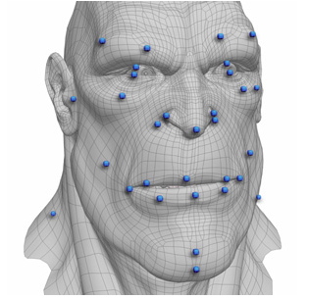
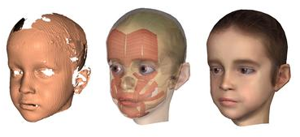
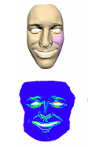
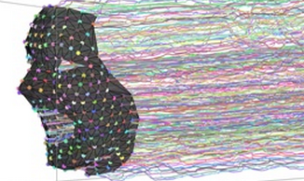
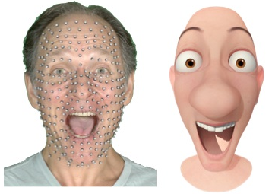
State of the Art
Artist work
Physical
Data Driven
Complex device
Notes:
The techniques in facial animation can be separated into several categories like physical, data driven , mesh deformation etc. Many of them require assistance of some expensive device and a lot of artist work.

Slide 3
Motivation
Help users more easily generate varieties of face models with simpler interface.
Notes:
In this project, I hope to help users more easily generate realistic facial animation with simple interface and intuitive Gui.

Slide 4
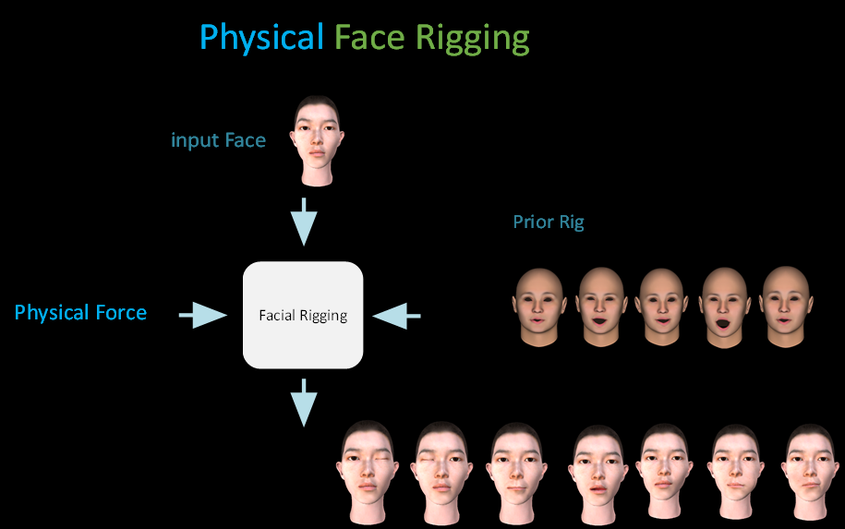
Proposed Formulation

Slide 5
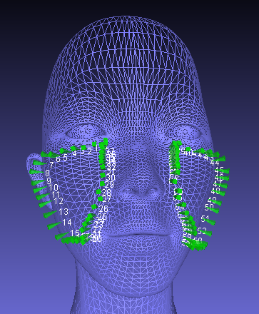
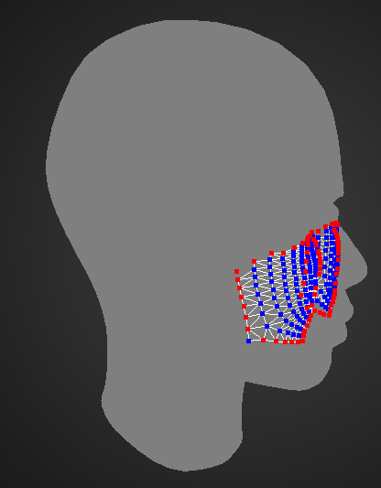
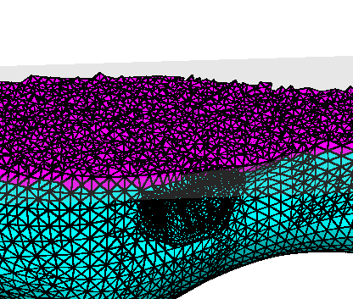
Physical based deformation
Spring Mesh
Tetrahedralize
Boundary
Apply Mass & Force

Slide 6
Numerics
is the expression generated by this method
is the ith blend shape generated by expression cloning
is the expression generate by spring mesh

Slide 7
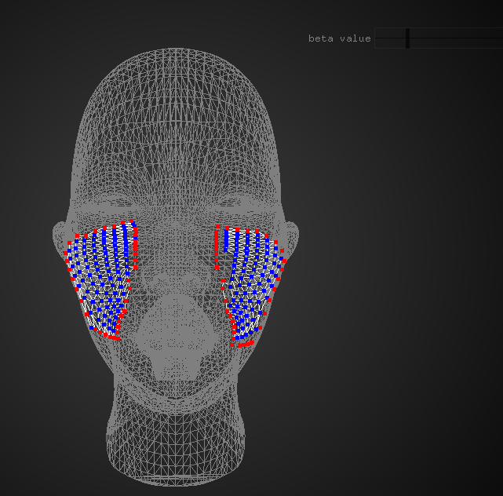
System Demonstrations
Interface to control the animation
Face deformation system

Slide 8
What I accomplished
Spring Mesh based deformation
Expression Cloning
The optimization formulation
Parameter based interface

Slide 9
Summary and Future work
This term I learned some technologies which I adopted in my project:
  Spring-mass system
  Integration methods
  Mesh deformation
In the future, I hope to implement more intuitive Gui to set boundary and deform coefficient and embed it into a video driven facial animation system.

Slide 10
Thank you

