Slide 1
776 Computer Vision
Jan-Michael Frahm
Spring 2012

Slide 2
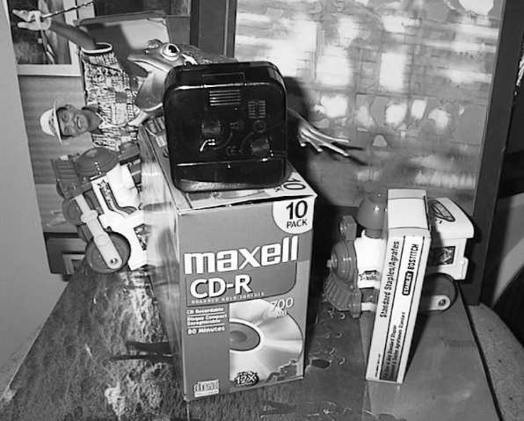
Scalability: Alignment to large databases
What if we need to align a test image with thousands or millions of images in a model database?
  Efficient putative match generation
    Approximate descriptor similarity search, inverted indices
Test image
?
Model database
slide: S. Lazebnik

Slide 3
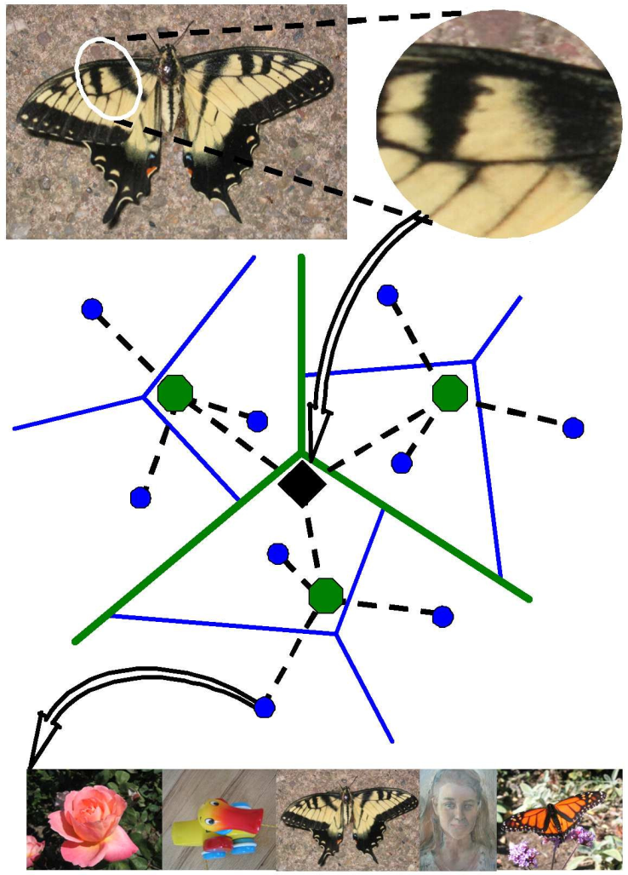
Scalability: Alignment to large databases
What if we need to align a test image with thousands or millions of images in a model database?
  Efficient putative match generation
    Fast nearest neighbor search, inverted indexes
Test image
D. Nistér and H. Stewénius, Scalable Recognition with a Vocabulary Tree,
CVPR 2006
Vocabulary tree with inverted index
Database
slide: S. Lazebnik

Slide 4
What is a Vocabulary Tree?
Nister and Stewenius CVPR 2006

Slide 5
What is a Vocabulary Tree?
Nister and Stewenius CVPR 2006
Multiple rounds of K-Means to compute decision tree (offline)
Fill and query tree online

Slide 6
Vocabulary tree/inverted index
Slide credit: D. Nister
Notes:
We now have the vocabulary tree, and the online phase can begin.
In order to add an image to the database, we perform feature extraction. Each descriptor vector is now dropped down from the root of the tree and quantized very efficiently into a path down the tree, encoded by a single integer.
Each node in the vocabulary tree has an associated inverted file index.
Indecies back to the new image are then added to the relevant inverted files.
This is a very efficient operation that is carried out whenever we want to add an image.

Slide 7
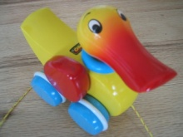

Populating the vocabulary tree/inverted index
Model images
Slide credit: D. Nister

Slide 8
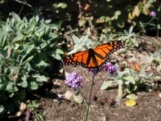

Model images
Populating the vocabulary tree/inverted index
Slide credit: D. Nister

Slide 9


Model images
Populating the vocabulary tree/inverted index
Slide credit: D. Nister

Slide 10
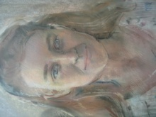

Model images
Populating the vocabulary tree/inverted index
Slide credit: D. Nister

Slide 11
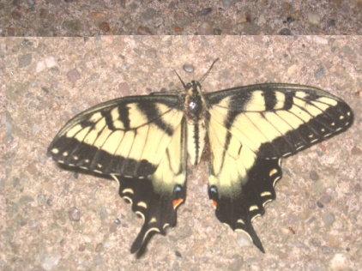
Model images
Test image
Looking up a test image
Slide credit: D. Nister
Notes:
When we then wish to query on an input image, we quantize the descriptor vectors of the input image in a similar way, and accumulate scores for the images in the database with so called term frequency inverse document frequency (tf-idf). This is effectively an entropy weighting of the information. The winner is the image in the database with the most common information with the input image.

Slide 12
Quantizing a SIFT Descriptor
Nister and Stewenius CVPR 2006
<12,21,22,76,77,90,202,…>
<1,20,22,23,40,41,42,…>
<4,5,6,23,40,50,51,…>

Slide 13
Scoring Images
<1,20,22,23,40,41,42,…>
<4,5,6,23,40,50,51,…>
In practice take into account likelyhood of visual word appearing
<12,21,22,76,77,90,202,…>
Current image features
<1>
Num Visual Words Found
Sum of Score
Nister and Stewenius CVPR 2006
1
*
*
*
*
*
*
*
Image ID

Slide 14
Voting for geometric transformations
Modeling phase: For each model feature, record 2D location, scale, and orientation of model (relative to normalized feature coordinate frame)
index
model
slide: S. Lazebnik

Slide 15
Voting for geometric transformations
Test phase: Each match between a test and model feature votes in a 4D Hough space (location, scale, orientation) with coarse bins
Hypotheses receiving some minimal amount of votes can be subjected to more detailed geometric verification
index
test image
model
slide: S. Lazebnik

Slide 16
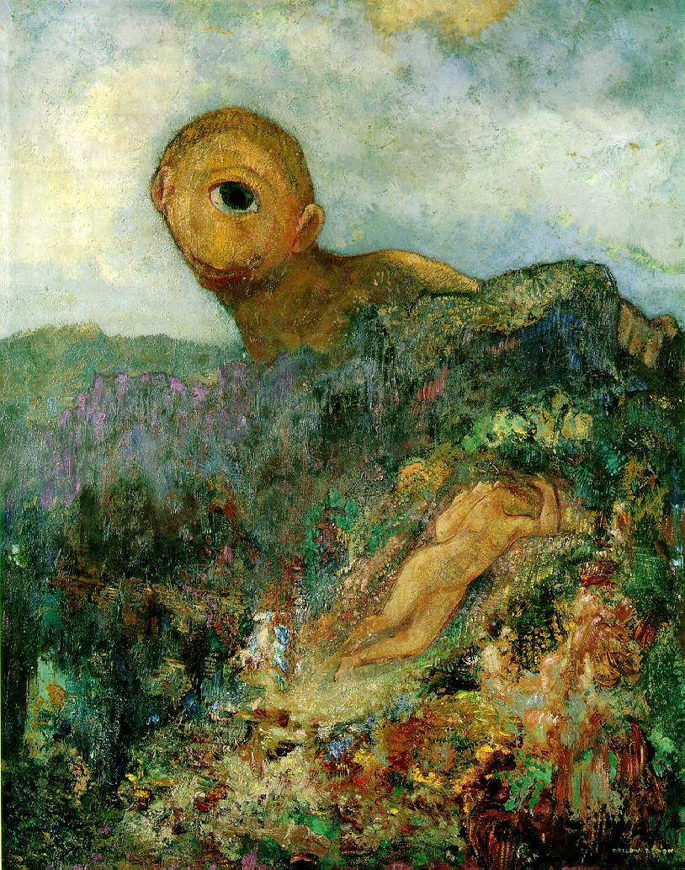
Single-view geometry
Odilon Redon, Cyclops, 1914
slide: S. Lazebnik

Slide 17
Our goal: Recovery of 3D structure
Recovery of structure from one image is inherently ambiguous
X?
X?
X?
x
slide: S. Lazebnik

Slide 18
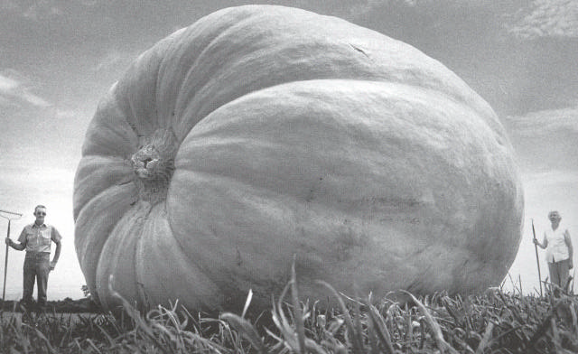
Our goal: Recovery of 3D structure
Recovery of structure from one image is inherently ambiguous
slide: S. Lazebnik

Slide 19
Our goal: Recovery of 3D structure
Recovery of structure from one image is inherently ambiguous
slide: S. Lazebnik

Slide 20
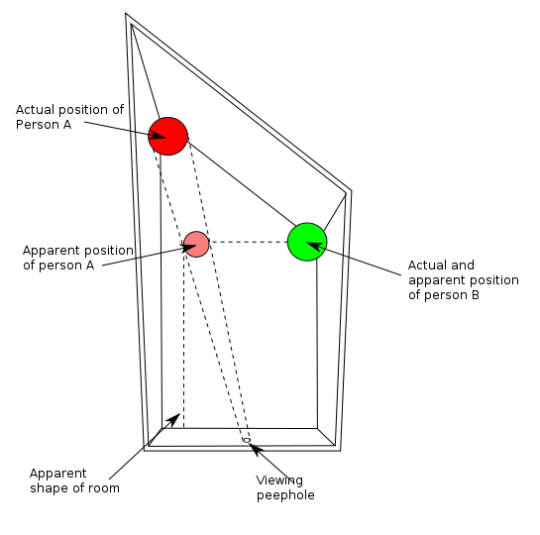
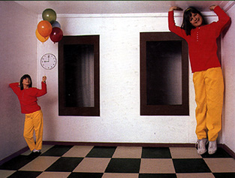
Ames Room
http://en.wikipedia.org/wiki/Ames_room
slide: S. Lazebnik

Slide 21
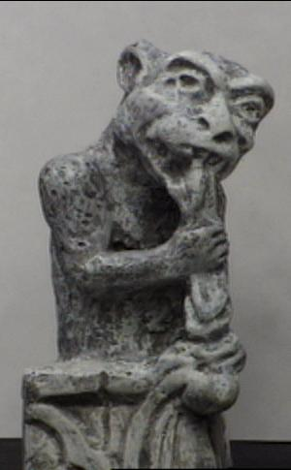
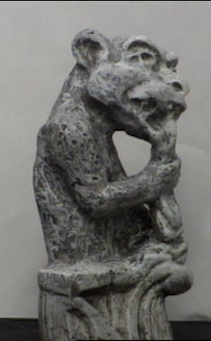
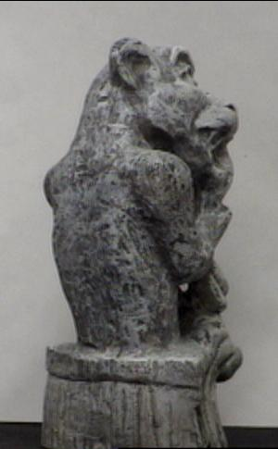
Our goal: Recovery of 3D structure
We will need multi-view geometry
slide: S. Lazebnik

Slide 22
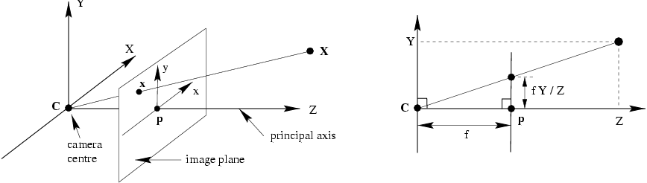
Recall: Pinhole camera model
Principal axis: line from the camera center perpendicular to the image plane
Normalized (camera) coordinate system: camera center is at the origin and the principal axis is the z-axis
slide: S. Lazebnik

Slide 23
Recall: Pinhole camera model
slide: S. Lazebnik

Slide 24
Image plane and image sensor
A sensor with picture elements (Pixel) is added onto the image plane
Z (Optical axis)
  Image center
  c= (c_{x}, c_{y})^{T}
  Pixel coordinates
  m = (y,x)^{T}
Image sensor
y
x
Y
Image-sensor mapping:
  Pixel scale
  f= (f_{x},f_{y})^{T}
X
Projection center
Pixel coordinates are related to image coordinates by affine transformation K with five parameters:
  Image center c=(c_{x},c_{y})^{T} defines optical axis
  Pixel size and pixel aspect ratio defines scale f=(f_{x},f_{y})^{T}
  image skew s to model angle between pixel rows and columns
Normalized coordinate system is centered at principal point (c_{x},c_{y})

Slide 25
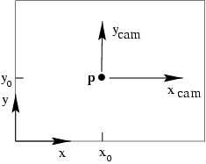
Principal point offset
p_{y}
principal point:
p_{x}
slide: S. Lazebnik

Slide 26
Principal point offset
principal point:
calibration matrix
slide: S. Lazebnik

Slide 27
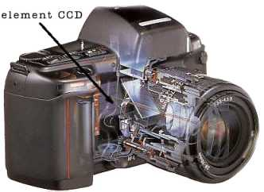
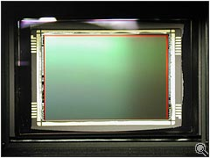
Pixel coordinates
Pixel size:
m_{x} pixels per meter in horizontal direction,
m_{y} pixels per meter in vertical direction
pixels/m
m
pixels
slide: S. Lazebnik
Notes:
To convert from metric image coordinates to pixel coordinates, we have to multiply the x, y coordinates by the x, y pixel magnification factors (pix/m)
Beta_x, beta_y is the principal point coordinates in pixels

Slide 28
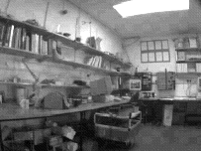
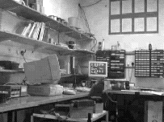
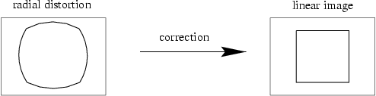
Camera parameters
Intrinsic parameters
  Principal point coordinates
  Focal length
  Pixel magnification factors
  Skew (non-rectangular pixels)
  Radial distortion

Slide 29
Projection in general pose
Rotation [R]
Projection:
m_{p}
In general camera is rotated and translated with respect to the world coordinate system
Projection center C
M
World coordinates

Slide 30
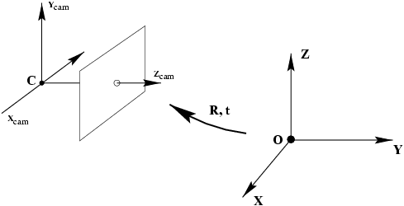
Camera rotation and translation
In non-homogeneous
coordinates:
Note: C is the null space of the camera projection matrix (PC=0)

Slide 31
Camera parameters
Intrinsic parameters
  Principal point coordinates
  Focal length
  Pixel magnification factors
  Skew (non-rectangular pixels)
  Radial distortion
Extrinsic parameters
  Rotation and translation relative to world coordinate system
slide: S. Lazebnik

Slide 32
Camera calibration

Slide 33

Camera calibration
Given n points with known 3D coordinates X_{i} and known image projections x_{i}, estimate the camera parameters
X_{i}
x_{i}
slide: S. Lazebnik

Slide 34
Camera Self-Calibration from H
Estimation of H between image pairs gives complete projective mapping (8 parameter).
Problem: How to compute camera projection matrix from H
  since K is unknown, we can not compute R
  H does not use constraints on the camera
  (constancy of K or some parameters of K)
Solution: self-calibration of camera calibration matrix K from image correspondences with H
imposing constraints on K may improve calibration
Interpretation of H for metric camera:

Slide 35
Self-calibration of K from H
Imposing structure on H can give a complete calibration from an image pair for constant calibration matrix K
Solve for elements of (KK^{T}) from this linear equation, independent of R
decompose (KK^{T}) to find K with Choleski factorisation
1 additional constraint needed (e.g. s=0) (Hartley, 94)

Slide 36
Self-calibration for varying K
Solution for varying calibration matrix K possible, if
  at least 1 constraint from K is known (s= 0)
  a sequence of n image homographies H_{0i} exist
Solve for varying K (e.g. Zoom) from this equation, independent of R
1 additional constraint needed (e.g. s=0)
different constraints on K_{i} can be incorporated (Agapito et. al., 01)

Slide 37
Camera estimation: Linear method
Two linearly independent equations
slide: S. Lazebnik

Slide 38
Camera estimation: Linear method
P has 11 degrees of freedom (12 parameters, but scale is arbitrary)
One 2D/3D correspondence gives us two linearly independent equations
Homogeneous least squares
6 correspondences needed for a minimal solution
slide: S. Lazebnik

Slide 39
Camera estimation: Linear method
Note: for coplanar points that satisfy Π^{T}X=0,
we will get degenerate solutions (Π,0,0), (0,Π,0), or (0,0,Π)
slide: S. Lazebnik

Slide 40
Camera estimation: Linear method
Advantages: easy to formulate and solve
Disadvantages
  Doesn’t directly tell you camera parameters
  Doesn’t model radial distortion
  Can’t impose constraints, such as known focal length and orthogonality
Non-linear methods are preferred
  Define error as difference between projected points and measured points
  Minimize error using Newton’s method or other non-linear optimization

Slide 41
Triangulation
Given projections of a 3D point in two or more images (with known camera matrices), find the coordinates of the point
X?
x₂
x₁
O₁
O₂
slide: S. Lazebnik

Slide 42
Triangulation
We want to intersect the two visual rays corresponding to x₁ and x₂, but because of noise and numerical errors, they don’t meet exactly
R₂
R₁
X?
x₂
x₁
O₁
O₂
slide: S. Lazebnik

Slide 43
Triangulation: Geometric approach
Find shortest segment connecting the two viewing rays and let X be the midpoint of that segment
X
x₂
x₁
O₁
O₂
slide: S. Lazebnik

Slide 44
Triangulation: Linear approach
Cross product as matrix multiplication:
slide: S. Lazebnik

Slide 45
Triangulation: Linear approach
Two independent equations each in terms of
three unknown entries of X
slide: S. Lazebnik

Slide 46
Triangulation: Nonlinear approach
Find X that minimizes
X?
x’₁
x₂
x₁
x’₂
O₁
O₂
slide: S. Lazebnik

Slide 47
Multi-view geometry problems
Structure: Given projections of the same 3D point in two or more images, compute the 3D coordinates of that point
?
Camera 1
Camera 3
R₁,t₁
Camera 2
R₃,t₃
R₂,t₂
Slide credit: Noah Snavely
Notes:
Structure from motion solves the following problem:
Given a set of images of a static scene with 2D points in correspondence, shown here as color-coded points, find…
a set of 3D points P and
a rotation R and position t of the cameras that explain the observed correspondences. In other words, when we project a point into any of the cameras, the reprojection error between the projected and observed 2D points is low.
This problem can be formulated as an optimization problem where we want to find the rotations R, positions t, and 3D point locations P that minimize sum of squared reprojection errors f. This is a non-linear least squares problem and can be solved with algorithms such as Levenberg-Marquart. However, because the problem is non-linear, it can be susceptible to local minima. Therefore, it’s important to initialize the parameters of the system carefully. In addition, we need to be able to deal with erroneous correspondences.

Slide 48
Multi-view geometry problems
Multi-view correspondence: Given a point in one of the images, where could its corresponding points be in the other images?
Camera 1
Camera 3
R₁,t₁
Camera 2
R₃,t₃
R₂,t₂
Slide credit: Noah Snavely
Notes:
Structure from motion solves the following problem:
Given a set of images of a static scene with 2D points in correspondence, shown here as color-coded points, find…
a set of 3D points P and
a rotation R and position t of the cameras that explain the observed correspondences. In other words, when we project a point into any of the cameras, the reprojection error between the projected and observed 2D points is low.
This problem can be formulated as an optimization problem where we want to find the rotations R, positions t, and 3D point locations P that minimize sum of squared reprojection errors f. This is a non-linear least squares problem and can be solved with algorithms such as Levenberg-Marquart. However, because the problem is non-linear, it can be susceptible to local minima. Therefore, it’s important to initialize the parameters of the system carefully. In addition, we need to be able to deal with erroneous correspondences.

Slide 49
Multi-view geometry problems
Motion: Given a set of corresponding points in two or more images, compute the camera parameters
Camera 1
?
Camera 2
?
?
Camera 3
R₁,t₁
R₃,t₃
R₂,t₂
Slide credit: Noah Snavely
Notes:
Structure from motion solves the following problem:
Given a set of images of a static scene with 2D points in correspondence, shown here as color-coded points, find…
a set of 3D points P and
a rotation R and position t of the cameras that explain the observed correspondences. In other words, when we project a point into any of the cameras, the reprojection error between the projected and observed 2D points is low.
This problem can be formulated as an optimization problem where we want to find the rotations R, positions t, and 3D point locations P that minimize sum of squared reprojection errors f. This is a non-linear least squares problem and can be solved with algorithms such as Levenberg-Marquart. However, because the problem is non-linear, it can be susceptible to local minima. Therefore, it’s important to initialize the parameters of the system carefully. In addition, we need to be able to deal with erroneous correspondences.

Slide 50
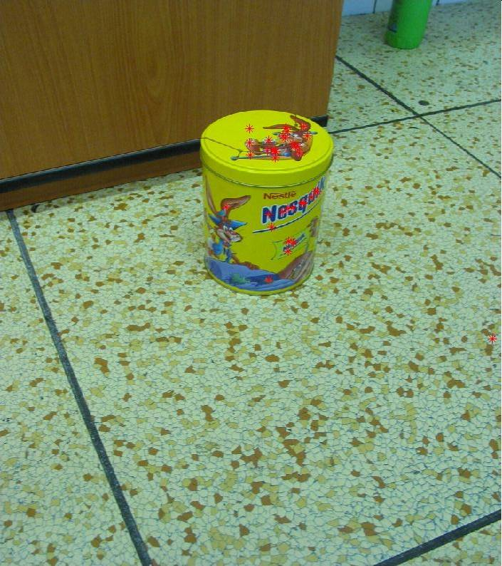
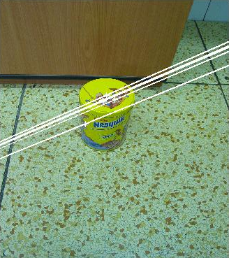
Two-view geometry

Slide 51

Epipolar geometry
X
x
x’
Baseline – line connecting the two camera centers
Epipolar Plane – plane containing baseline (1D family)
Epipoles
= intersections of baseline with image planes
= projections of the other camera center
slide: S. Lazebnik

Slide 52
Epipolar geometry
X
x
x’
Baseline – line connecting the two camera centers
Epipolar Plane – plane containing baseline (1D family)
Epipoles
= intersections of baseline with image planes
= projections of the other camera center
Epipolar Lines - intersections of epipolar plane with image
planes (always come in corresponding pairs)
slide: S. Lazebnik

Slide 53
2-view geometry: The uncalibrated F-Matrix
Projection onto two views:
Epipolar line
P₀
Z
Y
P₁
O
X
C₁

Slide 54
The Fundamental Matrix F
The projective points e₁ and (H∞m₀) define a plane in camera 1 (epipolar plane Π_{e})
the epipolar plane intersects the image plane 1 in a line (epipolar line u_{e})
the corresponding point m₁ lies on line u_{e}: m₁^{T}u_{e}= 0
If the points (e₁),(m₁),(H∞m₀) are all collinear, then the colinearity theorem applies: m₁^{T} (e₁ x H∞m₀) = 0.
Fundamental Matrix F
Epipolar constraint

Slide 55
The Fundamental Matrix F
F = [e]_{x}H = Fundamental Matrix
P0
L
m0
M
M
l1
Epipole
e₁
m1
Hm₀
P1

Slide 56
Estimation of F from image correspondences
Given a set of corresponding points, solve linearily for the 9 elements of F in projective coordinates
since the epipolar constraint is homogeneous up to scale, only eight elements are independent
since the operator [e]_{x} and hence F have rank 2, F has only 7 independent parameters (all epipolar lines intersect at e)
each correspondence gives 1 collinearity constraint
=> solve F with minimum of 7 correspondences
for N>7 correspondences minimize distance point-line:

Slide 57
Linear Estimation of F with 8-Point-Algorithm
solve F linearily with 8 correspondences using the normalized 8-point algorithm (Hartley 1995):
  normalize image coordinates of 8 correspondences for numerical conditioning
  solve the rank 8 equation Af = 0 for the elements f_{k} of matrix F.
  apply the rank-2 constraint det(F)=0 as additional condition to fix epipole
  denormalize F.

Slide 58
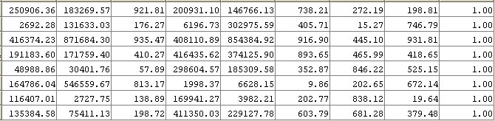
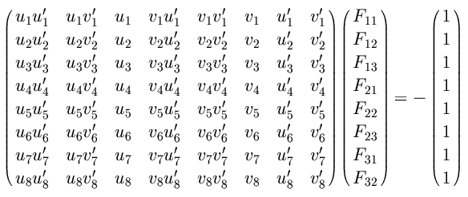
Problem with eight-point algorithm
Poor numerical conditioning
Can be fixed by rescaling the data
slide: S. Lazebnik

Slide 59
The normalized eight-point algorithm
(Hartley, 1995)
Center the image data at the origin, and scale it so the mean squared distance between the origin and the data points is 2 pixels
Use the eight-point algorithm to compute F from the normalized points
Enforce the rank-2 constraint (for example, take SVD of F and throw out the smallest singular value)
Transform fundamental matrix back to original units: if T and T’ are the normalizing transformations in the two images, than the fundamental matrix in original coordinates is T^{T} F T’
slide: S. Lazebnik

Slide 60

Comparison of estimation algorithms
 | 8-point | Normalized 8-point | Nonlinear least squares
Av. Dist. 1 | 2.33 pixels | 0.92 pixel | 0.86 pixel
Av. Dist. 2 | 2.18 pixels | 0.85 pixel | 0.80 pixel

Slide 61



Example: Converging cameras
slide: S. Lazebnik

Slide 62



Example: Motion parallel to image plane

Slide 63
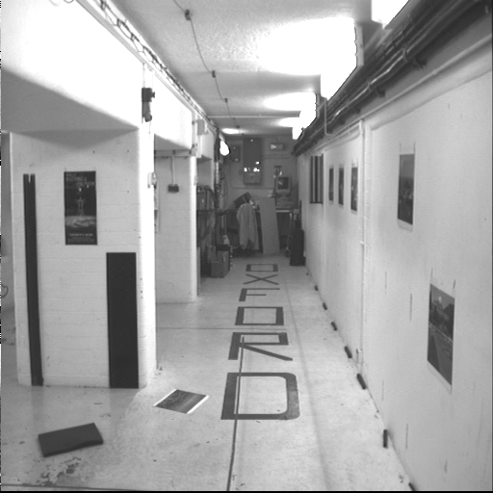
Example: Motion perpendicular to image plane
slide: S. Lazebnik

Slide 64
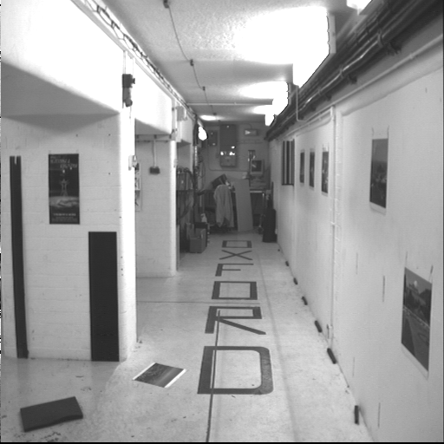
Example: Motion perpendicular to image plane
slide: S. Lazebnik

Slide 65
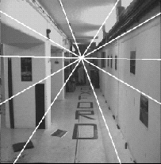
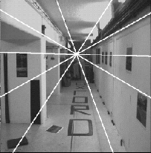
Example: Motion perpendicular to image plane
e’
e
Epipole has same coordinates in both images.
Points move along lines radiating from e: “Focus of expansion”
slide: S. Lazebnik

Slide 66
Epipolar constraint example
slide: S. Lazebnik

Slide 67
Epipolar constraint: Calibrated case
X
x
x’
Assume that the intrinsic and extrinsic parameters of the cameras are known
We can multiply the projection matrix of each camera (and the image points) by the inverse of the calibration matrix to get normalized image coordinates
We can also set the global coordinate system to the coordinate system of the first camera. Then the projection matrix of the first camera is [I | 0].
slide: S. Lazebnik

Slide 68
Epipolar constraint: Calibrated case
X
= RX’ + t
x
x’
t
R
The vectors x, t, and Rx’ are coplanar
slide: S. Lazebnik
Notes:
X’ is X in the second camera’s coordinate system
We can identify the non-homogeneous 3D vectors X and X’ with the homogeneous coordinate vectors x and x’ of the projections of the two points into the two respective images

Slide 69
Epipolar constraint: Calibrated case
X
x
x’
Essential Matrix
(Longuet-Higgins, 1981)
The vectors x, t, and Rx’ are coplanar
slide: S. Lazebnik

Slide 70
The Essential Matrix E
E holds the relative orientation of a calibrated camera pair. It has 5 degrees of freedom: 3 from rotation matrix R_{ik}, 2 from direction of translation e, the epipole.
E has a cubic constraint that restricts E to 5 dof (Nister 2004)

Slide 71
Relative Pose P from E
E holds the relative orientation between 2 calibrated cameras P₀ and P₁:
Given P₀ as coordinate frame, the relative orientation of P₁ is determined directly from E up to a 4-fold rotation ambiguity (P_{1a} - P_{1d}). The ambiguity is resolved by correspondence triangulation: The 3D point M of a corresponding 2D image point pair must be in front of both cameras. The epipolar vector e has norm 1.
Relative Pose from E and correspondence: Case c is correct relative pose in this case

