Slide 1
Segmentation
slides adopted from Svetlana Lazebnik

Slide 2

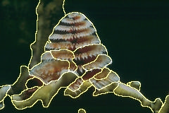
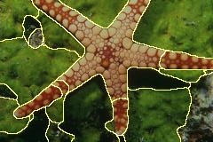
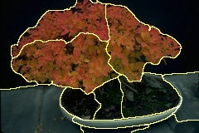
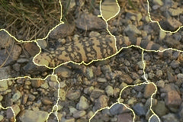
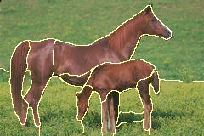
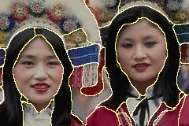
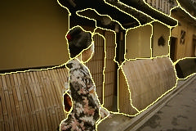
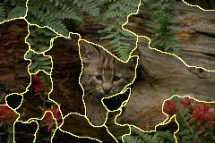
Image segmentation

Slide 3
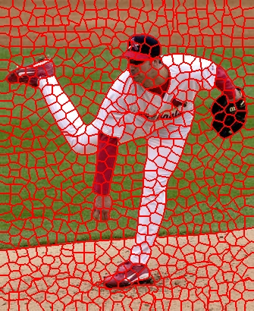
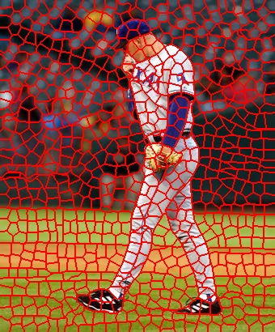
The goals of segmentation
Group together similar-looking pixels for efficiency of further processing
  “Bottom-up” process
  Unsupervised
“superpixels”
X. Ren and J. Malik. Learning a classification model for segmentation. ICCV 2003.

Slide 4




The goals of segmentation
Separate image into coherent “objects”
  “Bottom-up” or “top-down” process?
  Supervised or unsupervised?
image
human segmentation
Berkeley segmentation database:
http://www.eecs.berkeley.edu/Research/Projects/CS/vision/grouping/segbench/

Slide 5
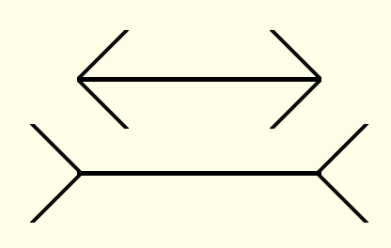
Inspiration from psychology
The Gestalt school: Grouping is key to visual perception
The Muller-Lyer illusion
http://en.wikipedia.org/wiki/Gestalt_psychology

Slide 6
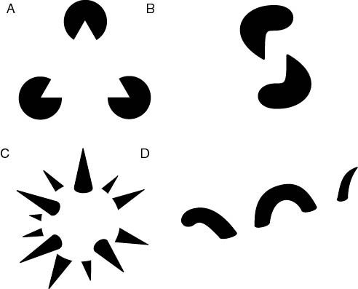
The Gestalt school
Elements in a collection can have properties that result from relationships
  “The whole is greater than the sum of its parts”
subjective contours
occlusion
familiar configuration
http://en.wikipedia.org/wiki/Gestalt_psychology

Slide 7
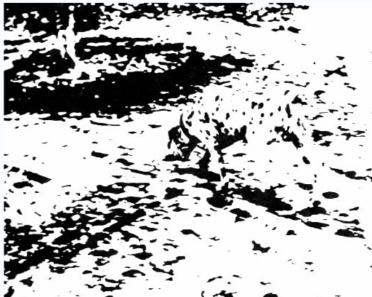
Emergence
http://en.wikipedia.org/wiki/Gestalt_psychology

Slide 8
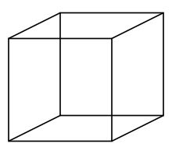
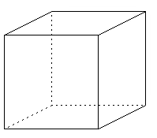
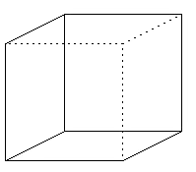
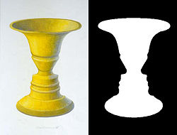
Multistability

Slide 9
Gestalt factors

Slide 10
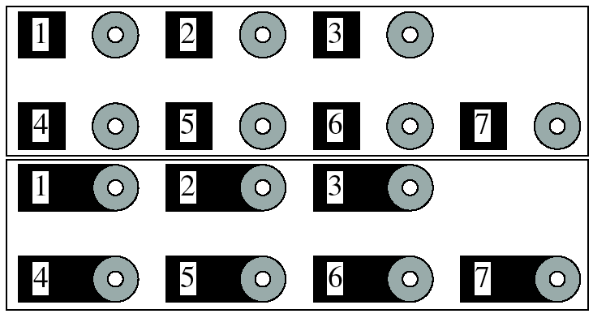
Grouping phenomena in real life
Forsyth & Ponce, Figure 14.7
Notes:
The story is in the book (figure 14.7)

Slide 11
Grouping phenomena in real life
Forsyth & Ponce, Figure 14.7
Notes:
The story is in the book (figure 14.7)

Slide 12
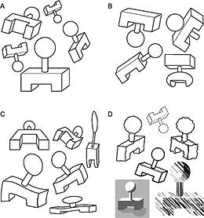
Invariance

Slide 13
Gestalt factors
These factors make intuitive sense, but are very difficult to translate into algorithms

Slide 14
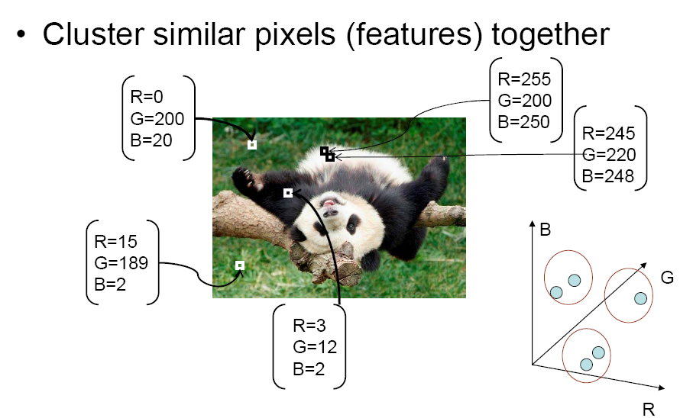
Segmentation as clustering
Source: K. Grauman

Slide 15
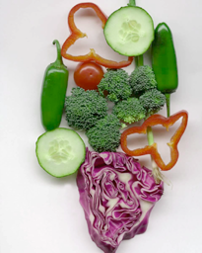
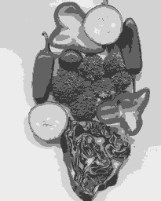
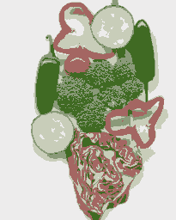
Segmentation as clustering
K-means clustering based on intensity or color is essentially vector quantization of the image attributes
  Clusters don’t have to be spatially coherent
Image
Intensity-based clusters
Color-based clusters
Notes:
I gave each pixel the mean intensity or mean color of its cluster --- this is basically just vector quantizing the image intensities/colors. Notice that there is no requirement that clusters be spatially localized and they’re not.

Slide 16
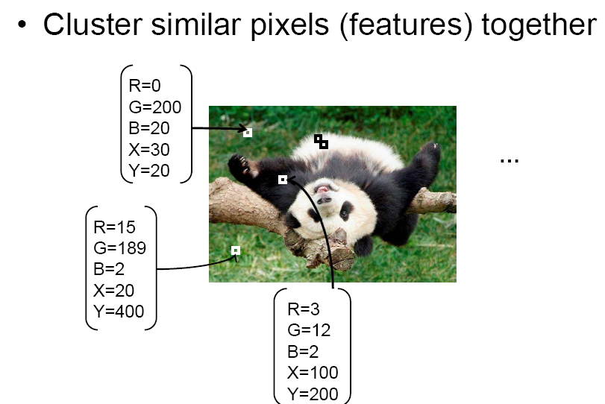
Segmentation as clustering
Source: K. Grauman

Slide 17

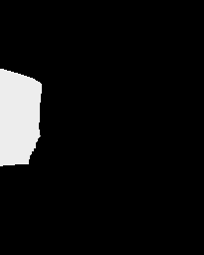



Segmentation as clustering
Clustering based on (r,g,b,x,y) values enforces more spatial coherence

Slide 18
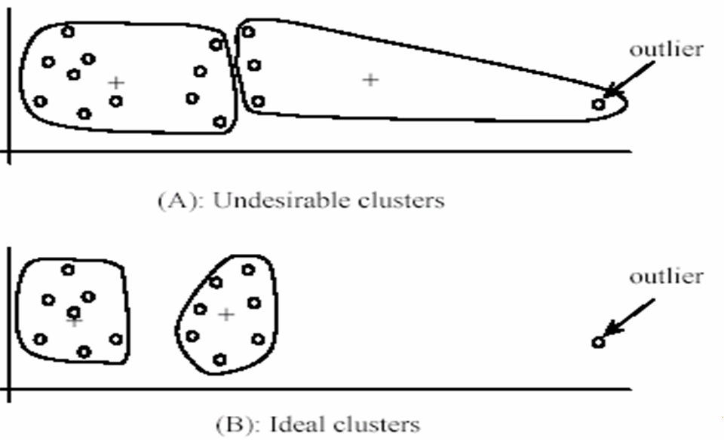
K-Means for segmentation
Pros
  Very simple method
  Converges to a local minimum of the error function
Cons
  Memory-intensive
  Need to pick K
  Sensitive to initialization
  Sensitive to outliers
  Only finds “spherical”
  clusters

Slide 19
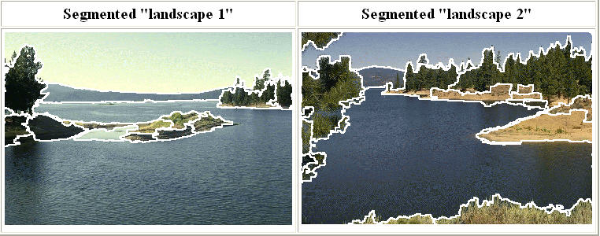
Mean shift clustering and segmentation
An advanced and versatile technique for clustering-based segmentation
http://www.caip.rutgers.edu/~comanici/MSPAMI/msPamiResults.html
D. Comaniciu and P. Meer, Mean Shift: A Robust Approach toward Feature Space Analysis, PAMI 2002.

Slide 20
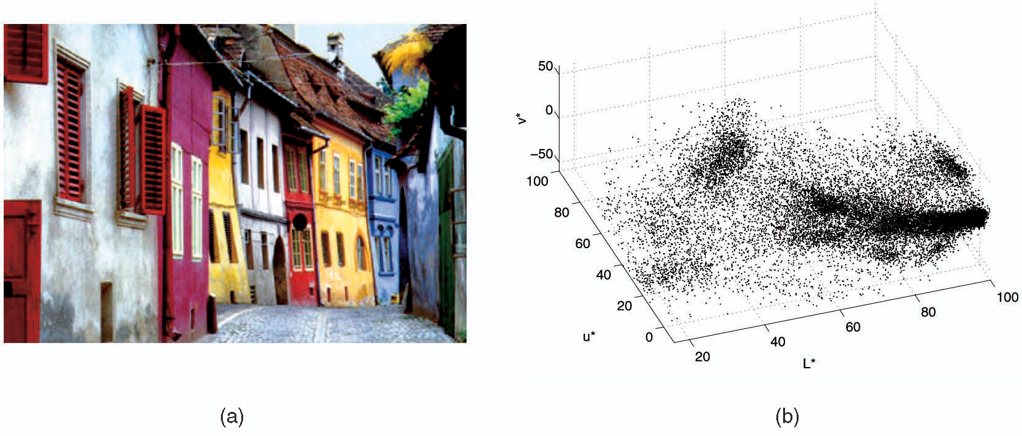
Mean shift algorithm
The mean shift algorithm seeks modes or local maxima of density in the feature space
Feature space
(L*u*v* color values)
image

Slide 21
Mean shift
Search
window
Center of
mass
Mean Shift
vector
Slide by Y. Ukrainitz & B. Sarel

Slide 22
Mean shift
Search
window
Center of
mass
Mean Shift
vector
Slide by Y. Ukrainitz & B. Sarel

Slide 23
Mean shift
Search
window
Center of
mass
Mean Shift
vector
Slide by Y. Ukrainitz & B. Sarel

Slide 24
Mean shift
Search
window
Center of
mass
Mean Shift
vector
Slide by Y. Ukrainitz & B. Sarel

Slide 25
Mean shift
Search
window
Center of
mass
Mean Shift
vector
Slide by Y. Ukrainitz & B. Sarel

Slide 26
Mean shift
Search
window
Center of
mass
Mean Shift
vector
Slide by Y. Ukrainitz & B. Sarel

Slide 27
Mean shift
Search
window
Center of
mass
Slide by Y. Ukrainitz & B. Sarel

Slide 28
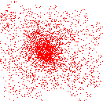
Mean shift clustering
Cluster: all data points in the attraction basin of a mode
Attraction basin: the region for which all trajectories lead to the same mode
Slide by Y. Ukrainitz & B. Sarel

Slide 29
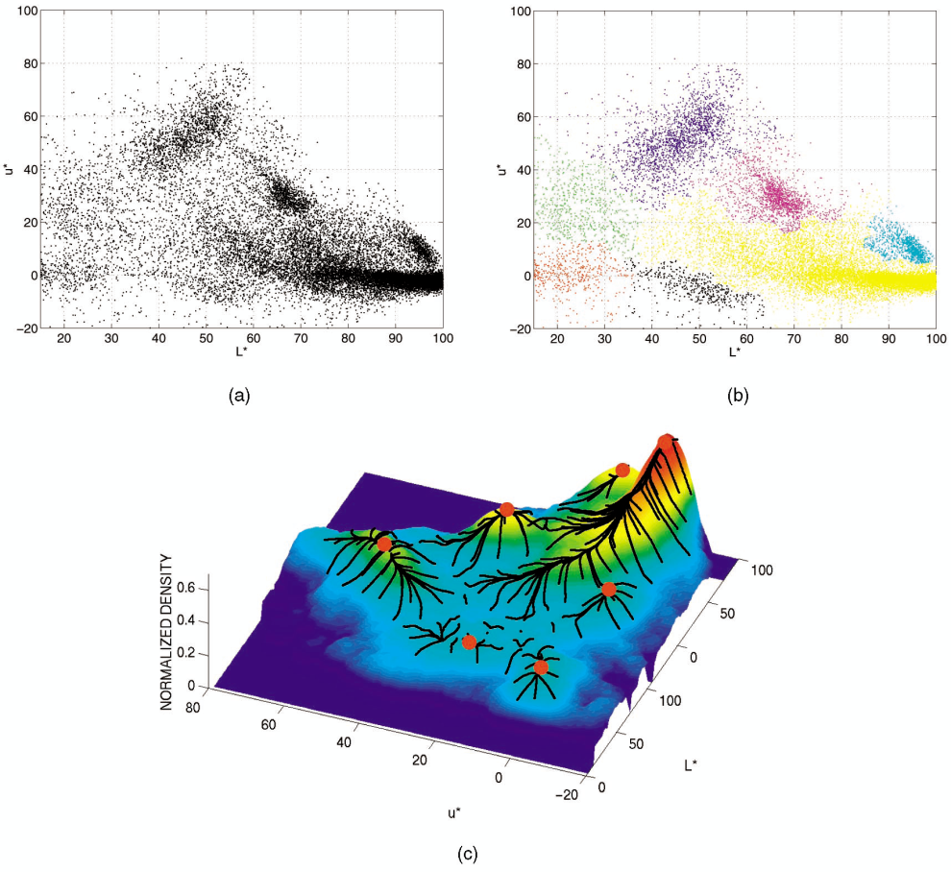
Mean shift clustering/segmentation
Find features (color, gradients, texture, etc)
Initialize windows at individual feature points
Perform mean shift for each window until convergence
Merge windows that end up near the same “peak” or mode

Slide 30
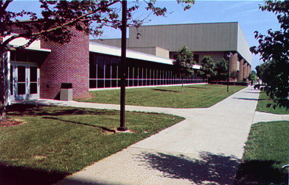
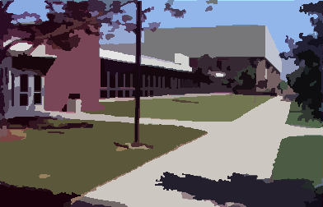
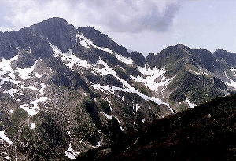

Mean shift segmentation results
http://www.caip.rutgers.edu/~comanici/MSPAMI/msPamiResults.html

Slide 31
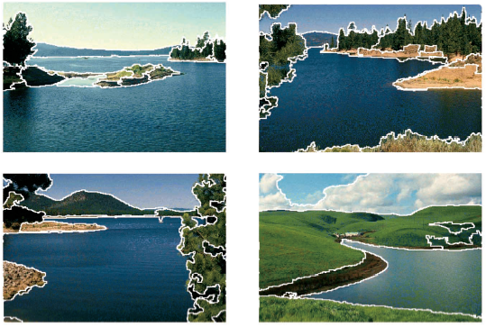
More results

Slide 32
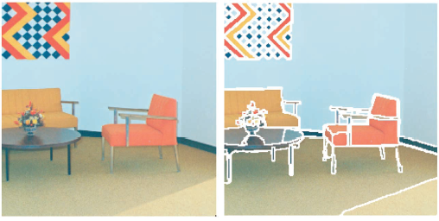
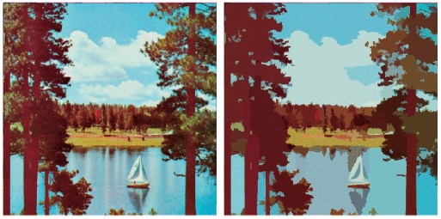
More results

Slide 33
Mean shift pros and cons
Pros
  Does not assume spherical clusters
  Just a single parameter (window size)
  Finds variable number of modes
  Robust to outliers
Cons
  Output depends on window size
  Computationally expensive
  Does not scale well with dimension of feature space

Slide 34
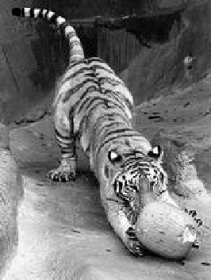
Images as graphs
j
w_{ij}
i
Node for every pixel
Edge between every pair of pixels (or every pair of “sufficiently close” pixels)
Each edge is weighted by the affinity or similarity of the two nodes
Source: S. Seitz

Slide 35
Segmentation by graph partitioning
j
w_{ij}
i
A
B
C
Break Graph into Segments
  Delete links that cross between segments
  Easiest to break links that have low affinity
    similar pixels should be in the same segments
    dissimilar pixels should be in different segments
Source: S. Seitz

Slide 36
Measuring affinity
Suppose we represent each pixel by a feature vector x, and define a distance function appropriate for this feature representation
Then we can convert the distance between two feature vectors into an affinity with the help of a generalized Gaussian kernel:

Slide 37
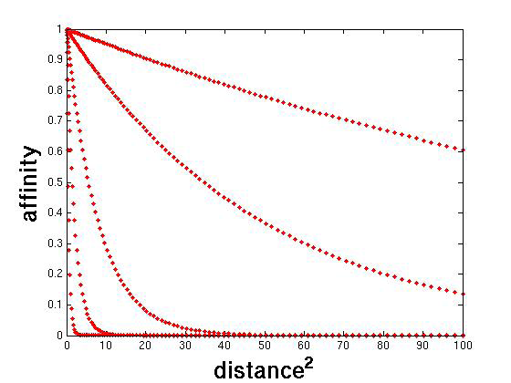
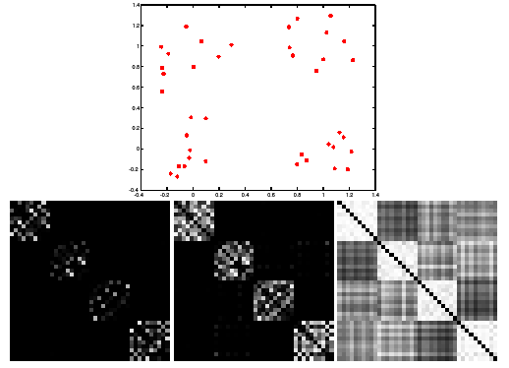
Scale affects affinity
Small σ: group only nearby points
Large σ: group far-away points

Slide 38
Graph cut
B
A
Set of edges whose removal makes a graph disconnected
Cost of a cut: sum of weights of cut edges
A graph cut gives us a segmentation
  What is a “good” graph cut and how do we find one?
Source: S. Seitz

Slide 39

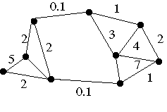
Minimum cut
We can do segmentation by finding the minimum cut in a graph
  Efficient algorithms exist for doing this
Minimum cut example

Slide 40
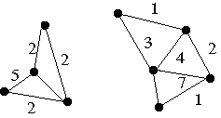
Minimum cut
We can do segmentation by finding the minimum cut in a graph
  Efficient algorithms exist for doing this
Minimum cut example

Slide 41
Normalized cut
Drawback: minimum cut tends to cut off very small, isolated components
Cuts with
lesser weight
than the
ideal cut
Ideal Cut
* Slide from Khurram Hassan-Shafique CAP5415 Computer Vision 2003

Slide 42
Normalized cut
Drawback: minimum cut tends to cut off very small, isolated components
This can be fixed by normalizing the cut by the weight of all the edges incident to the segment
The normalized cut cost is:
  w(A, B) = sum of weights of all edges between A and B
J. Shi and J. Malik. Normalized cuts and image segmentation. PAMI 2000

Slide 43
Normalized cut
Let W be the adjacency matrix of the graph
Let D be the diagonal matrix with diagonal entries D(i, i) = Σ_{j} W(i, j)
Then the normalized cut cost can be written as
where y is an indicator vector whose value should be 1 in the ith position if the ith feature point belongs to A and a negative constant otherwise
J. Shi and J. Malik. Normalized cuts and image segmentation. PAMI 2000

Slide 44
Normalized cut
Finding the exact minimum of the normalized cut cost is NP-complete, but if we relax y to take on arbitrary values, then we can minimize the relaxed cost by solving the generalized eigenvalue problem (D − W)y = λDy
The solution y is given by the generalized eigenvector corresponding to the second smallest eigenvalue
Intutitively, the ith entry of y can be viewed as a “soft” indication of the component membership of the ith feature
  Can use 0 or median value of the entries as the splitting point (threshold), or find threshold that minimizes the Ncut cost

Slide 45
Normalized cut algorithm
Represent the image as a weighted graph
G = (V,E), compute the weight of each edge, and summarize the information in D and W
Solve (D − W)y = λDy for the eigenvector with the second smallest eigenvalue
Use the entries of the eigenvector to bipartition the graph
To find more than two clusters:
Recursively bipartition the graph
Run k-means clustering on values of
several eigenvectors

Slide 46
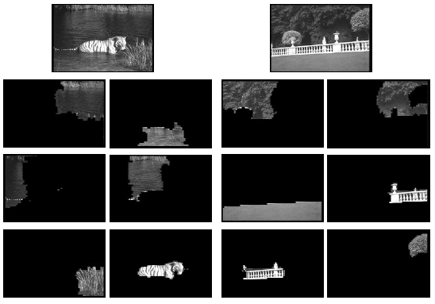
Example result

Slide 47
Segmentation
many slides from Svetlana Lazebnik, Anat Levin

Slide 48
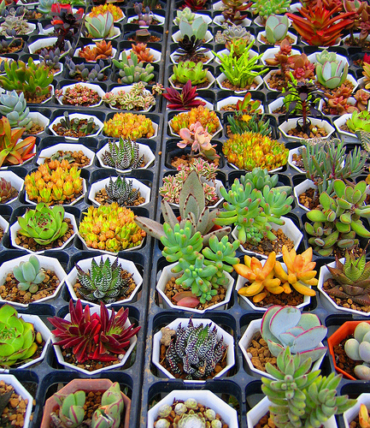
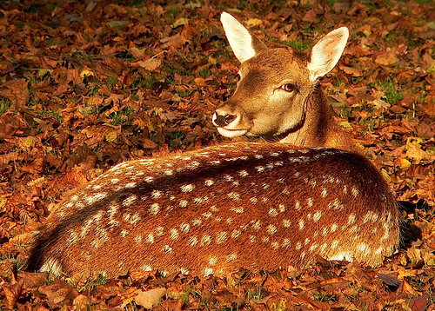
Challenge
How to segment images that are a “mosaic of textures”?

Slide 49
Using texture features for segmentation
Convolve image with a bank of filters
J. Malik, S. Belongie, T. Leung and J. Shi. "Contour and Texture Analysis for Image Segmentation". IJCV 43(1),7-27,2001.

Slide 50
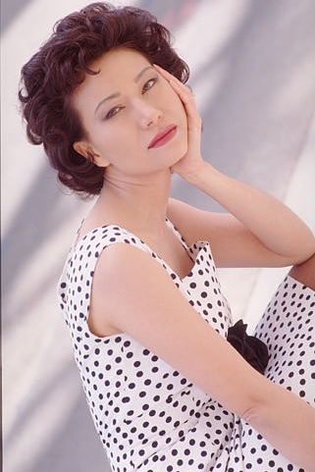
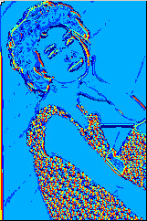
Using texture features for segmentation
Convolve image with a bank of filters
Find textons by clustering vectors of filter bank outputs
Image
Texton map
J. Malik, S. Belongie, T. Leung and J. Shi. "Contour and Texture Analysis for Image Segmentation". IJCV 43(1),7-27,2001.

Slide 51

Using texture features for segmentation
Convolve image with a bank of filters
Find textons by clustering vectors of filter bank outputs
The final texture feature is a texton histogram computed over image windows at some “local scale”
J. Malik, S. Belongie, T. Leung and J. Shi. "Contour and Texture Analysis for Image Segmentation". IJCV 43(1),7-27,2001.

Slide 52
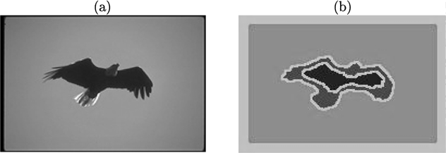
Pitfall of texture features
Possible solution: check for “intervening contours” when computing connection weights
J. Malik, S. Belongie, T. Leung and J. Shi. "Contour and Texture Analysis for Image Segmentation". IJCV 43(1),7-27,2001.

Slide 53
Example results

Slide 54
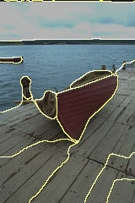
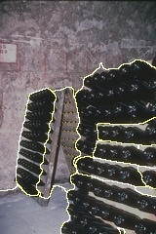
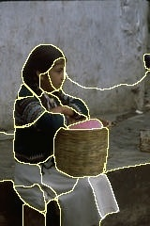






Results: Berkeley Segmentation Engine
http://www.cs.berkeley.edu/~fowlkes/BSE/

Slide 55
Normalized cuts: Pro and con
Pros
  Generic framework, can be used with many different features and affinity formulations
Cons
  High storage requirement and time complexity
  Bias towards partitioning into equal segments

Slide 56

Segments as primitives for recognition
J. Tighe and S. Lazebnik, ECCV 2010

Slide 57






Bottom-up segmentation
Bottom-up approaches: Use low level cues to group
similar pixels
Normalized cuts
Mean shift
…

Slide 58

Bottom-up segmentation is ill posed
Many possible segmentation are equally good based on low level cues alone.
Some segmentation example (maybe horses from Eran’s paper)
images from Borenstein and Ullman 02

Slide 59

Top-down segmentation
Class-specific, top-down segmentation (Borenstein & Ullman Eccv02)
Winn and Jojic 05
Leibe et al 04
Yuille and Hallinan 02.
Liu and Sclaroff 01
Yu and Shi 03

Slide 60



Combining top-down and bottom-up segmentation
+
Find a segmentation:
Similar to the top-down model
Aligns with image edges

Slide 61

Why learning top-down and bottom-up models simultaneously?
Large number of freedom degrees in tentacles configuration- requires a complex deformable top down model
On the other hand: rather uniform colors- low level segmentation is easy

Slide 62
Combined Learning Approach
Learn top-down and bottom-up models simultaneously
Reduces at run time to energy minimization with binary labels (graph min cut)

Slide 63


Energy model
Segmentation alignment with image edges
Consistency with fragments segmentation

Slide 64

Energy model
Segmentation alignment with image edges
Consistency with fragments segmentation

Slide 65



Energy model
Segmentation alignment with image edges
Consistency with fragments segmentation
Resulting min-cut segmentation

Slide 66





Learning from segmented class images
Training data:
Learn fragments for an energy function

Slide 67













Fragments selection
Candidate fragments pool:
Greedy energy design:

Slide 68
Fragments selection challenges
Straightforward computation of likelihood improvement is impractical
2000 Fragments
50 Training images
10 Fragments selection iterations
1,000,000 inference operations!

Slide 69
Fragments selection
First order approximation to log-likelihood gain:
Fragment with low error on the training set
Fragment not accounted for by the existing model

Slide 70
Fragments selection
First order approximation to log-likelihood gain:
Requires a single inference process on the previous iteration energy to evaluate approximations with respect to all fragments
First order approximation evaluation is linear in the fragment size

Slide 71





Training horses model

Slide 72






Training horses model-one fragment

Slide 73





Training horses model-two fragments

Slide 74





Training horses model-three fragments

Slide 75











Results- horses dataset

Slide 76
Results- horses dataset
Mislabeled pixels percent
Fragments number
Comparable to previous but with far fewer fragments

Slide 77



Results- artificial octopi

Slide 78

Top-down segmentation
E. Borenstein and S. Ullman, “Class-specific, top-down segmentation,” ECCV 2002
A. Levin and Y. Weiss, “Learning to Combine Bottom-Up and Top-Down Segmentation,” ECCV 2006.

Slide 79




Visual motion
Many slides adapted from S. Seitz, R. Szeliski, M. Pollefeys

Slide 80
Motion and perceptual organization
Sometimes, motion is the only cue

Slide 81

Motion and perceptual organization
Sometimes, motion is the only cue

Slide 82

Motion and perceptual organization
Even “impoverished” motion data can evoke a strong percept
G. Johansson, “Visual Perception of Biological Motion and a Model For Its Analysis", Perception and Psychophysics 14, 201-211, 1973.

Slide 83
Motion and perceptual organization
Even “impoverished” motion data can evoke a strong percept
G. Johansson, “Visual Perception of Biological Motion and a Model For Its Analysis", Perception and Psychophysics 14, 201-211, 1973.

Slide 84

Motion and perceptual organization
Even “impoverished” motion data can evoke a strong percept
G. Johansson, “Visual Perception of Biological Motion and a Model For Its Analysis", Perception and Psychophysics 14, 201-211, 1973.

Slide 85
Uses of motion
Estimating 3D structure
Segmenting objects based on motion cues
Learning and tracking dynamical models
Recognizing events and activities

Slide 86


Motion field
The motion field is the projection of the 3D scene motion into the image

Slide 87
Motion field and parallax
X(t) is a moving 3D point
Velocity of scene point: V = dX/dt
x(t) = (x(t),y(t)) is the projection of X in the image
Apparent velocity v in the image: given by components v_{x} = dx/dt and v_{y} = dy/dt
These components are known as the motion field of the image
X(t+dt)
X(t)
V
v
x(t+dt)
x(t)

Slide 88
Motion field and parallax
X(t+dt)
To find image velocity v, differentiate x=(x,y) with respect to t (using quotient rule):
X(t)
V
v
x(t+dt)
x(t)
Image motion is a function of both the 3D motion (V) and the
depth of the 3D point (Z)
Notes:
Quotient rule for differentiation: D(f/g) = (g f’ – g’ f)/g^2

Slide 89
Motion field and parallax
Pure translation: V is constant everywhere

Slide 90

Motion field and parallax
Pure translation: V is constant everywhere
The length of the motion vectors is inversely proportional to the depth Z
V_{z} is nonzero:
  Every motion vector points toward (or away from) the vanishing point of the translation direction
Notes:
At the vanishing point of the motion location, the visual motion is zero
We have v = 0 when V_z x = v_0 or x = (f V_x / V_z, f V_y / V_z)

Slide 91
Motion field and parallax
Pure translation: V is constant everywhere
The length of the motion vectors is inversely proportional to the depth Z
V_{z} is nonzero:
  Every motion vector points toward (or away from) the vanishing point of the translation direction
V_{z} is zero:
  Motion is parallel to the image plane, all the motion vectors are parallel

Slide 92



Optical Flow based segmentation
segmentation of flow vectors using the above techniques:
  mean shift
  normalized cuts
  top down approaches

