Slide 1
Introduction to the Essentials of Excel
COMP 066

Slide 2
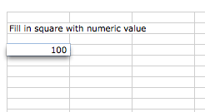
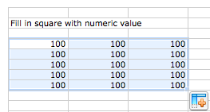
Fill in Square with Numeric Value
Click cell and type value <enter>
Click lower right corner of marked cell
Drag over fill area

Slide 3
Fill Square with Text Value
Analog to numeric value

Slide 4
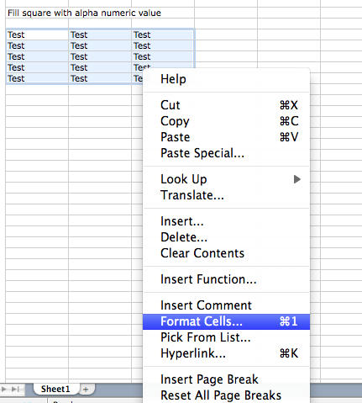
Format cells
Change the type of the data in the cell

Slide 5
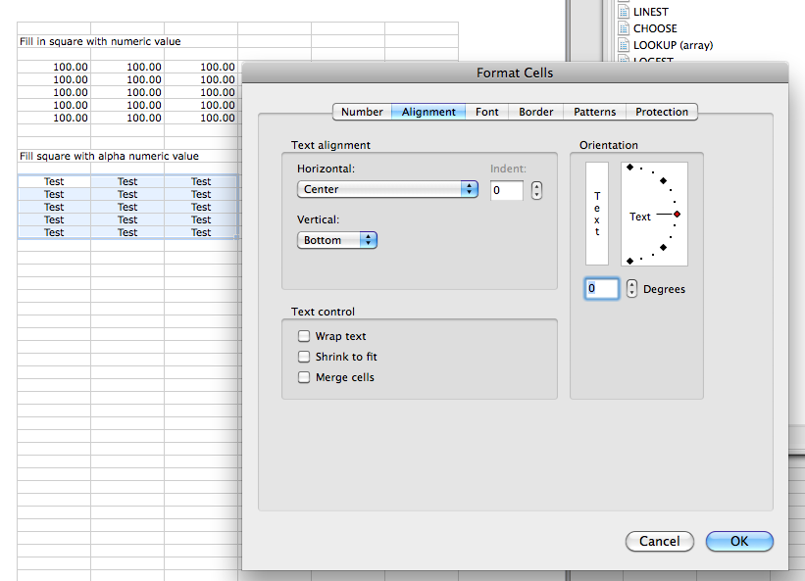
Format cell
Mark all cells to format
Right click on cells select <Format Cells…>
Select desired properties
number digits
alignment
date format

Slide 6
Arithmetic on Pairs of Values
For computation start with “=“ and then arithmetic expression
hit enter to calculate

Slide 7
Reference Values of other Cells
Reference through letter for column and number for row
$ makes reference absolute so it does not change during copy and paste as well as during extension
normally adapts itself during copy and paste

Slide 8
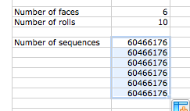
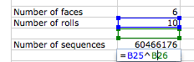
Extending Cells with References
Absolute reference:
Relative reference:

Slide 9
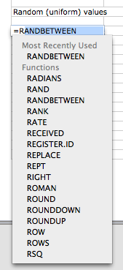
Function RANDBETWEEN() & RAND()
RANDBETWEEN(a,b) delivers integer between a and b
RAND() delivers uniformly distributed random number between 0 and 1

Slide 10
INT() & ROUND()
INT() truncates decimal digits
Round() rounds with given precision

Slide 11
Logical Values (TRUE/FALSE)
Comparison result
Combine logical values with AND() and OR() function
logical AND is multiplication, logical OR is addition

Slide 12
IF THEN ELSE
Conditionals used to decide about further computation

Slide 13
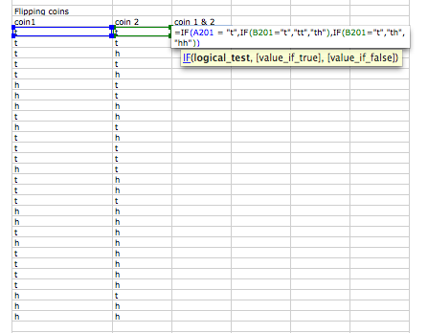
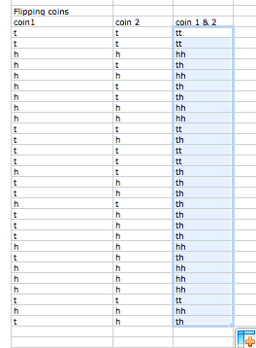
Combining cell values
Dual coin flip with double IF for test of results to generate output of double coin flip
= B201&C201

Slide 14
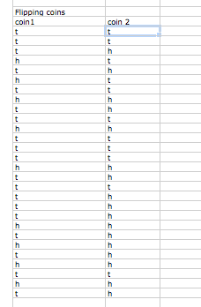
Flipping a coin
Random number 1 or 2 (use RANDBETWEEN)
Use IF to display
“h” for head when 2
“t” for tail when 1
Extend to simulate multiple coin flips

Slide 15
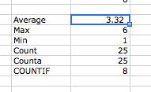
Operations on data
Average
Max
Min
Counting cells
counts all cells with numeric value
counts all non empty cells
counts cell fulfilling condition
=AVERAGE(D6:D30)
=MAX(D6:D30)
=MIN(D6:D30)
=COUNT(D5:D31)
=COUNTA(D5:D31)
=COUNTIF(D6:D30, "<=2")

Slide 16
INDEX
INDEX obtains the value of the indexed cell in value
D6-D30 give range of cells to select from
RANDBETWEEN delivers random index
COUNT delivers max index by counting the cells in D6-D30

Slide 17
Use Help
If you don’t know the function use the help function!
describes the functions
input
compute function
output
has examples to understand the function

Slide 18
Simulation in Excel
Enumerate the event outcomes
List the probabilities for each outcome, either by entry or by computation
Compute final entry in list with =1-sum(a:b) where a:b spans the rest of the list
For each compound event, compute its probability from the simple event probabilities:
using multiplication when the compound event outcome is the AND of two simple event outcomes
using addition when the compound event outcome is the OR of two or more simple event outcomes

