Slide 1
776 Computer Vision
Jan-Michael Frahm & Enrique Dunn

Slide 2
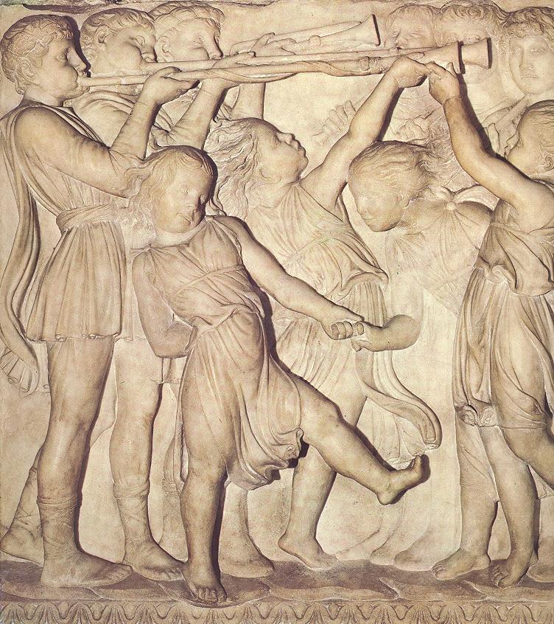
Photometric stereo (shape from shading)
Can we reconstruct the shape of an object based on shading cues?
Luca della Robbia,
Cantoria, 1438

Slide 3

Photometric stereo
Assume:
  A Lambertian object
  A local shading model (each point on a surface receives light only from sources visible at that point)
  A set of known light source directions
  A set of pictures of an object, obtained in exactly the same camera/object configuration but using different sources
  Orthographic projection
Goal: reconstruct object shape and albedo
S₂
S_{n}
S₁
???
Forsyth & Ponce, Sec. 5.4
slide: S. Lazebnik

Slide 4
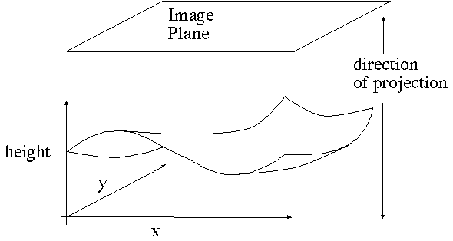
Surface model: Monge patch
Forsyth & Ponce, Sec. 5.4

Slide 5
Image model
Known: source vectors S_{j} and pixel values I_{j}(x,y)
We also assume that the response function of the camera is a linear scaling by a factor of k
Combine the unknown normal N(x,y) and albedo ρ(x,y) into one vector g, and the scaling constant k and source vectors S_{j} into another vector V_{j}:
slide: S. Lazebnik

Slide 6
Least squares problem
For each pixel, we obtain a linear system:
(n × 1)
(n × 3)
(3 × 1)
known
known
unknown
Obtain least-squares solution for g(x,y)
Since N(x,y) is the unit normal, ρ(x,y) is given by the magnitude of g(x,y) (and it should be less than 1)
Finally, N(x,y) = g(x,y) / ρ(x,y)
slide: S. Lazebnik

Slide 7
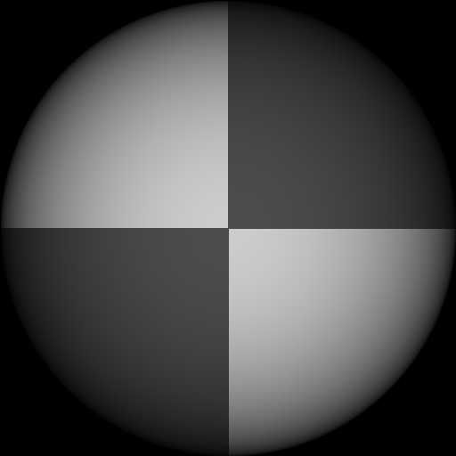
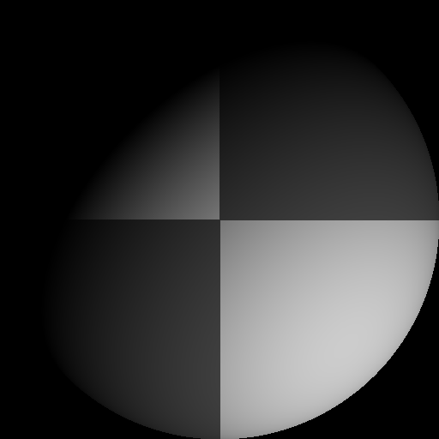
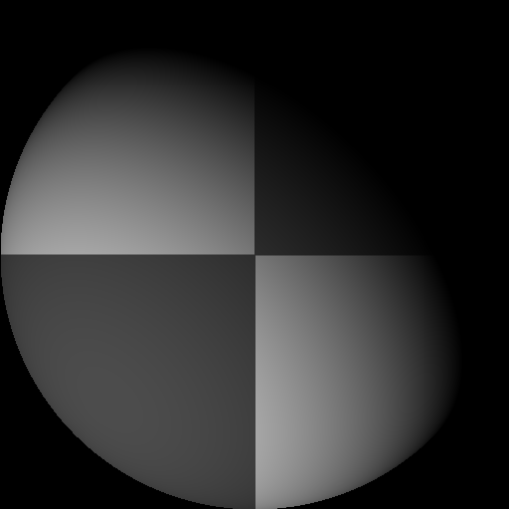
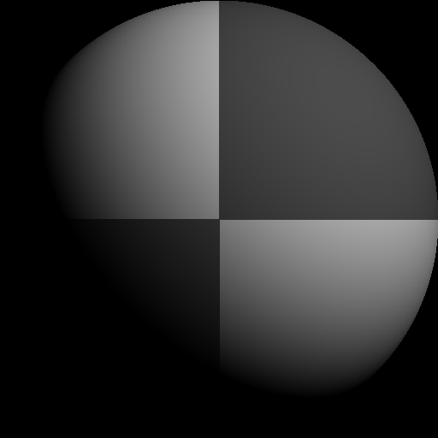
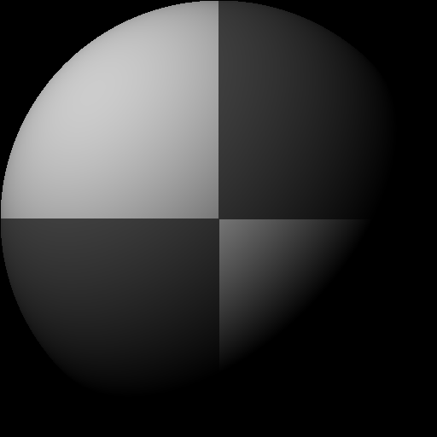
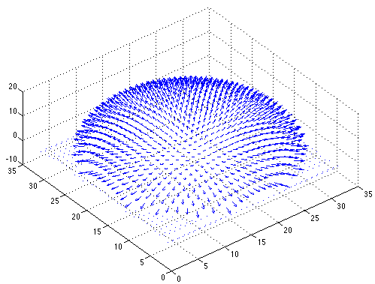

Example
Recovered albedo
Recovered normal field
Forsyth & Ponce, Sec. 5.4

Slide 8
Recovering a surface from normals
Recall the surface is written as
This means the normal has the form:
If we write the estimated vector g as
Then we obtain values for the partial derivatives of the surface:
slide: S. Lazebnik

Slide 9
Recovering a surface from normals
Integrability: for the surface f to exist, the mixed second partial derivatives must be equal:
We can now recover the surface height at any point by integration along some path, e.g.
(in practice, they should at least be similar)
(for robustness, can take integrals over many different paths and average the results)
slide: S. Lazebnik

Slide 10
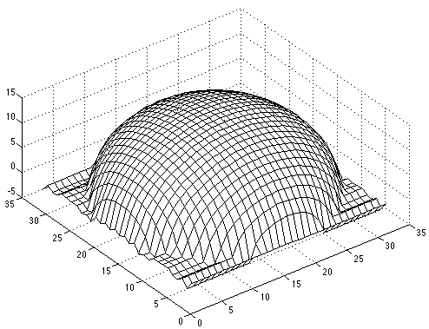
Surface recovered by integration
Forsyth & Ponce, Sec. 5.4

Slide 11
Reading
Szeliski 2.2-2.3
Szeliski 3.1-3.2

Slide 12
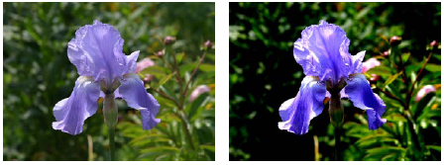
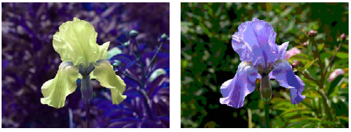
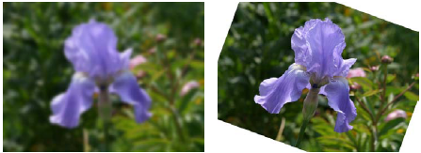
Typical image operations
image: R. Szeliski
Notes:
original, increased contrast, change in hue, posterized (quantized colors), blurred, rotated

Slide 13
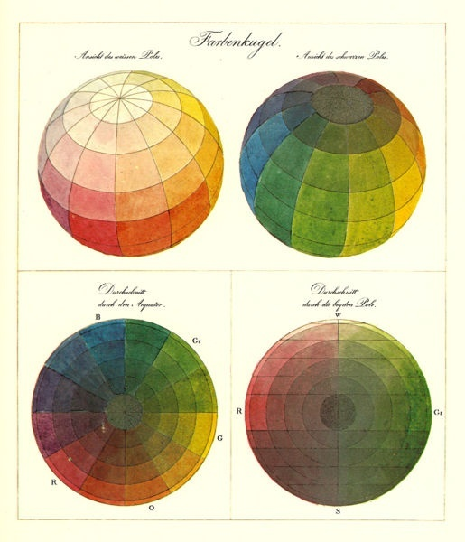
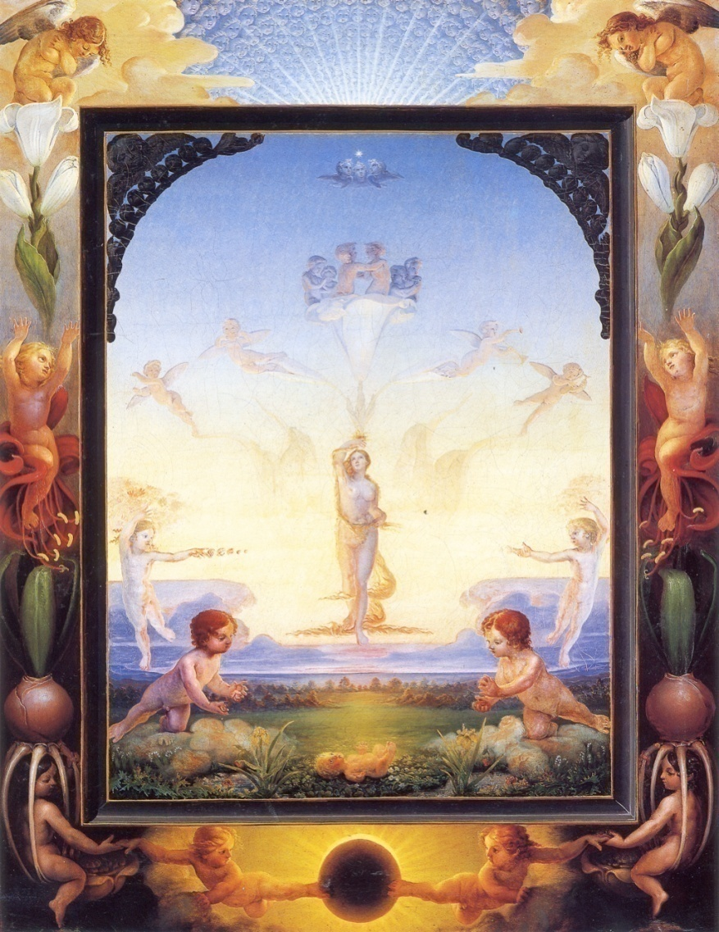
Color
Phillip Otto Runge (1777-1810)

Slide 14
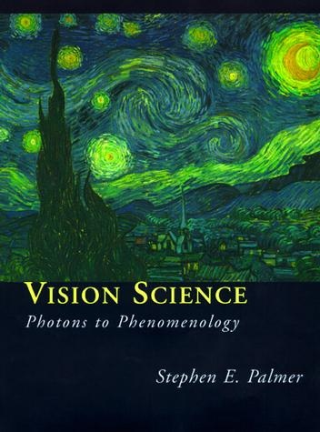
What is color?
Color is the result of interaction between physical light in the environment and our visual system
Color is a psychological property of our visual experiences when we look at objects and lights,
not a physical property of those objects or lights
(S. Palmer, Vision Science: Photons to Phenomenology)
slide: S. Lazebnik

Slide 15
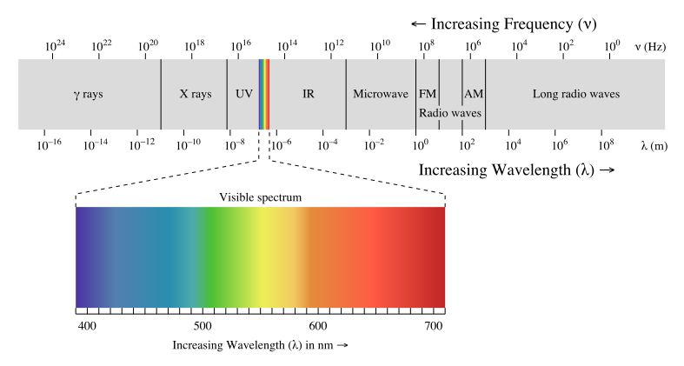
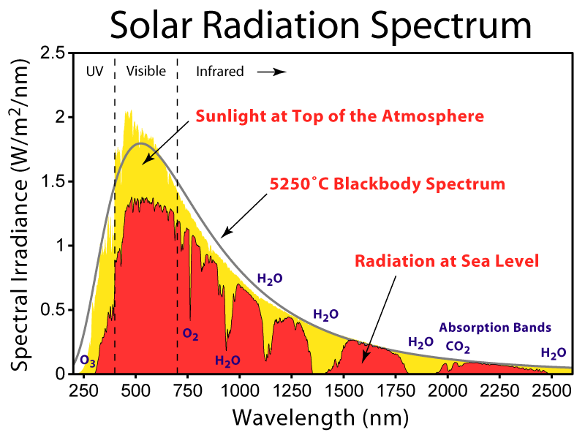

Electromagnetic spectrum
Human Luminance Sensitivity Function

Slide 16
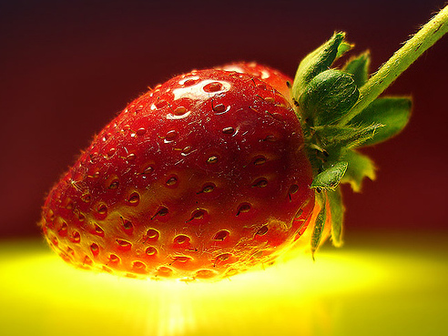
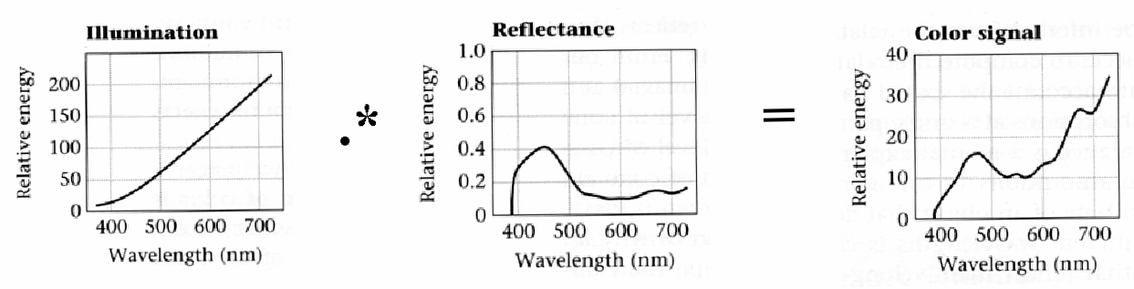
Interaction of light and surfaces
Reflected color is the result of interaction of light source spectrum with surface reflectance
slide: S. Lazebnik

Slide 17
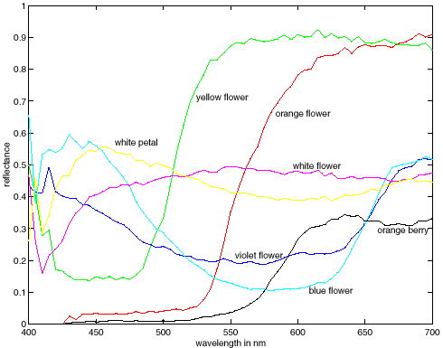
Spectra of some real-world surfaces
metamers
image: W. Freeman

Slide 18
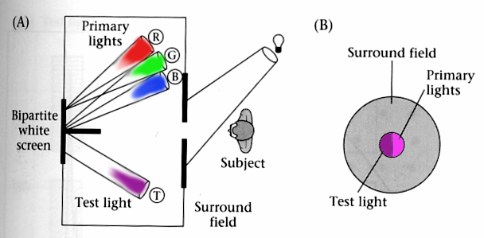
Standardizing color experience
We would like to understand which spectra produce the same color sensation in people under similar viewing conditions
Color matching experiments
Foundations of Vision, by Brian Wandell, Sinauer Assoc., 1995

Slide 19
Color matching experiment 1
Source: W. Freeman

Slide 20
Color matching experiment 1
p₁ p₂ p₃
Source: W. Freeman

Slide 21
Color matching experiment 1
p₁ p₂ p₃
Source: W. Freeman

Slide 22
Color matching experiment 1
The primary color amounts needed for a match
p₁ p₂ p₃
Source: W. Freeman

Slide 23
Color matching experiment 2
Source: W. Freeman

Slide 24
Color matching experiment 2
p₁ p₂ p₃
Source: W. Freeman

Slide 25
Color matching experiment 2
p₁ p₂ p₃
Source: W. Freeman

Slide 26
Color matching experiment 2
The primary color amounts needed for a match:
We say a “negative” amount of p₂ was needed to make the match, because we added it to the test color’s side.
p₁ p₂ p₃
p₁ p₂ p₃
p₁ p₂ p₃
Source: W. Freeman

Slide 27
Trichromacy
In color matching experiments, most people can match any given light with three primaries
  Primaries must be independent
For the same light and same primaries, most people select the same weights
  Exception: color blindness
Trichromatic color theory
  Three numbers seem to be sufficient for encoding color
  Dates back to 18th century (Thomas Young)
slide: S. Lazebnik

Slide 28
Grassman’s Laws
Color matching appears to be linear
If two test lights can be matched with the same set of weights, then they match each other:
  Suppose A = u₁ P₁ + u₂ P₂ + u₃ P₃ and B = u₁ P₁ + u₂ P₂ + u₃ P₃. Then A = B.
If we mix two test lights, then mixing the matches will match the result:
  Suppose A = u₁ P₁ + u₂ P₂ + u₃ P₃ and B = v₁ P₁ + v₂ P₂ + v₃ P₃. Then A + B = (u₁+v₁) P₁ + (u₂+v₂) P₂ + (u₃+v₃) P₃.
If we scale the test light, then the matches get scaled by the same amount:
  Suppose A = u₁ P₁ + u₂ P₂ + u₃ P₃.
  Then kA = (ku₁) P₁ + (ku₂) P₂ + (ku₃) P_{3.}
slide: S. Lazebnik

Slide 29
Linear color spaces
Defined by a choice of three primaries
The coordinates of a color are given by the weights of the primaries used to match it
mixing two lights produces
colors that lie along a straight
line in color space
mixing three lights produces
colors that lie within the triangle
they define in color space
slide: S. Lazebnik

Slide 30
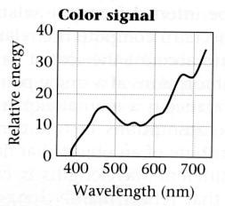
How to compute the weights of the primaries to match any spectral signal
Given: a choice of three primaries and a target color signal
Find: weights of the primaries needed to match the color signal
?
p₁ p₂ p₃
p₁ p₂ p₃
Matching functions: the amount of each primary needed to match a monochromatic light source at each wavelength
slide: S. Lazebnik

Slide 31
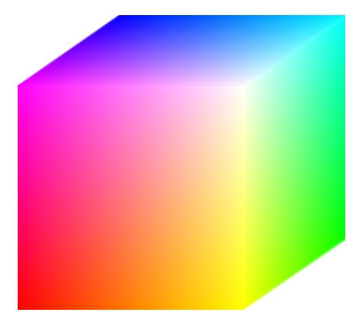
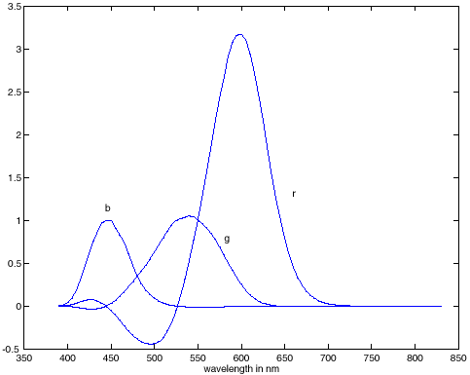
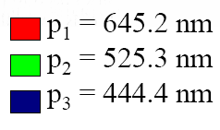
RGB space
Primaries are monochromatic lights (for monitors, they correspond to the three types of phosphors)
Subtractive matching required for some wavelengths
RGB primaries
RGB matching functions
slide: S. Lazebnik

Slide 32
How to compute the weights of the primaries to match any spectral signal
Let c(λ) be one of the matching functions, and let t(λ) be the spectrum of the signal. Then the weight of the corresponding primary needed to match t is
Matching functions, c(λ)
Signal to be matched, t(λ)
λ
slide: S. Lazebnik

Slide 33
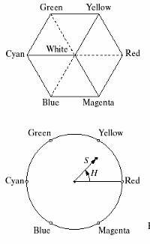
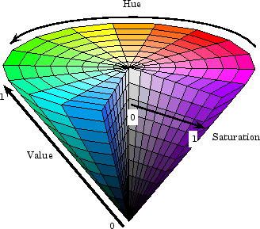
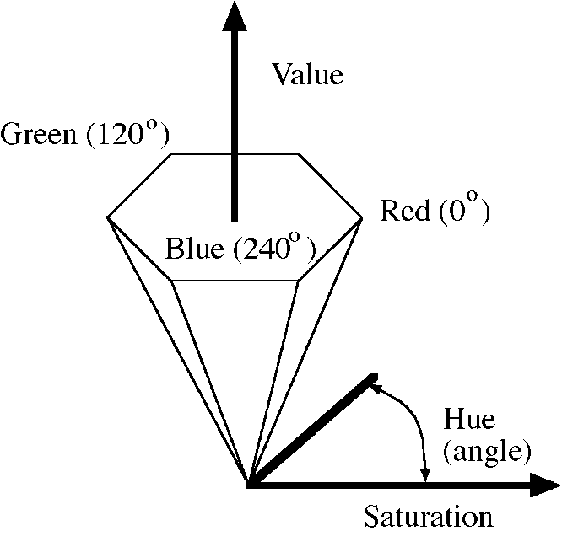
Nonlinear color spaces: HSV
Perceptually meaningful dimensions:
Hue, Saturation, Value (Intensity)
RGB cube on its vertex
slide: S. Lazebnik

Slide 34
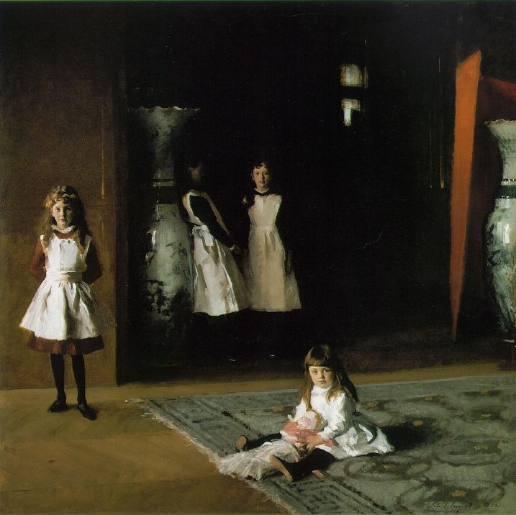
Color perception
Color/lightness constancy
  The ability of the human visual system to perceive the intrinsic reflectance properties of the surfaces despite changes in illumination conditions
Instantaneous effects
  Simultaneous contrast
  Mach bands
Gradual effects
  Light/dark adaptation
  Chromatic adaptation
  Afterimages
J. S. Sargent, The Daughters of Edward D. Boit, 1882
slide: S. Lazebnik

Slide 35

Simultaneous contrast/Mach bands
Source: D. Forsyth

Slide 36
Chromatic adaptation
The visual system changes its sensitivity depending on the luminances prevailing in the visual field
  The exact mechanism is poorly understood
Adapting to different brightness levels
  Changing the size of the iris opening (i.e., the aperture) changes the amount of light that can enter the eye
  Think of walking into a building from full sunshine
Adapting to different color temperature
  The receptive cells on the retina change their sensitivity
  For example: if there is an increased amount of red light, the cells receptive to red decrease their sensitivity until the scene looks white again
  We actually adapt better in brighter scenes: This is why candlelit scenes still look yellow
http://www.schorsch.com/kbase/glossary/adaptation.html
slide: S. Lazebnik

Slide 37
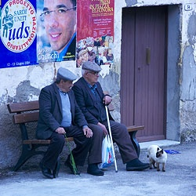
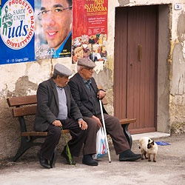
White balance
When looking at a picture on screen or print, we adapt to the illuminant of the room, not to that of the scene in the picture
When the white balance is not correct, the picture will have an unnatural color “cast”
incorrect white balance
correct white balance
http://www.cambridgeincolour.com/tutorials/white-balance.htm
slide: S. Lazebnik

Slide 38
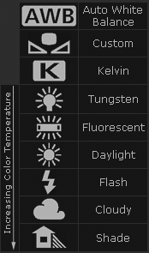
White balance
Film cameras:
  Different types of film or different filters for different illumination conditions
Digital cameras:
  Automatic white balance
  White balance settings corresponding to
  several common illuminants
  Custom white balance using a reference
  object
http://www.cambridgeincolour.com/tutorials/white-balance.htm
slide: S. Lazebnik

Slide 39
White balance
Von Kries adaptation
  Multiply each channel by a gain factor
slide: S. Lazebnik

Slide 40
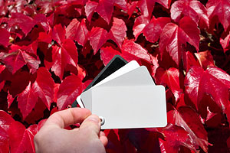
White balance
Von Kries adaptation
  Multiply each channel by a gain factor
Best way: gray card
  Take a picture of a neutral object (white or gray)
  Deduce the weight of each channel
    If the object is recoded as r_{w}, g_{w}, b_{w}
    use weights 1/r_{w}, 1/g_{w}, 1/b_{w}
slide: S. Lazebnik

Slide 41
White balance
Without gray cards: we need to “guess” which pixels correspond to white objects
Gray world assumption
  The image average r_{ave}, g_{ave}, b_{ave} is gray
  Use weights 1/r_{ave}, 1/g_{ave}, 1/b_{ave}
Brightest pixel assumption
  Highlights usually have the color of the light source
  Use weights inversely proportional to the values of the brightest pixels
Gamut mapping
  Gamut: convex hull of all pixel colors in an image
  Find the transformation that matches the gamut of the image to the gamut of a “typical” image under white light
Use image statistics, learning techniques
slide: S. Lazebnik

Slide 42
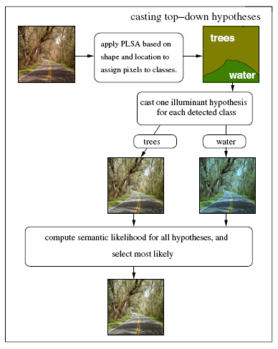
White balance by recognition
Key idea: For each of the semantic classes present in the image, compute the illuminant that transforms the pixels assigned to that class so that the average color of that class matches the average color of the same class in a database of “typical” images
J. Van de Weijer, C. Schmid and J. Verbeek, Using High-Level Visual Information for Color Constancy, ICCV 2007.
slide: S. Lazebnik

Slide 43
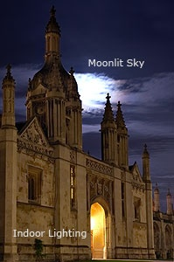
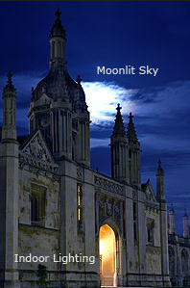
Mixed illumination
When there are several types of illuminants in the scene, different reference points will yield different results
Reference: moon
Reference: stone
http://www.cambridgeincolour.com/tutorials/white-balance.htm
slide: S. Lazebnik

Slide 44
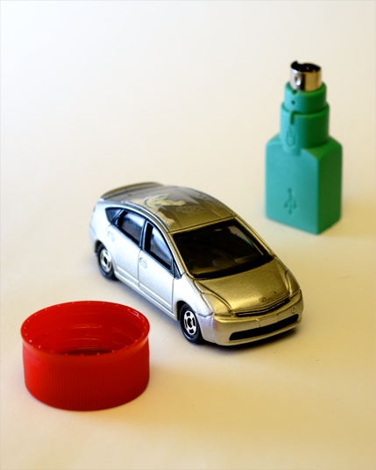
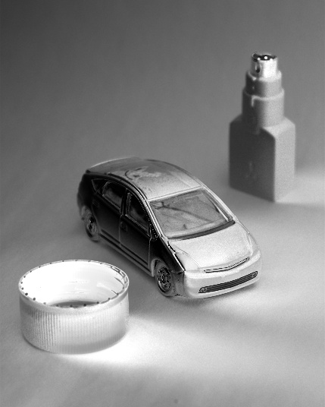
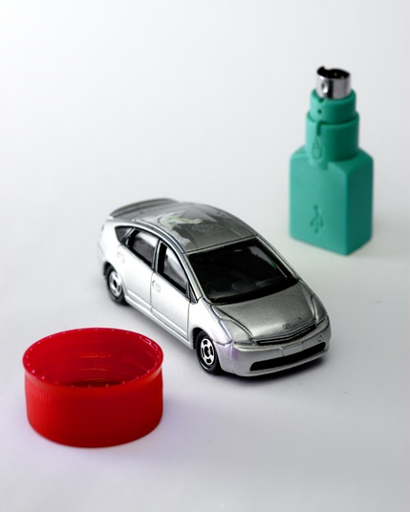
Spatially varying white balance
Input
Alpha map
Output
E. Hsu, T. Mertens, S. Paris, S. Avidan, and F. Durand, “Light Mixture Estimation for Spatially Varying White Balance,” SIGGRAPH 2008
slide: S. Lazebnik

Slide 45
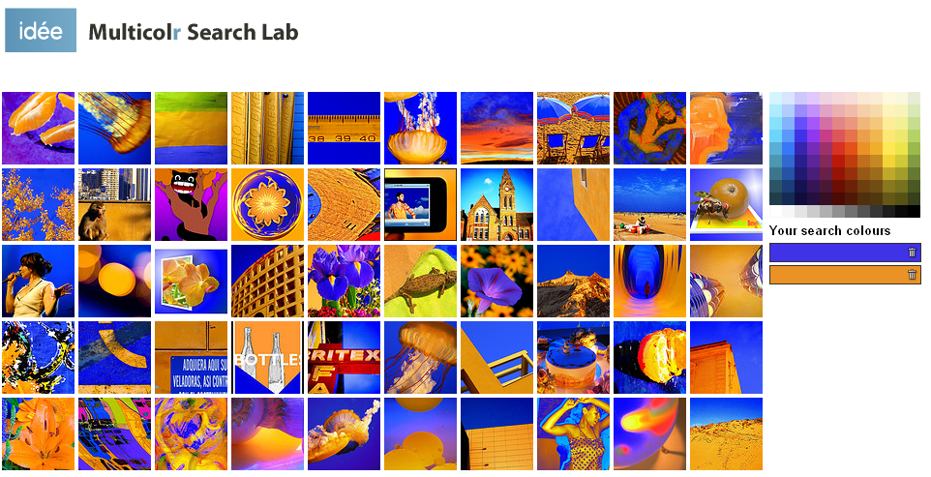
Uses of color in computer vision
Color histograms for image matching
http://labs.ideeinc.com/multicolr
slide: S. Lazebnik

Slide 46
Uses of color in computer vision
Image segmentation and retrieval
C. Carson, S. Belongie, H. Greenspan, and Ji. Malik, Blobworld: Image segmentation using Expectation-Maximization and its application to image querying, ICVIS 1999.
slide: S. Lazebnik

Slide 47
Uses of color in computer vision
Skin detection
M. Jones and J. Rehg, Statistical Color Models with Application to Skin Detection, IJCV 2002.
slide: S. Lazebnik

Slide 48
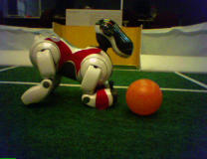
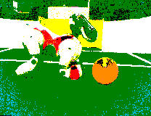
Uses of color in computer vision
Robot soccer
M. Sridharan and P. Stone, Towards Eliminating Manual Color Calibration at RoboCup. RoboCup-2005: Robot Soccer World Cup IX, Springer Verlag, 2006
Source: K. Grauman

Slide 49
Uses of color in computer vision
Building appearance models for tracking
D. Ramanan, D. Forsyth, and A. Zisserman. Tracking People by Learning their Appearance. PAMI 2007.
slide: S. Lazebnik

Slide 50


Linear filtering
slide: S. Lazebnik

Slide 51
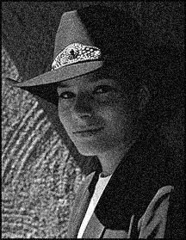
Motivation: Image denoising
How can we reduce noise in a photograph?
slide: S. Lazebnik
Notes:
Answer: take lots of images, average them

Slide 52

Moving average
Let’s replace each pixel with a weighted average of its neighborhood
The weights are called the filter kernel
What are the weights for the average of a
3x3 neighborhood?
1
1
1
1
1
1
1
1
1
“box filter”
Source: D. Lowe

Slide 53


Defining convolution
Let f be the image and g be the kernel. The output of convolving f with g is denoted f * g.
f
Convention:
kernel is “flipped”
MATLAB functions: conv2, filter2, imfilter
Source: F. Durand
Notes:
If we want to know the value of the filtered image at any location, we overlay the filer kernel over the image centered at that location, multiply the image values by the corresponding kernel values, and sum the result. To produce the entire filtered output image, we slide the filter kernel over every location and perform this operation.

Slide 54
Key properties
Linearity: filter(f₁ + f₂) = filter(f₁) + filter(f₂)
Shift invariance: same behavior regardless of pixel location: filter(shift(f)) = shift(filter(f))
Theoretical result: any linear shift-invariant operator can be represented as a convolution
slide: S. Lazebnik

Slide 55
Properties in more detail
Commutative: a * b = b * a
  Conceptually no difference between filter and signal
Associative: a * (b * c) = (a * b) * c
  Often apply several filters one after another: (((a * b₁) * b₂) * b₃)
  This is equivalent to applying one filter: a * (b₁ * b₂ * b₃)
Distributes over addition: a * (b + c) = (a * b) + (a * c)
Scalars factor out: ka * b = a * kb = k (a * b)
Identity: unit impulse e = […, 0, 0, 1, 0, 0, …],
a * e = a
slide: S. Lazebnik

Slide 56
Annoying details
What is the size of the output?
MATLAB: filter2(g, f, shape)
  shape = ‘full’: output size is sum of sizes of f and g
  shape = ‘same’: output size is same as f
  shape = ‘valid’: output size is difference of sizes of f and g
full
same
valid
g
g
g
g
f
f
f
g
g
g
g
g
g
g
g
slide: S. Lazebnik

Slide 57
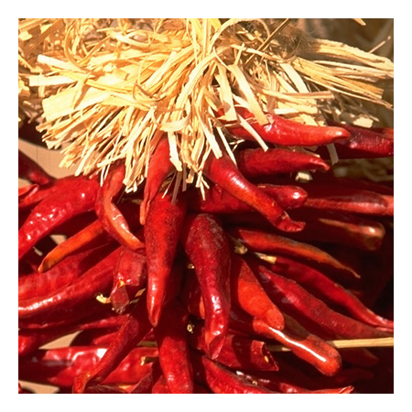
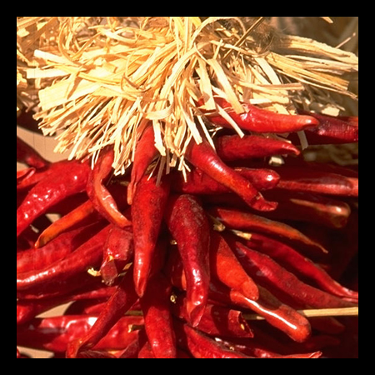

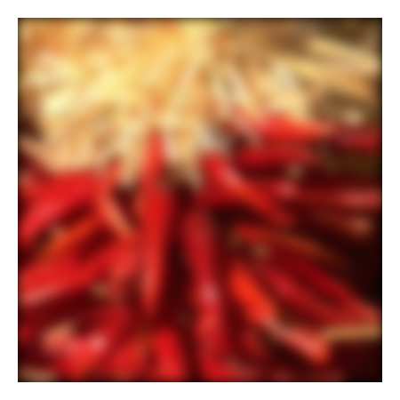
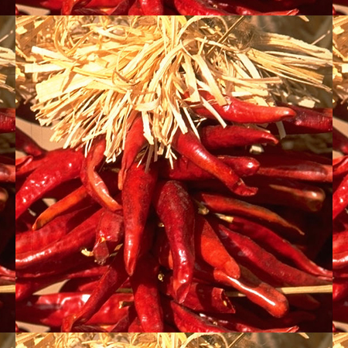

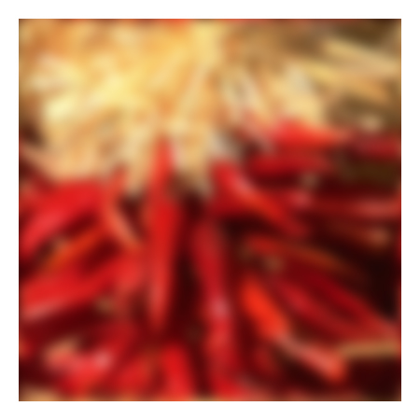
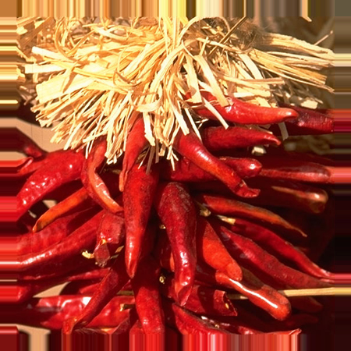


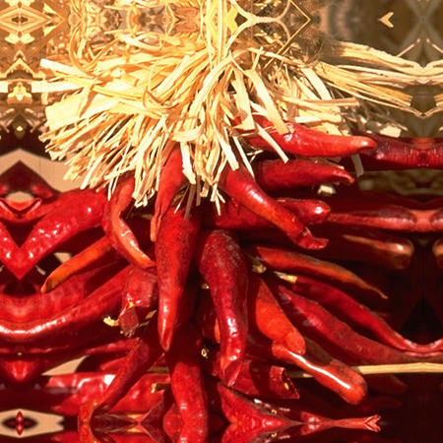


Annoying details
What about near the edge?
  the filter window falls off the edge of the image
  need to extrapolate
  methods:
    clip filter (black)
    wrap around
    copy edge
    reflect across edge
Source: S. Marschner

Slide 58
Annoying details
What about near the edge?
  the filter window falls off the edge of the image
  need to extrapolate
  methods (MATLAB):
    clip filter (black): imfilter(f, g, 0)
    wrap around: imfilter(f, g, ‘circular’)
    copy edge: imfilter(f, g, ‘replicate’)
    reflect across edge: imfilter(f, g, ‘symmetric’)
Source: S. Marschner

Slide 59

Practice with linear filters
0
0
0
?
0
1
0
0
0
0
Original
Source: D. Lowe

Slide 60
Practice with linear filters
0
0
0
0
1
0
0
0
0
Original
Filtered
(no change)
Source: D. Lowe

Slide 61
Practice with linear filters
0
0
0
?
0
0
1
0
0
0
Original
Source: D. Lowe

Slide 62
Practice with linear filters
0
0
0
0
0
1
0
0
0
Original
Shifted left
By 1 pixel
Source: D. Lowe

Slide 63
Practice with linear filters
1
1
1
?
1
1
1
1
1
1
Original
Source: D. Lowe

Slide 64

Practice with linear filters
1
1
1
1
1
1
1
1
1
Original
Blur (with a
box filter)
Source: D. Lowe

Slide 65
Practice with linear filters
0
0
0
-
1
1
1
?
0
2
0
1
1
1
0
0
0
1
1
1
(Note that filter sums to 1)
Original
Source: D. Lowe

Slide 66

Practice with linear filters
0
0
0
-
1
1
1
0
2
0
1
1
1
0
0
0
1
1
1
Original
Sharpening filter
  Accentuates differences with local average
Source: D. Lowe

Slide 67

Sharpening
Source: D. Lowe

Slide 68




Sharpening with unsharp masking
What does blurring take away?
–
=
original
smoothed (5x5)
detail
Let’s add it back:
+
=
original
detail
sharpened
slide: S. Lazebnik

Slide 69

Smoothing with box filter revisited
What’s wrong with this picture?
What’s the solution?
Source: D. Forsyth

Slide 70
Smoothing with box filter revisited
What’s wrong with this picture?
What’s the solution?
  To eliminate edge effects, weight contribution of neighborhood pixels according to their closeness to the center
“fuzzy blob”
slide: S. Lazebnik

Slide 71


Gaussian Kernel
0.003 0.013 0.022 0.013 0.003
0.013 0.059 0.097 0.059 0.013
0.022 0.097 0.159 0.097 0.022
0.013 0.059 0.097 0.059 0.013
0.003 0.013 0.022 0.013 0.003
5 x 5, σ = 1
Constant factor at front makes volume sum to 1 (can be ignored when computing the filter values, as we should renormalize weights to sum to 1 in any case)
Source: C. Rasmussen

Slide 72




Gaussian Kernel
σ = 2 with 30 x 30 kernel
σ = 5 with 30 x 30 kernel
Standard deviation σ: determines extent of smoothing
Source: K. Grauman

Slide 73
Choosing kernel width
The Gaussian function has infinite support, but discrete filters use finite kernels
Source: K. Grauman

Slide 74
Choosing kernel width
Rule of thumb: set filter half-width to about 3σ
slide: S. Lazebnik

Slide 75

Gaussian vs. box filtering
slide: S. Lazebnik

Slide 76
Gaussian filters
Remove “high-frequency” components from the image (low-pass filter)
Convolution with self is another Gaussian
  So can smooth with small-σ kernel, repeat, and get same result as larger-σ kernel would have
  Convolving two times with Gaussian kernel with std. dev. σ
  is same as convolving once with kernel with std. dev.
Separable kernel
  Factors into product of two 1D Gaussians
Source: K. Grauman
Notes:
Linear vs. quadratic in mask size

Slide 77

Separability of the Gaussian filter
Source: D. Lowe

Slide 78



Separability example
2D convolution
(center location only)
The filter factors
into a product of 1D
filters:
Perform convolution
along rows:
*
=
Followed by convolution
along the remaining column:
*
=
Source: K. Grauman

Slide 79
Why is separability useful?
What is the complexity of filtering an n×n image with an m×m kernel?
  O(n² m²)
What if the kernel is separable?
  O(n² m)
slide: S. Lazebnik

Slide 80
COMP 776
Jan-Michael Frahm

Slide 81
Noise
Salt and pepper noise: contains random occurrences of black and white pixels
Impulse noise: contains random occurrences of white pixels
Gaussian noise: variations in intensity drawn from a Gaussian normal distribution
Source: S. Seitz
Notes:
Salt and pepper and impulse noise can be due to transmission errors (e.g., from deep space probe), dead CCD pixels, specks on lens

Slide 82

Gaussian noise
Mathematical model: sum of many independent factors
Good for small standard deviations
Assumption: independent, zero-mean noise
Source: M. Hebert

Slide 83


Reducing Gaussian noise
Smoothing with larger standard deviations suppresses noise, but also blurs the image
slide: S. Lazebnik

Slide 84

Reducing salt-and-pepper noise
3x3
5x5
7x7
What’s wrong with the results?
slide: S. Lazebnik

Slide 85

Alternative idea: Median filtering
A median filter operates over a window by selecting the median intensity in the window
Is median filtering linear?
Source: K. Grauman
Notes:
Linearity of median filter: try filter([0 0 0; 0 1 0; 0 0 0] + [1 1 1; 1 1 2; 2 2 2])

Slide 86

Median filter
What advantage does median filtering have over Gaussian filtering?
  Robustness to outliers
Source: K. Grauman

Slide 87

Median filter
Salt-and-pepper noise
Median filtered
MATLAB: medfilt2(image, [h w])
Source: M. Hebert

Slide 88

Gaussian vs. median filtering
3x3
5x5
7x7
Gaussian
Median
slide: S. Lazebnik

Slide 89
Sharpening revisited
Source: D. Lowe

Slide 90
Sharpening revisited
What does blurring take away?
–
=
original
smoothed (5x5)
detail
Let’s add it back:
+ α
=
original
detail
sharpened
slide: S. Lazebnik

Slide 91



Unsharp mask filter
image
blurred
image
unit impulse
(identity)
unit impulse
Gaussian
Laplacian of Gaussian
slide: S. Lazebnik
Notes:
f + a(f - f * g) = (1+a)f-af*g = f*((1+a)e-g)

Slide 92

Application: Hybrid Images
A. Oliva, A. Torralba, P.G. Schyns,
“Hybrid Images,” SIGGRAPH 2006
slide: S. Lazebnik

Slide 93

slide: S. Lazebnik

Slide 94

Hybrid Images

Slide 95

Edge detection
Goal: Identify sudden changes (discontinuities) in an image
  Intuitively, most semantic and shape information from the image can be encoded in the edges
  More compact than pixels
Human vision: Uses line detection as a function
Ideal: artist’s line drawing (but artist is also using object-level knowledge)
Source: D. Lowe

Slide 96

Origin of edges
Edges are caused by a variety of factors:
surface normal discontinuity
depth discontinuity
surface color discontinuity
illumination discontinuity
Source: Steve Seitz

Slide 97

Characterizing edges
An edge is a place of rapid change in the image intensity function
intensity function
(along horizontal scanline)
image
first derivative
edges correspond to
extrema of derivative

Slide 98
Derivatives with convolution
For 2D function f(x,y), the partial derivative is:
For discrete data, we can approximate using finite differences:
To implement above as convolution, what would be the associated filter?
Source: K. Grauman

Slide 99

Partial derivatives of an image
-1 1
1 -1
-1 1
or
Which shows changes with respect to x?
slide: S. Lazebnik

Slide 100

Finite difference filters
Other approximations of derivative filters exist:
Source: K. Grauman

Slide 101






Image gradient
The gradient of an image:
The gradient points in the direction of most rapid increase in intensity
How does this direction relate to the direction of the edge?
The gradient direction is given by
The edge strength is given by the gradient magnitude
Source: Steve Seitz
Notes:
give definition of partial derivative: lim h->0 [f(x+h,y) – f(x,y)]/h

Slide 102




Effects of noise
Consider a single row or column of the image
  Plotting intensity as a function of position gives a signal
Where is the edge?
Source: S. Seitz
Notes:
How to fix?

Slide 103




Solution: smooth first
f
g
f * g
To find edges, look for peaks in
Source: S. Seitz

Slide 104

Derivative theorem of convolution
Differentiation is convolution, and convolution is associative:
This saves us one operation:
f
Source: S. Seitz

Slide 105


Derivative of Gaussian filter
x-direction
y-direction
Are these filters separable?
slide S. Seitz

Slide 106
Derivative of Gaussian filter
x-direction
y-direction
Which one finds horizontal/vertical edges?
slide S. Seitz

Slide 107



Scale of Gaussian derivative filter
1 pixel
3 pixels
7 pixels
Smoothed derivative removes noise, but blurs edge. Also finds edges at different “scales”
slide S. Seitz
Source: D. Forsyth

Slide 108
Review: Smoothing vs. derivative filters
Smoothing filters
  Gaussian: remove “high-frequency” components;
  “low-pass” filter
  Can the values of a smoothing filter be negative?
  What should the values sum to?
    One: constant regions are not affected by the filter
Derivative filters
  Derivatives of Gaussian
  Can the values of a derivative filter be negative?
  What should the values sum to?
    Zero: no response in constant regions
  High absolute value at points of high contrast
slide S. Lazebnik

Slide 109

The Canny edge detector
original image
Slide credit: Steve Seitz

Slide 110

The Canny edge detector
norm of the gradient
Slide credit: Steve Seitz

Slide 111

The Canny edge detector
thresholding
Slide credit: Steve Seitz

Slide 112


The Canny edge detector
How to turn these thick regions of the gradient into curves?
thresholding
Slide credit: Steve Seitz

Slide 113

Non-maximum suppression
Check if pixel is a local maximum along gradient direction, select single max across width of the edge
  requires checking interpolated pixels p and r
Slide credit: Steve Seitz

Slide 114

The Canny edge detector
Problem: pixels along this edge didn’t survive the thresholding
thinning
(non-maximum suppression)
Slide credit: Steve Seitz

Slide 115
Hysteresis thresholding
Use a high threshold to start edge curves, and a low threshold to continue them.
Source: Steve Seitz

Slide 116
Hysteresis thresholding
original image
high threshold
(strong edges)
low threshold
(weak edges)
hysteresis threshold
Source: L. Fei-Fei

Slide 117
Recap: Canny edge detector
Filter image with derivative of Gaussian
Find magnitude and orientation of gradient
Non-maximum suppression:
  Thin wide “ridges” down to single pixel width
Linking and thresholding (hysteresis):
  Define two thresholds: low and high
  Use the high threshold to start edge curves and the low threshold to continue them
MATLAB: edge(image, ‘canny’);
J. Canny, A Computational Approach To Edge Detection, IEEE Trans. Pattern Analysis and Machine Intelligence, 8:679-714, 1986.
Slide credit: S. Lazebnik

Slide 118






Edge detection is just the beginning…
image
human segmentation
gradient magnitude
Berkeley segmentation database:
http://www.eecs.berkeley.edu/Research/Projects/CS/vision/grouping/segbench/
Slide credit: S. Lazebnik

Slide 119






Low-level edges vs. perceived contours
Background
Texture
Shadows
Kristen Grauman, UT-Austin
Slide credit: S. Lazebnik

