Slide 1
776 Computer Vision
Jan-Michael Frahm, Enrique Dunn
Spring 2013

Slide 2
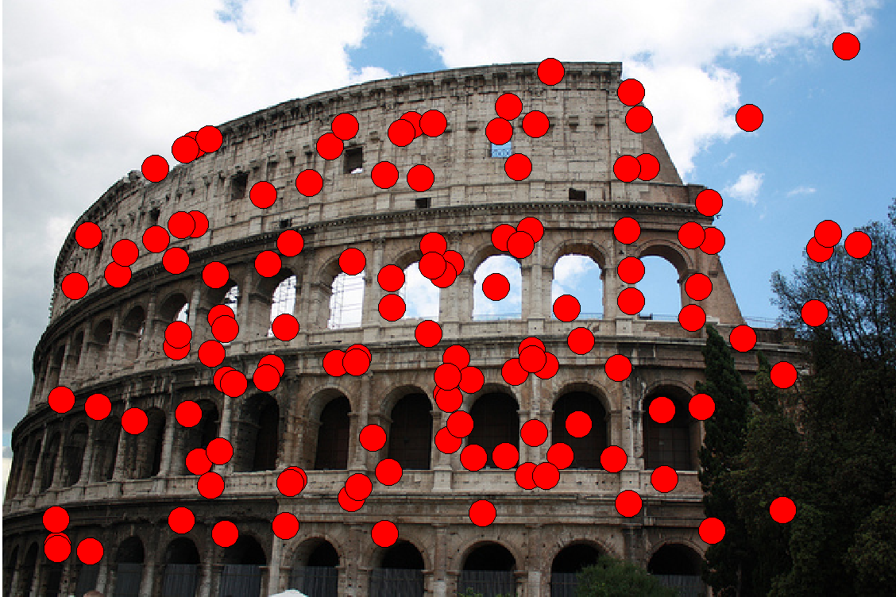
Feature extraction: Corners
9300 Harris Corners Pkwy, Charlotte, NC

Slide 3
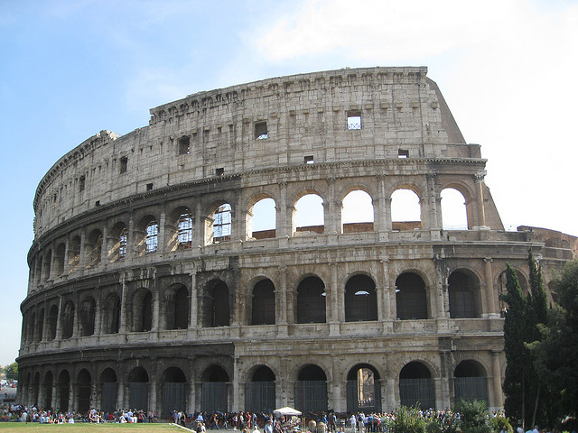
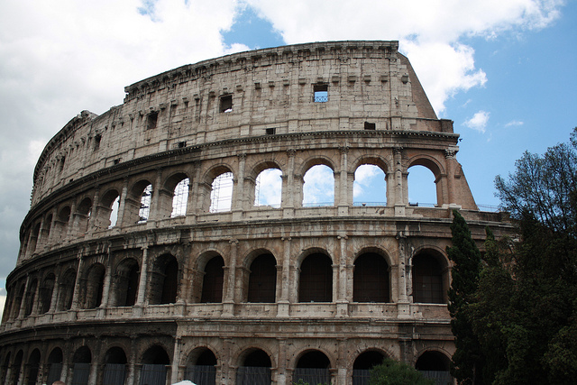
Why extract features?
Motivation: How do the images relate to each other
We have two images – how do we combine them?
1. Step extract features
2. Step match features

Slide 4
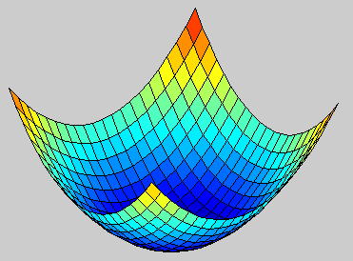
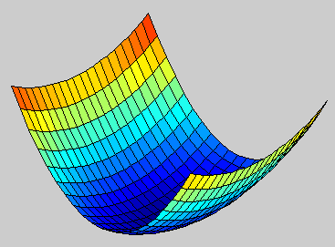
What are good features
X
X

Slide 5
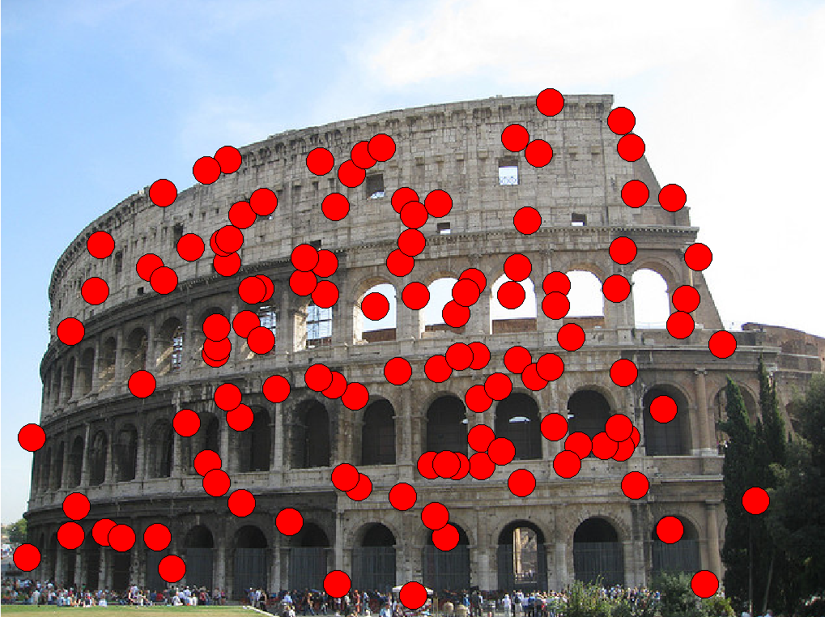
Characteristics of good features
Repeatability
The same feature can be found in several images despite geometric and photometric transformations
Saliency
Each feature is distinctive
Compactness and efficiency
Many fewer features than image pixels
Locality
A feature occupies a relatively small area of the image; robust to clutter and occlusion

Slide 6
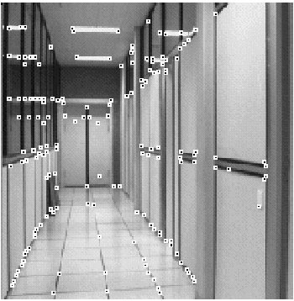
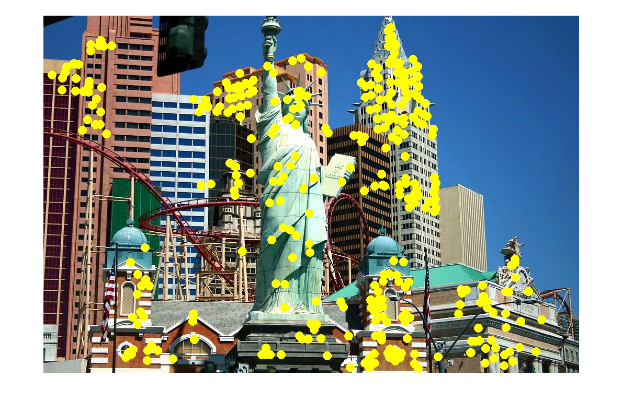
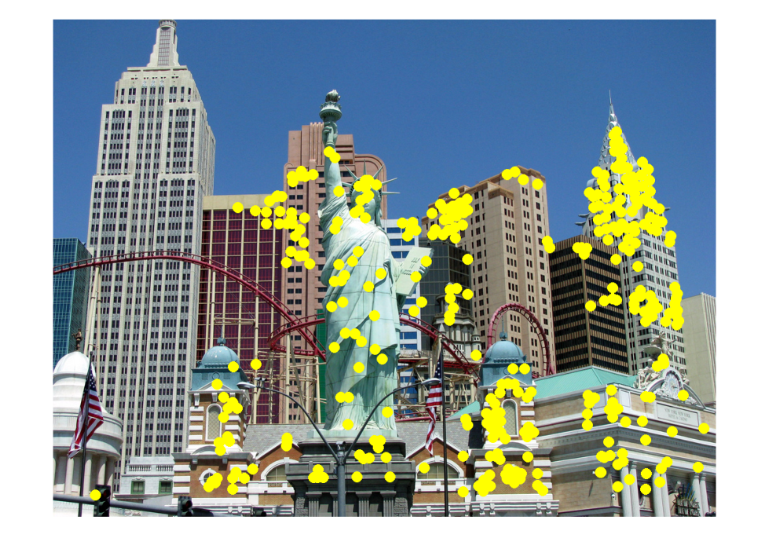
Applications
Feature points are used for:
Image alignment
3D reconstruction
Motion tracking
Robot navigation
Indexing and database retrieval
Object recognition
slide: S. Lazebnik

Slide 7
Finding Corners
Key property: in the region around a corner, image gradient has two or more dominant directions
Corners are repeatable and distinctive
C.Harris and M.Stephens. "A Combined Corner and Edge Detector.“ Proceedings of the 4th Alvey Vision Conference: pages 147--151.
slide: S. Lazebnik

Slide 8
Corner Detection: Basic Idea
We should easily recognize the point by looking through a small window
Shifting a window in any direction should give a large change in intensity
“flat” region: no change in all directions
“edge”: no change along the edge direction
“corner”: significant change in all directions
Source: A. Efros
slide: S. Lazebnik

Slide 9
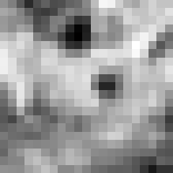
Corner Detection: Math
Change in appearance of window w(x,y)
for the shift [u,v]:
I(x, y)
E(u, v)
E(3,2)
w(x, y)
slide: S. Lazebnik

Slide 10
Corner Detection: Math
Change in appearance of window w(x,y)
for the shift [u,v]:
I(x, y)
E(u, v)
E(0,0)
w(x, y)
slide: S. Lazebnik

Slide 11
Corner Detection: Math
Change in appearance of window w(x,y)
for the shift [u,v]:
Window function
Shifted intensity
Intensity
Window function w(x,y) =
or
1 in window, 0 outside
Gaussian
Source: R. Szeliski

Slide 12
Corner Detection: Mathe
Change in appearance of window w(x,y)
for the shift [u,v]:
We want to find out how this function behaves for small shifts
E(u, v)
slide: S. Lazebnik

Slide 13
Corner Detection: Math
Change in appearance of window w(x,y)
for the shift [u,v]:
We want to find out how this function behaves for small shifts
Local quadratic approximation of E(u,v) in the neighborhood of (0,0) is given by the second-order Taylor expansion:
slide: S. Lazebnik

Slide 14
Corner Detection: Math
Second-order Taylor expansion of E(u,v) about (0,0):
slide: S. Lazebnik

Slide 15
Corner Detection: Math
Second-order Taylor expansion of E(u,v) about (0,0):
slide: S. Lazebnik

Slide 16
Corner Detection: Math
Second-order Taylor expansion of E(u,v) about (0,0):
slide: S. Lazebnik

Slide 17
Corner Detection: Math
The quadratic approximation simplifies to
where M is a second moment matrix computed from image derivatives:
M
slide: S. Lazebnik

Slide 18
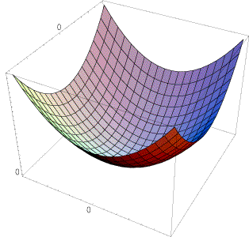
Interpreting the second moment matrix
The surface E(u,v) is locally approximated by a quadratic form. Let’s try to understand its shape.
slide: S. Lazebnik

Slide 19
Interpreting the second moment matrix
First, consider the axis-aligned case (gradients are either horizontal or vertical)
If either λ is close to 0, then this is not a corner, so look for locations where both are large.
slide: S. Lazebnik

Slide 20
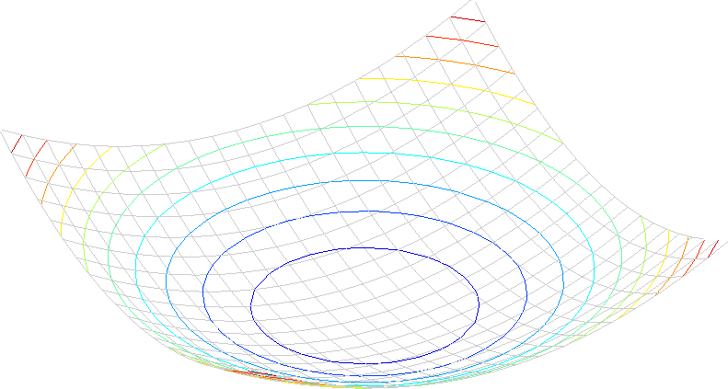
Interpreting the second moment matrix
Consider a horizontal “slice” of E(u, v):
This is the equation of an ellipse.
slide: S. Lazebnik

Slide 21
Interpreting the second moment matrix
Consider a horizontal “slice” of E(u, v):
This is the equation of an ellipse.
Diagonalization of M:
The axis lengths of the ellipse are determined by the eigenvalues and the orientation is determined by R
direction of the fastest change
direction of the slowest change
(λ_{max})^{-1/2}
(λ_{min})^{-1/2}
slide: S. Lazebnik

Slide 22
Visualization of second moment matrices
slide: S. Lazebnik

Slide 23
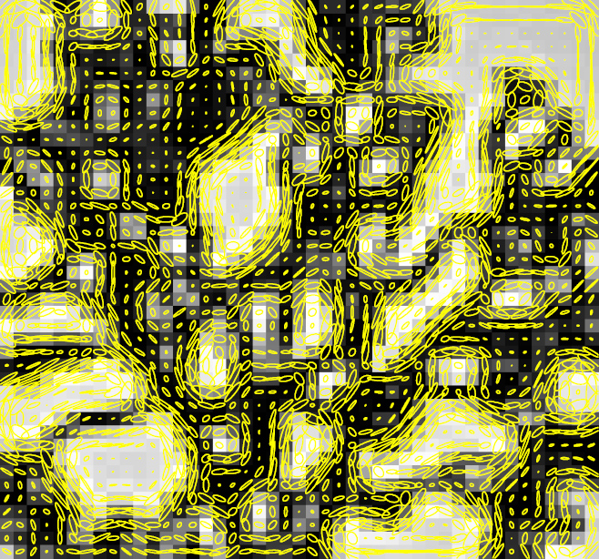
Visualization of second moment matrices
slide: S. Lazebnik

Slide 24
Interpreting the eigenvalues
Classification of image points using eigenvalues of M:
λ₂
“Edge” λ₂ >> λ₁
“Corner” λ₁ and λ₂ are large, λ₁ ~ λ₂; E increases in all directions
λ₁ and λ₂ are small; E is almost constant in all directions
“Flat” region
“Edge” λ₁ >> λ₂
λ₁
slide: S. Lazebnik

Slide 25
Corner response function
α: constant (0.04 to 0.06)
“Edge” R < 0
“Corner” R > 0
|R| small
“Flat” region
“Edge” R < 0
slide: S. Lazebnik

Slide 26
Harris detector: Steps
Compute Gaussian derivatives at each pixel
Compute second moment matrix M in a Gaussian window around each pixel
Compute corner response function R
Threshold R
Find local maxima of response function (nonmaximum suppression)
C.Harris and M.Stephens. “A Combined Corner and Edge Detector.” Proceedings of the 4th Alvey Vision Conference: pages 147—151, 1988.
slide: S. Lazebnik

Slide 27
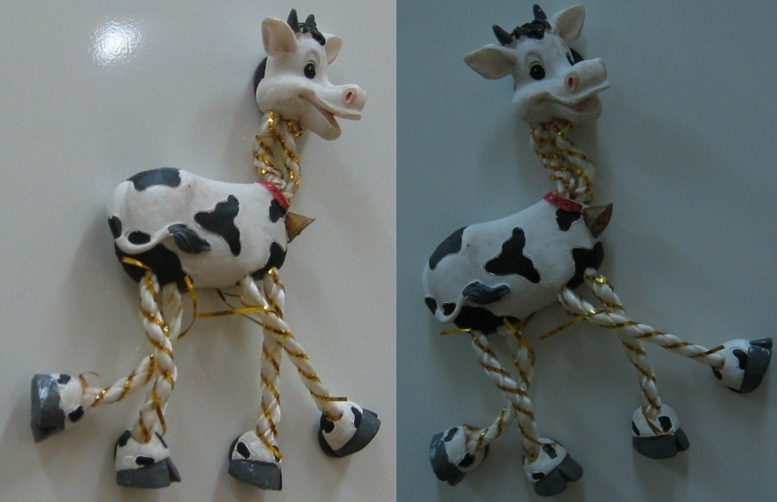
Harris Detector: Steps
slide: S. Lazebnik

Slide 28
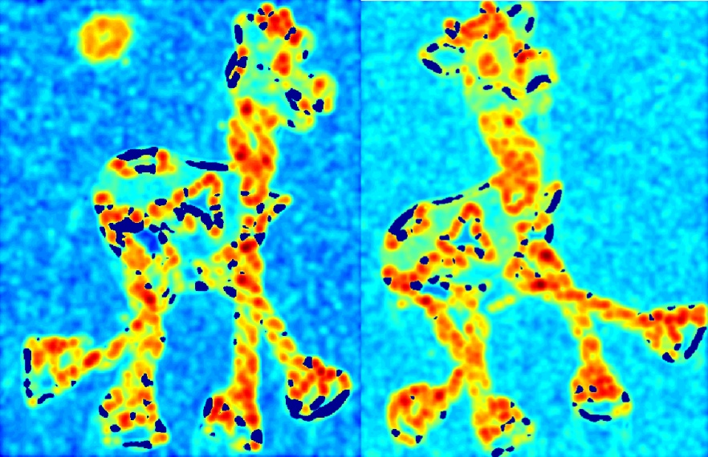
Harris Detector: Steps
Compute corner response R
slide: S. Lazebnik

Slide 29
Harris Detector: Steps
Find points with large corner response: R>threshold
slide: S. Lazebnik

Slide 30
Harris Detector: Steps
Take only the points of local maxima of R
slide: S. Lazebnik

Slide 31
Harris Detector: Steps
slide: S. Lazebnik

Slide 32
Invariance and covariance
We want corner locations to be invariant to photometric transformations and covariant to geometric transformations
Invariance: image is transformed and corner locations do not change
Covariance: if we have two transformed versions of the same image, features should be detected in corresponding locations
slide: S. Lazebnik

Slide 33
Affine intensity change
I → a I + b
Only derivatives are used => invariance to intensity shift I → I + b
Intensity scaling: I → a I
R
R
threshold
x (image coordinate)
x (image coordinate)
Partially invariant to affine intensity change
slide: S. Lazebnik

Slide 34
Image translation
Derivatives and window function are shift-invariant
Corner location is covariant w.r.t. translation
slide: S. Lazebnik

Slide 35
Image rotation
Second moment ellipse rotates but its shape (i.e. eigenvalues) remains the same
Corner location is covariant w.r.t. rotation
slide: S. Lazebnik

Slide 36
Scaling
Corner
All points will be classified as edges
Corner location is not covariant to scaling!
slide: S. Lazebnik

