Slide 1
776 Computer Vision
Jan-Michael Frahm
Fall 2014

Slide 2
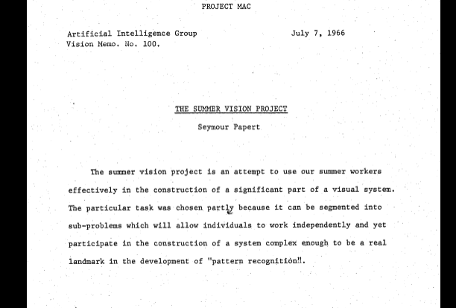
Start of Computer Vision

Slide 3

Object Recognition: Overview and History
Slides adapted from Fei-Fei Li, Rob Fergus, Antonio Torralba, Jean Ponce, Svetlana Lazebnik

Slide 4
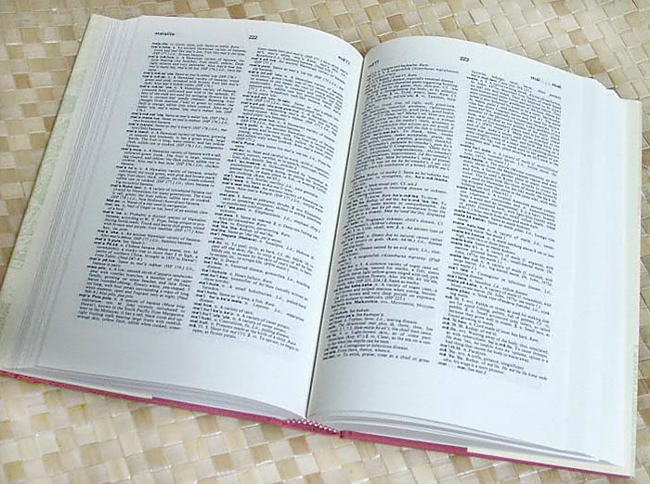

How many visual object categories are there?
~10,000 to 30,000
Biederman 1987
Notes:
15000-30000 basic-level nouns, ~10 types per basic-level category
Alternative explanation (Perona): ~1000 names per domain (broad scene category), 20-30 domains

Slide 5
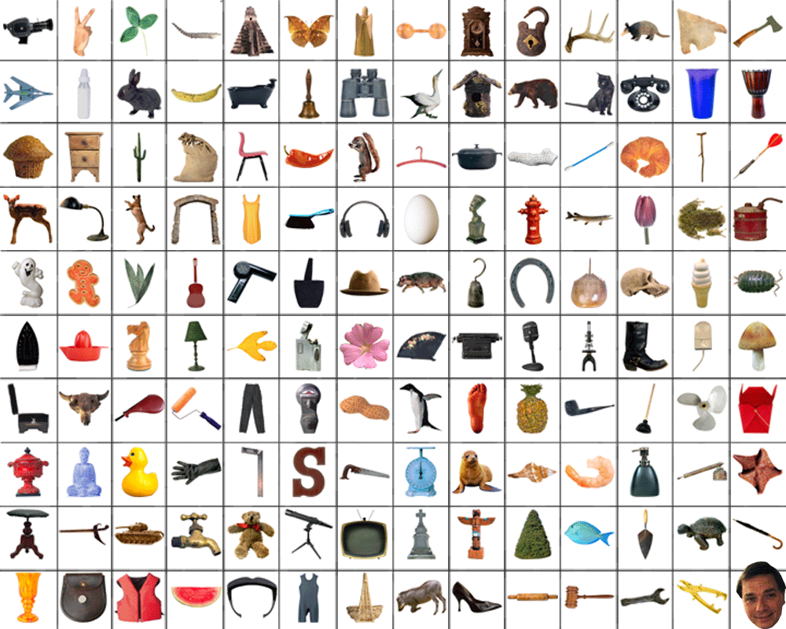
~10,000 to 30,000

Slide 6



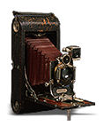
OBJECTS
ANIMALS
PLANTS
INANIMATE
NATURAL
MAN-MADE
…..
VERTEBRATE
MAMMALS
BIRDS
TAPIR
BOAR
GROUSE
CAMERA

Slide 7

Specific recognition tasks

Slide 8
Scene categorization
outdoor/indoor
city/forest/factory/etc.

Slide 9
Image annotation/tagging
street
people
building
mountain
…

Slide 10
Object detection
find pedestrians

Slide 11
Image parsing
sky
mountain
building
tree
building
banner
street lamp
market
people

Slide 12
Image understanding?

Slide 13
Recognition is all about modeling variability
Variability:
Camera position
Illumination
Shape parameters
Within-class variations?

Slide 14


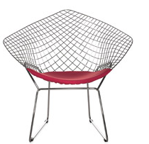


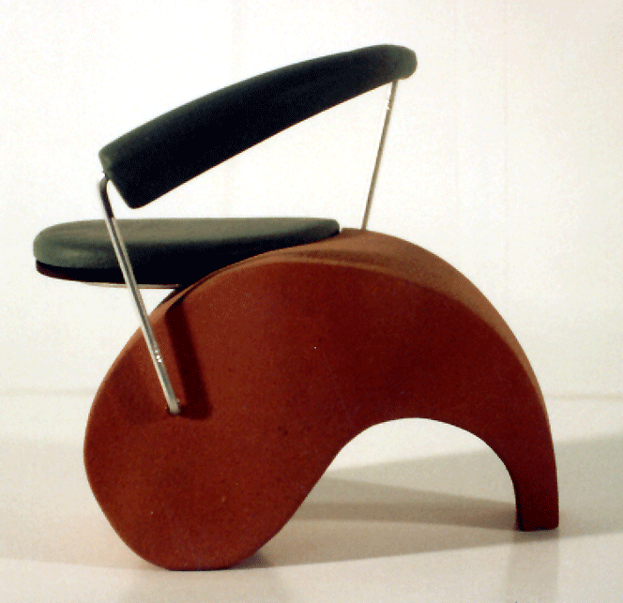
Within-class variations

Slide 15
History of ideas in recognition
1960s – early 1990s: the geometric era

Slide 16
θ
Variability:
Camera position
Illumination
Alignment
Shape: assumed known
Roberts (1965); Lowe (1987); Faugeras & Hebert (1986); Grimson & Lozano-Perez (1986); Huttenlocher & Ullman (1987)

Slide 17
Recall: Alignment
Alignment: fitting a model to a transformation between pairs of features (matches) in two images
x_{i}
x_{i}
Find transformation T
that minimizes
'
T

Slide 18
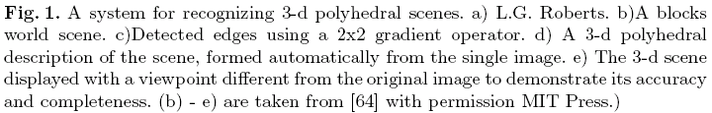
Recognition as an alignment problem:
Block world
L. G. Roberts, Machine Perception of Three Dimensional Solids, Ph.D. thesis, MIT Department of Electrical Engineering, 1963.
J. Mundy, Object Recognition in the Geometric Era: a Retrospective, 2006

Slide 19
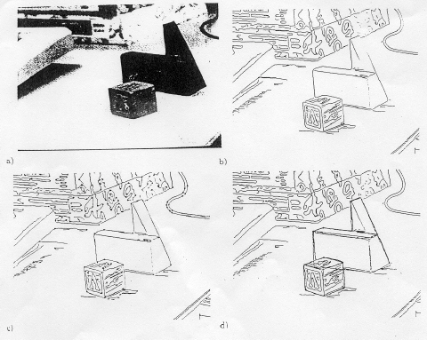
Alignment: Huttenlocher & Ullman (1987)

Slide 20
Variability
Invariance to:
Camera position
Illumination
Internal parameters
Duda & Hart ( 1972); Weiss (1987); Mundy et al. (1992-94);
Rothwell et al. (1992); Burns et al. (1993)

Slide 21
Example: invariant to similarity transformations computed from four points
B
C
D
A
Projective invariants (Rothwell et al., 1992):
General 3D objects do not admit monocular viewpoint
invariants (Burns et al., 1993)
Notes:
one view of a symmetric object corresponds to two views essentially enabling stereo to measure the geometry
polyhedral objects are protectively invariant with regard to their cross ratios

Slide 22






Representing and recognizing object categories
is harder...
ACRONYM (Brooks and Binford, 1981)
Binford (1971), Nevatia & Binford (1972), Marr & Nishihara (1978)

Slide 23
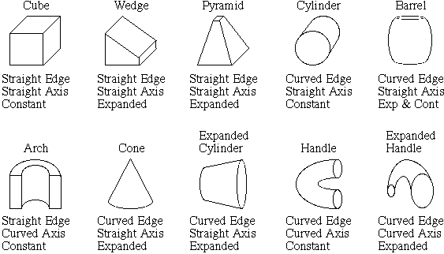
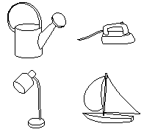
Recognition by components
Biederman (1987)
Primitives (geons)
Objects
http://en.wikipedia.org/wiki/Recognition_by_Components_Theory
Notes:
separating into geons (36 of them) for recognition (mug = cylinder + handle)
we focus on edges and concavities (where edges meet)
invariant edge propo

Slide 24
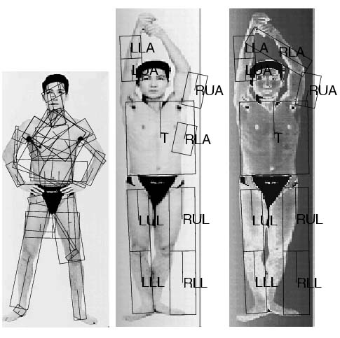
General shape primitives?
Generalized cylinders
Ponce et al. (1989)
Forsyth (2000)
Zisserman et al. (1995)

Slide 25
History of ideas in recognition
1960s – early 1990s: the geometric era
1990s: appearance-based models

Slide 26
Empirical models of image variability
Appearance-based techniques
Turk & Pentland (1991); Murase & Nayar (1995); etc.

Slide 27
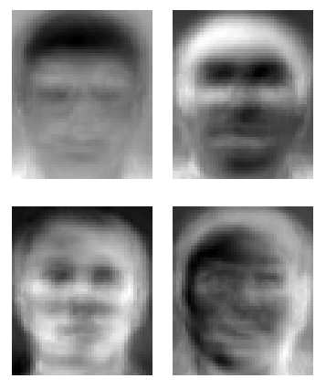
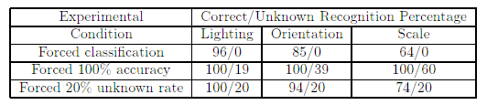
Eigenfaces (Turk & Pentland, 1991)

Slide 28
Color Histograms
Swain and Ballard, Color Indexing, IJCV 1991.

Slide 29
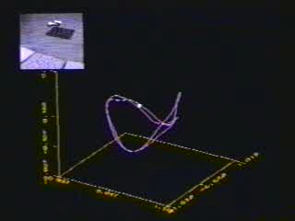
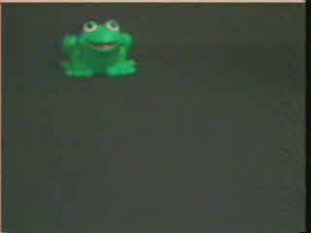
Appearance manifolds
H. Murase and S. Nayar, Visual learning and recognition of 3-d objects from appearance, IJCV 1995

Slide 30
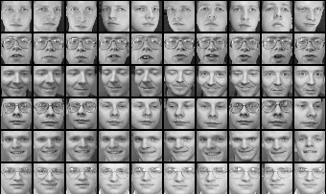
Limitations of global appearance models
Requires global registration of patterns
Not robust to clutter, occlusion, geometric transformations

Slide 31
History of ideas in recognition
1960s – early 1990s: the geometric era
1990s: appearance-based models
1990s – present: sliding window approaches

Slide 32

Sliding window approaches

Slide 33

Sliding window approaches
Turk and Pentland, 1991
Belhumeur, Hespanha, & Kriegman, 1997
Schneiderman & Kanade 2004
Viola and Jones, 2000
Schneiderman & Kanade, 2004
Argawal and Roth, 2002
Poggio et al. 1993

Slide 34
History of ideas in recognition
1960s – early 1990s: the geometric era
1990s: appearance-based models
Mid-1990s: sliding window approaches
Late 1990s: local features

Slide 35

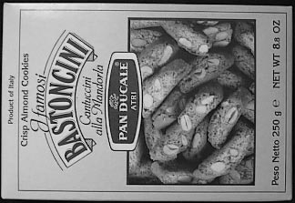

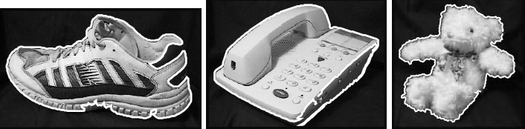
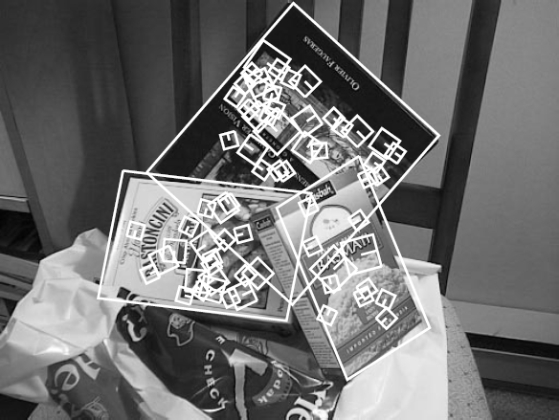
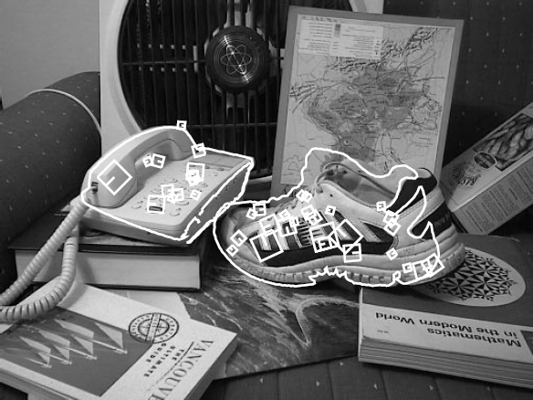
Local features for object instance recognition
D. Lowe (1999, 2004)

Slide 36
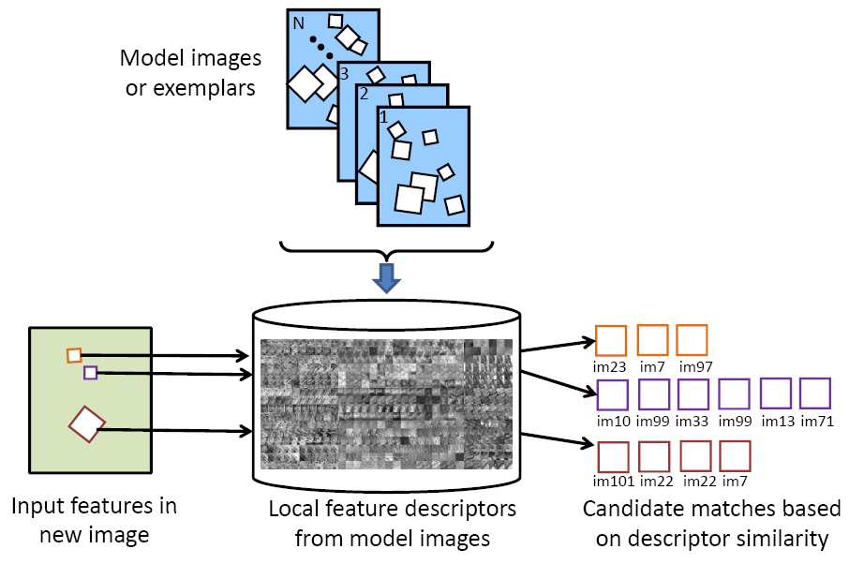
Large-scale image search
Combining local features, indexing, and spatial constraints
Image credit: K. Grauman and B. Leibe

Slide 37
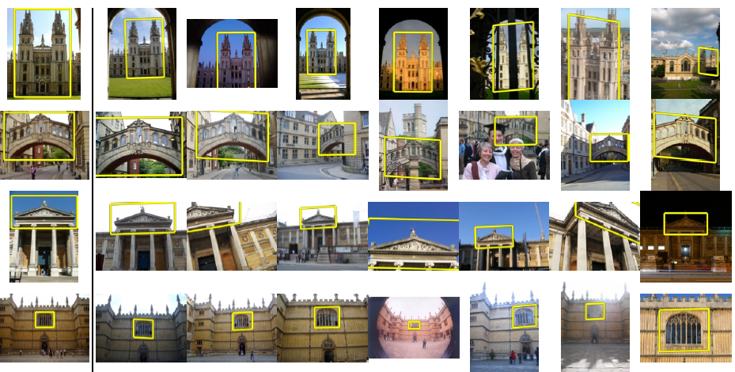
Large-scale image search
Combining local features, indexing, and spatial constraints
Philbin et al. ‘07

Slide 38
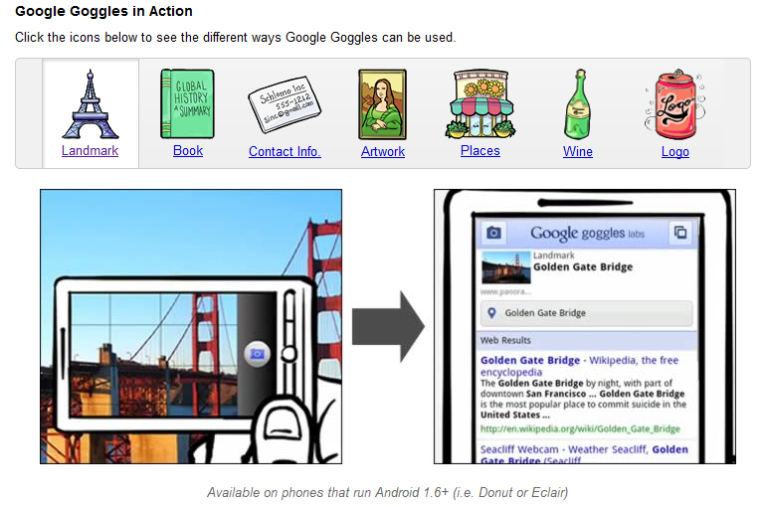
Large-scale image search
Combining local features, indexing, and spatial constraints

Slide 39
History of ideas in recognition
1960s – early 1990s: the geometric era
1990s: appearance-based models
Mid-1990s: sliding window approaches
Late 1990s: local features
Early 2000s: parts-and-shape models

Slide 40
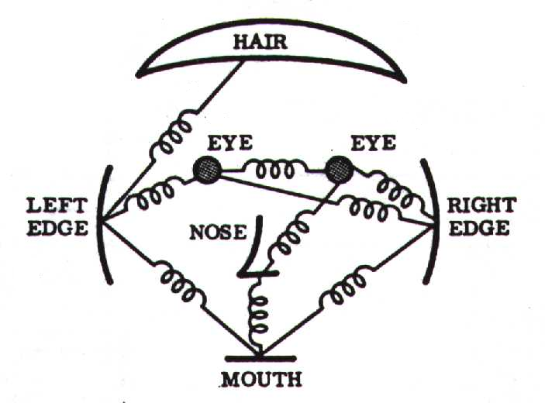
Parts-and-shape models
Model:
  Object as a set of parts
  Relative locations between parts
  Appearance of part
Figure from [Fischler & Elschlager 73]

Slide 41
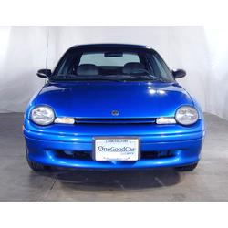
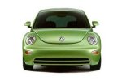
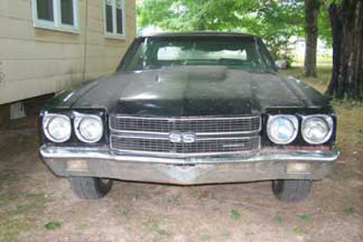
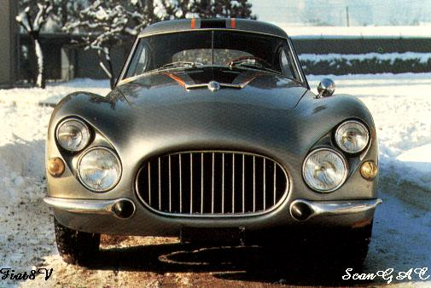
Constellation models
Weber, Welling & Perona (2000), Fergus, Perona & Zisserman (2003)
Notes:
Globally different, but have portions in common

Slide 42
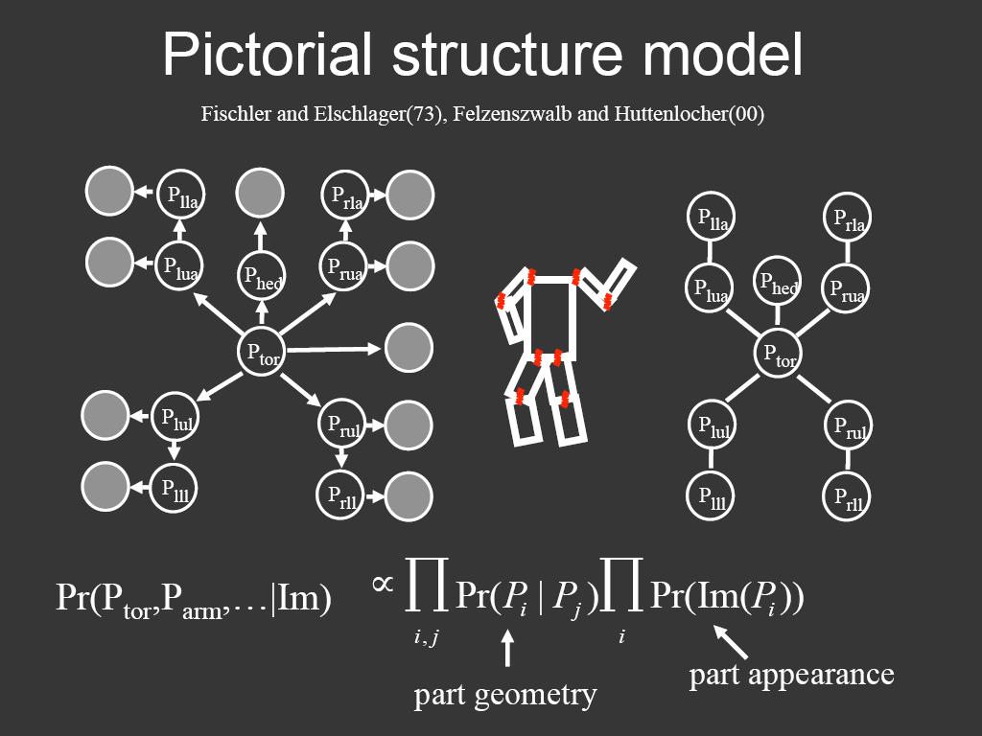
Representing people

Slide 43
History of ideas in recognition
1960s – early 1990s: the geometric era
1990s: appearance-based models
Mid-1990s: sliding window approaches
Late 1990s: local features
Early 2000s: parts-and-shape models
Mid-2000s: bags of features

Slide 44



Bag-of-features models
Bag of ‘words’
Object

Slide 45








Objects as texture
All of these are treated as being the same
No distinction between foreground and background: scene recognition?
Notes:
Motivation slide. Clearly location has to help, but bag-of-words doesn’t have it…

Slide 46
History of ideas in recognition
1960s – early 1990s: the geometric era
1990s: appearance-based models
Mid-1990s: sliding window approaches
Late 1990s: local features
Early 2000s: parts-and-shape models
Mid-2000s: bags of features
Present trends: combination of local and global methods, data-driven methods, context

Slide 47
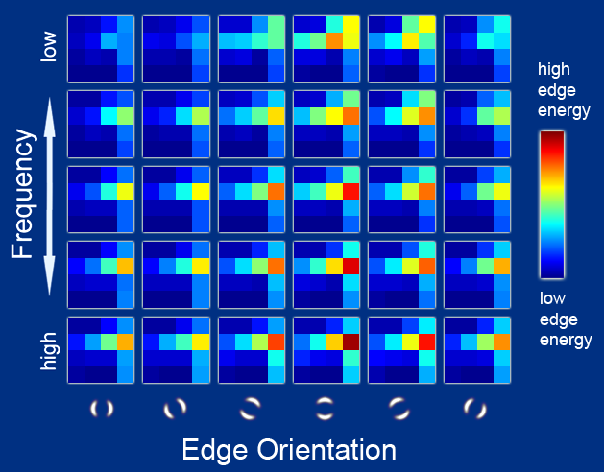
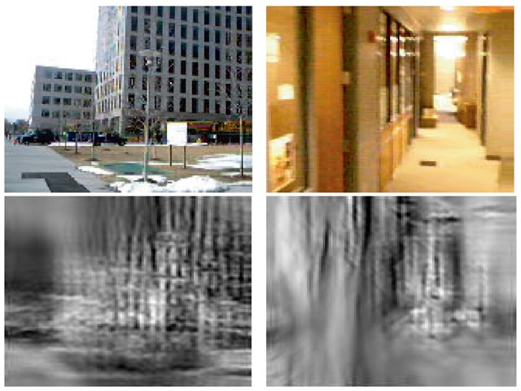

Global scene descriptors
The “gist” of a scene: Oliva & Torralba (2001)
http://people.csail.mit.edu/torralba/code/spatialenvelope/

Slide 48
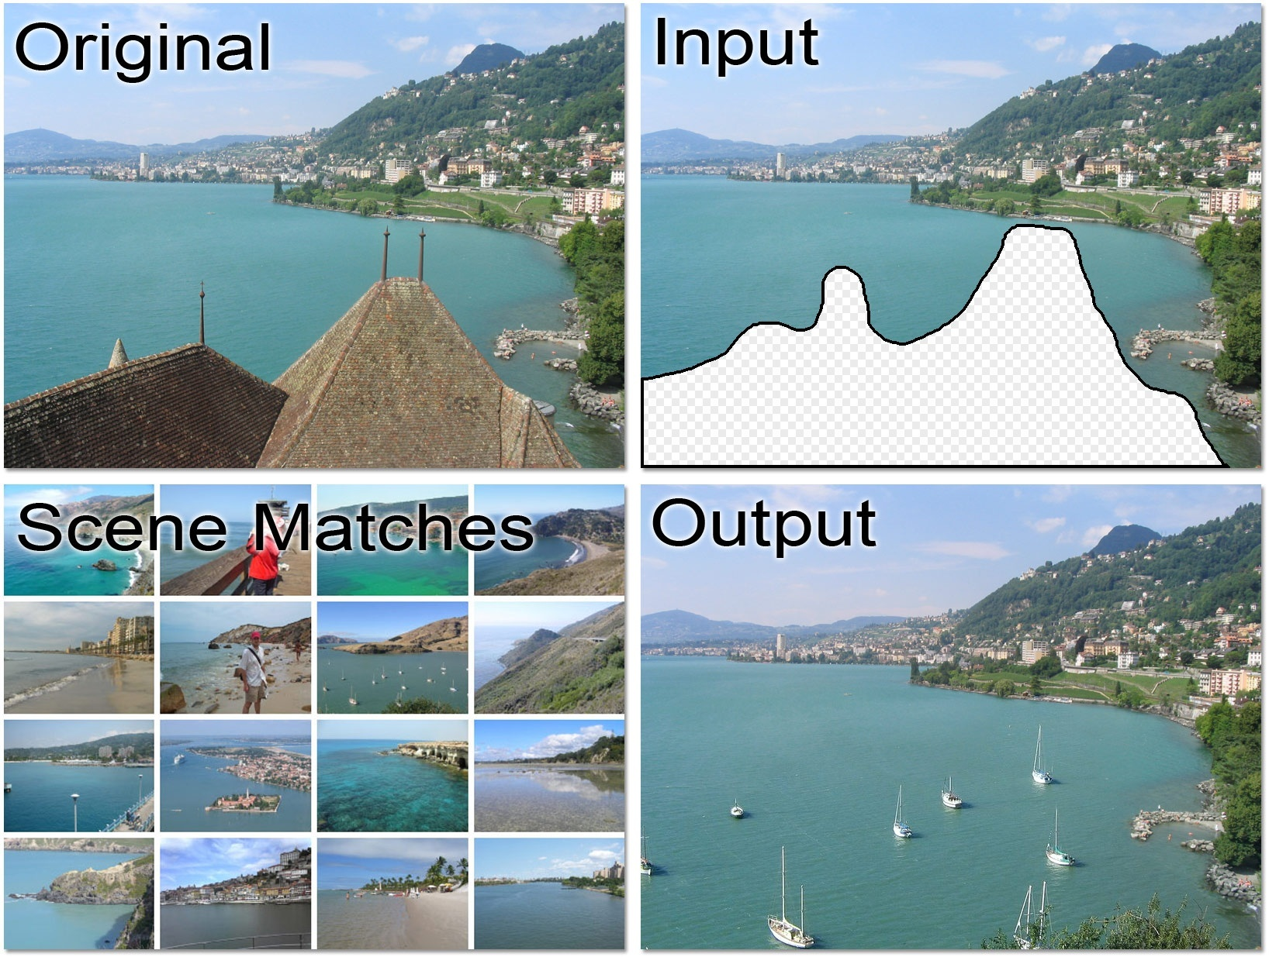
Data-driven methods
J. Hays and A. Efros, Scene Completion using Millions of Photographs, SIGGRAPH 2007

Slide 49
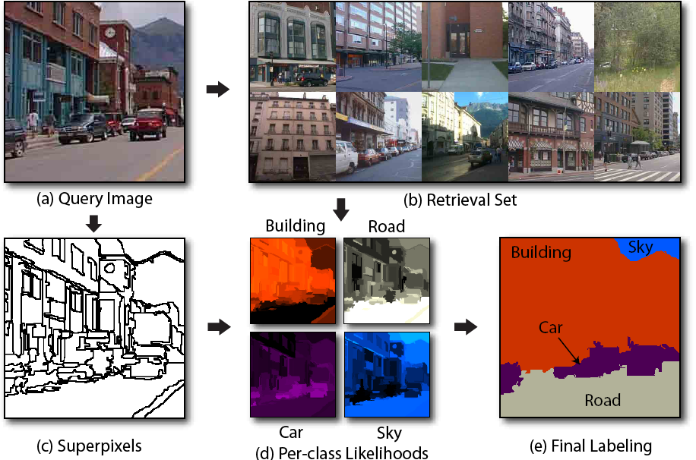
Data-driven methods
J. Tighe and S. Lazebnik, ECCV 2010

Slide 50
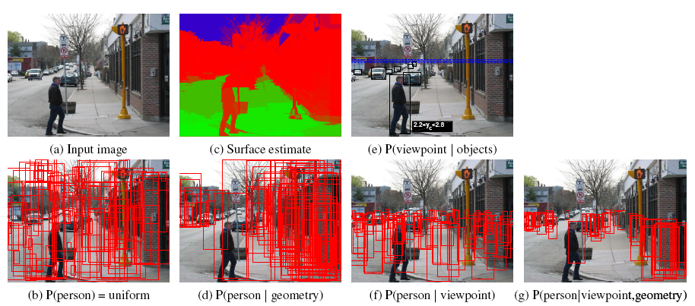
Geometric context
D. Hoiem, A. Efros, and M. Herbert. Putting Objects in Perspective. CVPR 2006.

Slide 51
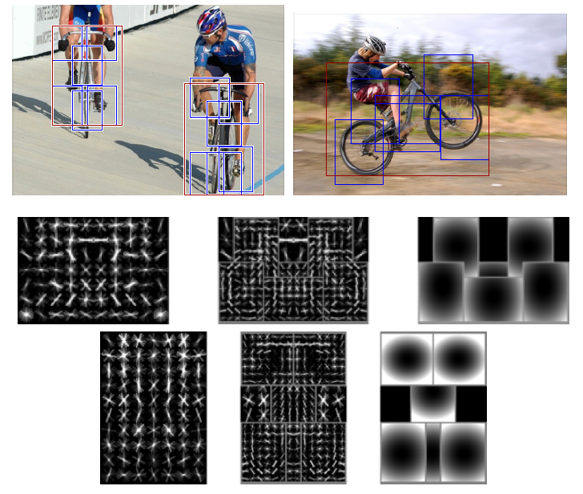
Discriminatively trained part-based models
P. Felzenszwalb, R. Girshick, D. McAllester, D. Ramanan, "Object Detection with Discriminatively Trained Part-Based Models," PAMI 2009

Slide 52
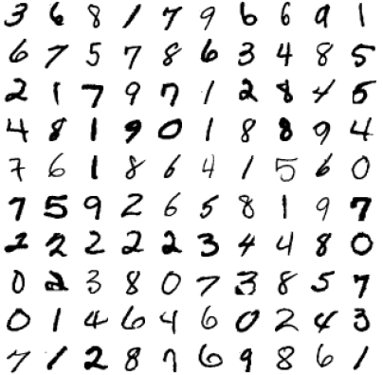
What “works” today
Reading license plates, zip codes, checks

Slide 53
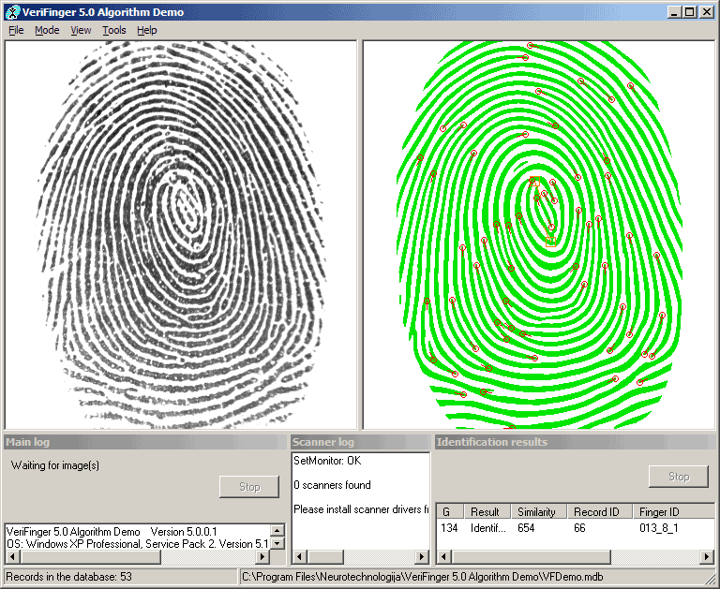
What “works” today
Reading license plates, zip codes, checks
Fingerprint recognition

Slide 54
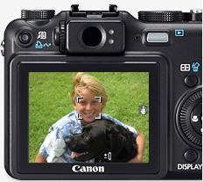
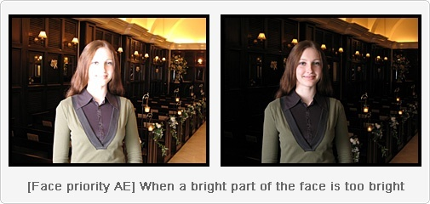
What “works” today
Reading license plates, zip codes, checks
Fingerprint recognition
Face detection

Slide 55
What “works” today
Reading license plates, zip codes, checks
Fingerprint recognition
Face detection
Recognition of flat textured objects (CD covers, book covers, etc.)

