Slide 1
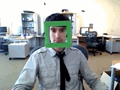
Face detection
Behold a state-of-the-art face detector!
(Courtesy Boris Babenko)
slides adapted from Svetlana Lazebnik

Slide 2
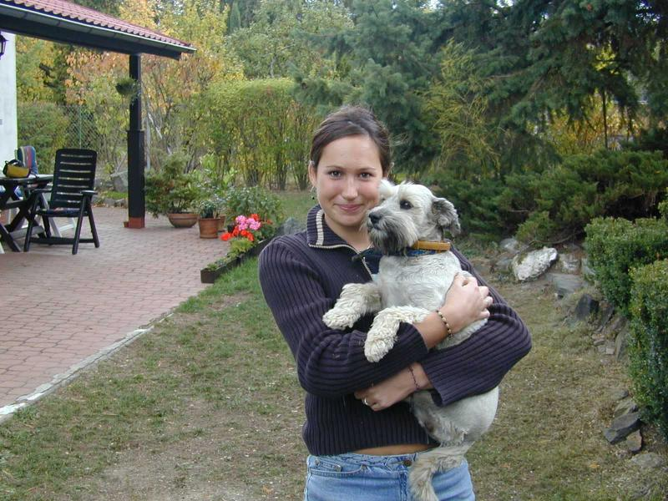
Face detection and recognition
Detection
Recognition
“Sally”

Slide 3
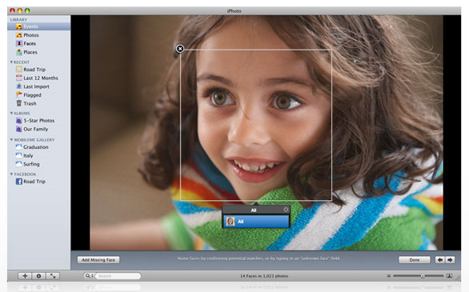
Consumer application: Apple iPhoto
http://www.apple.com/ilife/iphoto/

Slide 4
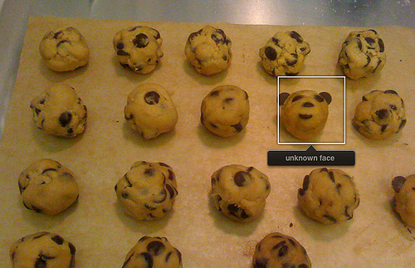
Consumer application: Apple iPhoto
Things iPhoto thinks are faces

Slide 5
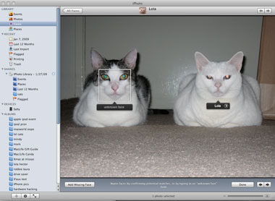
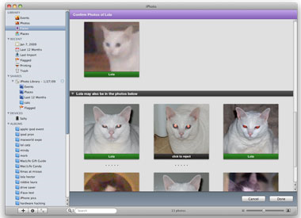
Consumer application: Apple iPhoto
Can be trained to recognize pets!
http://www.maclife.com/article/news/iphotos_faces_recognizes_cats

Slide 6
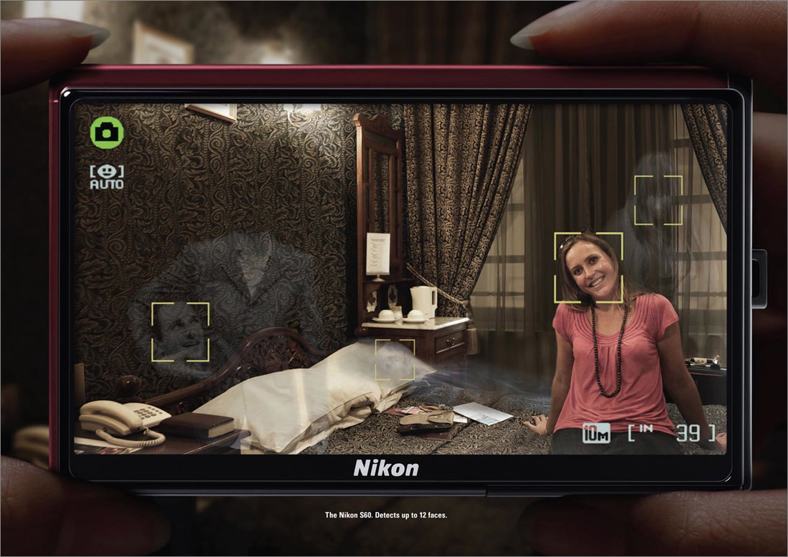
Funny Nikon ads
"The Nikon S60 detects up to 12 faces."

Slide 7
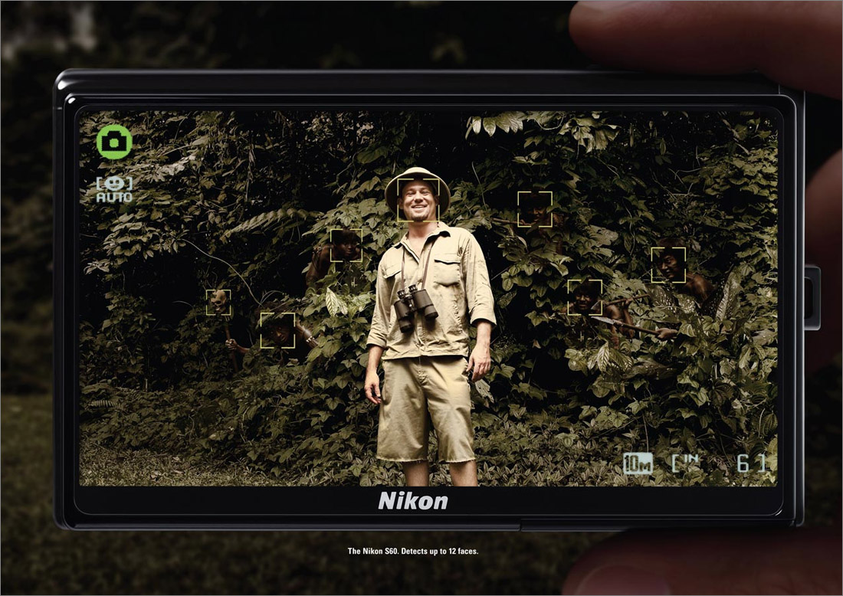
Funny Nikon ads
"The Nikon S60 detects up to 12 faces."

Slide 8
Challenges of face detection
Sliding window detector must evaluate tens of thousands of location/scale combinations
Faces are rare: 0–10 per image
For computational efficiency, we should try to spend as little time as possible on the non-face windows
A megapixel image has ~10⁶ pixels and a comparable number of candidate face locations
To avoid having a false positive in every image image, our false positive rate has to be less than 10⁻⁶

Slide 9
Eigenfaces

Slide 10
Principal Component Analysis
A N x N pixel image of a face, represented as a vector occupies a single point in N²-dimensional image space.
Images of faces being similar in overall configuration, will not be randomly distributed in this huge image space.
Therefore, they can be described by a low dimensional subspace.
Main idea of PCA for faces:
To find vectors that best account for variation of face images in entire image space.
These vectors are called eigen vectors.
Construct a face space and project the images into this face space (eigenfaces).

Slide 11
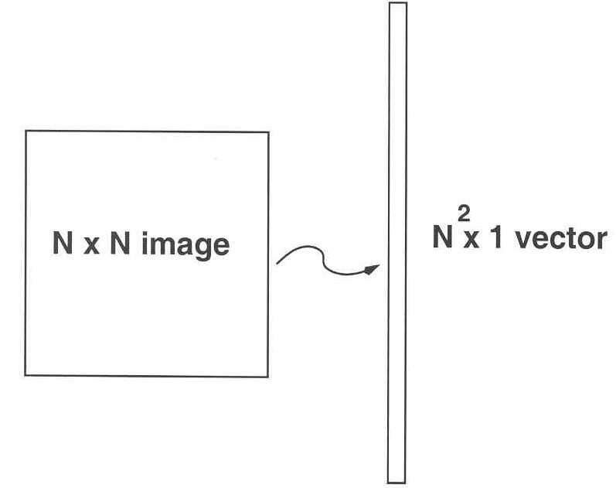
Image Representation
Training set of m images of size N*N are represented by vectors of size N²
x₁,x₂,x₃,…,x_{M}
Example

Slide 12
Average Image and Difference Images
The average training set is defined by
μ= (1/m) ∑^{m}_{i=1} x_{i}
Each face differs from the average by vector
r_{i} = x_{i} – μ

Slide 13
Covariance Matrix
The covariance matrix is constructed as
C = AA^{T} where A=[r₁,…,r_{m}]
Finding eigenvectors of N² x N² matrix is intractable. Hence, use the matrix A^{T}A of size m x m and find eigenvectors of this small matrix.
Size of this matrix is N² x N²

Slide 14
Eigenvalues and Eigenvectors - Definition
If v is a nonzero vector and λ is a number such that
Av = λv, then
v is said to be an eigenvector of A with eigenvalue λ.
Example
λ
(eigenvalues)
A
v
(eigenvectors)

Slide 15
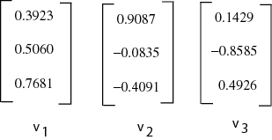
Eigenvectors of Covariance Matrix
The eigenvectors v_{i} of A^{T}A are:
Consider the eigenvectors v_{i} of A^{T}A such that
A^{T}Av_{i} = μ_{i}v_{i}
Premultiplying both sides by A, we have
AA^{T}(Av_{i}) = μ_{i}(Av_{i})

Slide 16
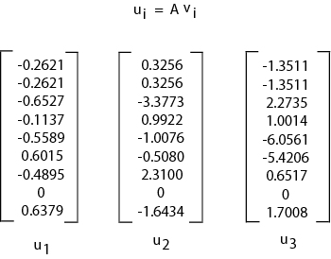
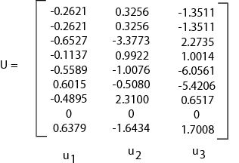
Face Space
The eigenvectors of covariance matrix are
u_{i} = Av_{i}
Face Space
u_{i} resemble facial images which look ghostly, hence called Eigenfaces
A face image can be projected into this face space by
p_{k} = U^{T}(x_{k} – μ) where k=1,…,m

Slide 17
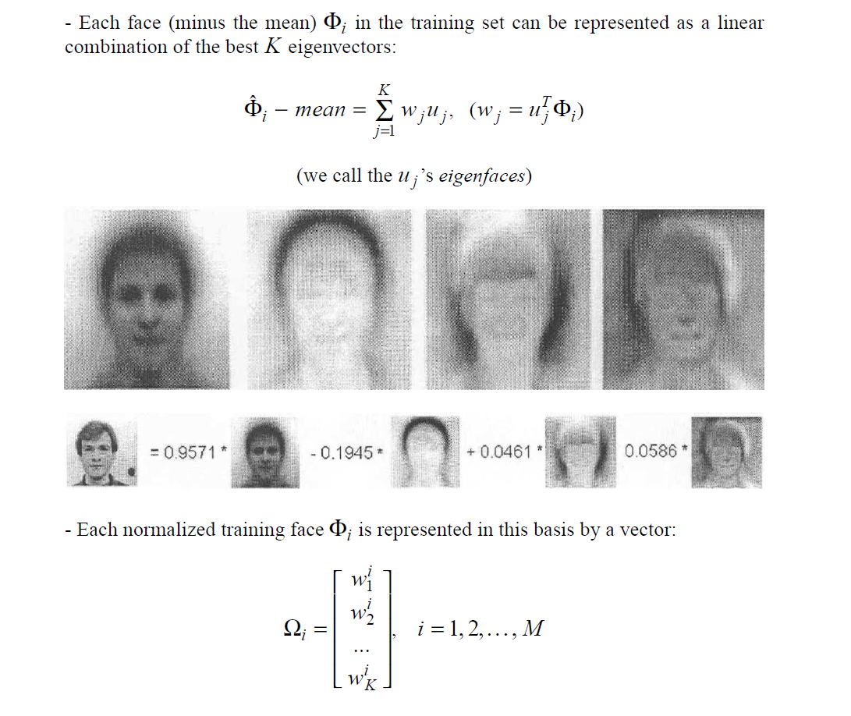
Projection into Face Space

Slide 18
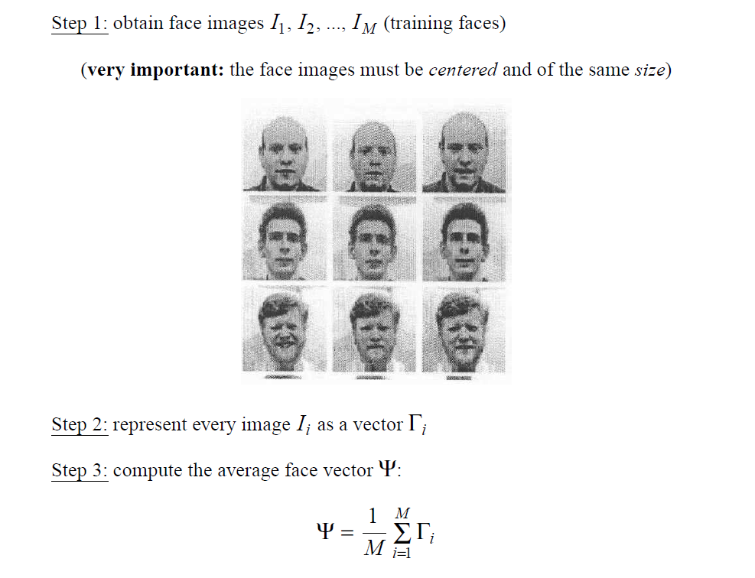
EigenFaces Algorithm

Slide 19
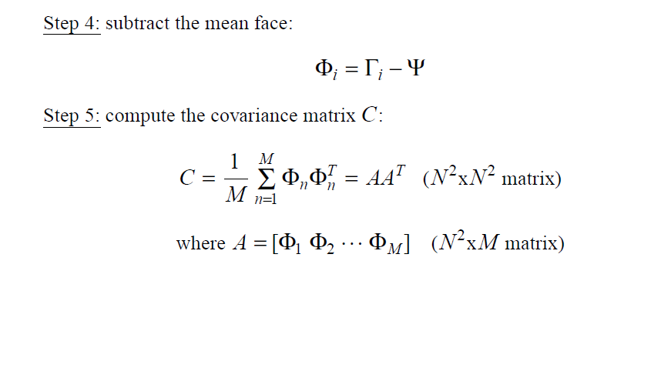
EigenFaces Algorithm

Slide 20
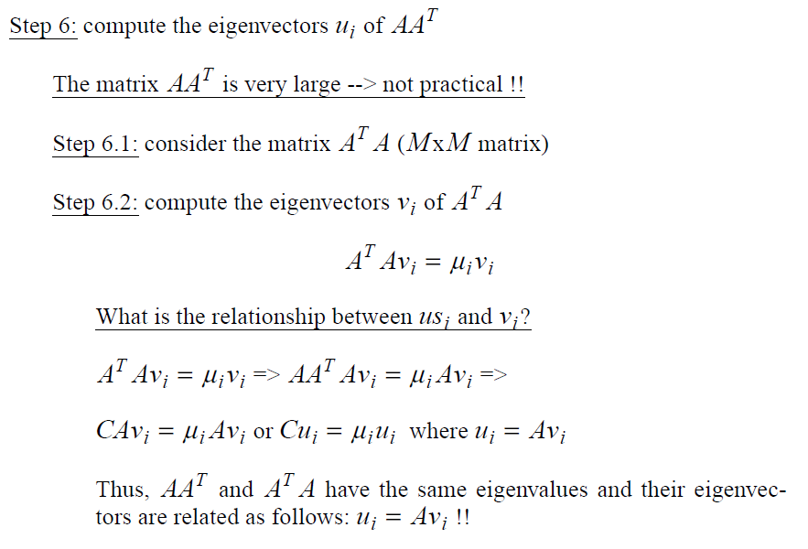
EigenFaces Algorithm

Slide 21
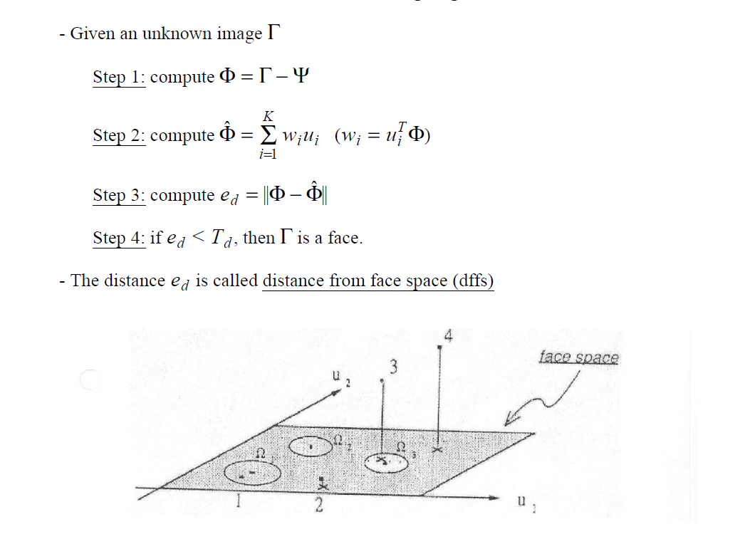
EigenFaces for Detection

Slide 22
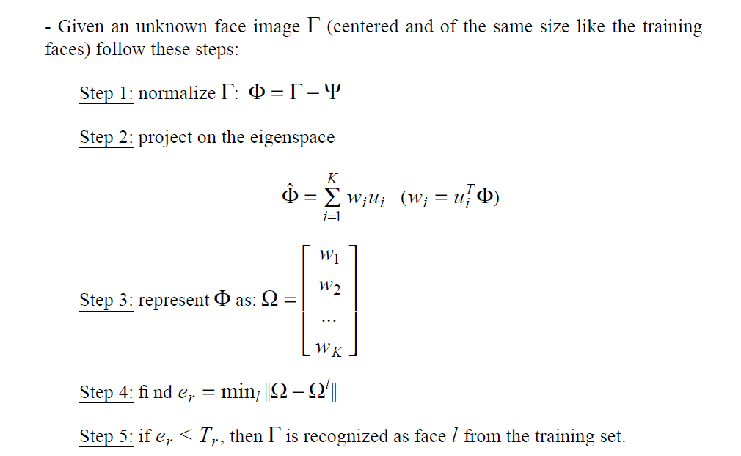
EigenFaces for Recognition

Slide 23
Limitations of Eigenfaces Approach
Variations in lighting conditions
Different lighting conditions for enrolment and query.
Bright light causing image saturation.
Differences in pose – Head orientation
- 2D feature distances appear to distort.
Expression
- Change in feature location and shape.

Slide 24
Linear Discriminant Analysis
PCA does not use class information
PCA projections are optimal for reconstruction from a low dimensional basis, they may not be optimal from a discrimination standpoint.
LDA is an enhancement to PCA
Constructs a discriminant subspace that minimizes the scatter between images of same class and maximizes the scatter between different class images

Slide 25
The Viola/Jones Face Detector
A seminal approach to real-time object detection
Training is slow, but detection is very fast
Key ideas
Integral images for fast feature evaluation
Boosting for feature selection
Attentional cascade for fast rejection of non-face windows
P. Viola and M. Jones. Rapid object detection using a boosted cascade of simple features. CVPR 2001.
P. Viola and M. Jones. Robust real-time face detection. IJCV 57(2), 2004.

Slide 26
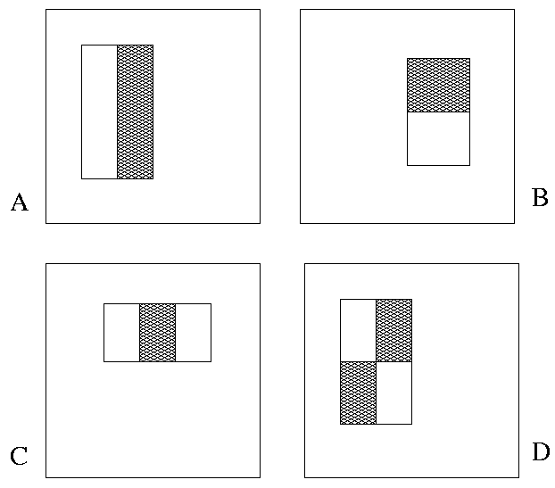
Image Features
“Rectangle filters”
Value =
∑ (pixels in white area) – ∑ (pixels in black area)
Notes:
For real problems results are only as good as the features used...
This is the main piece of ad-hoc (or domain) knowledge
Rather than the pixels, we have selected a very large set of simple functions
Sensitive to edges and other critcal features of the image
** At multiple scales
Since the final classifier is a perceptron it is important that the features be non-linear… otherwise the final classifier will be a simple perceptron.
We introduce a threshold to yield binary features

Slide 27
Example
Source
Result

Slide 28
Fast computation with integral images
The integral image computes a value at each pixel (x,y) that is the sum of the pixel values above and to the left of (x,y), inclusive
This can quickly be computed in one pass through the image
(x,y)

Slide 29
Computing the integral image

Slide 30
Computing the integral image
ii(x, y-1)
s(x-1, y)
i(x, y)
Cumulative row sum: s(x, y) = s(x–1, y) + i(x, y)
Integral image: ii(x, y) = ii(x, y−1) + s(x, y)
MATLAB: ii = cumsum(cumsum(double(i)), 2);

Slide 31
Computing sum within a rectangle
Let A,B,C,D be the values of the integral image at the corners of a rectangle
Then the sum of original image values within the rectangle can be computed as:
sum = A – B – C + D
Only 3 additions are required for any size of rectangle!
D
B
C
A

Slide 32
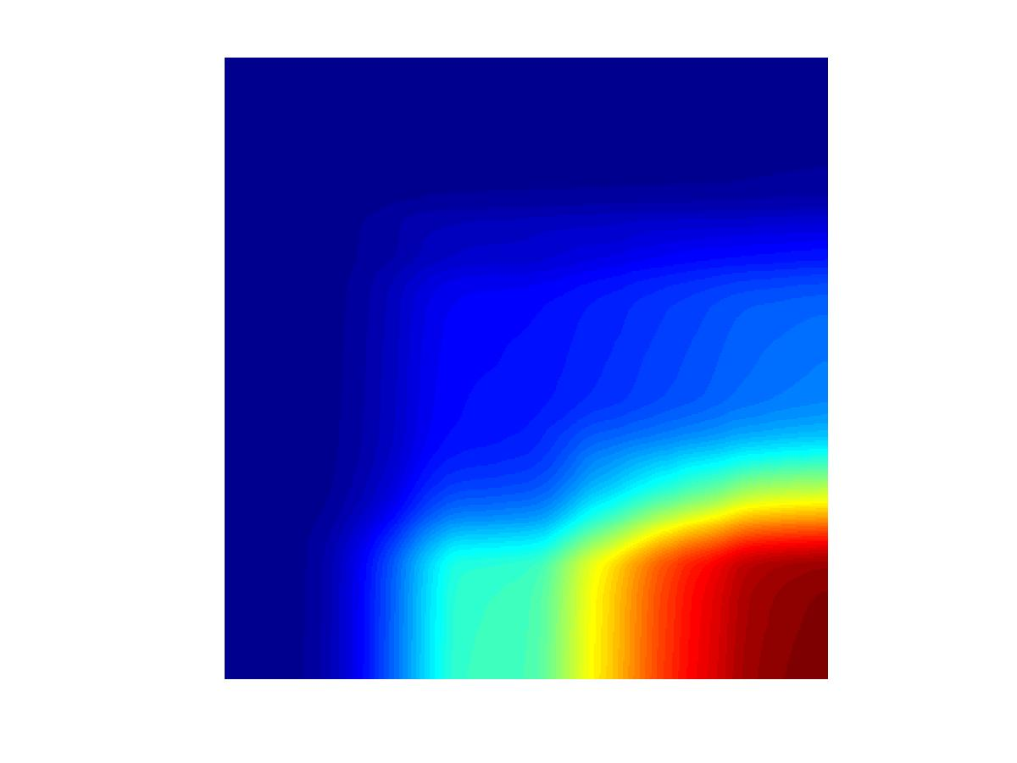
Example
Integral Image
-1
+1
+2
-2
-1
+1

Slide 33
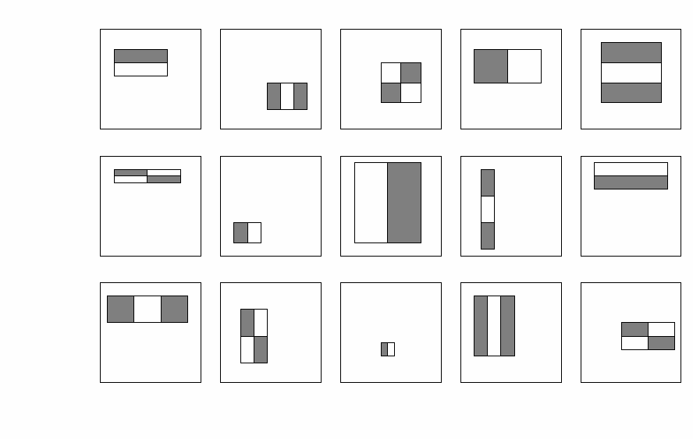
Feature selection
For a 24x24 detection region, the number of possible rectangle features is ~160,000!

Slide 34
Feature selection
For a 24x24 detection region, the number of possible rectangle features is ~160,000!
At test time, it is impractical to evaluate the entire feature set
Can we create a good classifier using just a small subset of all possible features?
How to select such a subset?

Slide 35
Boosting
Boosting is a classification scheme that combines weak learners into a more accurate ensemble classifier
Training procedure
Initially, weight each training example equally
In each boosting round:
Find the weak learner that achieves the lowest weighted training error
Raise the weights of training examples misclassified by current weak learner
Compute final classifier as linear combination of all weak learners (weight of each learner is directly proportional to its accuracy)
Exact formulas for re-weighting and combining weak learners depend on the particular boosting scheme (e.g., AdaBoost)
Y. Freund and R. Schapire, A short introduction to boosting, Journal of Japanese Society for Artificial Intelligence, 14(5):771-780, September, 1999.

Slide 36
Boosting for face detection
Define weak learners based on rectangle features
For each round of boosting:
Evaluate each rectangle filter on each example
Select best filter/threshold combination based on weighted training error
Reweight examples
value of rectangle feature
parity
threshold
window

Slide 37
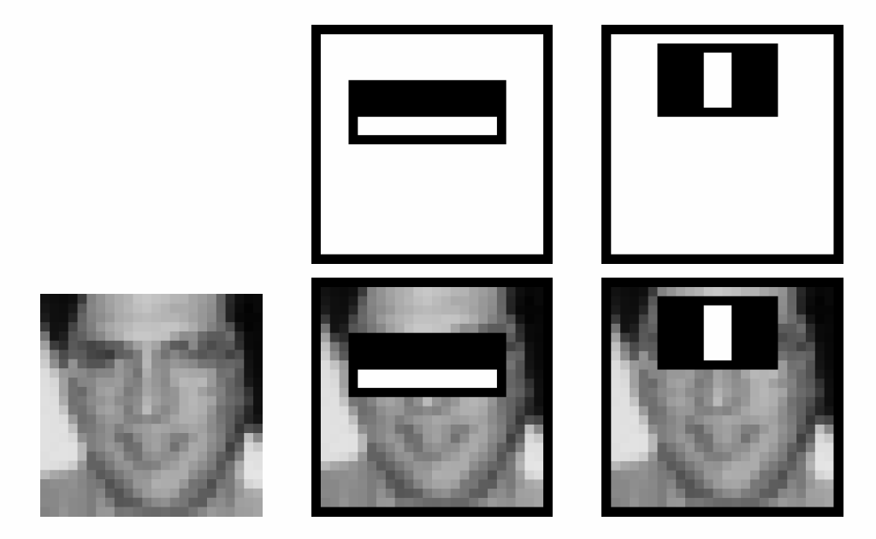
Boosting for face detection
First two features selected by boosting: This feature combination can yield 100% detection rate and 50% false positive rate

Slide 38
Boosting vs. SVM
Advantages of boosting
Integrates classifier training with feature selection
Complexity of training is linear instead of quadratic in the number of training examples
Flexibility in the choice of weak learners, boosting scheme
Testing is fast
Easy to implement
Disadvantages
Needs many training examples
Training is slow
Often doesn’t work as well as SVM (especially for many-class problems)

Slide 39
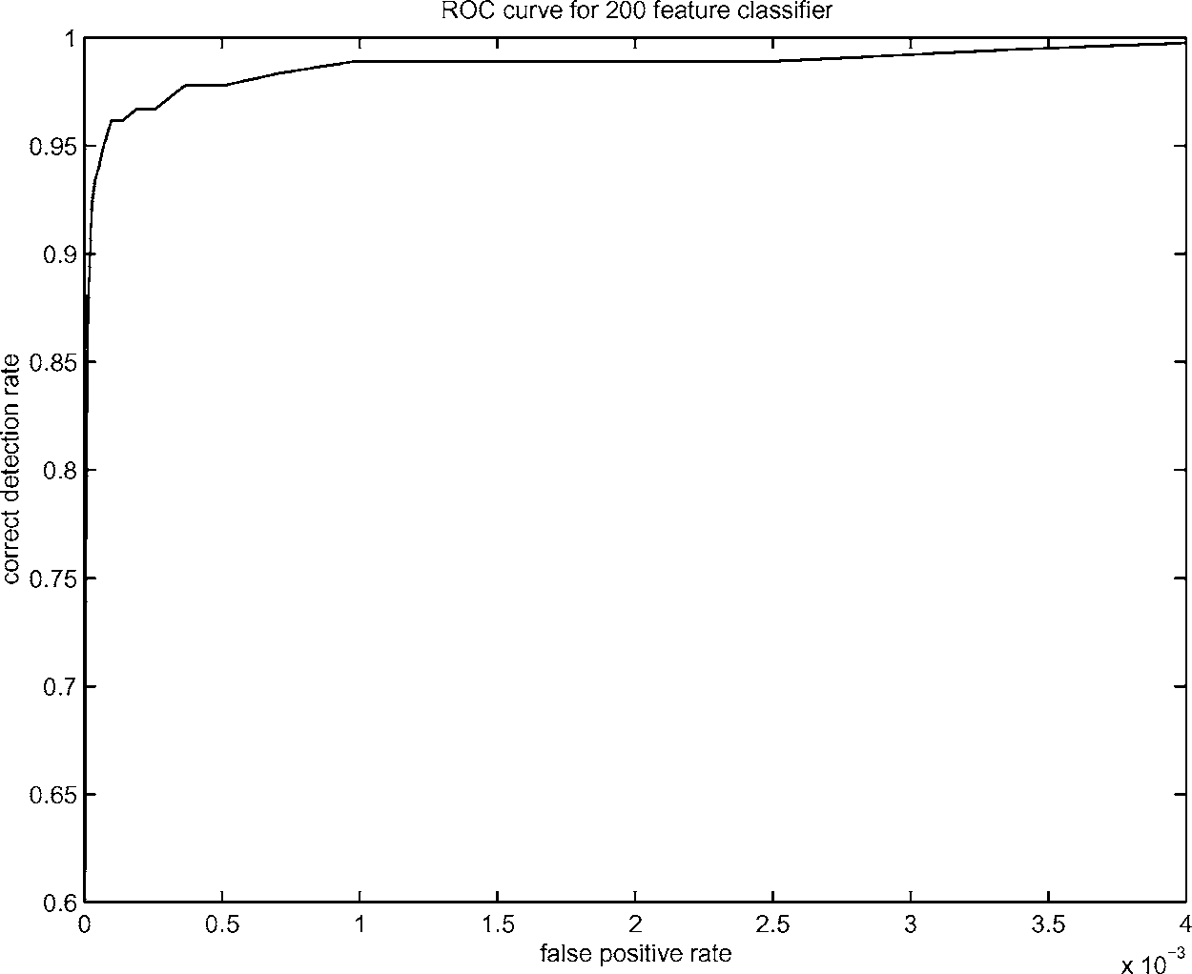
Boosting for face detection
A 200-feature classifier can yield 95% detection rate and a false positive rate of 1 in 14084
Not good enough!
Receiver operating characteristic (ROC) curve

Slide 40
Attentional cascade
We start with simple classifiers which reject many of the negative sub-windows while detecting almost all positive sub-windows
Positive response from the first classifier triggers the evaluation of a second (more complex) classifier, and so on
A negative outcome at any point leads to the immediate rejection of the sub-window
T
T
T
IMAGE
SUB-WINDOW
T
FACE
Classifier 1
Classifier 2
Classifier 3
F
F
F
NON-FACE
NON-FACE
NON-FACE

Slide 41
Attentional cascade
Chain classifiers that are progressively more complex and have lower false positive rates:
Receiver operating characteristic
% False Pos
0
50
vs
false
neg
determined by
0 100
% Detection
T
T
T
IMAGE
SUB-WINDOW
T
FACE
Classifier 1
Classifier 2
Classifier 3
F
F
F
NON-FACE
NON-FACE
NON-FACE
Notes:
In general simple classifiers, while they are more efficient, they are also weaker.
We could define a computational risk hierarchy (in analogy with structural risk minimization)…
A nested set of classifier classes
The training process is reminiscent of boosting…
- previous classifiers reweight the examples used to train subsequent classifiers
The goal of the training process is different
- instead of minimizing errors minimize false positives

Slide 42
Attentional cascade
The detection rate and the false positive rate of the cascade are found by multiplying the respective rates of the individual stages
A detection rate of 0.9 and a false positive rate on the order of 10⁻⁶ can be achieved by a 10-stage cascade if each stage has a detection rate of 0.99 (0.99¹⁰ ≈ 0.9) and a false positive rate of about 0.30 (0.3¹⁰ ≈ 6×10⁻⁶)
T
T
T
IMAGE
SUB-WINDOW
T
FACE
Classifier 1
Classifier 2
Classifier 3
F
F
F
NON-FACE
NON-FACE
NON-FACE

Slide 43
Training the cascade
Set target detection and false positive rates for each stage
Keep adding features to the current stage until its target rates have been met
Need to lower AdaBoost threshold to maximize detection (as opposed to minimizing total classification error)
Test on a validation set
If the overall false positive rate is not low enough, then add another stage
Use false positives from current stage as the negative training examples for the next stage

Slide 44
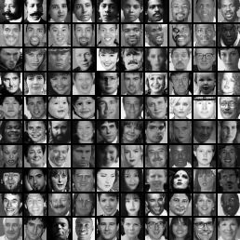
The implemented system
Training Data
5000 faces
All frontal, rescaled to 24x24 pixels
300 million non-faces
9500 non-face images
Faces are normalized
Scale, translation
Many variations
Across individuals
Illumination
Pose
Notes:
This situation with negative examples is actually quite common… where negative examples are free.

Slide 45
System performance
Training time: “weeks” on 466 MHz Sun workstation
38 layers, total of 6061 features
Average of 10 features evaluated per window on test set
“On a 700 Mhz Pentium III processor, the face detector can process a 384 by 288 pixel image in about .067 seconds”
15 Hz
15 times faster than previous detector of comparable accuracy (Rowley et al., 1998)

Slide 46
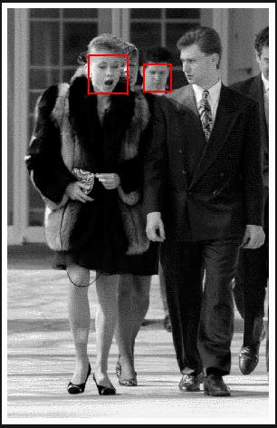
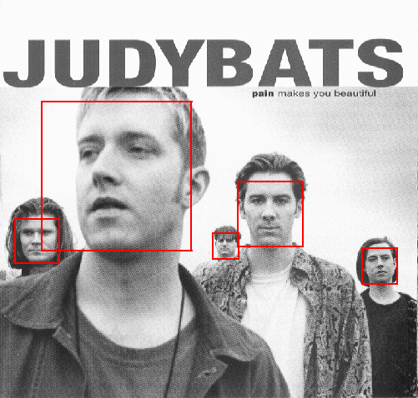
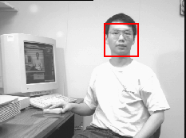
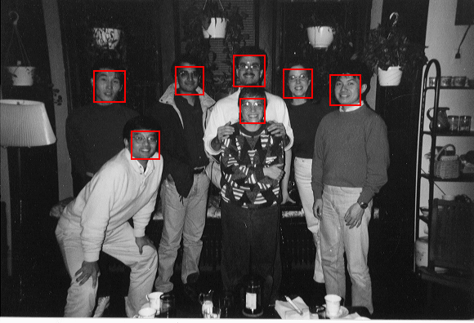
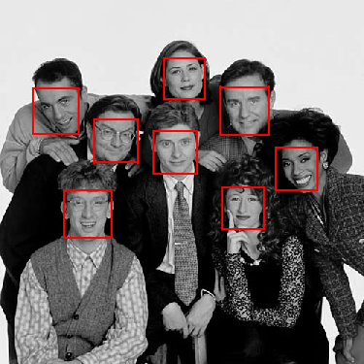
Output of Face Detector on Test Images

Slide 47
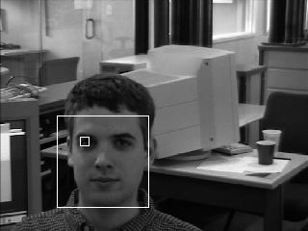
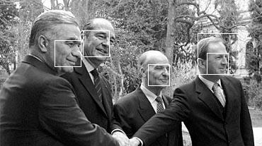
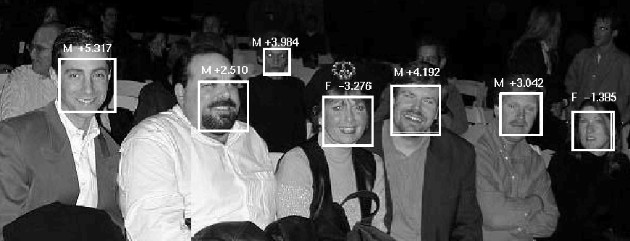
Other detection tasks
Facial Feature Localization
Profile Detection
Male vs. female

Slide 48
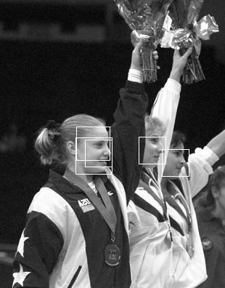
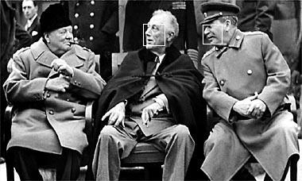
Profile Detection

Slide 49
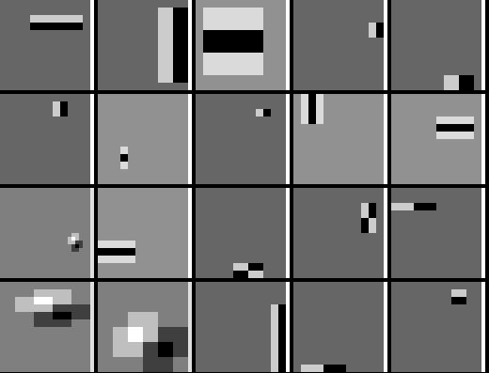
Profile Features

Slide 50
Summary: Viola/Jones detector
Rectangle features
Integral images for fast computation
Boosting for feature selection
Attentional cascade for fast rejection of negative windows

Slide 51
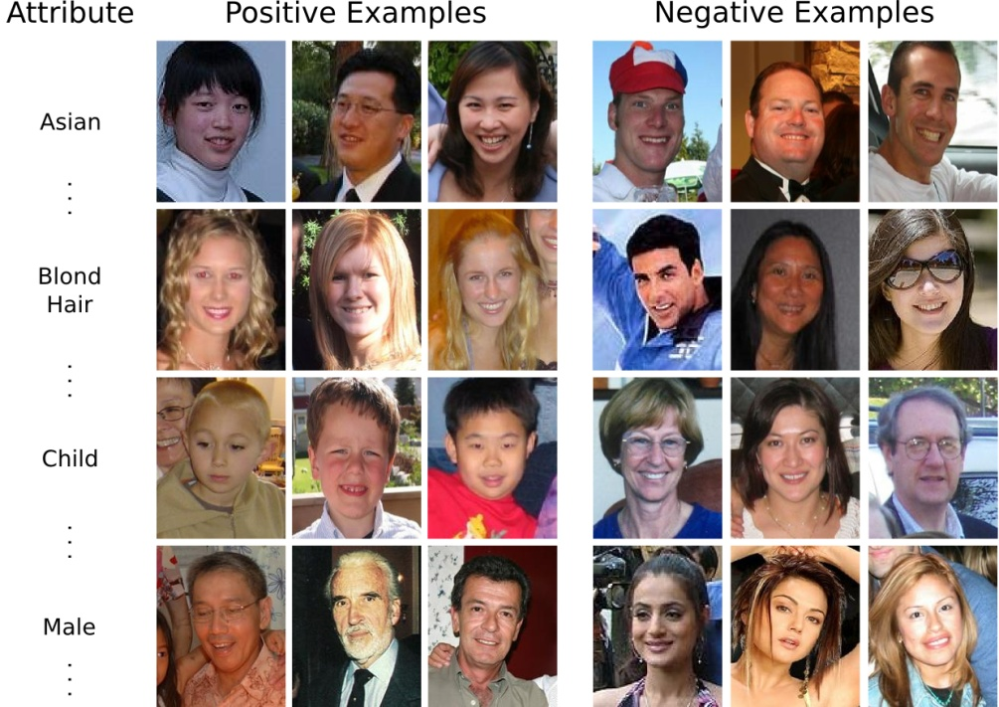
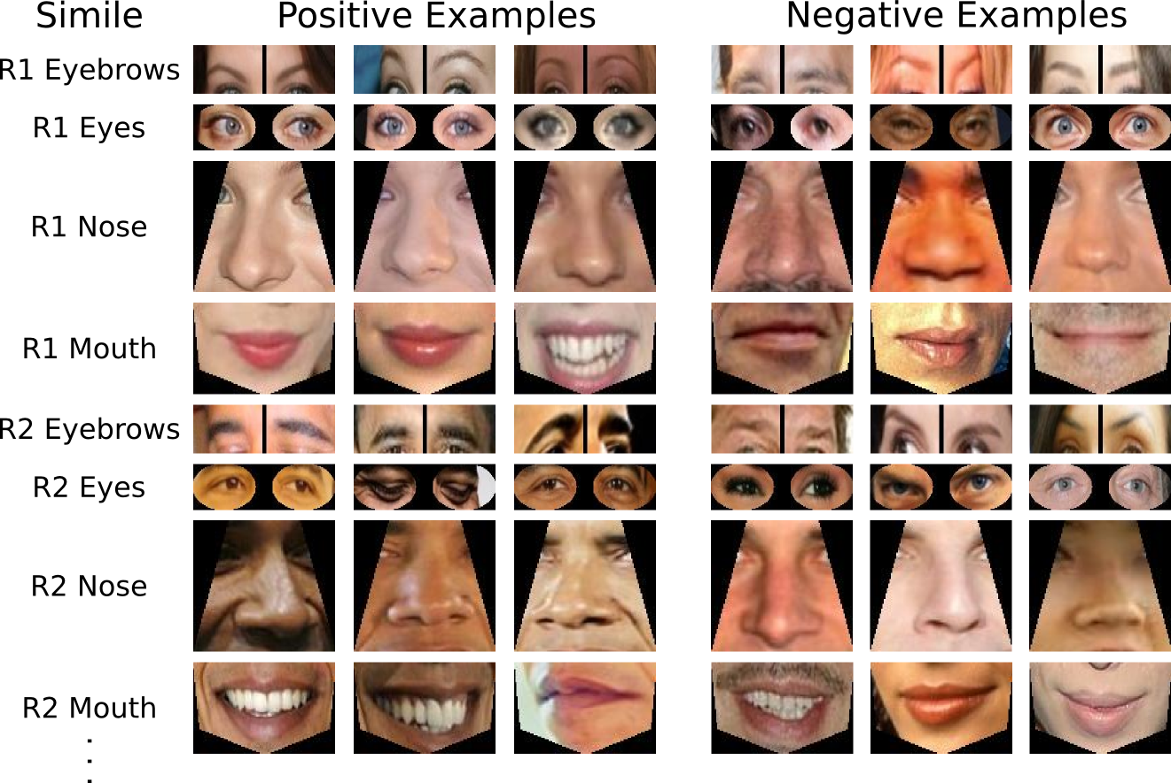
Face Recognition
Attributes for training
Similes for training
N. Kumar, A. C. Berg, P. N. Belhumeur, and S. K. Nayar, "Attribute and Simile Classifiers for Face Verification," ICCV 2009.

Slide 52
Face Recognition with Attributes
Low-level
features
Images
Attributes
Verification
RGB
+
HOG
LBP
SIFT
-
…
Dark
hair
Asian
Round
Jaw
Different
Male
RGB
+
HOG
LBP
-
SIFT
…

Slide 53
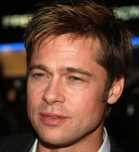
Learning an attribute classifier
Training
images
Low-level
features
Feature
selection
Train
classifier
RGB
HoG
RGB, Nose
HSV
HoG, Eyes
…
HSV, Hair
Gender
classifier
Males
RGB
Edges, Mouth
HoG
…
HSV
Male
…
0.87
Females

Slide 54
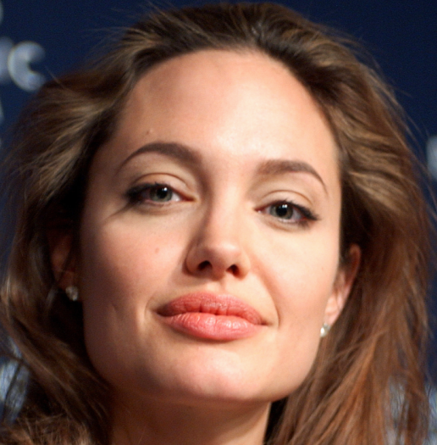
Describe faces using similes
Penelope Cruz
Angelina Jolie
Notes:
simile classifiers are binary classifiers trained to recognize the similarity of faces, or regions of faces, to specific reference people

Slide 55
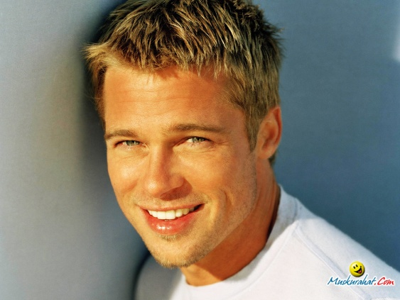
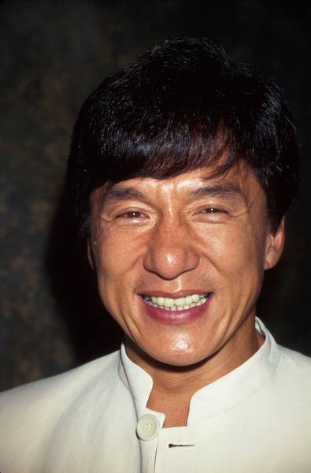
Training simile classifiers
’s eyes
Images of Penelope Cruz
’s eyes
Images of other people

Slide 56
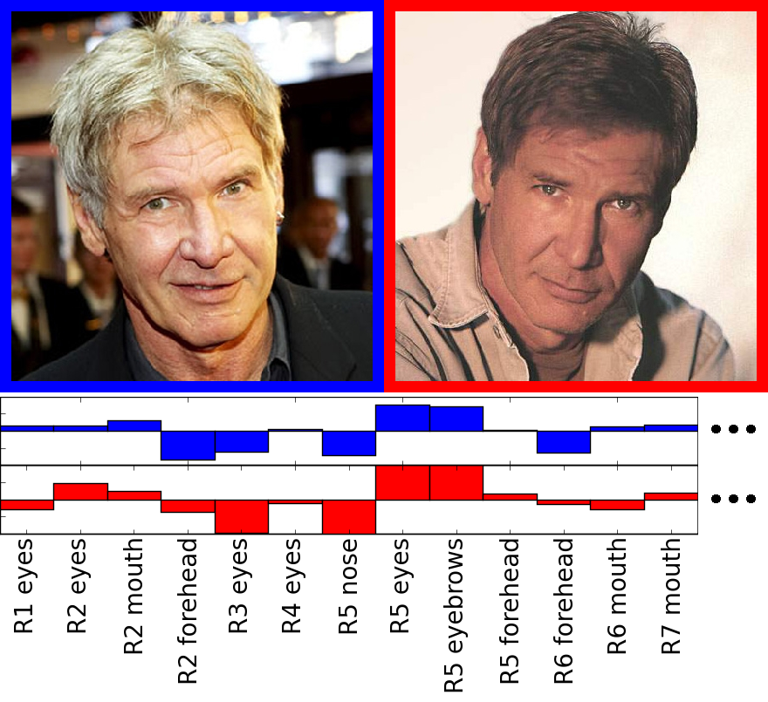
Using simile classifiers for verification
Verification
classifier

Slide 57
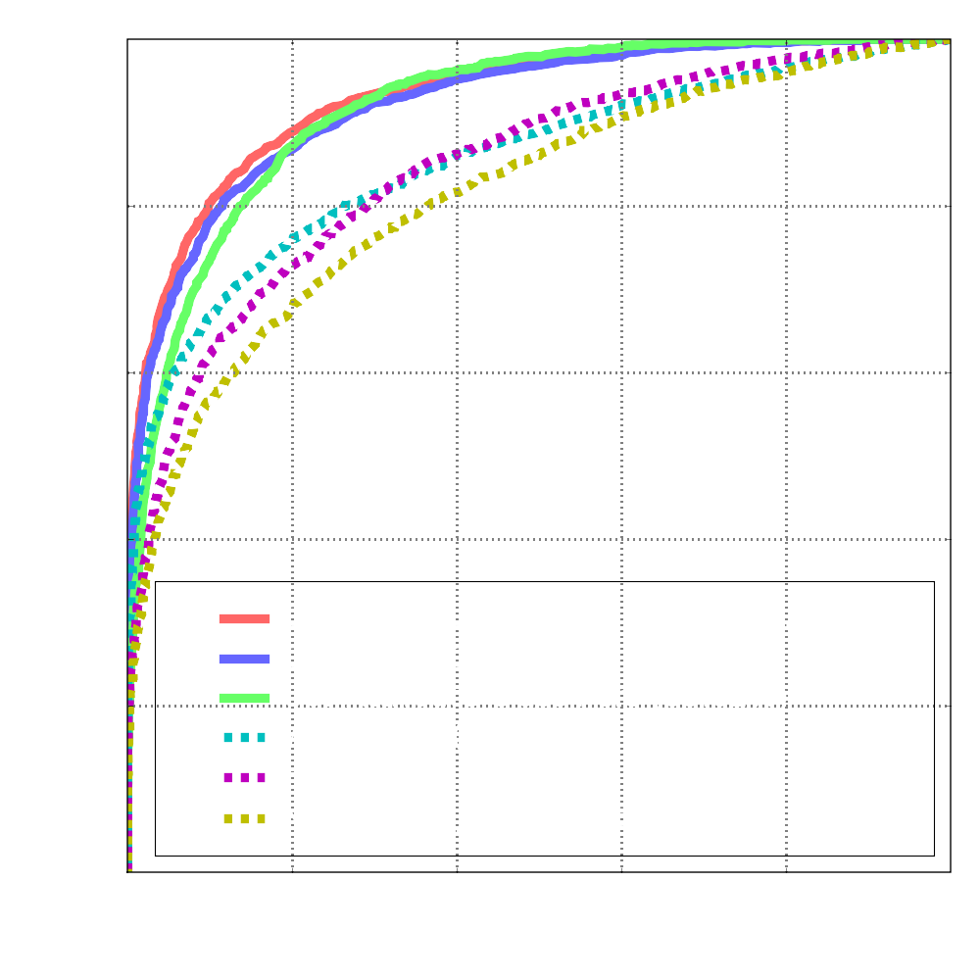
Performance on LFW
85.29% Accuracy
(31.68% Drop in error rates)
as of May 2009

Slide 58
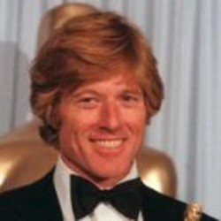
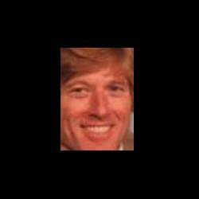
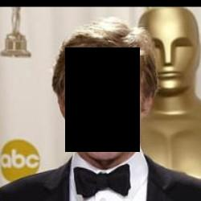
Human face verification performance
Original
99.20%
Cropped
97.53%
Inverse
Cropped
94.27%

Slide 59
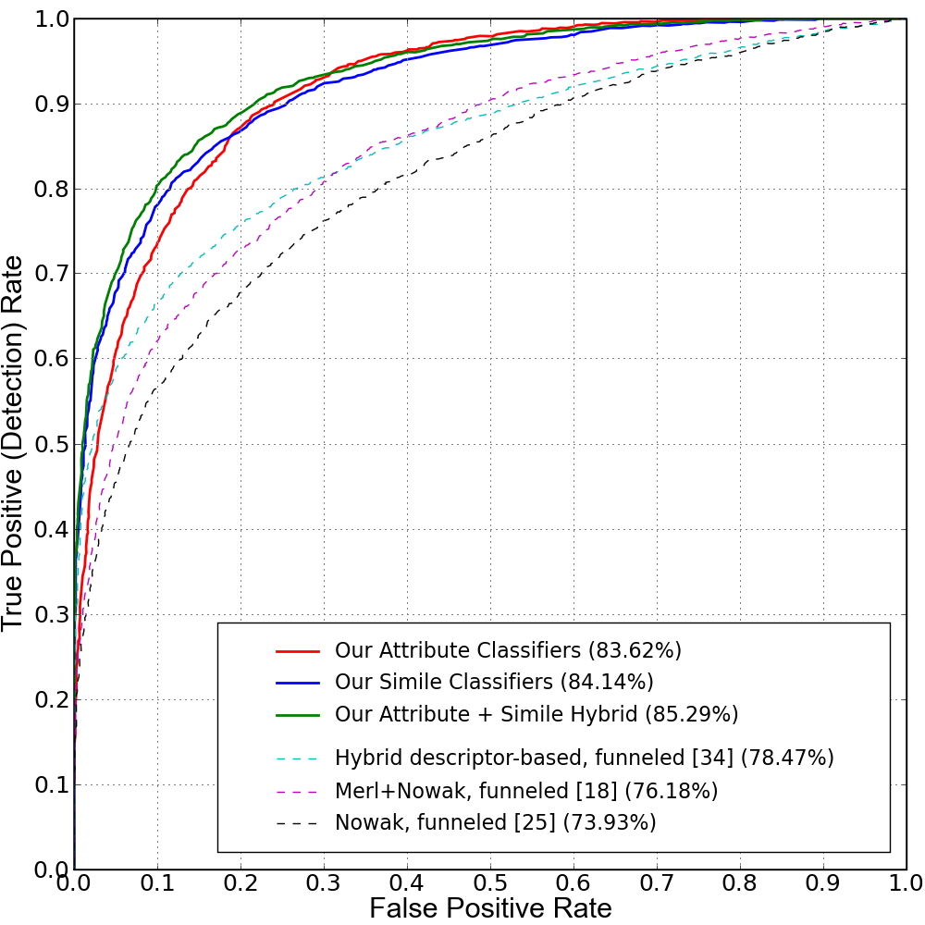
Face Recognition
Results on Labeled Faces in the Wild Dataset
N. Kumar, A. C. Berg, P. N. Belhumeur, and S. K. Nayar, "Attribute and Simile Classifiers for Face Verification," ICCV 2009.

