Slide 1
776 Computer Vision
Jan-Michael Frahm
Fall 2015

Slide 2
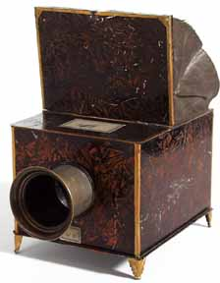
Last class

Slide 3
Last Class
World to
camera coord.
trans. matrix
(4x4)
3D
point
(4x1)
2D
point
(3x1)
Camera to
pixel coord.
trans. matrix
(3x3)
Perspective
projection matrix
(3x4)
=

Slide 4
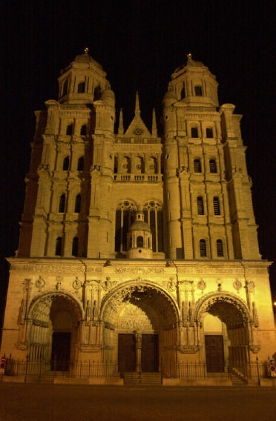
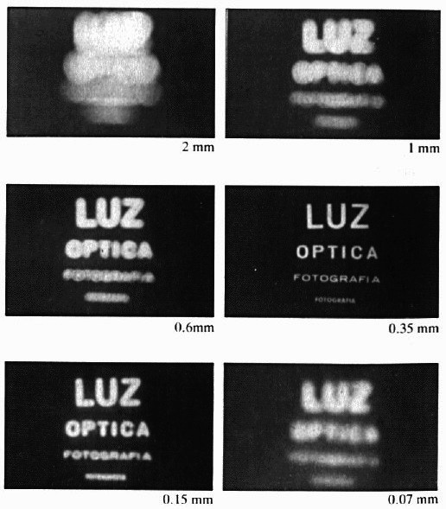
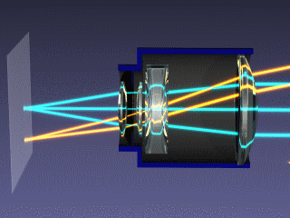
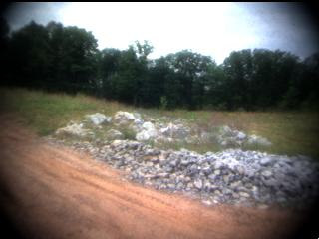
Facing Real Cameras
There are undesired effects in real situations
  perspective distortion
Camera artifacts
  aperture is not infinitely small
  lens
  vignetting

Slide 5
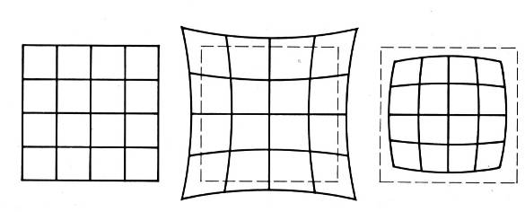
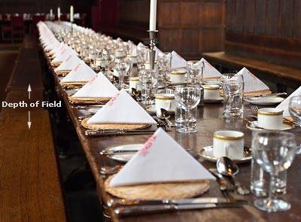
Last Class
radial distortion
depth of field
field of view

Slide 6
Facing Real Cameras
There are undesired effects in real situations
  perspective distortion
Camera artifacts
  aperture is not infinitely small
  lens
  vignetting, radial distortion
  depth of field
  field of view

Slide 7
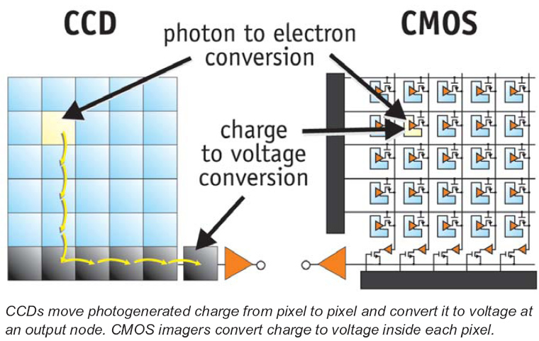
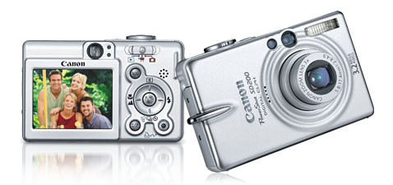
Digital camera
A digital camera replaces film with a sensor array
  Each cell in the array is light-sensitive diode that converts photons to electrons
  Two common types
    Charge Coupled Device (CCD)
    Complementary metal oxide semiconductor (CMOS)
  http://electronics.howstuffworks.com/digital-camera.htm
Slide by Steve Seitz

Slide 8
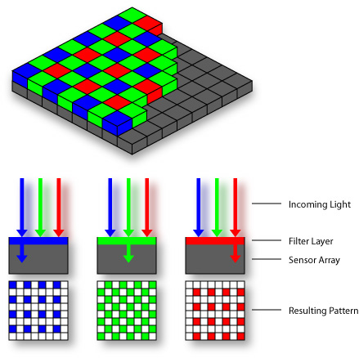

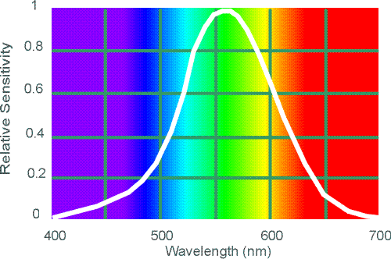
Color sensing in camera: Color filter array
Bayer grid
Estimate missing components from neighboring values
(demosaicing)
Why more green?
Human Luminance Sensitivity Function
Source: Steve Seitz

Slide 9
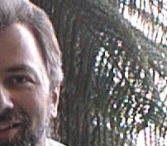
Problem with demosaicing: color moire
Slide by F. Durand

Slide 10
The cause of color moire
detector
Fine black and white detail in image
misinterpreted as color information
Slide by F. Durand

Slide 11
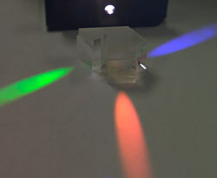
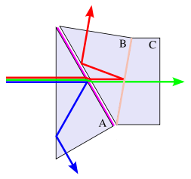
Color sensing in camera: Prism
Requires three chips and precise alignment
More expensive
CCD(R)
CCD(G)
CCD(B)
slide: S. Lazebnik

Slide 12
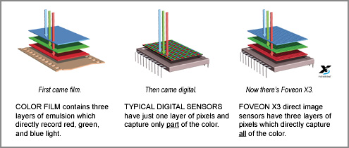
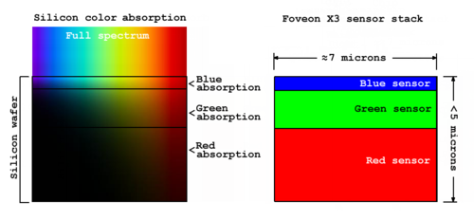
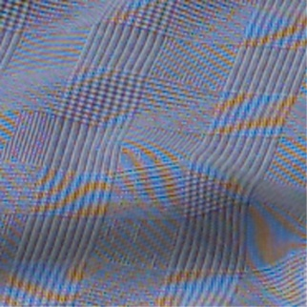
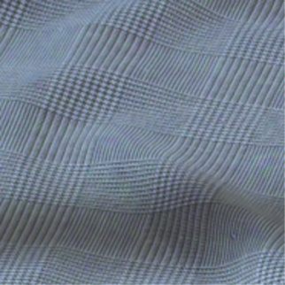
Color sensing in camera: Foveon X3
CMOS sensor
Takes advantage of the fact that red, blue and green light penetrate silicon to different depths
http://www.foveon.com/article.php?a=67
http://en.wikipedia.org/wiki/Foveon_X3_sensor
better image quality
Source: M. Pollefeys

Slide 13
Facing Real Cameras
There are undesired effects in real situations
  perspective distortion
Camera artifacts
  Aperture is not infinitely small
  Lens
  Vignetting, radial distortion
  Depth of field
  Field of view
  Color sensing

Slide 14
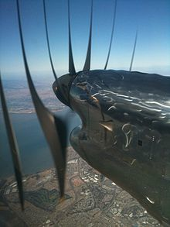
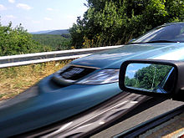
Rolling Shutter Cameras
Many cameras use CMOS sensors (mobile, DLSR, …)
To save cost these are often rolling shutter cameras
  lines are progressively exposed
  line by line image reading
Rolling shutter artifacts
image source: Wikipedia

Slide 15
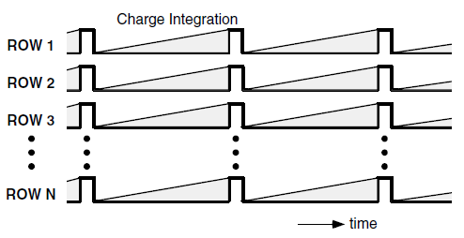
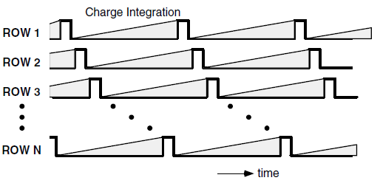
Rolling Shutter
regular camera
(global shutter)
rolling shutter camera

Slide 16
Facing Real Cameras
There are undesired effects in real situations
  perspective distortion
Camera artifacts
  Aperture is not infinitely small
  Lens
  Vignetting, radial distortion
  Depth of field
  Field of view
  Color sensing
  Rolling shutter cameras

Slide 17
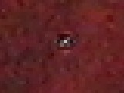

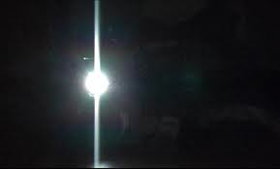
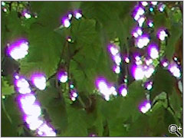
Digital camera artifacts
Noise
    low light is where you most notice noise
    light sensitivity (ISO) / noise tradeoff
    stuck pixels
In-camera processing
    oversharpening can produce halos
Compression
    JPEG artifacts, blocking
Blooming
    charge overflowing into neighboring pixels
Smearing
  columnwise overexposue
Color artifacts
    purple fringing from microlenses,
    white balance
modified from Steve Seitz

Slide 18
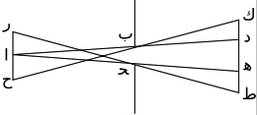
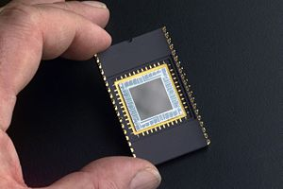
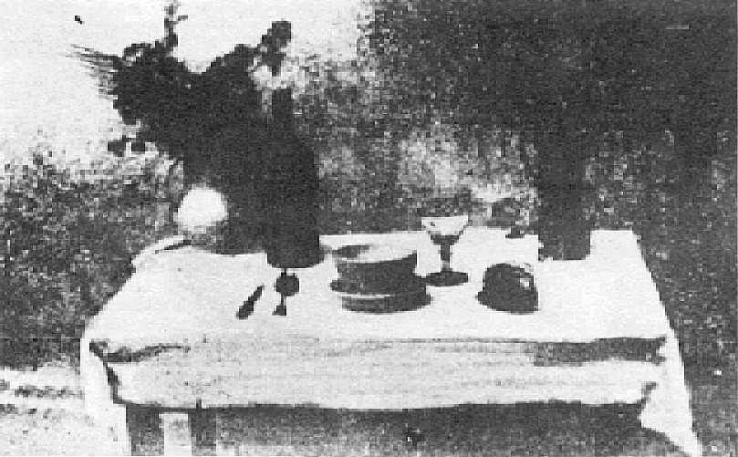
Historic milestones
Pinhole model: Mozi (470-390 BCE),
Aristotle (384-322 BCE)
Principles of optics (including lenses):
Alhacen (965-1039 CE)
Camera obscura: Leonardo da Vinci
(1452-1519), Johann Zahn (1631-1707)
First photo: Joseph Nicephore Niepce (1822)
Daguerréotypes (1839)
Photographic film (Eastman, 1889)
Cinema (Lumière Brothers, 1895)
Color Photography (Lumière Brothers, 1908)
Television (Baird, Farnsworth, Zworykin, 1920s)
First consumer camera with CCD
Sony Mavica (1981)
First fully digital camera: Kodak DCS100 (1990)
Alhacen’s notes
Niepce, “La Table Servie,” 1822
CCD chip

Slide 19
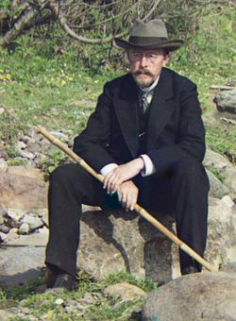
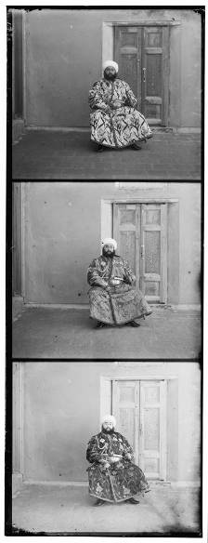
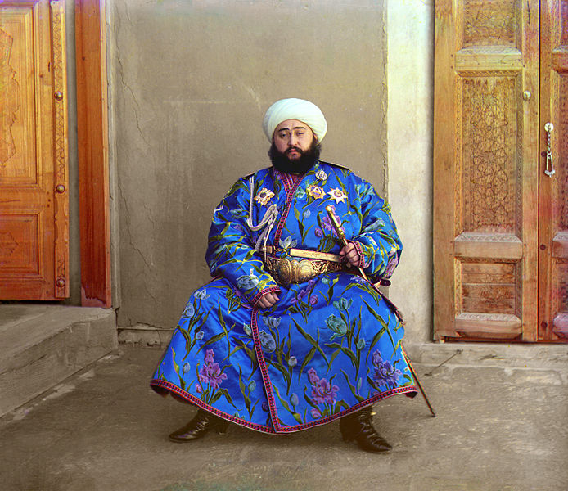
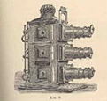
Early color photography
Sergey Prokudin-Gorskii (1863-1944)
Photographs of the Russian empire (1909-1916)
Lantern
projector
http://en.wikipedia.org/wiki/Sergei_Mikhailovich_Prokudin-Gorskii
http://www.loc.gov/exhibits/empire/

Slide 20
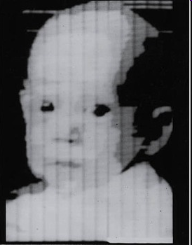
First digitally scanned photograph
1957, 176x176 pixels
http://listverse.com/history/top-10-incredible-early-firsts-in-photography/

Slide 21
Assignment
Normalized cross correlation
  C = normxcorr2(template, A) (Matlab)
Sum of squared differences
  per patch sum(sum((A-B).^2)) for SSD of patch A and B

