Slide 1
776 Computer Vision
Jan-Michael Frahm
Fall 2015

Slide 2
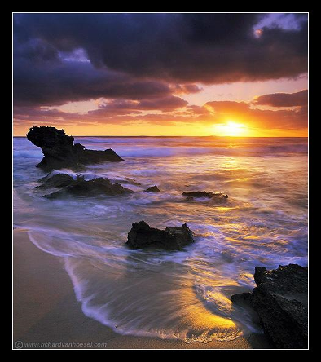
Capturing light
Source: A. Efros

Slide 3
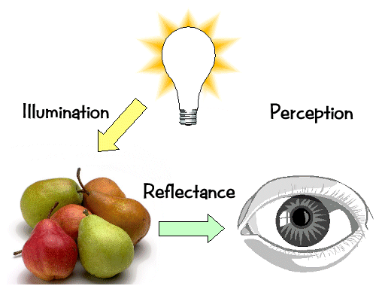
Light transport
slide: R. Szeliski

Slide 4

What is light?
Electromagnetic radiation (EMR) moving along rays in space
  R(λ) is EMR, measured in units of power (watts)
    λ is wavelength
Light field
  We can describe all of the light in the scene by specifying the radiation (or “radiance” along all light rays) arriving at every point in space and from every direction
slide: R. Szeliski

Slide 5
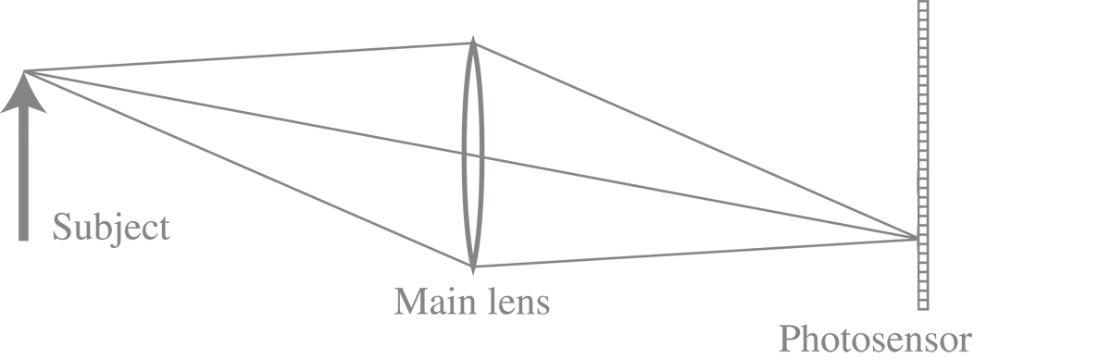
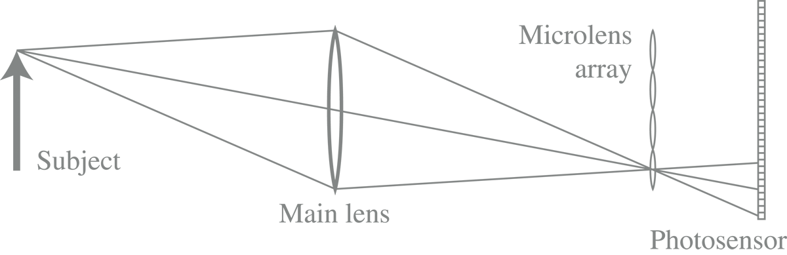
Conventional versus light field camera
slide: Marc Levoy

Slide 6

Conventional versus light field camera
slide: Marc Levoy

Slide 7

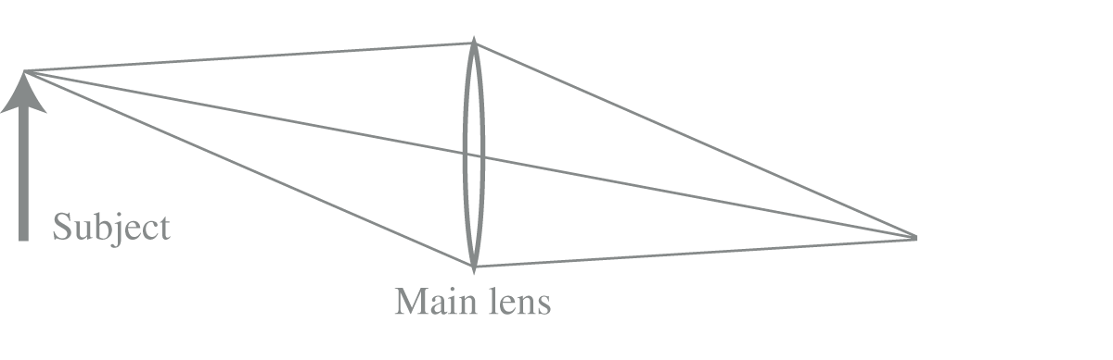
Conventional versus light field camera
slide: Marc Levoy

Slide 8
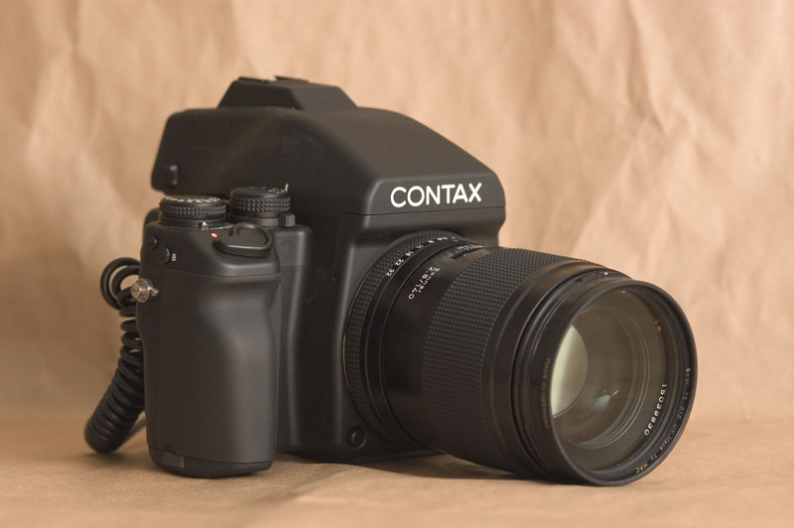
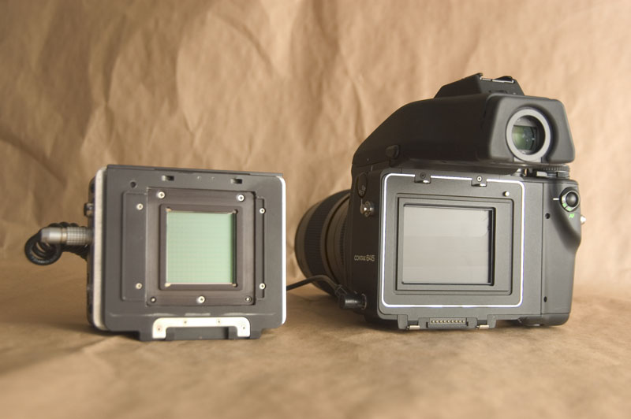
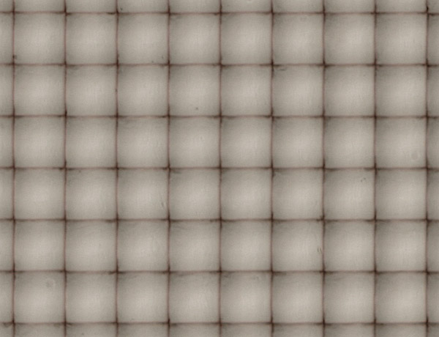
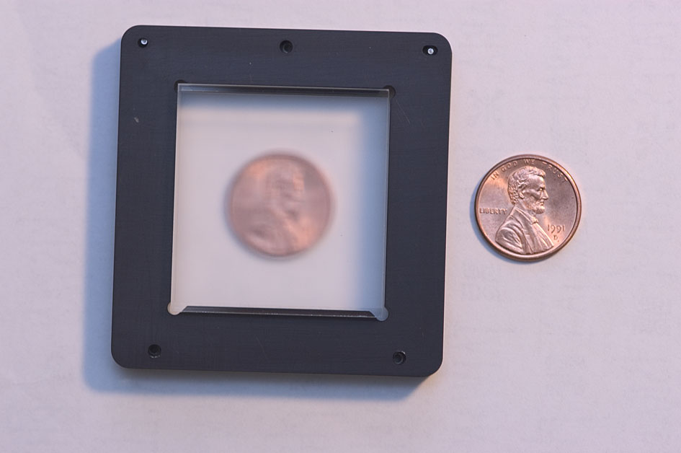
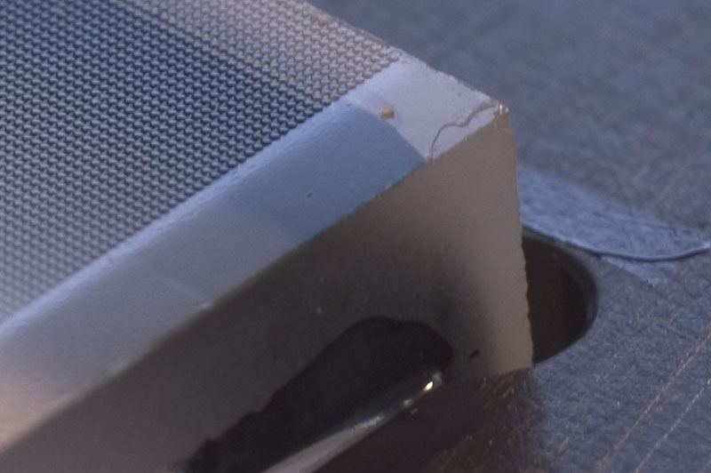
Prototype camera
Contax medium format camera
Kodak 16-megapixel sensor
Adaptive Optics microlens array
125μ square-sided microlenses
4000 × 4000 pixels ÷ 292 × 292 lenses = 14 × 14 pixels per lens
slide: Marc Levoy

Slide 9
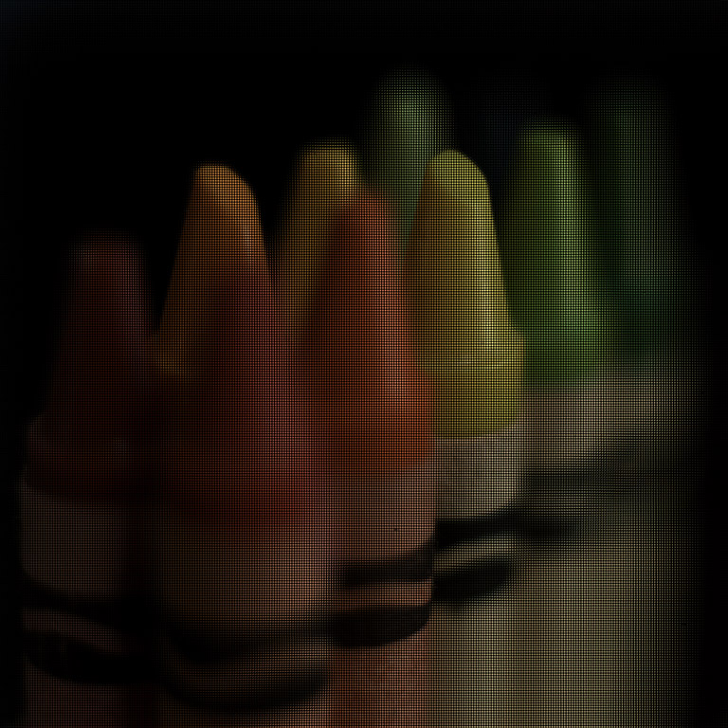
slide: Marc Levoy

Slide 10
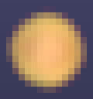
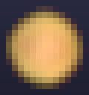
Digitally stopping-down
stopping down = summing only the central portion of each microlens
Σ
Σ
f / N light field camera, with P × P pixels under each microlens, can produce views as sharp as an f / (N × P) conventional camera
slide: Marc Levoy

Slide 11
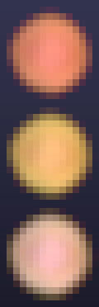
Digital refocusing
refocusing = summing windows extracted from several microlenses
Σ
Σ
f/N light field camera can produce views with a shallow depth of field ( f / N ) focused anywhere within the depth of field of an f / (N × P) camera
images: Marc Levoy

Slide 12
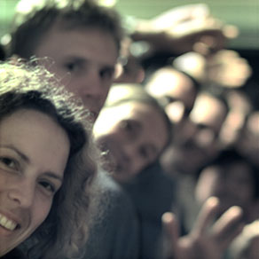
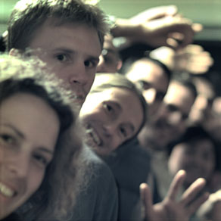
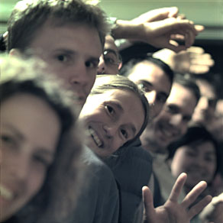
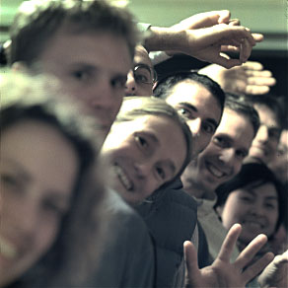
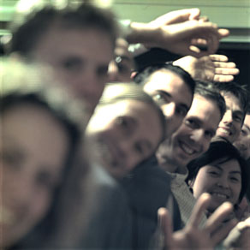
Example of digital refocusing
images: Marc Levoy

Slide 13
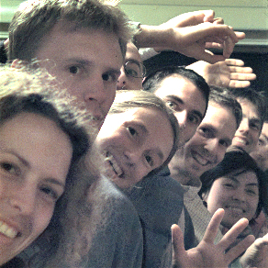
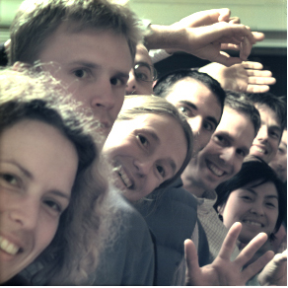



Extending the depth of field
conventional photograph,
main lens at f / 4
conventional photograph,
main lens at f / 22
light field, main lens at f / 4,
after all-focus algorithm
[Agarwala 2004]
images: Marc Levoy

Slide 14
Digitally moving the observer
Σ
Σ
moving the observer = moving the window we extract from the microlenses
images: Marc Levoy

Slide 15
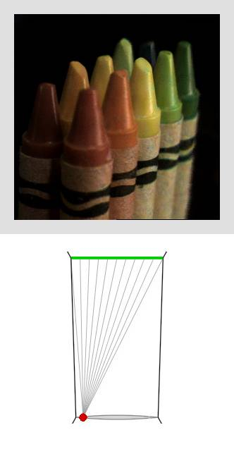
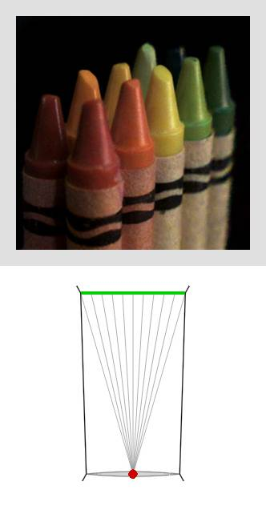
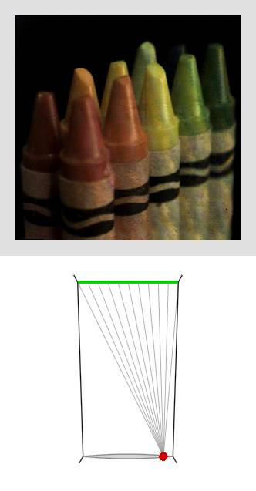
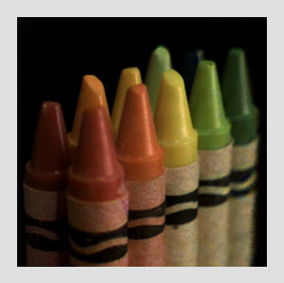
Example of moving the observer
slide: Marc Levoy

Slide 16
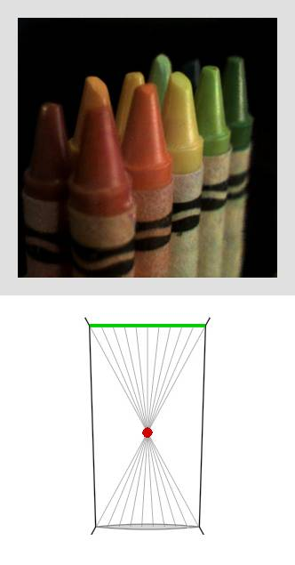
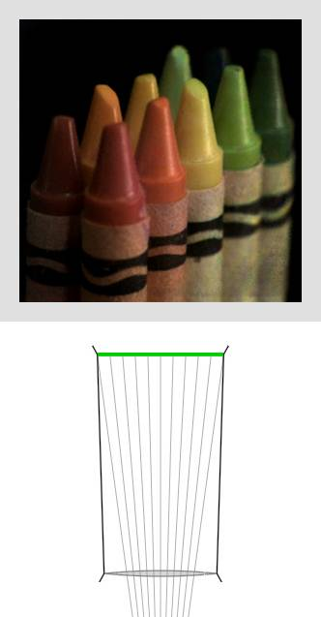
Moving backward and forward
slide: Marc Levoy

Slide 17
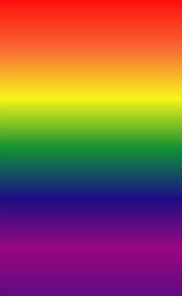
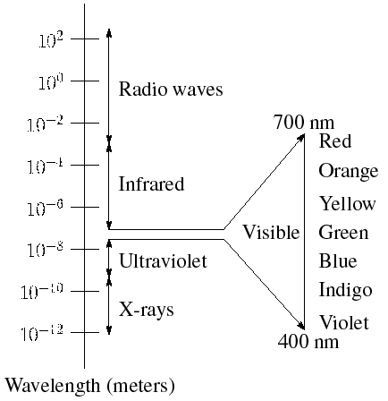
The visible light spectrum
We “see” electromagnetic radiation in a range of wavelengths

Slide 18
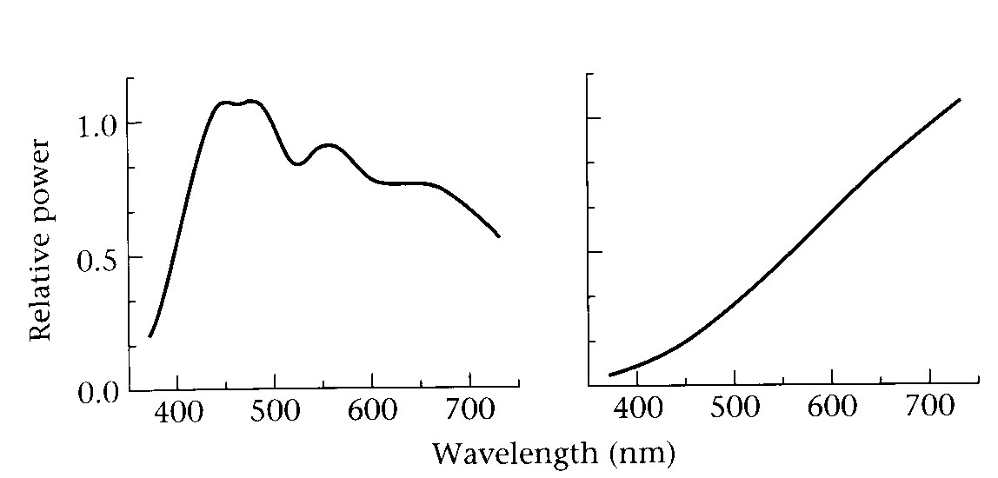

Light spectrum
The appearance of light depends on its power spectrum
  How much power (or energy) at each wavelength
image: R. Szeliski
daylight
tungsten bulb
Our visual system converts a light spectrum into “color”
  This is a rather complex transformation
Human Luminance Sensitivity Function

Slide 19

Brightness contrast and constancy
The apparent brightness depends on the surrounding region
  brightness contrast: a constant colored region seems lighter or darker depending on the surroundings:
    http://www.sandlotscience.com/Contrast/Checker_Board_2.htm
  brightness constancy: a surface looks the same under widely varying lighting conditions.
slide modified from : R. Szeliski

Slide 20
Light response is nonlinear
Our visual system has a large dynamic range
  We can resolve both light and dark things at the same time (~20 bit)
  One mechanism for achieving this is that we sense light intensity on a logarithmic scale
    an exponential intensity ramp will be seen as a linear ramp
    retina has about 6.5 bit dynamic range
  Another mechanism is adaptation
    rods and cones adapt to be more sensitive in low light, less sensitive in bright light.
  Eye’s dynamic range is adjusted with every saccade
Notes:
retina has 100:1 contrast ratio, adjusted during any saccade => 1, 000, 000 :1 for the eye

Slide 21
After images
Tired photoreceptors
  Send out negative response after a strong stimulus
http://www.michaelbach.de/ot/mot_adaptSpiral/index.html

Slide 22
Light transport
slide: R. Szeliski

Slide 23
Light sources
Basic types
  point source
  directional source
    a point source that is infinitely far away
  area source
    a union of point sources
slide: R. Szeliski

Slide 24
The interaction of light and matter
What happens when a light ray hits a point on an object?
  Some of the light gets absorbed
    converted to other forms of energy (e.g., heat)
  Some gets transmitted through the object
    possibly bent, through “refraction”
  Some gets reflected
    as we saw before, it could be reflected in multiple directions at once
Let’s consider the case of reflection in detail
  In the most general case, a single incoming ray could be reflected in all directions. How can we describe the amount of light reflected in each direction?
slide: R. Szeliski

Slide 25



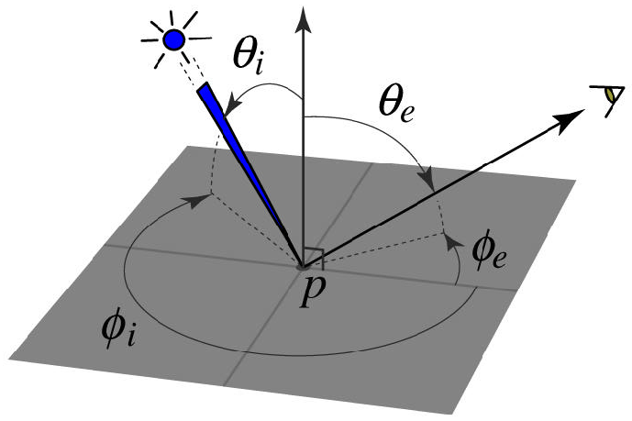
The BRDF
The Bidirectional Reflection Distribution Function
  Given an incoming ray and outgoing ray
  what proportion of the incoming light is reflected along outgoing ray?
surface normal
Answer given by the BRDF:
slide: R. Szeliski

Slide 26
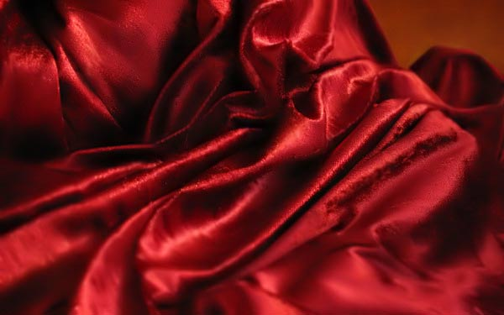

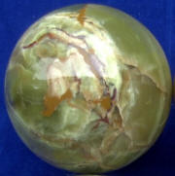
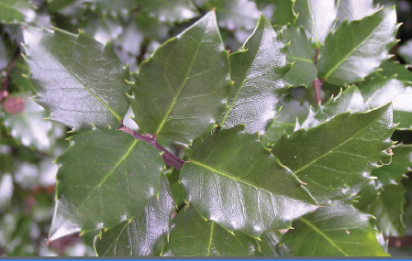
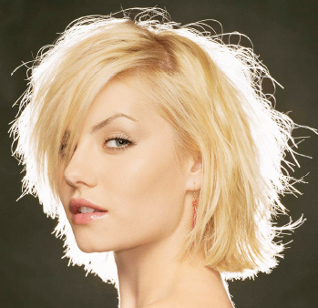
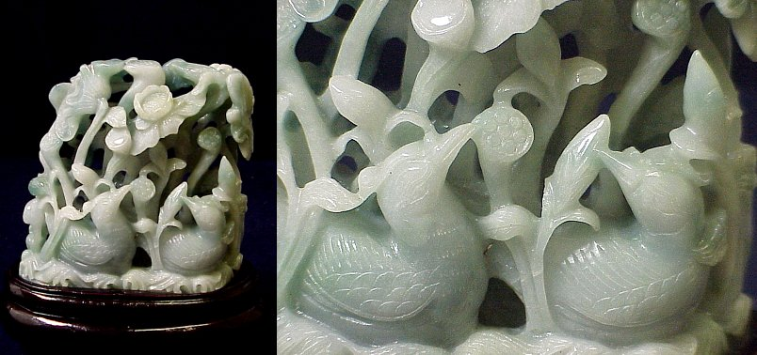

BRDFs can be incredibly complicated…
slide: S. Lazebnik

Slide 27
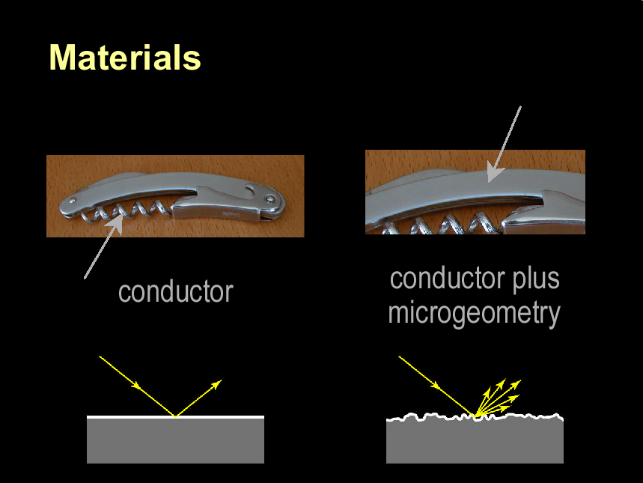
from Steve Marschner

Slide 28
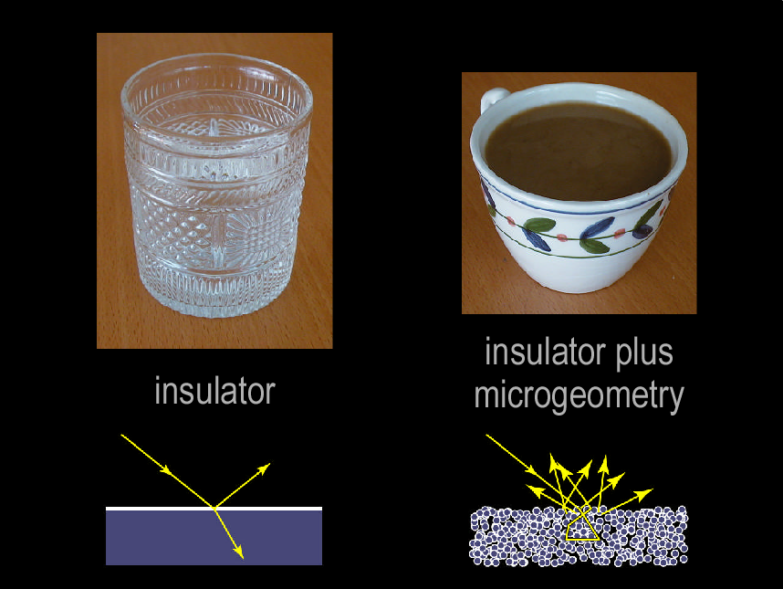
from Steve Marschner

Slide 29
Constraints on the BRDF
Energy conservation
  Quantity of outgoing light ≤ quantity of incident light
    integral of BRDF ≤ 1
Helmholtz reciprocity
  reversing the path of light produces the same reflectance
=
slide: R. Szeliski

Slide 30
Diffuse reflection
Diffuse reflection
  Dull, matte surfaces like chalk or latex paint
  Microfacets scatter incoming light randomly
  Effect is that light is reflected equally in all directions
slide: R. Szeliski

Slide 31
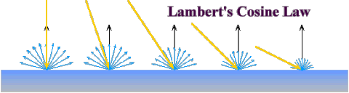




Diffuse reflection
Diffuse reflection governed by Lambert’s law
  Viewed brightness does not depend on viewing direction
  Brightness does depend on direction of illumination
  This is the model most often used in computer vision
Lambert’s Law:
L, N, V unit vectors
I_{e} = outgoing radiance
I_{i} = incoming radiance
BRDF for Lambertian surface
slide: R. Szeliski

Slide 32
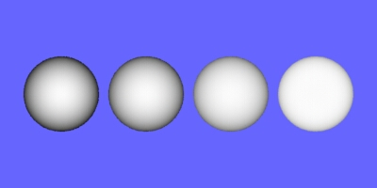
Lambertian Sphere

Slide 33
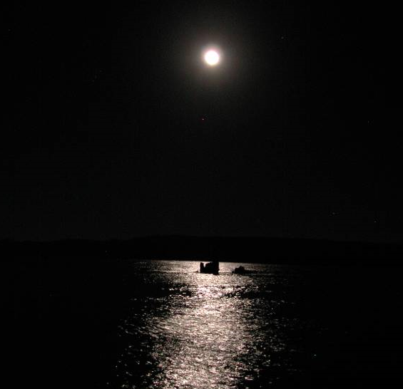
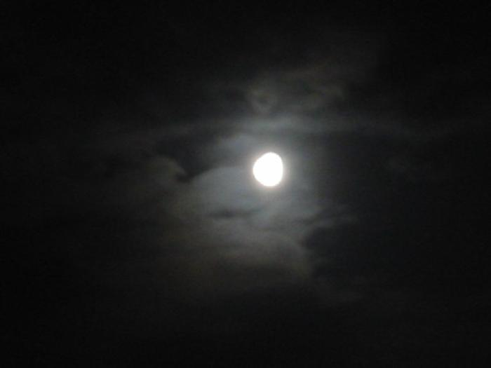
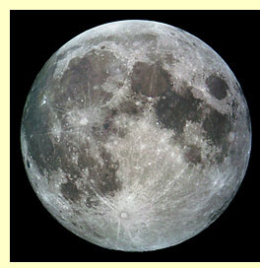
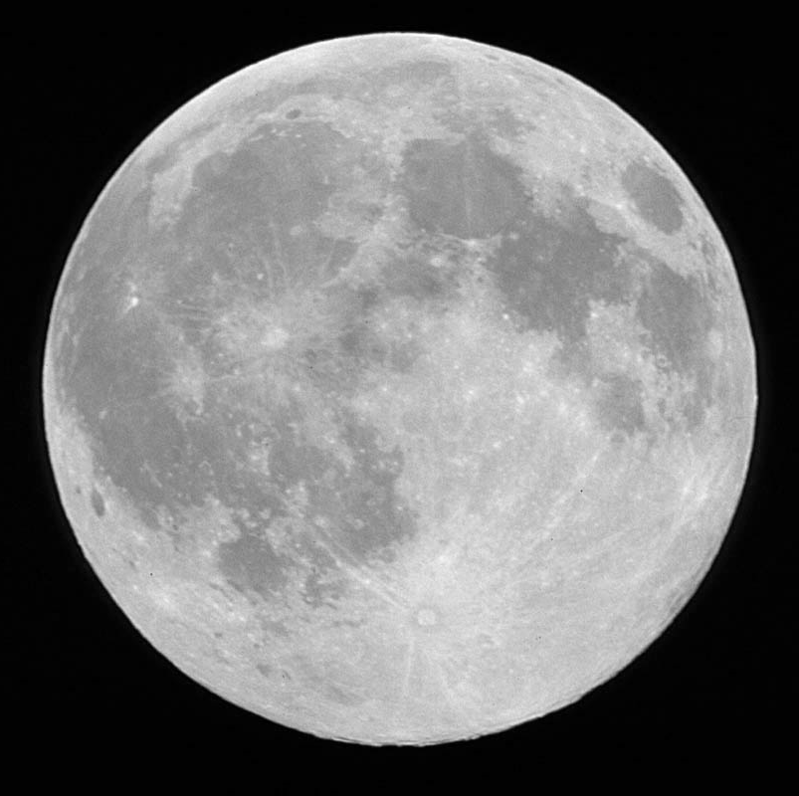
Why does the Full Moon have a flat appearance?
The moon appears matte (or diffuse)
But still, edges of the moon look bright
(not close to zero) when illuminated by
earth’s radiance.
Thanks to Michael Oren, Shree Nayar, Ravi Ramamoorthi, Pat Hanrahan

Slide 34

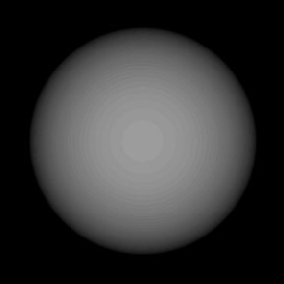
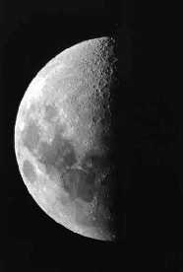
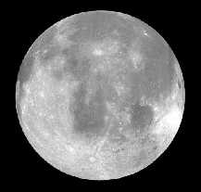
Why does the Full Moon have a flat appearance?
Lambertian Spheres and Moon Photos illuminated similarly
Thanks to Michael Oren, Shree Nayar, Ravi Ramamoorthi, Pat Hanrahan

Slide 35
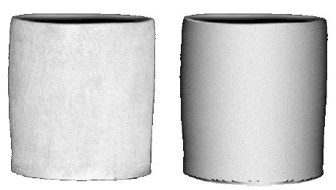
Surface Roughness Causes Flat Appearance
Actual Vase
Lambertian Vase
Thanks to Michael Oren, Shree Nayar, Ravi Ramamoorthi, Pat Hanrahan

Slide 36
Surface Roughness Causes Flat Appearance
Increasing surface roughness
Lambertian model
Valid for only SMOOTH MATTE surfaces.
Bad for ROUGH MATTE surfaces.
Thanks to Michael Oren, Shree Nayar, Ravi Ramamoorthi, Pat Hanrahan

Slide 37

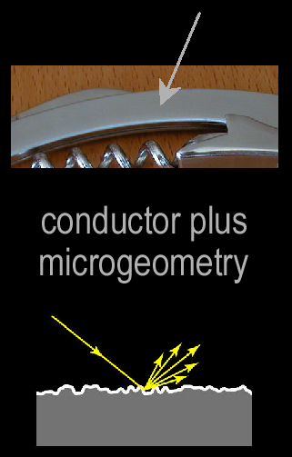
Specular reflection
For a perfect mirror, light is reflected about N
Near-perfect mirrors have a highlight around R
  common model:
slide: R. Szeliski

Slide 38
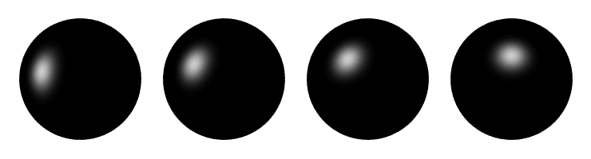

Specular reflection
Moving the light source
Changing n_{s}
slide: R. Szeliski

Slide 39





Blurred Highlights and Surface Roughness - RECAP
Roughness

Slide 40
Oren-Nayar Model – Main Points
Physically Based Model for Diffuse Reflection.
Based on Geometric Optics.
Explains view dependent appearance in Matte Surfaces
Take into account partial inter reflections.
Roughness represented
Lambertian model is simply an extreme case with
roughness equal to zero.

Slide 41

View Dependence of Matte Surfaces - Key Observation
Overall brightness increases as the angle between the source and viewing direction decreases. WHY?
Pixels have finite areas. As the viewing direction changes, different mixes between dark and bright are added up to give pixel brightness.

Slide 42

Phong illumination model
Phong approximation of surface reflectance
  Assume reflectance is modeled by three components
    Diffuse term
    Specular term
    Ambient term (to compensate for inter-reflected light)
L, N, V unit vectors
I_{e} = outgoing radiance
I_{i} = incoming radiance
I_{a} = ambient light
k_{a} = ambient light reflectance factor
(x)₊ = max(x, 0)
slide: R. Szeliski

Slide 43
BRDF models
Phenomenological
  Phong
  Ward
  Lafortune et al.
  Ashikhmin et al.
Physical
  Cook-Torrance
  Dichromatic
  He et al.
Here we’re listing only some well-known examples
slide: R. Szeliski

Slide 44


Measuring the BRDF
traditional
design by Greg Ward
Gonioreflectometer
  Device for capturing the BRDF by moving a camera + light source
  Need careful control of illumination, environment
slide: R. Szeliski

Slide 45

Gonioreflectometer
image credit: www.mdpi.com

Slide 46

BRDF databases
MERL (Matusik et al.): 100 isotropic, 4 nonisotropic, dense
CURET (Columbia-Utrect): 60 samples, more sparsely sampled, but also bidirectional texure functions (BTF)
slide: R. Szeliski

Slide 47

Image formation
How bright is the image of a scene point?
slide: S. Lazebnik

Slide 48

Radiometry
Radiometry is the science of light energy measurement
Radiance energy carried by
a ray energy/solid angle
[watts per steradian per
square meter (W·sr⁻¹·m⁻²)]
image: R. Szeliski
Notes:
Radiance characterizes the light emitted by the surface
Irradiance characterizes the light received by an optical device/eye

Slide 49
Radiometry: Measuring light
The basic setup: a light source is sending radiation to a surface patch
What matters:
  How big the source and the patch “look” to each other
source
patch
slide: S. Lazebnik
Notes:
Consider the hemisphere of directions at a given point on the surface. Light can only arrive at the point along these directions. If two different sources result in exactly the same amount of radiation arriving along every incoming direction, they must have the same effect on the surface.

Slide 50

Solid Angle
The solid angle subtended by a region at a point is the area projected on a unit sphere centered at that point
  Units: steradians
The solid angle dω subtended by a patch of area dA is given by:
A
slide: S. Lazebnik
Notes:
dA projected onto surface of the sphere of radius r: dA cos theta
Ratio of surface areas of spheres of radii 1 and r: 4 pi / (4 pi r^2) = 1/r^2

Slide 51
Radiance
Radiance (L): energy carried by a ray
  Power per unit area perpendicular to the direction of travel,
  per unit solid angle
  Units: Watts per square meter per steradian (W m⁻² sr⁻¹)
n
dω
θ
dA
slide: S. Lazebnik
Notes:
P is area orthogonal to the incoming light ray

Slide 52
Radiometry
Radiometry is the science of light energy measurement
Radiance energy carried by
a ray energy/solid angle
[watts per steradian per
square meter (W·sr⁻¹·m⁻²)]
Irradiance energy per unit area
falling on a surface
image: R. Szeliski
Notes:
Radiance characterizes the light emitted by the surface
Irradiance characterizes the light received by an optical device/eye

Slide 53
Irradiance
Irradiance (E): energy arriving at a surface
  Incident power per unit area not foreshortened
  Units: W m⁻²
  For a surface receiving radiance L coming in from dω the corresponding irradiance is
n
dω
θ
dA
slide: S. Lazebnik

Slide 54

Radiometry of thin lenses
L: Radiance emitted from P toward P’
E: Irradiance falling on P’ from the lens
What is the relationship between E and L?
slide: S. Lazebnik

Slide 55
Radiometry of thin lenses
dA
dA’
o
Area of the lens:
The power δP received by the lens from P is
The radiance emitted from the lens towards P’ is
The irradiance received at P’ is
Solid angle subtended by the lens at P’
slide: S. Lazebnik
Notes:
See section 4.2.3 of F&P
Explanation of last equation:
Use the definition of irradiance from slide 7
Compute the solid angle subtended by the lens at P’ using the definition on slide 4

Slide 56
Radiometry of thin lenses
Image irradiance is linearly related to scene radiance
Irradiance is proportional to the area of the lens and inversely proportional to the squared distance between the lens and the image plane
The irradiance falls off as the angle α between the viewing ray and the optical axis increases
slide: S. Lazebnik
Notes:
Explain the difference between the cos^4 alpha effect and vignetting: the former effect has nothing to do with light getting lost in the lens system but is a basic radiometric property even of a perfect lens; vignetting is usually much stronger.

Slide 57

From light rays to pixel values
Camera response function: the mapping f from irradiance to pixel values
  Useful if we want to estimate material properties
  Enables us to create high dynamic range images
Source: S. Seitz, P. Debevec

Slide 58
From light rays to pixel values
Camera response function: the mapping f from irradiance to pixel values
For more info
  P. E. Debevec and J. Malik. Recovering High Dynamic Range Radiance Maps from Photographs. In SIGGRAPH 97, August 1997
Source: S. Seitz, P. Debevec

Slide 59

Photometric stereo (shape from shading)
Can we reconstruct the shape of an object based on shading cues?
Luca della Robbia,
Cantoria, 1438

