Slide 1
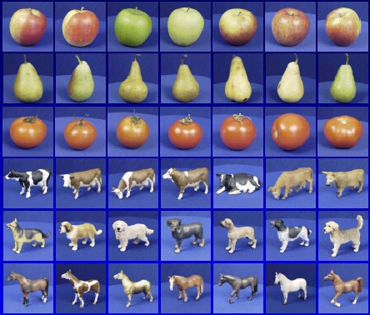
Recognition: A machine learning approach
Slides adapted from Fei-Fei Li, Rob Fergus, Antonio Torralba, Kristen Grauman, Derek Hoiem, Svetlana Lazebnik

Slide 2



The machine learning framework
Apply a prediction function to a feature representation of the image to get the desired output:
f( ) = “apple”
f( ) = “tomato”
f( ) = “cow”

Slide 3
The machine learning framework
y = f(x)
Training: given a training set of labeled examples {(x₁,y₁), …, (x_{N},y_{N})}, estimate the prediction function f by minimizing the prediction error on the training set
Testing: apply f to a never before seen test example x and output the predicted value y = f(x)
output
prediction function
Image feature

Slide 4

Steps
Training
Training Labels
Training Images
Image Features
Training
Learned model
Learned model
Testing
Image Features
Prediction
Test Image
Slide credit: D. Hoiem

Slide 5
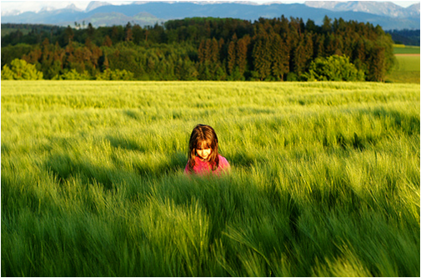
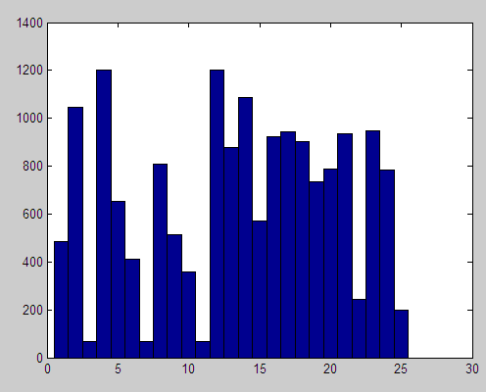
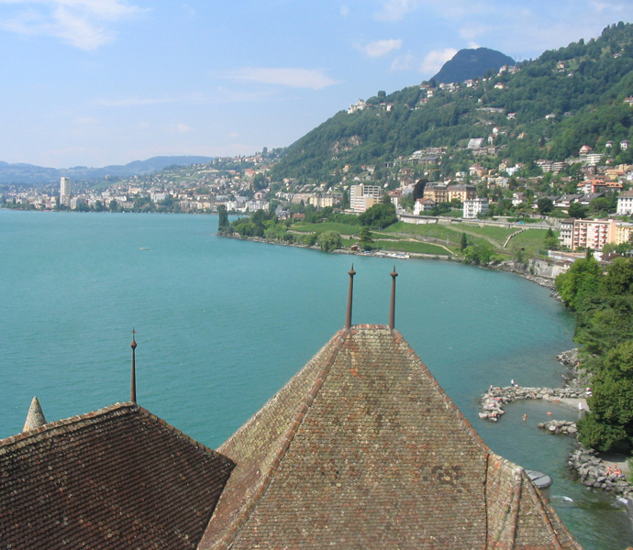
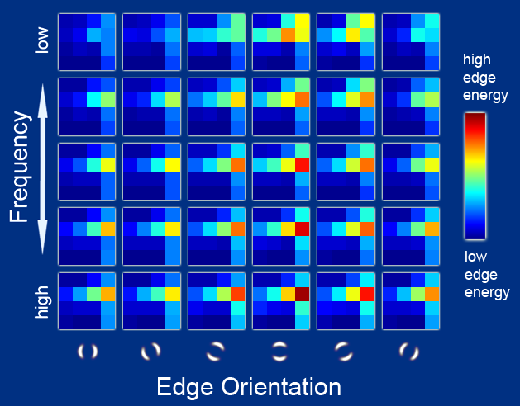
Features
Raw pixels
Histograms
GIST descriptors
…

Slide 6
Classifiers: Nearest neighbor
Test example
Training examples from class 2
Training examples from class 1
f(x) = label of the training example nearest to x
All we need is a distance function for our inputs
No training required!

Slide 7
Classifiers: Linear
Find a linear function to separate the classes:
f(x) = sgn(w ⋅ x + b)

Slide 8
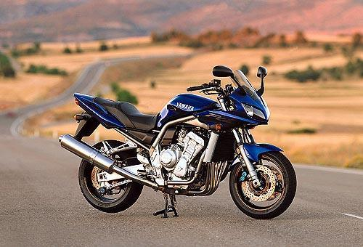
Recognition task and supervision
Images in the training set must be annotated with the “correct answer” that the model is expected to produce
Contains a motorbike

Slide 9
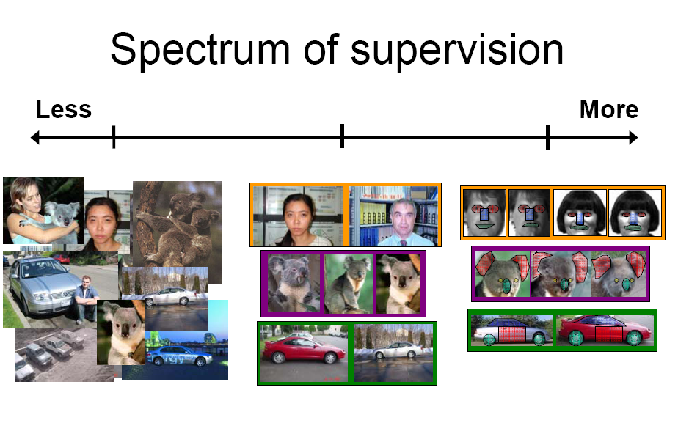
Unsupervised
“Weakly” supervised
Fully supervised
Definition depends on task

Slide 10

Generalization
Training set (labels known)
Test set (labels unknown)
How well does a learned model generalize from the data it was trained on to a new test set?

Slide 11
Generalization
Components of generalization error
  Bias: how much the average model over all training sets differ from the true model?
    Error due to inaccurate assumptions/simplifications made by the model
  Variance: how much models estimated from different training sets differ from each other
Underfitting: model is too “simple” to represent all the relevant class characteristics
  High bias and low variance
  High training error and high test error
Overfitting: model is too “complex” and fits irrelevant characteristics (noise) in the data
  Low bias and high variance
  Low training error and high test error

Slide 12
Bias-variance tradeoff
Underfitting
Overfitting
Error
Test error
Training error
High Bias
Low Variance
Complexity
Low Bias
High Variance
Slide credit: D. Hoiem

Slide 13
Bias-variance tradeoff
Few training examples
Test Error
Many training examples
High Bias
Low Variance
Complexity
Low Bias
High Variance
Slide credit: D. Hoiem
Notes:
Note: these figures don’t work in pdf

Slide 14
Effect of Training Size
Fixed prediction model
Error
Testing
Generalization Error
Training
Number of Training Examples
Slide credit: D. Hoiem

Slide 15
Datasets
Circa 2001: 5 categories, 100s of images per category
Circa 2004: 101 categories
Today: up to thousands of categories, millions of images

Slide 16
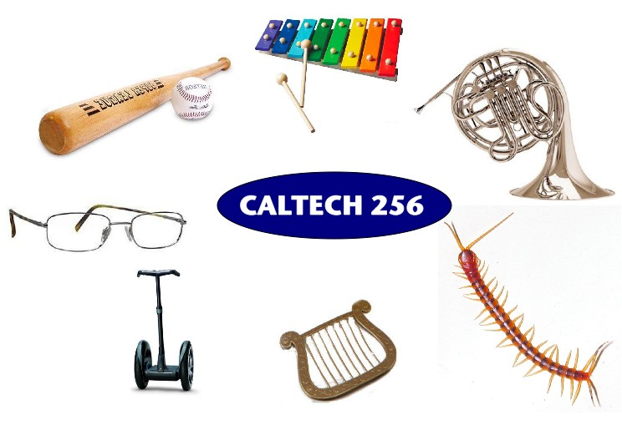
Caltech 101 & 256
http://www.vision.caltech.edu/Image_Datasets/Caltech101/
http://www.vision.caltech.edu/Image_Datasets/Caltech256/
Griffin, Holub, Perona, 2007
Fei-Fei, Fergus, Perona, 2004

Slide 17
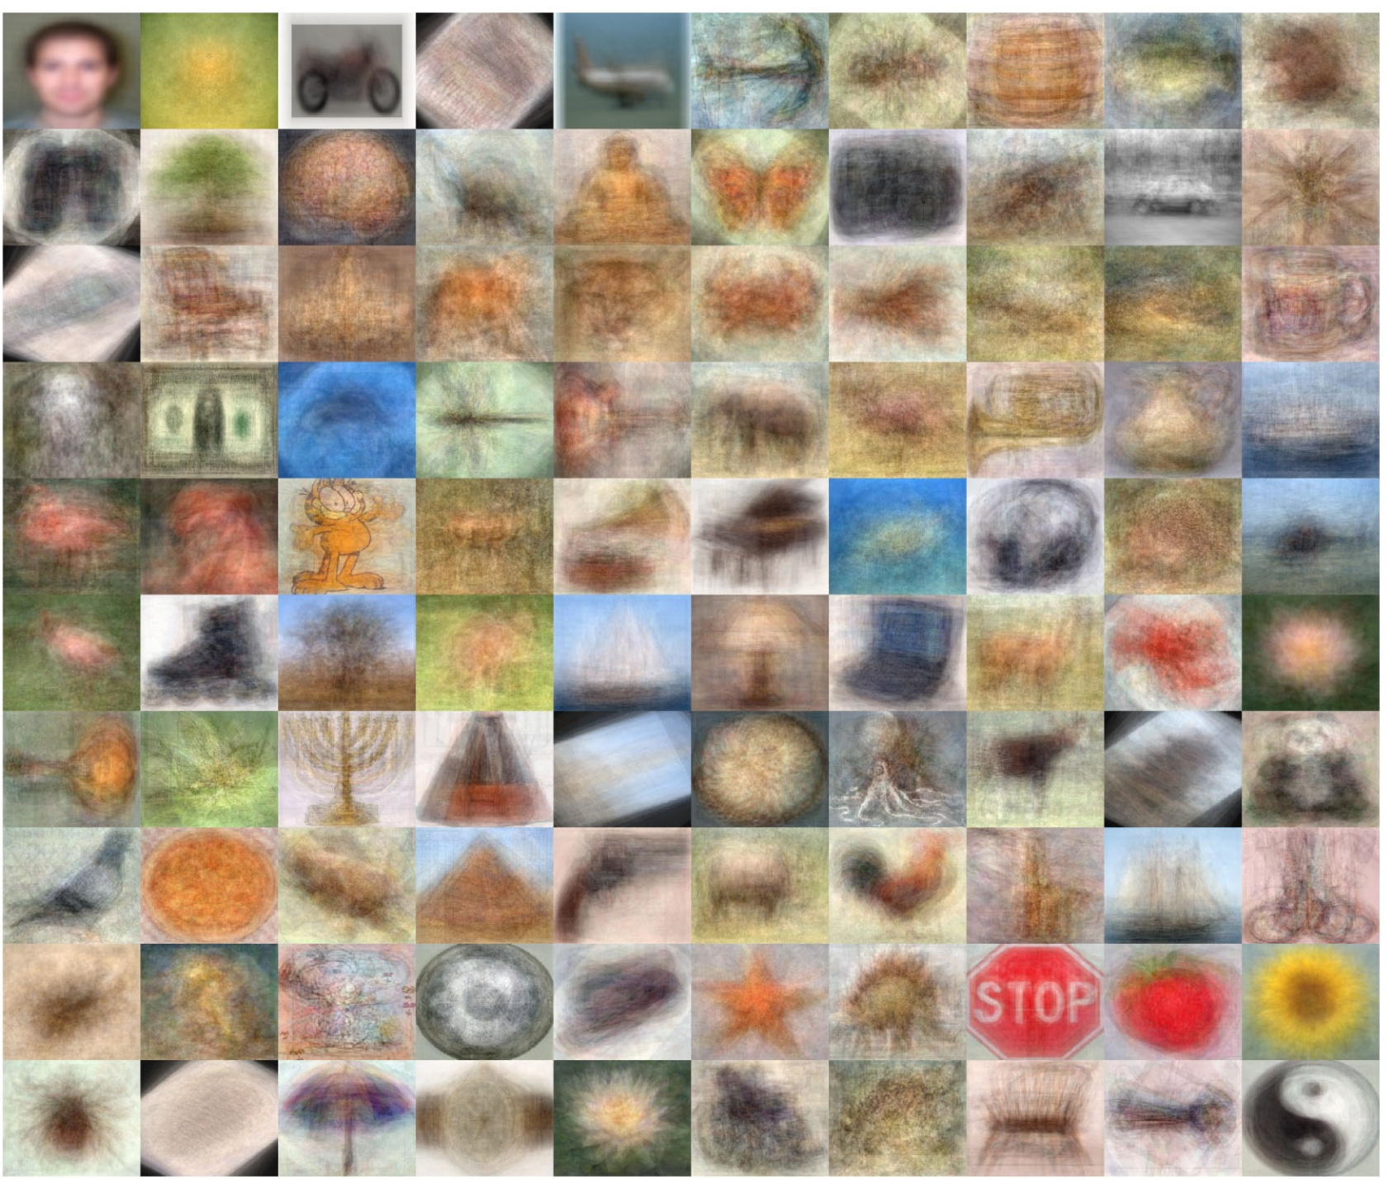
Caltech-101: Intraclass variability

Slide 18
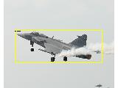
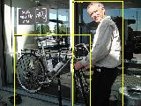
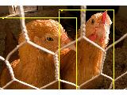
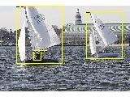
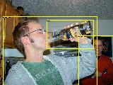
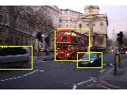
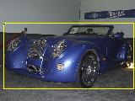
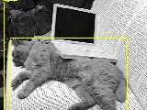
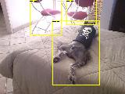
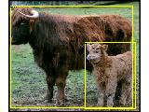
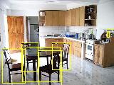
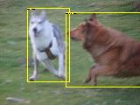
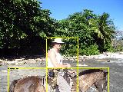
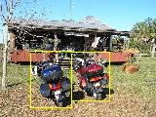
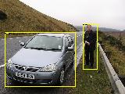
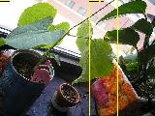
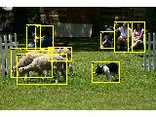
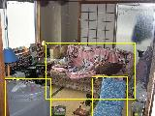
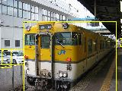
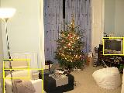
The PASCAL Visual Object Classes Challenge (2005-present)
http://pascallin.ecs.soton.ac.uk/challenges/VOC/
Challenge classes:
Person: person
Animal: bird, cat, cow, dog, horse, sheep
Vehicle: aeroplane, bicycle, boat, bus, car, motorbike, train
Indoor: bottle, chair, dining table, potted plant, sofa, tv/monitor

Slide 19
The PASCAL Visual Object Classes Challenge (2005-present)
http://pascallin.ecs.soton.ac.uk/challenges/VOC/
Main competitions
  Classification: For each of the twenty classes, predicting presence/absence of an example of that class in the test image
  Detection: Predicting the bounding box and label of each object from the twenty target classes in the test image

Slide 20
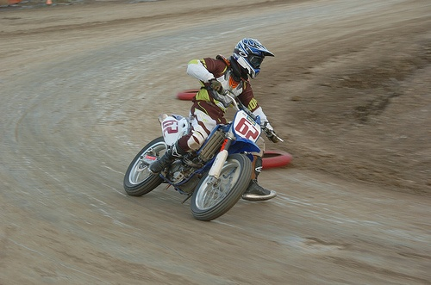
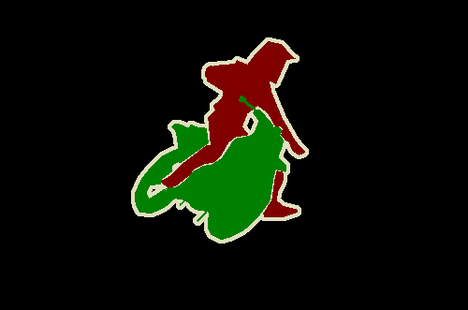
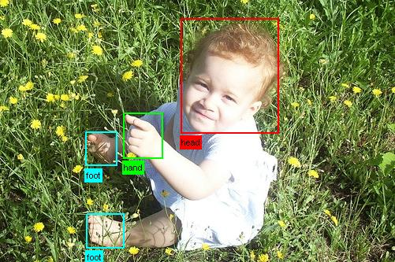
The PASCAL Visual Object Classes Challenge (2005-present)
http://pascallin.ecs.soton.ac.uk/challenges/VOC/
“Taster” challenges
  Segmentation: Generating pixel-wise segmentations giving the class of the object visible at each pixel, or "background" otherwise
  Person layout: Predicting the bounding box and label of each part of a person (head, hands, feet)

Slide 21
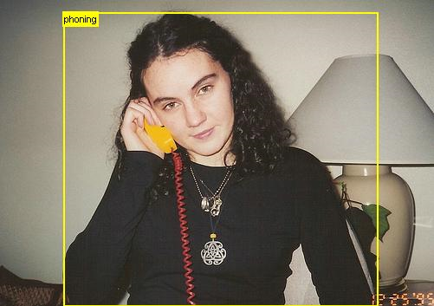
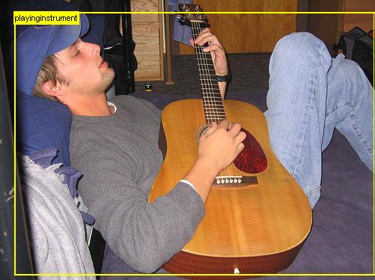
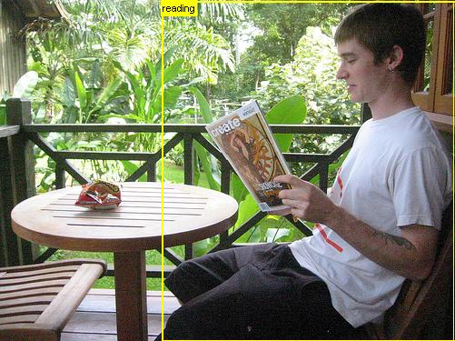
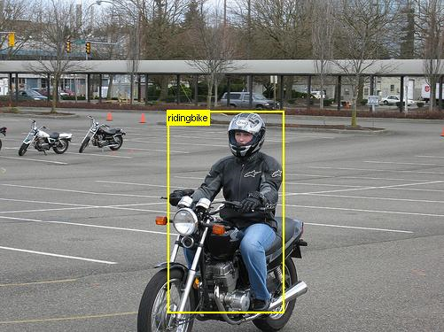
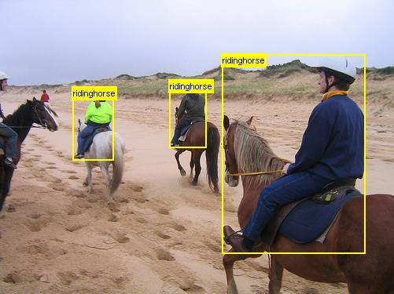
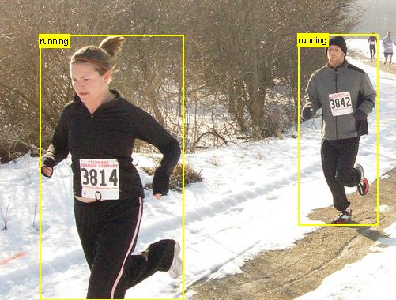
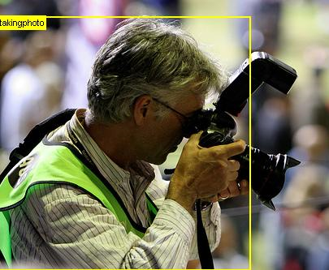
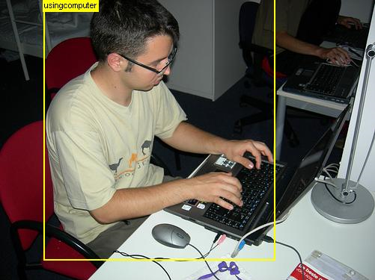
The PASCAL Visual Object Classes Challenge (2005-present)
http://pascallin.ecs.soton.ac.uk/challenges/VOC/
“Taster” challenges
  Action classification

Slide 22
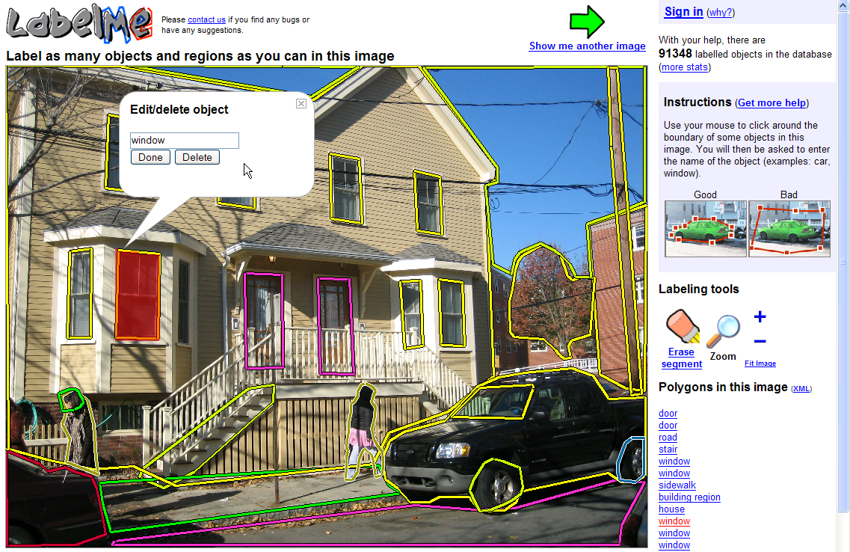
LabelMe
http://labelme.csail.mit.edu/
Russell, Torralba, Murphy, Freeman, 2008

Slide 23
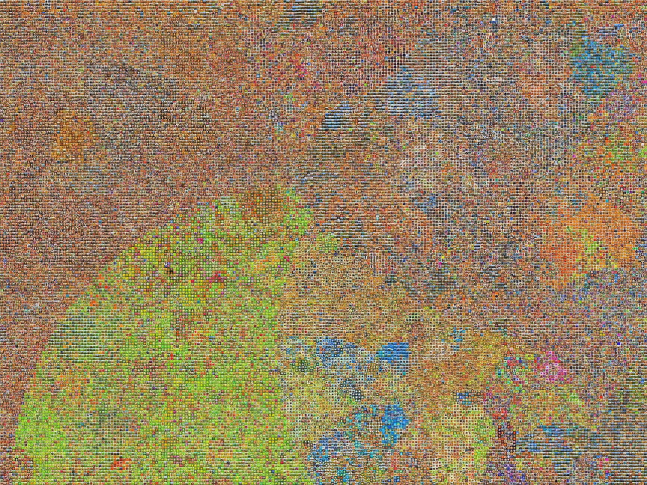
80 Million Tiny Images
http://people.csail.mit.edu/torralba/tinyimages/

Slide 24

ImageNet
http://www.image-net.org/

Slide 25
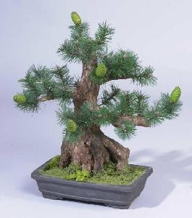
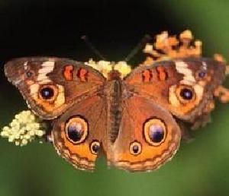
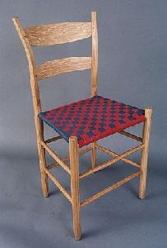
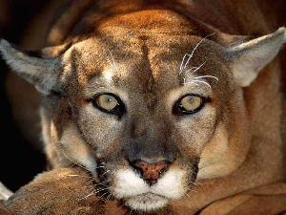

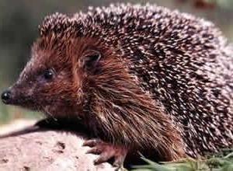
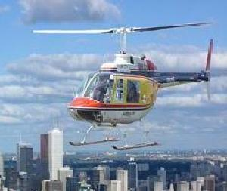
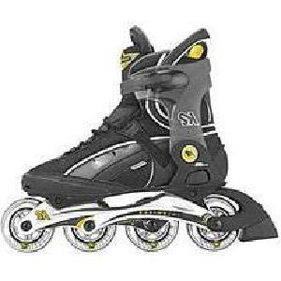
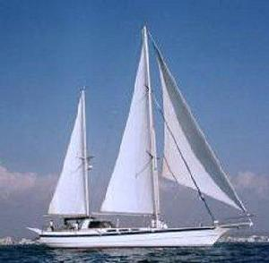






Caltech101 dataset
http://www.vision.caltech.edu/Image_Datasets/Caltech101/Caltech101.html
Multi-class classification results (30 training images per class)

Slide 26

Bags of features for action recognition
Space-time interest points
Juan Carlos Niebles, Hongcheng Wang and Li Fei-Fei, Unsupervised Learning of Human Action Categories Using Spatial-Temporal Words, IJCV 2008.

Slide 27

Bags of features for action recognition
Juan Carlos Niebles, Hongcheng Wang and Li Fei-Fei, Unsupervised Learning of Human Action Categories Using Spatial-Temporal Words, IJCV 2008.

Slide 28



Image classification
Given the bag-of-features representations of images from different classes, how do we learn a model for distinguishing them?

Slide 29


Classifiers
Learn a decision rule assigning bag-of-features representations of images to different classes
Decision
boundary
Zebra
Non-zebra

Slide 30
Classification
Assign input vector to one of two or more classes
Any decision rule divides input space into decision regions separated by decision boundaries

Slide 31

Nearest Neighbor Classifier
Assign label of nearest training data point to each test data point
from Duda et al.
Voronoi partitioning of feature space
for two-category 2D and 3D data
Source: D. Lowe

Slide 32

K-Nearest Neighbors
For a new point, find the k closest points from training data
Labels of the k points “vote” to classify
Works well provided there is lots of data and the distance function is good
k = 5
Source: D. Lowe

Slide 33
Functions for comparing histograms
L1 distance:
χ² distance:
Quadratic distance (cross-bin distance):
Histogram intersection (similarity function):

Slide 34
Linear classifiers
Find linear function (hyperplane) to separate positive and negative examples
Which hyperplane
is best?

Slide 35
Support vector machines
Find hyperplane that maximizes the margin between the positive and negative examples
C. Burges, A Tutorial on Support Vector Machines for Pattern Recognition, Data Mining and Knowledge Discovery, 1998

Slide 36
Support vector machines
Find hyperplane that maximizes the margin between the positive and negative examples
For support vectors,
Distance between point and hyperplane:
Therefore, the margin is 2 / ||w||
Support vectors
Margin
C. Burges, A Tutorial on Support Vector Machines for Pattern Recognition, Data Mining and Knowledge Discovery, 1998

Slide 37
Finding the maximum margin hyperplane
Maximize margin 2/||w||
Correctly classify all training data:
Quadratic optimization problem:
Minimize
Subject to y_{i}(w·x_{i}+b) ≥ 1
C. Burges, A Tutorial on Support Vector Machines for Pattern Recognition, Data Mining and Knowledge Discovery, 1998

Slide 38
Finding the maximum margin hyperplane
Solution:
learned
weight
Support
vector
C. Burges, A Tutorial on Support Vector Machines for Pattern Recognition, Data Mining and Knowledge Discovery, 1998

Slide 39
Finding the maximum margin hyperplane
Solution:
b = y_{i} – w·x_{i} for any support vector
Classification function (decision boundary):
Notice that it relies on an inner product between the test point x and the support vectors x_{i}
Solving the optimization problem also involves computing the inner products x_{i} · x_{j} between all pairs of training points
C. Burges, A Tutorial on Support Vector Machines for Pattern Recognition, Data Mining and Knowledge Discovery, 1998

Slide 40
Nonlinear SVMs
Datasets that are linearly separable work out great:
But what if the dataset is just too hard?
We can map it to a higher-dimensional space:
0
x
0
x
x²
0
x
Slide credit: Andrew Moore

Slide 41
Nonlinear SVMs
General idea: the original input space can always be mapped to some higher-dimensional feature space where the training set is separable:
Φ: x → φ(x)
Slide credit: Andrew Moore

Slide 42
Nonlinear SVMs
The kernel trick: instead of explicitly computing the lifting transformation φ(x), define a kernel function K such that
K(x_{i} , x_{j}) = φ(x_{i} ) · φ(x_{j})
(to be valid, the kernel function must satisfy Mercer’s condition)
This gives a nonlinear decision boundary in the original feature space:
C. Burges, A Tutorial on Support Vector Machines for Pattern Recognition, Data Mining and Knowledge Discovery, 1998

Slide 43
Nonlinear kernel: Example
Consider the mapping
x²

Slide 44
Kernels for bags of features
Histogram intersection kernel:
Generalized Gaussian kernel:
D can be L1 distance, Euclidean distance,
χ² distance, etc.
J. Zhang, M. Marszalek, S. Lazebnik, and C. Schmid, Local Features and Kernels for Classifcation of Texture and Object Categories: A Comprehensive Study, IJCV 2007

Slide 45
Summary: SVMs for image classification
Pick an image representation (in our case, bag of features)
Pick a kernel function for that representation
Compute the matrix of kernel values between every pair of training examples
Feed the kernel matrix into your favorite SVM solver to obtain support vectors and weights
At test time: compute kernel values for your test example and each support vector, and combine them with the learned weights to get the value of the decision function

Slide 46
What about multi-class SVMs?
Unfortunately, there is no “definitive” multi-class SVM formulation
In practice, we have to obtain a multi-class SVM by combining multiple two-class SVMs
One vs. others
  Traning: learn an SVM for each class vs. the others
  Testing: apply each SVM to test example and assign to it the class of the SVM that returns the highest decision value
One vs. one
  Training: learn an SVM for each pair of classes
  Testing: each learned SVM “votes” for a class to assign to the test example

Slide 47
SVMs: Pros and cons
Pros
  Many publicly available SVM packages:
  http://www.kernel-machines.org/software
  Kernel-based framework is very powerful, flexible
  SVMs work very well in practice, even with very small training sample sizes
Cons
  No “direct” multi-class SVM, must combine two-class SVMs
  Computation, memory
    During training time, must compute matrix of kernel values for every pair of examples
    Learning can take a very long time for large-scale problems

Slide 48
Summary: Classifiers
Nearest-neighbor and k-nearest-neighbor classifiers
  L1 distance, χ² distance, quadratic distance, histogram intersection
Support vector machines
  Linear classifiers
  Margin maximization
  The kernel trick
  Kernel functions: histogram intersection, generalized Gaussian, pyramid match
  Multi-class
Of course, there are many other classifiers out there
  Neural networks, boosting, decision trees, …

