Slide 1
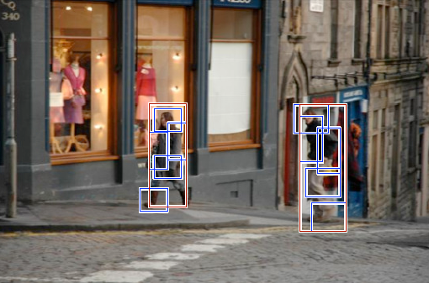
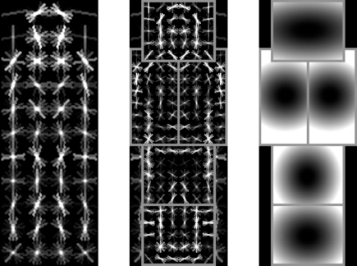
More sliding window detection:
Discriminative part-based models
Many slides based on P. Felzenszwalb, E. Seemann, N. Dalal

Slide 2
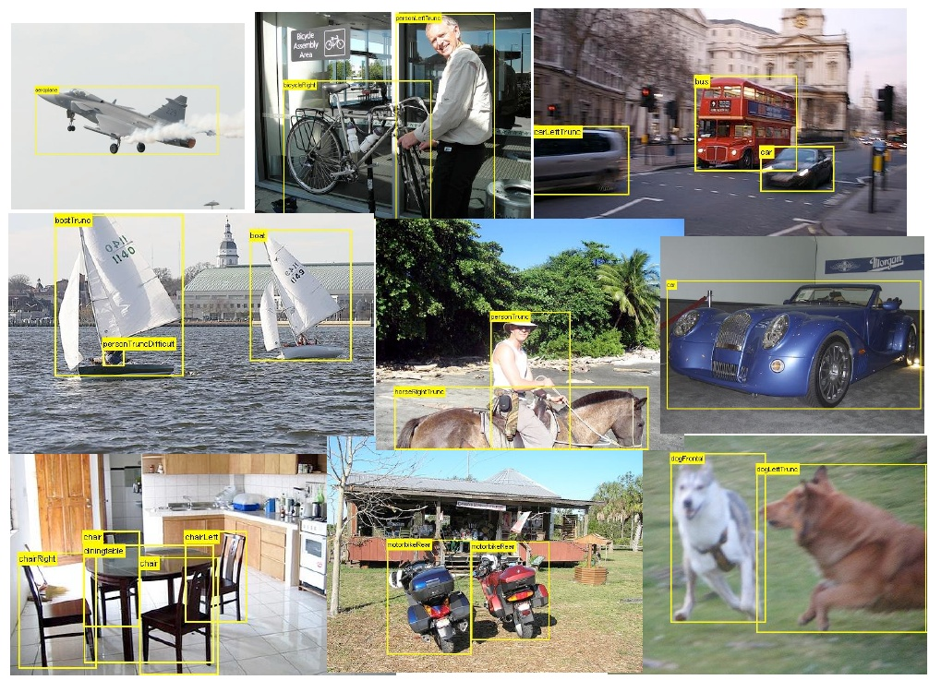
Challenge: Generic object detection

Slide 3
Gradient Histograms
Have become extremely popular and successful in the vision community
Avoid hard decisions compared to edge based features
Examples:
  SIFT (Scale-Invariant Image Transform)
  HOG (Histogram of Oriented Gradients)

Slide 4
Computing gradients
One sided:
Two sided:
Filter masks in x-direction
  One sided:
  Two sided:
Gradient:
  Magnitude:
  Orientation:
-1
1
-1
0
1
Notes:
Achtung: bogenmass
Treppenfunktion mit Beispiel, wie dort der gradient aussieht

Slide 5

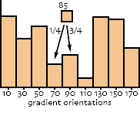
Histograms
Gradient histograms measure the orientations and strengths of image gradients within an image region

Slide 6
Histograms of Oriented Gradients
Gradient-based feature descriptor developed for people detection
  Authors: Dalal&Triggs (INRIA Grenoble, France)
Global descriptor for the complete body
Very high-dimensional
  Typically ~4000 dimensions

Slide 7
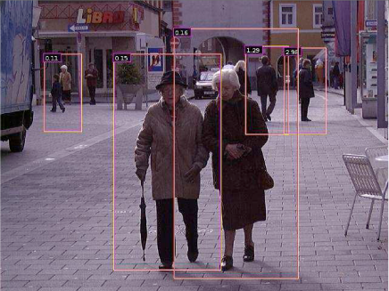
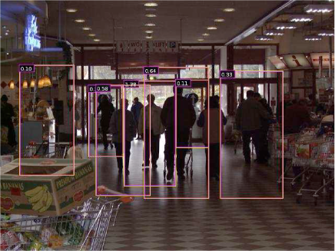
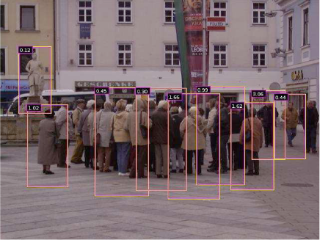
HOG
Very promising results on challenging data sets
Phases
  Learning Phase
  Detection Phase

Slide 8
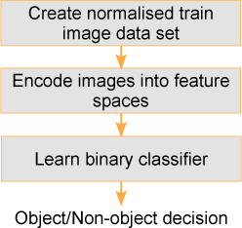
Detector: Learning Phase
Learning
Set of cropped images containing pedestrians in normal environment
Global descriptor rather
than local features
Using linear SVM

Slide 9
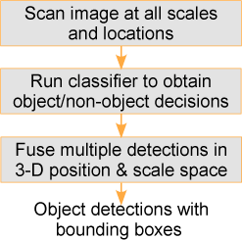
Detector: Detection Phase
Detection
Sliding window over each scale
Simple SVM prediction

Slide 10


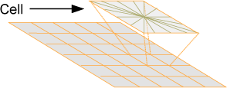
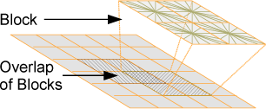
Descriptor
Compute gradients on an image
region of 64x128 pixels
Compute histograms on ‘cells’ of
typically 8x8 pixels (i.e. 8x16 cells)
Normalize histograms within
overlapping blocks of cells
(typically 2x2 cells, i.e. 7x15 blocks)
Concatenate histograms

Slide 11
HOG Descriptors
HOG: Histogram of Oriented Gradients
Parameters
Gradient scale
Orientation bins
Block overlap area
R-HOG/SIFT
Cell
Schemes
RGB or Lab, Color/gray-space
Block normalization
  L2-hys,
or
  L1-sqrt,
Block
C-HOG
Center bin
Notes:
L2-hys, L2 normalize -> clip v va
HOGs can have any shape, like Lowe’s SIFT or more psychological inspired 3D version of shape context of Belongie et al. The log-polar shape of CHOG are motivated from human fovea system – where there are more cells at center and resolution decreases at the peripheries. Even in RHOG, we find that putting a Gaussian weight on top of block help increase the perform.
But HOG has lot of parameters… that is hard to tune in. Surprisingly, our experience shows we only need to vary some – even if we change the object class or our detection window size.
We take inspiration from Biological…

Slide 12





Gradients
Convolution with [-1 0 1] filters
No smoothing
Compute gradient magnitude+direction
Per pixel: color channel with greatest magnitude -> final gradient

Slide 13
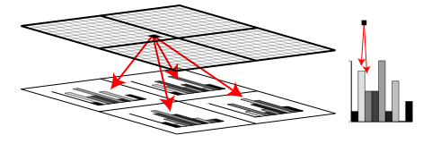
Cell histograms
9 bins for unsigned gradient
orientations (0-180 degrees)
vote is gradient magnitude
Interpolated trilinearly:
  Bilinearly into spatial cells
  Linearly into orientation bins

Slide 14
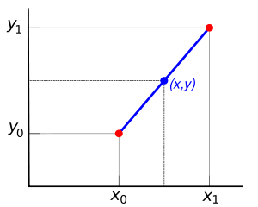

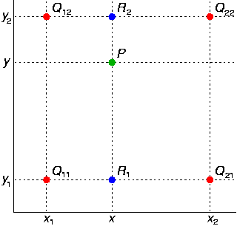

Linear and Bilinear interpolation for subsampling
Linear:
Bilinear:
Notes:
Draw this on the black board

Slide 15
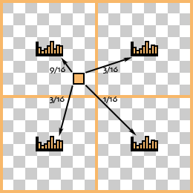
Histogram interpolation example
θ=85 degrees
Distance to bin centers
  Bin 70 -> 15 degrees
  Bin 90 -> 5 degress
Ratios: 5/20=1/4, 15/20=3/4
Distance to bin centers
  Left: 2, Right: 6
  Top: 2, Bottom: 6
Ratio Left-Right: 6/8, 2/8
Ratio Top-Bottom: 6/8, 2/8
Ratios:
  6/8*6/8 = 36/64 = 9/16
  6/8*2/8 = 12/64 = 3/16
  2/8*6/8 = 12/64 = 3/16
  2/8*2/8 = 4/64 = 1/16

Slide 16
Blocks
Overlapping blocks of 2x2 cells
Cell histograms are concatenated
and then normalized
  Note that each cell has several occurrences with different normalization in final descriptor
Normalization
  Different norms possible
  (L2, L2hys etc.)
  We add a normalization
  epsilon to avoid division by zero
Notes:
Shortly explain l2hys

Slide 17
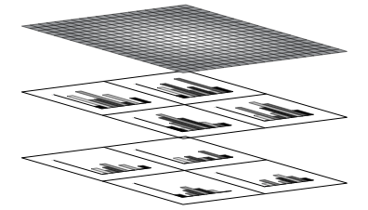
Blocks
Gradient magnitudes are
weighted according to a
Gaussian spatial window
Distant gradients contribute
less to the histogram

Slide 18
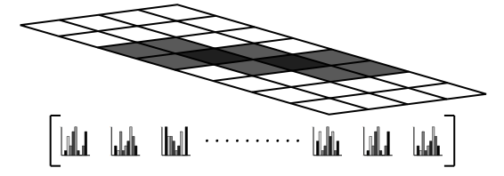





Final Descriptor
Concatenation of Blocks
Visualization:

Slide 19
Engineering
Developing a feature descriptor requires a lot of engineering
  Testing of parameters (e.g. size of cells, blocks, number of cells in a block, size of overlap)
  Normalization schemes (e.g. L1, L2-Norms etc., gamma correction, pixel intensity normalization)
An extensive evaluation of different choices was performed, when the descriptor was proposed
It’s not only the idea, but also the engineering effort

Slide 20
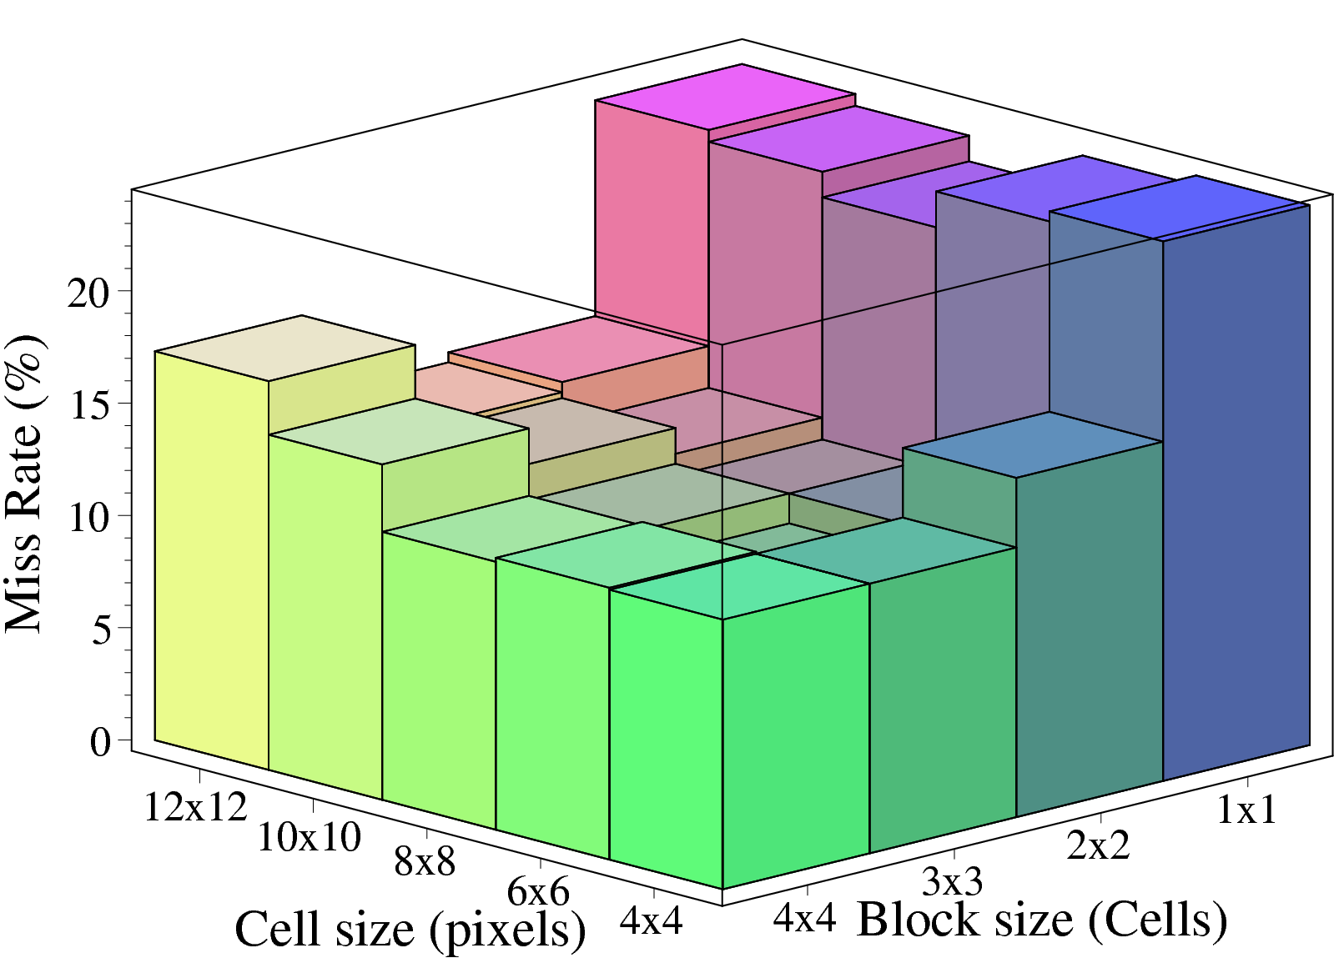

Effect of Block and Cell Size
64
128
Trade off between need for local spatial invariance and need for finer spatial resolution

Slide 21
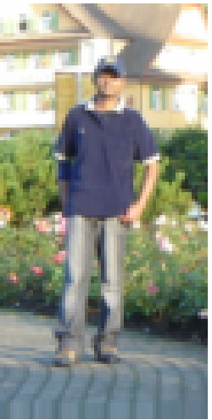

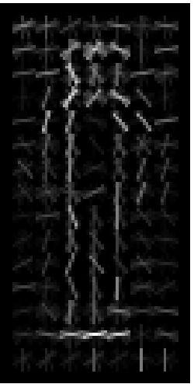
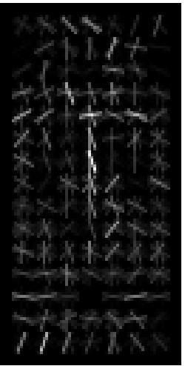
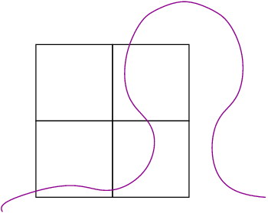
Descriptor Cues: Persons
Outside-in weights
Input example
Average gradients
Weighted pos wts
Weighted neg wts
Most important cues are head, shoulder, leg silhouettes
Vertical gradients inside a person are counted as negative
Overlapping blocks just outside the contour are most important
Notes:
Of course we want to know what is going behind the scenes…
On left, we have an example window. Then average gradient……
In some separate tests, not shown here, we find that if we reduce the background information, the detector performance drops.

Slide 22









Training Set
More than 2000 positive & 2000 negative training images (96x160px)
Carefully aligned and resized
Wide variety of backgrounds

Slide 23
Model learning
Simple linear SVM on top of the HOG Features
  Fast (one inner product per evaluation window)
  Hyper plane normal vector:
  with y_{i} in {0,1} and x_{i} the support vectors
  Decision:
Slightly better results can be achieved by using a SVM with a Gaussian kernel
  But considerable increase in computation time
Notes:
Show on blackboard how normal svm equation with kernel is -> then linear -> then decision

Slide 24
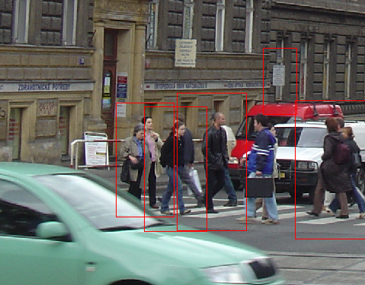
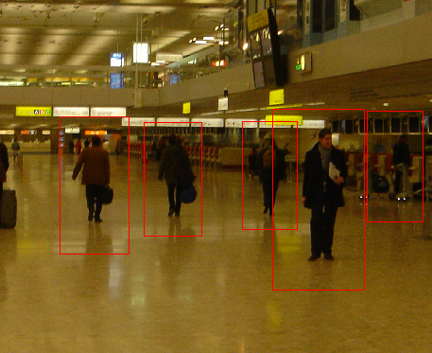
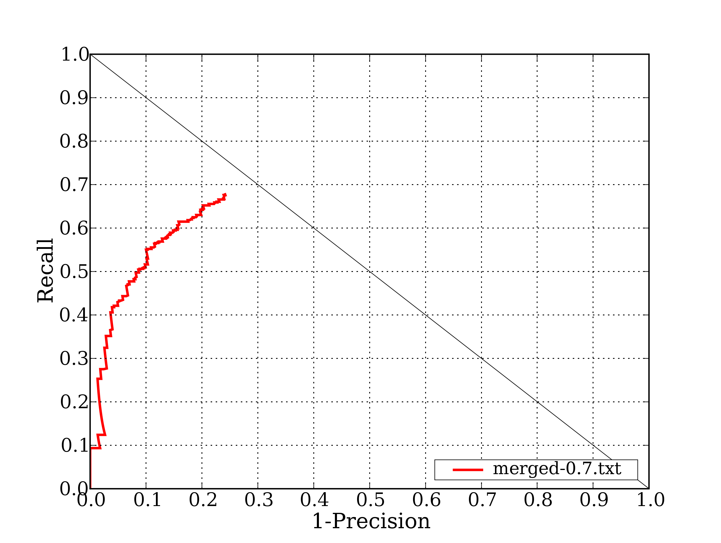
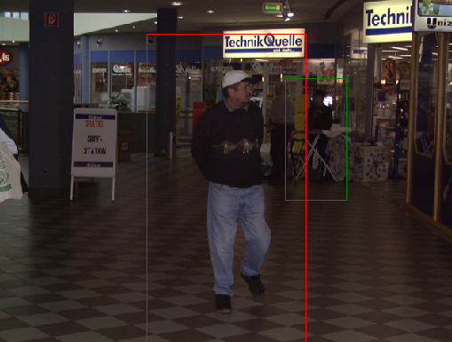
Result on INRIA database
Test Set contains 287 images
Resolution ~640x480
589 persons
Avg. size: 288 pixels

Slide 25
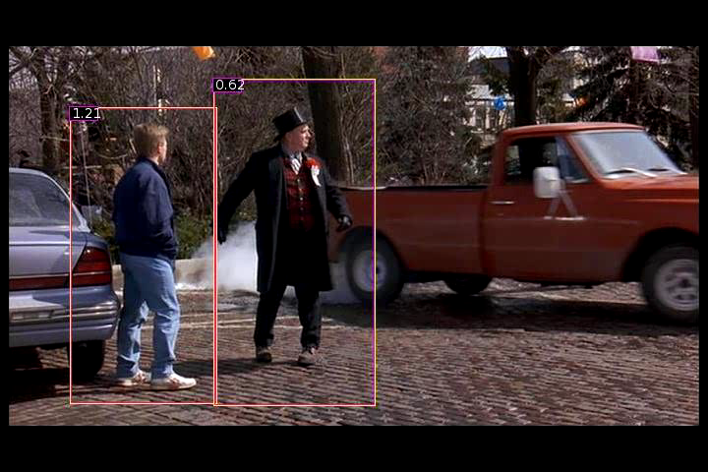
Demo

Slide 26
Computer Vision
Fall 2015

Slide 27
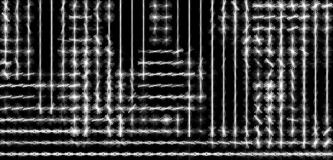
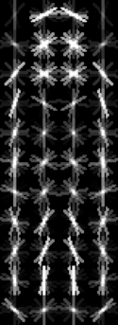
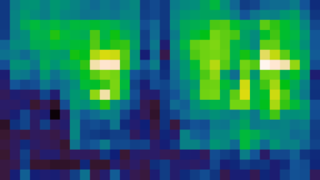
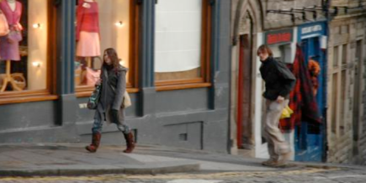
Last Class: Pedestrian detection
Features: Histograms of oriented gradients (HOG)
  Partition image into 8x8 pixel blocks and compute histogram of gradient orientations in each block
Learn a pedestrian template using a linear support vector machine
  At test time, convolve feature map with template
HOG feature map
Template
Detector response map
N. Dalal and B. Triggs, Histograms of Oriented Gradients for Human Detection, CVPR 2005

Slide 28
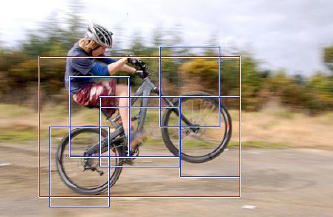

Discriminative part-based models
Root filter
Part filters
Deformation weights
P. Felzenszwalb, R. Girshick, D. McAllester, D. Ramanan, Object Detection with Discriminatively Trained Part Based Models, PAMI 32(9), 2010

Slide 29
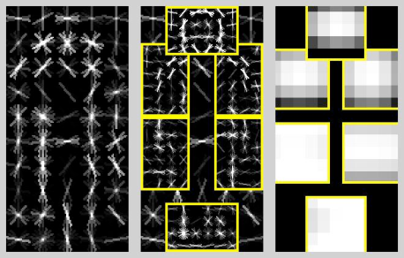
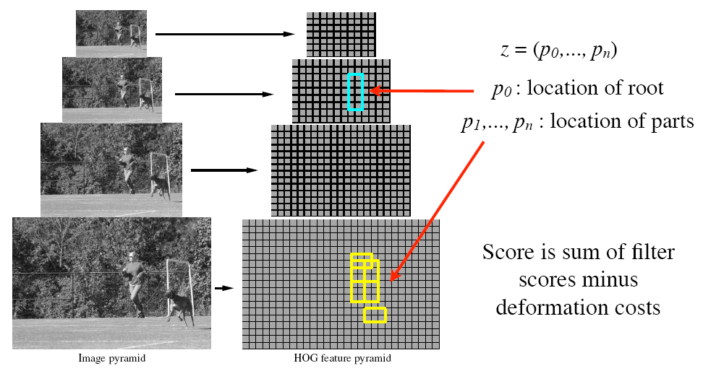
Object hypothesis
Multiscale model: the resolution of part
filters is twice the resolution of the root

Slide 30
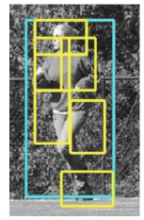
Scoring an object hypothesis
The score of a hypothesis is the sum of filter scores minus the sum of deformation costs
Subwindow features
Displacements
Filters
Deformation weights

Slide 31
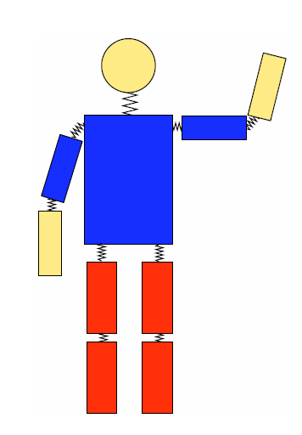
Scoring an object hypothesis
The score of a hypothesis is the sum of filter scores minus the sum of deformation costs
Pictorial structures
Subwindow features
Displacements
Filters
Deformation weights
Matching cost
Deformation cost

Slide 32
Scoring an object hypothesis
The score of a hypothesis is the sum of filter scores minus the sum of deformation costs
Subwindow features
Displacements
Filters
Deformation weights
Concatenation of filter and deformation weights
Concatenation of subwindow features and displacements

Slide 33
Detection
Define the score of each root filter location as the score giving the best part placements:

Slide 34

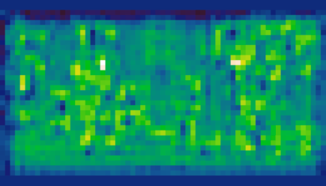
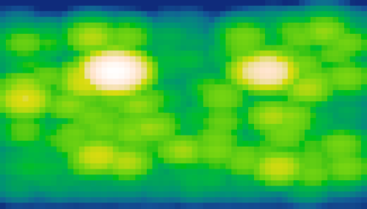
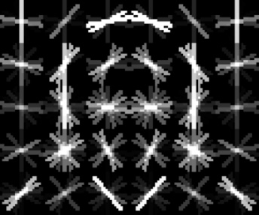
Detection
Define the score of each root filter location as the score given the best part placements:
Efficient computation: generalized distance transforms
  For each “default” part location, find the best-scoring displacement
Head filter responses
Distance transform
Head filter

Slide 36
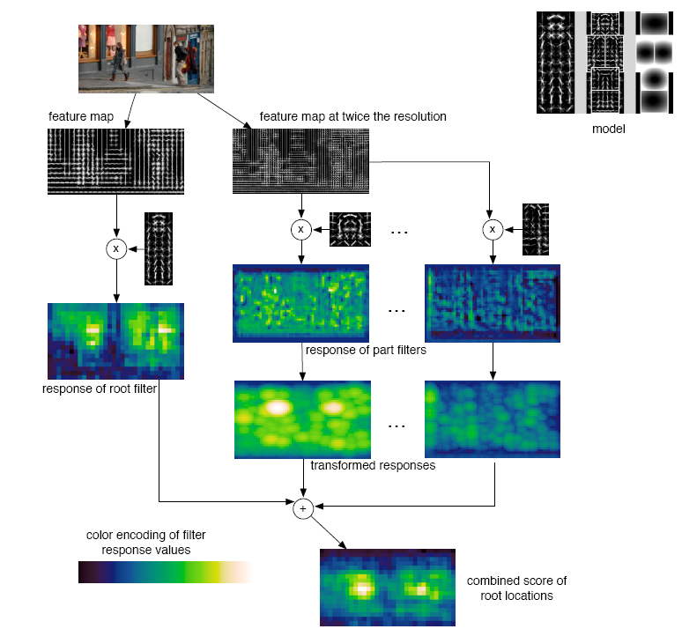
Detection

Slide 37
Matching result

Slide 38
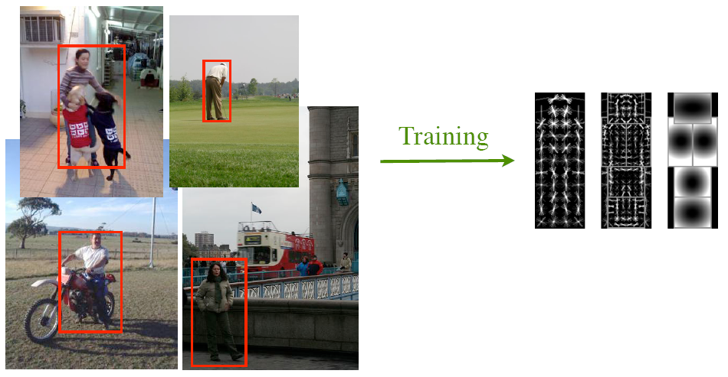
Training
Training data consists of images with labeled bounding boxes
Need to learn the filters and deformation parameters

Slide 39
Training
Classifier has the form
w are model parameters, z are latent hypotheses (z = (c,p₀,...,p_{nc}) parameters for model component C), represents the object configuration
Latent SVM training:
  Initialize w and iterate:
    Fix w and find the best z for each training example (detection)
    Fix z and solve for w (standard SVM training)
Issue: too many negative examples
  Do “data mining” to find “hard” negatives
Notes:
z object config
An object hypothesis for a mixture model specifies a mixture component, 1 ≤ c ≤ m, and a location for each filter of Mc, z = (c,p₀,...,p_{nc}). Here nc is the number of parts in Mc. The score of this hypothesis is the score of the hypothesis z′ = (p₀,...,p_{nc}) for the c-th model component.

Slide 40


Car model
Component 1
Component 2

Slide 41
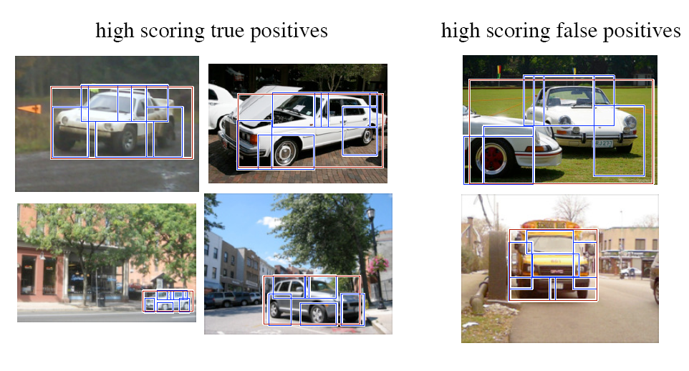
Car detections

Slide 42
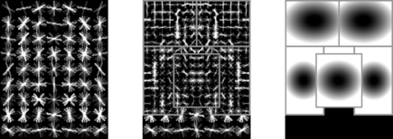
Person model

Slide 43
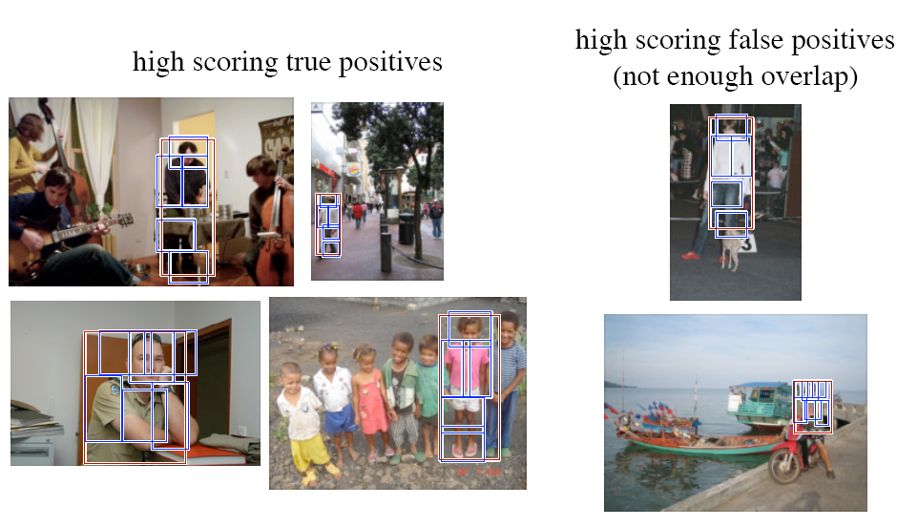
Person detections

Slide 44

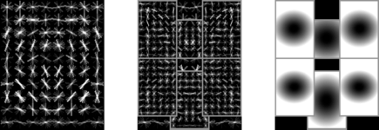
Cat model

Slide 45
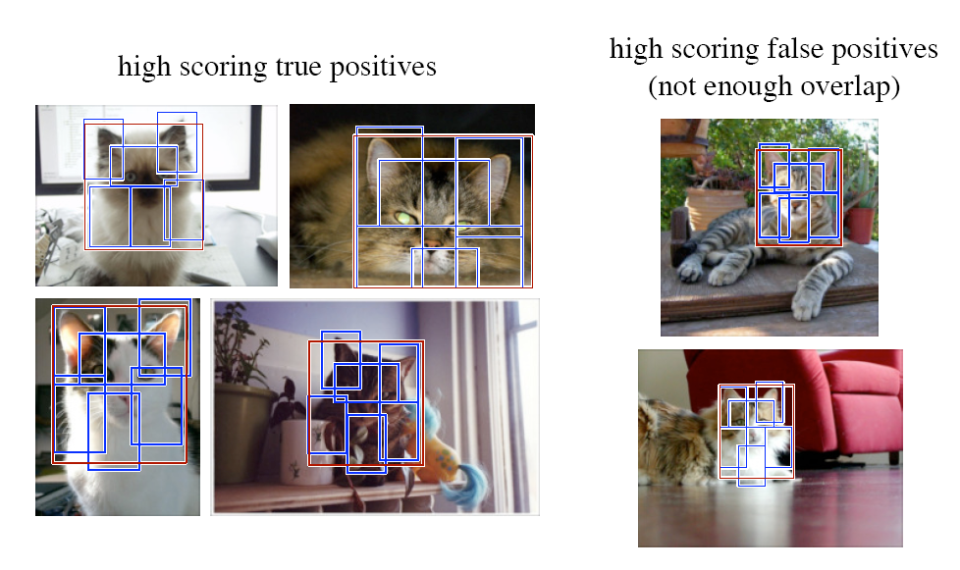
Cat detections

Slide 46
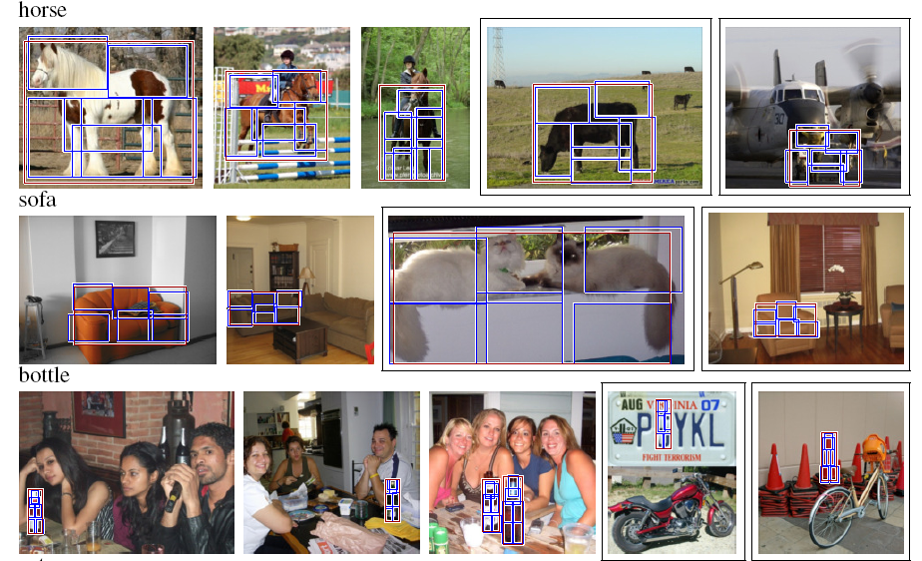
More detections

Slide 47
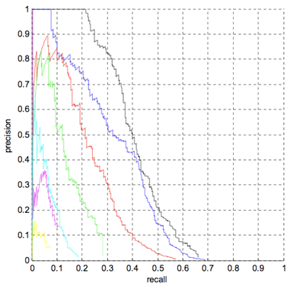
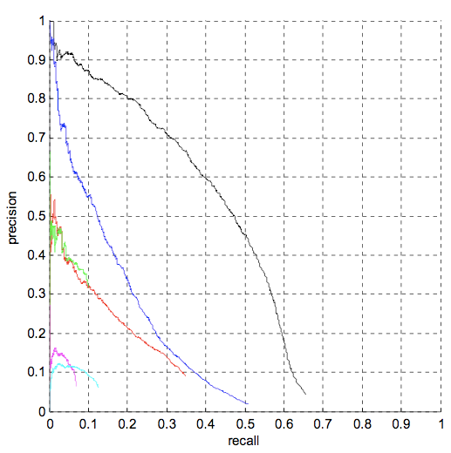
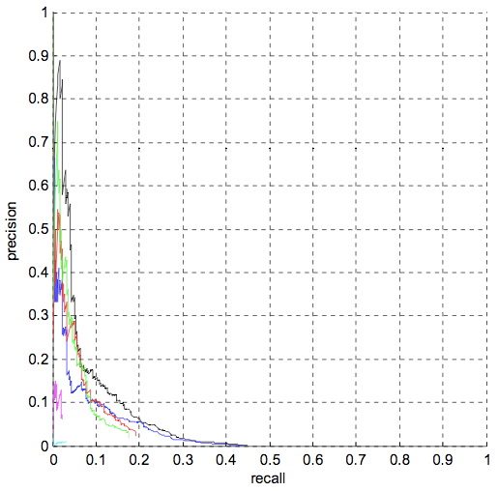
Quantitative results (PASCAL 2008)
7 systems competed in the 2008 challenge
Out of 20 classes, first place in 7 classes and second place in 8 classes
Bicycles
Person
Bird
Proposed approach
Proposed approach
Proposed approach

