Slide 1
776 Computer Vision
Jan-Michael Frahm
Fall 2016

Slide 2
Change in Start Time
Can class start at 3 pm or 3:15 pm?

Slide 3
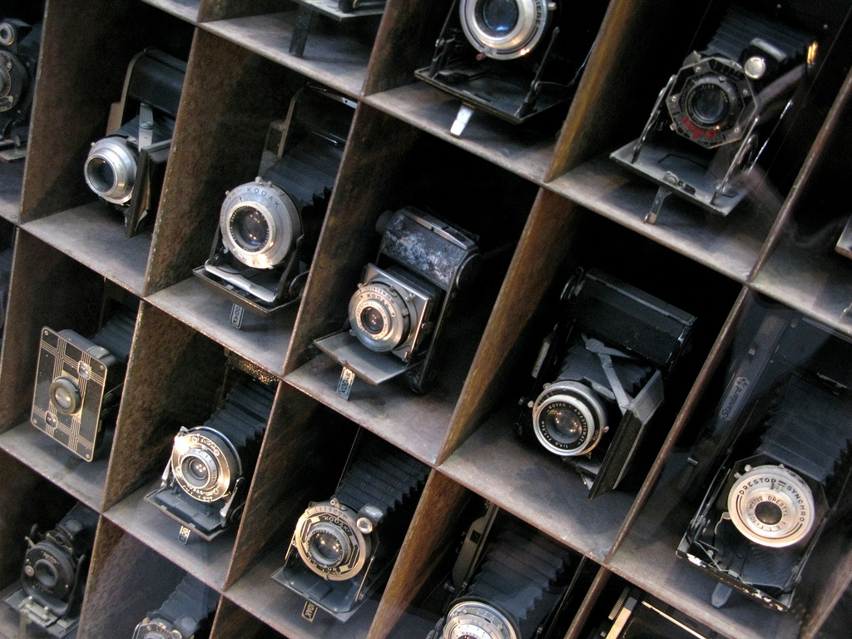
Camera

Slide 4


Camera
sensor (CCD, CMOS, etc.)
object point emits light in all directions
put a sensor to capture the image
block most of the rays with a barrier called aperture

Slide 5
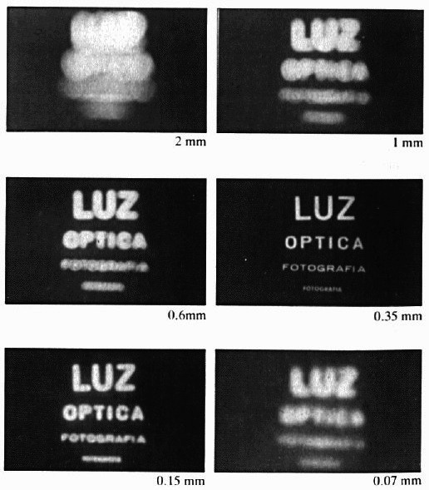
Capture an Object
Barrier is known as aperture
  blocks of most of the rays
  reduces blur
image source: S. Seitz

Slide 6
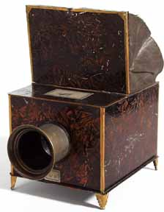
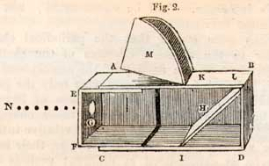
Capture an Object
Barrier is known as aperture
  blocks of most of the rays
  reduces blur
Pinhole camera (camera obscura)
Interior of camera obscura
(Sunday Magazine, 1838)
Camera obscura
(France, 1830)

Slide 7
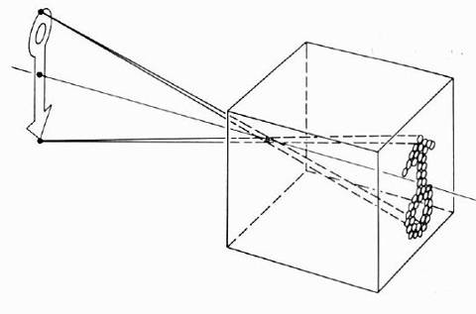
Capture an Object
Barrier is known as aperture
  blocks of most of the rays
  reduces blur
Pinhole camera (camera obscura)
  infinitely small aperture (pinhole)
  captures all rays going through the pinhole (pencil of rays)
  image is captured on image plane
image source: S. Seitz

Slide 8
Properties of Pinhole Camera
What is preserved
  points project to points
  lines, incidence (except for parallel lines, lines through focal point)
  planes project to planes
What is lost
  depth (all points on a ray project to the same point)
  angles, length

Slide 9
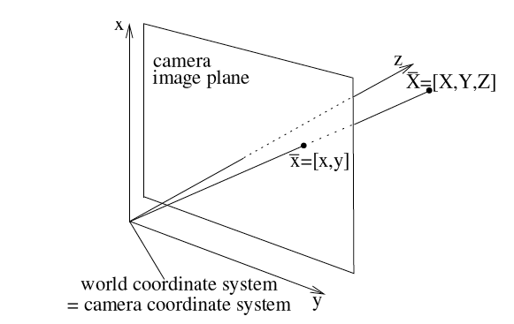
Camera Projection
Z
Project 3D point [X,Y,Z] into image point [x,y]
camera in origin [0,0,0]
no rotation, translation of the camera

Slide 10
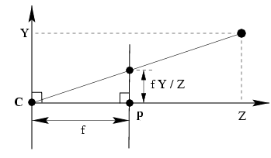
Pinhole Camera Projection
M =(X,Y,Z)
y
x
sensor
focal length
0
0
z
Image point is the intersection of the ray from the object point through the origin 0 with the image plane
Image point can be derived through similar triangles
Projection eliminates last component

Slide 11
Camera Projection
Is this a linear transformation?
Can we make it a linear transformation?
M
e₃
a₃
Vector relative to 0:
e₂
a₂
Point in affine coordinates:
0
e₁
a₁
Notes:
Not linear due to division by Z

Slide 12
Camera Projection
Unified notation by including origin 0 into the representation
M
e₃
a₃
e₂
a₂
homogenous
representation of M
0
e₁
a₁

Slide 13
Special transformation: Rotation
Rigid transformation: Angles and lengths preserved
R is orthonormal matrix defined by three angles around three coordinate axes
e_{z}
α
e_{y}
e_{x}
Rotation with angle α around e_{z}

Slide 14
Projective geometry in 2D
Projective space is space of rays emerging from 0
  view point 0 forms projection center (focal point) for all rays
  rays v emerge from viewpoint into scene
  ray g is called projective point, defined as scaled v: g=λv
w
y
0
x

Slide 15
Projective and homogeneous points
Projective space is space of rays emerging from 0
  view point 0 forms projection center for all rays
  rays v emerge from viewpoint into scene
  ray g is called projective point, defined as scaled v: g=λv
w
w=1
Π
(R²)
y
0
x

Slide 16
Finite and infinite points
All rays g that are not parallel to Π intersect at an affine point v on Π.
The ray g(w=0) does not intersect Π. Hence v∞ is not an affine point but a direction. Directions have the coordinates (x,y,0)^{T}
Projective space combines affine space with infinite points (directions).
w=1
Π
(R²)
O

Slide 17
Pinhole Camera Projection
M=(X,Y,Z)
y
x
sensor
focal length
0
z
Z (Optical axis)
y
Image plane
  Z₀
Π
(R²)
x
Y
0
Camera center
X

Slide 18
Perspective projection
Perspective projection models pinhole camera:
  scene geometry is affine R³ space with coordinates M=(X,Y,Z,1)^{T}
  camera focal point in 0=(0,0,0,1)^{T}, camera viewing direction along Z
  image plane (x,y) in Π(R²) aligned with plane (X,Y) at Z₀= f (focal length)
  scene point M projects onto point m on plane surface
Z (Optical axis)
y
Image plane
  f
Π
(R²)
x
Y
0
Camera center
X

Slide 19
Projective Transformation
Projective Transformation maps P onto p
Y
O
X
Projective Transformation linearizes projection

Slide 20
Perspective Projection
Dimension reduction from R³ into R² by projection onto Π(R²)
(R²)
Π
Y
0
X

Slide 21
Perspective Projection
Dimension reduction from R³ into R² by projection onto Π(R²)
(R²)
Π
Y
0
X

Slide 22
Projection in General Pose
Rotation [R]
Projection:
m
Projection center C
M
World coordinates

Slide 23
Image plane and image sensor
A sensor with picture elements (Pixel) is added onto the image plane
Z (Optical axis)
  Image center
  c= (c_{x}, c_{y})^{T}
  Pixel coordinates
  m = (y,x)^{T}
Image sensor
y
x
Y
Image-sensor mapping:
  Pixel scale
  f= (f_{x},f_{y})^{T}
X
Projection center
Pixel coordinates are related to image coordinates by affine transformation K with five parameters:
  Image center c=(c_{x},c_{y})^{T} defines optical axis
  Pixel size and pixel aspect ratio defines scale f=(f_{x},f_{y})^{T}
  image skew s to model angle between pixel rows and columns

Slide 24
Projection matrix P
Camera projection matrix P combines:
  inverse affine transformation T_{cam}⁻¹ from general pose to origin
  Perspective projection P₀ to image plane at Z₀ =1
  affine mapping K from image to sensor coordinates
World to
camera coord.
trans. matrix
(4x4)
3D
point
(4x1)
2D
point
(3x1)
Camera to
pixel coord.
trans. matrix
(3x3)
Perspective
projection matrix
(3x4)
=

Slide 25
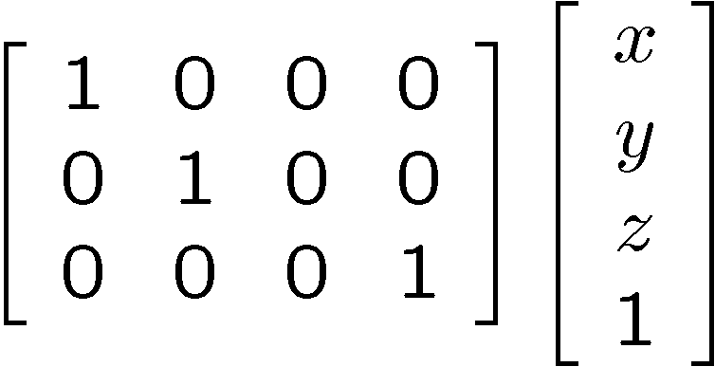
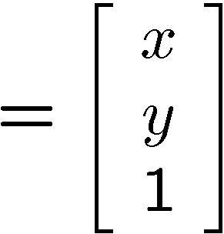

Orthographic Projection
Special case of perspective projection
  Distance from center of projection to image plane is infinite
  Also called “parallel projection”
  What’s the projection matrix?
Image
World
Slide by Steve Seitz
Notes:
Is this a linear function?

Slide 26
Projection properties
Many-to-one: any points along same visual ray map to same point in image
Points → points
  But projection of points on focal plane is undefined
Lines → lines (collinearity is preserved)
  But lines through focal point (visual rays) project to a point
Planes → planes (or half-planes)
  But planes through focal point project to lines
slide: S. Lazebnik

Slide 27

Vanishing points
Each direction in space has its own vanishing point
  All lines going in that direction converge at that point
  Exception: directions parallel to the image plane
slide: S. Lazebnik

Slide 28
Vanishing points
Each direction in space has its own vanishing point
  All lines going in that direction converge at that point
  Exception: directions parallel to the image plane
How do we construct the vanishing point of a line?
image plane
vanishing point
camera
center
line on ground plane
slide: S. Lazebnik

Slide 29
Facing Real Cameras
There are undesired effects in real situations
  perspective distortion

Slide 30
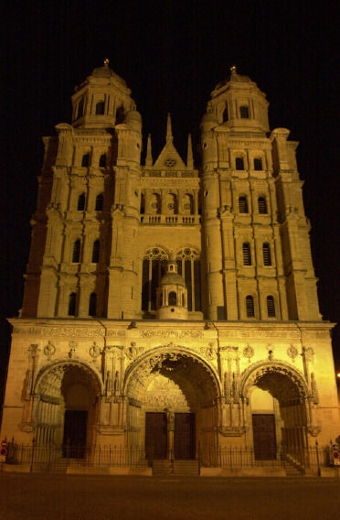
Perspective distortion
Problem for architectural photography: converging verticals
Where do they converge to?
image source: F. Durand

Slide 31
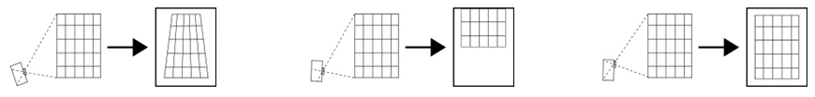
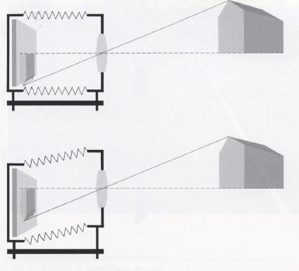
Perspective distortion
Problem for architectural photography: converging verticals
Solution: view camera (lens shifted w.r.t. film)
Tilting the camera upwards results in converging verticals
Keeping the camera level, with an ordinary lens, captures only the bottom portion of the building
Shifting the lens upwards results in a picture of the entire subject
http://en.wikipedia.org/wiki/Perspective_correction_lens
Source: F. Durand

Slide 32
Perspective distortion
Problem for architectural photography: converging verticals
Result:
shifted lens
tilted camera with regular lens
Source: F. Durand

Slide 33
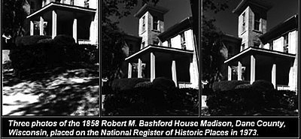
Perspective distortion
Which image is captured with a shifted lens?
image: Wikipedia
Notes:
right one

Slide 34
Perspective distortion
What does a sphere project to?
Image source: F. Durand

Slide 35
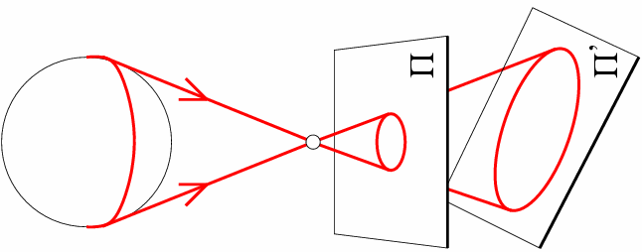
Perspective distortion
What does a sphere project to?
slide: S. Lazebnik

Slide 36
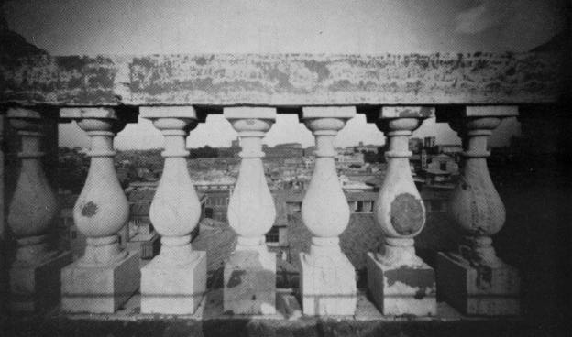
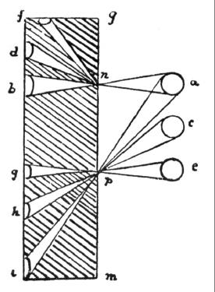
Perspective distortion
The exterior columns appear bigger
The distortion is not due to lens flaws
Problem pointed out by Da Vinci
Slide by F. Durand

Slide 37

Perspective distortion: People
slide: S. Lazebnik

Slide 38
Facing Real Cameras
There are undesired effects in real situations
  perspective distortion
Camera artifacts

Slide 39
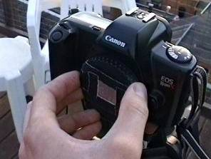
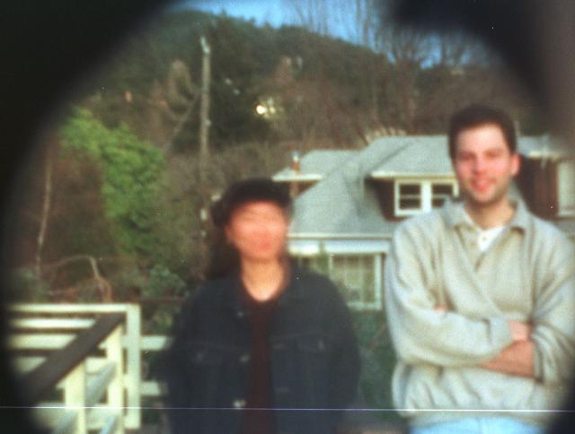
Home-made pinhole camera
Why so
blurry?
Slide by A. Efros
http://www.debevec.org/Pinhole/

Slide 40
Shrinking the aperture
Why not make the aperture as small as possible?
  Less light gets through
  Diffraction effects…
Slide by Steve Seitz

Slide 41
Shrinking the aperture

Slide 42
Facing Real Cameras
There are undesired effects in real situations
  perspective distortion
Camera artifacts
  aperture is not infinitely small

Slide 43
Adding a lens
A lens focuses light onto the film
  Thin lens model:
    Rays passing through the center are not deviated
    (pinhole projection model still holds)
Slide by Steve Seitz
Notes:
thin lens is a lens with a thickness (distance along the optical axis between the two surfaces of the lens) that is negligible compared to the radii of curvature of the lens surfaces

Slide 44
Adding a lens
focal point
f
A lens focuses light onto the film
  Thin lens model:
    Rays passing through the center are not deviated
    (pinhole projection model still holds)
    All parallel rays converge to one point on a plane located at the focal length f
Slide by Steve Seitz

Slide 45
Adding a lens
“circle of
confusion”
A lens focuses light onto the film
  There is a specific distance at which objects are “in focus”
    other points project to a “circle of confusion” in the image
Slide by Steve Seitz

Slide 46
Thin lens formula
What is the relation between the focal length (f),
the distance of the object from the optical center (D),
and the distance at which the object will be in focus (D’)?
D’
D
f
image plane
lens
object
Slide by Frédo Durand
Notes:
This is the relation between the focal length (f), the distance of the object from the camera (D), and the distance at which the object will be in focus (D’)

Slide 47
Thin lens formula
Similar triangles everywhere!
D’
D
f
image plane
lens
object
Slide by Frédo Durand

Slide 48
Thin lens formula
y’/y = D’/D
Similar triangles everywhere!
D’
D
f
y
y’
image plane
lens
object
Slide by Frédo Durand

Slide 49
Thin lens formula
y’/y = D’/D
Similar triangles everywhere!
y’/y = (D’-f)/f
D’
D
f
y
y’
image plane
lens
object
Slide by Frédo Durand

Slide 50
Thin lens formula
1
1
1
Any point satisfying the thin lens equation is in focus.
+
=
D’
D
f
D’
D
f
image plane
lens
object
Slide by Frédo Durand
Notes:
And the set of all such points forms a plane parallel to the image (plane of focus).

Slide 51
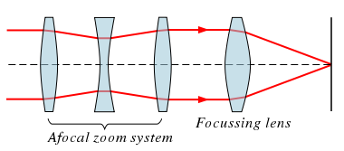
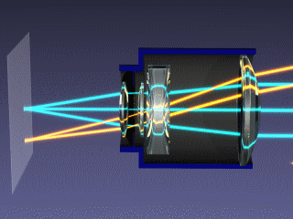
Real Lenses
Zoom lens
image: Simal

Slide 52
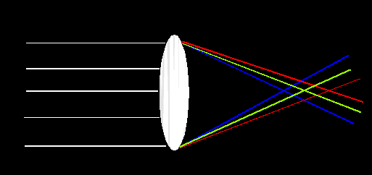

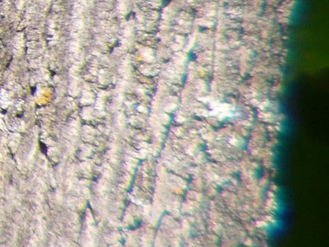
Lens Flaws: Chromatic Aberration
Lens has different refractive indices for different wavelengths: causes color fringing
Near Lens Center
Near Lens Outer Edge
slide: S. Lazebnik

Slide 53
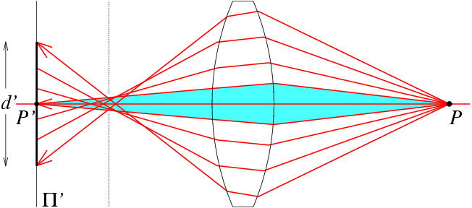
Lens flaws: Spherical aberration
Spherical lenses don’t focus light perfectly
Rays farther from the optical axis focus closer
slide: S. Lazebnik

Slide 54
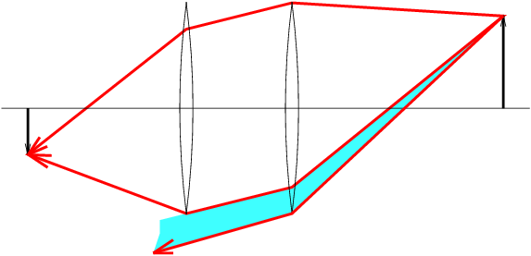


Lens flaws: Vignetting
slide: S. Lazebnik

Slide 55
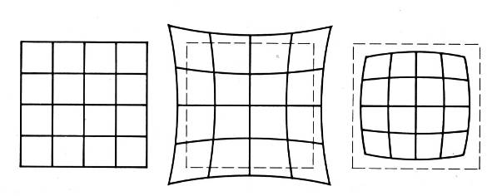
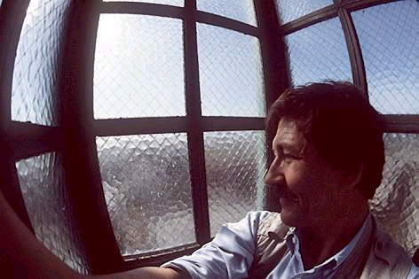
Radial Distortion
  Caused by imperfect lenses
  Deviations are most noticeable near the edge of the lens
No distortion
Pin cushion
Barrel
slide: S. Lazebnik

Slide 56
Radial Distortion
Brown’s distortion model
  accounts for radial distortion
  accounts for tangential distortion (distortion caused by lens placement errors)
typically K₁ is used or K₁, K₂, P₁, P₂
(x_{u}, y_{u}) undistorted image point as in ideal pinhole camera
(x_{d},y_{d}) distorted image point of camera with radial distortion
(x_{c},y_{c}) distortion center
K_{n} n-th radial distortion coefficient
P_{n} n-th tangential distortion coefficient

Slide 57
Facing Real Cameras
There are undesired effects in real situations
  perspective distortion
Camera artifacts
  aperture is not infinitely small
  lens
  vignetting, radial distortion

Slide 58

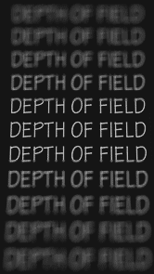
Depth of Field
http://www.cambridgeincolour.com/tutorials/depth-of-field.htm
Slide by A. Efros
Notes:
Depth of field is the range of distance within the subject that is acceptably sharp.

Slide 59
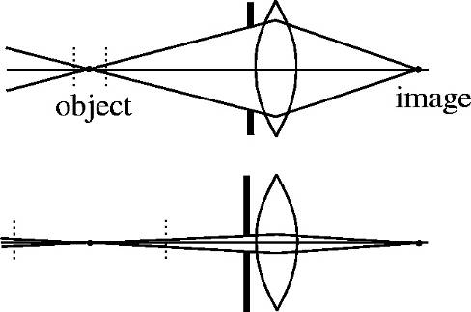
How can we control the depth of field?
Changing the aperture size affects depth of field
  A smaller aperture increases the range in which the object is approximately in focus
  But small aperture reduces amount of light – need to increase exposure
Slide by A. Efros

Slide 60
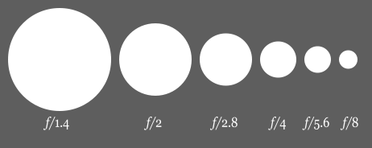
F Number of the Camera
f number (f-stop) ratio of focal length to aperture

Slide 61
Cell Phone Cameras
What is the depth of field of a cell phone camera?
  large depth of field
  small aperture

Slide 62


Varying the aperture
Large aperture = small DOF
Small aperture = large DOF
Slide by A. Efros

Slide 63
Facing Real Cameras
There are undesired effects in real situations
  perspective distortion
Camera artifacts
  aperture is not infinitely small
  lens
  vignetting, radial distortion
  depth of field

Slide 64
Field of View
What does FOV depend on?
Slide by A. Efros

Slide 65
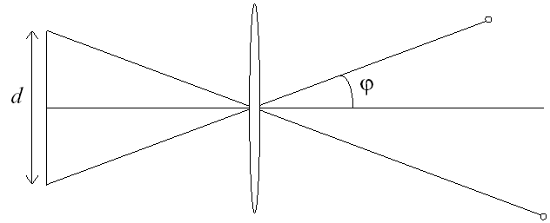
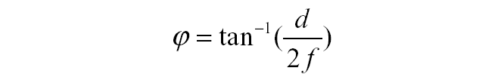
Field of View
f
f
FOV depends on focal length and size of the aperture
Smaller FOV = larger Focal Length
Slide by A. Efros

Slide 66

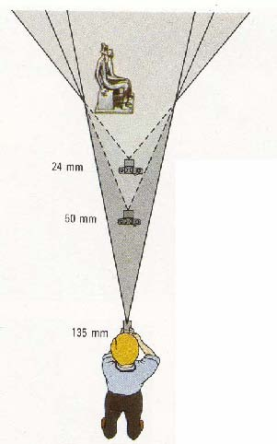

Field of View / Focal Length
Large FOV, small f
Camera close to car
Small FOV, large f
Camera far from the car
Sources: A. Efros, F. Durand

Slide 67
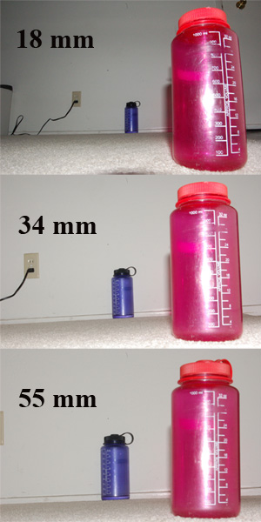
Field of View / Focal Length

Slide 68



Same effect for faces
wide-angle
standard
telephoto
Source: F. Durand

Slide 69
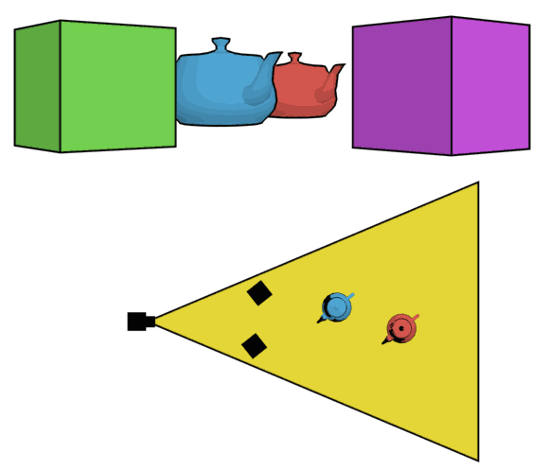
The dolly zoom
Continuously adjusting the focal length while the camera moves away from (or towards) the subject
http://en.wikipedia.org/wiki/Dolly_zoom
slide: S. Lazebnik
Notes:
human visual perception uses both size and perspective cues => this is an unsettling effect

Slide 70

The Dolly Zoom

