Slide 1
776 Computer Vision
Jan-Michael Frahm
Fall 2016, MW 3:35 pm – 4:50 pm

Slide 2

What is computer vision?
Terminator 2
Notes:
Clips: terminator 2, enemy of the state (from UCSD “Fact or Fiction” DVD)

Slide 3

The goal of computer vision
To extract “meaning” from pixels
Humans are remarkably good at this…
Source: “80 million tiny images” by Torralba et al.

Slide 4

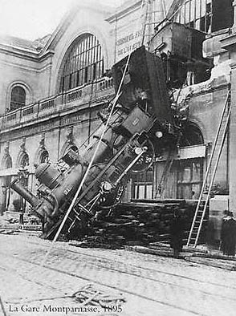
The goal of computer vision
To extract “meaning” from pixels
What we see
What a computer sees
Source: S. Narasimhan

Slide 5
Can computers match (or beat) human vision?
Yes and no (but mostly no!)
  humans are much better at “hard” things
  computers can be better at “easy” things
Source: Seitz, Szeliski
Notes:
If you can write a formula for it, computers can excel
Computer vision can’t solve the whole problem (yet), so breaks it down into pieces.
Many of the pieces have important applications.

Slide 6
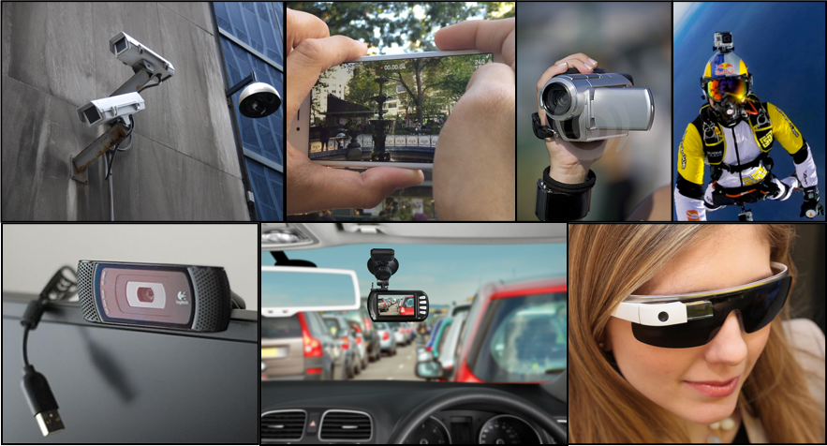
A World of Cameras
Close to a quadrillion photos taken last year
Trillions uploaded every year
Notes:
Crowd of data producers
Uploaded data sometimes poor judgement or mistake but we lost control
My work aims to understand and order the data
Facebook & WhatsApp alone have more than 1 trillion shared every year
Snapshat likely close to a trillion as well (700 million about two years ago)

Slide 7
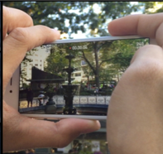
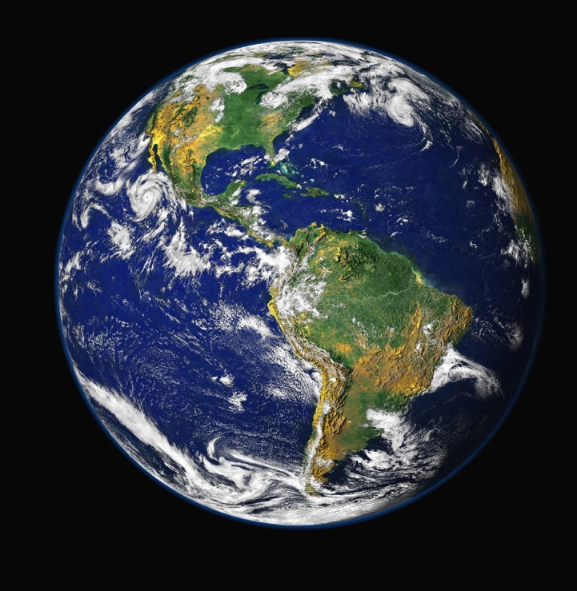
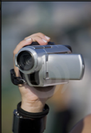
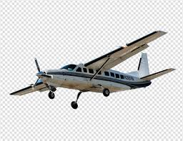
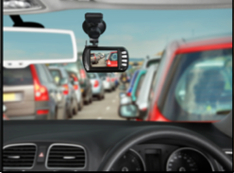
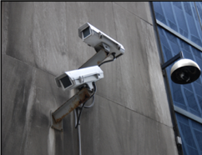
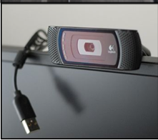

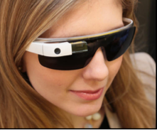
Super Sensor
Diverse
Uncontrolled
Asynchronous
Notes:
TODAY sparse but soon dense
Other sources THZ, depth cameras, etc. Lightfield arrarys …..

Slide 8
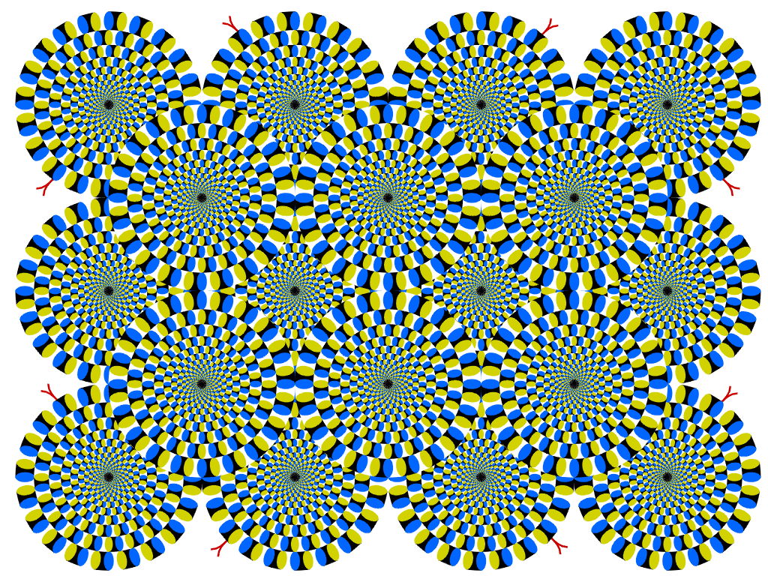
Copyright A.Kitaoka 2003

Slide 9
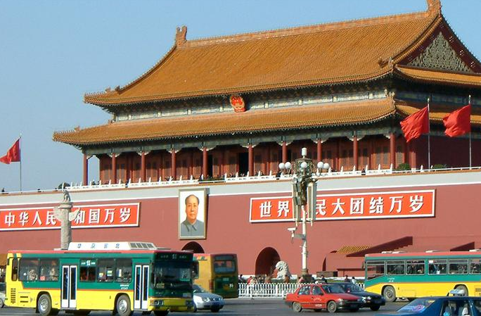
Vision as a source of semantic information
slide credit: Fei-Fei, Fergus & Torralba

Slide 10
Object categorization
sky
building
flag
face
banner
wall
street lamp
bus
bus
cars
slide: Fei-Fei, Fergus & Torralba

Slide 11
Scene and context categorization
outdoor
city
traffic
…
slide: Fei-Fei, Fergus & Torralba

Slide 12
Qualitative spatial information
slanted
non-rigid moving object
vertical
rigid moving object
rigid moving object
horizontal
slide: Fei-Fei, Fergus & Torralba

Slide 13
Applications of Computer Vision

Slide 14
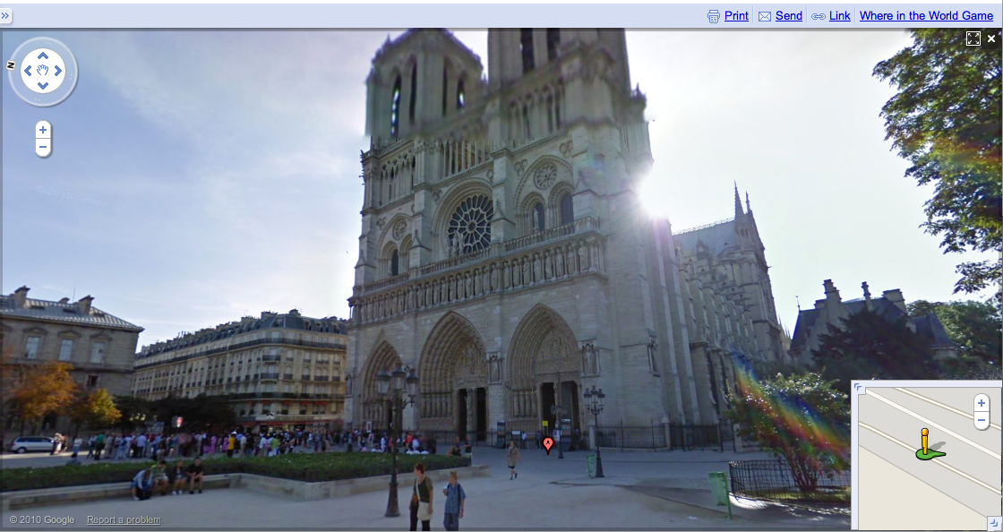
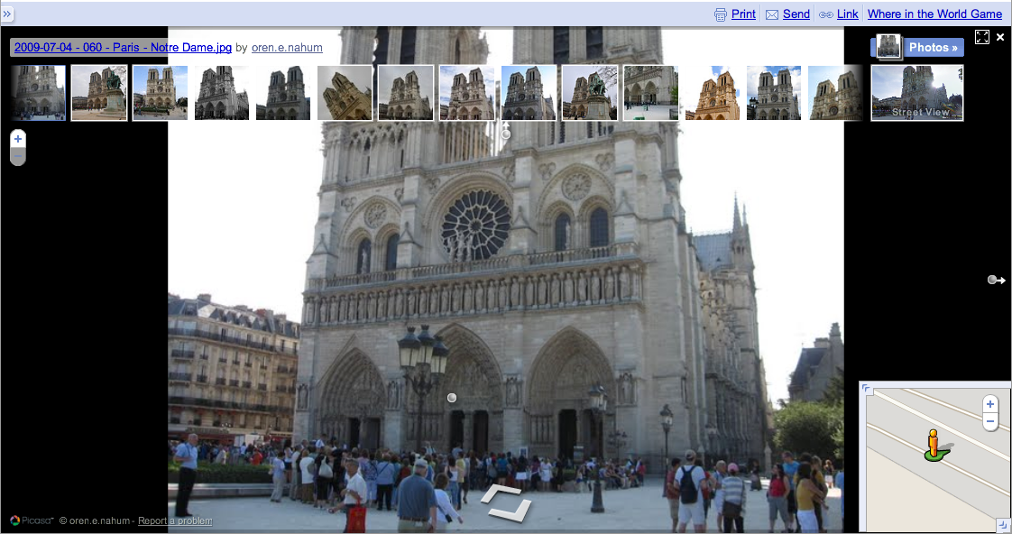
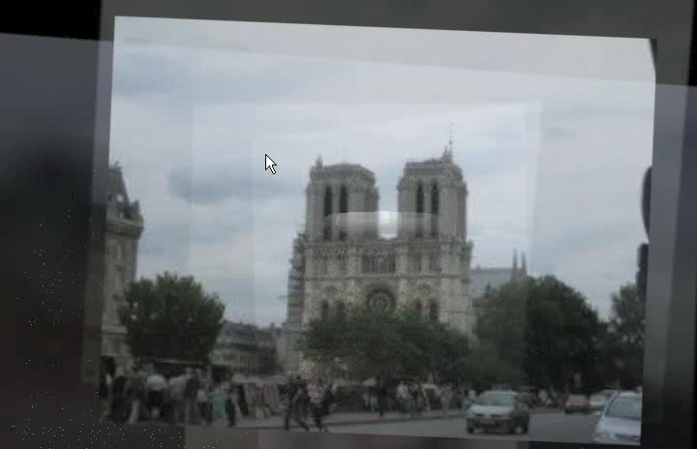
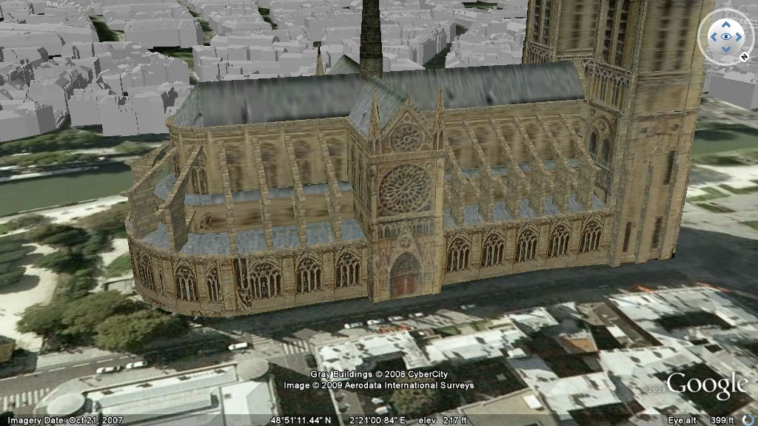
Views of the world
Street-side panoramas
Photo-based exploration
3D Landmarks
Notes:
too much exploration
Photo exploration limits to originally captured view points not in-between or extrapolation
3D model is what we want for navigation but MANUAL labor EXPENSIVE, my research is <click> automatic generation of models from videos and photos

Slide 15
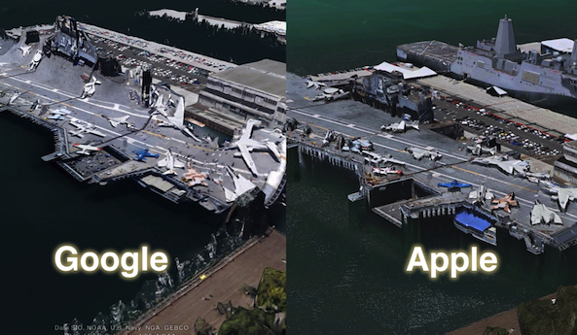
Earth viewers (3D modeling)
Image from Google Earth, Apple Maps@iOS6)
Source: Jeff Benjamin

Slide 16

Realistic World Model
Notes:
4th most photographed landmark in the world

Slide 17
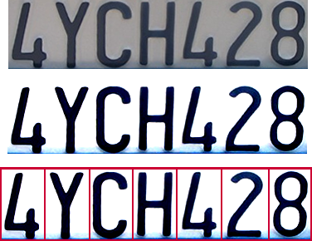
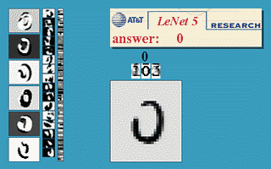
Optical character recognition (OCR)
Technology to convert scanned docs to text
  If you have a scanner, it probably came with OCR software
Digit recognition, AT&T labs
http://www.research.att.com/~yann/
License plate readers
http://en.wikipedia.org/wiki/Automatic_number_plate_recognition
Source: Seitz, Szeliski

Slide 18
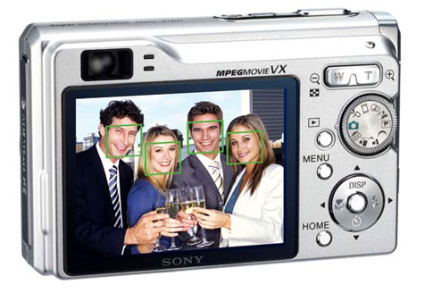
Face detection
Many new digital cameras now detect faces
  Canon, Sony, Fuji, …
Source: Seitz, Szeliski
Notes:
Why would this be useful? Main reason is focus. Also enables “smart” cropping.

Slide 19
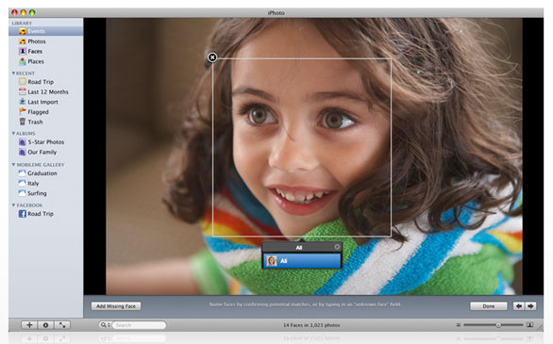
Face recognition: Apple iPhoto software
http://www.apple.com/ilife/iphoto/
Source: L. Lazebnik

Slide 20
Smile detection?
Sony Cyber-shot® T70 Digital Still Camera
Source: Seitz, Szeliski

Slide 21
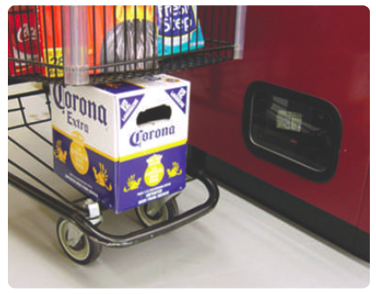
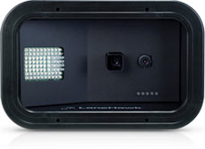

Object Recognition
Item recognition by Evolution Robotics
12 pack Coca Cola

Slide 22

iSpy: Optical Evesdropping
Developed here at UNC
http://www.cs.unc.edu/~rraguram/ispy/main.html

Slide 23

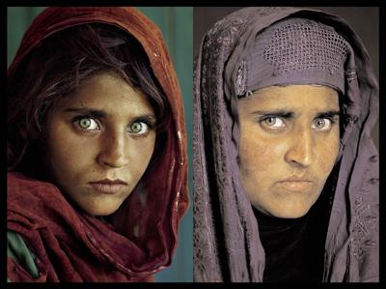
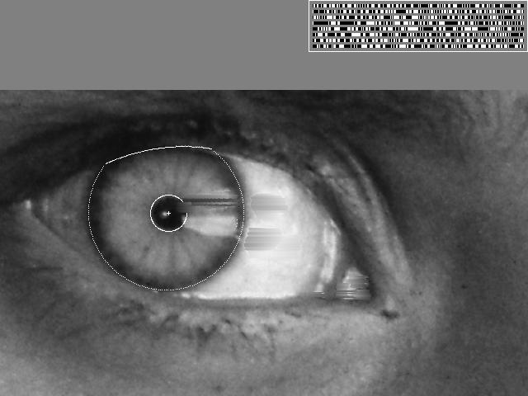
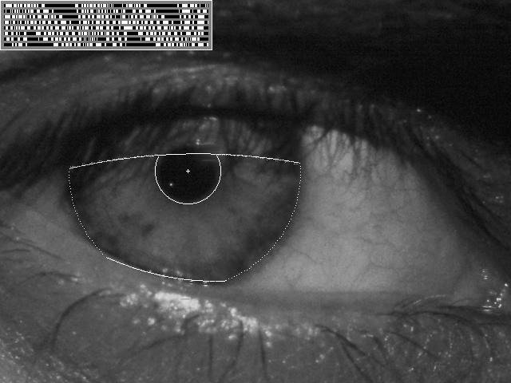
Biometrics
How the Afghan Girl was Identified by Her Iris Patterns
Source: S. Seitz

Slide 24
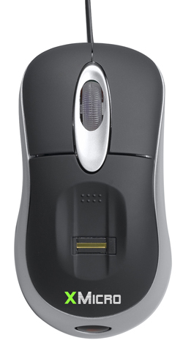

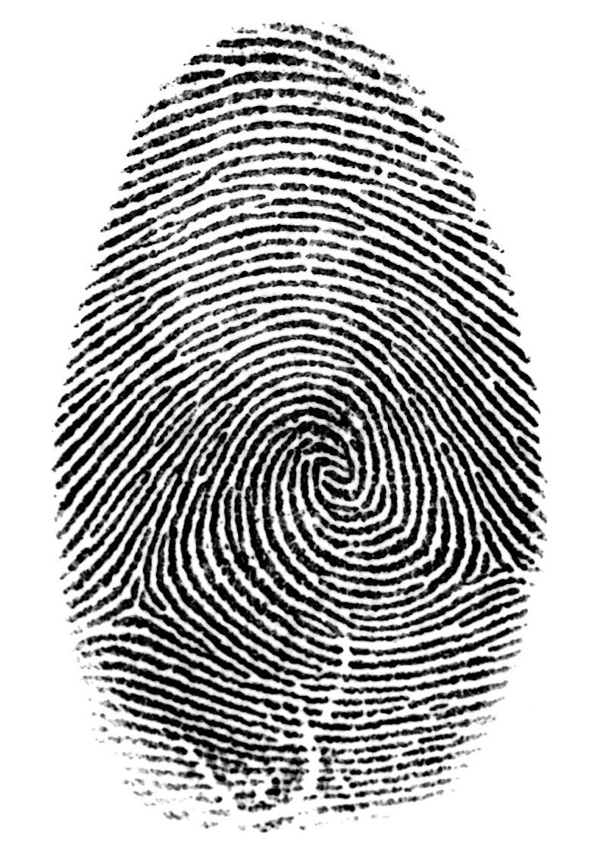

Login without a password…
Fingerprint scanners on many new laptops,
other devices
Face recognition systems now beginning to appear more widely
http://www.sensiblevision.com/
Source: S. Seitz

Slide 25
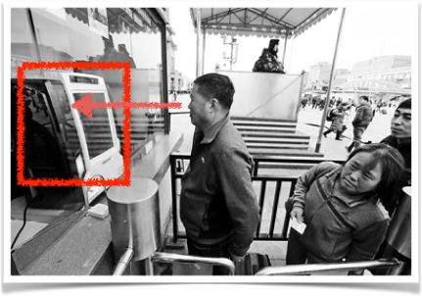

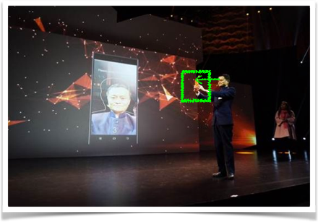
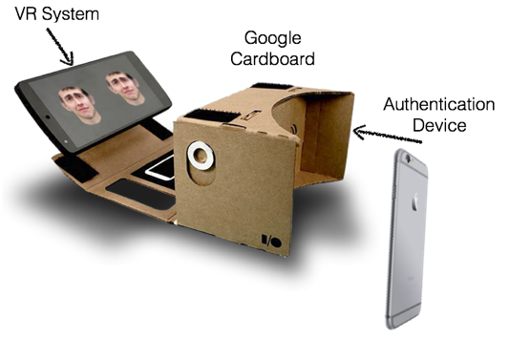
Privacy Threats Through Social Media
[Xu et al. CCS 2016]

Slide 26

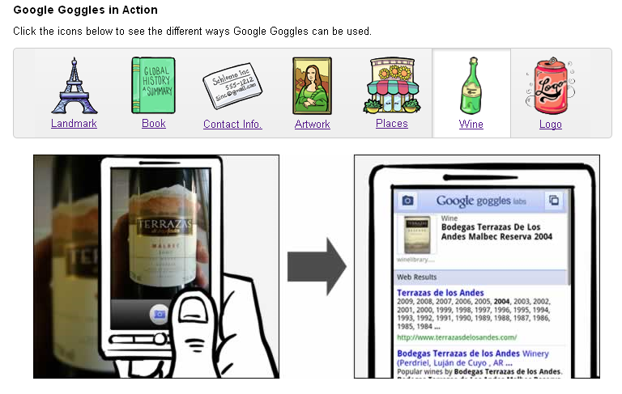
Mobile visual search: Google Goggles
Source: L. Lazebnik

Slide 27
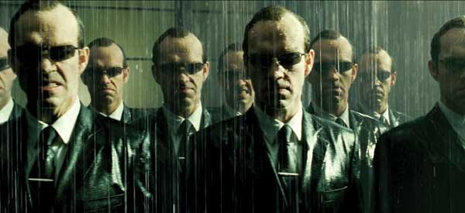
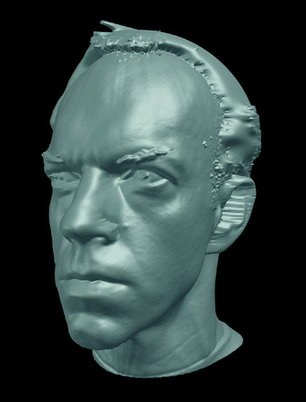
Special effects: shape capture
The Matrix movies, ESC Entertainment, XYZRGB, NRC
Source: S. Seitz

Slide 28


Special effects: motion capture
Pirates of the Carribean, Industrial Light and Magic
Click here for interactive demo
Source: S. Seitz

Slide 29
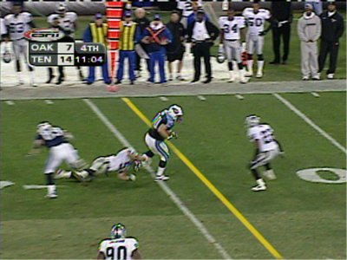
Sports
Sportvision first down line
Nice explanation on www.howstuffworks.com
Source: S. Seitz

Slide 30
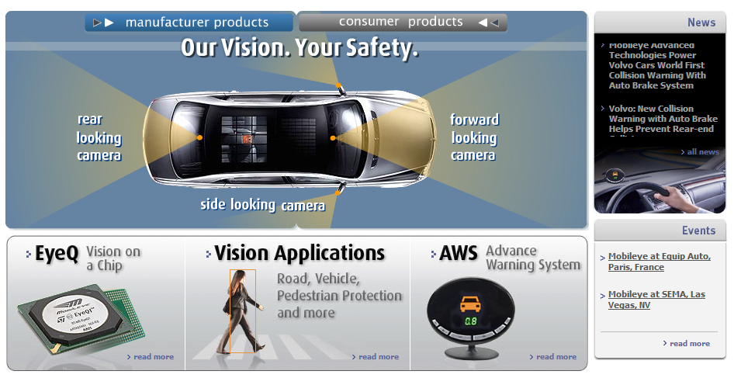
Smart cars
Slide content courtesy of Amnon Shashua
Mobileye
  Vision systems currently in high-end BMW, GM, Volvo models, after market
  Forward collision warning, Pedestrian collision warning
  Lane departure warning
  Headway monitoring and warning
  Video demo
Source: S. Seitz

Slide 31
Driver Assistant Systems

Slide 32
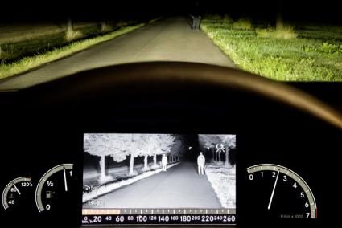
Night Vision Systems
Daimler Night Vision system with pedestrian detection

Slide 33
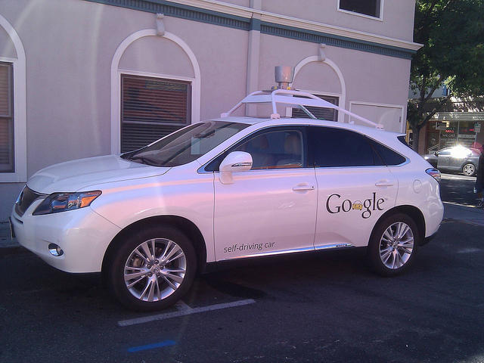
Autonomous Driving
Google Car

Slide 34
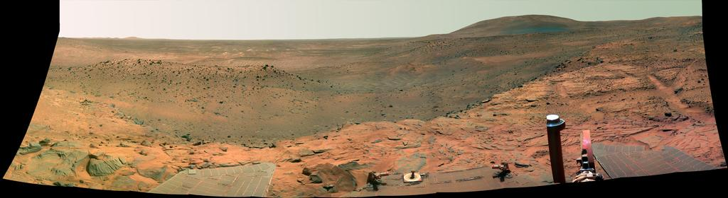
Vision in space
NASA'S Mars Exploration Rover Spirit captured this westward view from atop
a low plateau where Spirit spent the closing months of 2007.
Vision systems (JPL) used for several tasks
  Panorama stitching
  3D terrain modeling
  Obstacle detection, position tracking
  For more, read “Computer Vision on Mars” by Matthies et al.
Source: S. Seitz

Slide 35
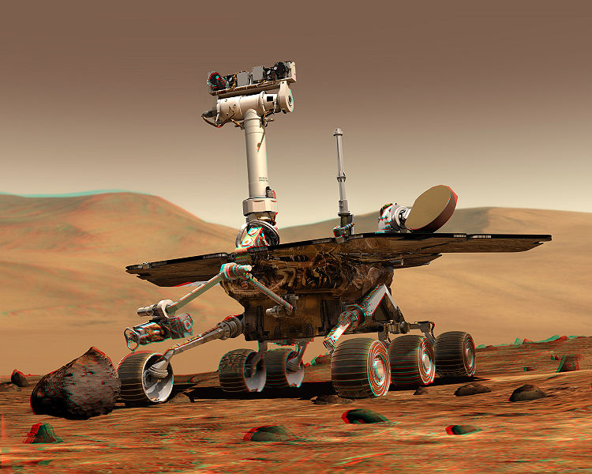
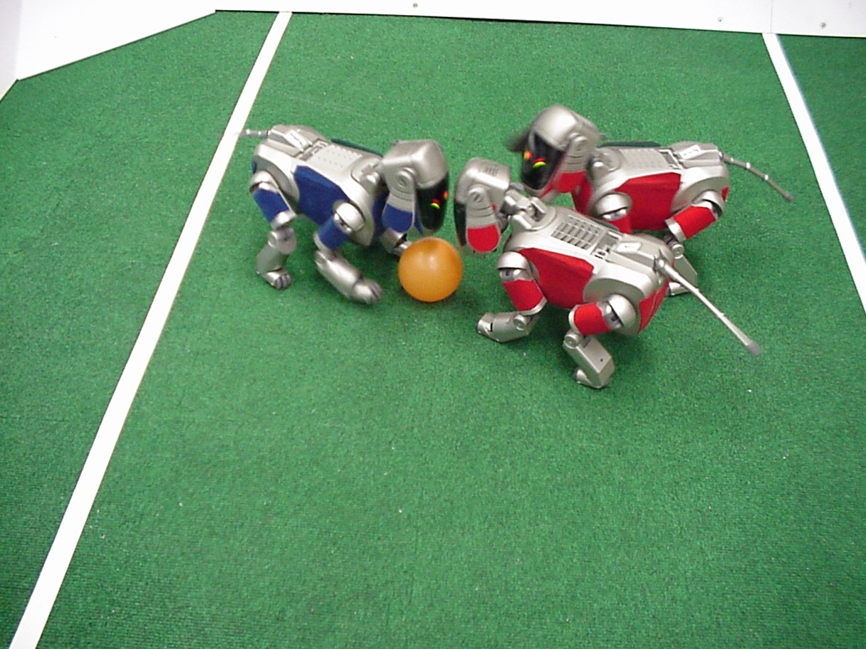
Robotics
NASA’s Mars Spirit Rover
http://en.wikipedia.org/wiki/Spirit_rover
http://www.robocup.org/
Source: S. Seitz

Slide 36
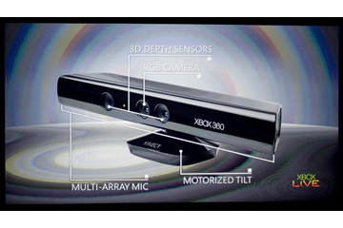
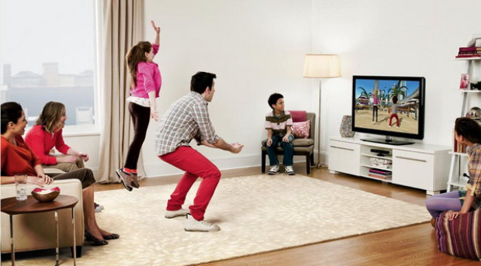
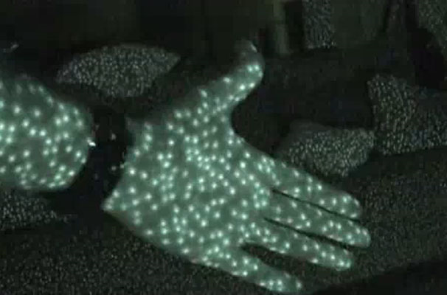
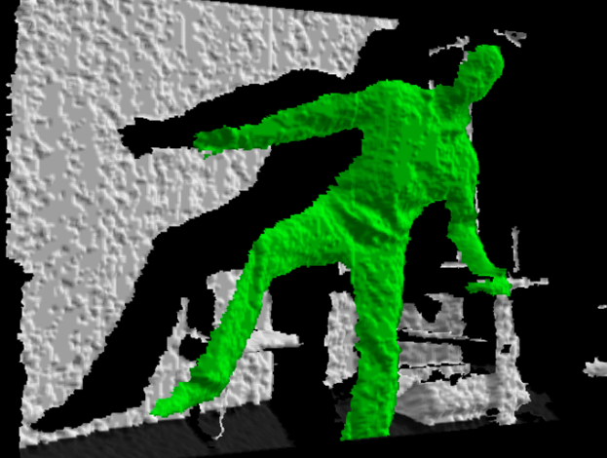
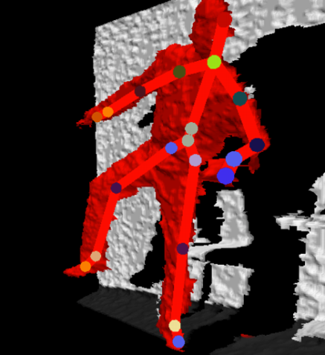
Vision-based interaction: Xbox Kinect
http://blogs.howstuffworks.com/2010/11/05/how-microsoft-kinect-works-an-amazing-use-of-infrared-light/
http://electronics.howstuffworks.com/microsoft-kinect.htm
http://www.ismashphone.com/2010/12/kinect-hacks-more-interesting-than-the-devices-original-intention.html
http://www.xbox.com/en-US/Live/EngineeringBlog/122910-HowYouBecometheController
Source: L. Lazebnik

Slide 37

Augmented Reality

Slide 38
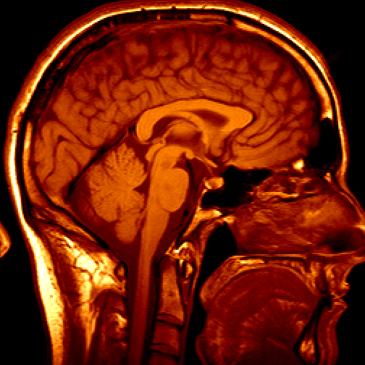
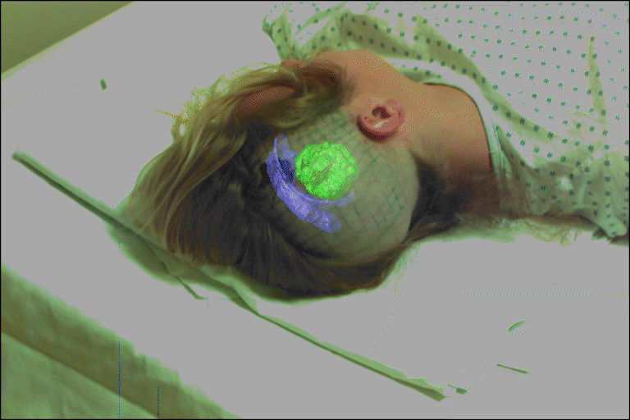
Medical imaging
3D imaging
MRI, CT
Image guided surgery
Grimson et al., MIT
Source: S. Seitz

Slide 39
The computer vision industry
A list of companies in the different areas of computer vision is maintained by D. Lowes
http://www.cs.ubc.ca/spider/lowe/vision.html

Slide 40
History and Challenges in Computer Vision

Slide 41
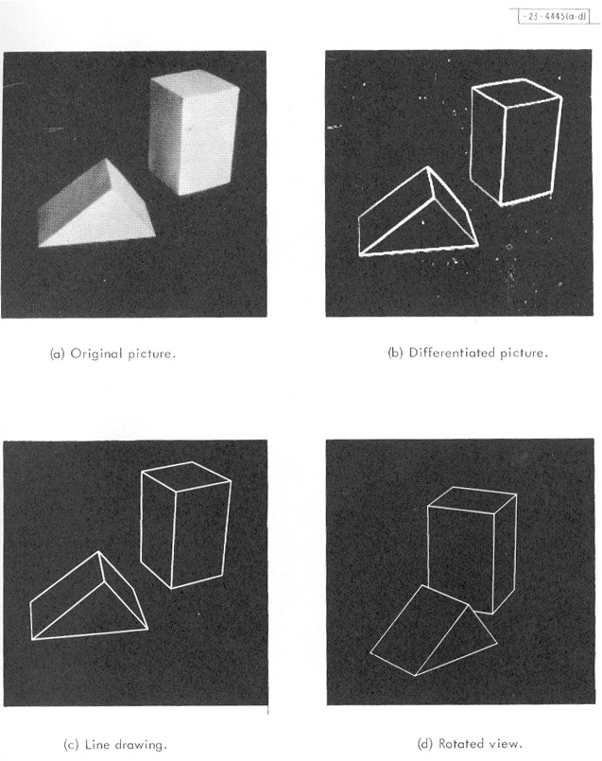
Origins of computer vision
L. G. Roberts, Machine Perception of Three Dimensional Solids, Ph.D. thesis, MIT Department of Electrical Engineering, 1963.
Source: L. Lazebnik

Slide 42
Connections to other disciplines
Artificial Intelligence
Robotics
Machine Learning
Computer Vision
Computer Graphics
Cognitive science
Neuroscience
Image Processing
Source: L. Lazebnik

Slide 43


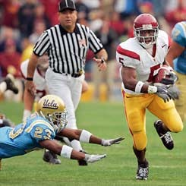



























Why study computer vision?
Vision is useful: Images and video are everywhere!
Personal photo albums
Movies, news, sports
Surveillance and security
Medical and scientific images
Source: L. Lazebnik

Slide 44
Why study computer vision?
Vision is useful
Vision is interesting
Vision is difficult
  Half of primate cerebral cortex is devoted to visual processing
  Achieving human-level visual perception is probably “AI-complete”
Source: L. Lazebnik

Slide 45



Challenge: Viewpoint Change
Michelangelo 1475-1564
slide: Fei-Fei, Fergus & Torralba

Slide 46
Challenge: Illumination
image credit: J. Koenderink

Slide 47

Challenge: Scale
slide credit: Fei-Fei, Fergus & Torralba

Slide 48

Challenge: Deformation
Xu, Beihong 1943
slide credit: Fei-Fei, Fergus & Torralba

Slide 49

Challenge:
Occlusion
Magritte, 1957
slide credit: Fei-Fei, Fergus & Torralba

Slide 50

Challenge: Background Clutter

Slide 51

Challenge: Motion
slide credit: Fei-Fei, Fergus & Torralba

Slide 52






Challenges: object intra-class variation
slide credit: Fei-Fei, Fergus & Torralba

Slide 53


Challenge: local ambiguity
slide credit: Fei-Fei, Fergus & Torralba

Slide 54
Challenges or opportunities?
Images are confusing, but they also reveal the structure of the world through numerous cues
Our job is to interpret the cues!
Image source: J. Koenderink

Slide 55

Depth cues: Linear perspective
slide: : S. Lazebnik

Slide 56

Depth cues: Aerial perspective
slide: : S. Lazebnik

Slide 57

Depth ordering cues: Occlusion
Source: J. Koenderink

Slide 58

Shape cues: Texture gradient
slide: : S. Lazebnik

Slide 59

Shape and lighting cues: Shading
image: E. Prados

Slide 60
Position and lighting cues: Cast shadows
Source: J. Koenderink

Slide 61

Grouping cues: Similarity (color, texture, proximity)
slide: : S. Lazebnik

Slide 62

Grouping cues: “Common fate”
Image credit: Arthus-Bertrand (via F. Durand)

Slide 63


Inherent ambiguity of the problem
Many different 3D scenes could have given rise to a particular 2D picture
Possible solutions
  Bring in more constraints (more images)
  Use prior knowledge about the structure of the world
Need a combination of geometric and statistical methods
slide: : S. Lazebnik

Slide 64
776 Computer Vision
Instructor: Jan-Michael Frahm (jmf@cs.unc.edu)
Office hours: By appointment, FB 246
Webpage: www.cs.unc.edu/~jmf/Teaching.html
Suggested textbooks
Hartley & Zisserman, “Multiple View-Geometry in Computer Vision”, Cambridge University Press, March 2004
Richard Szeliski, “Computer Vision: Algorithms and Applications, (online)

Slide 65
Course Requirements
Hands on work for experiencing computer vision
Programming assignments 45%
  multiple assignments
  Matlab & Python (only using brew installable packages, clearly specifying packages)
Final assignment 25%
Class participation 30%
  attendance
  questions (asking and answering)

Slide 66
Collaboration Policy
You can discuss and brainstorm in groups but the programming has to be done on an individual basis
You can use sources on the web as long as it does not make things trivial. All sources used must be identified.
No copying or replicating of other existing solutions

Slide 67
Course Overview
Geometry
  Imaging
  Single View Characteristics
  Two View Geometry
  Robust Estimation
  Structure from motion and dense depth

Slide 68
Course Overview
Recognition
  Traditional Recognition
    Face detection
    Segmentation
    Attributes
  Deep Learning for Recognition

