Slide 1
COMP 110-003
Introduction to Programming
For Statement and More Loops
February 12, 2013
Haohan Li
TR 11:00 – 12:15, SN 011
Spring 2013

Slide 2
Review: While Statement
While statement
while (boolean condition expression) { body statements; }
Do-while statement
do { body statements; } while (boolean condition expression);

Slide 3
Review: While Statement
If we want to repeat some actions for a given number of times
We need to count using a while loop
The code will look like this:
number = keyboard.nextInt();
int count = 1;
while (count <= number) {
// all the actions
count++;
}

Slide 4
Review: While Statement
If we want to repeat some actions for a given number of times
We need to count using a while loop
The code will look like this:
There are three lines referring count
number = keyboard.nextInt();
int count = 1;
while (count <= number) {
// all the actions
count++;
}

Slide 5
For Statement
Is there a better way to organize the code?
For statement (or usually called for loop)
Used to executes the body of a loop a fixed number of times
number = keyboard.nextInt();
count = 1;
while (count <= number) {
// all the actions
count++;
}
number = keyboard.nextInt();
int count;
for (count = 1; count<=number; count++) {
// all the actions
}

Slide 6
For Statement
Syntax:
for (Initializing_Action; Boolean_Expression; Update_Action){ Body; }
for (count = 1; count <= number; count++) {
// all the actions
}

Slide 7
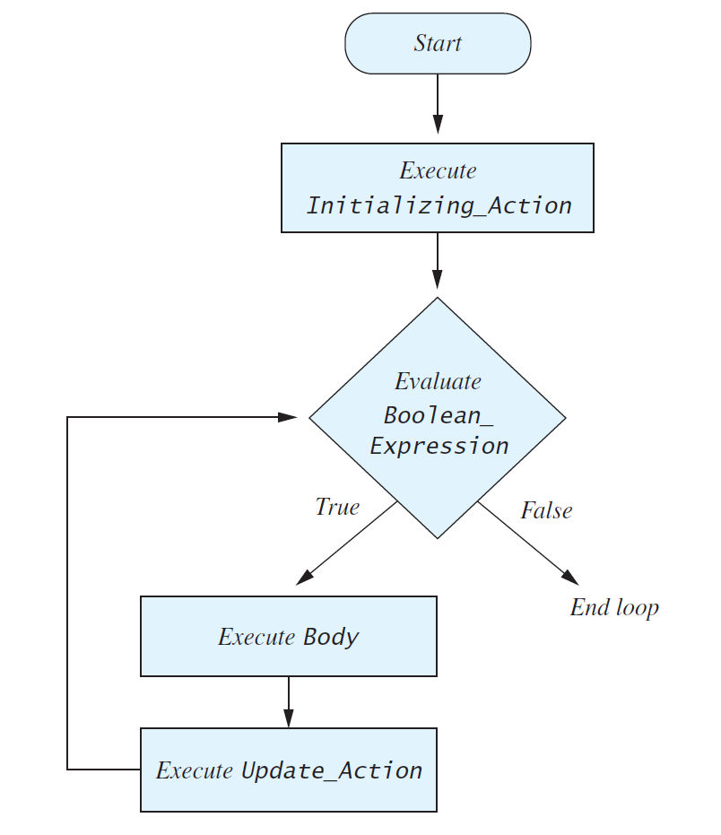
For Statement
Flow chart
for (Initializing_Action; Boolean_Expression; Update_Action){ Body; }

Slide 8
For Statement
Unrolled code
count = 1; // initialize for only once
if (count <= 2) {// count == 1, so yes
// all the actions
count++;
}
if (count <= 2) {// count == 2, yes again
// all the actions again
count++;
}
if (count <= 2) {// count == 3, so no
// no action again;
// no count++ again;
}
// stop
for (count = 1; count<= 2; count++) {
// all the actions
}

Slide 9
Local Variable
The counter can be defined in the for loop
That counter variable will be only available in this loop
It is undefined out of the loop
Although you can, it is really bad idea to name the count variable the same as other variable out of the loop
for (int i = 1; i <= 100; i++) {
// all the actions
}
System.out.println(i);
//WRONG! i is not available out of the loop

Slide 10
Local Variable
Local variables can also be defined in if and while statements
These variables are invalid out of the statement
if (true) {
int temp = 0;
}
do {
int temp2 = 2;
} while (false);

Slide 11
For Loop: Don’t Overcount
Repeat 3 times
Repeat 3 times
Repeat 4 times!
for (int count = 1; count <= 3; count++) {
// all the actions
}
for (int count = 0; count < 3; count++) {
// all the actions
}
for (int count = 0; count <= 3; count++) {
// all the actions
}

Slide 12
For Loop: Infinite Loop
Still, if you get things wrong, it may never end
int num = 3;
// initializing action; boolean expression; update action
for (count = 5; count >= num; count++)
{
System.out.print(count + “, ”);
}

Slide 13
For Loop: Case Study
Let the user input 10 numbers, then output the sum of those numbers
Write your program
It’s suggested that you don’t use eclipse
Don’t run the program until I ask you to

Slide 14
For Loop: Case Study
Let the user input 10 numbers, then output the sum of those numbers
WHY?
Sum = 0
Get user input
sum = sum + input
Get user input
sum = sum + input
Get user input
sum = sum + input
Output sum

Slide 15
For Loop: Case Study
Let the user input 10 numbers, then output the sum of those numbers
1111, 2222, 3333, 4444, 5555, 6666, 7777, 8888, 9999, 12345

Slide 16
For Loop: Case Study
Let the user input 10 numbers, then output the sum of those numbers
1111, 2222, 3333, 4444, 5555, 6666, 7777, 8888, 9999, 12345
The sum should be 62340

Slide 17
For Loop: Case Study
Let the user input 10 numbers, then output the sum of those numbers
import java.util.Scanner;
public class input {
public static void main(String[] args) {
Scanner keyboard = new Scanner(System.in);
int sum = 0;
for (int i = 1; i <= 10; i++) {
System.out.println("Please enter a new number (" + i + " of 10):");
int input = keyboard.nextInt();
sum += input;
}
System.out.println("Total sum is: " + sum);
}
}

Slide 18
For Loop: Case Study
Let the user input 10 numbers, then output the sum of those numbers
import java.util.Scanner;
public class input {
public static void main(String[] args) {
Scanner keyboard = new Scanner(System.in);
int sum = 0;
for (int i = 1; i <= 10; i++) {
System.out.println("Please enter a new number (" + i + " of 10):");
int input = keyboard.nextInt();
sum += input;
}
System.out.println("Total sum is: " + sum);
}
}

Slide 19
For Loop: Case Study
What’s wrong with this piece of code?
import java.util.Scanner;
public class input {
public static void main(String[] args) {
Scanner keyboard = new Scanner(System.in);
for (int i = 1; i <= 10; i++) {
int sum = 0;
System.out.println("Please enter a new number (" + i + " of 10):");
int input = keyboard.nextInt();
sum += input;
}
System.out.println("Total sum is: " + sum);
}
}

Slide 20
For Loop: Case Study
What’s wrong with this piece of code?
import java.util.Scanner;
public class input {
public static void main(String[] args) {
Scanner keyboard = new Scanner(System.in);
for (int i = 1; i <= 10; i++) {
int sum = 0;
System.out.println("Please enter a new number (" + i + " of 10):");
int input = keyboard.nextInt();
sum += input;
}
System.out.println("Total sum is: " + sum);
}
}
Syntax error & logical error

Slide 21
For Loop: Case Study
Let the user input 10 numbers, then output the product of those numbers
import java.util.Scanner;
public class input {
public static void main(String[] args) {
Scanner keyboard = new Scanner(System.in);
int product = 0;
for (int i = 1; i <= 10; i++) {
System.out.println("Please enter a new number (" + i + " of 10):");
int input = keyboard.nextInt();
product *= input;
}
System.out.println("Total product is: " + product);
}
}

Slide 22
For Loop: Case Study
Let the user input 10 numbers, then output the product of those numbers
import java.util.Scanner;
public class input {
public static void main(String[] args) {
Scanner keyboard = new Scanner(System.in);
int product = 1;
for (int i = 1; i <= 10; i++) {
System.out.println("Please enter a new number (" + i + " of 10):");
int input = keyboard.nextInt();
product *= input;
}
System.out.println("Total product is: " + product);
}
}

Slide 23
Ending a Loop
If you know number of loop iterations?
Count-controlled loops
for(count = 0; count < iterations; count++)
User controlled ending
Ask-before-iterating (e.g. “yes/no”)
Sentinel value

Slide 24
Count-Controlled Loop
We’ve seen it
for (count = 1; count <= number; count++) {
// all the actions
}

Slide 25
Ask-Before-Iterating
Quit loop when the input is not yes
Why don’t we initialize answer?
String answer;
do {
// do stuff in your code here
System.out.print("Continue? yes/no");
answer = keyboard.next();
} while (answer.equalsIgnoreCase("yes"));

Slide 26
Ask-Before-Iterating
Quit loop when the input is not yes
Using a while loop
answer has to be initialized
String answer = "YES";
while (answer.equalsIgnoreCase("yes")) {
// do stuff in your code here
System.out.print("Continue? yes/no");
answer = keyboard.next();
}

Slide 27
Ask-Before-Iterating
Quit loop when the input is negative
Think about initializations – is this the best way to do it?
System.out.print("enter a negative number to end the loop");
int next = keyboard.nextInt();
int sum = 0;
while (next >= 0) {
sum = sum + next;
System.out.print("enter a number");
next = keyboard.nextInt();
}

Slide 28
Nested Loop
There can be a loop inside another loop
Mostly for loops
int count, count2;
for (count = 0; count <= 3; count++)
for (count2 = 0; count2 < count; count2++)
System.out.println(count2);

Slide 29
What is the Output?
int count, count2;
for (count = 0; count <= 3; count++)
for(count2 = 0; count2 < count; count2++)
System.out.println(count2);
1
0
2
Count =
3
4
Output will be 0, 0, 1, 0, 1, 2
Count2 =
3
Intuition: exhaustively list all possibilities
0
1
2

Slide 30
Understanding a For Loop
int count, count2;
for (count = 0; count <= 3; count++)
for(count2 = 0; count2 < count; count2++)
System.out.println(count2);
Think it in this way:
count goes from 0 to 3
count2 goes from 0 to count-1 (for every count’s value)
What values of count2 will be visited, or printed?

Slide 31
Another For Loop Example
Still, pay attention to brackets
for (int i = 0; i < 10; i++)
for (int j = 0; j < 10; j++)
System.out.print(i * 10 + j + ", ");
System.out.println("100.");
for (int i = 0; i < 10; i++) {
for (int j = 0; j < 10; j++){
System.out.print(i * 10 + j + ", ");
}
}
System.out.println("100.");

Slide 32
Another For Loop Example
What does this piece of code do?
Run it and see if your guess is good
for (int i = 1; i <= 10; i++)
for (int j = 1; j <= 10; j++)
System.out.print(i * 10 + j + ", ");

