Slide 1
RightView Pro
By Matt Orth

Slide 2
What is it?
A training system for baseball and softball that allows you to analyze your swing or pitching motion and also compare your swing or motion to professional models.
RVP allows you to get immediate feedback with state of the art video analysis.

Slide 3
The RVP Systems
There are 3 different types of systems
The IS300
The CE300
The CV300

Slide 4
The CV300
This system is primarily used by youth coaches and individuals
It is designed to be used in your own home

Slide 5
The CE300
This system is primarily used for High School coaches
This edition provides much more speed and organization to create more real-time teaching for the coaches and players

Slide 6
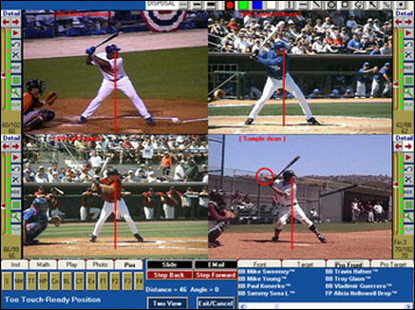
The IS300
This system is used primarily by professionals, college athletes, and training facilities
It has all the features necessary to run a business, camp, or a clinic

Slide 7
The RVP instruction series
Contains a series of short and concise lessons that walk the user through a specific skill
Instructs the user on what to look for, explaining what is important and it suggests analogies and drill to help reinforce the correct moves
The instruction series was designed to help coaches and players understand how to analyze the motion and then illustrate or communicate where improvement can be made.

Slide 8
The Hitting Equation
RVP puts the games’ best hitters at the plate to show how they combine the three measures of the swing - force, big zone, and efficiency.
Force (Power) – How much force is generated and delivered into the ball.
Big Zone (Contact) – The longer the bat stays through the plane of the pitch, the greater the chances for success.
Efficiency (Time and Energy) – The more efficient the batter, the more time and energy available to focus on how, when and where to make contact. Any jerk in the swing is an inefficient adjustment to the speed and location of the pitch.
http://www.youtube.com/watch?v=ZSvA-9khajA

Slide 9
Pitching Mechanics
RVP breaks down your mechanics into 12 steps
Compare your mechanics to MLB pitchers
http://www.youtube.com/watch?v=Ks_D6s65vLo
Power – The mechanics of generating arm speed
Control – The principles that enable a pitcher to have a consistent, repeatable delivery.
Deception – The ability to change speeds, create movement, and minimize any "tells" to the hitter.

Slide 10
Player Roster
The RVP Systems use a great number of the professional players as models.
With the IP300-AS series, the pro series, The RVP Instruction Player All-Star Baseball contains a series of 59 easy-to-follow video clips, each about one-three minutes long
Each clip can be selected and played pertaining to a specific area of the swing.
If you add this instruction player to any one of the RVP analysis systems, you will be to able to analyze the swings of all Major league players from up to 4 different angles and at 60fps

Slide 11
Continued
With the series Pv300, the collegiate system, you are able to analyze up to 25 major league hitters. You will be able to analyze the swings of all the players from up to 4 different angles and at 60fps.
With the Cv300, the basic system, you are only able to analyze up to 17 major league players

Slide 12
Required Equipment
RightView Pro's Software is designed to be highly compatible with nearly every computer and camera
You can use either a MiniDV camera or a Hard Drive camera.

Slide 13
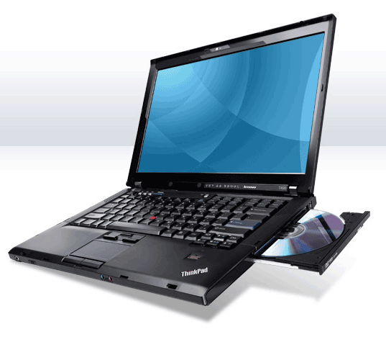
COMPUTER
Minimum System Requirements include…
-Windows xp
-Windows Vista
-Windows 7 which is preferred
-windows 8

Slide 14
Computer
With the basic system, CE3000, you need to have windows 7 or 8
20 GB available disk space
CD-R Drive (or higher)
the CE300 can capture up to two streaming videos simultaneously

Slide 15
Computer
With the IS300, the stadium edition, you need….
-Intel Core Duo or Intel Core 2 Duo or equivalent (i3 or higher recommended)
Windows 7, Vista or XP
2 - 4 GB RAM
40 GB available disk space
CD/DVD-RW Drive
-for 2 camera operations you will need both an internal and external firewire port

Slide 16
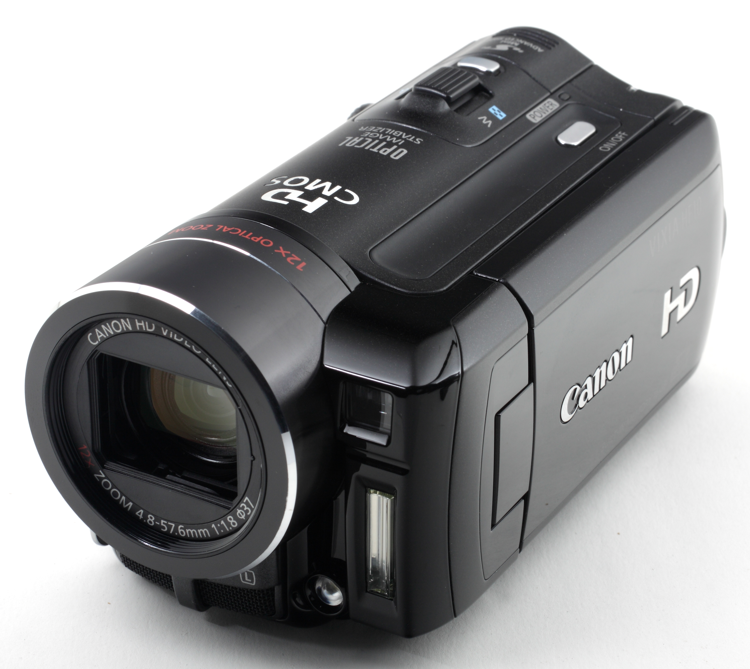
Camcorders
If you want to stream live, a camcorder is what you use
if you want to stream footage live into your computer you will need one of these options…..
1. MiniDV camera + Firewire + Firewire port on your Computer
2. Hard Drive Camera + Firewire + Canopus Box + Firewire Port on your Computer
-RVP recommends you use a cannon Vixia HV40

Slide 17
Camcorders
The Cannon Vixia is recommended because…
It has 10x, 20x, 30x Optical Zoom
External microphone for Is300 users
Has a Remote
High Shutter Speed of 1/1000 or higher
3 CCD camcorder for better color quality

Slide 18
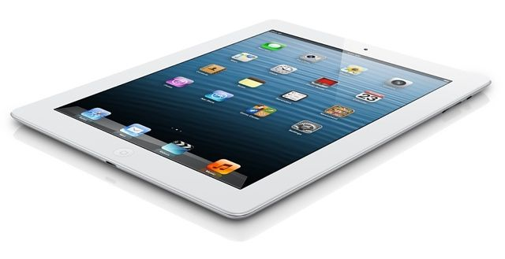
Mobile Devices
You can use Ipad, Iphone or any android device
The mobile device camera will have blur in the bat and pitching motion, because you are not able to manipulate the shutter speed
If you have bright lighting you will capture better footage.
It will also be 30 frames per second compared to the 60 frames per second that you are used to on your analysis system

Slide 19
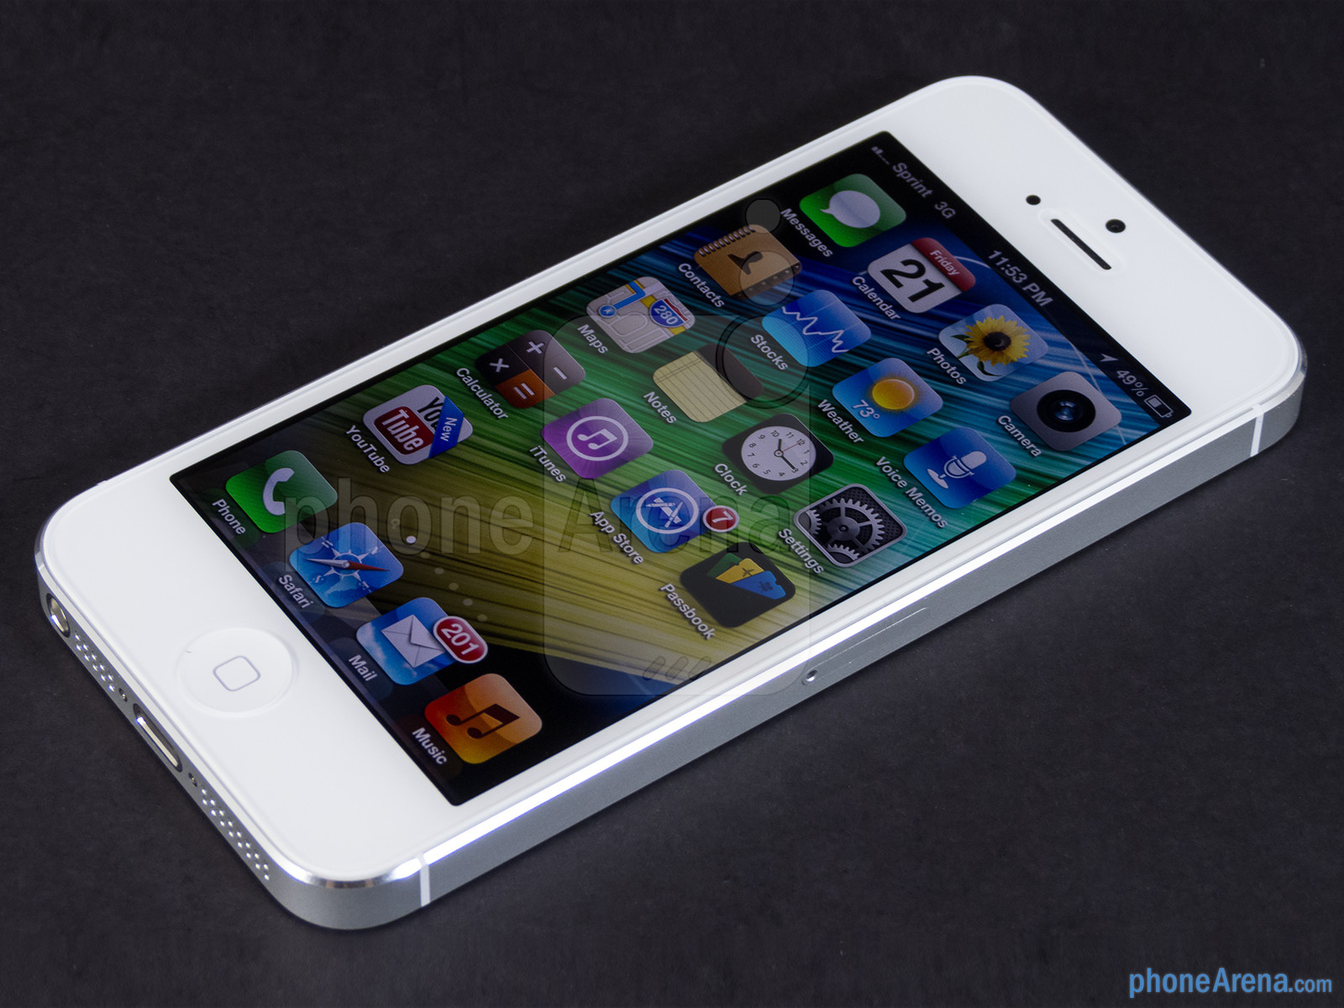
Mobile Devices
you probably won’t be analyzing “bat path” with the iPad for example, you will be able to analyze bigger motions like posture, negative move, bat angle or pressure between the knees.
It’s a great “quick feedback” tool, but it’s not your “end all, be all”.

