Slide 1
Behind the scenes of VR
Chris and Keerthi

Slide 2
Genesis of Virtual Reality
Virtual reality was primarily known as Virtual World
While working with Ivan Sutherland, Jaron Lanier thought that the term Virtual Reality is more of an accurate term than Virtual World.
This is because people are treating this view as their reality.

Slide 3
What is VR?
Webster defined as: “an artificial environment which is experienced through sensory stimuli (as sights and sounds) provided by a computer and in which one's actions partially determine what happens in the environment”
Usually: computer generated 3D that a user can interact with
  User normally wears glasses or a head-mounted display (HMD)
  Recently haptic devices provide feedback

Slide 4

First Forms of Virtual Reality
The first forms of Virtual Reality were created during the 1860’s in the form of panoramic 360° murals.
Baldassare Peruzzi
Sala Delle Prospettive

Slide 5
The sensorama!
During the 1950’s Morton Heilig wrote of an “experience theater” that used sight, smell, touch, and sound. He created a prototype of this vision and called it the sensorama.

Slide 6
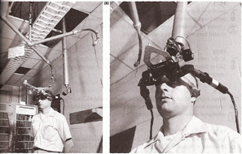
First headset
In 1968, Ivan Sutherland and Bob Sproull created the first virtual and augmented reality head-mounted display system. This system was so heavy that it had to be suspended from the ceiling.

Slide 7
More Amazing VR Developments
Aspen Movie Map of 1977 created by MIT is also one of the hypermedia and Virtual Reality systems.
During the 1980’s the term “Virtual Reality” was coined and popularized by Jaron Lanier.
In 1991, Antonio Medina, a MIT graduate and NASA Scientist, designed a virtual reality system to “drive” Mars rovers from Earth.

Slide 8
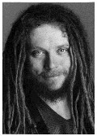
Founding Father-Jaron Lanier
Jaron Lanier is a computer scientist, composer, visual artist, and author.
Coined and popularized the term “Virtual Reality” during the early 1980’s.
IEEE Virtual Reality Career Award in 2009
Named one of TIME's 100 most influential people
in 2010.

Slide 9

Feeling overwhelmed?

Slide 10
Benefits of VR
Currently used in many fields to assist workers
  used in military, fashion, business, engineering, health care, architecture, and much more.
Used to assist people with phobias and other disorders like PTSD
Entertainment in video games
Immediate feedback
Haptic Responses

Slide 11
VR in military training
Currently used by United States military in both training and recovery from war.
Soldiers are put into virtual environments to prepare for situations in war.
Have controller that acts similar to a weapon
In the air force, it is most used to train pilots
  Joystick provides haptic feedback from damages to the plane and even the effect of weather
http://www.youtube.com/watch?v=NND7Hk5fYdI

Slide 12
VR in education
Tucson Arizona has an entire class that makes virtual reality worlds.
http://www.cbsnews.com/8301-18563_162-57589958/innovative-ariz-class-turns-students-dreams-into-reality/
In East Hartford, Connecticut it is used to simulate work on virtual cars.
Helps children comprehend more about the real world.
Saves time and money.
Some schools do not believe that it is worth it.

Slide 13
VR in health
Healthcare is one of the biggest adopters of virtual reality which encompasses surgery simulation, phobia treatment, robotic surgery and skills training
One of the advantages of this technology is that it allows healthcare professionals to learn new skills as well as refresh existing ones in a safe environment. Plus it allows this without causing any danger to the patients

Slide 14
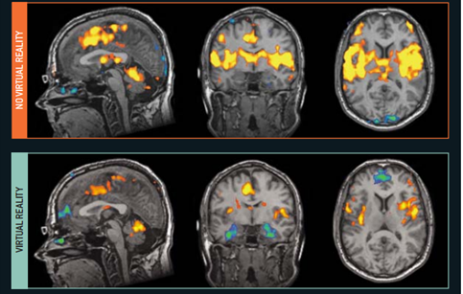
Virtual Reality Therapy
Burn patients
  University of Washington
  distract them from pain
  more real the virtual world, less pain

Slide 15
Virtual Reality Therapy Cont.
PTSD/Phobias
  Used Spider world to help cure arachnophobia
  Recreates events to help people deal with them
  Fort Bragg is testing out how VR can help marines with PTSD
  These virtual worlds are made very realistic to help emotionally handle the situation.
  Seat vibrates and controller is like a gun
  $30,000-$40,000

Slide 16

Helping you forget this as well

Slide 17
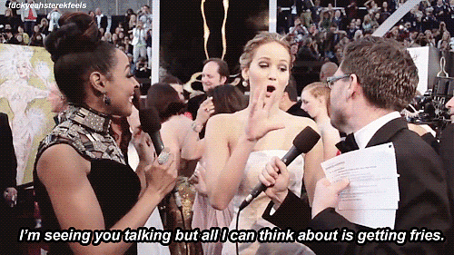

Slide 18
Costs of VR
Some people believe that advanced virtual reality will cut back on face-to-face interaction
Reliability on virtual training
Actual cost for households
  (HMD)
  Haptic Glove
  Head trackers
  software
  http://www.vrealities.com/
$599
$585
$750
$325

Slide 19
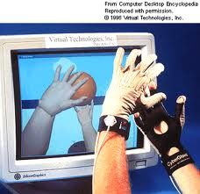
Data Gloves, Sensors,
Gloves
covered in sensors
allow more freedom in
movement
  possibility outside of gaming ASL translation
allows for haptic feedback and more involvement in virtual world

Slide 20
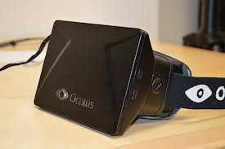
HMD’s
needed for virtual reality
measures head movement
recent developments in Oculus Rift
farther field of vision
adjusted lenses/ magnification
$300
Expected around December this year.

Slide 21
Ethical issues of VR
VR games with violence and guns influencing the player
distinguishing reality from virtual reality becoming more difficult
influence on younger users
addiction to VR more than addiction to normal video games

Slide 22
Making VR
most companies focusing on PC software
texturing objects to make them appear more real
frame-rate needs to be about 25 frames per second
stereo vision often used to appear more realistic
so much goes into making the world realistic like lighting, definition, and even computer speed
much is still in the early stages of perfecting

Slide 23
Future of VR
Nanobots in possibly 25 years
  put into the body and interact with neurons to make experience completely real
  lots of doubt about this process
Household use if price goes down
More realistic environments
More applications in training

Slide 24
Conclusion
VR is still far from being perfected
it has many uses and has been around for quite a few years
becoming more innovative in its uses
cost saving once obtained, but very costly to get

Slide 25

May the odds be ever in your favor

