Slide 1
Computer Aided Sustainability and Green Computing
Bryan Iddings

Slide 2

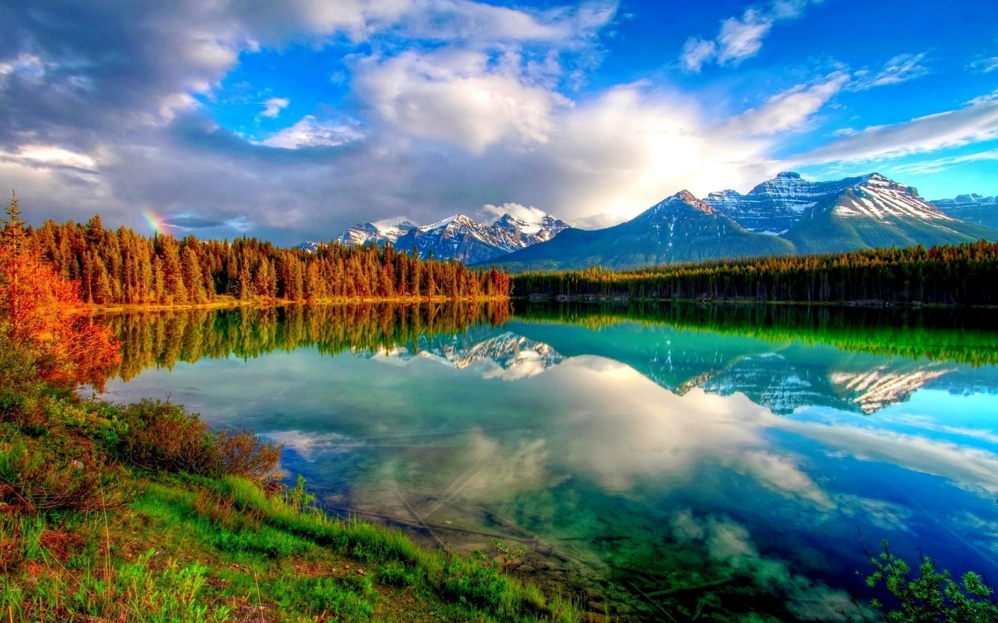
Motivation
Notes:
I wanted to do my presentation on this topic because I’ve always loved nature and environmentalism, and I wanted to do something to show the connection between technology and the environment. This actually directly relates to what I want to do after college, because I’m a computer science major with a minor in sustainability.

Slide 3
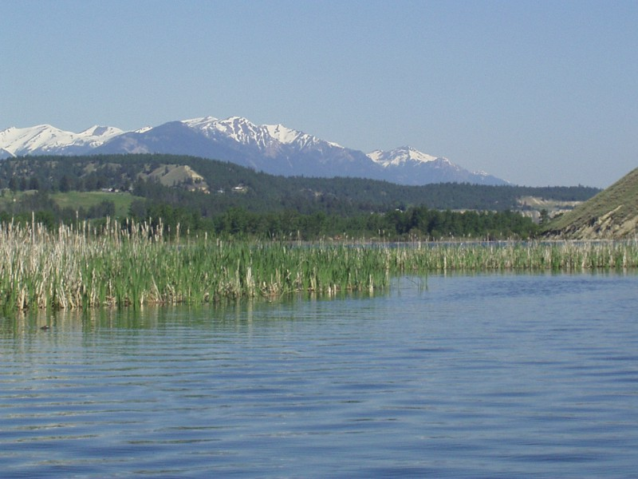
Sustainability
The use of a resource at a rate which allows the resource to replenish itself at least as fast as it is being used.
Notes:
This is a very specific definition for what has become a more general term encompassing many aspects of environmental concern like reducing wasted energy and reducing pollution, and overall the use of best management practices.

Slide 4

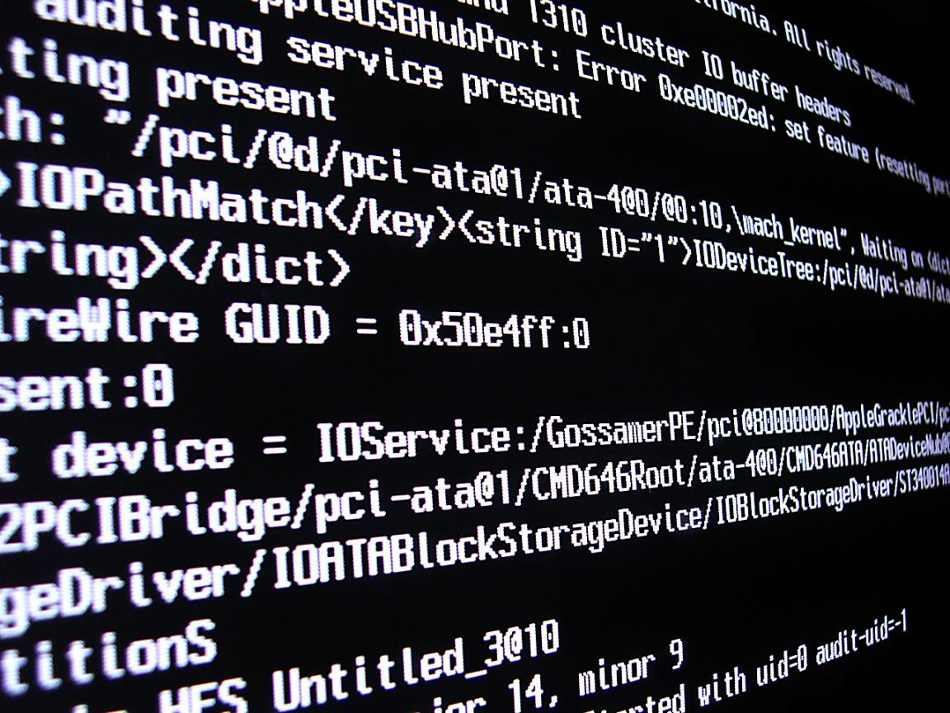
Computer Aided Sustainability vs. Green Computing
Computer Aided Sustainability – Use of computers to promote sustainable design.
Green Computing – Sustainable design of computers themselves.
Notes:
Computer Aided Sustainability – the use of technology to aid in making decisions towards sustainability. e.g. running simulations of the effects of creating or destroying a wetland, simulating the effects of a new development/the amount of resources required to build and maintain a new development, and the use of computers/IT to spread information regarding sustainable management and design.
Green Computing – directly improving the efficiency and sustainability of computers. e.g. designing more energy efficient computer components to reduce power consumption, or use less harmful chemicals in the production of components.

Slide 5
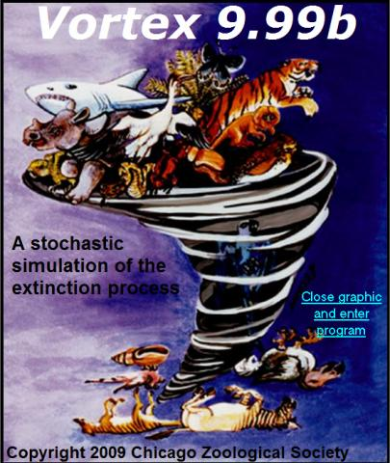
Population Viability Analysis Simulation
Vortex is an individual-based simulation of deterministic forces as well as demographic, environmental and genetic stochastic events on wildlife populations. It can model many of the extinction vortices that can threaten persistence of small populations. Vortex models population dynamics as discrete, sequential events that occur according to probabilities that are random variables following user-specified distributions. Vortex simulates a population by stepping through a series of events that describe an annual cycle of a typical sexually reproducing, diploid organism: mate selection, reproduction, mortality, increment of age by one year, dispersal among populations, removals, supplementation, and then truncation (if necessary) to the carrying capacity. The simulation of the population is iterated many times to generate the distribution of fates that the population might experience.
Source: Vortex inc.
Notes:
PVA – measure/estimation of the viability of a population based on many factors i.e. (available resources, rate of use of resources, population growth, etc.), in other words, it can be used to simulate how long a population will survive at their current rate of resource consumption.

Slide 6

Internet Technology
Computers can be used to create and host websites to spread information on sustainability and maintaining sustainable practices.
Many times people don’t utilize best management practices simply because they don’t know how.
The best way to reduce our impact
on the environment is to spread
information so that everyone
knows the impact of their actions,
and what they can do to reduce
those impacts.
Notes:
Examples include EPA.gov, social networking sites, theGreenists.com, and many others.

Slide 7

Green Computing Approaches
Hardware
  Energy Use
  Product Longevity
  Material Selection
Software
  Efficient Design
Notes:
Energy Use – Using components that require less power
Product Longevity – Designing products to last a long time to reduce landfill impact and total resource usage.
Material Selection – Designing products with materials that a) don’t require a lot of energy to acquire b) don’t put the environment at risk once they are disposed of

Slide 8

Algorithmic Efficiency
Use of shorter more efficient algorithms to reduce the amount of computing power
required to complete
a task. This reduces
the amount of energy
required, to complete
a task by reducing the
number of smaller
tasks that must be
executed.

Slide 9
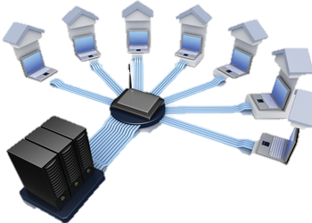
Virtualization
Virtualization is the process of running multiple virtual machines on a single physical system. For example, a powerful enough system can run many instances of an OS on emulated hardware through virtualization. This allows a reduction in power consumption due to less total hardware, and less cooling costs.

Slide 10
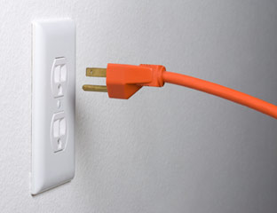
Smart Power Management
A computer can detect when a specific piece of hardware is not being used and shut it down to save power. For example, many computers shutdown their hard drives when they aren’t in use. Computers can also reduce the clock speed of a processor when high performance is not needed to reduce power. Laptops will reduce screen brightness when they are idle to save power as well.

Slide 11
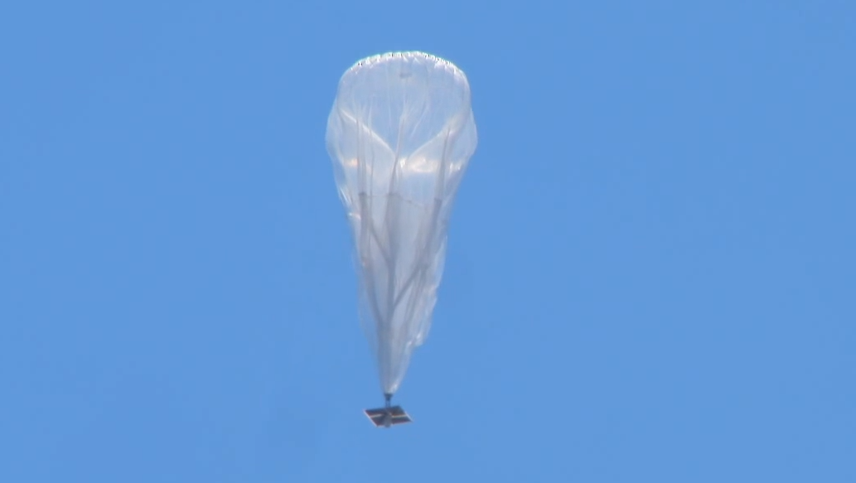
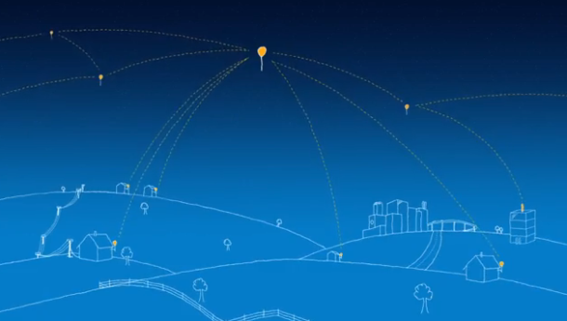
Project Loon
YouTube
Notes:
Project loon contributes to both computer aided sustainability and green computing. It expands the amount of people connected to the internet, which allows more and more people to gain access to websites like the EPA’s that have information regarding sustainable practices. It is also represents green computing because it is completely solar powered making it 100% sustainable, and ensuring it has almost no environmental impact.

Slide 12
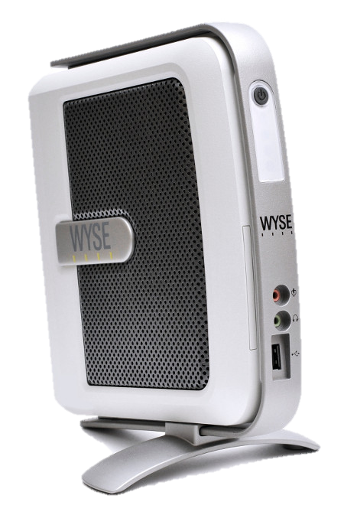
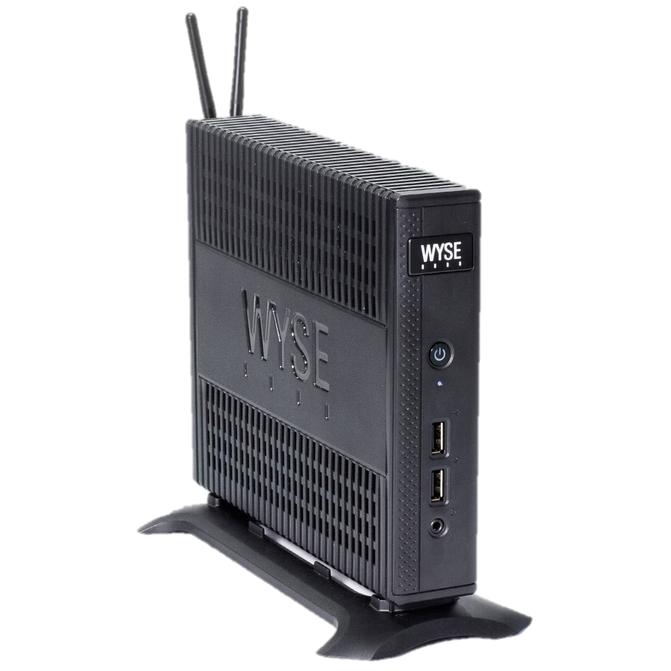
WYSE Technology
YouTube (BBC)

Slide 13
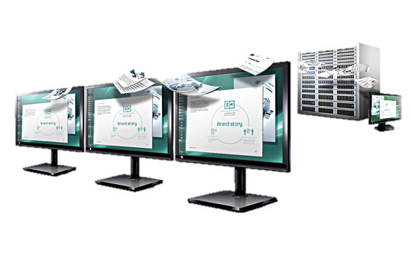
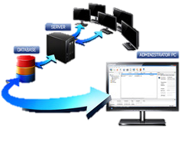
Samsung Cloud Display
YouTube (Samsung)

Slide 14
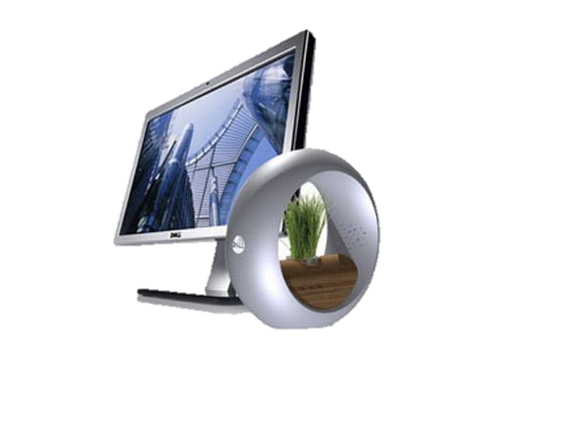
Future of Green Computing
Green computing is continuing to advance as more and more of an emphasis is being placed on conservation and sustainability. The biggest key to continuing to reduce the ecological footprint of computers and technology is continuing to optimize both hardware and software to run as efficiently and with as little wasted energy as possible.

