Slide 1
The Effects of Video Gaming
Daniel Larimore

Slide 2
What is Video Gaming?
Video gaming is a common hobby that is done by many age groups and crosses international borders.
Video gaming is any action taking place in a realistic virtual setting that allows a person to take control of a person or an object and perform functions specific to each game.

Slide 3
How many people play video games of any kind?
63% of the people living in the United States play video games (according to the National Purchase Diary)
This translates to 70% of the people living worldwide play video games, which is about 4.932 billion people (according to the National Purchase Diary and the United States Census Bureau)

Slide 4
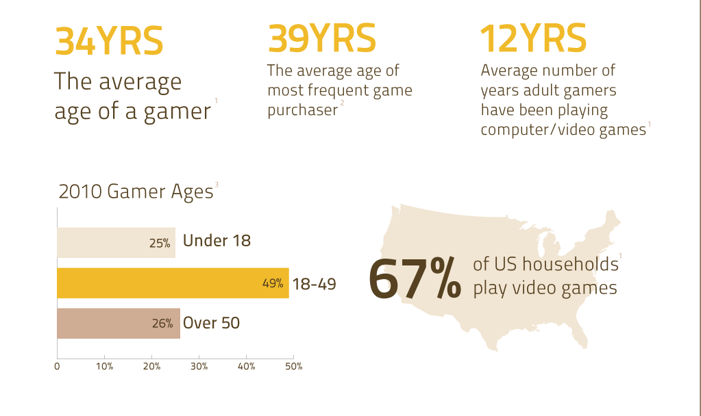

Slide 5
The Video Game Industry
The video game industry is rapidly growing and has become one of the largest industries of manufacturing worldwide.
Around 14 billion dollars in revenue was made last year, which is increasing each year with expected growth to be around 16 billion dollars in revenue this year alone.

Slide 6
Platforms for Playing Video Games
Console based games
Online based games
Joystick based games

Slide 7
Console Based Games
Console based games include the style of gaming that involves a console and some form of controller.
Types of consoles are:
Nintendo Wii
Playstation 3
Xbox One

Slide 8
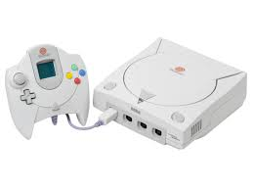

Slide 9
Online Based Games
Online based games are all played on the computer, however some games are not played by accessing the internet.
The basic functions that control game play for online based game style is the mouse and the keyboard.

Slide 10
Joystick Based Games
These are the most rare platform of gaming preference now because the other kinds are nicer and more convenient.
The only forms left of joystick based games are found in arcades and a big systems that are tougher to move and the graphics are not at the level of the online or console based games.

Slide 11
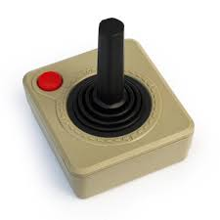

Slide 12
What are the different types of video games?
There are many different types of video games which include:
Massively Multiplayer Online
Role Playing Games
First Person Shooter
Multiplayer Online Battle Arena

Slide 13
Massively Multiplayer Online Games
Most often referenced to as MMO’s.
These games are played on the computer and are often played with other people online in servers that allow large numbers to play and interact at once.
Common MMO’s include:
World of Warcraft
Star Wars: The Old Republic

Slide 14
Role Playing Games
Commonly referenced to as RPG’s.
A role playing game is on that involves the person taking control of a character in a fictional virtual setting that makes the game feel somewhat realistic, and are most commonly played on the computer.
Common RPG’s include:
Fable
Star Wars: Knights of the Old Republic

Slide 15
First Person Shooter
Also referenced as FPS’s.
These games involve the player taking control of a character that holds a gun or other form of projectile, which is the central focus of the game.
Also unlike the before mentions game genres, FPS’s can be played on consoles or on computers/online.
Common FPS’s include:
Call of Duty
Halo

Slide 16
Multiplayer Online Battle Arena Games
Also known as MOBA’s
MOBA’s are games that are played online on computers that have large servers, but interactions only occur within the specific arena being played in at the time.
Common MOBA’s include:
League of Legends
Smite

Slide 17
The Good

Slide 18
Brain Stimulation
Playing video games is a way of increasing brain stimulation from causing quick reactions to allow the player of the games to increase in skill.
Commonly people who play increased amounts of games are often called nerd, however this stereotype is not a myth because the people playing them often need critical thinking skills, which develop while playing the games.
Studies have shown that mental capacity is increased by playing a limited, but structured amount of video games.

Slide 19
Reaction Times
Video gaming is fast moving and involves quick reaction to be successful.
The reaction times developed with gaming have been shown to cause a person to react almost 10% quicker than someone who does not play video games.

Slide 20
A Way to Make Money
Video gaming is a profession now that allows those who are talented to perform on a level with other talented players.
Professional gaming is something that takes hard work and much practice just as other professional sports do.
Programs have even been made to give people that cannot find work a way to work by playing, officiating, or commentating on a live professional level.

Slide 21
A Hobby
The last reason why video gaming is a good thing is that is can be a hobby that relieves stress, much like any other hobby that relieves stress.
Families can have fun playing games, which is good, wholesome fun for everyone. Games are made for every demographic.

Slide 22
The Bad

Slide 23
Time Management
Time management is a large problem for some people, so adding gaming in the mix generally does not help, and often makes time management worse.
Self control is the only way to prevent the problems with time management.

Slide 24
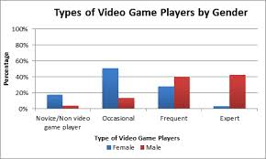

Slide 25
Sleep Deprivation
Many people that play video games do it late at night after all daily duties are done, and sometimes to relieve stress.
However, a majority of the people playing often lose to much sleep, which leads to other complications.
A way to avoid this is to have a set sleep schedule and to follow it, so gaming late at night does not cause sleep loss.

Slide 26
Weight Gain
Video gaming has led to increasing weight.
While sedentary and playing games, adding in sleep deprivation causes the body to be lethargic and causes fat absorption from foods, as well as less calories burned.
Making sure to balance and get an hour of exercise can counteract weight gain while gaming.
People who do not balance in exercise are the people that make up the 60% to 80% of people that play video games to gain weight and become overweight or obese.

Slide 27
The Ugly

Slide 28
Violent Natures
Studies show that the number of violent video games directly correspond to the increase in crime rates worldwide.
As a matter of fact video games played in large quantities leads to many people that have communication issues and violent natures.
The lack of playing after a long period of playing leads to rash decisions; some studies show.

Slide 29
Addiction
Perhaps the most ugly part of gaming is the fact that 10% of people that ever play a video game become addicted to playing them.
Addiction has led to the increased number of people needing therapy to stop the growing problem.
People with addictive natures are 75% more likely to become addicted to playing video games.
People that become addicted rely on playing video games and withdrawal from playing games has even led to death.

Slide 30
Overview

Slide 31
Good, Bad or Ugly
Arguments can be made for all three cases, but a majority of people find video games to be a negative hobby for people.
53% of Americans find video games to be bad for society, but only 14% of teenager believe video games to be bad.
Doctors now encourage patients to spend an hour or less playing games because of the direction society is heading and the dependency upon video games.

