Slide 1
The Evolution of Robotic Prosthetics
Sam Hammock & Nick Bui

Slide 2
Activity
Upper Body-Write on the Board & Throw Ball

Slide 3
Key Questions
What do you need for an effective prosthetic?
What makes a prosthetic effective?
How has the priority of prosthetics changed over time?
How has the psychosocial aspect of prosthetics changed over time?

Slide 4
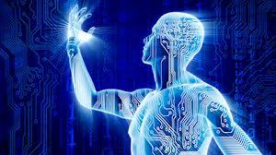
Psychosocial effects
older patients: harder to cope
younger patients: easier to adapt
cause of amputation matters
-appreciation for individuality
-depression and negative associations

Slide 5
What is a prosthetic?
Prosthetic: an artificial body part that serves to replace the cosmetic and functional processes of the initial limb
Internal
eg: total joint replacements
External
eg: for amputees
We are focusing on External Prosthetics

Slide 6
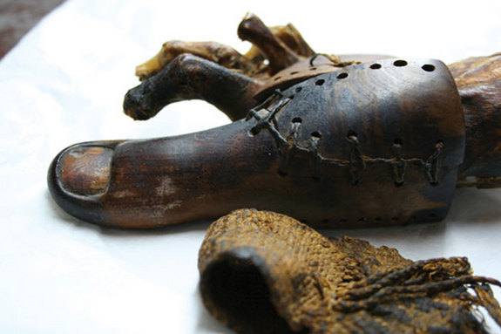
From the Very Beginning
-In 2000, an artificial big toe was found on the foot of an Egyptian mummy
named the Greville Chester
Great Toe that dates back
anywhere from 1295 to 664
B.C

Slide 7
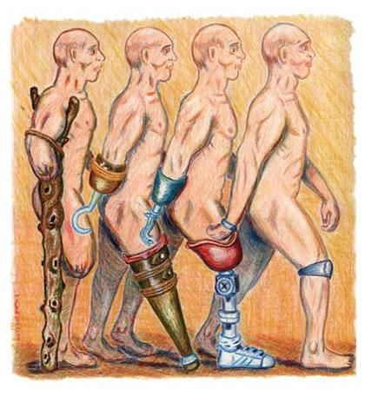
It’s been around for awhile...
-Greek and Roman Times
-little advancement throughout history
-evolution coincides with technological evolution

Slide 8

The Greeks and Romans
-In ancient times most Greeks and Romans only used prosthetics to hide their missing limbs and not for functionality
-Historical account of Marcus Sergius, a Roman general who lost his right hand in battle, making
a prosthetic hand out of iron to hold his
shield and returning to battle

Slide 9
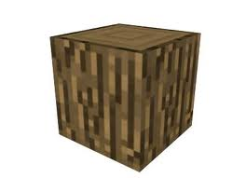
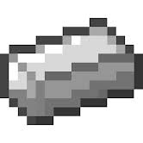

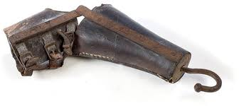
First Materials
-The earliest form of prosthetics were made out of wood and metal and held together by leather attachments and continued to be made this way for a long period of time
Supposed to be leather...
+ + = ???

Slide 10
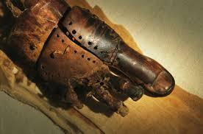
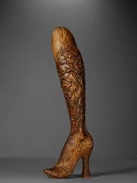
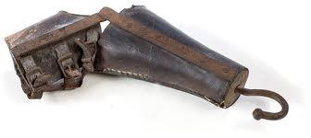
Wood, Metal, and Leather Limitations
Majority of evolutionary timeline
performed basic mechanics
extremely limited flexibility
minimal control

Slide 11
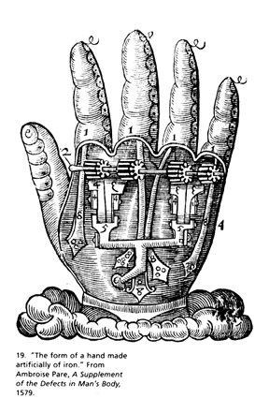
Progress - Ambroise Pare
-French military doctor Ambroise Pare
contributed some of the first major advances in
prosthetics in the early 16th century
-Pare invented a hinged mechanical hand that
used catches and springs as well as prosthetic
legs that featured locking knees and specialized attachment harnesses

Slide 12
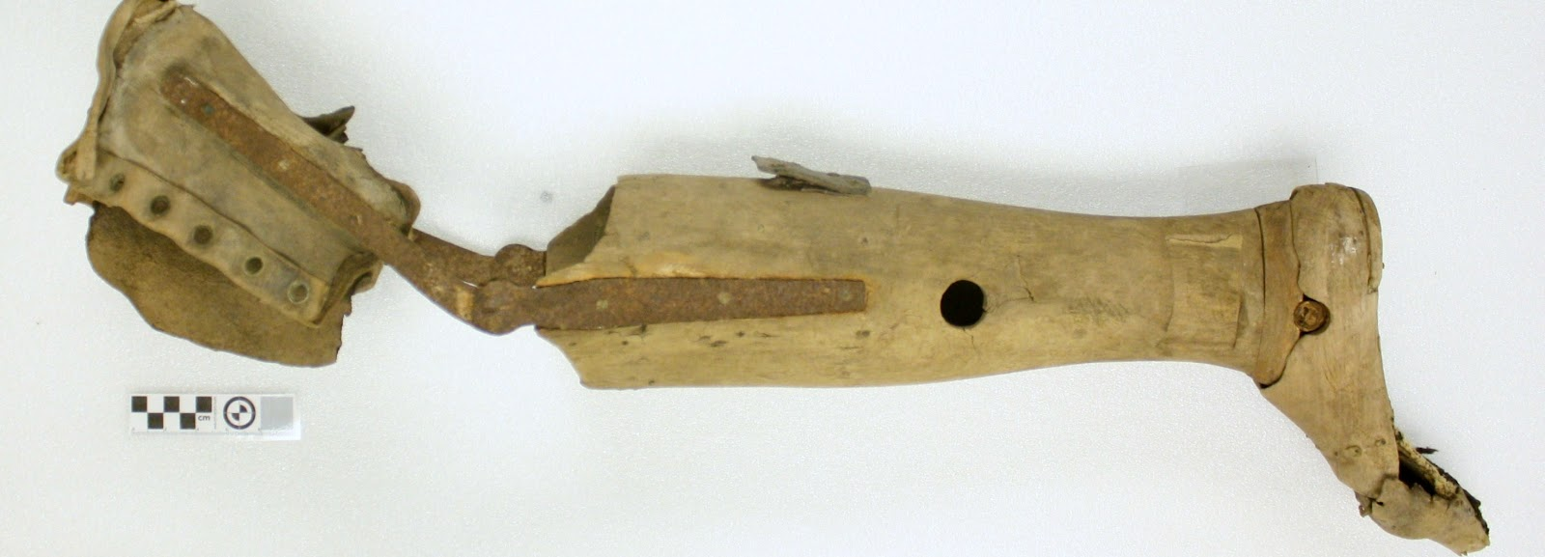
More Progress - Pieter Verduyn
-Around the 1690s a Dutch surgeon, Pieter
Verduyn, developed a lower leg prosthetic with specialized hinges and a leather cuff for
improved attachment to the body
-Verduyn’s and Pare’s contributions to
prosthetics are common features in many
modern day prosthetics

Slide 13
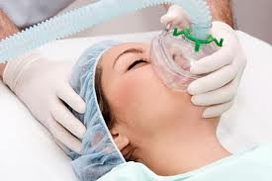
Introduction of Anesthesia
-With the discovery of gaseous anesthesia in the 1840s doctors could perform more complex and long amputation surgeries which allowed them to prepare the limb stump for interfacing with the prosthetic
-Other advances such as germ free
surgeries caused the success rate
for amputation to increase thus
increasing the demand for prosthetics

Slide 14
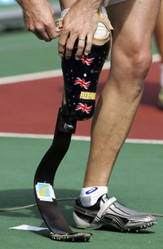
Out with the old and in with the new
-A major difference between modern prosthetic limbs and ancient ones is the material
-With modern day science new materials such as advanced plastics and carbon-fiber composites were created to make lighter and stronger prosthetic limbs

Slide 15
Major Advances in Modern Prosthetics
-Bluetooth
-microprocessors
-myoelectric technology
-Targeted muscle reinnervation
-3D printing

Slide 16

Bluetooth
-Small wireless range
-battery operated
-Made with a motor inside of them to mimic the motions of the other leg in order to walk

Slide 17
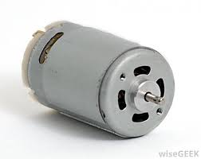
Benefits of Bluetooth Prosthetics
-Older prosthetics could cause great strain on already damaged muscles by requiring them to lug around a giant hunk of wood or metal
-New bluetooth prosthetics have a motor
built into them so users don’t have to
expend as much energy when using
them allowing for more freedom without using as much energy

Slide 18
Bluetooth prosthetics at work
-Marine Joshua Bleil lost both of his legs in a bombing in Iraq but now thanks to the technology of bluetooth prosthetic legs he is regaining the ability to walk again
-The bluetooth prosthetic legs mimic each others actions in order to walk when force is applied by the thighs. They will also stop walking when resistance is applied
-http://www.cnn.com/2008/TECH/01/25/bluetooth.legs/#cnnSTCVideo

Slide 19
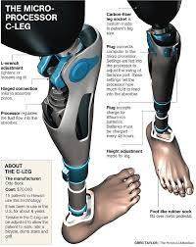
Microprocessors
-mainly used for prosthetics involving the knee (above knee amputations)
-prevents buckling by monitoring fluid in knee by using a microprocessor in the knee
-Microprocessor knees have an internal
computer inside of them that monitors the
fluid in the knee so the wearer can walk
efficiently at different speeds and up and
down ramps/stairs

Slide 20
The C-Leg
-The c-leg is the main brand of prosthetics out there right now that uses microprocessing technology
-http://www.youtube.com/watch?v=TUa9WmSHqdk

Slide 21
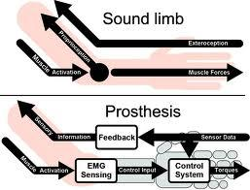
Myoelectric Technology
Upper Body
muscle sensors at amputated site communicate with prosthetic
allows for more precise movement
uses a battery and electric motors to detect muscle,nerve, and EMG activity which is then translated into movement via motors in prosthetic
-Electromyography- skeletal system

Slide 22
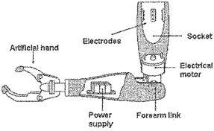
Myoelectric Technology
suction technology rather than straps
greater dexterity and functionality
cons: weight and cost
varied muscle intensity controls strength and speed
http://www.youtube.com/watch?v=_qUPnnROxvY

Slide 23
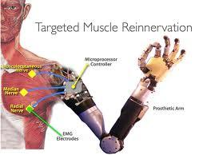
Targeted Muscle Reinnervation
-couples with myoelectric technology
-Involves a surgery that reassigns nerves
that would have controlled the limb into
another part of the body so all you would
have to do is think about moving the prosthetics and it would move!

Slide 24
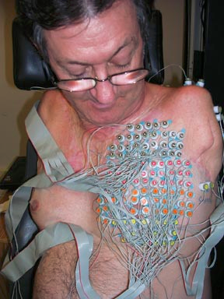
Targeted Muscle Reinnervation
-Process can take about a year or longer
-Amputation above the elbow or shoulder within the last 10 years
-usually fitted for a myoelectric prosthetic arm

Slide 25
With the new advancements in prosthetics that make them so great why doesn’t everyone who needs them have one?

Slide 26
3D Printing
-With the advancements in prosthetics making them so expensive, some ranging from tens of thousands of dollar it would be much cheaper to replace the limb with a metal rod
-So a new method of making functional prosthetics was created, 3D printing, which was much cheaper but still effective
http://www.youtube.com/watch?v=6dI-dNE2yQ0

Slide 27

The Future of prosthetics
-While there is still a long way to go this is
what future scientists and inventors hope
to accomplish with prosthetics:
-Future prosthetic limbs will be immersed
in our flesh instead of being placed outside of it
-Athletes will be able to create prosthetics that are perfectly tailored to their bodies and replace old limbs that are worn out

Slide 28
Not Only In Humans!
-Prosthetics aren’t just for humans!
-Buttercup the duck was born with a foot deformity and was unable to swim or walk
-Flexible silicone prosthetic foot was developed for Buttercup using 3D modeling
-http://www.youtube.com/watch?v=_ewU8ZIf3Bg

